Slide 1

BASKET BALL
Prediction

Slide 2
UNDER THE GUIDENCE OF: MR.D.RAMESH ASST.PROF CSE(AIML)
S.SAMSKRUTHI
HALL TICKET NO:2203A52176

Slide 3

"It's not about the prediction, it's about the preparation"

Slide 4
Problem statement: Champion prediction: To develop a predictive model for determining Basket ball Tournament Champion based on the provided features: i.ePlayedGames,WonGames,DrawnGames,LostGames,BasketGiven, TournamentChampion

Slide 5
INTRODUCTION
. Introduction to BasketballBasketball is a thrilling and fast-paced sport that has captured the hearts of millions of people worldwide. With its high-flying dunks, lightning-fast passes, and nail-biting finishes, it's no wonder that basketball has become one of the most popular sports on the planet.From the streets of New York City to the courts of Beijing, basketball has transcended borders and cultures, bringing people together through the love of the game. Whether you're a seasoned pro or just starting out, there's something for everyone in the world of basketball.

Slide 6
History of Basketball:
.
Basketball was invented in December 1891 by Canadian physical education instructor James Naismith. The game was created as an alternative to football, which was considered too violent for indoor play during the winter months. Naismith's original rules called for a ball that was 30 inches in circumference and weighed 20 ounces. The first official game of basketball was played on December 21, 1891, with nine players on each team and a final score of 1-0.Over time, the game of basketball has evolved significantly. In 1932, the International Basketball Federation (FIBA) was founded, which helped to standardize the rules of the game and promote its growth worldwide. The National Basketball Association (NBA) was founded in 1949 and has since become one of the most popular professional sports leagues in the world. Today, basketball is played at all levels, from amateur to professional, and is enjoyed by millions of people around the globe..

Slide 7
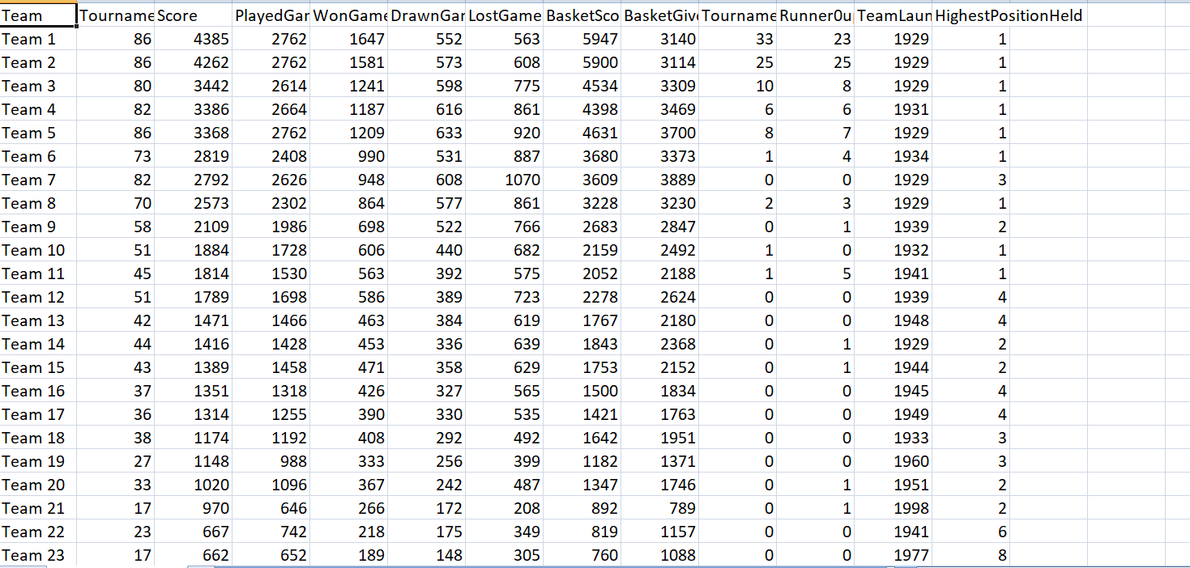
Data set:

Slide 8
Introduction to Machine learning models
Welcome to Machine Learning Models IntroductionLadies and gentlemen, welcome to the exciting world of machine learning models! Today, we are going to explore the cutting-edge technology that is changing the way we live and work. Machine learning models are powerful tools that can help us solve complex problems, make better decisions, and improve our lives in countless ways.But what exactly are machine learning models? Simply put, they are algorithms that can learn from data and make predictions or decisions based on that data. They are used in a wide range of applications, from speech recognition and image classification to fraud detection and medical diagnosis. And as the amount of data we generate continues to grow exponentially, the importance of machine learning models only increases.

Slide 9

The machine learning models used for this project are
SVR
LINEAR REGRESSION
LOGISTIC REGRESSION
KNN
LASSO
RIDGE
BOOT STRAP

Slide 10
SUPPORT VECTOR REGRESSION(SVR)
INTRODUCTION TO SUPPORT VECTOR REGRESSION(SVR)
Welcome to the world of Support Vector Regression (SVR), an exciting new algorithm that is revolutionizing the field of machine learning! With its ability to handle both linear and non-linear data, SVR is quickly becoming one of the most popular algorithms in use today.At its core, SVR is all about finding patterns in data and using those patterns to make predictions. Whether you're looking to predict stock prices, forecast the weather, or diagnose medical conditions, SVR has the power to help you achieve your goals.

Slide 11
Application to SVR
Support Vector Regression (SVR) has been used in a variety of real-world applications, including predicting stock market trends, forecasting weather patterns, and aiding in medical diagnoses. For example, SVR can be used to predict future stock prices based on historical data, helping investors make informed decisions about their investments. In weather forecasting, SVR can be used to model complex atmospheric systems and predict future weather patterns with greater accuracy. Finally, in medical diagnosis, SVR can be used to analyze large datasets of patient information and help doctors identify potential health risks or diagnose illnesses more accurately.One of the key advantages of SVR is its ability to handle large datasets with high dimensionality, making it particularly useful in fields like finance, meteorology, and healthcare where vast amounts of data are generated every day. Additionally, because SVR is based on statistical learning theory, it is able to generalize well to new data and make accurate predictions even when dealing with noisy or incomplete datasets.

Slide 12
SVR for my project:
SVR Mean Squared Error: 7.3160134780203885
SVR R-squared (R2) Score: 0.9049941387901148

Slide 13
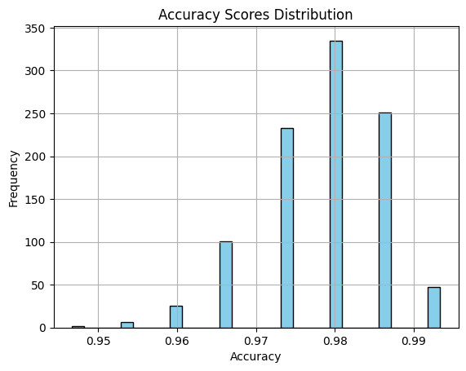
SVM boot strap: Mean Accuracy: 0.9797 Standard Deviation of Accuracy: 0.025908364157803038

Slide 14
Linear regression
Introduction to Linear Regression
Welcome everyone! Today, we're going to talk about one of the most important concepts in data analysis - linear regression.Linear regression is a statistical method used to model the relationship between two variables. It's a powerful tool that can help us understand how changes in one variable affect another. But don't worry, you don't need to be a math genius to understand it! We'll explain everything in a way that's easy to follow and understand.

Slide 15
What is Linear Regression?
Linear regression is a statistical method used to model the relationship between two variables by fitting a linear equation to the observed data. It is commonly used in data analysis to identify trends and patterns in the data, and to make predictions based on those trends.For example, let's say you are analyzing the relationship between a person's age and their income. You could use linear regression to determine if there is a correlation between these two variables and to predict someone's income based on their age. The equation for a simple linear regression model would be: Income = b0 + b1 * Age, where b0 is the intercept and b1 is the slope of the line.There are many different types of linear regression, including simple linear regression, multiple linear regression, and polynomial regression. Each type is appropriate to use depending on the nature of the data and the research question being asked.Overall, linear regression is a powerful tool for analyzing data and making predictions. By understanding this concept, you can gain valuable insights into the relationships between variables and make informed decisions based on that knowledge.

Slide 16
Linear Regression for my project:
Linear Regression Mean Squared Error: 8.24174544774805
Linear Regression R-squared (R2) Score: 0.8929725694890563

Slide 17
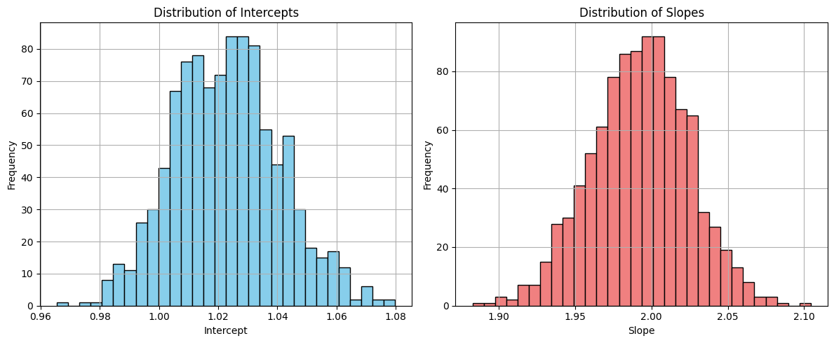
Linear bootstrap: Original Intercept: 2.2 Original Slope: 0.6 Mean of Bootstrapped Intercepts: 2.380114770004067 Mean of Bootstrapped Slopes: 0.5806030497125324 Standard Deviation of Bootstrapped Intercepts: 1.2152394480584328 Standard Deviation of Bootstrapped Slopes: 0.3862480931229792

Slide 18

Logistic regression
Introduction to Logistic Regression
Logistic regression is a statistical method used to analyze datasets with binary outcomes, meaning that there are only two possible results for each observation. It is a powerful tool that can help us understand the relationships between different variables and predict outcomes based on those relationships.In data analysis, logistic regression is often used for classification problems, such as predicting whether a customer will churn or not. This is because logistic regression can provide probabilities for each possible outcome, which can be used to make informed decisions.

Slide 19
Applications of Logistic Regression
Logistic regression is a powerful tool for data analysis that has a wide range of applications in real-world scenarios. One of the most common uses of logistic regression is in predicting customer churn. By analyzing customer data such as purchase history and demographics, logistic regression can help identify customers who are at risk of leaving and allow companies to take proactive measures to retain them.Another important application of logistic regression is in identifying fraudulent activity. By analyzing patterns in financial transactions, logistic regression can help detect suspicious behavior and alert authorities before any significant damage is done. These are just a few examples of the many ways in which logistic regression can be used to gain insights and make informed decisions.

Slide 20
Logistic Regression for my project:
Logistic Regression Accuracy: 0.8461538461538461
Random Forest Accuracy: 0.8461538461538461

Slide 21
KNN
Introduction to KNN
KNN, or k-nearest neighbors, is a type of machine learning algorithm that is used for classification and regression tasks. It works by finding the k closest data points to a given query point and using their labels to predict the label of the query point.One of the main advantages of KNN is its simplicity - it is easy to understand and implement. Additionally, KNN can be used for both classification and regression tasks, making it a versatile algorithm in the field of machine learning.
KNN in Real-World Applications
One of the most exciting aspects of KNN is its versatility. It has been successfully applied in a wide range of industries, from healthcare to finance to e-commerce. In healthcare, KNN has been used to predict patient outcomes based on their medical history and other relevant data. This has allowed doctors to make more informed decisions about treatment options and improve patient outcomes.In finance, KNN has been used to detect fraud and identify patterns in financial data. This has helped financial institutions to reduce losses and better manage risk. In e-commerce, KNN has been used to personalize product recommendations for customers based on their browsing and purchase history. This has led to increased customer satisfaction and higher sales.

Slide 22
KNN for my project:
KNN Regression Mean Squared Error: 41.36923076923077 KNN Regression R-squared (R2) Score: 0.46277854618103575

Slide 23
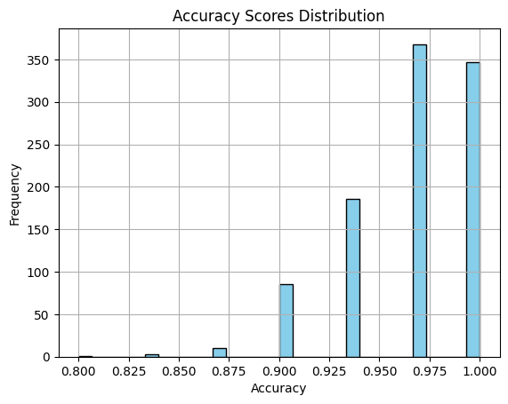
Knn using boot strap: Mean Accuracy: 0.9648000000000001 Standard Deviation of Accuracy: 0.03387663895174175

Slide 24
RIDGE REGRESSION:
Ridge regression is a model tuning method that is used to analyse any data that suffers from multicollinearity. This method performs L2 regularization. When the issue of multicollinearity occurs, least-squares are unbiased, and variances are large, this results in predicted values being far away from the actual values.
Ridge regression for my project:
Mean Squared Error:1.0701545778834662

Slide 25
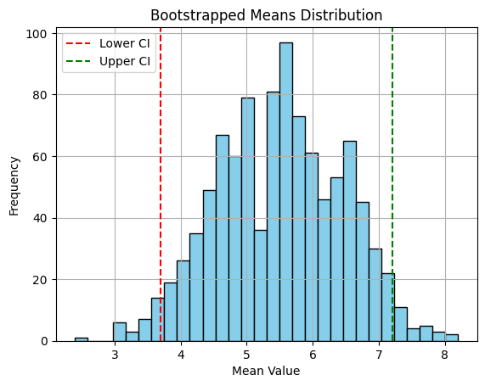
Ridge bootstrap: Estimated Mean: 5.476699999999999 95% Confidence Interval: [3.9 7.3]

Slide 26
LASSO REGRESSION:
Lasso regression is a regularization technique. It is used over regression methods for a more accurate prediction. This model uses shrinkage. Shrinkage is where data values are shrunk towards a central point as the mean. The lasso procedure encourages simple, sparse models (i.e. models with fewer parameters).

Slide 27
Lasso for my project:
Mean Squared Error: 0.03999999999999901
Feature coefficients: [3.28888889 0. 0. ]
Estimated Mean: 5.5535 95% Confidence Interval: [3.8 7.3025]

Slide 28
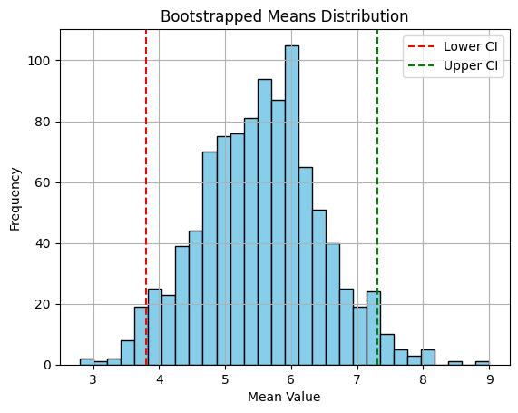
Lasso bootstrap: Estimated Mean: 5.5535 95% Confidence Interval: [3.8 7.3025]

Slide 29
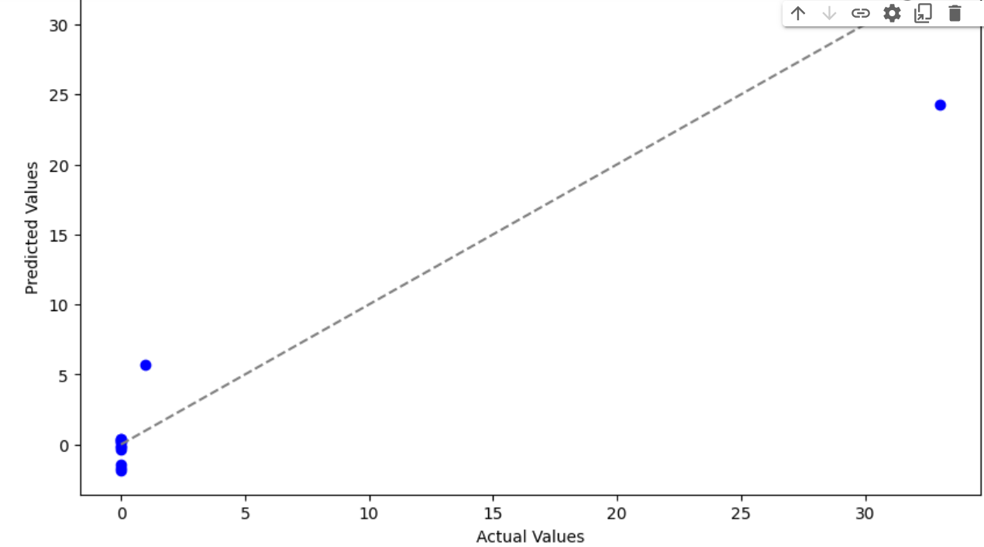
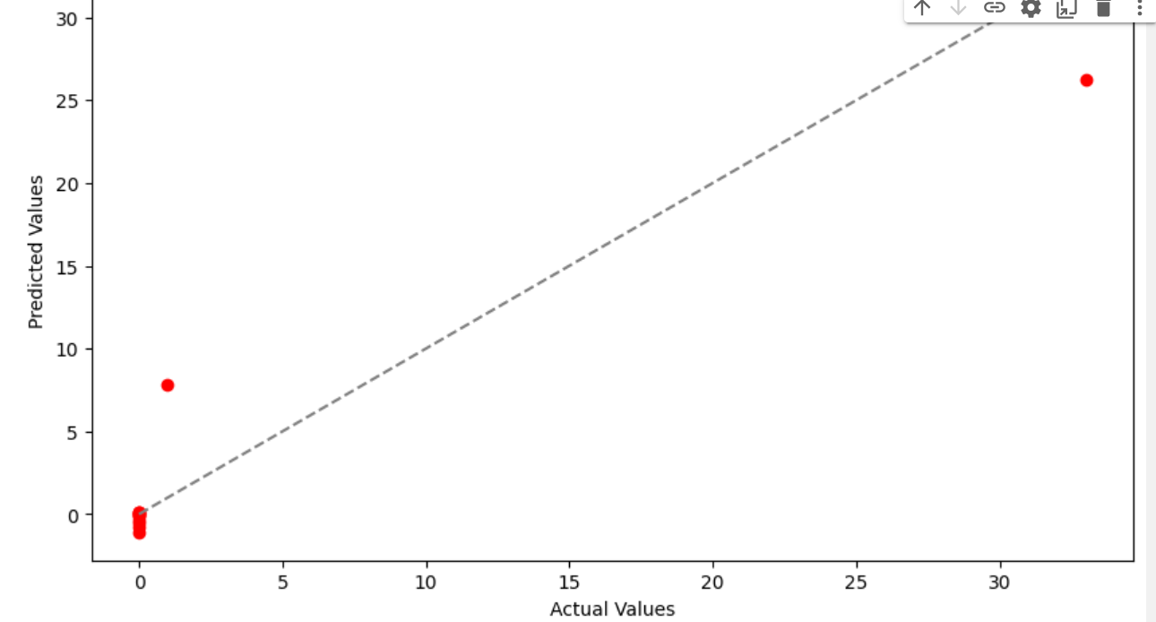
Linear regression:Actual vs predicted values
SVR:Actual vs predicted values

Slide 30
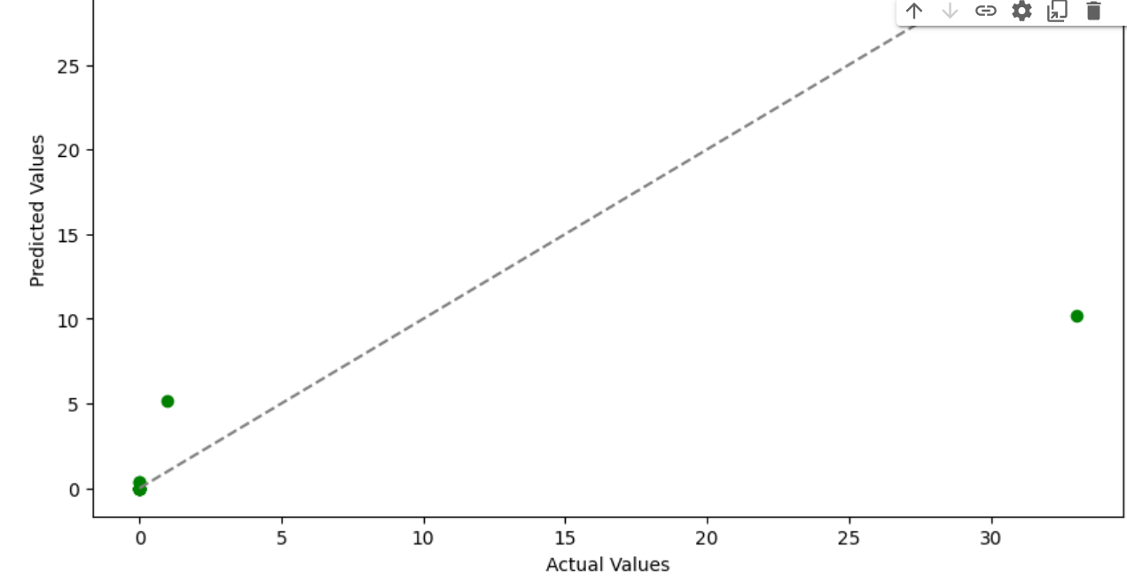
KNN regression:Actual vs predicted values

Slide 31
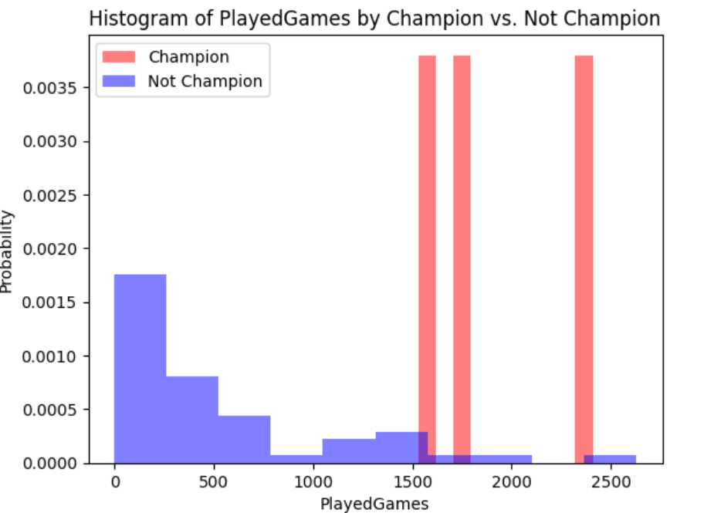
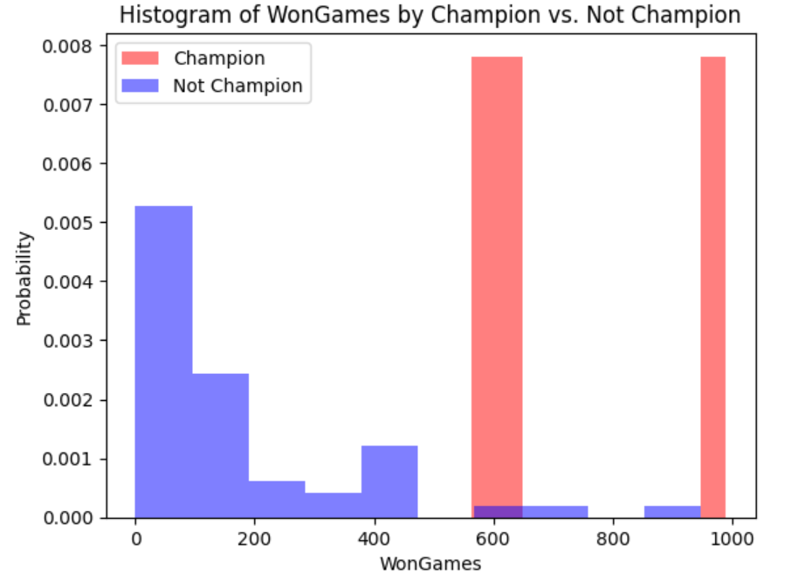
Graphs

Slide 32
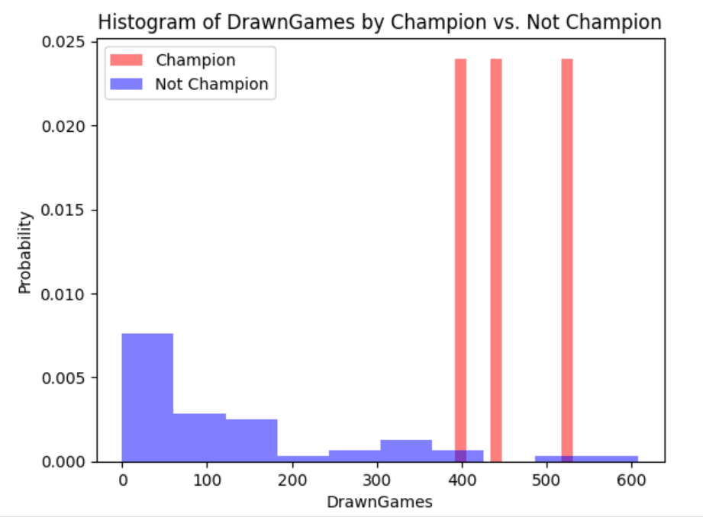
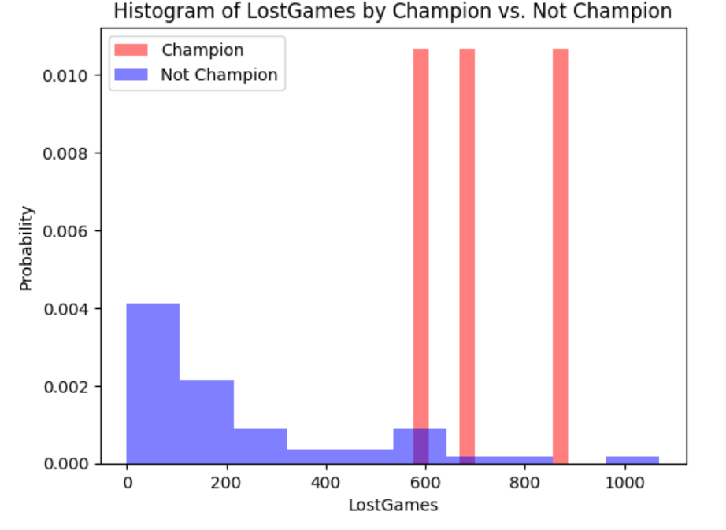

Slide 33
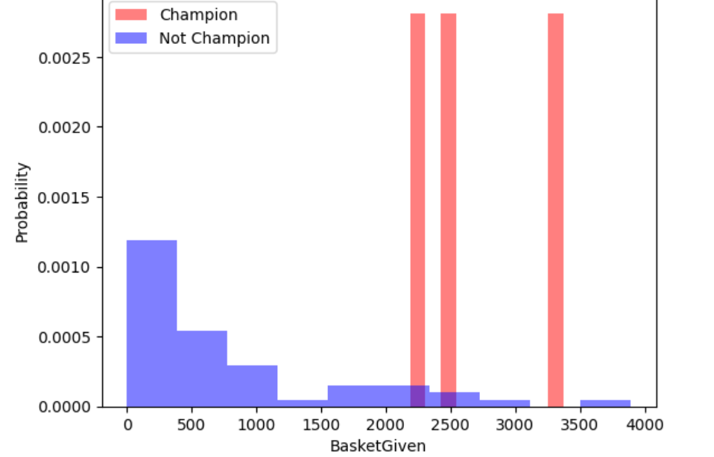
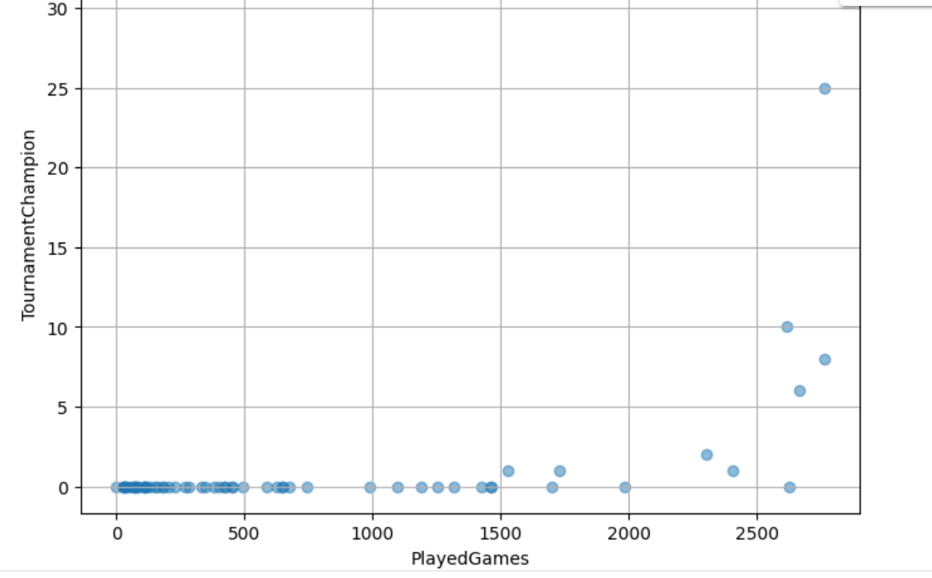
Histogram of basket given by champion vs notchampion
Scatter plot of played games vs Tournamentchampion

Slide 34
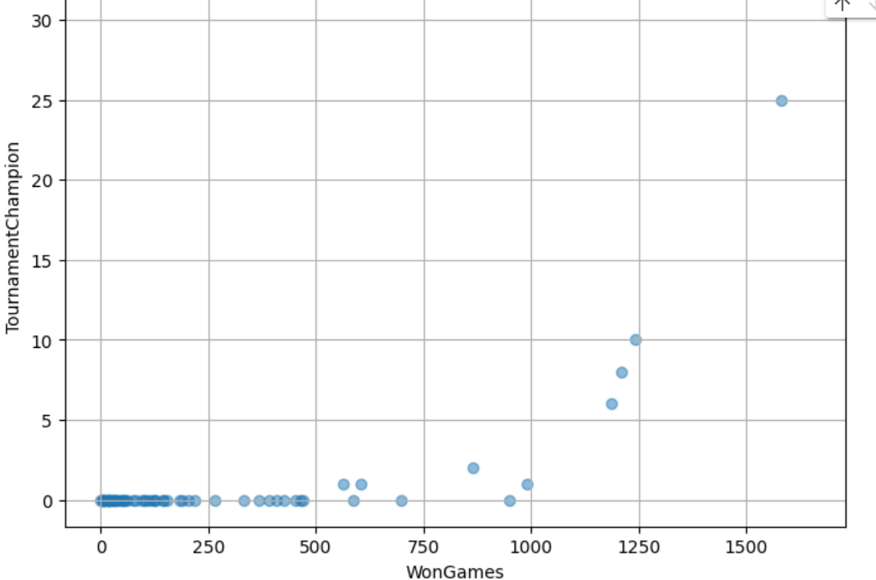
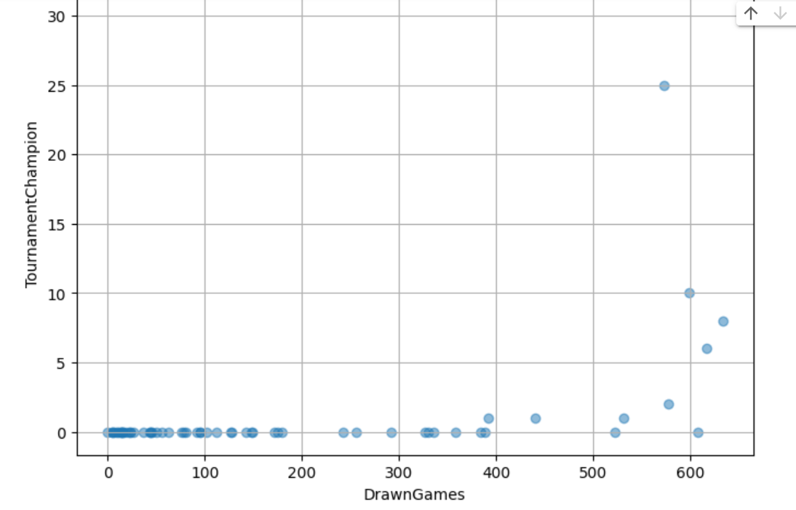
Scatter plot of won games vs Tournamentchampion
Scatter plot of drawngames vs Tournamentchampion

Slide 35
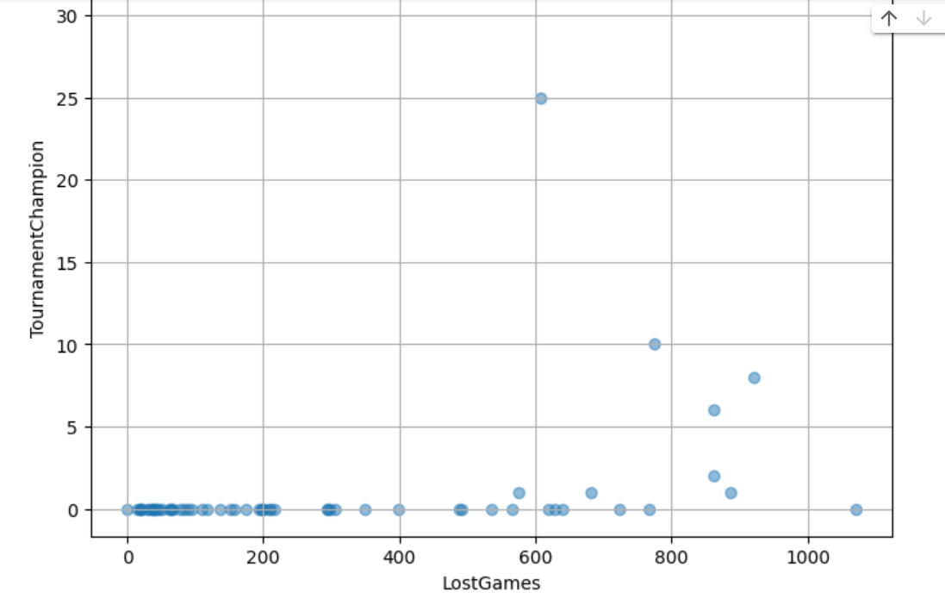
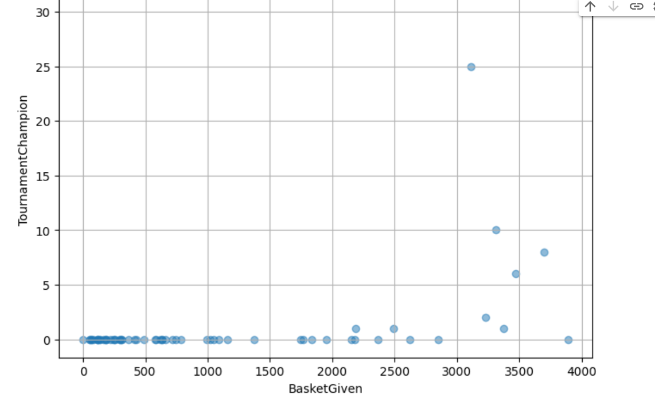
Scatter plot of Lost games vs Tournamentchampion
Scatter plot of Basketgiven vs Tournamentchampion

Slide 36
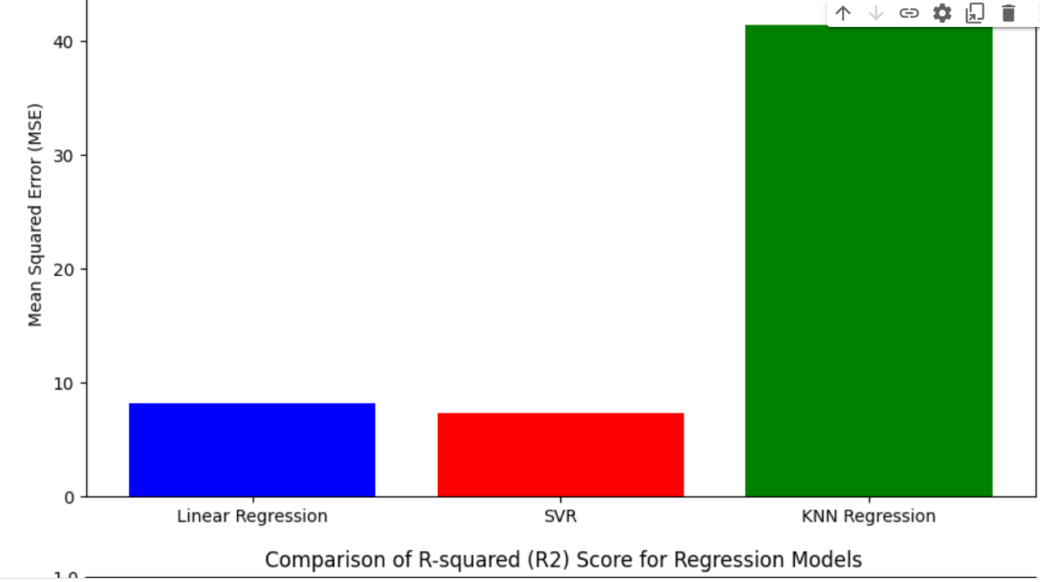
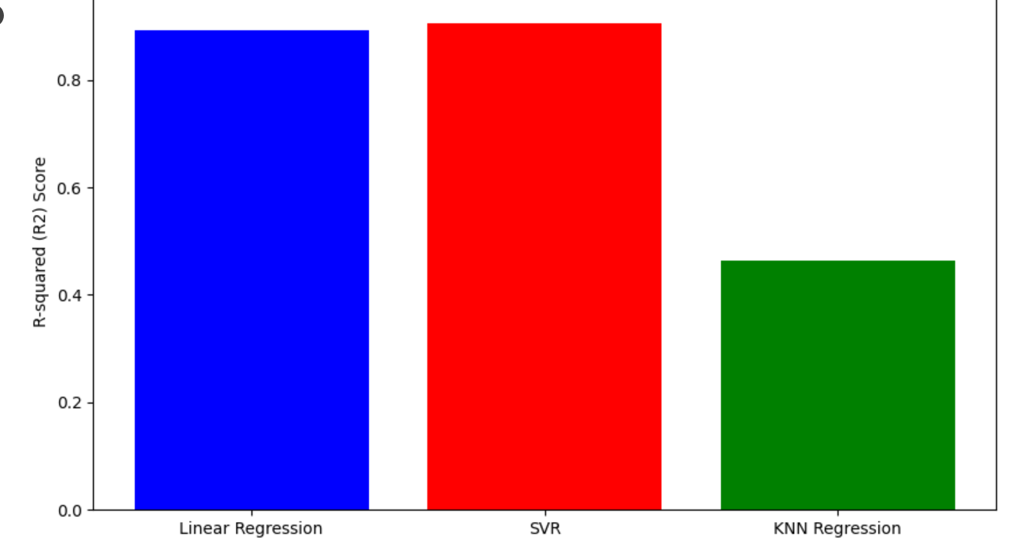
Comparision of mean sqaure error(MSE)for regression models
Comparision of R-squared(R2)Score for regression models

Slide 37
CONCLUSION In this study, extensive efforts have been dedicated to crafting a system focused on predicting basketball game outcomes. While the dynamics of a basketball match are multifaceted, our experiments utilizing available datasets aim to establish a highly reliable predictive model.The objective is to develop a system akin to those used for predicting outcomes in various sports, where the intricacies of each game may not be entirely predictable, but data-driven methodologies can be harnessed to forge a robust predictive model.Through this research endeavor, we aspire to contribute to more accurate forecasts in basketball, which can potentially enhance decision-making for stakeholders in the realm of sports analytics and ultimately lead to improved outcomes for teams and enthusiasts alike. Github: https://github.com/Samskruthi020/MLProject1.git

