Slide 1

Introduction to Cloud Security
Samitha Somathilaka
Department of Computing & Mathematics, WIT

Slide 2
If cloud computing is so great, why isn’t everyone doing it?
The cloud acts as a big black box, nothing inside the cloud is visible to the clients
Clients have no idea or control over what happens inside a cloud
Clouds are still subject to traditional data confidentiality, integrity, availability, and privacy issues, plus some additional attacks

Slide 3
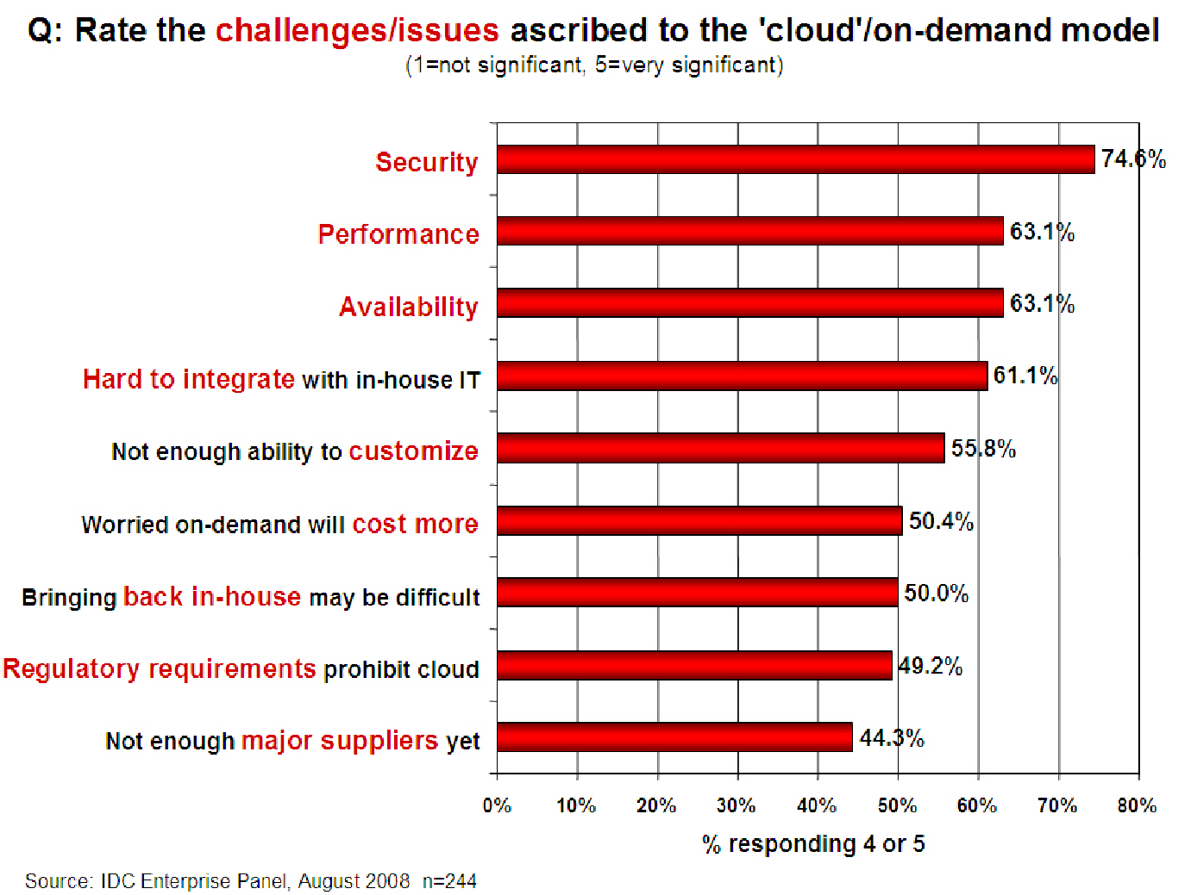
Companies are still afraid to use clouds

Slide 4
Taxonomy of Fear
Confidentiality
Fear of loss of control over data
Will the sensitive data stored on a cloud remain confidential?
Will cloud compromises leak confidential client data
Will the cloud provider itself be honest and won’t peek into the data?
Integrity
How do I know that the cloud provider is doing the computations correctly?
How do I ensure that the cloud provider really stored my data without tampering with it?

Slide 5
Taxonomy of Fear (cont.)
Availability
Will critical systems go down at the client,
What if the provider is attacked in a Denial of Service attack?

Slide 6
Taxonomy of Fear (cont.)
Privacy issues raised via massive data mining
Cloud now stores data from a lot of clients, and can run data mining algorithms to get large amounts of information on clients
Increased attack surface
Entity outside the organization now stores and computes data, and so
Attackers can now target the communication link between cloud provider and client

Slide 7
Taxonomy of Fear (cont.)
Auditability and forensics (out of control of data)
Difficult to audit data held outside organization in a cloud
Forensics also made difficult since now clients don’t maintain data locally
Legal quagmire and transitive trust issues
Who is responsible for complying with regulations?
If cloud provider subcontracts to third party clouds, will the data still be secure?

Slide 8
Cloud Security Challenges
Increased Attack Surface
Lack of Visibility and Tracking
Ever-Changing Workloads
DevOps, DevSecOps and Automation
Granular Privilege and Key Management
Complex Environments
Cloud Compliance and Governance

Slide 9
Increased Attack Surface
The public cloud environment has become a large and highly attractive attack surface for attackers who exploit poorly secured cloud ingress ports in order to access and disrupt workloads and data in the cloud.
Malware, Zero-Day, Account Takeover and many other malicious threats have become a day-to-day reality.

Slide 10
Lack of Visibility and Tracking
In the IaaS model, the cloud providers have full control over the infrastructure layer and do not expose it to their customers.
The lack of visibility and control is further extended in the PaaS and SaaS cloud models. Cloud customers often cannot effectively identify and quantify their cloud assets or visualize their cloud environments.

Slide 11
Ever-Changing Workloads
Cloud assets are provisioned and decommissioned dynamically—at scale and at velocity.
Traditional security tools are simply incapable of enforcing protection policies in such a flexible and dynamic environment with its ever-changing and ephemeral workloads.

Slide 12
Granular Privilege and Key Management
Often cloud user roles are configured very loosely, granting extensive privileges beyond what is intended or required.
One common example is giving database delete or write permissions to untrained users or users who have no business need to delete or add database assets.
At the application level, improperly configured keys and privileges expose sessions to security risks.

Slide 13
Complex Environments
Managing security in a consistent way in the cloud environments requires methods and tools that work seamlessly across public cloud providers, private cloud providers, and on-premise deployments
Including branch office edge protection for geographically distributed organizations.

Slide 14
Cloud Compliance and Governance
All the leading cloud providers have aligned themselves with most of the well-known accreditation programs such as PCI 3.2, NIST 800-53, HIPAA and GDPR.
However, customers are responsible for ensuring that their workload and data processes are compliant.
Given the poor visibility as well as the dynamics of the cloud environment, the compliance audit process becomes close to mission impossible unless tools are used to achieve continuous compliance checks and issue real-time alerts about misconfigurations.

