Slide 1
1. INTRODUCTION
A well-functioning Vital Registration System (VRS) plays a critical role in any society. It ensures the legal documentation of :
Births
Deaths
Marriages and
potentially other events, providing essential proof of identity.
VRS data also serves as a valuable resource for generating vital statistics, which inform crucial decisions around public health, social welfare, and resource allocation.
Unfortunately, many countries lack robust VRS infrastructure, leading to unregistered births and deaths, incomplete data, and inefficiencies.

Slide 2
2.PROBLEM STATEMENT
Lack of robust VIRS and using labor-intensive based system to register, search, distribute and report on vital status for their citizens in robe Robe city municipal leads to the following problem's. This are:
Needs extra manual labor
Too difficult and time consuming.
High redundancy in data storage
Not very much accurate
No data insurance, file system is not secured.
Moreover, the existing system consumes much time to
generate certificate when issued by the resident.

Slide 3
: 3.SIGNIFIGANCE OF THE PROJECT
The project is also significant over the current one in the following terms:
Minimize data redundancy.
Minimize loose of data.
Secure means of storing files.
Provide timely response

Slide 4
4. OBJECTIVES
4.1 General Objectives
Developing Web based Electronic Vital event registration system for Robe city.

Slide 5
4. OBJECTIVES
4.1 General Objectives
Developing Web based Electronic Vital event registration system for Robe city.

Slide 6
4. OBJECTIVES
4.2 Specific Objectives
To Develop a Secure and Automated Database
To Streamline Event Registration
To Facilitate Certificate Issuance
To Provide User-Friendly Interface
To Ensure Widespread Accessibility

Slide 7
5. Scope and Limitation
5.1 Scope
Registration and certification of vital events like birth, marriages, deaths and divorces as Ethiopia agrees only.
Generate report based on customers’ query.
Searching residents by using identification numbers.
Check previous records and mange personal information.
It checks information of resident by barcode number.

Slide 8
5. Scope and Limitation
5.2 Limitation
Our system doesn’t support searching for legal citizens using finger prints and face recognitions.

Slide 9
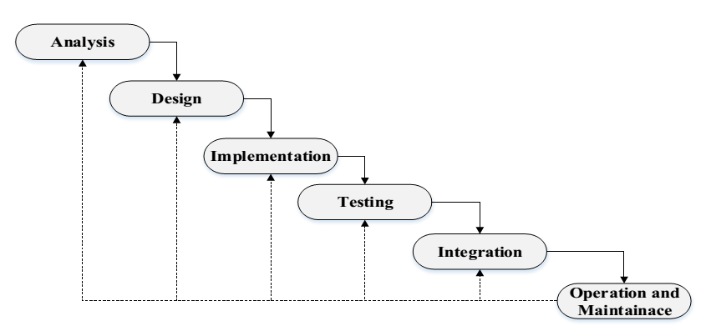
6.PROJECT DEVELOPMET MODEL
Water fall model of system design used:

Slide 10
7. BUSINESS RULE
BR1: To register it must have id card of kebele and who live in that kebele.
BR2: To register for marriage it must come with marriage agreement paper from court and two peoples as evidence.
BR3: for divorce Register it must be given divorce witness paper from court.
BR4: Resident should have to be registered to kebele before taking their certificate.
BR5: Only the kebele worker of the VERS is authorized to prepare certificate and generate the system.
BR6: The user will only access the system if the user enters valid username and password.
BR7: resident can only take his own personal information; they cannot take other person information.
BR8: kebele record office of EVERS prepares resident’ status.

Slide 11
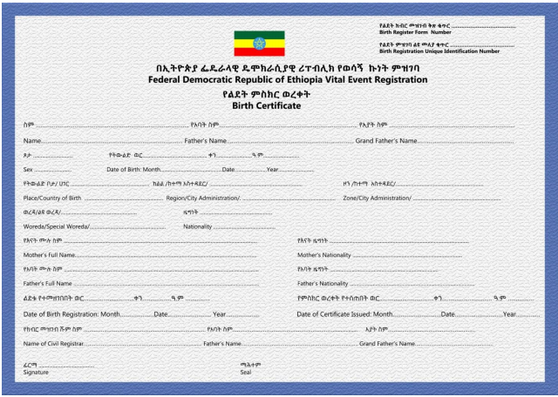
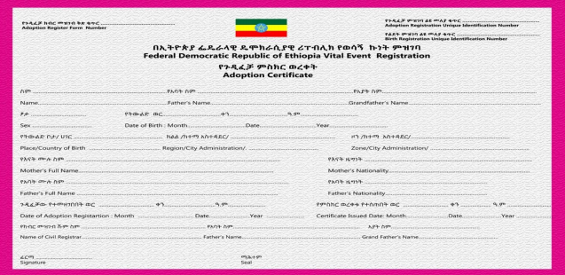
8. FORM USED IN EXISTING SYSTEM
Birth Certificate
Adoption Certificate

Slide 12
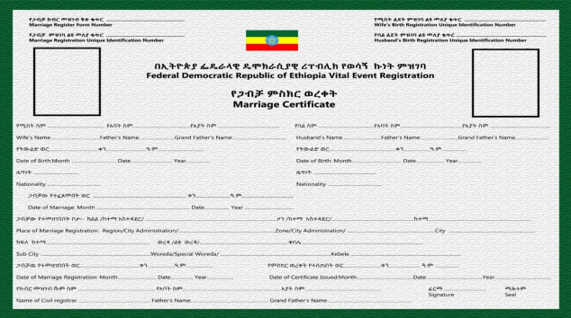
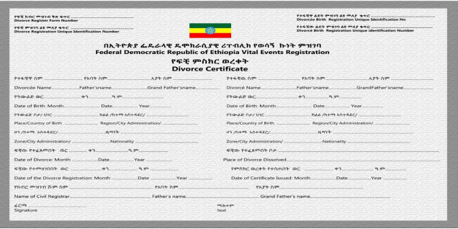
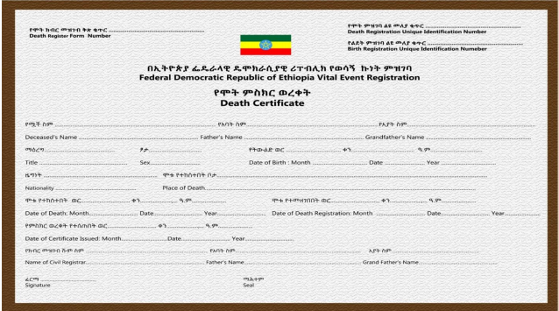
8. FORM USED IN EXISTING SYSTEM
Marriage Certificate
Divorce Certificate
Death certificate

Slide 13
9. FUNCTIONAL AND NON-FUNCTIONAL REQUIRMENT
Functional Requirement:-
Registration
Account management
Searching
Requesting vital certificate
Reporting vital concerns
Non-functional Requirement
Performance
Dependability
End user criteria
Error Handling
User Interface and Human Requirements
Security
Maintainability

Slide 15
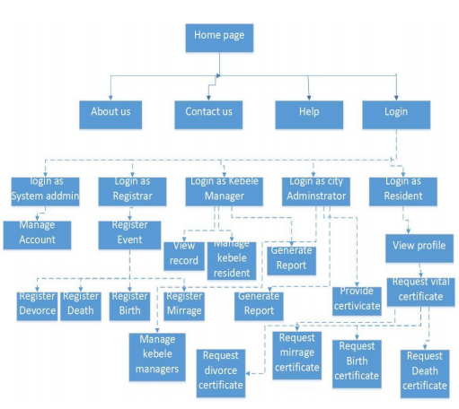
11. USER INTERFACE PROTOTYPE DIAGRAM

Slide 16
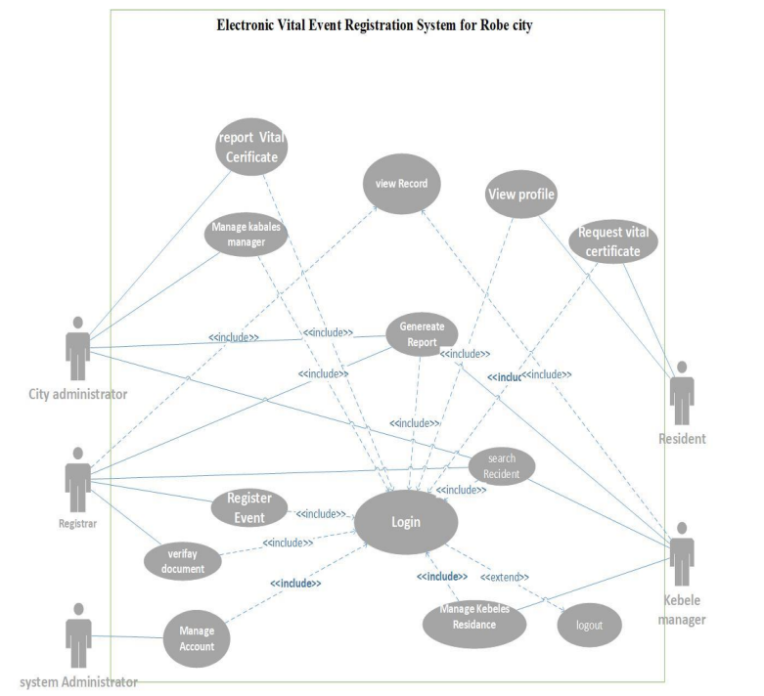
12. USE CASE DIAGRAM

Slide 17
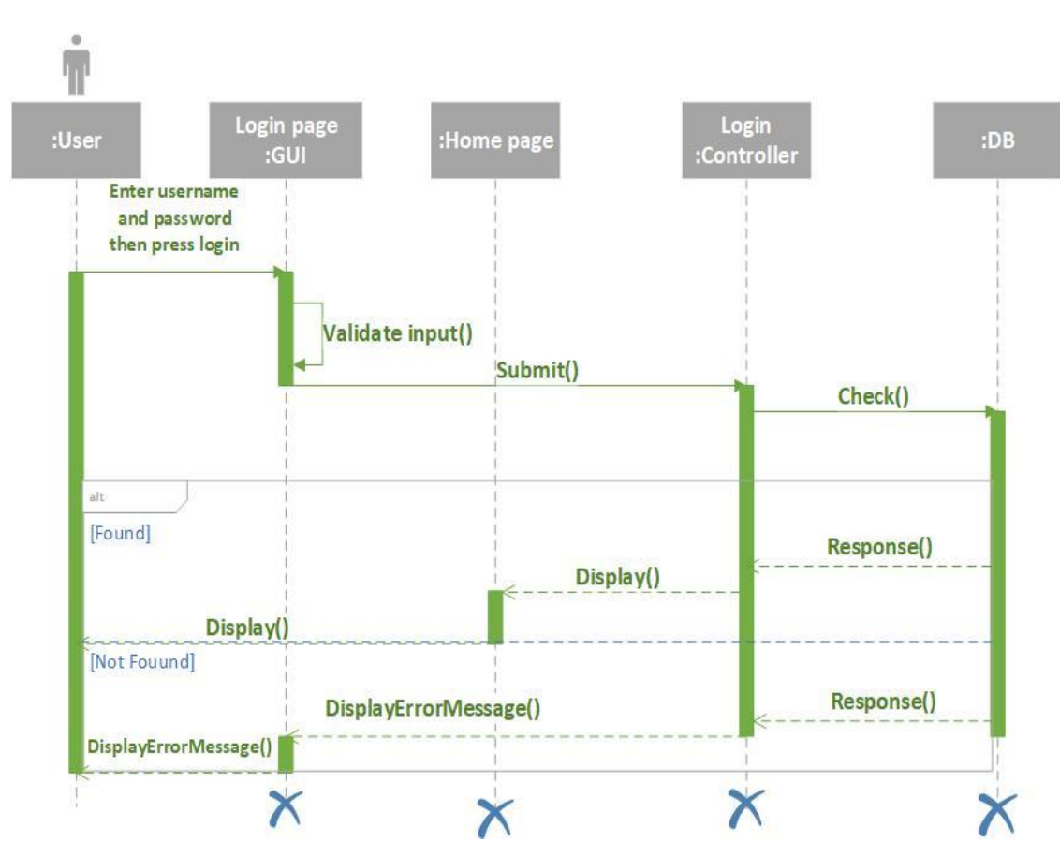
13. LOGIN SEQUINCE DIAGRAM

Slide 18
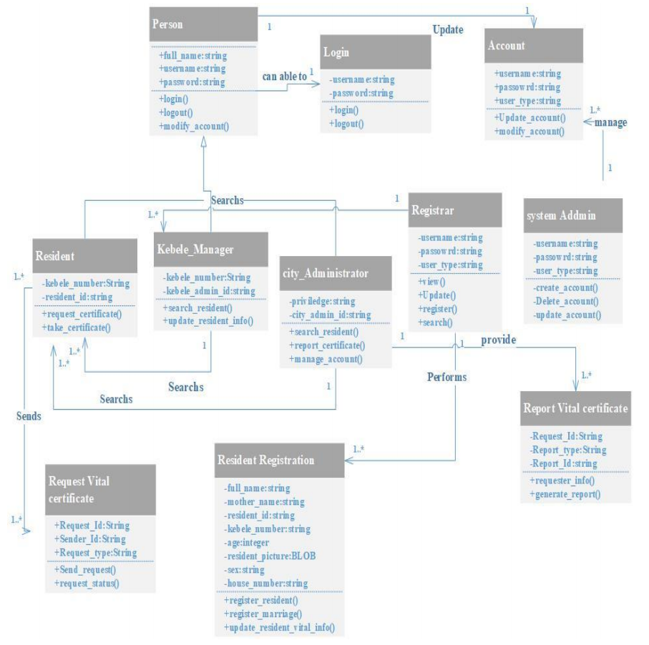
14. CLASS AND OBJECT DIAGRAM

Slide 19
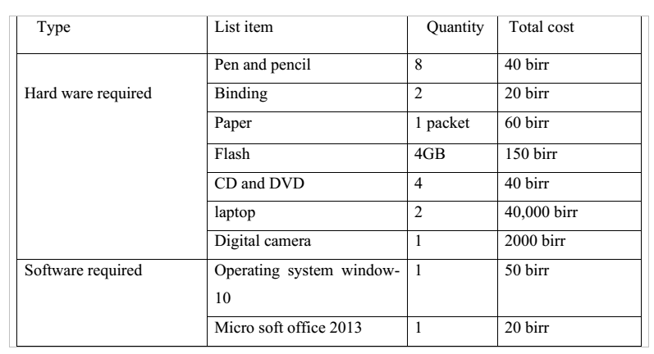
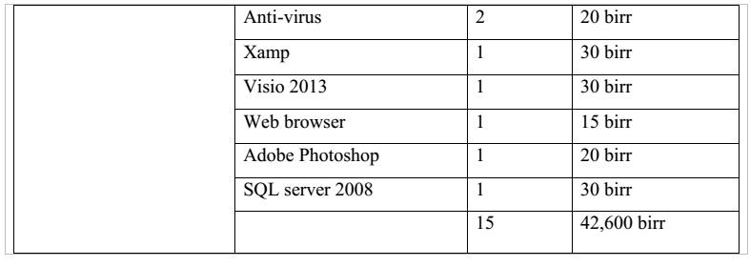
15. PROJECT BUDGET

Slide 20
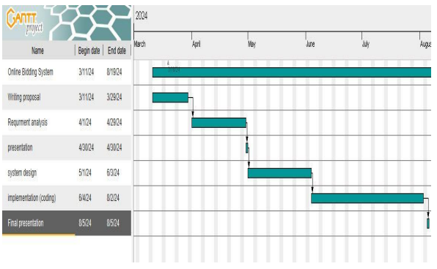
16. PROJECT SCHEDULE

Slide 21
Frontend Frameworks
Front-End Development:
HTML
CSS
JavaScript
HTML Basics:
- Tags, elements, and attributes in HTML
- Semantic HTML for better accessibility and SEO
- Creating a basic HTML document structure
.

Slide 22
Cont….
CSS Fundamentals:
- Selectors, properties, and values in CSS
- Styling text, colors, backgrounds, and layouts
- Using CSS frameworks like Bootstrap for responsive design
JavaScript Essentials:
- Variables, data types, operators, and control structures in JavaScript
- DOM manipulation for interacting with web elements
- Event handling and functions for adding interactivity

Slide 23
Backend Frameworks
Flask Framework
Introduction to Flask:
- Lightweight web framework written in Python
- Ideal for building small to medium-sized web applications
- Easy to learn and flexible to use
Setting Up Flask:
- Install Flask using pip
- Create a virtual environment for your project
- Set up a basic Flask application structure

Slide 24
Cont….
Creating Routes:
- Define routes using route decorators
- Handle different HTTP methods (GET, POST, etc.)
- Return responses with custom data or templates
Templates and Static Files:
- Use Jinja2 templating engine for dynamic content
- Organize static files (CSS, JavaScript) in the project structure
- Render templates and serve static files in Flask

Slide 25
THANK YOU!

