Slide 1
Data Structures and Algorithms
The Array Data Structure

Slide 2
The Array
An indexed sequence of components or elements
The indices (or subscripts) are sequential, with upper and lower bounds
The index provides direct access to the corresponding component
In an array, data will be stored in a continuous memory location

Slide 3
What is an Array?
An array is a data structure used for storing a collection of data items that are all the same type.
By using an array, we can associate a single variable name with an entire collection of data.
This enables us to save the entire collection of data in adjacent cells of main memory and to easily reference individual items by an Index number.
To process an individual item, we need to specify the array name and indicate which array element is being manipulated.

Slide 4
Storage comparison
Using normal variables
Using an array
5
8
3
6
2
Var1
Var2
Var3
Var4
Var5
Index
5
(0)
8
(1)
3
(2)
6
(3)
2
(4)
MyArray

Slide 5
C++ Arrays
0
1
2
3
4
L-2
L-1
Indices range from 0 to length-1
Each component of the same type
Length fixed when storage is allocated

Slide 6
C-Style Arrays Data Structures:
    As an ADT Implemented in C++
ordered
fixed size
same type elements
direct access
indices numbered 0, 1, 2, . . ., CAPACITY - 1
CAPACITY specifies the capacity of the array
element_type is the type of elements
subscript operator []
score[0]
score[1]
score[2]
element_type array_name[CAPACITY];
score[3]
where
element_type is any type
array_name is the name of the array — any valid identifier
CAPACITY (a positive integer constant) is the number of elements in the array
.
.
.
.
score[99]

Slide 7
Subscript operator
[] is an actual operator and not simply a notation/punctuation as in some other languages.
Its two operands are an array variable and an integer index (or subscript) and is written
array_name[i]
Here i is an integer expression with 0 < i < CAPACITY – 1.
[] returns the address of the element in location i in array_name;
So array_name[i]is a variable, called an indexed (or subscripted) variable,
whose type is the specified element_type of the array.

Slide 8
Array Example
int MAX_NUM = 100;
Int intStore [MAX_NUM];
int count = 0;
while (count<MAX_NUM)
{
intStore[count] = count*count;
count++;
}
for (int i=count;i>0;i--) {
cout<<intStore[i-1];
}

Slide 9
Size of an Array
The size of an array can be found by the following formula:
N = Ub – Lb + 1
Where :
    Lb is lower index
    Ub is the Higher index
    N is the array size/length

Slide 10
Traversing an Array
The method of visiting each element of an array at least once is called Traversing.
It is used to perform operations such as:
  Reading an element
  Printing an element
  Processing an element

Slide 11
Traversing an Array - Steps
Set index λ to Lb (lower bound)
Visit the value of λ
Increase the value of λ and compare with Ub (upper bound)
If λ < Ub or λ = Ub then go to step 2
Exit operation

Slide 12
Traversing an Array - Example
Algorithm Averages(A, Ub)
Input array A of U integers
Output averages of A
Average ← 0
Sum ← 0
For λ ← Lb to Ub Do
    Sum ← Sum + A[λ]
    λ ← λ + 1
Average ← Sum/Ub
Return Average
Exit operation

Slide 13
Insert Component Algorithm
Insertion of an element into an array can be done at the end or in the middle of the array.
STEPS:
Compare α to Ub
where α is where element is to be inserted
2. If α = (Ub+1) then insert the new element at A[α ]
3. If α <= Ub then:
a. Shift A[Ub], A[Ub-1], A[Ub-2]......,A[α] to A[Ub+1], A[Ub], A[Ub-1]......,A[α+1]
b. Insert the new element at A[α]
4. Increase the values of Ub
Ub=Ub+1.

Slide 14
Insert Component Example
Algorithm InsertEle(A, Ub, pos)
Input array A of Ub, pos integers
Output new A with Ub+1 Elements
For j ← Lb to Ub Do
If pos ← Ub+1
A[pos] = 200
Else
If pos <= Ub
For i ← Ub to pos Do
A[i+1] = A[i]
A[pos] = 200
Ub= Ub+1
Exit operation
 | A[8]
0 | 30 | 360060
1 | 56
2 | 45
3 | 21
4 | 12
5 | 56
6 | 890
7 | 678
200

Slide 15
Insert Component Example
 | A[8]
0 | 30 | 360060
1 | 56
2 | 45
3 | 21
4 | 12
5 | 56
6 | 890
7 | 678
For j ← 0 to 7 Do
If 4 ← 8 //7+1
A[ 4] = 200
Else
If 4 <= 7
For i ← 7 to 4 Do
A[i+1] = A[i]
A[ 4] = 200
Ub= 7+1
Exit operation
 | A[9]
0 | 30
1 | 56
2 | 45
3 | 21
4 | 200
5 | 12
6 | 56
7 | 890
8 | 678
200

Slide 16
Delete Component Algorithm
STEPS:
Steps to delete the β^{th} element from an array are as follows:
Copy the element A[β ] into a variable DeItem
where β is the position of the element to be deleted
2. Shift A[β +1], A[β +2], A[β +3]......,A[Ub] to A[β], A[β+1], A[β +2]......,A[Ub-1]
4. Decrease the values of Ub
Ub=Ub-1.

Slide 17
Delete Component Example
 | A[8]
0 | 30 | 360060
1 | 56
2 | 45
3 | 21
4 | 12
5 | 56
6 | 890
7 | 678
Algorithm DeleteEle(A, Ub, pos)
Input array A of Ub, pos integers
Output new A with Ub-1 Elements
DeItem ← A[pos]
For j ← pos to Ub-1 Do
A[j] = A[j+1]
Ub= Ub - 1
Exit operation
Delete

Slide 18
Delete Component Example
 | A[8]
0 | 30 | 360060
1 | 56
2 | 45
3 | 21
4 | 12
5 | 56
6 | 890
7 | 678
DeItem ← 21
For j ← 3 to 6 Do
A[j] = A[j+1]
Ub= 7 - 1
Exit operation
 | A[7]
0 | 30
1 | 56
2 | 45
3 | 12
4 | 56
5 | 890
6 | 678
Delete

Slide 19
Two Dimensional Arrays
This is the method of representing arrays row wise and column wise
Two dimensional arrays are useful when data needs to be arranged in a tabular form.
A bidimensional array can be imagined as a bidimensional table made of elements, all of which are of the same uniform data type.

Slide 20
Two Dimensional Arrays
 |  | 0 | 1 | 2 | 3 | 4
Stud_Marks | 0
 | 1
 | 2
 | 3
Stud_Marks[0][0]
Stud_Marks[2][4]

Slide 21
2D Arrays - Memory Representation
Two methods are used to represent 2 dimensional arrays in memory:
  Row major Representation
  Column major representation

Slide 22
Row major Representation
In this method, Elements are stored row-wise
First row of the array is stored in the first location
Second row is stored in the second location
And so on…
A[1][1]
A[1][2]
A[2][1]
A[2][2]
A[3][1]
A[3][2]
  A[3][2]
A[1][1] | A[1][2]
A[2][1] | A[2][2]
A[3][1] | A[3][2]

Slide 23
Column major representation
In this method, Elements are stored Column-wise
First column of the array is stored in the first location
Second column is stored in the second location
And so on…
A[1][1]
A[2][1]
A[3][1]
A[1][2]
A[2][2]
A[3][2]
  A[3][2]
A[1][1] | A[1][2]
A[2][1] | A[2][2]
A[3][1] | A[3][2]

Slide 24
Multidimensional Arrays
Declaring Variables of Multidimensional Arrays and Creating Multidimensional Arrays
int[][] matrix = new int[10][10];
or
int matrix[][] = new int[10][10];
matrix[0][0] = 3;
for (int i=0; i<matrix.length; i++)
for (int j=0; j<matrix[i].length; j++)
{
matrix[i][j] = (int)(Math.random()*1000);
}
double[][] x;

Slide 25
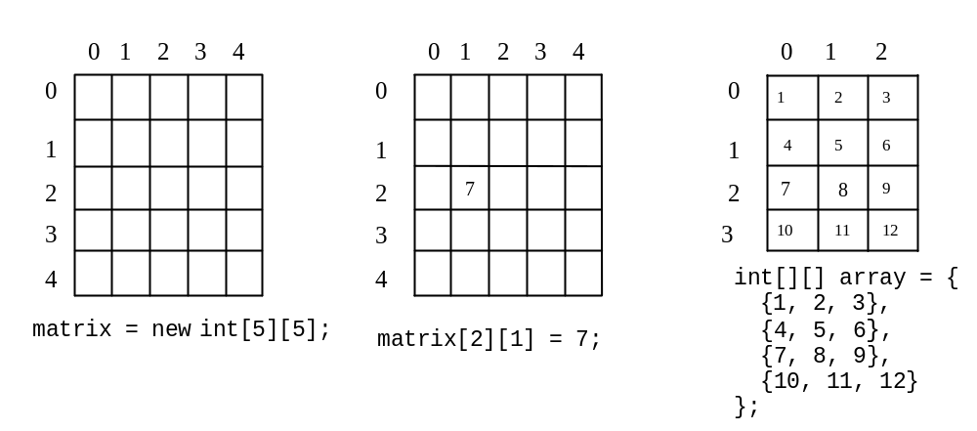
Multidimensional Array Illustration

Slide 26
Declaring, Creating, and Initializing Using Shorthand Notations
You can also use a shorthand notation to declare, create and initialize a two-dimensional array. For example,
int[][] array = {
{1, 2, 3},
{4, 5, 6},
{7, 8, 9},
{10, 11, 12}
};
This is equivalent to the following statements:
int[][] array = new int[4][3];
array[0][0] = 1; array[0][1] = 2; array[0][2] = 3;
array[1][0] = 4; array[1][1] = 5; array[1][2] = 6;
array[2][0] = 7; array[2][1] = 8; array[2][2] = 9;
array[3][0] = 10; array[3][1] = 11; array[3][2] = 12;

Slide 27
Lengths of Multidimensional Arrays
int[][] array = {
{1, 2, 3},
{4, 5, 6},
{7, 8, 9},
{10, 11, 12}
};
array.length
array[0].length
array[1].length
array[2].length

Slide 28
Ragged Arrays
Each row in a two-dimensional array is itself an array. So, the rows can have different lengths. Such an array is known as a ragged array. For example,
int[][] matrix = {
{1, 2, 3, 4, 5},
{2, 3, 4, 5},
{3, 4, 5},
{4, 5},
{5}
};

Slide 29
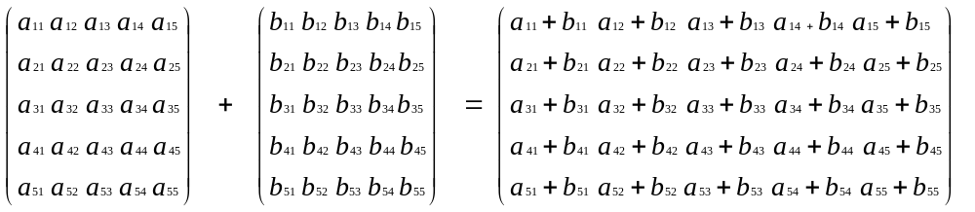
Example 5.7
Adding and Multiplying Two Matrices
Objective: Use two-dimensional arrays to create two matrices, and then add and multiply the two matrices.
TestMatrixOperation
Run

Slide 30
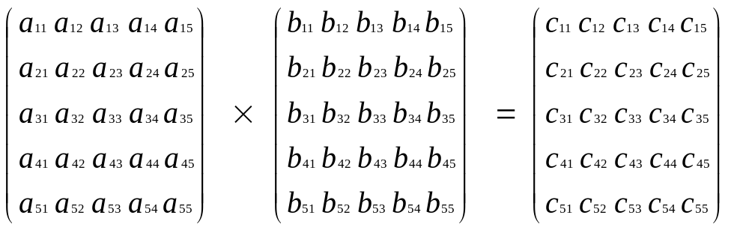
Example 5.7 (cont) Adding and Multiplying Two Matrices
c_{ij} = a_{i1}×b_{1j}+a_{i2}×b_{2j}+a_{i3}×b_{3j}+a_{i4}×b_{4j}+a_{i5}×b_{5j}

Slide 31
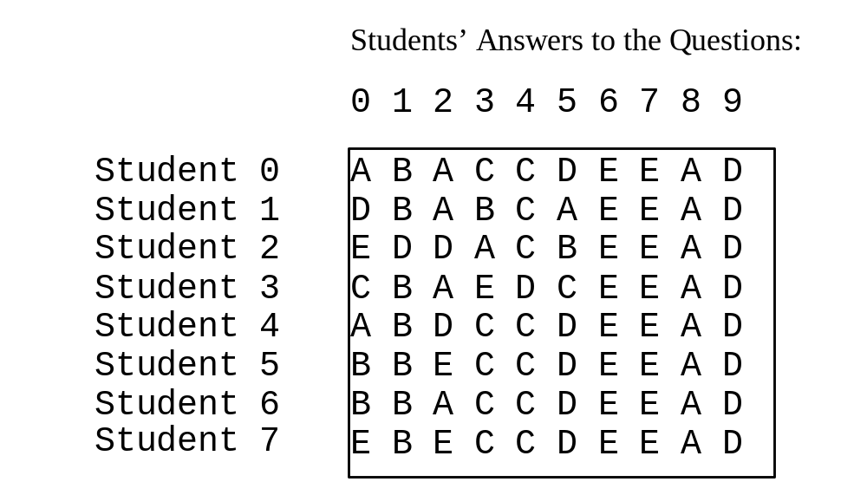
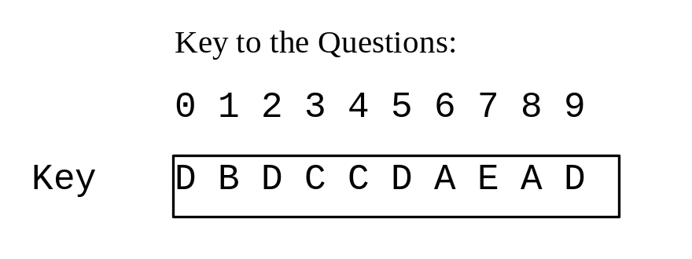
Example 5.8
Grading Multiple-Choice Test
Objective: write a program that grades multiple-choice test.
Grade Exam
Run

Slide 32
Example 5.9
Calculating Total Scores
Objective: write a program that calculates the total score for students in a class. Suppose the scores are stored in a three-dimensional array named scores. The first index in scores refers to a student, the second refers to an exam, and the third refers to the part of the exam. Suppose there are 7 students, 5 exams, and each exam has two parts--the multiple-choice part and the programming part. So, scores[i][j][0] represents the score on the multiple-choice part for the i’s student on the j’s exam. Your program displays the total score for each student, .
TotalScore
Run

Slide 33
Data Structures and Algorithms
Search Algorithms
Lecturer - Lempogo Forgor

Slide 34
Common Problems
There are some very common problems that we use computers to solve:
  Searching through a lot of records for a specific record or set of records
  Placing records in order, which we call sorting
There are numerous algorithms to perform searches and sorts.
We will briefly explore a few common ones.
Lempogo Forgor © 2010. All Rights Reserved

Slide 35
Search Algorithms
A search algorithm is a method of locating a specific item of information in a larger collection of data.
Lempogo Forgor © 2010. All Rights Reserved

Slide 36
Search Algorithms
Necessary components to search a list of fdata
  Array containing the list
  Length of the list
  Item for which you are searching
After search completed
  If item found, report “success,” return location in array
  If item not found, report “not found” or “failure”
Lempogo Forgor © 2010. All Rights Reserved

Slide 37
Searching
A question you should always ask when selecting a search algorithm is “How fast does the search have to be?”
The reason is that, in general, the faster the algorithm, the more complex it is.
Bottom line:
  you don’t always need to use the fastest algorithm.
Let’s explore the following search algorithms, keeping speed in mind.
  Linear (Sequential) search
  Binary search
Lempogo Forgor © 2010. All Rights Reserved

Slide 38
The Linear Search
This is a very simple algorithm.
It uses a loop to sequentially step through an array, starting with the first element.
It compares each element with the value being searched for and stops when that value is found or the end of the array is reached.
Lempogo Forgor © 2010. All Rights Reserved

Slide 39
The Linear Search
Looks for the target from the first to the last element of the list
The later in the list the target occurs the longer it takes to find it
Does not assume anything about the order of the elements in the list, so it can be used with an unsorted list

Slide 40
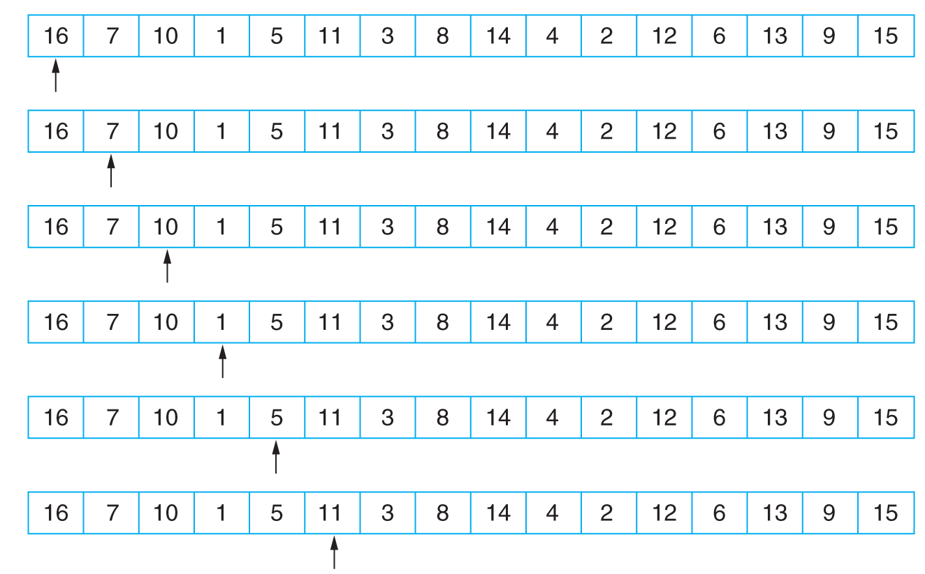
The Linear Search Example

Slide 41
Linear Search Algorithm
Basic algorithm:
  Get the search criterion (key)
  Get the first record from the file
  While ( (record != key) and (still more records) )
  Get the next record
  End_while
When do we know that there wasn’t a record in the file that matched the key?
Lempogo Forgor © 2010. All Rights Reserved

Slide 42
Linear Search Algorithm
public static int linSearch(int[] list, int listLength, int key) {
int loc;
boolean found = false;
for(int loc = 0; loc < listLength; loc++) {
if(list[loc] == key) {
found = true;
break;
}
}
if(found)
return loc;
else
return -1;
}

Slide 43
The Linear Search Algorithm
for i = 1 to N do
  if (target == list[i])
      return i
  end if
end for
Return -1

Slide 44

The Linear Search (Cont’d)
Suppose that you want to determine whether 27 is in the list
First compare 27 with list[0]; that is, compare 27 with 35
Because list[0] ≠ 27, you then compare 27 with list[1]
Because list[1] ≠ 27, you compare 27 with the next element in the list
Because list[2] = 27, the search stops
This search is successful!
Lempogo Forgor © 2010. All Rights Reserved

Slide 45
The Linear Search (Cont’d)
Let’s now search for 10
The search starts at the first element in the list; that is, at list[0]
Proceeding as before, we see that this time the search item, which is 10, is compared with every item in the list
Eventually, no more data is left in the list to compare with the search item; this is an unsuccessful search
Lempogo Forgor © 2010. All Rights Reserved

Slide 46
Performance of the Linear Search
Suppose that the first element in the array list contains the variable key, then we have performed one comparison to find the key.
Suppose that the second element in the array list contains the variable key, then we have performed two comparisons to find the key.
Carry on the same analysis till the key is contained in the last element of the array list. In this case, we have performed N comparisons (N is the size of the array list) to find the key.
Finally if the key is NOT in the array list, then we would have performed N comparisons and the key is NOT found and we would return -1.
Lempogo Forgor © 2010. All Rights Reserved

Slide 47
Worst-Case Analysis
If the target is in the last location, we look at all of the elements to find it
If the target is not in the list, we need to look at all of the elements to learn that
Therefore, the largest number of comparisons we will do in this algorithm is N

Slide 48
Performance of the Linear Search (Cont’d)
Therefore, the best case is: 1
And, the worst case is: N
The average case is:
Worst case and key found at the end of
the array list!
Best case
1 + 2 + 3 + …..+ N + N
Average Number of
Comparisons
=
N+1
Worst case and key is NOT found!
Number of possible cases
Lempogo Forgor © 2010. All Rights Reserved

Slide 49
Efficiency of the Linear Search
The advantage is its simplicity.
  It is easy to understand
  Easy to implement
  Does not require the array to be in order
The disadvantage is its inefficiency
  If there are 20,000 items in the array and what you are looking for is in the 19,999th element, you need to search through the entire list.
Lempogo Forgor © 2010. All Rights Reserved

Slide 50
The Binary Search
If we have an ordered list and we know how many things are in the list (i.e., number of records in a file), we can use a different strategy.
The binary search gets its name because the algorithm continually divides the list into two parts.

Slide 51
Binary Search Algorithm
Can only be performed on a sorted list !!!
Uses divide and conquer technique to search list
The binary search is much more efficient than the linear search.
Lempogo Forgor © 2010. All Rights Reserved

Slide 52
Binary Search Algorithm (Cont’d)
Search item is compared with middle element of list
If search item < middle element of list, search is restricted to first half of the list
If search item > middle element of list, search second half of the list
If search item = middle element, search is complete
Lempogo Forgor © 2010. All Rights Reserved

Slide 53

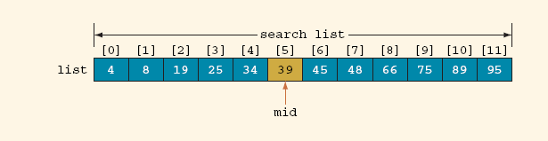
Binary Search Algorithm (Cont’d)
Determine whether 75 is in the list
Lempogo Forgor © 2010. All Rights Reserved

Slide 54
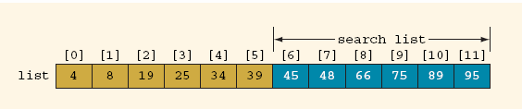
Binary Search Algorithm (Cont’d)
Lempogo Forgor © 2010. All Rights Reserved

Slide 55
Binary Search Algorithm (Cont’d)
public static int binarySearch(int[] list, int listLength, int key) {
int first = 0, last = listLength - 1;
int mid;
boolean found = false;
while (first <= last && !found) {
mid = (first + last) / 2;
if (list[mid] == key)
found = true;
else
if(list[mid] > key)
last = mid - 1;
else
first = mid + 1;
}
if (found)
return mid;
else
return –1;
} //end binarySearch
Lempogo Forgor © 2010. All Rights Reserved

Slide 56

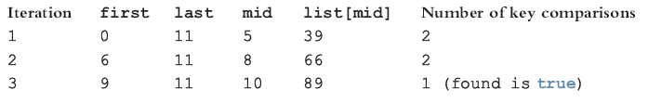
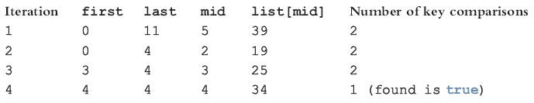
Binary Search Algorithm (Cont’d)
key = 89
key = 34
Lempogo Forgor © 2010. All Rights Reserved

Slide 57

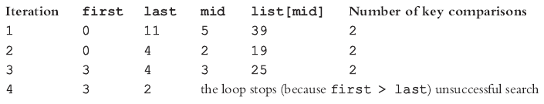
Binary Search Algorithm (Cont’d)
key = 22
Lempogo Forgor © 2010. All Rights Reserved

Slide 58

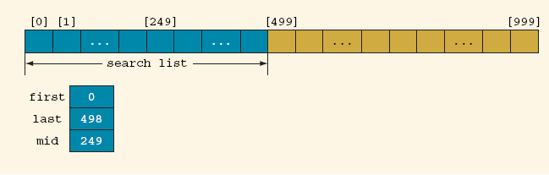
Performance of Binary Search Algorithm
key ≠ List[499]
key < List[499]
Lempogo Forgor © 2010. All Rights Reserved

Slide 59
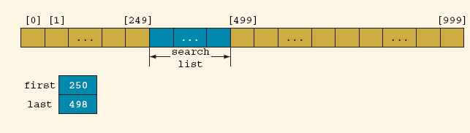
Performance of Binary Search Algorithm (Cont’d)
key > List[249]
Lempogo Forgor © 2010. All Rights Reserved

Slide 60
Efficiency of the Binary Search
Much more efficient than the linear search.
Lempogo Forgor © 2010. All Rights Reserved

Slide 61
Algorithm Review
Each comparison eliminates about half of the elements of the list from consideration
If we begin with N = 2^{k} – 1 elements in the list, there will be 2^{k–1} – 1 elements on the second pass, and 2^{k–2} – 1 elements on the third pass

Slide 62
Worst-Case Analysis
In the worst case, we will either find the target on the last pass, or not find the target at all
The last pass will have only one element left to compare, which happens when
2¹-1 = 1
If N = 2^{k} – 1, then there must be
k = lg(N+1) passes
On the worst-case, binary search has O(logN) complexity

Slide 63
How Fast is a Binary Search?
Worst case: 11 items in the list took 4 tries
How about the worst case for a list with 32 items ?
  1st try - list has 16 items
  2nd try - list has 8 items
  3rd try - list has 4 items
  4th try - list has 2 items
  5th try - list has 1 item

Slide 64
How Fast is a Binary Search? (con’t)
List has 512 items
1st try - 256 items
2nd try - 128 items
3rd try - 64 items
4th try - 32 items
5th try - 16 items
6th try - 8 items
7th try - 4 items
8th try - 2 items
9th try - 1 item
List has 250 items
1st try - 125 items
2nd try - 63 items
3rd try - 32 items
4th try - 16 items
5th try - 8 items
6th try - 4 items
7th try - 2 items
8th try - 1 item

Slide 65
What’s the Pattern?
List of 11 took 4 tries
List of 32 took 5 tries
List of 250 took 8 tries
List of 512 took 9 tries
32 = 2⁵ and 512 = 2⁹
8 < 11 < 16 2³ < 11 < 2⁴
128 < 250 < 256 2⁷ < 250 < 2⁸

Slide 66
A Very Fast Algorithm!
How long (worst case) will it take to find an item in a list 30,000 items long?
  2¹⁰ = 1024 2¹³ = 8192
  2¹¹ = 2048 2¹⁴ = 16384
  2¹² = 4096 2¹⁵ = 32768
So, it will take only 15 tries!

Slide 67
Lg n Efficiency
We say that the binary search algorithm runs in log₂ n time. (Also written as lg n)
Lg n means the log to the base 2 of some value of n.
8 = 2³ lg 8 = 3 16 = 2⁴ lg 16 = 4

Slide 68
Data Structures and Algorithms
Sorting Algorithms

Slide 69
What is Sorting?
  Sorting: an operation that segregates items into groups according to specified criterion.
  An operation that arrange data into a certain order.
  A = { 3 1 6 2 1 3 4 5 9 0 }
  A = { 0 1 1 2 3 3 4 5 6 9 }

Slide 70
Why Sort and Examples
Consider:
  Sorting Books in Library
  Sorting Individuals by Height (Feet and Inches)
  Sorting Movies in Blockbuster (Alphabetical)
  Sorting Numbers (Sequential)

Slide 71
Types of Sorting Algorithms
There are many different types of sorting algorithms, but the primary ones are:
Bubble Sort
Selection Sort
Insertion Sort
Merge Sort
Quick Sort
Radix sort

Slide 72
Selection Sort
A relatively easy to understand algorithm
Sorts an array in passes
  Each pass selects the next smallest element
  At the end of the pass, places it where it belongs
Lempogo Forgor © 2010. All Rights Reserved

Slide 73
Selection Sorting
Step:
1. select the smallest element
among data[i]~ data[data.length-1];
2. swap it with data[i];
3. if not finishing, repeat 1&2
20
8
5
10
7
5
8
20
10
7
5
7
20
10
8
5
7
8
10
20
5
7
8
10
20
Lempogo Forgor © 2010. All Rights Reserved

Slide 74
Selection Sort Algorithm
for fill = 0 to n-2 do // steps 2-6 form a pass
set posMin to fill
for next = fill+1 to n-1 do
if item at next < item at posMin
set posMin to next
Exchange item at posMin with one at fill
Lempogo Forgor © 2010. All Rights Reserved

Slide 75
Selection Sort Example
35 65 30 60 20 scan 0-4, smallest 20
swap 35 and 20
20 65 30 60 35 scan 1-4, smallest 30
swap 65 and 30
20 30 65 60 35 scan 2-4, smallest 35
swap 65 and 35
20 30 35 60 65 scan 3-4, smallest 60
swap 60 and 60
20 30 35 60 65 done
Lempogo Forgor © 2010. All Rights Reserved

Slide 76
C++ IMPLEMENTTION
#include<iostream>
using namespace std;
int main()
{
int i,j,n,loc,temp,min,a[30];
cout<<"Enter the number of elements:";
cin>>n;
cout<<"\nEnter the elements\n";
for(i=0;i<n;i++)
{
cin>>a[i];
}
for(i=0;i<n-1;i++)
{
min=a[i];
loc=i;
for(j=i+1;j<n;j++)
{
if(min>a[j])
{
min=a[j];
loc=j;
}
}
temp=a[i];
a[i]=a[loc];
a[loc]=temp;
}
cout<<"\nSorted list is as follows\n";
for(i=0;i<n;i++)
{
cout<<a[i]<<" ";
}
return 0;
}

Slide 77
Efficiency of Selection Sort
Efficiency is O(n²), hence called a quadratic sort
Performs:
  O(n²) comparisons
  O(n) exchanges (swaps)
Lempogo Forgor © 2010. All Rights Reserved

Slide 78
Bubble Sort
Compares adjacent array elements
  Exchanges their values if they are out of order
Smaller values bubble up to the top of the array
  Larger values sink to the bottom
Lempogo Forgor © 2010. All Rights Reserved

Slide 79
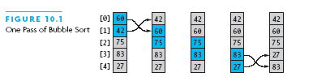
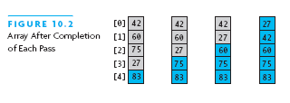
Bubble Sort Example
Lempogo Forgor © 2010. All Rights Reserved

Slide 80
Bubble Sort Algorithm
Procedure bubble_sort (array , N)
array – list of items to be sorted
N – size of array
begin
swapped = false
repeat
for I = 1 to N-1
if array[i-1] > array[i] then
swap array[i-1] and array[i]
swapped = true
end if
end for
until not swapped
end procedure
Lempogo Forgor © 2010. All Rights Reserved

Slide 81
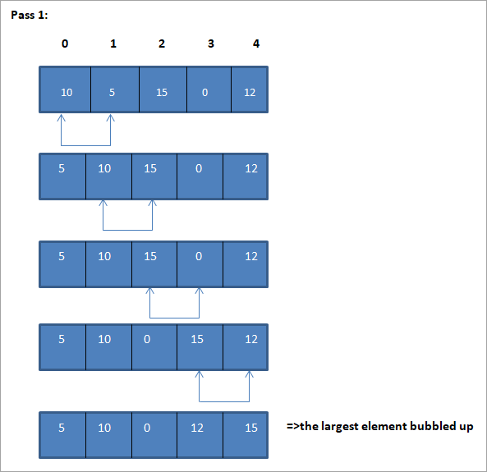
example

Slide 82
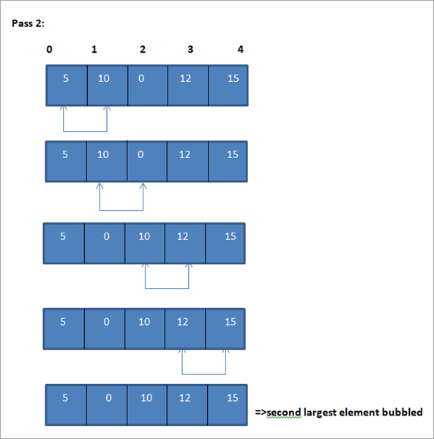
example

Slide 83
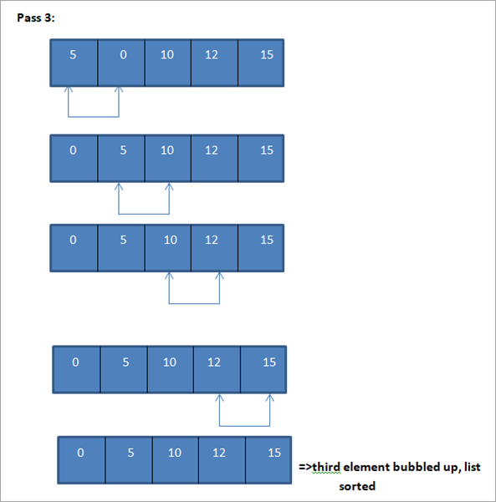
example

Slide 84
C++ IMPLEMENTATION
#include<iostream>
using namespace std;
int main ()
{
int i, j,temp,pass=0;
int a[10] = {10,2,0,14,43,25,18,1,5,45};
cout <<"Input list ...\n";
for(i = 0; i<10; i++) {
cout <<a[i]<<"\t";
}
cout<<endl;
for(i = 0; i<10; i++) {
for(j = i+1; j<10; j++)
{
if(a[j] < a[i]) {
temp = a[i];
a[i] = a[j];
a[j] = temp;
}
}
pass++;
}
cout <<"Sorted Element List ...\n";
for(i = 0; i<10; i++) {
cout <<a[i]<<"\t";
}
cout<<"\nNumber of passes taken to sort the list:"<<pass<<endl;
return 0;
}

Slide 85
Analysis of Bubble Sort
From the pseudo code and the illustration that we have seen above, in bubble sort, we make N-1 comparisons in the first pass, N-2 comparisons in the second pass and so on.
Hence the total number of comparisons in bubble sort is:
Sum = (N-1) + (N-2) + (N-3)+ … + 3 + 2 + 1
= N(N-1)/2
= O(n2) => Time complexity of bubble sort technique

Slide 86
Analysis of Bubble Sort
Excellent performance in some cases
  But very poor performance in others!
Works best when array is nearly sorted to begin with
Worst case number of comparisons: O(n²)
Worst case number of exchanges: O(n²)
Best case occurs when the array is already sorted:
  O(n) comparisons
  O(1) exchanges (none actually)
Lempogo Forgor © 2010. All Rights Reserved

Slide 87
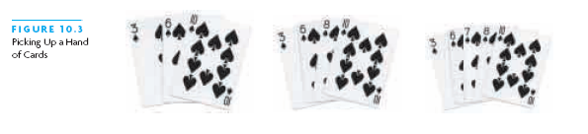
Insertion Sort
Based on technique of card players to arrange a hand
  Player keeps cards picked up so far in sorted order
  When the player picks up a new card
    Makes room for the new card
    Then inserts it in its proper place
Lempogo Forgor © 2010. All Rights Reserved

Slide 88
Insertion Sort
In the insertion sort technique, we start from the second element and compare it with the first element and put it in a proper place. Then we perform this process for the subsequent elements.
We compare each element with all its previous elements and put or insert the element in its proper position. Insertion sort technique is more feasible for arrays with a smaller number of elements. It is also useful for sorting linked lists.

Slide 89
Insertion Sort Algorithm
For each element from 2nd (nextPos = 1) to last:
  Insert element at nextPos where it belongs
  Increases sorted subarray size by 1
To make room:
  Hold nextPos value in a variable
  Shuffle elements to the right until gap at right place
Lempogo Forgor © 2010. All Rights Reserved

Slide 90
Insertion Sort Algorithm
procedure insertionSort(array,N )
array – array to be sorted
N- number of elements
begin
int freePosition
int insert_val
for i = 1 to N -1 do:
insert_val = array[i]
freePosition = i
//locate free position to insert the element
whilefreePosition> 0 and array[freePosition -1] >insert_val do:
array [freePosition] = array [freePosition -1]
freePosition = freePosition -1
end while
//insert the number at free position
array [freePosition] = insert_val
end for
end procedure

Slide 91
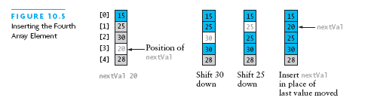
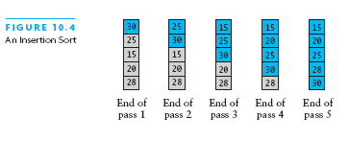
Insertion Sort Example
Lempogo Forgor © 2010. All Rights Reserved

Slide 92
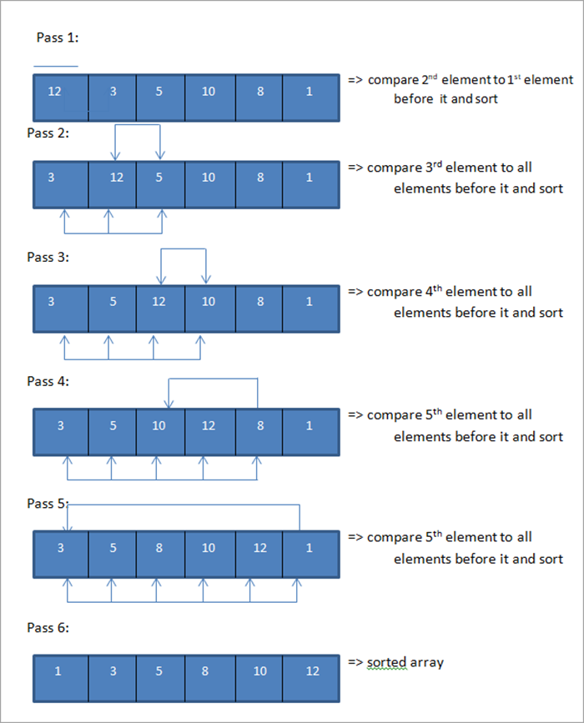
Example

Slide 93
C++ IMPLMENETAION
#include<iostream>
using namespace std;
int main ()
{
int myarray[10] = { 12,4,3,1,15,45,33,21,10,2};
cout<<"\nInput list is \n";
for(int i=0;i<10;i++)
{
cout <<myarray[i]<<"\t";
}
for(int k=1; k<10; k++)
{
int temp = myarray[k];
int j= k-1;
while(j>=0 && temp <= myarray[j])
{
myarray[j+1] = myarray[j];
j = j-1;
}
myarray[j+1] = temp;
}
cout<<"\nSorted list is \n";
for(int i=0;i<10;i++)
{
cout <<myarray[i]<<"\t";
}
}

Slide 94
Analysis of Insertion Sort
Maximum number of comparisons: O(n²)
In the best case, number of comparisons: O(n)
Lempogo Forgor © 2010. All Rights Reserved

Slide 95
Analysis of Insertion Sort
Maximum number of comparisons: O(n²)
In the best case, number of comparisons: O(n)
# shifts for an insertion = # comparisons - 1
  When new value smallest so far, # comparisons
A shift in insertion sort moves only one item
  Bubble or selection sort exchange: 3 assignments
Lempogo Forgor © 2010. All Rights Reserved

Slide 96
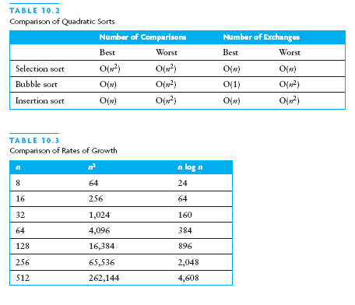
Comparison of Quadratic Sorts
None good for large arrays!
Lempogo Forgor © 2010. All Rights Reserved

Slide 97
Divide-and-Conquer
Divide and Conquer is a method of algorithm design.
This method has three distinct steps:
  Divide: If the input size is too large to deal with in a straightforward manner, divide the data into two or more disjoint subsets.
  Recur: Use divide and conquer to solve the subproblems associated with the data subsets.
  Conquer: Take the solutions to the subproblems and “merge” these solutions into a solution for the original problem.
Lempogo Forgor © 2010. All Rights Reserved

Slide 98
Merge-Sort
Algorithm:
  Divide:
  If S has zero or one element then nothing needs to be don
  If S has at leas two elements remove all the elements from S and put them into two sequences, S₁ and S₂, each containing about half of the elements of S.
  S₁ contains the first ⎡n/2⎤ elements and S₂ contains the remaining ⎣n/2⎦ elements.
  Recur: Recursive sort sequences S₁ and S₂.
  Conquer: Put back the elements into S by merging the sorted sequences S₁ and S₂ into a unique sorted sequence.
Lempogo Forgor © 2010. All Rights Reserved

Slide 99
Merge Sort Algorithm
Overview:
Split array into two halves
Sort the left half (recursively)
Sort the right half (recursively)
Merge the two sorted halves
Lempogo Forgor © 2010. All Rights Reserved

Slide 100
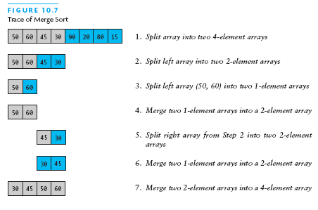
Merge Sort Example
Lempogo Forgor © 2010. All Rights Reserved

Slide 101
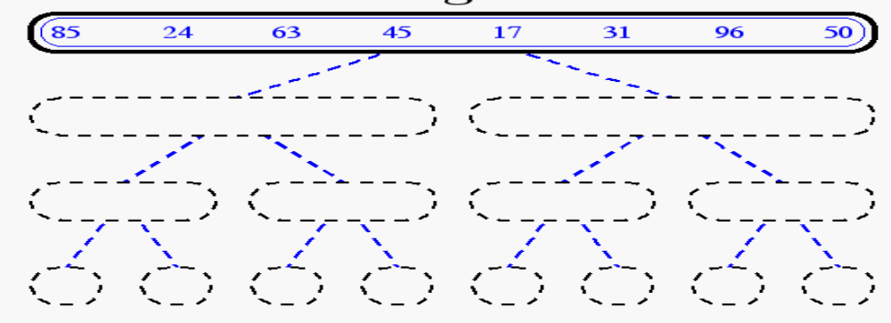
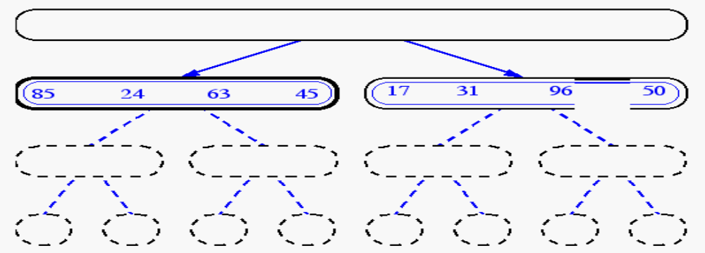
Merge-Sort Example
Lempogo Forgor © 2010. All Rights Reserved

Slide 102
Merge Algorithm (Two Sequences)
Merging two sequences:
  Access the first item from both sequences
  While neither sequence is finished
    Compare the current items of both
    Copy smaller current item to the output
    Access next item from that input sequence
  Copy any remaining from first sequence to output
  Copy any remaining from second to output
Lempogo Forgor © 2010. All Rights Reserved

Slide 103
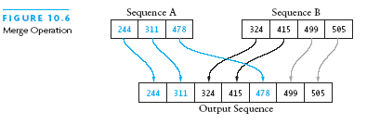
Picture of Merge
Lempogo Forgor © 2010. All Rights Reserved

Slide 104
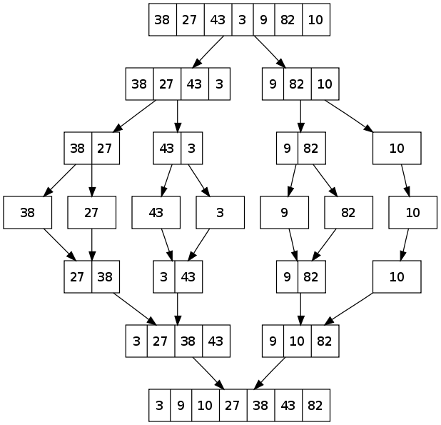
Merge-Sort Example
Lempogo Forgor © 2010. All Rights Reserved

Slide 105
C++ IMPLEMENTATION
#include <iostream>
using namespace std;
void merge(int *,int, int , int );
void merge_sort(int *arr, int low, int high)
{
int mid;
if (low < high){
//divide the array at mid and sort independently using merge sort
mid=(low+high)/2;
merge_sort(arr,low,mid);
merge_sort(arr,mid+1,high);
//merge or conquer sorted arrays
merge(arr,low,high,mid);
}
}
// Merge sort
void merge(int *arr, int low, int high, int mid)
{
int i, j, k, c[50];
i = low;
k = low;
j = mid + 1;
while (i <= mid && j <= high) {
if (arr[i] < arr[j]) {
c[k] = arr[i];
k++;
i++;
}
else {
c[k] = arr[j];
k++;
j++;
}
}
while (i <= mid) {
c[k] = arr[i];
k++;
i++;
}
while (j <= high) {
c[k] = arr[j];
k++;
j++;
}
for (i = low; i < k; i++) {
arr[i] = c[i];
}
}
// read input array and call mergesort
int main()
{
int myarray[30], num;
cout<<"Enter number of elements to be sorted:";
cin>>num;
cout<<"Enter "<<num<<" elements to be sorted:";
for (int i = 0; i < num; i++) { cin>>myarray[i];
}
merge_sort(myarray, 0, num-1);
cout<<"Sorted array\n";
for (int i = 0; i < num; i++)
{
cout<<myarray[i]<<"\t";
}
}

Slide 106
Analysis of Merge
Two input sequences, total length n elements
  Must move each element to the output
  Merge time is O(n)
Must store both input and output sequences
  An array cannot be merged in place
  Additional space needed: O(n)
Lempogo Forgor © 2010. All Rights Reserved

Slide 107
Merge Sort Analysis
Splitting/copying n elements to subarrays: O(n)
Merging back into original array: O(n)
Recursive calls: 2, each of size n/2
  Their total non-recursive work: O(n)
Next level: 4 calls, each of size n/4
  Non-recursive work again O(n)
Size sequence: n, n/2, n/4, ..., 1
  Number of levels = log n
  Total work: O(n log n)
Lempogo Forgor © 2010. All Rights Reserved

Slide 108
Running Time of Merge-Sort
At each level in the binary tree created for Merge Sort, there are n elements, with O(1) time spent at each element
  → O(n) running time for processing one level
The height of the tree is O(log n)
Therefore, the time complexity is O(nlog n)
Lempogo Forgor © 2010. All Rights Reserved

Slide 109
Quicksort
Given a pivot value:
  Rearranges array into two parts:
    Left part ≤ pivot value
    Right part > pivot value
Average case for Quicksort is O(n log n)
  Worst case is O(n²)
Lempogo Forgor © 2010. All Rights Reserved

Slide 110
Quick-Sort
Divide :
If the sequence S has 2 or more elements, select an element x from S to be your pivot.
Any arbitrary element, like the last, will do. Remove all the elements of S and divide them into 3 sequences:
    L, holds S’s elements less than x
    E, holds S’s elements equal to x
    G, holds S’s elements greater than x
2) Recurse: Recursively sort L and G
3) Conquer: Finally, to put elements back into S in order, first inserts the elements of L, then those of E, and those of G.
Lempogo Forgor © 2010. All Rights Reserved

Slide 111
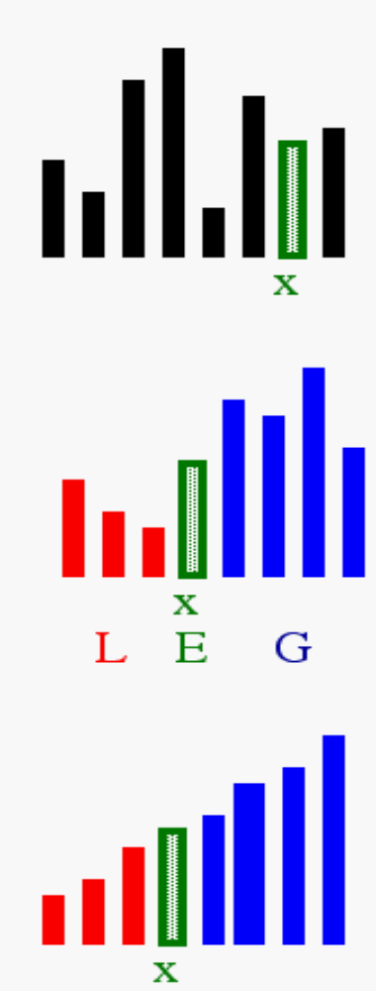
Idea of Quick Sort
1) Select: pick an element
2) Divide: rearrange elements so that x goes to its final position E
3) Recurse and Conquer: recursively sort
Lempogo Forgor © 2010. All Rights Reserved

Slide 112
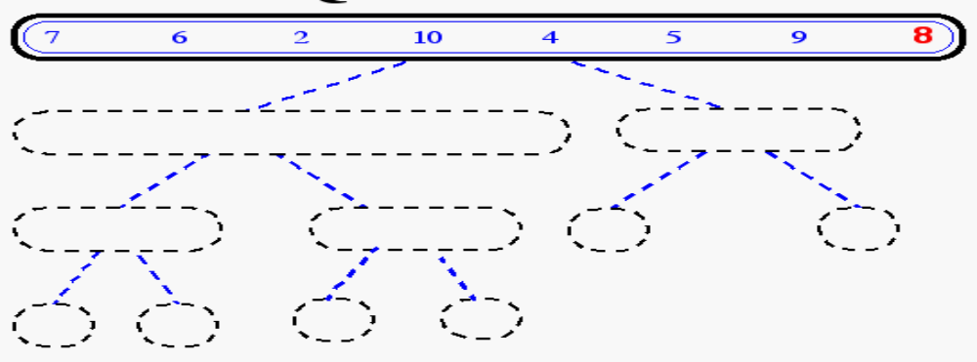
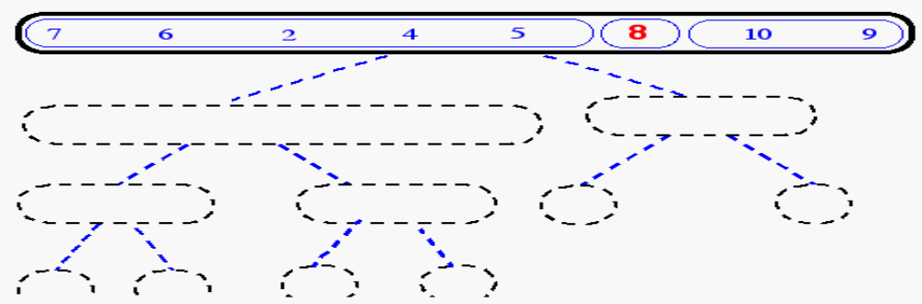
Quick-Sort Tree
Lempogo Forgor © 2010. All Rights Reserved

Slide 113
Algorithm for Quicksort
first and last are end points of region to sort
if first < last
Partition using pivot, which ends in pivIndex
Apply Quicksort recursively to left subarray
Apply Quicksort recursively to right subarray
Performance: O(n log n) provide pivIndex not always too close to the end
Performance O(n²) when pivIndex always near end
Lempogo Forgor © 2010. All Rights Reserved

Slide 114
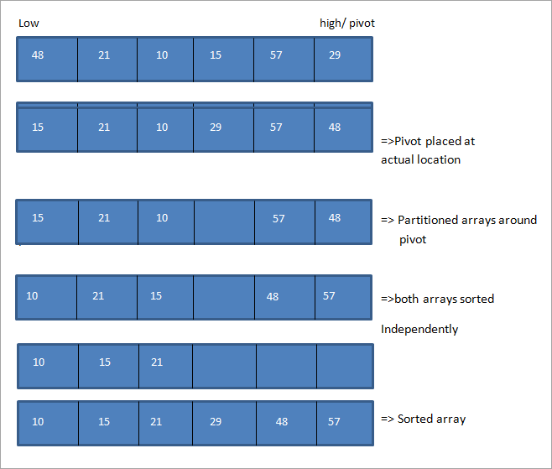
Example

Slide 115
Algorithm for Partitioning
Set pivot value to a[fst]
Set up to fst and down to lst
do
Increment up until a[up] > pivot or up = lst
Decrement down until a[down] <= pivot or
  down = fst
if up < down, swap a[up] and a[down]
while up is to the left of down
swap a[fst] and a[down]
return down as pivIndex
Lempogo Forgor © 2010. All Rights Reserved

Slide 116
Partitioning (Quicksort)
A key step in the Quicksort algorithm is partitioning the array
  We choose some (any) number p in the array to use as a pivot
  We partition the array into three parts:
p
numbers less than p
p
numbers greater than or equal to p
Lempogo Forgor © 2010. All Rights Reserved

Slide 117
Partitioning
Choose an array value (say, the first) to use as the pivot
Starting from the left end, find the first element that is greater than or equal to the pivot
Searching backward from the right end, find the first element that is less than the pivot
Interchange (swap) these two elements
Repeat, searching from where we left off, until done
Lempogo Forgor © 2010. All Rights Reserved

Slide 118
C++ IMPLEMENTATION
#include <iostream>
using namespace std;
// Swap two elements - Utility function
void swap(int* a, int* b)
{
int t = *a;
*a = *b;
*b = t;
}
// partition the array using last element as pivot
int partition (int arr[], int low, int high)
{
int pivot = arr[high]; // pivot
int i = (low - 1);
for (int j = low; j <= high- 1; j++)
{
//if current element is smaller than pivot, increment the low element
//swap elements at i and j
if (arr[j] <= pivot)
{
i++; // increment index of smaller element
swap(&arr[i], &arr[j]);
}
}
swap(&arr[i + 1], &arr[high]);
return (i + 1);
}
//quicksort algorithm
void quickSort(int arr[], int low, int high)
{
if (low < high)
{
//partition the array
int pivot = partition(arr, low, high);
//sort the sub arrays independently
quickSort(arr, low, pivot - 1);
quickSort(arr, pivot + 1, high);
}
}
void displayArray(int arr[], int size)
{
int i;
for (i=0; i < size; i++)
cout<<arr[i]<<"\t";
}
int main()
{
int arr[] = {12,23,3,43,51,35,19,45};
int n = sizeof(arr)/sizeof(arr[0]);
cout<<"Input array"<<endl;
displayArray(arr,n);
cout<<endl;
quickSort(arr, 0, n-1);
cout<<"Array sorted with quick sort"<<endl;
displayArray(arr,n);
return 0;
}

Slide 119
Analysis of quicksort—best case
Suppose each partition operation divides the array almost exactly in half
Then the depth of the recursion is log₂n
  because that’s how many times we can halve n
However, there are many recursions at each level!
  How can we figure this out?
  We note that
    Each partition is linear over its subarray
    All the partitions at one level cover the array
Lempogo Forgor © 2010. All Rights Reserved

Slide 120
Partitioning at various levels
Lempogo Forgor © 2010. All Rights Reserved

Slide 121
Best case
We cut the array size in half each time
So the depth of the recursion is log₂n
At each level of the recursion, all the partitions at that level do work that is linear in n
O(log₂n) * O(n) = O(n log₂n)
What about the worst case?
Lempogo Forgor © 2010. All Rights Reserved

Slide 122
Worst case
In the worst case, partitioning always divides the size n array into these three parts:
  A length one part, containing the pivot itself
  A length zero part, and
  A length n-1 part, containing everything else
We don’t recur on the zero-length part
Recurring on the length n-1 part requires (in the worst case) recurring to depth n-1
Lempogo Forgor © 2010. All Rights Reserved

Slide 123
Worst case partitioning
Lempogo Forgor © 2010. All Rights Reserved

Slide 124
Worst case for quicksort
In the worst case, recursion may be O(n) levels deep (for an array of size n).
But the partitioning work done at each level is still O(n).
O(n) * O(n) = O(n²)
So worst case for Quicksort is O(n²)
When does this happen?
  When the array is sorted to begin with!
Lempogo Forgor © 2010. All Rights Reserved

Slide 125
Typical case for quicksort
If the array is sorted to begin with, Quicksort is terrible: O(n²)
It is possible to construct other bad cases
However, Quicksort is usually O(n log₂n)
The constants are so good that Quicksort is generally the fastest algorithm known
Most real-world sorting is done by Quicksort
Lempogo Forgor © 2010. All Rights Reserved

Slide 126
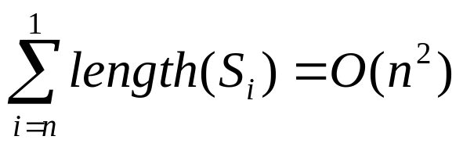
Quick Sort Running Time
Worst case: when the pivot does not divide the sequence in two
At each step, the length of the sequence is only reduced by 1
Total running time
General case:
  Time spent at level i in the tree is O(n)
  Running time: O(n) * O(height)
Average case:
  O(n log n)
Lempogo Forgor © 2010. All Rights Reserved

Slide 127
Radix Sort
Radix sort algorithm different than other sorting algorithms that we talked.
  It does not use key comparisons to sort an array.
The radix sort :
  Treats each data item as a character string.
  First it groups data items according to their rightmost character, and put these groups into order w.r.t. this rightmost character.
  Then, combine these groups.
  We, repeat these grouping and combining operations for all other character positions in the data items from the rightmost to the leftmost character position.
  At the end, the sort operation will be completed.
CENG 213 Data Structures

Slide 128
Radix Sort – Example
mom, dad, god, fat, bad, cat, mad, pat, bar, him original list
(dad,god,bad,mad) (mom,him) (bar) (fat,cat,pat) group strings by rightmost letter
dad,god,bad,mad,mom,him,bar,fat,cat,pat combine groups
(dad,bad,mad,bar,fat,cat,pat) (him) (god,mom) group strings by middle letter
dad,bad,mad,bar,fat,cat,pat,him,god,mom combine groups
(bad,bar) (cat) (dad) (fat) (god) (him) (mad,mom) (pat) group strings by first letter
bad,bar,cat,dad,fat,god,him,mad,mom,par combine groups (SORTED)
CENG 213 Data Structures

Slide 129
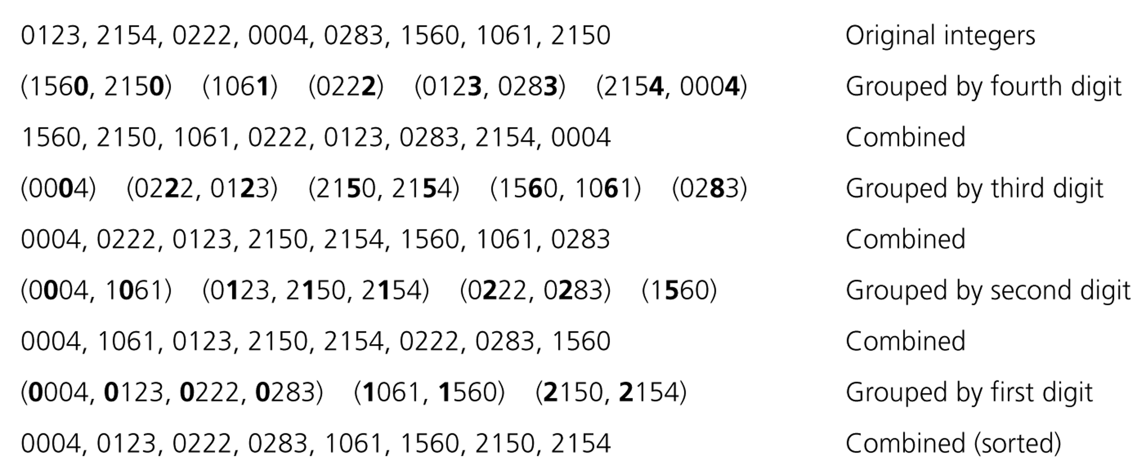
Radix Sort – Example
CENG 213 Data Structures

Slide 130
Radix Sort - Algorithm
radixSort(inout theArray:ItemArray, in n:integer, in d:integer)
// sort n d-digit integers in the array theArray
for (j=d down to 1) {
Initialize 10 groups to empty
Initialize a counter for each group to 0
for (i=0 through n-1) {
k = jth digit of theArray[i]
Place theArrar[i] at the end of group k
Increase kth counter by 1
}
Replace the items in theArray with all the items in group 0,
followed by all the items in group 1, and so on.
}
CENG 213 Data Structures

Slide 131
Radix Sort -- Analysis
The radix sort algorithm requires 2*n*d moves to sort n strings of d characters each.
➔ So, Radix Sort is O(n)
Although the radix sort is O(n), it is not appropriate as a general-purpose sorting algorithm.
  Its memory requirement is d * original size of data (because each group should be big enough to hold the original data collection.)
  For example, we need 27 groups to sort string of uppercase letters.
  The radix sort is more appropriate for a linked list than an array. (we will not need the huge memory in this case)
CENG 213 Data Structures

Slide 132
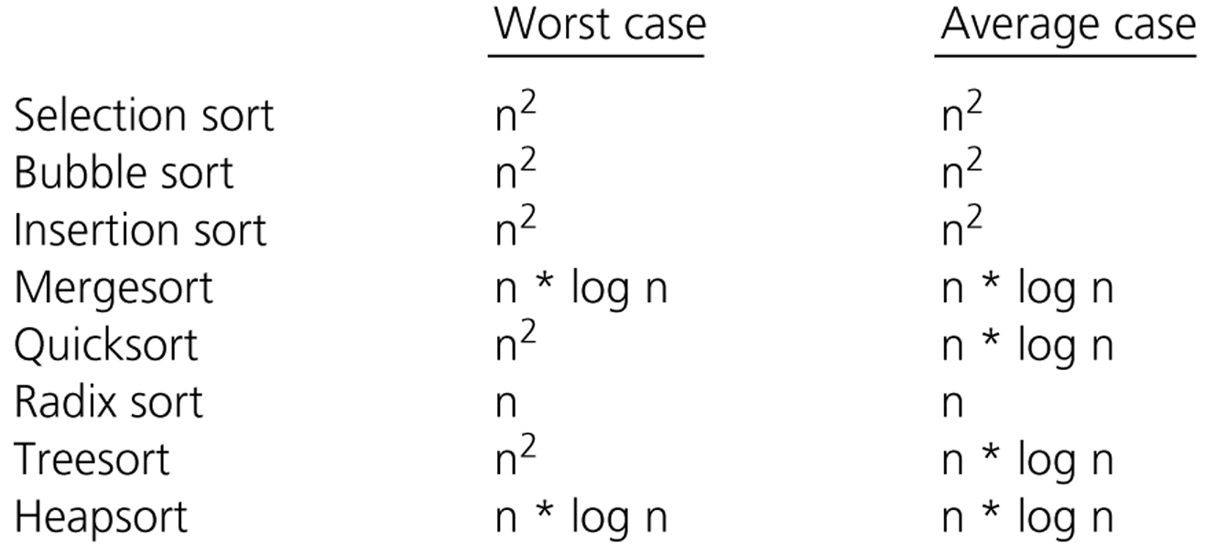
Comparison of Sorting Algorithms
CENG 213 Data Structures

Slide 133
lecture Summary
Three quadratic sorting algorithms:
  Selection sort, bubble sort, insertion sort
Quicksort: average-case O(n log n)
  If the pivot is picked poorly, get worst case: O(n²)
Merge sort and heapsort: guaranteed O(n log n)
  Merge sort: space overhead is O(n)
Lempogo Forgor © 2010. All Rights Reserved

Slide 134
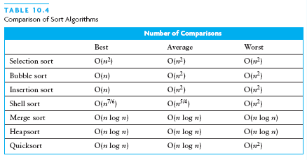
Chapter Summary (2)
Lempogo Forgor © 2010. All Rights Reserved

Slide 135
Any Questions?
Lempogo Forgor © 2010. All Rights Reserved

Slide 136
Any Questions?
Lempogo Forgor © 2010. All Rights Reserved

Slide 137
Any Questions?

