Slide 1
Stacks and Queues

Slide 2
Stack Overview
Stack ADT
Basic operations of stack
Pushing, popping etc.
Implementations of stacks using
array
linked list

Slide 3
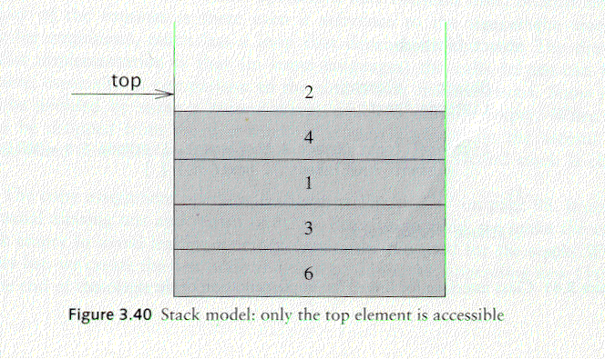
Stack ADT
A stack is a list in which insertion and deletion take place at the same end
This end is called top
The other end is called bottom
Stacks are known as LIFO (Last In, First Out) lists.
The last element inserted will be the first to be retrieved

Slide 4
Push and Pop
Primary operations: Push and Pop
Push
Add an element to the top of the stack
Pop
Remove the element at the top of the stack
empty stack
push an element
push another
pop
top
B
top
top
top
A
A
A

Slide 5
Implementation of Stacks
Any list implementation could be used to implement a stack
Arrays (static: the size of stack is given initially)
Linked lists (dynamic: never become full)
We will explore implementations based on array and linked list
Let’s see how to use an array to implement a stack first

Slide 6
Stack class
class Stack {
public:
Stack(int size = 10); // constructor
~Stack() { delete [] values; } // destructor
bool IsEmpty() { return top == -1; }
bool IsFull() { return top == maxTop; }
double Top(); // examine, without popping
void Push(const double x);
double Pop();
void DisplayStack();
private:
int maxTop; // max stack size = size - 1
int top; // current top of stack
double* values; // element array
};

Slide 7
Stack class
Attributes of Stack
maxTop: the max size of stack
top: the index of the top element of stack
values: point to an array which stores elements of stack
Operations of Stack
IsEmpty: return true if stack is empty, return false otherwise
IsFull: return true if stack is full, return false otherwise
Top: return the element at the top of stack
Push: add an element to the top of stack
Pop: delete the element at the top of stack
DisplayStack: print all the data in the stack

Slide 8
Array impln: Create Stack
The constructor of Stack
Allocate a stack array of size. By default, size = 10.
Initially top is set to -1. It means the stack is empty.
When the stack is full, top will have its maximum value, i.e. size – 1.
Stack::Stack(int size /*= 10*/) {
values = new double[size];
top = -1;
maxTop = size - 1;
}
Although the constructor dynamically allocates the stack array, the stack is still static. The size is fixed after the initialization.

Slide 9
Array Impln: Push Stack
void Push(const double x);
Push an element onto the stack
Note top always represents the index of the top element. After pushing an element, increment top.
void Stack::Push(const double x) {
if (IsFull()) // if stack is full, print error
cout << "Error: the stack is full." << endl;
else
values[++top] = x;
}

Slide 10
Array Impln: Pop Stack
double Pop()
Pop and return the element at the top of the stack
Don’t forgot to decrement top
double Stack::Pop() {
if (IsEmpty()) { //if stack is empty, print error
cout << "Error: the stack is empty." << endl;
return -1;
}
else {
return values[top--];
}
}

Slide 11
Array Impln: Stack Top
double Top()
Return the top element of the stack
Unlike Pop, this function does not remove the top element
double Stack::Top() {
if (IsEmpty()) {
cout << "Error: the stack is empty." << endl;
return -1;
}
else
return values[top];
}

Slide 12

Array Impln: Printing all the elements
void DisplayStack()
Print all the elements
void Stack::DisplayStack() {
cout << "top -->";
for (int i = top; i >= 0; i--)
cout << "\t|\t" << values[i] << "\t|" << endl;
cout << "\t|---------------|" << endl;
}

Slide 13
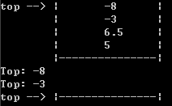
Using Stack
result
int main(void) {
Stack stack(5);
stack.Push(5.0);
stack.Push(6.5);
stack.Push(-3.0);
stack.Push(-8.0);
stack.DisplayStack();
cout << "Top: " << stack.Top() << endl;
stack.Pop();
cout << "Top: " << stack.Top() << endl;
while (!stack.IsEmpty()) stack.Pop();
stack.DisplayStack();
return 0;
}

Slide 14
Implementation based on Linked List
Now let’s implement a stack based on a linked list
To make the best out of the code of List, we implement Stack by inheriting List
To let Stack access private member head, we make Stack as a friend of List
class List {
public:
List(void) { head = NULL; } // constructor
~List(void); // destructor
bool IsEmpty() { return head == NULL; }
Node* InsertNode(int index, double x);
int FindNode(double x);
int DeleteNode(double x);
void DisplayList(void);
private:
Node* head;
friend class Stack;
};

Slide 15
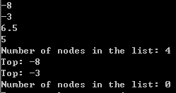
Implementation based on Linked List
class Stack : public List {
public:
Stack() {} // constructor
~Stack() {} // destructor
double Top() {
if (head == NULL) {
cout << "Error: the stack is empty." << endl;
return -1;
}
else
return head->data;
}
void Push(const double x) { InsertNode(0, x); }
double Pop() {
if (head == NULL) {
cout << "Error: the stack is empty." << endl;
return -1;
}
else {
double val = head->data;
DeleteNode(val);
return val;
}
}
void DisplayStack() { DisplayList(); }
};
Note: the stack implementation based on a linked list will never be full.

Slide 16
Application: Balancing Symbols
To check that every right brace, bracket, and parentheses must correspond to its left counterpart
e.g. [( )] is legal, but [( ] ) is illegal
Algorithm
(1) Make an empty stack.
(2) Read characters until end of file
i. If the character is an opening symbol, push it onto the stack
ii. If it is a closing symbol, then if the stack is empty, report an error
iii. Otherwise, pop the stack. If the symbol popped is not the
corresponding opening symbol, then report an error
(3) At end of file, if the stack is not empty, report an error

Slide 17
Array implementation versus linked list implementations
push, pop, top are all constant-time operations in both array implementation and linked list implementation
For array implementation, the operations are performed in very fast constant time

Slide 18
Queue Overview
Queue ADT
Basic operations of queue
Enqueuing, dequeuing etc.
Implementation of queue
Array
Linked list

Slide 19
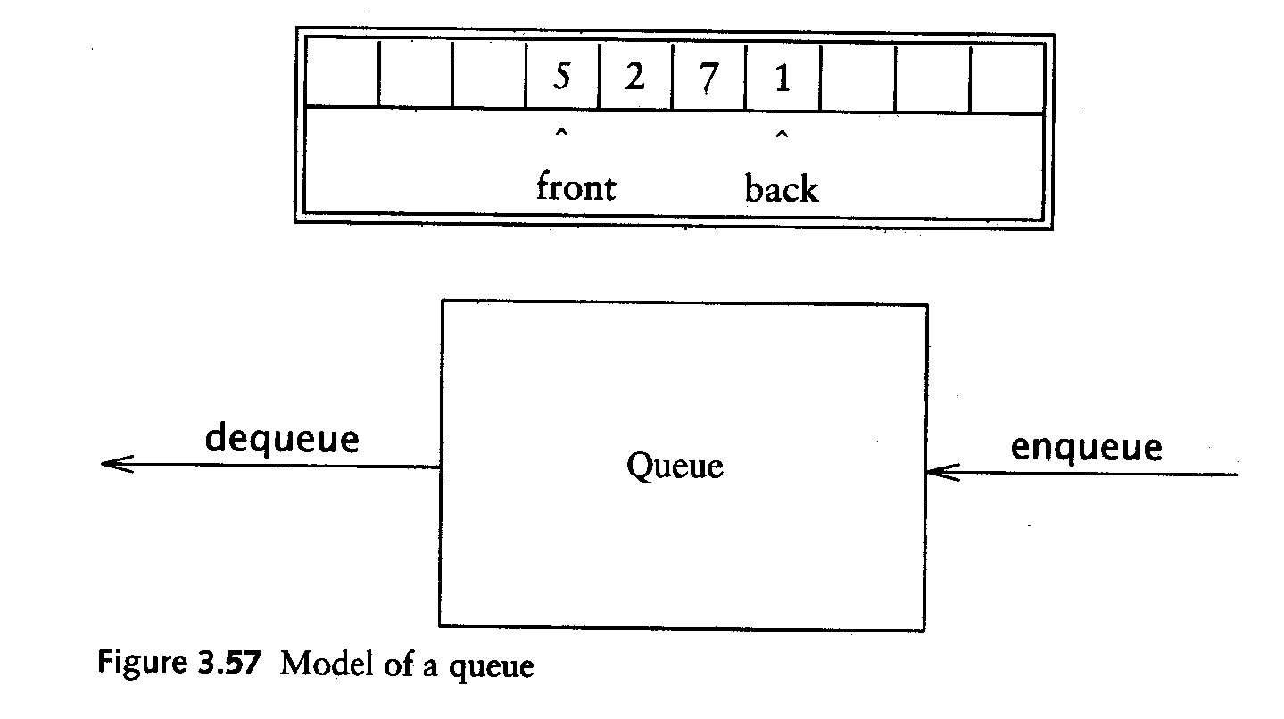
Queue ADT
Like a stack, a queue is also a list. However, with a queue, insertion is done at one end, while deletion is performed at the other end.
Accessing the elements of queues follows a First In, First Out (FIFO) order.
Like customers standing in a check-out line in a store, the first customer in is the first customer served.

Slide 20
Enqueue and Dequeue
Primary queue operations: Enqueue and Dequeue
Like check-out lines in a store, a queue has a front and a rear.
Enqueue – insert an element at the rear of the queue
Dequeue – remove an element from the front of the queue
Remove (Dequeue)
Insert (Enqueue)
front
rear

Slide 21
Implementation of Queue
Just as stacks can be implemented as arrays or linked lists, so with queues.
Dynamic queues have the same advantages over static queues as dynamic stacks have over static stacks

Slide 22
Queue Implementation of Array
There are several different algorithms to implement Enqueue and Dequeue
Naïve way
When enqueuing, the front index is always fixed and the rear index moves forward in the array.
rear
rear
rear
3
3
6
3
6
9
front
front
front
Enqueue(3)
Enqueue(6)
Enqueue(9)

Slide 23
Queue Implementation of Array
Naïve way (cont’d)
When dequeuing, the front index is fixed, and the element at the front the queue is removed. Move all the elements after it by one position. (Inefficient!!!)
rear
rear
rear = -1
6
9
9
front
front
front
Dequeue()
Dequeue()
Dequeue()

Slide 24
Queue Implementation of Array
A better way
When an item is enqueued, the rear index moves forward.
When an item is dequeued, the front index also moves forward by one element
(front)
XXXXOOOOO (rear)
OXXXXOOOO (after 1 dequeue, and 1 enqueue)
OOXXXXXOO (after another dequeue, and 2 enqueues)
OOOOXXXXX (after 2 more dequeues, and 2 enqueues)
The problem here is that the rear index cannot move beyond the last element in the array.

Slide 25
Implementation using Circular Array
Using a circular array
When an element moves past the end of a circular array, it wraps around to the beginning, e.g.
OOOOO7963 → 4OOOO7963 (after Enqueue(4))
After Enqueue(4), the rear index moves from 3 to 4.
How to detect an empty or full queue, using a circular array algorithm?
Use a counter of the number of elements in the queue.

Slide 26
Queue Implementation of Linked List
class Queue {
public:
Queue(int size = 10); // constructor
~Queue() { delete [] values; } // destructor
bool IsEmpty(void);
bool IsFull(void);
bool Enqueue(double x);
bool Dequeue(double & x);
void DisplayQueue(void);
private:
int front; // front index
int rear; // rear index
int counter; // number of elements
int maxSize; // size of array queue
double* values; // element array
};

Slide 27
Queue Class
Attributes of Queue
front/rear: front/rear index
counter: number of elements in the queue
maxSize: capacity of the queue
values: point to an array which stores elements of the queue
Operations of Queue
IsEmpty: return true if queue is empty, return false otherwise
IsFull: return true if queue is full, return false otherwise
Enqueue: add an element to the rear of queue
Dequeue: delete the element at the front of queue
DisplayQueue: print all the data

Slide 28
Create Queue
Queue(int size = 10)
Allocate a queue array of size. By default, size = 10.
front is set to 0, pointing to the first element of the array
rear is set to -1. The queue is empty initially.
Queue::Queue(int size /* = 10 */) {
values = new double[size];
maxSize = size;
front = 0;
rear = -1;
counter = 0;
}

Slide 29
IsEmpty & IsFull
Since we keep track of the number of elements that are actually in the queue: counter, it is easy to check if the queue is empty or full.
bool Queue::IsEmpty() {
if (counter) return false;
else return true;
}
bool Queue::IsFull() {
if (counter < maxSize) return false;
else return true;
}

Slide 30
Enqueue
bool Queue::Enqueue(double x) {
if (IsFull()) {
cout << "Error: the queue is full." << endl;
return false;
}
else {
// calculate the new rear position (circular)
rear = (rear + 1) % maxSize;
// insert new item
values[rear] = x;
// update counter
counter++;
return true;
}
}

Slide 31
Dequeue
bool Queue::Dequeue(double & x) {
if (IsEmpty()) {
cout << "Error: the queue is empty." << endl;
return false;
}
else {
// retrieve the front item
x = values[front];
// move front
front = (front + 1) % maxSize;
// update counter
counter--;
return true;
}
}

Slide 32

Printing the elements
void Queue::DisplayQueue() {
cout << "front -->";
for (int i = 0; i < counter; i++) {
if (i == 0) cout << "\t";
else cout << "\t\t";
cout << values[(front + i) % maxSize];
if (i != counter - 1)
cout << endl;
else
cout << "\t<-- rear" << endl;
}
}

Slide 33
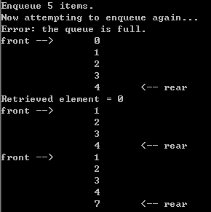
Using Queue
int main(void) {
Queue queue(5);
cout << "Enqueue 5 items." << endl;
for (int x = 0; x < 5; x++)
queue.Enqueue(x);
cout << "Now attempting to enqueue again..." << endl;
queue.Enqueue(5);
queue.DisplayQueue();
double value;
queue.Dequeue(value);
cout << "Retrieved element = " << value << endl;
queue.DisplayQueue();
queue.Enqueue(7);
queue.DisplayQueue();
return 0;
}

Slide 34
Queue Implementation based on Linked List
class Queue {
public:
Queue() { // constructor
front = rear = NULL;
counter = 0;
}
~Queue() { // destructor
double value;
while (!IsEmpty()) Dequeue(value);
}
bool IsEmpty() {
if (counter) return false;
else return true;
}
void Enqueue(double x);
bool Dequeue(double & x);
void DisplayQueue(void);
private:
Node* front; // pointer to front node
Node* rear; // pointer to last node
int counter; // number of elements
};

Slide 35
Enqueue
void Queue::Enqueue(double x) {
Node* newNode = new Node;
newNode->data = x;
newNode->next = NULL;
if (IsEmpty()) {
front = newNode;
rear = newNode;
}
else {
rear->next = newNode;
rear = newNode;
}
counter++;
}
rear
8
5
rear
8
5
newNode

Slide 36
Dequeue
bool Queue::Dequeue(double & x) {
if (IsEmpty()) {
cout << "Error: the queue is empty." << endl;
return false;
}
else {
x = front->data;
Node* nextNode = front->next;
delete front;
front = nextNode;
counter--;
}
}
front
3
8
5
front
8
5

Slide 37
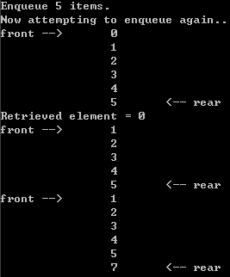
Printing all the elements
void Queue::DisplayQueue() {
cout << "front -->";
Node* currNode = front;
for (int i = 0; i < counter; i++) {
if (i == 0) cout << "\t";
else cout << "\t\t";
cout << currNode->data;
if (i != counter - 1)
cout << endl;
else
cout << "\t<-- rear" << endl;
currNode = currNode->next;
}
}

Slide 38
Result
Queue implemented using linked list will be never full
based on array
based on linked list

