Slide 1

N.B.K.R INSTITUTE OF SCIENCE & TECHNOLOGY
(Autonomous)
Vidyanagar, Tirupati - 524413
Customer Churning Prediction using XGBOOST and CATBOOST
Team Members (AI&DS):
1. Y. Samson(21KB1A30A2) 2. U. Siva Raju (21KB1A3093)
3. S. Sri Charan(21KB1A3089) 4. M. Lazar (21KB1A3054)
5. N. Charan Reddy(22KB5A3013)
Under the Guidance of
Mrs. P. Jyothi,
Assistant Professor,
Department of IT and AI&DS.

Slide 2
Index
Introduction
Algorithm Explanation
Detailed Implementation
Screenshots
Conclusion and future Enhancement

Slide 3
Introduction
Customer retention is essential for business success.
Retaining existing clients is more cost-effective than acquiring new ones.
Customer churn are the one who stopped using service of your business.
Traditional churn analysis focus on customer churn after it occurs. Our system predict churn before it happens.
Objective is to develop a superior machine learning system to predict customer churn.
Our system empowers businesses to implement more effective retention strategies, boosting customer lifetime value.

Slide 4
Algorithm Explanation
XG BOOST :
(Extreme Gradient Boosting) is a powerful and efficient implementation of gradient boosting.
It builds an ensemble of decision trees in a sequential manner to improve model accuracy.
Known for speed and performance, especially on structured/tabular data like customer records.
Content:
Ensemble Method: Combines multiple decision trees for improved accuracy.
Boosting: Sequentially adds trees to correct errors of previous ones.
Gradient Descent: Minimizes a loss function for better predictions.
Regularization: Prevents overfitting with L1 (Lasso) and L2 (Ridge).
Tree Pruning: Controls complexity for better generalization.
Parallel Processing: Utilizes multiple cores for faster training.

Slide 5
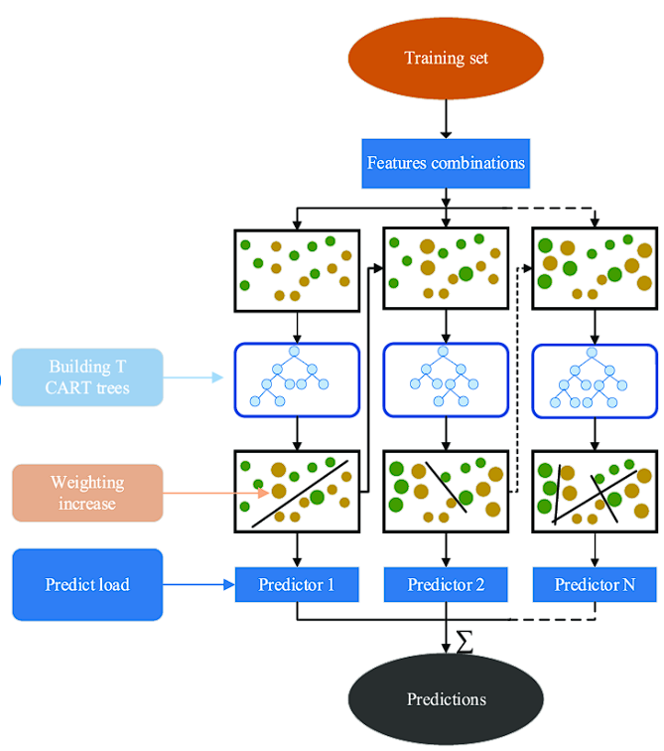

Slide 6
Detailed Implementation
#MODEL TRAINING
smote = SMOTE(random_state=42)
X_train_smote, y_train_smote = smote.fit_resample(X_train, y_train)
# Model training
models = {
'LogisticRegression': LogisticRegression(random_state=42),
'RandomForestClassifier': RandomForestClassifier(random_state=42),
'XGBClassifier': XGBClassifier(random_state=42)
}

Slide 7
best_model = None
best_accuracy = 0
for model_name, model in models.items():
model.fit(X_train_smote, y_train_smote)
y_pred = model.predict(X_test)
accuracy = accuracy_score(y_test, y_pred)
print(f'{model_name}: {accuracy:.4f}')
if accuracy > best_accuracy:
best_accuracy = accuracy
best_model = model print("Best model",best_model)
#OUTPUT
LogisticRegression: 0.7665 RandomForestClassifier: 0.7786 XGBClassifier: 0.7807
Best model: XGBClassifier(num_parallel_tree=None, random_state=42, ...)

Slide 8
import pickle
import pandas as pd
# Load the saved model and encoders
with open('best_model.pkl', 'rb') as f:
model = pickle.load(f)
with open('encoders.pkl', 'rb') as f:
encoders = pickle.load(f)
# Create a DataFrame with the input values
input_data = pd.DataFrame([[1.00, 0.00, 1.00, 0.00, 6.00, 1.00, 2.00, 1.00, 0.00, 0.00, 0.00, 0.00, 2.00, 0.00, 0.00, 1.00, 2.00, 82.85, 460.25]],
columns=['gender', 'SeniorCitizen', 'Partner', 'Dependents', 'tenure', 'PhoneService', 'MultipleLines', 'InternetService', 'OnlineSecurity', 'OnlineBackup', 'DeviceProtection', 'TechSupport', 'StreamingTV', 'StreamingMovies', 'Contract', 'PaperlessBilling', 'PaymentMethod', 'MonthlyCharges', 'TotalCharges’]) # Identify categorical columns
categorical_cols = ['gender', 'SeniorCitizen', 'Partner', 'Dependents', 'PhoneService', 'MultipleLines', 'InternetService', 'OnlineSecurity', 'OnlineBackup', 'DeviceProtection', 'TechSupport', 'StreamingTV', 'StreamingMovies', 'Contract', 'PaperlessBilling', 'PaymentMethod']

Slide 9
# Encode categorical columns and print encoded values
for col in categorical_cols:
# Replace unseen values with the most frequent category
valid_classes = encoders[col].classes_
input_data[col] = input_data[col].apply(lambda x: x if str(x) in valid_classes else valid_classes[0])
# Transform using the encoder
input_data[col] = encoders[col].transform(input_data[col].astype(str))
# Make a prediction
prediction = model.predict(input_data)[0]
# Print the result
if prediction == 1:
print("Churn")
else:
print("Not Churn") #OUTPUT
Churn

Slide 10
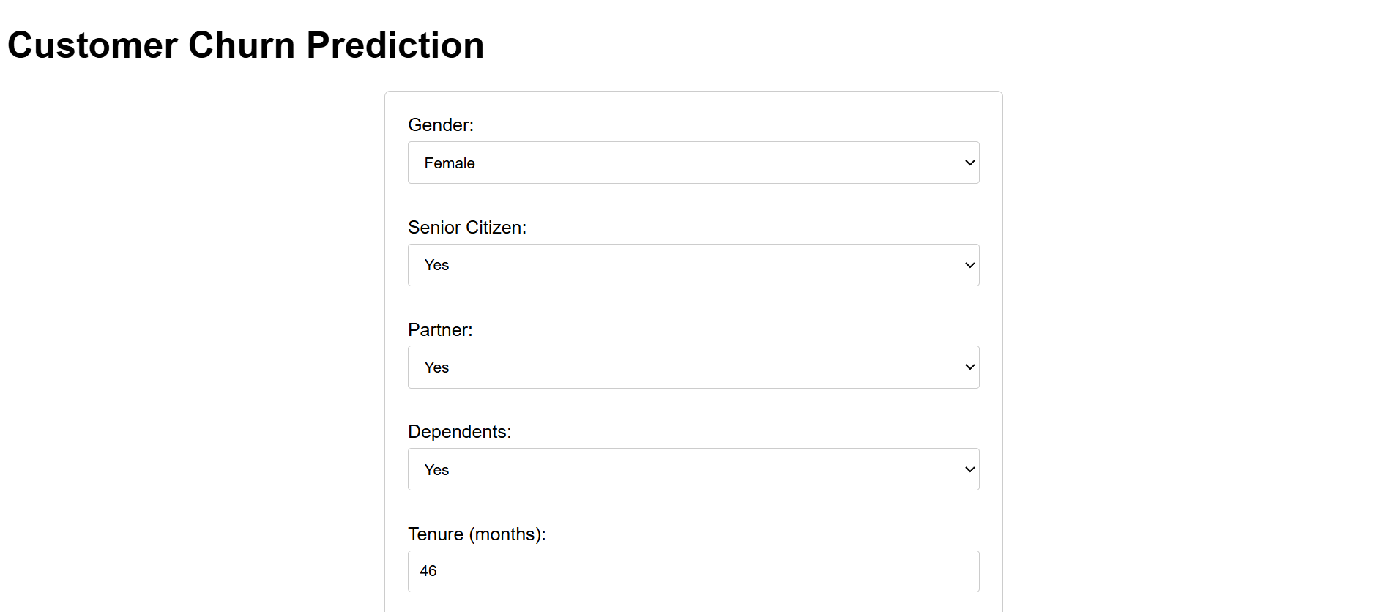
Screenshots

Slide 11
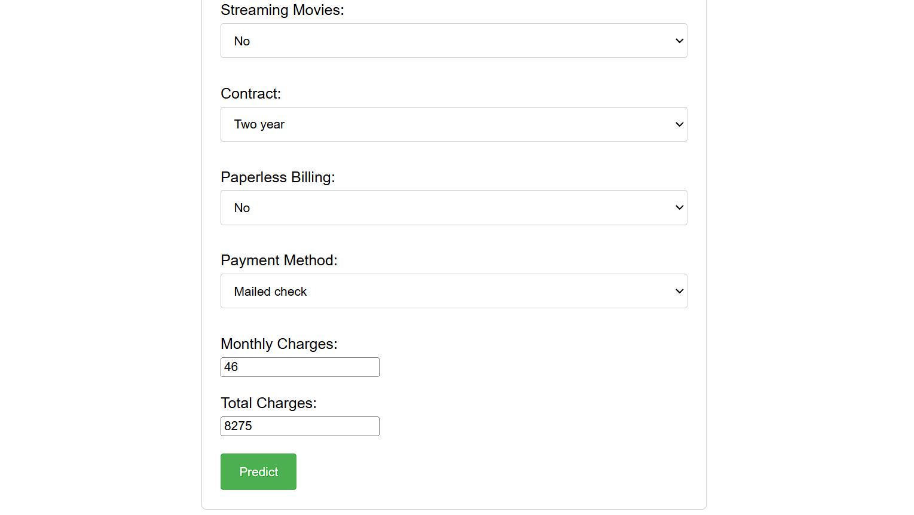

Slide 12
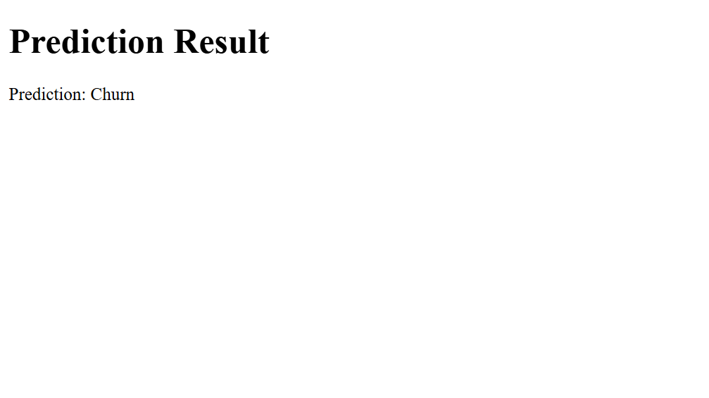

Slide 13
Conclusion
Customer Churn Model Development: We developed a predictive model for customer churn using the XGBoost algorithm, known for its high performance with structured data.
Handling Class Imbalance: To address the imbalance in churn labels, we applied SMOTE (Synthetic Minority Over-sampling Technique), which helped improve model sensitivity toward the minority class.
Performance Evaluation: We initially assessed model performance using accuracy. Moving forward, we aim to include precision, recall, and F1-score to better evaluate the model, particularly in light of the class imbalance.
Model Saving and Deployment: For reusability and smooth deployment, we saved the trained XGBoost model .

Slide 14
Future Enhacement
Model Deployment: We will deploy the model as a web service or API, allowing seamless integration with our existing systems and applications. This enables real-time access to churn predictions for new customer data.
Data Streaming and Preprocessing: We will integrate a data streaming pipeline to capture and preprocess real-time customer data, ensuring it's compatible with the model's input format. This involves handling missing values, encoding categorical features, and potentially generating new features.
Prediction API: We will develop an API endpoint that accepts customer data as input and returns the predicted churn probability in real-time. This enables other applications or systems within our organization to access churn predictions on demand.
Monitoring and Feedback Loop: We will implement a monitoring system to track the model's performance in real-time, identifying potential drifts or degradation. This feedback loop will trigger model retraining or updates to maintain accuracy and adaptability to evolving churn patterns.
Alerting and Actionable Insights: We will integrate an alerting mechanism to notify relevant stakeholders when a customer is identified as high-risk for churn. This allows for proactive interventions and personalized retention strategies to be implemented in a timely manner.

Slide 15
Reference
Omar Adwan, Hossam Faris, Khalid Jaradat, Osama Harfoushi, Nazeeh Ghatasheh, Predicting customer churn in telecom industry using multilayer preceptron neural networks: modeling and analysis, Life Sci. J. 11 (3) (2014) 75–81.
Mohammad Ridwan Ismail, Mohd Khalid Awang, M. Nordin A. Rahman, Mokhairi Makhtar, A multi-layer perceptron approach for customer churn prediction, International Journal of Multimedia and Ubiquitous Engineering 10 (7) (2015) 213–222.
Farhad Shaikh, Brinda Pardeshi, Ajay Jachak, Akash Bendale, Nandakishor Sonune, Mangal Katkar, Customer churn prediction using nlp and machine learning: an overview, International Journal Of Advance Scientific Research And Engineering Trends 6 (2) (2021) 40–45.
Anuj Sharma, DrPrabin Kumar Panigrahi, A neural network based approach for predicting customer churn in cellular network services, Int. J. Comput. Appl. 27 (11) (2011) 26–31.
Ammara Ahmed, D. Maheswari Linen, A review and analysis of churn prediction methods for customer retention in telecom industries, in: 2017 4th International Conference on Advanced Computing and Communication Systems (ICACCS), IEEE, 2017, pp. 1–7.

Slide 16
ThankYou

