Slide 1

Activity Analysis
Samson Boileau
Python for Data Analysis

Slide 2
Problem : Recognition of Human Activities
Captured data of 30 people practicing physical activities with a smartphone
How can we identify the activity with only the data from an accelerometer ?

Slide 3
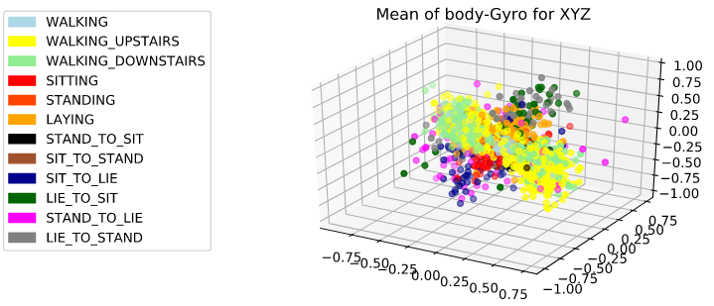
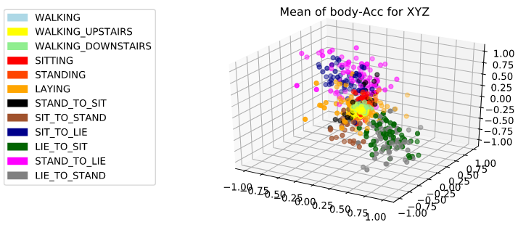
Data Visualization
Try to find a pattern to enable the identification of the activities
Here the dots represents values of XYZ (mean of Body acceleration and Gyroscope acceleration)
We can observe that the activities (by color) tend to have similar values

Slide 4
Model Training and Classification
We decides to create a list of several Classificater (Naïve Bayes, Random Forest) to test and observe their efficiency
We train the models and test them to gather data such as the accuracy,the trainig time and the overall time of the operation (training+test).

Slide 5
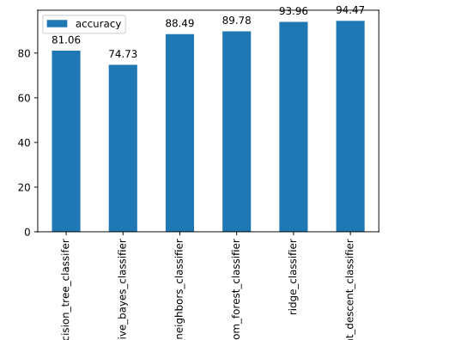
Results Analysis
We can observe that the most accurate algorithm to recognize human activities is the Stochastic Gradient Descent Classifier

