Slide 1
HealthConnect
No-Show Analysis — Final Decision Support Presentation
Samson Arawande | Data Analytics Track | AnalystLab Africa 2026 Experience Lab | Week 8

Slide 2
The Problem
Nearly 1 in 2 scheduled appointments never happen.
48.46%
of all appointments end in a no-show
HealthConnect Clinic — AnalystLab Africa — Week 8
2

Slide 3
What Actually Drives No-Shows
Not age. Not gender. Not the day of the week.
Booking Lead Time
Prior No-Show History
27.81% → 67.69%
43.51% → 67.95%
0–7 days out 46–60 days out
0 prior no-shows 3+ prior no-shows
χ² = 364.81, p < 0.001
χ² = 80.71, p < 0.001
HealthConnect Clinic — AnalystLab Africa — Week 8
3

Slide 4
How the Two Factors Combine
I expected the risks to multiply into something extreme. They didn't.
Additive Prediction
Observed Rate
~87%
vs.
91.30%
Longest lead time + 3+ prior no-shows
The two risks stack — they don't multiply.
This means HealthConnect can flag its highest-risk patients using a simple, transparent risk score — no complicated model required.
HealthConnect Clinic — AnalystLab Africa — Week 8
4

Slide 5
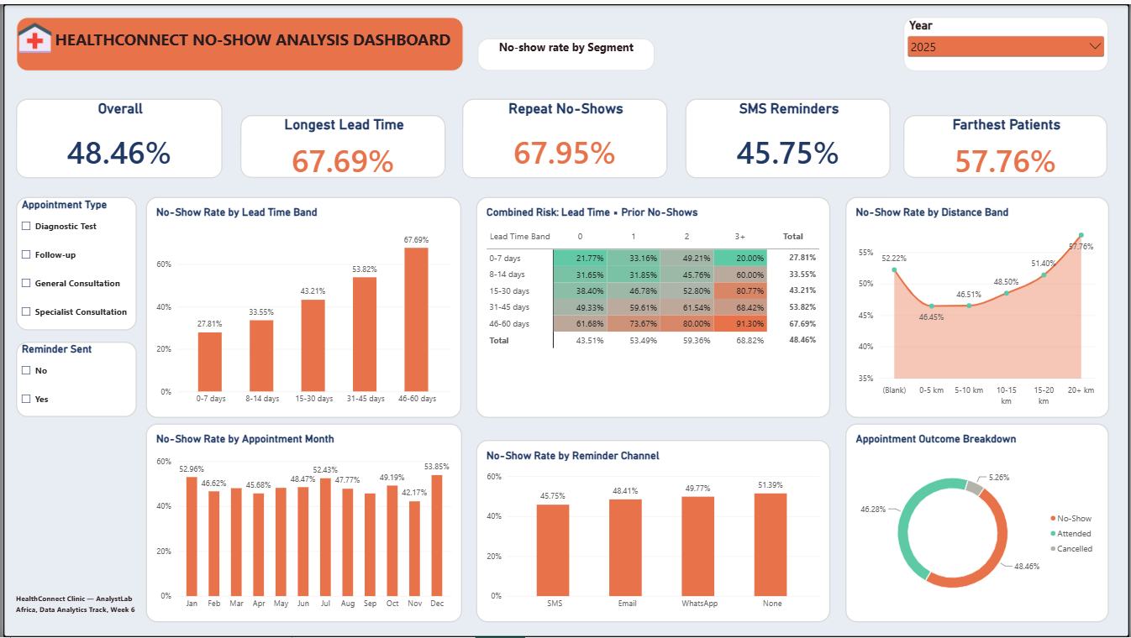
The Dashboard
Tested, fixed, and validated across every project document.
HealthConnect Clinic — AnalystLab Africa — Week 8
5

Slide 6
What Doesn't Move the Needle
Tested and confirmed — not assumed.
1
Appointment Type
~4.6pt spread
Why this matters
Day of Week
~3.9pt spread
2
A validated “no” is still a finding. It tells HealthConnect exactly where not to spend limited resources.
3
Time of Day
~1.6pt spread — weakest signal
4
Age Group
~5.6pt spread
5
Gender
~5.2pt spread
HealthConnect Clinic — AnalystLab Africa — Week 8
6

Slide 7
Recommendations
Five prioritized, evidence-backed actions.
1
A second confirmation touchpoint
for appointments booked 30+ days in advance
2
Flag “high-priority outreach”
patients with 2+ prior no-shows AND a 30+ day lead time
3
SMS as the default reminder channel
clinic-wide — the one fully controllable lever
4
Pilot telehealth
for lower-acuity appointments, 20+ km patients
5
Deprioritise demographic targeting
redirect effort to the four recommendations above
HealthConnect Clinic — AnalystLab Africa — Week 8
7

Slide 8
Cross-Track Collaboration
A real, two-way exchange with the Data Science track — not a one-off handoff.
1
2
3
4
Week 6
Week 6→7
Week 7
Result
Delivered a validated findings package — feature priorities, data-quality flags
→
Received their model's error patterns and 7 specific validation requests
→
Tested all 7 concerns with statistical significance tests; sent evidence-based answers
→
Their feature engineering decisions were directly shaped by validated Data Analytics findings
HealthConnect Clinic — AnalystLab Africa — Week 8
8

Slide 9
The Bottom Line
Two measurable, statistically confirmed factors drive most preventable no-shows. They combine predictably. HealthConnect already has a low-cost lever — SMS reminders — it can deploy today.
Thank you.
Samson Arawande | Data Analytics Track | AnalystLab Africa

