Slide 1

BUSINESS ANALYTICS REPORT
Customer Behaviour & Business Performance Analysis
Company: ABC Communications Ltd
Project no.: Project 1
Role: Junior Data Analyst (AnalystLab Africa)
Prepared for: Management
Prepared by: Samson Oluwatimilehin Arawande

Slide 2

Executive Summary
The telecommunications industry operates in a highly competitive environment where customer retention is critical to maintaining stable revenue and long-term growth. Understanding customer behavior and the factors associated with churn enables businesses to improve retention and strengthen customer relationships.
This project analyzes customer churn within a telecommunications customer base to identify patterns that support better retention decisions for ABC Communications Ltd.

Slide 3

Problem Statement & Business Objectives
Business Problem
ABC Communications Ltd is experiencing customer churn and needs to understand the patterns and customer characteristics associated with customers leaving the business.
Key Business Questions
Business Objective
Who are our customers?
Which customer segments have the highest churn?
Analyze churn data, identify trends and patterns, and provide actionable insights to support more effective customer retention strategies.
Does contract type influence retention?
Does customer tenure influence retention?
Which service features are associated with churn?
Which payment methods have higher churn?

Slide 4

Dataset & Data Preparation
Telco Customer Churn Dataset
7,043 customer records covering demographics, account info, services, contract details, payment methods, charges, and churn status.
Preparation Steps
01
02
Reviewed structure; checked completeness and consistency.
Standardized categorical labels; converted fields to analytical
formats.
03
04
Grouped customers by tenure, demographics, service,
contract, and payment.
Calculated churn rates; prepared PivotTables and dashboard data.

Slide 5
Customer Demographics
Highest Demographic Churn Segments
Male: 50.48% · Female: 49.52%
Non-Senior Citizens: 83.70% · Senior Citizens: 16.30%
Without Partner: 51.70% · With Partner: 48.30%
Without Dependents: 70.04% · With Dependents: 29.96%
Senior Citizens
Without Partner
Without Dependents
Female

Slide 6
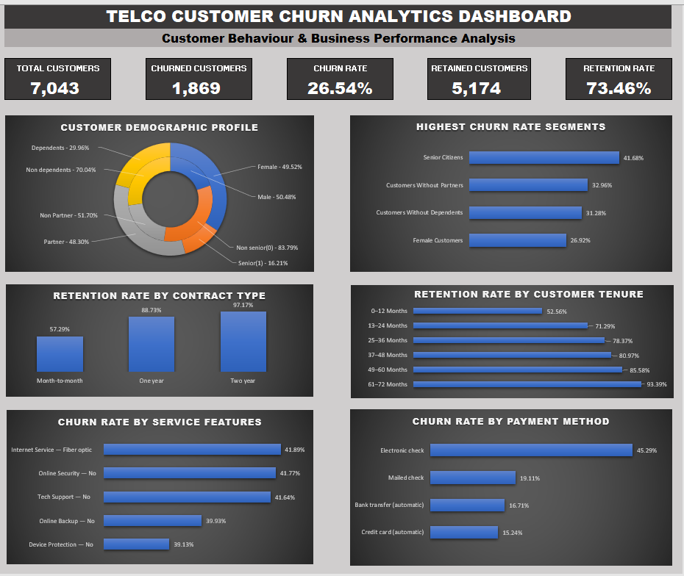

Slide 7
Contract, Tenure, Services & Payment
Contract Type
Month-to-month customers show weaker retention than those on longer-term contracts. Contract commitment is strongly associated with higher retention.
Customer Tenure
Retention generally improves as customer tenure increases. Loyalty strengthens with longer relationships.
Services & Payment
Churn varies across service configurations. Electronic Check customers record the highest churn among all payment methods analyzed.

Slide 8

Business Insights
Churn is Significant
Senior Citizens at Highest Risk
Contract Commitment Retains
26.54% of customers have churned — 1,869 customers lost.
Churn rate of 41.68%, substantially above the overall average.
Month-to-month customers show weaker retention than longer-term contract holders.
Loyalty Grows with Tenure
Electronic Check Risk
Highest payment-method churn — requires deeper investigation.
Longer-tenure customers demonstrate higher retention rates.

Slide 9

Business Risks
Customer Revenue Loss
The 26.54% churn rate creates significant risk of continued customer and recurring-revenue loss.
Concentrated High-Risk Segments
High churn among Senior Citizens and other identified segments creates a risk that generic retention strategies will fail to address vulnerable groups.
Early Customer Attrition
Lower retention among month-to-month and newer customers creates a risk of losing customers before long-term loyalty develops.

Slide 10




Business Opportunities
Targeted Retention
Use customer characteristics and churn patterns to identify and proactively engage high-risk customers.
Contract Conversion
Create value-based incentives for suitable month-to-month customers to adopt longer-term contracts.
Customer Experience Optimization
Investigate service configurations and Electronic Check customers to identify opportunities to improve the customer experience and retention.

Slide 11
Recommendations & Conclusion
Key Recommendations
Conclusion
Launch targeted retention campaigns
Prioritize high-risk segments, particularly Senior Citizens.
Strengthen early-tenure engagement
Proactive onboarding and support during the first 12–24 months.
Customer churn is a significant challenge at 26.54%, but it is not evenly distributed. Notable differences exist across demographics, contract type, tenure, services, and payment method.
Encourage longer-term contracts
Offer relevant incentives to month-to-month customers.
Investigate Electronic Check churn
Assess whether alternative payment options could improve retention.
The strongest opportunities lie in targeted retention, early-tenure engagement, longer-term contract adoption, and deeper investigation of high-risk groups. A proactive, data-driven strategy can help identify vulnerable customers earlier and improve long-term retention.
Develop proactive churn monitoring
Build a churn-risk framework using contract type, tenure, demographics, services, and payment method.

