Slide 1
DATA STRATEGY FOR SCALABLE & PROFITABLE GROWTH
Group 9
Samson Awinsone Ayamga - 11219536
Chrappah Christabel Kabukie - 11207632
Helina Commey - 11115880
CASE STUDY: FashionHub Ghana
From -GHS 90K Loss to Profitable Scale Through Data

Slide 2
Complete Data Strategy Framework
1
Organizational Context & Strategic Objectives
2
Business Questions Strategy Must Answer
3
Current Data & Analytics Maturity Assessment
4
Target Data Vision
5
Data Architecture & Technology Stack
6
Data Governance, Ethics & Risk
7
Implementation Roadmap
8
Measuring Success & Strategic Impact

Slide 3
Organizational Context &
Strategic Objectives

Slide 4
Meet FashionHub Ghana
MONTH 1 CRISIS
COMPANY PROFILE
GHS 450,000
Location: Accra, Ghana
Founder: Ama (Young Entrepreneur)
Monthly Revenue
Business: Online Fashion E-Commerce
-GHS 90,000
Product: Ghanaian-designed clothing
Monthly Loss (-20%!)
Stage: Startup (Month 1)
Market: Local + Diaspora
500 customers
GHS 120 CAC
85% churn
30% delivery failure
Channels: Instagram, WhatsApp, Web

Slide 5
Industry & Competitive Landscape
Market Dynamics
Competition
85.03% mobile penetration
Growing middle class
60% Cash-on-Delivery preference
Logistics infrastructure challenges
Jumia, Tonaton (established)
Instagram sellers (informal)
Traditional retail
International brands
Industry-Wide Challenges
1. Payment: Limited digital adoption, 1.5-3% transaction fees
2. Logistics: Poor addressing, traffic, high delivery costs
3. Trust: Returns concerns, quality fears
4. Data & Tech: Manual operations, no analytics
5. Profitability: High CAC (GHS 120), low retention (10-20%)

Slide 6
Core Business Goals
1
Achieve Profitability
+15% margin
-GHS 90K → +GHS 65K profit in 90 days
2
Improve Retention
45% repeat rate
From 15% through data-driven engagement
3
Optimize Operations
92% delivery success
From 30% failure to < 8%
4
Reduce CAC
GHS 80 CAC
From GHS 120 through targeting
5
Build Data Culture
100% data-backed
From guesswork to evidence

Slide 7
Key Strategic Focus (Vision)
VISION
"Transform FashionHub from a growth-at-all-costs startup into a sustainably profitable, data-driven business that delights customers, optimizes operations, and scales intelligently."
Strategic Shift: Move Fast & Break Things → Move Smart & Build Value

Slide 8
Business Questions the
Strategy Must Answer

Slide 9
Critical Decisions Currently Made Poorly
Customer
Product
Which customers to prioritize?
Which products are profitable?
What's LTV by segment?
What to stock/discontinue?
]Why 85% never return?
How to price optimally?
Marketing
Operations
Which channels have best ROI?
Why 30% delivery failure?
Is GHS 120 CAC justified?
Which areas to avoid?
Where to allocate budget?
How to reduce costs?

Slide 10
Strategic vs Operational Questions
STRATEGIC (Long-term)
OPERATIONAL (Day-to-day)
Expand to new cities?
Orders to deliver today?
Is target segment profitable?
• Abandoned carts to contact?
• Own vs 3rd party logistics?
• Low inventory items?
• Model changes for profit?
• Failed deliveries to reschedule?
• Best product categories?
• Today's cash position?
Needs: Trend analysis, cohorts, predictive models
Needs: Real-time dashboards, alerts, transactional reports

Slide 11
Short-Term vs Long-Term Information Needs
SHORT-TERM (0-3 months)
LONG-TERM (6-18 months)
STOP THE BLEEDING
BUILD FOR SCALE
Daily P&L by product/channel
→ LTV prediction models
Delivery failure patterns
→ Churn risk scoring
Payment method costs
→ Market expansion analysis
High-value customers
→ Supply chain optimization
Order bottlenecks
→ Competitive analytics
Quick cost wins
→ New revenue streams

Slide 12
Current Data & Analytics
Maturity Assessment

Slide 13
Data Sources (Internal & External)
INTERNAL SOURCES
EXTERNAL SOURCES
Limited
WhatsApp Orders
Unstructured
Poor
Social Media
Instagram only
Payments
Manual sheets
Medium
Market Research
Not accessed
None
Deliveries
Incomplete
Poor
Competitor Data
No monitoring
None
Customers
Basic only
Low
Economic Data
Not tracked
None
Inventory
No system
None
Reviews
Scattered
Low
Financials
Monthly only
Low
Benchmarks
Unknown
None
Status: Fragmented, manual, unreliable
Status: Minimal external data use

Slide 14
Data Quality Issues
1
Incomplete
HIGH
Missing/wrong addresses → 30% delivery fails
2
Inconsistent
MED
Product names/prices vary across channels
3
Inaccurate
HIGH
Manual entry errors in payments, inventory
4
Inaccessible
CRITICAL
Data locked in WhatsApp, phones, paper
5
Untimely
HIGH
Monthly reports only, no real-time view
6
Ungoverned
CRITICAL
No ownership, validation, audit trail

Slide 15
Existing Tools & Skills
CURRENT TOOLS
TEAM SKILLS
WhatsApp
Orders
Not scalable
Data Analysis
Beginner
★☆☆☆☆
Excel
Financials
Manual
Excel
Basic
★★☆☆☆
Instagram
Marketing
Working
E-commerce Ops
Learning
★★☆☆☆
Mobile Money
Payments
High fees
Marketing
Intermediate
★★★☆☆
No CRM
Customers
Critical gap
Customer Service
Good
★★★★☆
No Analytics
BI
Critical gap
Technical/IT
None
☆☆☆☆☆

Slide 16
Data Maturity Level
Descriptive → Diagnostic → Predictive → Prescriptive
1
Descriptive
What happened?
CURRENT
2
Diagnostic
Why?
Target: 6mo
3
Predictive
What will happen?
Target: 12mo
4
Prescriptive
What to do?
Target: 18mo
Current: Level 1 — Basic reporting only, no insights, reactive decisions

Slide 17
Target Data Vision

Slide 18
What "Data-Driven" Means for FashionHub
DATA-DRIVEN ORGANIZATION
Every decision informed by data, not gut feelings
Real-time visibility into business (daily P&L, KPIs)
Customer behavior understood (segmentation, analytics)
Operations optimized (routes, inventory, pricing)
Marketing spend based on measured ROI
Predictive insights guide proactive actions
A/B testing culture: measure, learn, iterate
Data quality embedded in all processes
Team trained and empowered to use data

Slide 19
Key Outcomes Enabled by Data
Profitability
-GHS 90K
→
+GHS 65K
Cost cuts + retention
Retention
15% repeat
→
45% repeat
LTV segmentation
Operations
30% fail
→
8% fail
Address + routing
CAC
GHS 120
→
GHS 80
Attribution + targeting
Time Savings
167 hrs/mo
→
40 hrs/mo
Automation
Speed
Monthly reports
→
Real-time
Live dashboards

Slide 20
Success Metrics for Data Strategy
BUSINESS IMPACT
DATA MATURITY
✓ Monthly profit: -20% → +15%
✓ Quality: <20% → >85%
✓ LTV tracked by segment
✓ Real-time: 0% → 90%
✓ Repeat rate: 15% → 45%
✓ Data decisions: 10% → 80%
✓ CAC payback: <6 months
✓ Tool adoption: 0% → 95%
OPERATIONAL EFFICIENCY
✓ Delivery success: 70% → 92%
✓ Order processing: 20 min → 5 min per order
✓ Manual work: 167 hrs → 40 hrs/month
✓ Payment costs: GHS 6,750 → GHS 2,000/month

Slide 21
Data Architecture &
Technology Stack

Slide 22
Conceptual Data Architecture
Four-Layer Design
LAYER 1: DATA SOURCES
E-commerce • Payments • Delivery • WhatsApp • Social • Web
LAYER 2: STORAGE
Cloud warehouse (BigQuery) • Centralized • Historical retention
LAYER 3: PROCESSING
ETL • Cleaning • Transformation • ML training
LAYER 4: CONSUMPTION
Dashboards • Mobile reports • Alerts • APIs

Slide 23
Technology Stack (Conceptual)
Affordable Tools for Ghana
E-Commerce
Shopify/WooCommerce
$30/mo
M1
Analytics
Google Analytics 4
Free
M1
CRM
HubSpot/Zoho
$20/mo
M1
Delivery
Kwik/Sendbox
$50/mo
M1
Payments
Paystack
1.95%
M1
Warehouse
BigQuery
Usage
M2
BI
Looker Studio
Free
M2
WhatsApp
Twilio API
Usage
M2
ETL
Zapier/Make
$30/mo
M2
Support
Tidio
$20/mo
M3
Total: ~$150/month + transaction fees ≈ $200/month total

Slide 24
Integration Considerations
E-comm ↔ Analytics
Track behavior, conversions
GA4 integration
E-comm ↔ CRM
Unified customer view
API sync
Orders ↔ Delivery
Automated fulfillment
Webhooks
Payment ↔ Accounting
Reconciliation
API integration
All → Warehouse
Centralized reporting
ETL pipelines
WhatsApp ↔ CRM
Conversation history
Business API

Slide 25
Data Governance,
Ethics & Risk

Slide 26
Data Ownership & Stewardship
DATA GOVERNANCE FRAMEWORK
Data Owner (Ama)
Accountable for data strategy, privacy compliance, budget decisions
Data Steward (Ops Manager)
Quality assurance, access control, documentation
Data Users (Team)
Follow guidelines, report issues, request access formally
Tech Partner (External)
Infrastructure, security, backups, integrations
Key Policies:
Access Control: Role-based permissions, audit logs
Data Retention: 7 years financial, 3 years operational
Change Management: All schema changes documented and approved

Slide 27
Privacy, Regulatory & Ethical Considerations
PRIVACY & REGULATORY
ETHICAL PRINCIPLES
Ghana Data Protection Act 2012
Transparency: Customers know data use
Customer consent for marketing
Fairness: No discriminatory pricing
Right to access/delete data
Security: Encrypted data at rest/transit
Payment card industry (PCI) for cards
Accountability: Clear responsibility
KEY COMPLIANCE ACTIONS
1. Privacy policy published on website
2. Customer consent checkboxes for marketing
3. Encrypted connections (SSL/TLS) for all systems
4. Regular security audits (quarterly)
5. Staff training on data protection (monthly)

Slide 28
Risk Mitigation Strategies
Data Breach
HIGH
Encryption, access controls, security audits
System Downtime
HIGH
Cloud redundancy, daily backups
Poor Data Quality
MED
Validation rules, automated checks
Staff Resistance
MED
Change management, training
Vendor Lock-in
LOW
Open standards, export capabilities, multi-cloud strategy
Cost Overruns
MED
Monthly budget reviews, usage alerts, optimize queries

Slide 29
Implementation
Roadmap

Slide 30
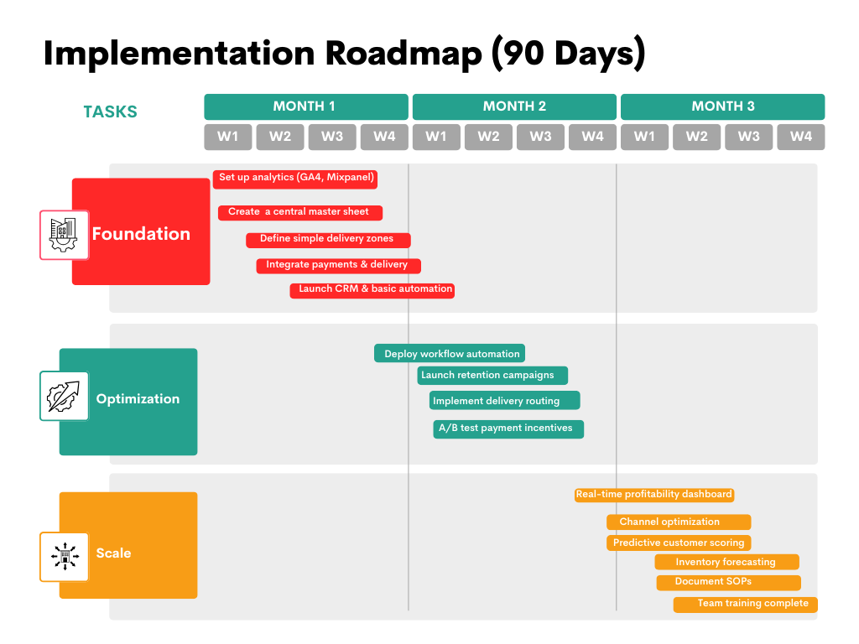

Slide 31
Key Milestones, Dependencies & Risks
KEY MILESTONES
DEPENDENCIES
Week 2
E-commerce platform live
• Budget approval: GHS 2,500/mo
Week 4
First automated campaign sent
• Tech partner hired by Week 1
Week 6
Daily dashboard operational
• Team availability: 10 hrs/week
• Customer data access granted
Week 8
Delivery success >80%
Week 10
Repeat rate >30%
Week 12
Monthly profitability achieved
IMPLEMENTATION RISKS
Staff training time underestimated
Tool integration more complex
Customer resistance to changes
Budget constraints if sales dip

Slide 32
Measuring Success &
Strategic Impact

Slide 33
KPIs for Data Maturity
How We'll Measure Data Strategy Progress
Data Quality
Completeness: < 20% → >90%
Accuracy: Manual errors → <8%
Timeliness: Monthly → Real-time
Data Usage
Decisions data-backed: 10% → 80%
Tool adoption: 0% → 95%
Report usage: 0 → 50 views/day
Capabilities
Maturity: Level 1 → Level 2
Team skills:1★ → 3★ (Beginner to Competent)
Process automation: 0% → 80%

Slide 34
Business Impact Metrics
The Bottom Line: Financial & Operational Results
METRIC
BASELINE
TARGET
TRACKING
Monthly Profit
-GHS 90,000
+GHS 65,000
Track weekly
Repeat Purchase Rate
15%
45%
Track monthly
Delivery Success
70%
92%
Track daily
Customer Acquisition Cost
GHS 120
GHS 80
Track weekly
Order Processing Time
30 min
5 min
Track daily
Customer Lifetime Value
Unknown
GHS 1,200
Track monthly
Manual Work Hours
167 hrs/mo
40 hrs/mo
Track monthly
Payment Processing Cost
GHS 6,750
GHS 2,000
Track monthly

Slide 35
Review & Feedback Mechanism
Continuous Improvement Cycle
REVIEW CADENCE
FEEDBACK LOOPS
Daily
Key metrics dashboard
Ama & Ops Mgr
✓ Team surveys: Monthly pulse checks
Weekly
Progress vs targets
Full team
✓ Customer feedback: NPS tracking
✓ Data quality audits: Bi-weekly
Monthly
Business review + adjustments
Ama & stakeholders
✓ Tool usage analytics: Automated
Quarterly
Strategy review
Board/advisors
✓ Incident reports: As needed
✓ Success stories: Share wins
Success = Business goals achieved + Data capabilities matured + Team empowered

Slide 36
The Path Forward
FROM
TO
-GHS 90K monthly loss
→
+GHS 65K monthly profit
85% customer churn
→
45% repeat purchase rate
30% delivery failure
→
92% delivery success
Manual, guesswork decisions
→
Data-driven, automated operations
No visibility, no control
→
Real-time insights, proactive management
Data Strategy = Competitive Advantage

Slide 37
THANK YOU!

