Slide 1
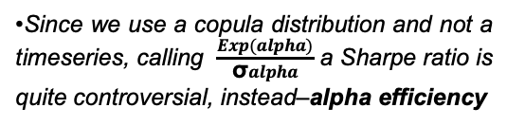
Conditional Alpha Predict
Ugly Sunfish | aka (SamChyst)
Ticker: {ticker}
Valuation date:
Alpha horizon: 1 year
•All projections are meant to be taken as a pet project. Author has nothing to do with user’s gambling addiction \
The model assigns a {qualitative_word} probability of market outperformance over a one-year horizon. The expected alpha is {expected_alpha}, with a distribution that is {skew_description}.
Downside risk remains {risk_level}.
P(alpha > 0)
P(alpha < 0)
P(alpha < -10%)
P(alpha < -20%)
Median(alpha)
Exp(alpha)
Alpha efficiency
{Football Field}
•The football field shows quantiles of the conditional alpha distribution given the current ML alpha estimate and implied upside. It should not be read as a deterministic price target. Instead, it summarizes the range of market-relative outcomes historically associated with similar signal conditions.
Notes
Input Data
•Since we use a copula distribution and not a timeseries, calling $\frac{Exp(alpha)}{\text{σ}alpha}$ a Sharpe ratio is quite controversial, instead–alpha efficiency
Implied upside: {implied_upside}
10Y US T-Bond yield: {t_bond_rate}
Alpha ML prediction: {alpha_hat}

