Slide 1


From Sign-Up to Success
Comprehensive Internship Capstone Project Consolidating Feature Engineering, Trend Discovery, and Predictive Churn Modeling
Presented By
Date:
Team 6
February 13, 2026

Slide 2

SUMMARY
OBJECTIVE:
To analyze the Excelerate Talent Discovery dataset to identify patterns in learner engagement, quantify factors leading to churn, and provide actionable recommendations for platform optimization.
Data Scope: 8,263 cleaned records across 27 features.
Goal: Move from "Sign-up" to "Rewarded" status by minimizing friction in the learner funnel.

Slide 3
SUMMARY
Workflow | Tool
Data Cleaning and Validation | Excel and Python (Pandas)
Feature Engineering | Python
Churn Analysis and Dashboard | Power Bi
Predictive Modeling | Python (Scikit-Learn Library)
Predictive Model | Random Forest Classifier
Report | Microsoft Word

Slide 4
DATA CLEANING AND FEATURE ENGINEERING
Data Cleaning
Standardized 8,558 raw rows into 8,263 high-quality records by resolving 3,804 missing values and fixing inconsistent institution names (e.g., Saint Louis University).
Signup Entry Lag
Captures administrative/system delays (the time between sign-up and system entry).
Signup → Apply Delay
Measures learner motivation.
Applied Flag
Distinguishes between casual sign-ups and high-intent applicants.
Risk Outcome
The primary metric for tracking Engaged, Rewarded, Dropout, and Rejected statuses.

Slide 5
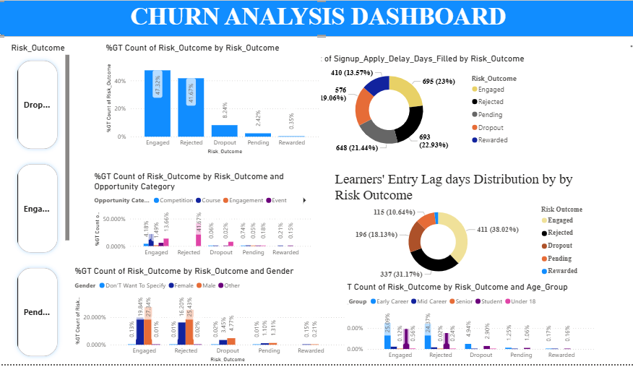

CHURN ANALYSIS DASHBOARD

Slide 6
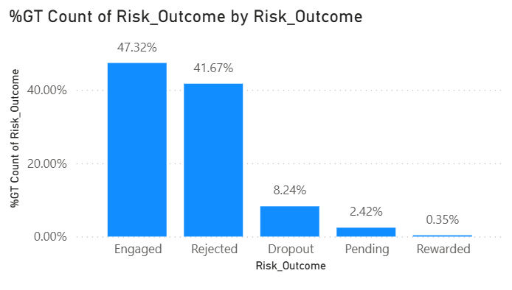
Churn Analysis
Risk Outcome Distribution
PEDRO FERNANDES
This chart highlights the overall performance of the learner funnel.
A significant proportion of learners fall into Dropout/Rejection categories.
The gap between Sign-up and Rewarded status indicates friction in the conversion journey.
CFO - Financial planning and analysis.
REESE MILLER
CEO - Strategic leadership and vision.
Over 20 years of experience in the industry.
SAMIRA HADID
CEO - Strategic leadership and vision.
Over 20 years of experience in the industry.

Slide 7
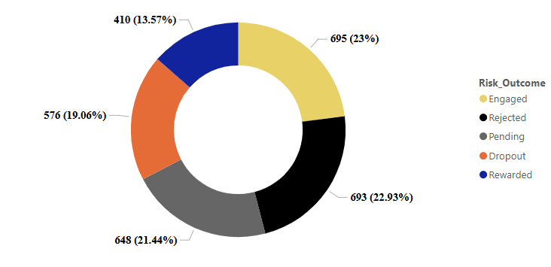
Churn Analysis
Sign up Apply delay
PEDRO FERNANDES
CFO - Financial planning and analysis.
Learners who apply quickly after signup show higher engagement rates.
Delayed applications correlate strongly with eventual dropout.
Early inactivity is an early warning signal for churn.
REESE MILLER
CEO - Strategic leadership and vision.
Over 20 years of experience in the industry.
SAMIRA HADID
CEO - Strategic leadership and vision.
Over 20 years of experience in the industry.

Slide 8
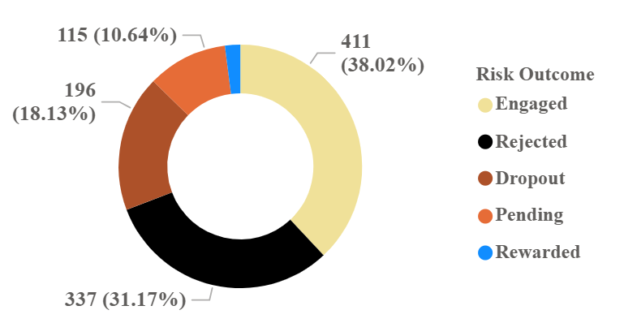
Churn Analysis
Risk Outcome Distribution by signup entry lag
PEDRO FERNANDES
CFO - Financial planning and analysis.
As signup entry lag increases, dropout probability rises significantly.
Administrative processing delays directly impact retention outcomes.
REESE MILLER
CEO - Strategic leadership and vision.
Over 20 years of experience in the industry.
SAMIRA HADID
CEO - Strategic leadership and vision.
Over 20 years of experience in the industry.

Slide 9

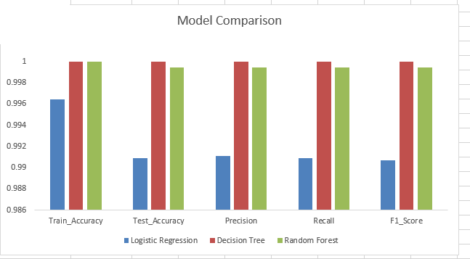
PREDICTIVE MODELING
Model Comparison
Multiple models were evaluated to identify the best-performing classifier.
Random Forest outperformed alternatives in accuracy and stability.

Slide 10
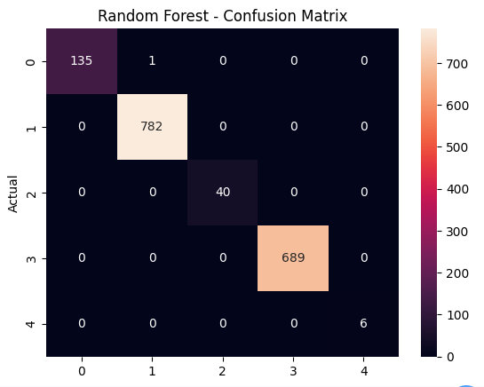
PREDICTIVE MODELING
Evaluation of Random Forest Classifier
• Strong diagonal dominance indicates highly accurate predictions
• Very minimal misclassification across all risk categories
• Model reliably distinguishes between outcome classes

Slide 11
Key Findings and Insights
Signup Entry Lag is the strongest churn driver: Learners delayed more than 100 days are significantly more likely to drop out.
Faster application after signup increases success rates – Early application reflects stronger commitment and predicts engagement.
Longer program duration increases dropout risk – Extended timelines contribute to learner fatigue and disengagement.
Churn can be predicted early using the model – Random Forest identifies high-risk learners before dropout occurs.
Friction in early funnel stages drives risk outcomes – Delays between Sign-up, Application, and Engagement compound dropout probability.

Slide 12
RECOMMENDATIONS
Reduce signup entry lag to under at most 100 days it’s the strongest predictor of risk.
Use early risk alerts from the model to trigger timely nudges and advisor outreach.
Encourage immediate application after signup through a “Quick Apply” flow.
Redesign long-duration programs with milestones to reduce learner fatigue.

Slide 13
PROJECT RESOURCES & DOCUMENTATION
Model Training and Testing Notebook- Click here
Model Evaluation Summary: Click here
Final Predictive Model - Click here
Churn Analysis Report: click here
Group Presentation Slide: Click here
Group Presentation Video: Click here
Power BI Dashboard Link: Click here

Slide 14

Team 6
Richard Boadu
Ogochukwu Anichebe
Sindhuja Baikadi
Samson Matthew.
Sandra Nsofor
Faith Pearl
Onyedika Kenechukwu
Neel Mukherjee
Lawal Ali
THANK YOU FOR LISTENING

