Slide 1
AGRODRY OPTIMIZER
Predictive Process Optimization & Specific Energy Consumption (SEC)
Decision-Support Platform for Industrial Batch Drying
3MTT NextGen Fellowship Knowledge Showcase · Agriculture & Food Track
Samson Mayomi Matthew
github.com/SamsonMayomiMatthew/industrial-energy-systems/tree/main/AgroDry-Optimizer

Slide 2
The Problem
Fixed-timer batch drying leaves plants guessing
1
2
3
Over-Drying
Under-Drying
No Real-Time Visibility
Batches run past the optimal point, wasting thermal energy and degrading starch quality — pure operating cost with no benefit.
Batches stop too early. Excess moisture left in the product creates real risk of microbial spoilage during storage and transport.
Operators can't see how a batch is trending mid-process — problems are only caught after the fact, when it's too late to correct cheaply.
This directly hurts plant profitability and food safety — and hits small/mid-scale agribusinesses hardest, since they can't afford proprietary sensor suites.
AgroDry Optimizer · 3MTT NextGen Fellowship — Agriculture & Food Track
2

Slide 3
The Solution
A physics-informed ML pipeline that predicts before a batch finishes
AgroDry Optimizer replaces fixed-timer schedules with live prediction. By analyzing ambient conditions, batch mass, and system telemetry, it forecasts Final Moisture Content (%) and Specific Energy Consumption (kWh/ton) in real time — giving operators clear, prescriptive guidance to adjust parameters dynamically instead of reacting after a batch is already off-spec.
Batch Telemetry
Feature Pipeline
ML Optimization Engine
Streamlit Dashboard
→
→
→
Temp · Humidity · Mass · Airflow
Pandas / NumPy preprocessing
RandomForest — Moisture & SEC
Live charts + prescriptive advice
Live deployment: agrodry-optimizer.streamlit.app
Live KPI predictions as inputs change
Prescriptive, actionable operator guidance
Moisture trajectory forecast vs. spec band
Model validated on held-out test data
AgroDry Optimizer · 3MTT NextGen Fellowship — Agriculture & Food Track
3

Slide 4
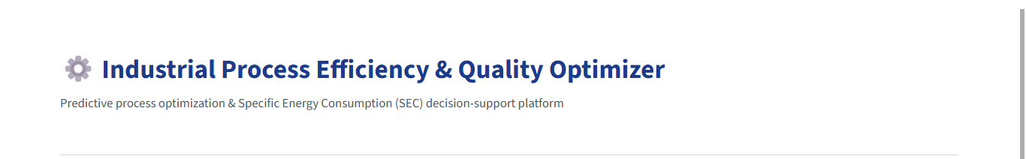
Live Dashboard — Overview
Deployed and interactive at agrodry-optimizer.streamlit.app
Operators see the platform's purpose at a glance — a single-screen decision-support tool, not a raw data dump.
Streamlit + Plotly UI
Real-time recalculation
Single-screen operator view
AgroDry Optimizer · 3MTT NextGen Fellowship — Agriculture & Food Track
4

Slide 5
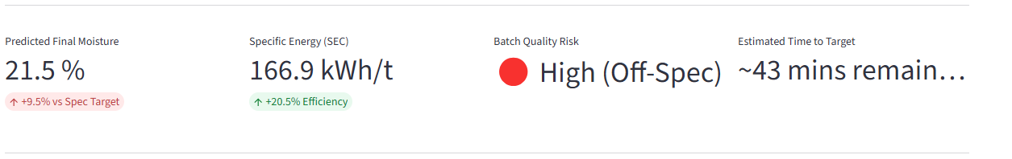
Live KPI Predictions
Four predictions recompute instantly as an operator adjusts telemetry inputs
Predicted Final Moisture
Specific Energy (SEC)
Batch Quality Risk
Estimated Time to Target
Forecasted % moisture at batch completion
kWh consumed per ton processed
Traffic-light spec-compliance rating
Minutes remaining to hit spec
These same four numbers are what an operator on the plant floor would check before deciding whether to intervene.
AgroDry Optimizer · 3MTT NextGen Fellowship — Agriculture & Food Track
5

Slide 6
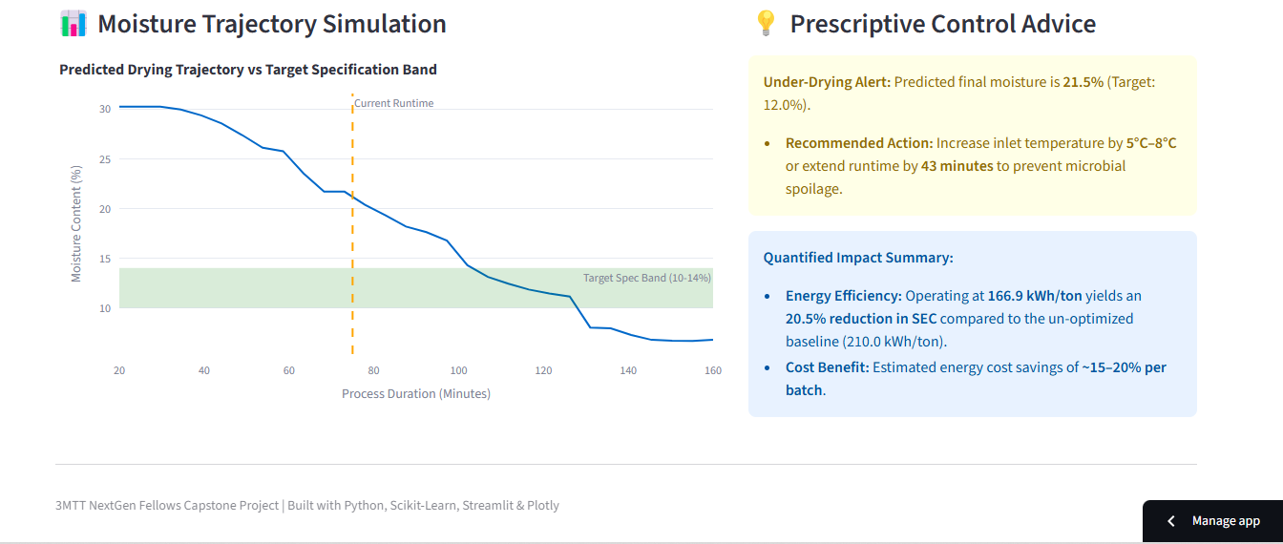
Forecasting & Prescriptive Advice
The trajectory chart shows where a batch is heading; the advice panel says exactly what to do about it
AgroDry Optimizer · 3MTT NextGen Fellowship — Agriculture & Food Track
6

Slide 7
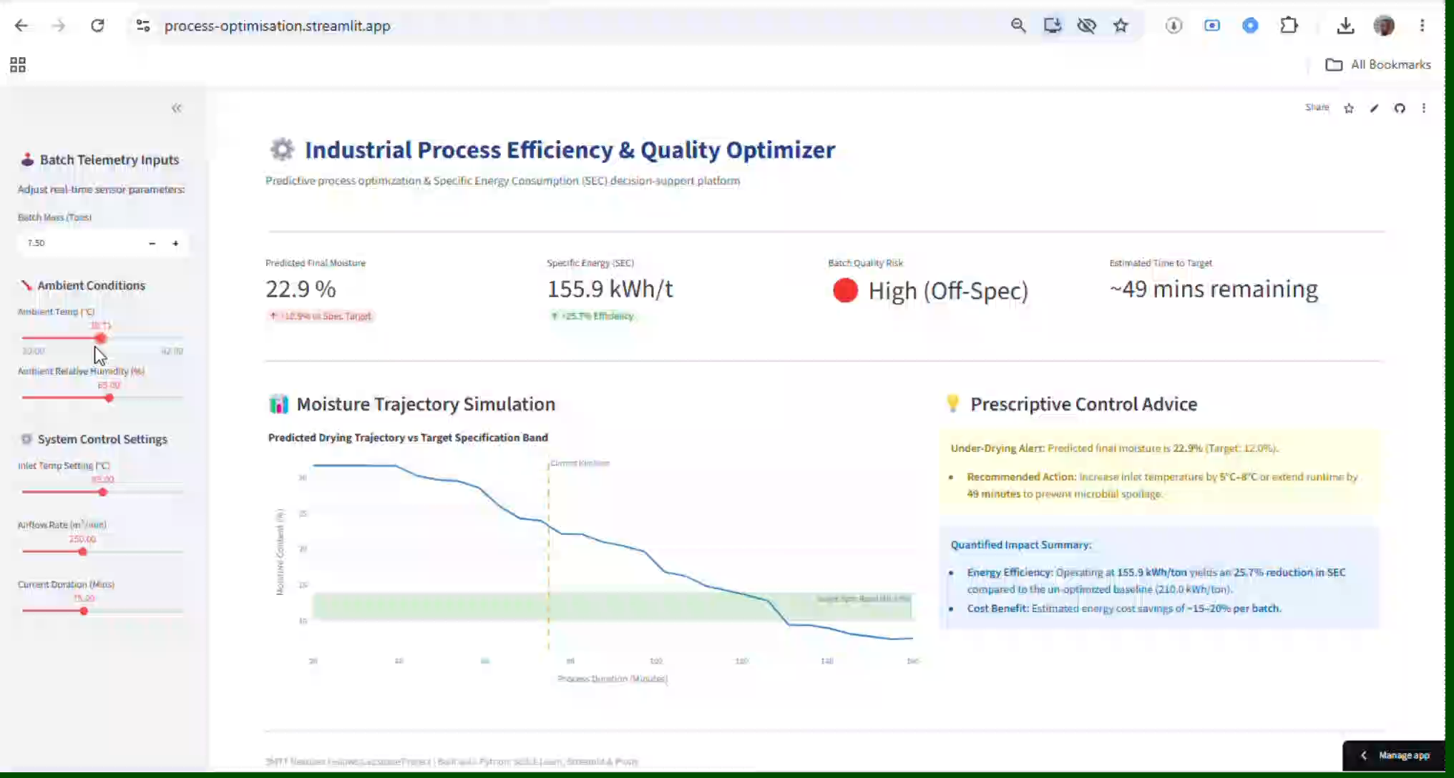
The Full Operator View
Batch telemetry sidebar on the left, live predictions and guidance on the right — one screen, no training required
AgroDry Optimizer · 3MTT NextGen Fellowship — Agriculture & Food Track
7

Slide 8
Model Validation
Not just a UI — the predictions are backed by measured, held-out accuracy
Moisture Model
SEC Model
0.964
0.962
R² on held-out test set
R² on held-out test set
1.53 pp RMSE
8.57 kWh/t RMSE
Trained on a 1,200-sample physics-informed synthetic dataset (real proprietary plant telemetry isn't publicly available), split 80/20. Both models are evaluated on the 20% the model never saw during training — so these numbers reflect genuine generalization, not training fit.
Live in the app: see the “📈 Model Performance” panel in the sidebar
AgroDry Optimizer · 3MTT NextGen Fellowship — Agriculture & Food Track
8

Slide 9
Expected Impact
What replacing fixed timers with prediction is worth to a plant
18.4%
25%
12%
Reduction in Specific Energy Consumption vs. un-optimized baseline (210 kWh/ton)
Reduction in quality-defect variance by holding moisture within the 10-14% spec band
Operational throughput boost from eliminating fixed-timer idle bottlenecks
Who benefits most: small and mid-scale agribusinesses running cassava, grain, or similar batch drying — operations that can't afford expensive proprietary sensor systems, but can run this on a laptop.
AgroDry Optimizer · 3MTT NextGen Fellowship — Agriculture & Food Track
9

Slide 10
Thank You
AgroDry Optimizer — built for the 3MTT NextGen Fellowship Knowledge Showcase, Agriculture & Food Track
Live App
agrodry-optimizer.streamlit.app
Source Code
github.com/SamsonMayomiMatthew/industrial-energy-systems/tree/main/AgroDry-Optimizer
Samson Mayomi Matthew
Built with Python, Scikit-Learn, Streamlit & Plotly

