Slide 1
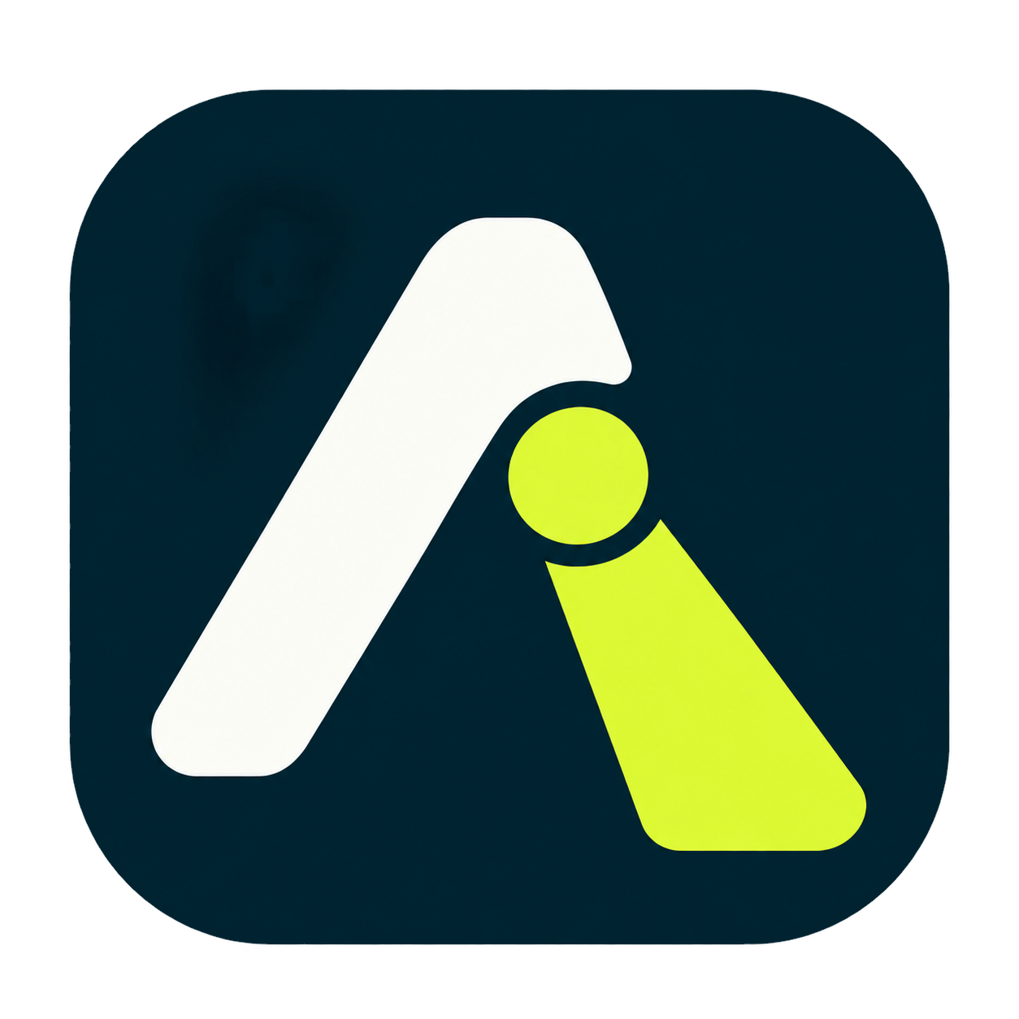
Samlytics Data Services
Attenlume quick guide
Record sessions, photograph slides, mark key moments, then take home one tidy package.
For Android phones and tablets, and Windows.

Slide 2
Four steps, one tidy package
Attenlume keeps the details of a conference so you can give the speaker your attention. Everything stays on your device unless you choose to share it.
1
2
3
4
Set up
Capture
Review
Export
Create your conference in seconds.
Record, bookmark, note and photograph.
Play back, find key moments, trim.
Save one package and share it.

Slide 3
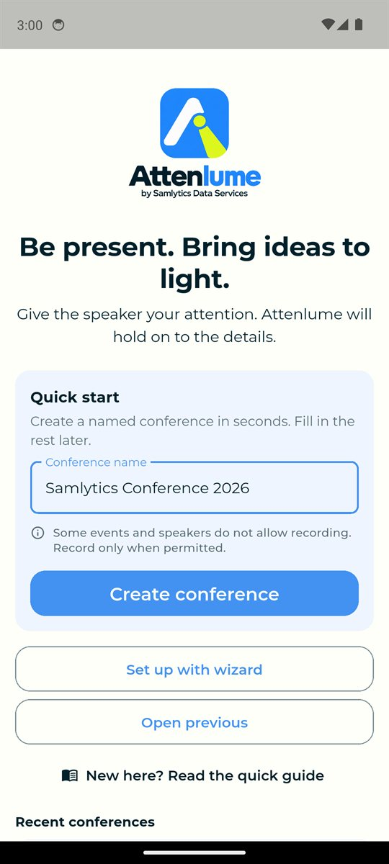
1
Set up
One name is all you need to start.

Slide 4
1 Set up
Create your conference
Type the conference name, for example Samlytics Conference 2026.
Tap Create conference. You can add dates and goals later.
Prefer to fill everything in now? Tap Set up with wizard.

Slide 5
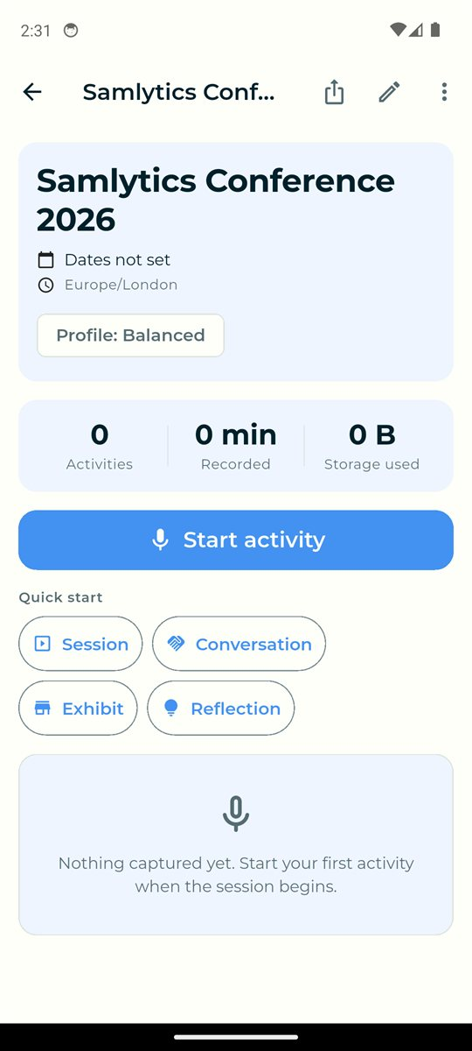
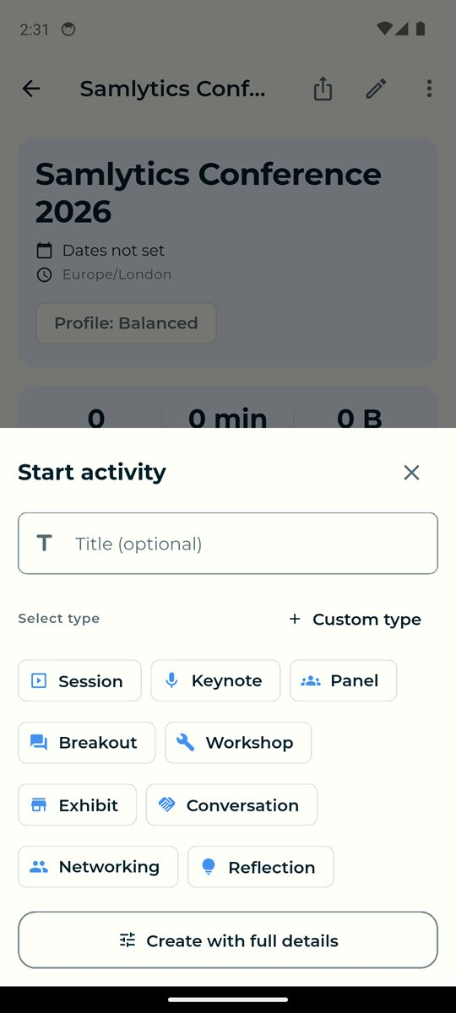
1 Set up
Start an activity
An activity is anything you capture: a keynote, panel, workshop, conversation or your own reflection.
Tap Start activity, add a title if you like, then choose its type.
Quick start buttons create a Session, Conversation, Exhibit or Reflection in one tap.

Slide 6
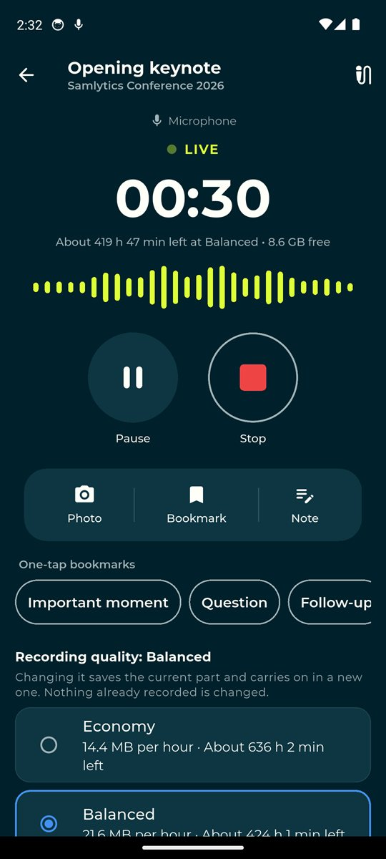
2
Capture
Stay present. Attenlume holds on to the details.

Slide 7
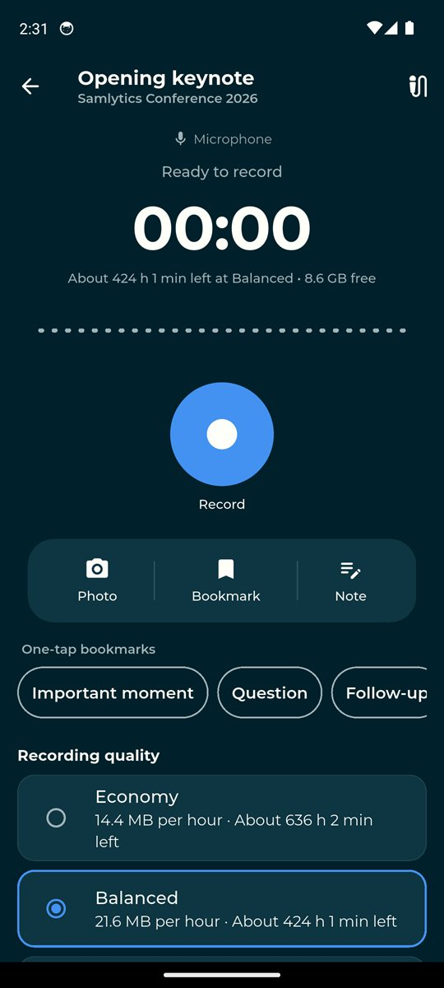
2 Capture
Record
Tap Record. The first time, allow microphone access.
LIVE, the timer and the level meter show it is recording. The line under the timer shows how many hours your storage allows.
Pause or Stop at any time. Recording carries on with the screen locked, and Android shows Stop in the notification.

Slide 8
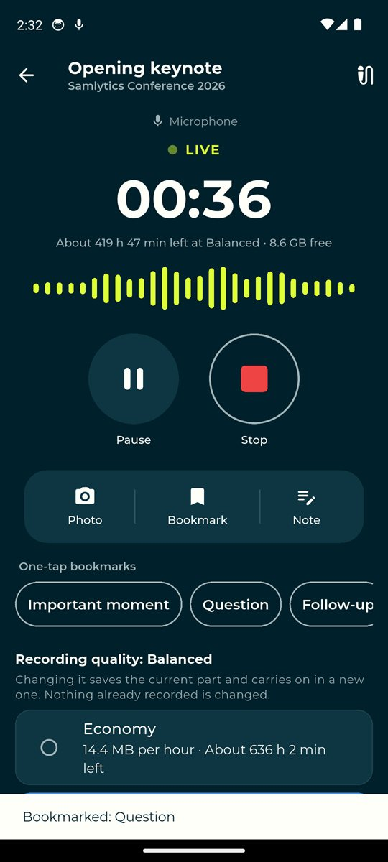
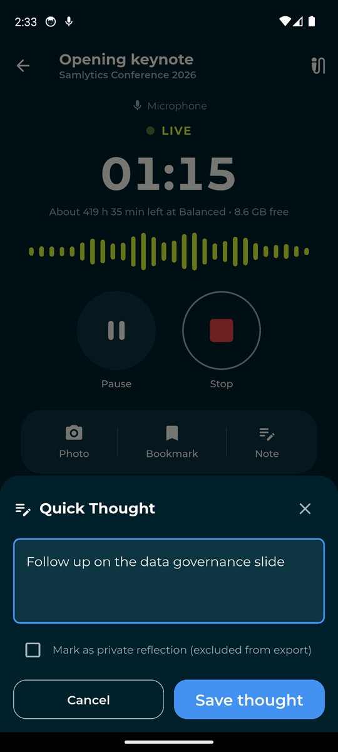
2 Capture
Bookmarks and notes
Tap a one-tap bookmark such as Important moment, Question or Follow-up. It is saved at that point in the recording.
Tap Note to write a quick thought.
Tick Mark as private reflection to keep it out of exports.

Slide 9
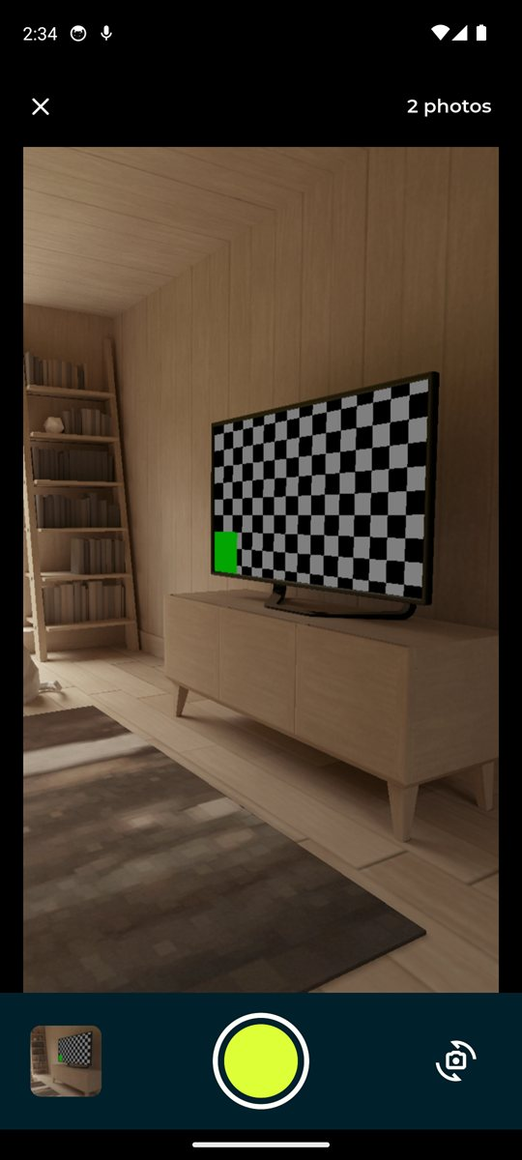
2 Capture
Photograph slides
Tap Photo to open the camera. The recording carries on.
Tap the shutter for each slide or poster. Each photo is linked to the moment it was taken.
Tap the switch button to use the front camera. Tap X to return to the recorder.

Slide 10
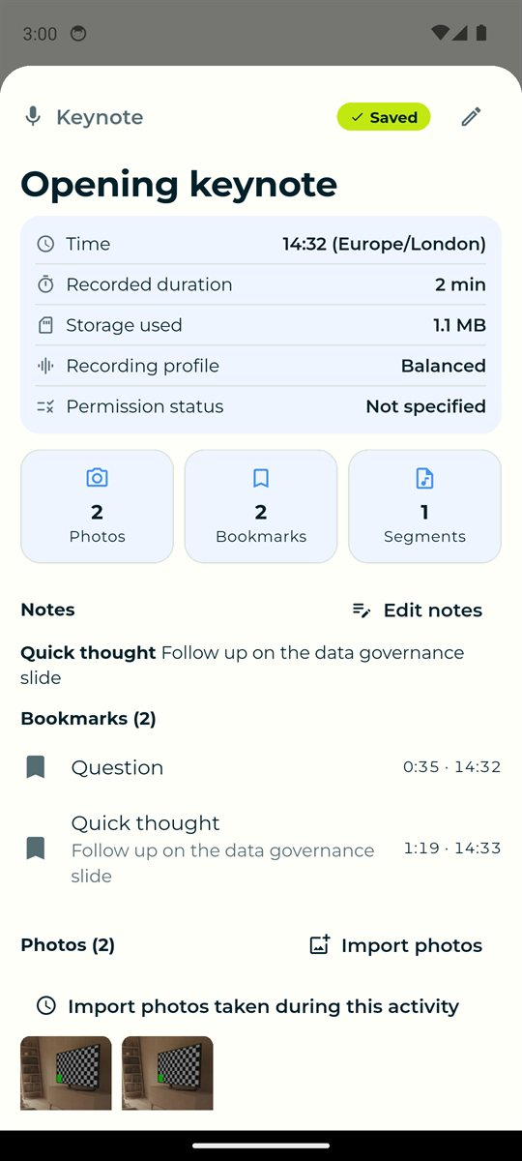
3
Review
Find what mattered in minutes, not hours.

Slide 11
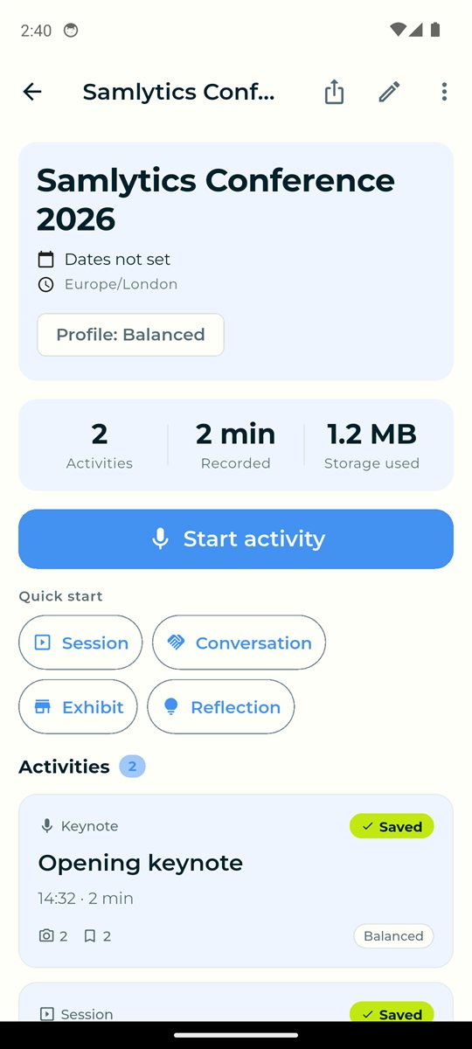
3 Review
Your activities
Every activity appears on the conference page with its length, photos and bookmarks.
Tap one to see its notes, bookmarks and photos.
Import photos adds pictures from your gallery taken during the session.

Slide 12
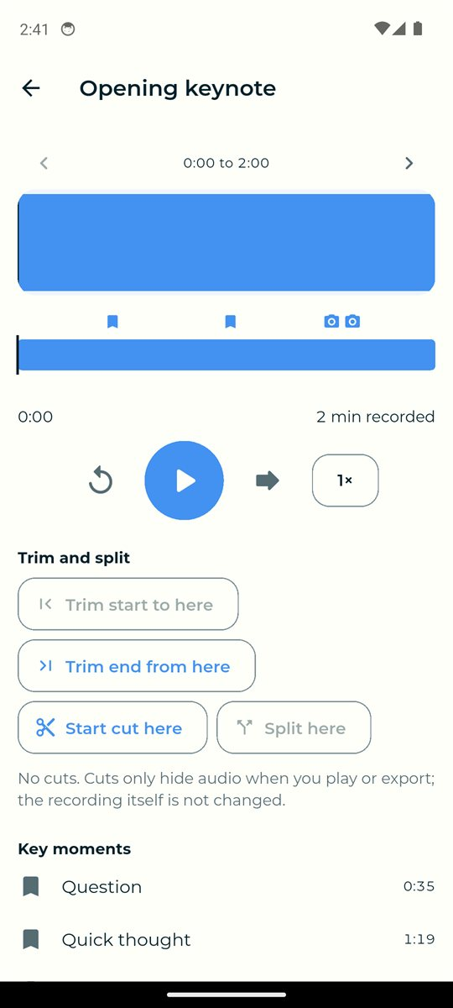
3 Review
Play, trim and split
Tap Play and review. Bookmarks and photos appear on the timeline and under Key moments.
Use Trim start, Trim end or Start cut to hide parts you do not need. Undo is always there.
Your original recording is never changed unless you choose to apply trims permanently.

Slide 13
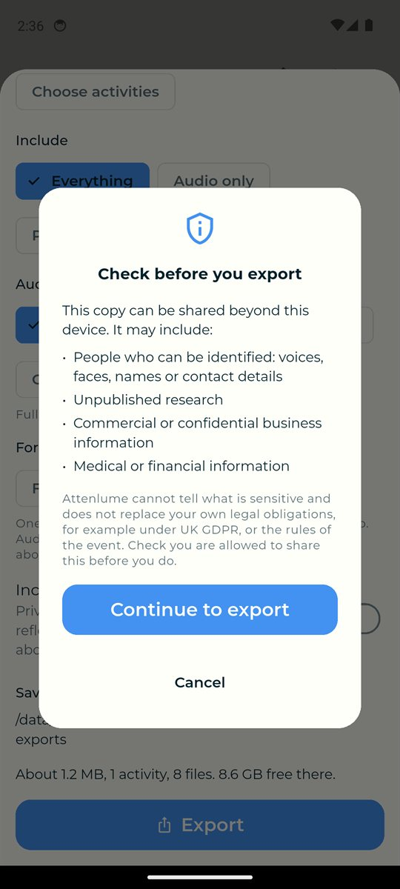
4
Export and share
One package for your notes, your team or your AI tool.

Slide 14
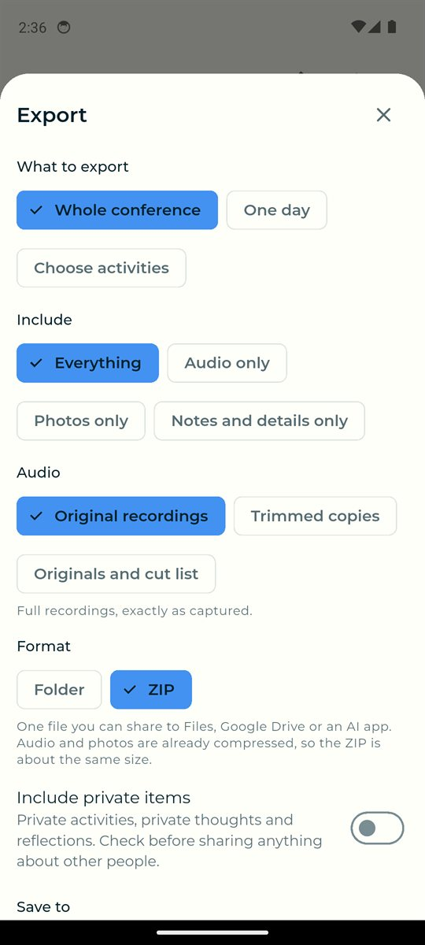
4 Export and share
What to export
Tap the export button at the top of a conference.
Choose the whole conference, one day or chosen activities, and what to include. On a phone, ZIP is one file you can share.
Private items stay out unless you switch them on. Attenlume asks you to check before every export.

Slide 15
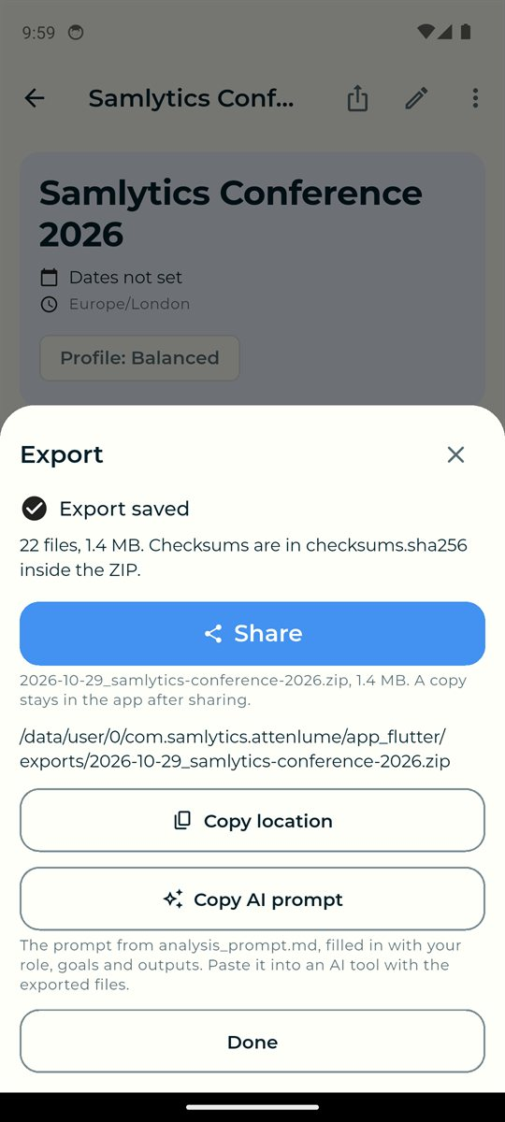
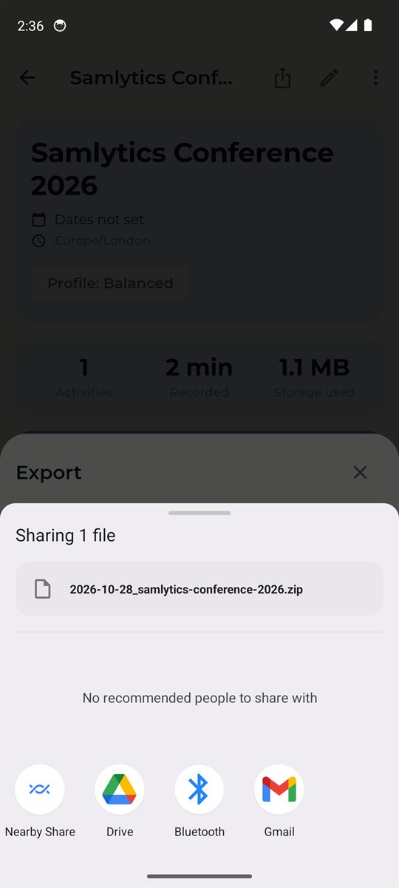
4 Export and share
Save, share and ask AI
When the export is saved, tap Share to send the ZIP to Google Drive, Gmail, Files or an AI app.
Tap Copy AI prompt, then paste it into ChatGPT, Claude or Gemini with the exported files. It already holds your role, goals and the outputs you want.
Inside the export, README_START_HERE explains every file, and timeline.csv lists each bookmark and photo with the exact place in the recording.

Slide 16
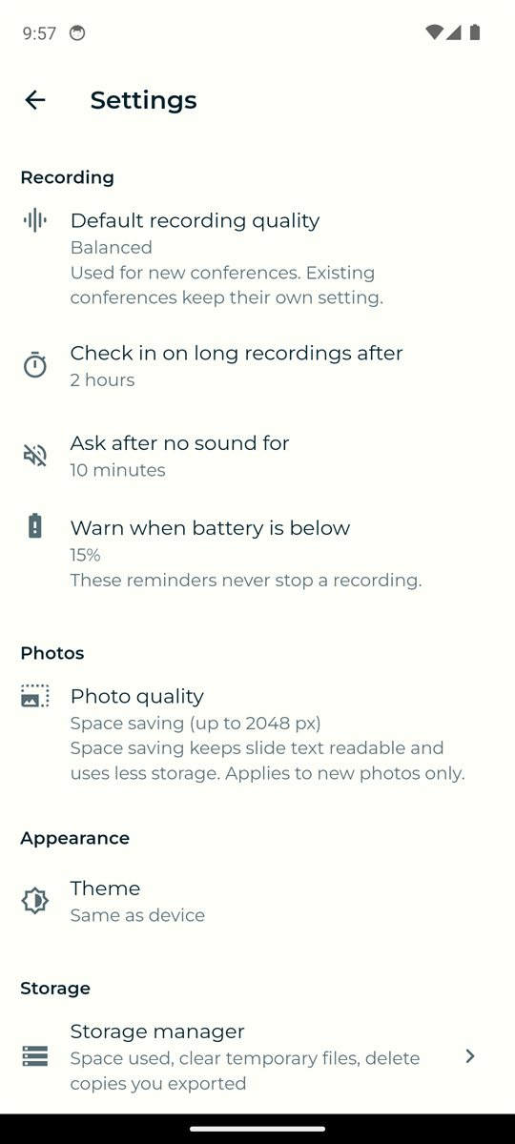
5
Settings and storage
Make Attenlume work your way, and keep your device tidy.

Slide 17
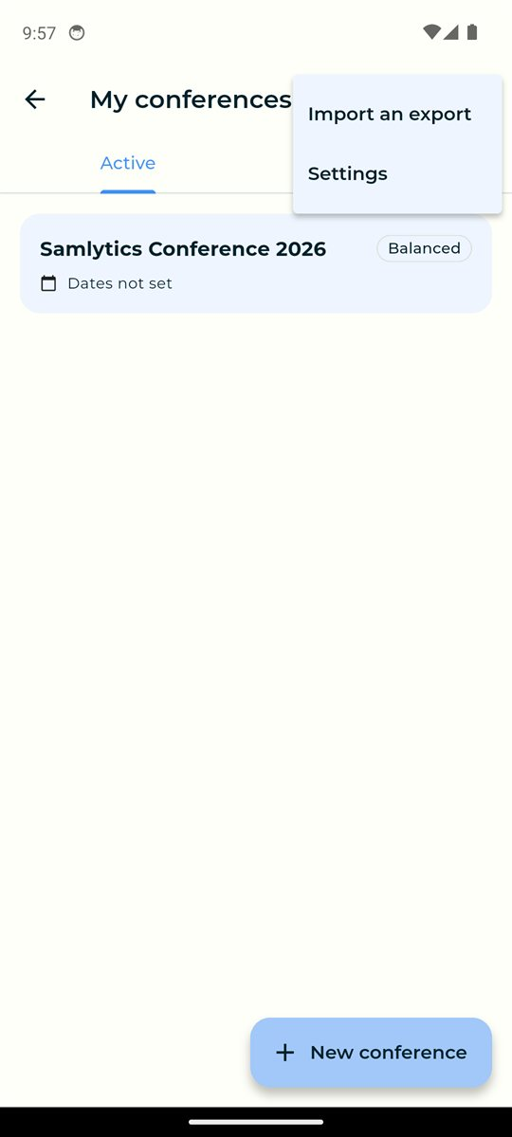
5 Settings and storage
Settings
On My conferences, tap the menu, then Settings.
Choose the default recording quality, when Attenlume checks in during long recordings, photo quality and the theme.
Privacy and app lock, the quick guide and About are here too.

Slide 18
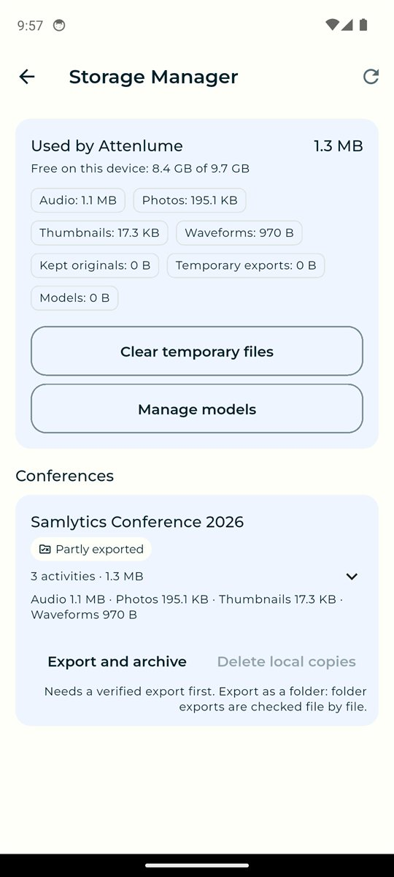
5 Settings and storage
Storage manager
See how much space each conference uses, and whether it is exported, partly exported or verified.
Clear temporary files at any time. Your recordings and photos are never touched.
Delete local copies is only possible after a complete, verified export of a folder, with a preview and a second confirmation.

Slide 19
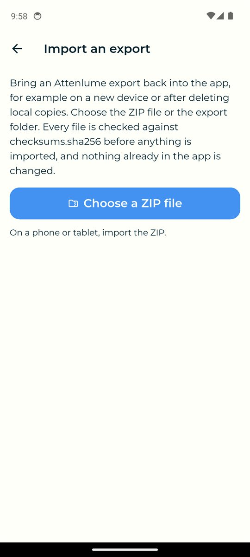
5 Settings and storage
Moving to a new device
Export the conference, then copy the ZIP to the new device.
On the new device, tap the menu on My conferences, then Import an export.
Every file is checked first, and nothing already in the app is overwritten.

Slide 20
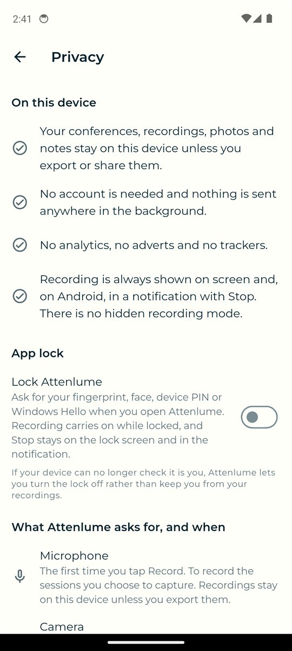
Your privacy
✓
Your conferences, recordings, photos and notes stay on this device unless you export or share them.
✓
No account, no analytics, no adverts and no trackers.
✓
Recording is always shown on screen. There is no hidden recording mode.
✓
Turn on App lock under My conferences, menu, Settings, Privacy and app lock, to ask for your fingerprint, face or PIN.

Slide 21
Good to know
Ask before you record
Long sessions
Some events and speakers do not allow recording. Record only when permitted.
Attenlume checks in after two hours, after ten minutes of silence and when the battery is low. Change these in Settings.
Updating
Before you uninstall
Installing a newer version keeps all your recordings.
Uninstalling deletes everything in the app. Export and share your conferences first.

Slide 22
Be present. Bring ideas to light.
Download for Android or Windows
github.com/SamsonOluwaseun/attenlume
Samlytics Data Services

