Slide 1
FoodWhizNet: A Web-based Food Classification System using Multi-Color Space Siamese-CNN Model
University of the Philippines Tacloban College
Samson Jr. D. Rollo
Researcher
John Paul T. Yusiong, PhD
Research Adviser
January 11, 2024
Notes:
Good afternoon, ladies and gentlemen. To my co researchers, To my research adviser, Sir, John Paul Yusiong, PhD. Thank you for being here today. I am honored to have the opportunity to share with you my research proposal on the alternative approach to application of deep learning to food classification problem. Over the course of my review, I aimed to address the food classification problem in relation to input variation. The findings I will present today shed light on intuitive feasibility of the proposed study based on the pieces of literature.

Slide 2
Contents
Introduction
Literature Review
Statement of the Problem
Objectives
Significance of the Study
Theoretical and Conceptual Framework
Proposed Methodology
Initial Experiment Results
Schedule of Activities

Slide 3
Introduction

Slide 4
Introduction
Food is essentially one of the most important component of human life as per Maslow’s Hierarchy of Needs. [1]
Nobody wants to eat unknown and unhealthy foods?
There are a lot of food classes!
Classifying food accordingly is a challenge due to its intraclass variability and increasing number contributing to its increasing complexity.
Deep Learning on Food Classification is a growing field.
Food datasets includes the Food-101, UECFood100, UECFood256, and some other local food datasets.
Notes:
Food really stands out as one of our very basic needs. As per Maslow's pyramid, it lies at the bottom, signifying its utmost importance to us, humans. Now, being able to know what you are eating is a trend especially if you are conscious with your health. Classifying which food is which on a local setting is easy because there are only few of them locally so you may be able to classify them accordingly. What if we widen our scope to reach every corner of the globe. The problem here? There’s too many food classes. Which is sometimes overwhelming to know. This is where deep learning comes in. There have been already models produced to classify food classes but as the number of classes increase so as the complexity of classifying them. To fulfill studies with deep learning, publicly available datasets are needed for easy conduct, otherwise, an additional step for validation of ground truth is needed. Some of the publicly available datasets include the Food-101, UECFood100, and UECFood256.

Slide 5
Literature Review

Slide 6
Transfer Learning for Food Classification
Vijayakumari et al. [2] and Islam et al. [7] produced studies that utilized a single pretrained CNN for transfer learning in food classification.
Single Input, Single CNN
Single Input
CNN
(For Transfer)
Prediction

Slide 7
Multiple Parallel CNN for Image Analysis
Studies of Pandey et. Al [6], Martinel et al.[3], and Al-Sarayreh et al. [5] reflects the use of multiple parallel CNN for specific tasks, such as food classification.
Single Input, Multiple CNN
CNN
.
.
.
Single Input
Prediction
CNN
Notes:
Pandey et al. conducted a study on the use of three fine-tuned pre-trained model that runs in parallel. Using AlexNet, GoogleNet, and ResNet, they have created an ensemble of these models and hypothesized that each of the parallel networks would perform their best to achieve high accuracy. Martinel et al, on the other hand, utilized 2 parallel networks, one is pre-trained transfer learning ResNet and the other is a naive CNN slice network. The Slice network specifically aims to capture the vertical features of the samples from the dataset while the ResNet ensures to capture features missed by the slice network. Al-Sarayreh also conducted a study with a parallel network model with one network capturing the spectral feature of the sample while the other network captures the spatial features. The spectral capturing network processes a 1D input while the spatial capturing network processes a 3D input. These studies provide insight into the robustness of having 2 or more parallel networks in mining for discriminative features. In the case of Larbi et al., it utilizes three identical CNNs fed with three different color spaces for spoofing detection.

Slide 8
Multiple Parallel CNN for Image Analysis
He et al. [8], and Larbi et al. [9] also reflects the use of multiple parallel CNN for specific tasks, such as fake image detection.
Single Input-Multiple Variation, Multiple CNN
Input Var A
CNN
Single Input
Input Var B
CNN
Prediction
Input Var B
CNN

Slide 9
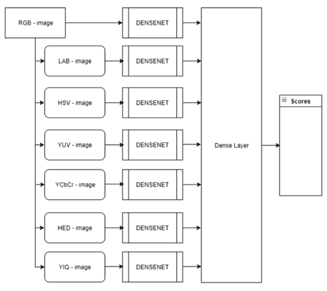
Multiple Color Spaces in DL tasks
Studies that utilized the color spaces include Larbi et al. [9], He et al. [10], and Gowda and Yuan [10].
Structure of Larbi et al. and He et al.
is the same on the previous slide.
The image represents Gowda and
Yuan’s architecture.
Notes:
Both Larbi et al. and He et al. used multiple color spaces in detecting fake images. Larbi used three identical CNNs fed with RGB, HSV, and YCbCr color spaces and conducted a voting mechanism on the output. Each generates different histograms which primarily notify a fake image. He et al. used the same method where the use of three identical CNNs was used. They focused mainly on the chrominance components of the images where they utilized the HSV, YCbCr, and Lab color spaces as inputs. In the study of Gowda and Yuan, some color spaces degrade the resulting accuracy therefore disregarding them. They proceed to promote the use of RGB, YIQ, LAB, HSV, YUV, YCbCr, and HED color spaces to achieve high accuracy. On a two-color space input, they found out that a combination of YUV and LAB produced a high accuracy. In the compilation of Kang, the Lab color space was hailed as one of the best for food quality analysis due to its independence of lighting effect.

Slide 10
Statement of the Problem

Slide 11
Statement of the Problem
There is a significant improvement in the performance of food classification in terms of accuracy and efficiency when incorporating a Siamese Convolutional Neural Network model with multiple color spaces as input compared to the existing approaches.

Slide 12
Research Gap
Food classification is a growing field so there are gaps that we can observe, one is on the model used together with the type of input. Recent food classification systems do not include a single feature multiple variant input, e.i. multi-color spaces input. Existing works of literature also have utilized multiple parallel networks for food classification but none was a Siamese CNN architecture. Siamese CNN is commonly used for similarity detection and few to none for creating a robust model.
Notes:
The research gap was selected carefully on the basis of deep learning. Narrowing first to food classification problem, literature and studies were scanned as to what gap is present. With the help of our adviser, we identify the single feature multiple variant input. Specifically, no studies were currently using a single feature such as color as input to a Siamese CNN which accepts the multiple variant of the feature to be processed. Related literature helps us validate the existence of the gap and identified the problem as it is.

Slide 13
Research Gap Diagram
Existing Approach
Single Input, Single CNN
Single Input
CNN
Prediction
Single Input, Multiple CNN
CNN
Single Input
Prediction
CNN
My Approach
Single Input-Multiple Variation, Siamese CNN
Input Var A
CNN
Single Input
Prediction
Input Var B
CNN
Notes:
Most existing approaches to food classification problem includes a single input and a single cnn model. The input is primarily a single color space, by default, an RGB. Another existing approach is the using of multiple CNN but utilizes a single input. The multiple CNN are not necessarily identical, such that each subnetwork are different models with either concatenated or ensembled output for prediction. Our proposed approach includes the use of two identical CNNs that accepts two variation of a single input. In this case, two variations of color spaces from a single image. This hopes for a robust performance of the model.

Slide 14
Objectives

Slide 15
General Objective
To deploy a functional web-based food classification system that utilize multiple color spaces extracted from an image as an input to a Siamese-CNN deep learning network.

Slide 16
Specific Objectives
To develop an alternative approach to food classification using multiple color spaces extracted from a food image.
To conduct an ablation study on the best 2-color space input combination for the Siamese-CNN model.
To compare the performance of the proposed model with the current state-of-the-art models in the food classification problem.
To implement a Siamese-CNN deep learning model on food classification using a web-based application.

Slide 17
Significance of the Study

Slide 18
Significance of the Study
Food is one of our basic needs. It dictates our health status to whether we will be living for a long time or not. In that sense, diet really thus matter to whether we will be susceptible to diseases. This study complements the use of food classification system and the medical field. There are food classification systems and as the number of food classes grows so as the complexity on classifying them.
This aims to fill in the gap on the use of multiple color spaces as input to a Siamese CNN to address the ever increasing complexity of the food classification system.
Notes:
-Reiterate the importance of food to humans.
-Its importance to the medical field as a tool for diet planning for those having diabetes and allergies.
-Its importance to the research community as basis for future studies.
-It can validate the previous studies especially on the robustness of using certain pretrained models, and the right choice of color space combination.
- The study FoodWhizNet: A web-based food classification system using multi-color space Siamese CNN is worth pursuing due to the fact that food classification system exhibit both high and low intraclass variability challenges making it a good avenue for creating a robust and accurate methods that can be also applied to the image classification problem in general. The use of Siamese CNN is to ensure the proper propagation of input data along the model in order to create a balanced classification along the way of creating a bond of similarities between the two different variation of color space from an input. Multiple color spaces as input can be justified to be significant considering it as the primary feature to be noticed as per Kang, and is the most valuable when conducting a discriminative feature extraction.

Slide 19
Theoretical and Conceptual Framework

Slide 20
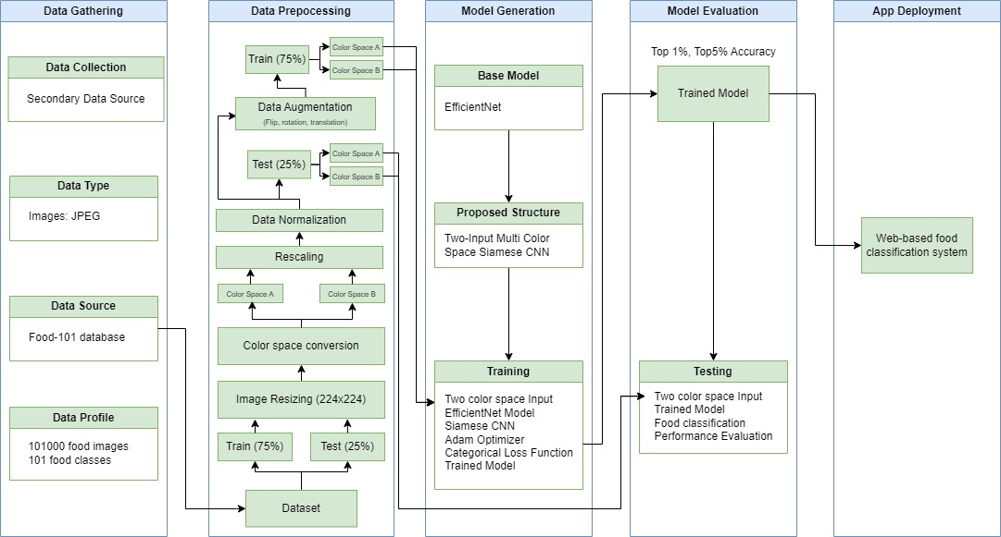
Theoretical and Conceptual Framework

Slide 21
Proposed Methodology

Slide 22
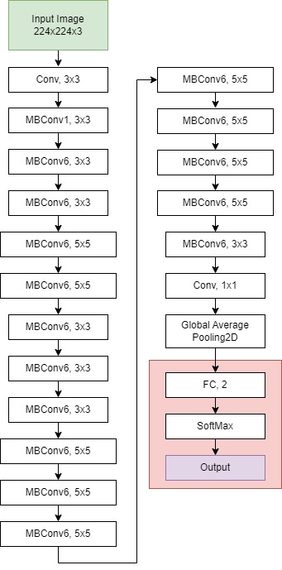
Network Design and Architecture
The base model is based on the EfficientNet Family. The diagram shows the structure of the EfficientNetB0. The red box at the end indicates the removal of the top layer of the base model.

Slide 23
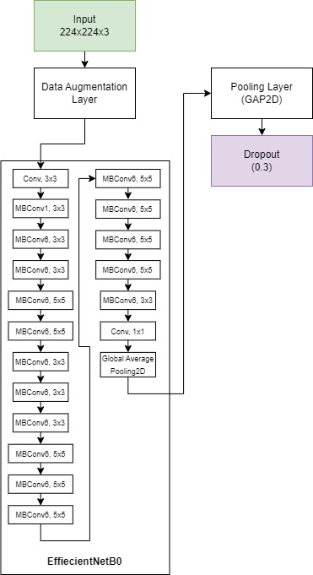
Network Design and Architecture
We enforce the base model in our proposed model. The diagram in represents a single subnetwork of the proposed Siamese CNN. Before we utilize the base model, we first added a data augmentation layer. Note that the Data Augmentation layer is only active during the training phase of the model and deactivates during evaluation.

Slide 24
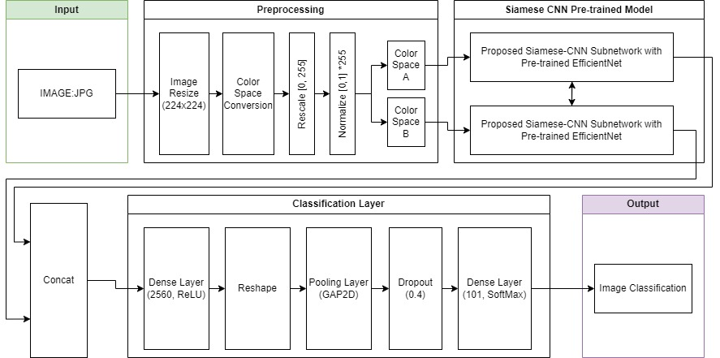
Network Design and Architecture
Notes:
The proposed model.

Slide 25
Dataset
Class Name | Total Instances | Training Instances | Testing Instances
apple pie | 1000 | 750 | 250
baby back ribs | 1000 | 750 | 250
baklava | 1000 | 750 | 250
. . . | . . . | . . . | . . .
tiramisu | 1000 | 750 | 250
tuna tartare | 1000 | 750 | 250
waffles | 1000 | 750 | 250
Notes:
The primary dataset is the Food101 dataset used initially by Bossard et al for its RFMF study. The table shows the profile of the dataset. It contains 101 classes with 1000 instances in each class. The split is conducted as 75-25 for training and testing, respectively. The dataset is uniform so there is a uniform number for all splits.

Slide 26
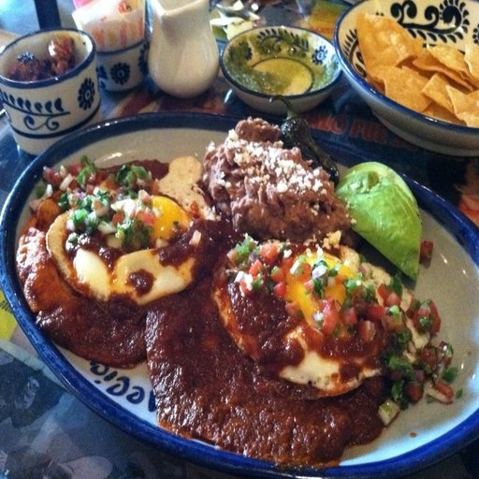
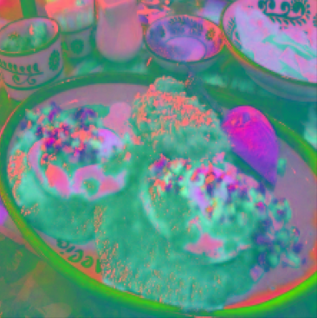
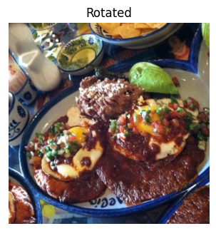
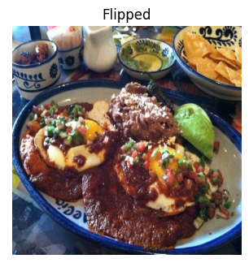
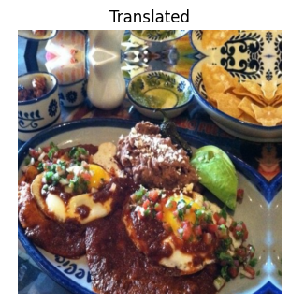
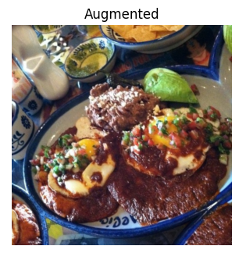
Data Processing
CS A: RGB
Rescale
[0,255]
Normalize [0,1]*255
Resize
CS Convert
CS B: LAB
224 x 224
Input
For Training
To Model
+
+
=

Slide 27
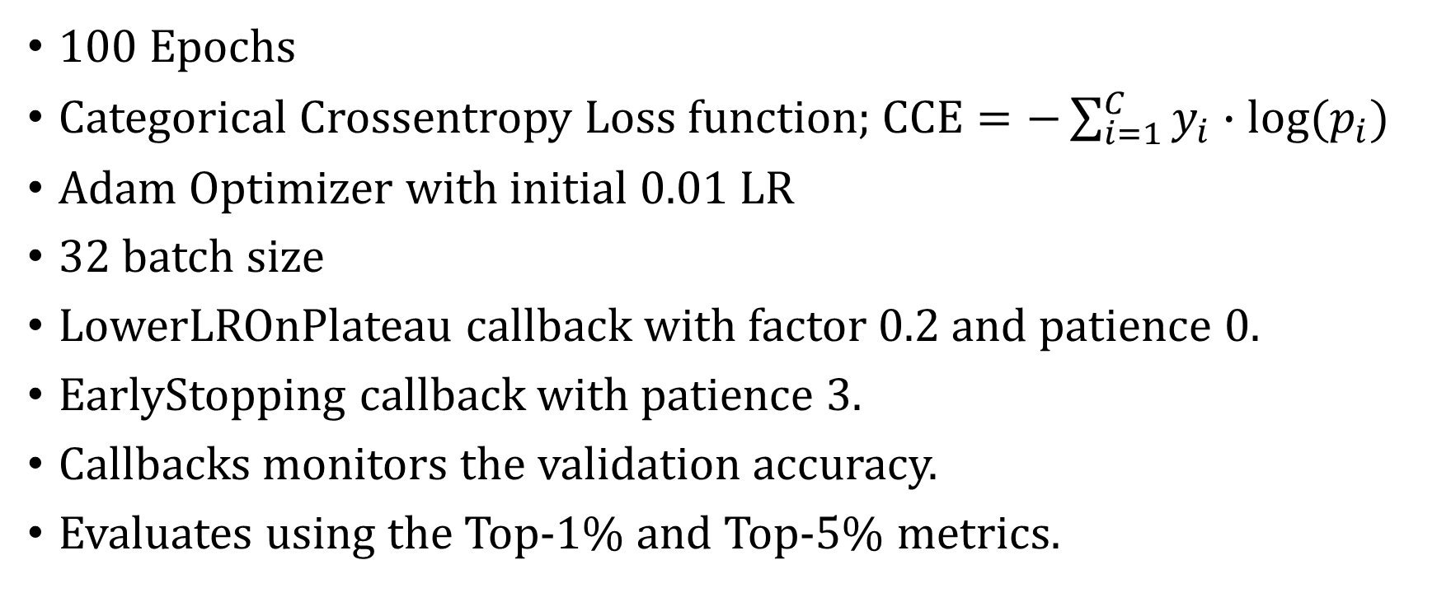
Model Training and Evaluation Details
100 Epochs
Categorical Crossentropy Loss function; $CCE=−\sum_{i=1}^{C}{y_{i}}∙log⁡(p_{i})$
Adam Optimizer with initial 0.01 LR
32 batch size
LowerLROnPlateau callback with factor 0.2 and patience 0.
EarlyStopping callback with patience 3.
Callbacks monitors the validation accuracy.
Evaluates using the Top-1% and Top-5% metrics.
Notes:
Validation set is 15% of the test set per epoch.

Slide 28
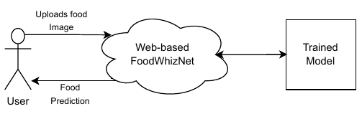
Deployment Details
Front-end: CSS, HTML, and JavaScript
Backend: Flask and the trained model
Github Pages or Jimdo webhost

Slide 29
Initial Experiment Results

Slide 30
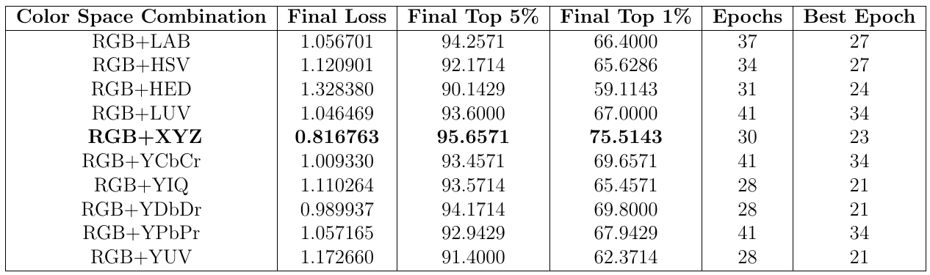
Version 1: The Prototype Result
Notes:
Ran using Food101 with 14 classes only based Kaur (2023). To check on the best 2 combination of color spaces. This only covers RGB combinations.

Slide 31
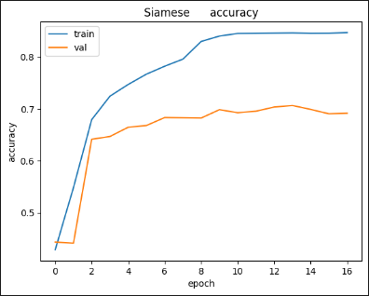
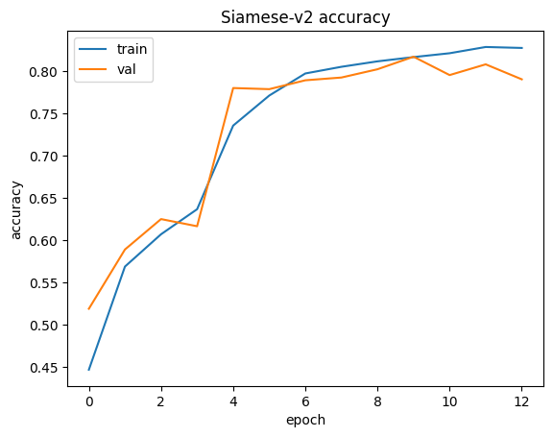
Version 2: The Model – Accuracy
RGB+LAB Color spaces: 69.93%
RGB+XYZ Color spaces: 80.07%

Slide 32
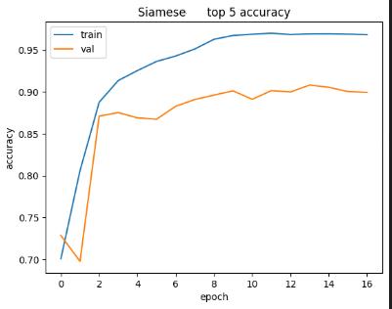
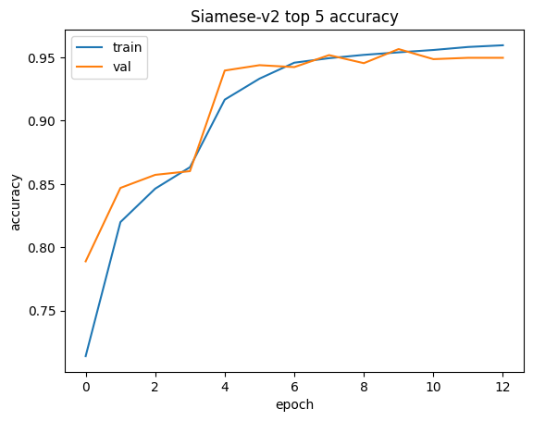
Version 2: The Model – Accuracy
RGB+LAB Color spaces: 69.93%
RGB+XYZ Color spaces: 80.07%

Slide 33
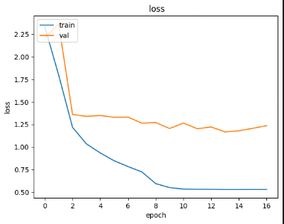
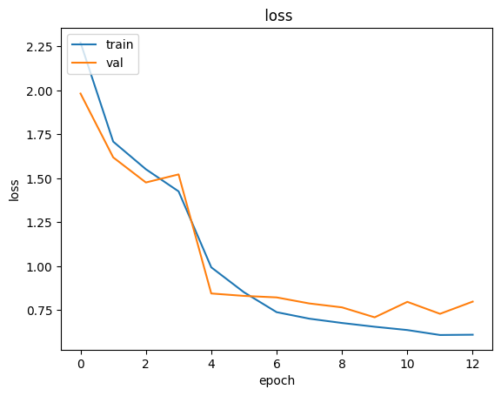
Version 2: The Model – Final Loss
RGB+LAB Color spaces: 1.2020
RGB+XYZ Color spaces: 0.7663

Slide 34
Schedule of Activities

Slide 35
Gantt Chart
Objectives | Target Activities | Target Accomplishments | Year 1
Objective 1 | To develop an alternative approach to food classification using only multiple color spaces extracted from a food image. | Implement an initial prototype that test the feasibility of the study using Python, Keras, and TensorFlow. Using EfficientNetB0 in building the prototype to see the performance difference between the previous studies and the current study. Using the built prototype to test the feasibility of multi-color space input performance difference between the previous studies and the current study | 1 | 2 | 3 | 4 | 5 | 6 | 7 | 8 | 9 | 10 | 11 | 12
Objective 1 | To develop an alternative approach to food classification using only multiple color spaces extracted from a food image.

Slide 36
Gantt Chart
Objectives | Target Activities | Target Accomplishments | Year 1
Objective 2 | To conduct an ablation study on the best 2-color space input combination for the Siamese-CNN model. | Given the related literature on the multi color spaces, test and validate the results and perform ablation study on the 2 best color space combination to be utilized in the study. | 1 | 2 | 3 | 4 | 5 | 6 | 7 | 8 | 9 | 10 | 11 | 12
Objective 1 | To develop an alternative approach to food classification using only multiple color spaces extracted from a food image.

Slide 37
Gantt Chart
Objectives | Target Activities | Target Accomplishments | Year 2
Objective 3 | To compare the outcome of the study to the currently accepted best models in the food classification problem. | Develop the true version of the model. Perform experiments based on the methodology. Conduct a comparison and analysis on the results taken from the experiment and the previous study. Validate the feasibility of the prototype that it can outperform current best models in food classification. | 1 | 2 | 3 | 4 | 5 | 6 | 7 | 8 | 9 | 10 | 11 | 12
Objective 1 | To develop an alternative approach to food classification using only multiple color spaces extracted from a food image.

Slide 38
Gantt Chart
Objectives | Target Activities | Target Accomplishments | Year 2
Objective 4 | To implement a Siamese-CNN deep learning model on food classification using a web-based application. | Develop the front-end of the web-based system using the HTML, CSS, and JavaScript Stack. Develop the back-end using Flask. Deploy the web-based food classification system to production. | 1 | 2 | 3 | 4 | 5 | 6 | 7 | 8 | 9 | 10 | 11 | 12
Objective 1 | To develop an alternative approach to food classification using only multiple color spaces extracted from a food image.

Slide 39
Thank You!

Slide 40
References
[1] Saul Mcleod. Maslow’s Hierarchy of Needs. 2023. url: https://www.simplypsychology.org/maslow.html?ez_vid=2cae626a2fe896279da43d587baa3eb663083817. (accessed: 09.21.2023).
[2] G VijayaKumari, Priyanka Vutkur, and P Vishwanath. “Food classification using
transfer learning technique”. In: Global transitions proceedings 3.1 (June 1, 2022),
pp. 225–229. doi: 10.1016/j.gltp.2022.03.027. url: https://doi.org/10.
1016/j.gltp.2022.03.027.
[3] Niki Martinel, Gian Luca Foresti, and Christian Micheloni. “Wide-Slice Residual Networks for Food Recognition”. In: 2018 IEEE Winter Conference on Applications of Computer Vision (WACV) (Mar. 1, 2018). doi: 10.1109/wacv.2018.00068. url: https://doi.org/10.1109/wacv.2018.00068.
[4] Seong Pal Kang. Color in food evaluation. Jan. 1, 2011, pp. 138–141. doi: 10.1007/ 978-90-481-3585-1_236. url: https://doi.org/10.1007/978-90-481-3585-1_236.
[5] Mahmoud Al-Sarayreh et al. “Detection of Red-Meat adulteration by deep Spectral–Spatial features in hyperspectral images”. In: Journal of Imaging 4.5 (May 3, 2018), p. 63. doi: 10.3390/jimaging4050063. url: https://doi.org/10.3390/jimaging4050063.
[6] Paritosh Pandey et al. “FoodNet: Recognizing foods using ensemble of deep networks”. In: IEEE Signal Processing Letters 24.12 (Dec. 1, 2017), pp. 1758–1762. doi: 10.1109/lsp.2017.2758862. url: https://doi.org/10.1109/lsp.2017.
2758862.
[7] Tohidul Islam et al. “Image Recognition with Deep Learning”. In: 2018 International Conference on Intelligent Informatics and Biomedical Sciences (ICIIBMS) (Oct. 1, 2018). doi: 10.1109/iciibms.2018.8550021. url: https://doi.org/10.1109/iciibms.2018.8550021.

Slide 41
References
[8] Peisong He, Haoliang Li, and Hongxia Wang. “Detection of Fake Images Via TheEnsemble of Deep Representations from Multi Color Spaces”. In: 2019 IEEE International Conference on Image Processing (ICIP) (Sept. 1, 2019). doi: 10.1109/icip.2019.8803740. url: https://doi.org/10.1109/icip.2019.8803740.
[9] Kaouthar Larbi et al. “DeepColorFASD: Face Anti Spoofing Solution Using a Multi Channeled Color Spaces CNN”. In: 2018 IEEE International Conference on Systems, Man, and Cybernetics (Oct. 1, 2018). doi: 10.1109/smc.2018.00680. url: https://doi.org/10.1109/smc.2018.00680.
[10] Shreyank N Gowda and Chun Yuan. ColorNet: Investigating the importance of color spaces for image classification. Jan. 1, 2019, pp. 581–596. doi: 10.1007/978-3-030-20870-7_36. url: https://doi.org/10.1007/978-3-030-20870-7_36.

