Slide 1
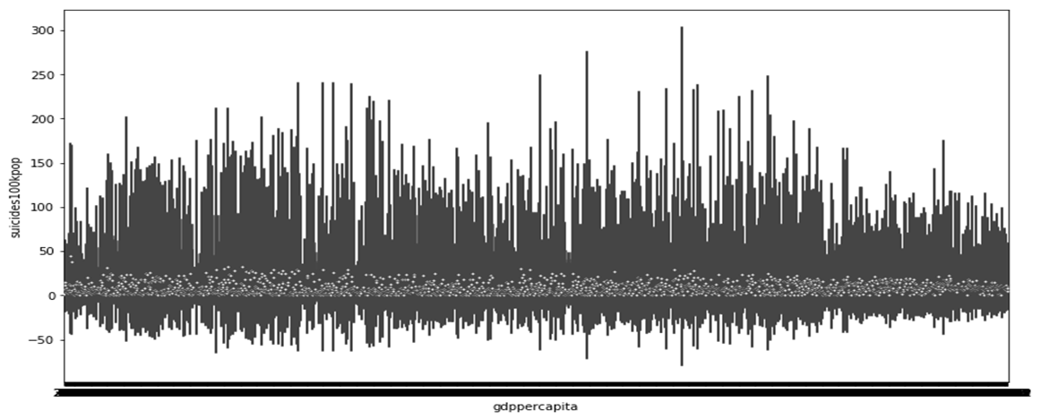
GLOBAL SUICIDE VS. HDI
BOOTCAMPIMMERSIVEDATA
FINAL PROJECT
JANE / GISO / BOB
COPYRIGHT © 2019 BOB XIONG ALL RIGHTS RESERVED

Slide 2
INTRODUCTION
Data Collection and Processing
Data Source from: https://www.kaggle.com/russellyates88/suicide-rates-overview-1985-to-2016,http://hdr.undp.org/en/composite/trends, https://twitter.com/search?q=suicidal%20thoughts&src=typd
Scrapehero.com
The datasets files are “suicide.xls”,“HDI.csv” and suicidio.csv
12396 and 1876 records from “suicide.xls” and Twitter (“Suicidal Thoughts”) feeds, respectively are analyzed
Efficiently analyzing data by processing CSV files, including converting objects into integer, strings, lists, cleaning, dropping the duplicated records, deleting the outliers, etc.

Slide 3
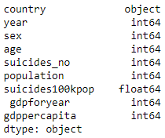
INTRODUCTION
Methodology
Jupyter - Python + R
In terms of visualization and the regression, we primarily use the jupyter - a combination of Python and R coding to create representations of our results.

Slide 4
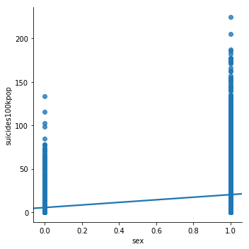
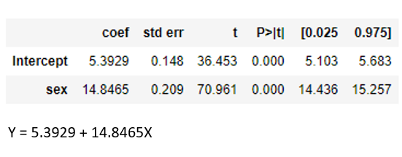
ANALYSIS AND RESULTS
What are the relationships of the suicide rate and one factor for suicide?
#make a scatterplot - linear regression suicides/100k pop by sex - 'female':0,'male':1
sns.lmplot(x='sex', y='suicides100kpop', data=df, fit_reg=True)

Slide 5
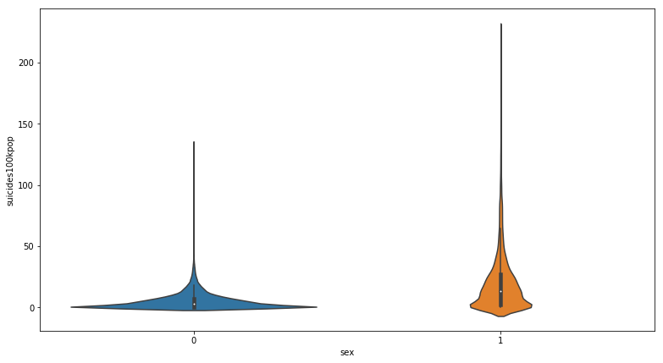
ANALYSIS AND RESULTS
What are the relationships of the suicide rate and one factor for suicide?
#violin plot shows the distribution of attack power for each type
sns.violinplot(x='sex', y='suicides100kpop', data=df)

Slide 6
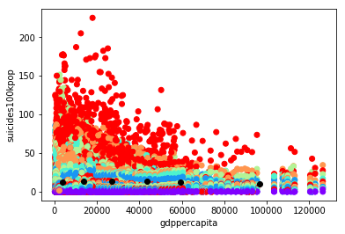
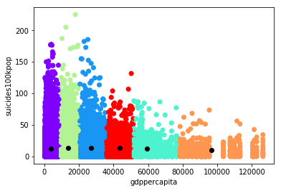
K-MEANS (BINNING/MANUAL VS MACHINE)

Slide 7
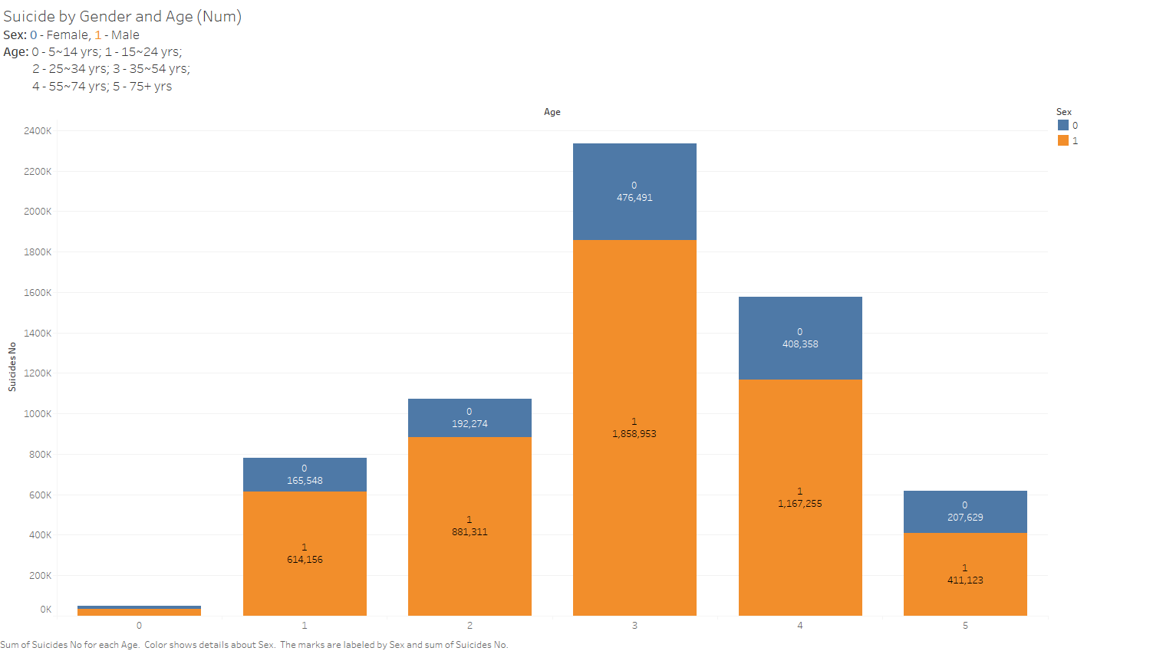

Slide 8
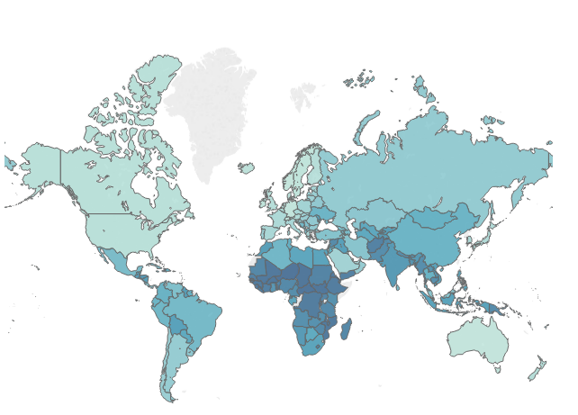
HDI
(HUMAN DEVELOPMENT INDEX - A STATISTIC OF HEALTH, EDUCATION AND STANDARD OF LIVING)

Slide 9
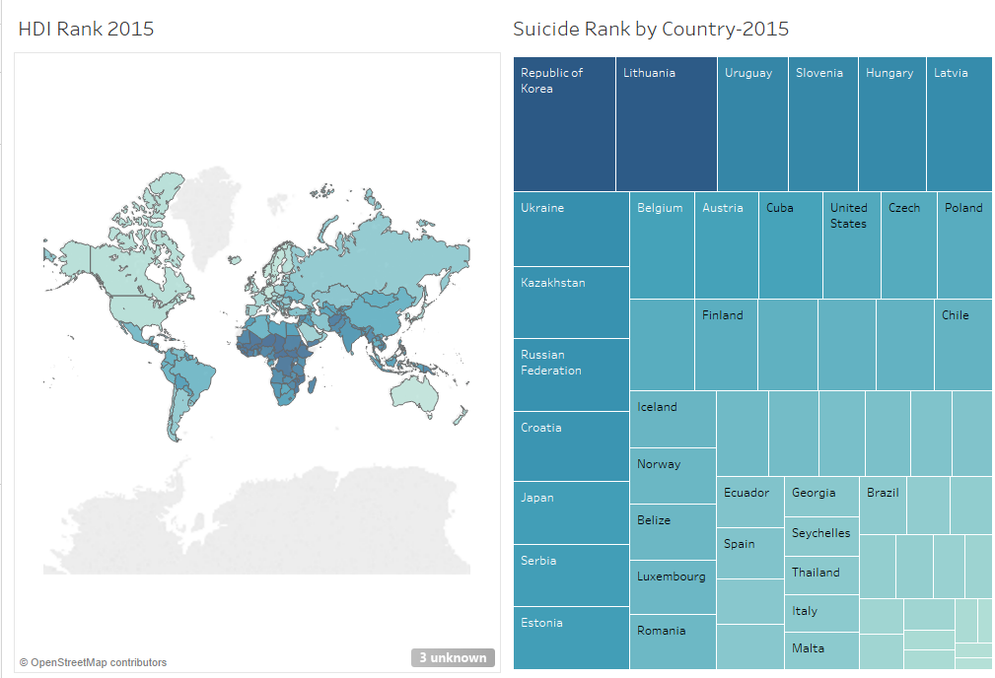
HDI VS SUICIDE

Slide 10
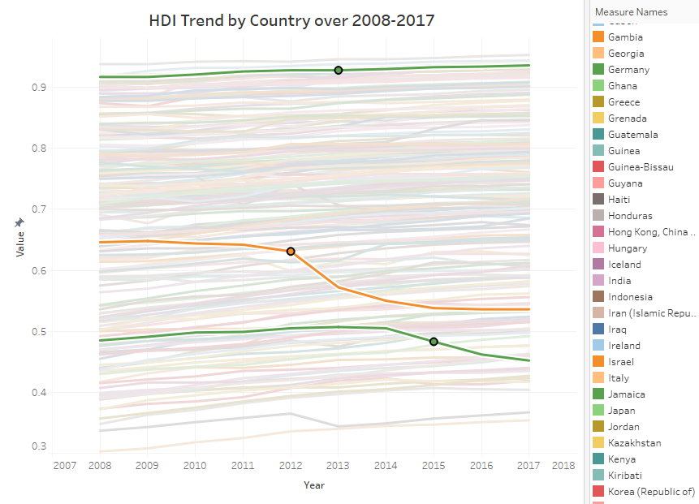

Slide 11
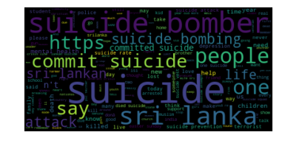
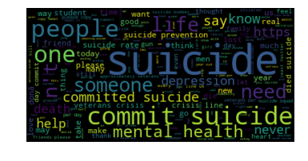
WORDS (67865 -> 9583 -> 5025)
BEFORE: {'COMPOUND': -1.0, 'NEG': 0.343, 'NEU': 0.531, 'POS': 0.127}
AFTER: {'COMPOUND': -1.0, 'NEG': 0.34, 'NEU': 0.502, 'POS': 0.158}

Slide 12

{'COMPOUND': -1.0, 'NEG': 0.348, 'NEU': 0.492, 'POS': 0.161}
73722 -> 6946

Slide 13

TRADUTTORE TRADITORE! QUESTIONS?

