Slide 1
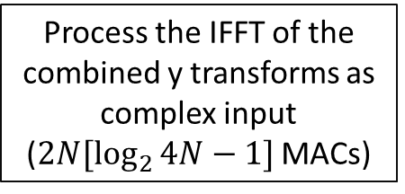
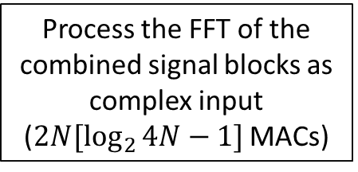
OVERLAP-SAVE
Get two signal blocks of length N from both signal streams (No MAC operations)
Process the IFFT of the combined y transforms as complex input
($2N[\log_{2}{4N}−1]$ MACs)
Process the FFT of the combined signal blocks as complex input ($2N[\log_{2}{4N}−1]$ MACs)
Take the real and imaginary parts as the output blocks, but discard the first M samples
(No MAC operations)
Multiply the UPR and signal transforms to get the transform of both outputs
(2N MACs)
N-M samples of output are generated per output stream, so 2(N-M) output samples are generated total

Slide 2
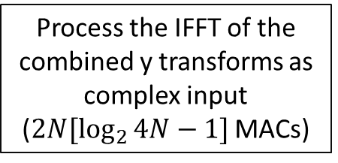

OVERLAP-ADD
Get two signal blocks of length (N-M) from both signal streams and zero-pad them to length N
(No MAC operations)
N-M samples of output are generated per output stream, so 2(N-M) output samples are generated total
Multiply the UPR and signal responses to get the transform of both outputs
(2N MACs)
Process the FFT of the combined signal blocks as complex input ($2N[\log_{2}{4N}−1]$ MACs)
Process the IFFT of the combined y transforms as complex input
($2N[\log_{2}{4N}−1]$ MACs)
Extract the FFT of the individual signals
(4N MACs)
Take the real and imaginary parts as the output blocks, add them to the output vector
(No MAC operations)

Slide 3


OVERLAP-ADD
Get two signal blocks of length (N-M) from both signal streams and zero-pad them to length N
(No MAC operations)
Process the IFFT of the combined y transforms as complex input
($2N[\log_{2}{4N}−1]$ MACs)
Process the FFT of the combined signal blocks as complex input ($2N[\log_{2}{4N}−1]$ MACs)
Take the real and imaginary parts as the output blocks, add them to the output vector
(No MAC operations)
Multiply the UPR and signal transforms to get the transform of both outputs
(2N MACs)
N-M samples of output are generated per output stream, so 2(N-M) output samples are generated total

