Slide 1

“Alexa, Stop Spying on Me!”: Speech Privacy Protection Against Voice Assistants
Ke Sun, Chen Chen, and Xinyu Zhang
University of California, San Diego
SenSys’20 Nov 16th, 2020

Slide 2
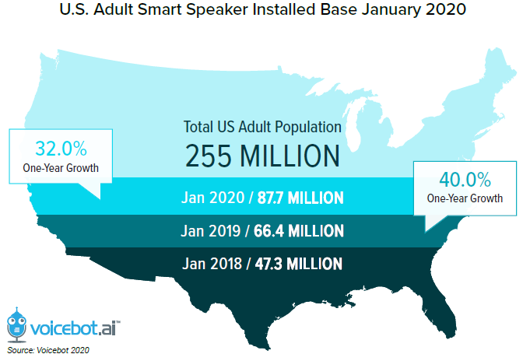
Motivation
Over 4.2 Billion Devices Provide Voice Assistant Access Today
Voice Assistant Usage Seen Growing To 8.4 Billion Devices in 2024

Slide 3
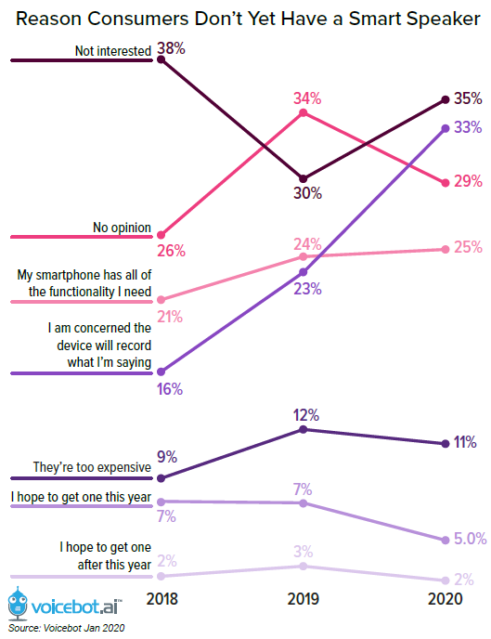
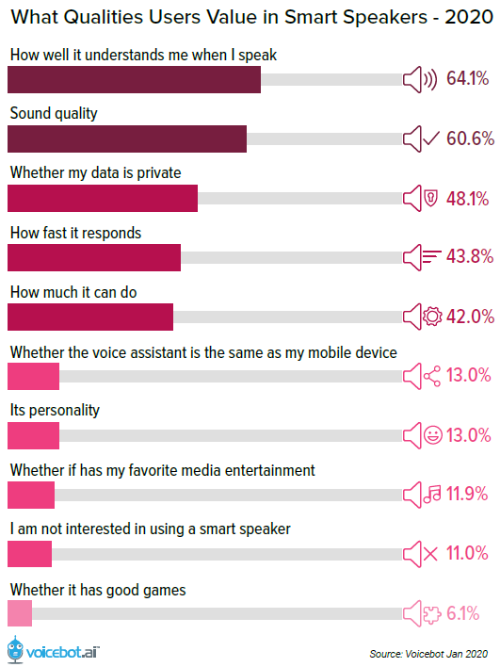
Privacy Issues has become a key concern for Voice Assistant consumer.

Slide 4
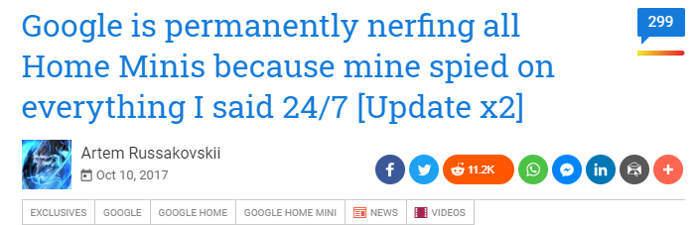
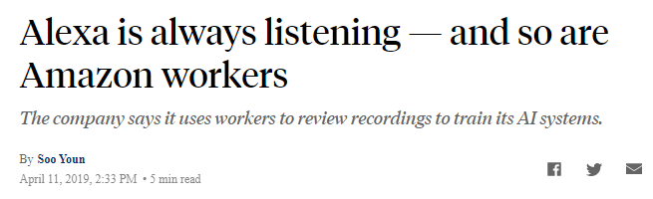
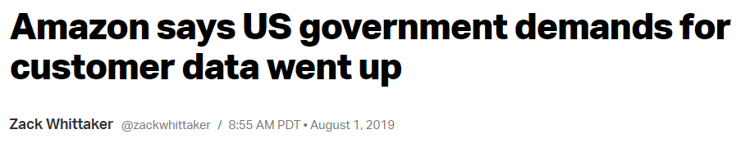
Motivation: Privacy Concern
Always-on Microphone can upload your private speech to a remote cloud!

Slide 5
Can we force the Voice Assistant to record the legitimate commands only, rather than private speech?
Selectively Jamming

Slide 6
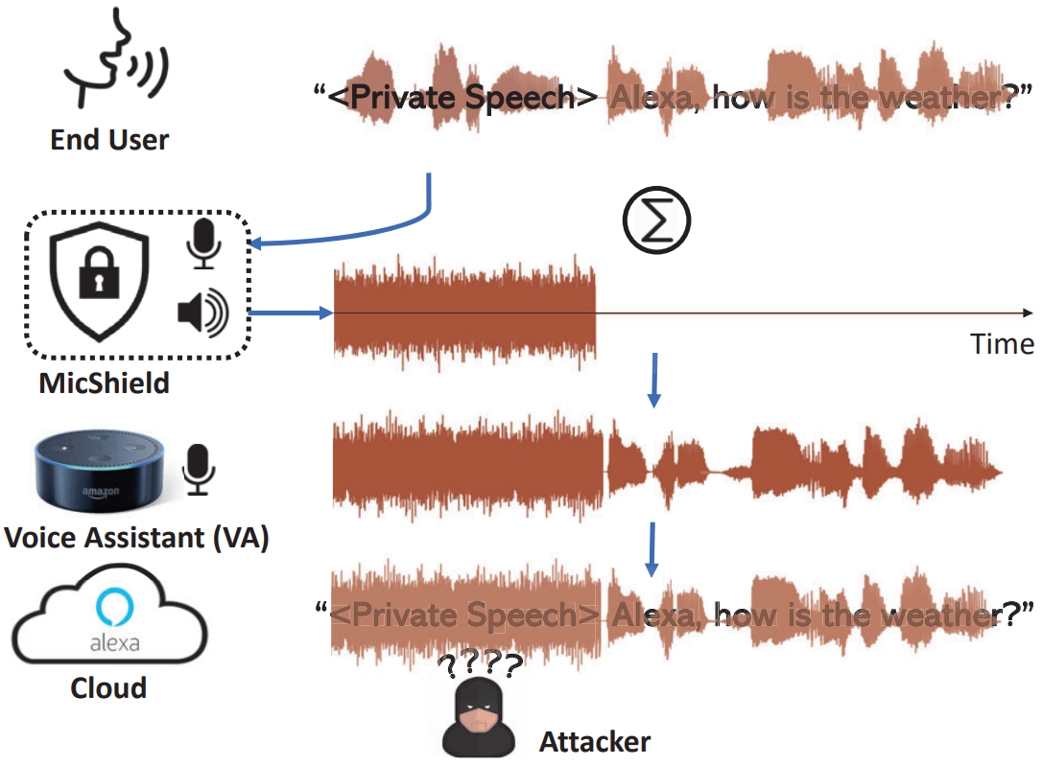
Our Vision
MicShield is a companion device which prevents VAs from recording private speech without affecting the VAs’ normal functionalities → Selectively Jamming

Slide 7
Threat Model
MicShield targets the scenario where adversaries use VA’s always-on microphones to eavesdrop on private speech.
Protection Goals: Under the premise of not breaking the VAs’ functionalities, MicShield aims to prevent the private speech from reaching the VAs.
Private Speech: voice signals that are not preceded by a wake word.

Slide 8
Challenge 1
How to enable the selective jamming automatically?
Jamming
Stop Jamming
Jamming

Slide 9
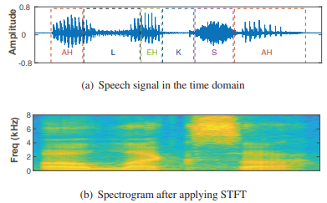
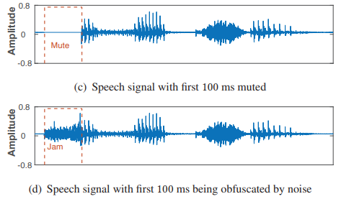

Selective Jamming: Phoneme-level
Basic idea: identify wake words from its early onset from phoneme-level
Observation: Even with the first 60 ms muted or jammed, the wake word can still activate the Echo Dot with 95% accuracy–the same as the case without mute/jamming.
120 ms
Alexa
Switch off jamming after identifying the first phoneme

Slide 10
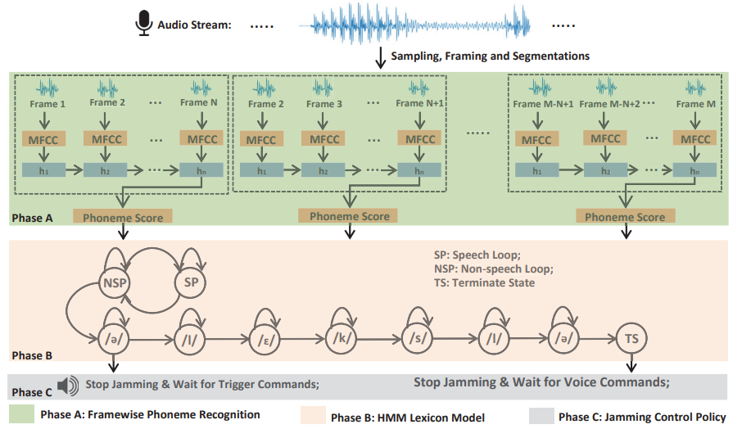
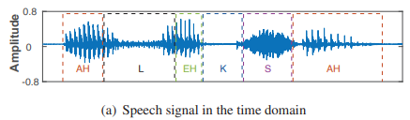
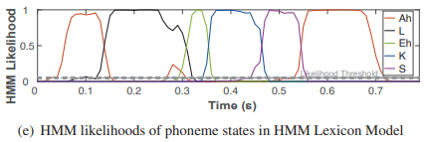
Jamming Control Pipeline

Slide 11
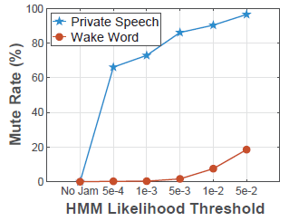
Selective Jamming
Minimizing Wake Word Mute Rate
Avoid disturbing the VAs’ basic functionalities
Maximizing Private Speech Mute Rate
Ensure the private speech is successfully obfuscated by the jamming signal
Whether 90% Private Speech Mute Rate and 1% Wake Word Mute Rate is enough for MicShield?

Slide 12
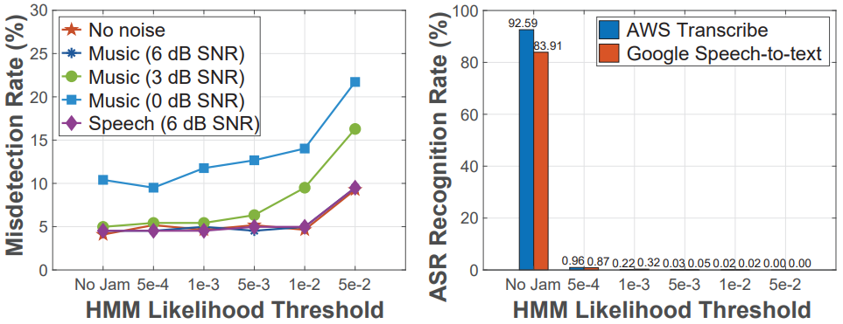
Selective Jamming
Use end-to-end evaluation metrics to balance the trade-off
Wake Word Misdetection → First priority
Private Speech Word Recognition Rate→ Phoneme-level leakage is negligible
Achieves 5% Wake word Misdetection Rate (the same as w/o MicShield),
while 0.03% Private Speech Word Recognition Rate (e.g, “I”, “a”, “am”, “as”).

Slide 13
Challenges
How to enable the effective & practical jamming?
Jamming a single microphone
Jamming a microphone array

Slide 14
Adversaries Attack Capabilities
Access the always-on microphones recordings;
Post processing algorithm to enhance the sound quality
Microphone-array based speech enhancement methods
Infer the semantic content
Use existing ASR algorithms
Use human perception
Worst case protection scenario:
High Sound Pressure Level (SPL) private speech
Advanced VAs with microphone arrays

Slide 15
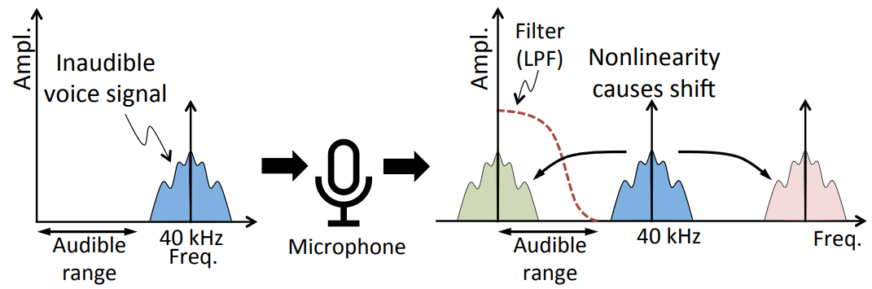
Inaudible Jamming
To prevent disturbing users, we reuse the inaudible jamming methods based on the literature.
[1] Inaudible voice commands: The long-range attack and defense. NSDI 2018

Slide 16
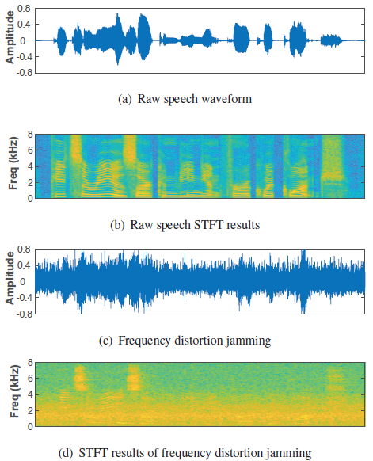
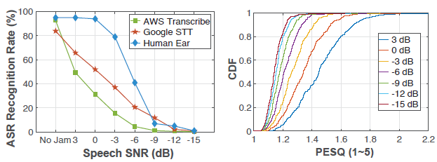
Jamming a single microphone
Inaudible Jamming Sound to avoid disturbing users
(Refer to inaudible voice attack by using ultrasound)
Frequency distortion jamming
Frequency distortion jamming can effectively protect the speech privacy for the single-microphone VA when the speech SNR is less than −15 dB.

Slide 17
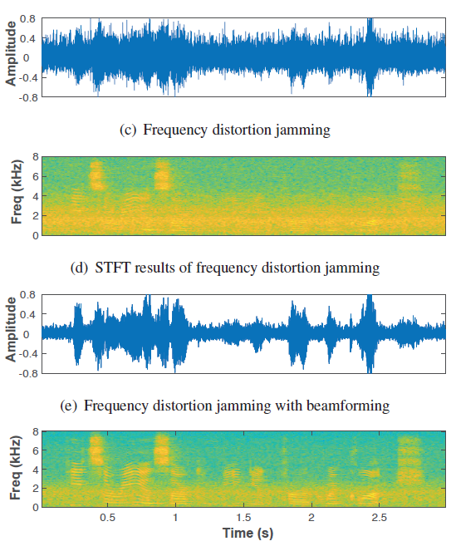
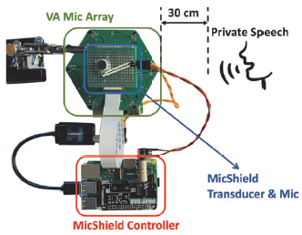
Jamming a microphone array
Challenge: How to jam these microphone arrays?
Beamforming based Attack：
The 6-microphone beamforming to circumvent MicShield protection can enhance the speech SNR by 12 dB.
Beamforming-based Attack
Beamforming based Attack

Slide 18
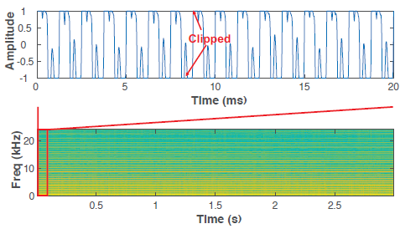
Jamming a microphone array
Gain Suppression Jamming
Transmit high-volume sound to saturate the microphone
Traditionally, the volume needs 110 dBA to enable gain suppression jamming
New Challenge: How to make all the microphones saturate?
Beamforming-based Attack
Gain suppression jamming: (a) zoomed-in saturated jammed signal in time domain; (b) spectrogram of jammed signal.

Slide 19
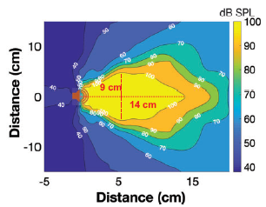
Jamming a microphone array
Jamming noise volume V.S. audibility and safety
High input power will trigger the speaker non-linearity and make the sound audible.
High volume ultrasound is not safe for users
Jamming noise volume V.S. coverage
The largest jamming coverage for a single ultrasonic transducer even with a class-D amplifier.
More powerful amplifier may make the jamming sound audible.

Slide 20
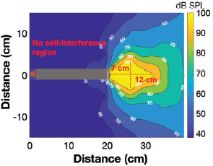
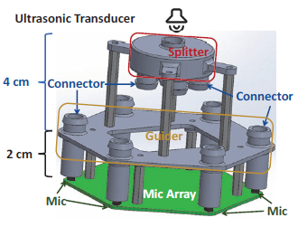
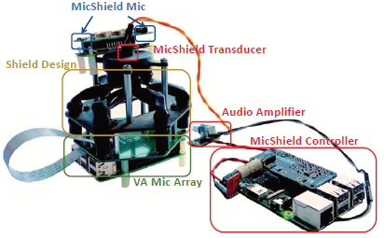
Jamming a microphone array
Proposed methods:
Design an Acoustic Waveguide Design to extend the coverage
“Acoustic multiplexer”
20 cm flexible silicone tube will also enable the gain suppression jamming.
3D model for MicShield
Jamming microphone array w/ shield

Slide 21
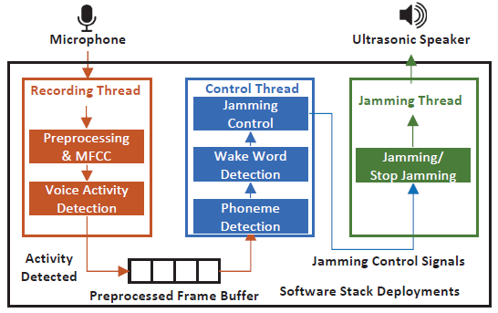
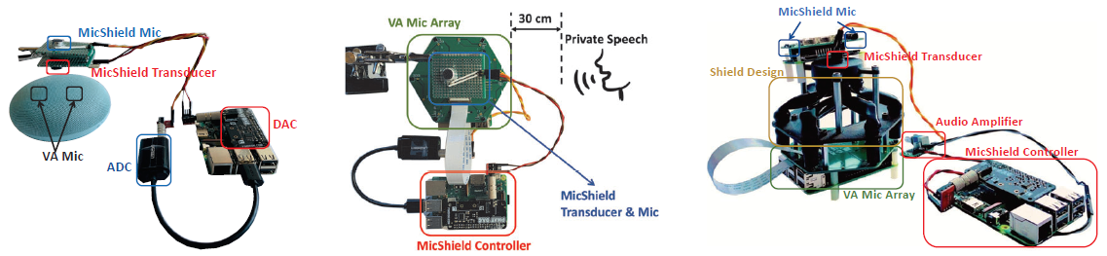
Implementation

Slide 22
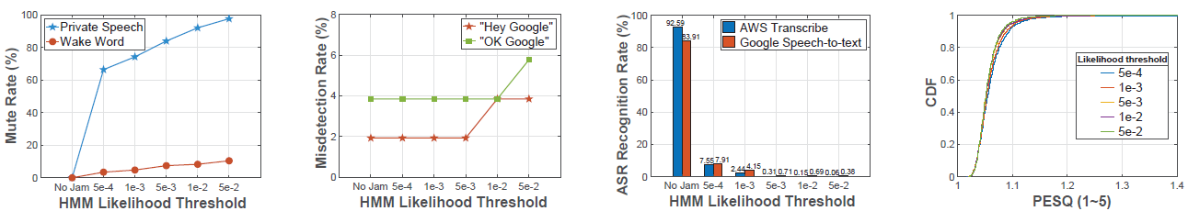
Generalization
Generalizations across Wake Words
“Alexa”, “Amazon”, “Computer”, “Echo”
Generalizations for multiple wake words at the same time.
“OK Google”, “Hey Google”
Fine-tune the phoneme recognition model for multiple wake words.
Generalizations across VA Devices
Amazon Echo Dot (4 microphones)
Google Home Mini (2 microphones)

Slide 23
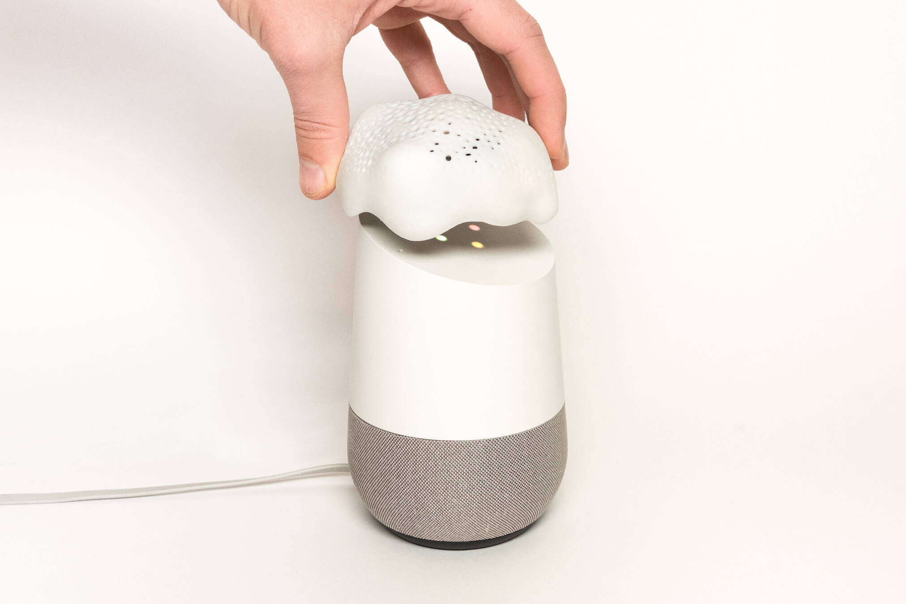
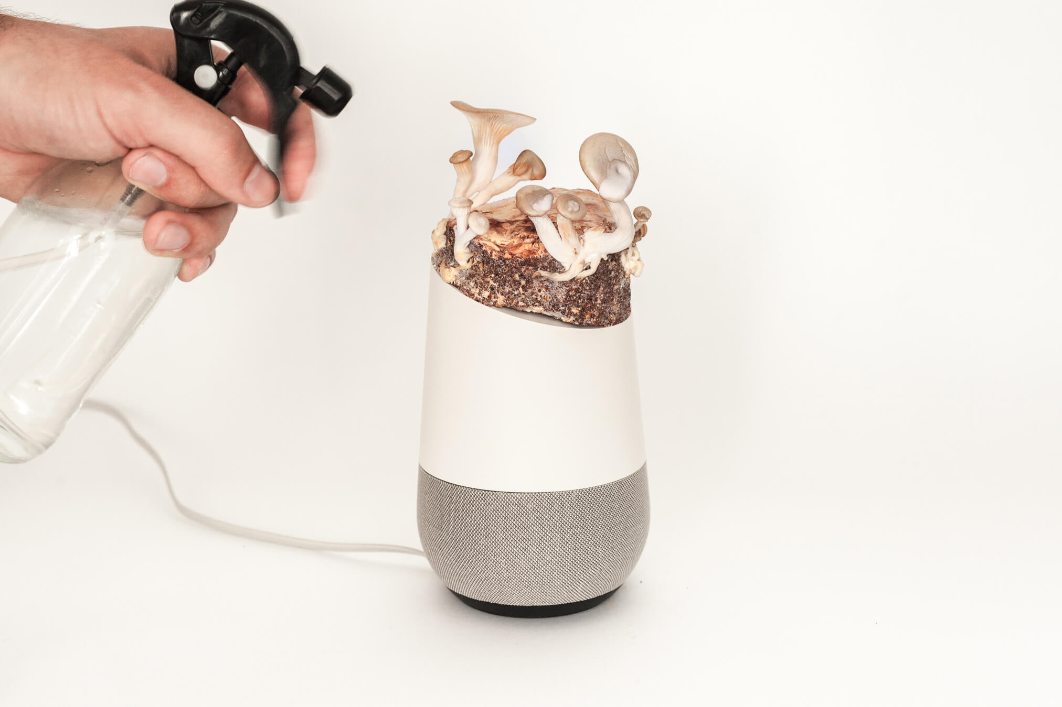
Conclusion
Automatically protect speech privacy against always-on microphones
Introduces a novel selectively jamming mechanism, which can obfuscate private speech while passing the voice command.
Prototype implementation and experiments verify the feasibility and effectiveness.
Project Alias, 2019

Slide 24
Thank you
Q&A

