Slide 1

VILLI’S CAFE
Project Demonstration
A local-first Android café ordering experience
15 MINUTES
10 min Project and system demo
5 min Individual contribution
Presenter: ____________________
Notes:
Time: 0:00–0:30
Good morning/afternoon. This presentation demonstrates Villi’s Cafe, an Android ordering application developed with Flutter. The first ten minutes explain the problem, objectives, architecture, object-oriented design, and the working system. The final five minutes cover the individual contribution, technology decisions, and risk management.
Do not spend time reading the title slide. Move directly to the problem.

Slide 2
PROBLEM
0:30–1:30
The ordering journey was fragmented
A small café needed the useful parts of a delivery app—without marketplace complexity.
Observed customer friction
Design question
● Menu discovery depended on being at the café
● Order totals were not visible before checkout
● Promotions, loyalty, and order status were disconnected
● Large delivery platforms added fees and unnecessary scope
How could one small Android app support discovery, ordering, and follow-up while keeping data local and the code understandable?
Constraint-led justification
No real payment gateway • No complex backend • Android coursework scope
PUSL2023 • VILLI’S CAFE • PROJECT DEMONSTRATION
02
Notes:
Time: 0:30–1:30
The identified problem was not simply “the café needs an app.” The real issue was a fragmented customer journey. Customers could not browse comfortably before arrival, understand a total, or keep promotions and order follow-up in one place. Commercial delivery platforms solve this at marketplace scale, but they introduce fees, remote infrastructure, and operational complexity that did not fit a small undergraduate project.
The solution therefore had to reproduce the valuable interaction pattern while remaining local, explainable, and safe to demonstrate.

Slide 3
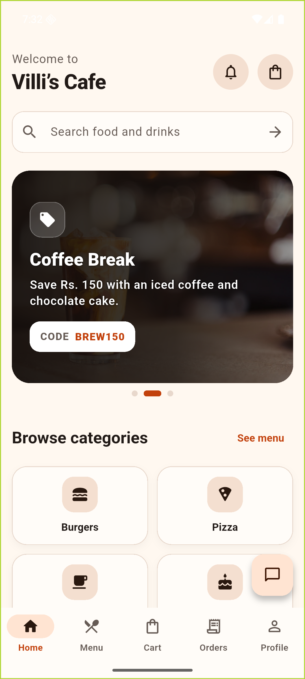
SOLUTION AND OBJECTIVES
1:30–2:45
One local-first flow from discovery to loyalty
The application joined the complete café journey without processing real money.
Villi’s Cafe combined
Clear
Reliable
1
2
A five-tab customer journey with explicit actions.
SQLite persistence, constraints, and atomic ordering.
● Local authentication and role-based entry
● Searchable products and categories
● Persistent cart and validated checkout
● Order confirmation, history, and loyalty
● Promotions, notifications, and café chat
● Administrator product/order/chat controls
3
Safe
4
Testable
Simulated payment; card values never persisted.
Layered code with provider and widget tests.
Outcome: a complete Android demo, not a production payment service.
PUSL2023 • VILLI’S CAFE • PROJECT DEMONSTRATION
03
Notes:
Time: 1:30–2:45
The solution was a local-first Flutter application that joined discovery, cart management, checkout, order history, loyalty, promotions, notifications, chat, and administration. The four objectives were clarity, reliability, safety, and testability.
Clarity came from a consistent five-tab customer shell. Reliability came from SQLite persistence and atomic order placement. Safety came from openly simulated payments and the decision not to save card fields. Testability came from separating UI, state, and persistence so each layer could be checked independently.

Slide 4
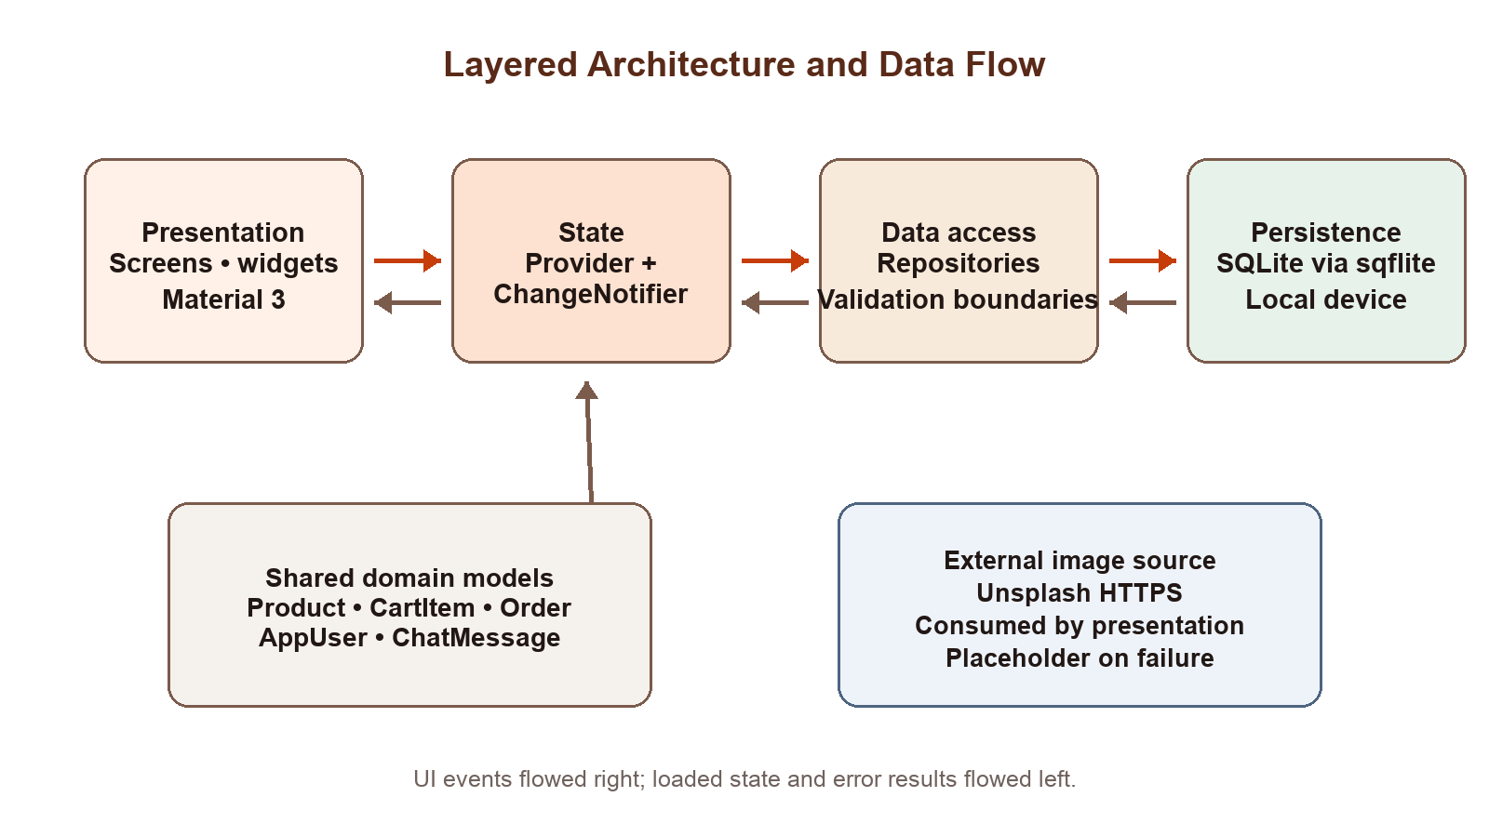
ARCHITECTURE
2:45–4:00
The architecture kept UI state separate from SQL
A layered design made every action traceable and easier to test.
Example data flow
1
Tap Add to Cart
2
CartProvider updates state
3
CartRepository executes SQL
4
SQLite persists quantity
5
Provider reloads the cart
PUSL2023 • VILLI’S CAFE • PROJECT DEMONSTRATION
04
Notes:
Time: 2:45–4:00
The architecture used four layers. Screens and widgets handled presentation. Provider and ChangeNotifier represented observable state, including loading and error states. Repositories owned database operations, while DatabaseService created and upgraded SQLite.
For example, an Add to Cart tap did not contain SQL. It called CartProvider, which called CartRepository. SQLite persisted the quantity, and the provider reloaded the cart so the interface updated. This separation reduced coupling and made provider behaviour testable with repository stubs.

Slide 5
OBJECT-ORIENTED DEVELOPMENT
4:00–5:15
OOP concepts appeared in working code—not only diagrams
Dart classes modelled the domain and isolated change.
Encapsulation
Abstraction
Inheritance
Private provider state such as _items and _isLoading was exposed through controlled getters and methods.
Repositories hid SQL details from widgets; screens worked with domain operations instead of database statements.
Widgets extended StatelessWidget or StatefulWidget; providers extended ChangeNotifier.
CartProvider • OrderProvider
CartRepository • OrderRepository
ProfileScreen • ProductCard
Polymorphism
Composition
Typed models
Test repositories overrode methods to simulate success and failure without changing production providers.
MultiProvider assembled services, while screens composed reusable cards, images, banners, and navigation.
Product, CartItem, OrderModel, AppUser, and ChatMessage protected data shape across layers.
Repository stubs in tests
QuickBiteApp • MainShell
fromMap • toMap • copyWith
PUSL2023 • VILLI’S CAFE • PROJECT DEMONSTRATION
05
Notes:
Time: 4:00–5:15
Object orientation was visible in the implemented system. Providers encapsulated private state. Repositories abstracted persistence. Flutter widgets and ChangeNotifier demonstrated inheritance. Test doubles demonstrated polymorphism by overriding repository operations. Composition appeared in MultiProvider and the reuse of smaller widgets. Finally, typed domain models carried consistent data across the architecture.
Point to one source example for each concept if asked. Avoid giving textbook definitions without connecting them to this project.

Slide 6
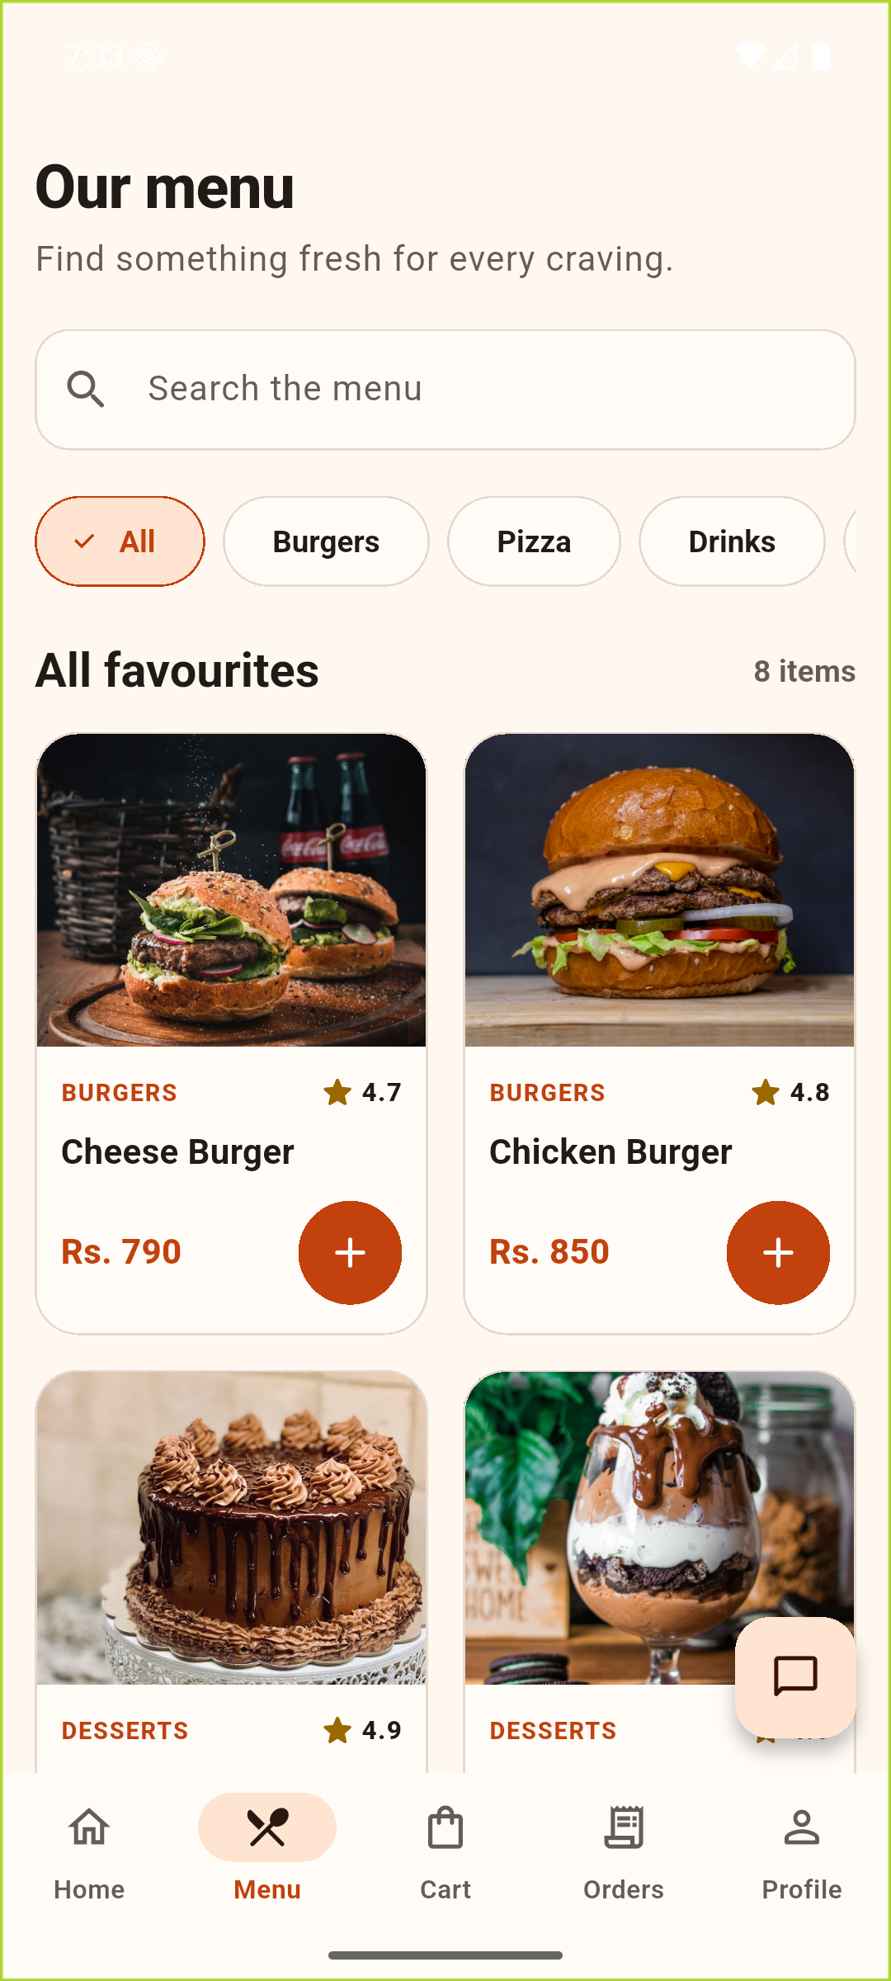
START THE SCREEN RECORDING
Live system demonstration
Follow one continuous story so every operation has a reason.
01
Sign in
Show local account entry
02
Discover
Search, category, details
03
Order
Cart, checkout, confirmation
04
Follow up
Orders, loyalty, chat
05
Admin
Products, status, replies
5-MINUTE LIVE WALKTHROUGH
Notes:
Time: 5:15–5:45
Start or confirm the video recording now. Switch from the slides to the Android emulator. Keep the narration continuous and explain the purpose of each action instead of silently tapping.
Demo order:
1. Sign in or use the prepared local customer account.
2. Home → promotion/search/categories.
3. Menu → filter → product details → quantity → Add to Cart.
4. Cart → checkout → complete safe demo details → Cash on Delivery → Place Order.
5. Confirmation → Orders → Profile loyalty → customer chat.
6. Log out and open the local administrator account → products → orders → chat.
If the live app fails, use the next three screenshot slides as a narrated recovery route.

Slide 7
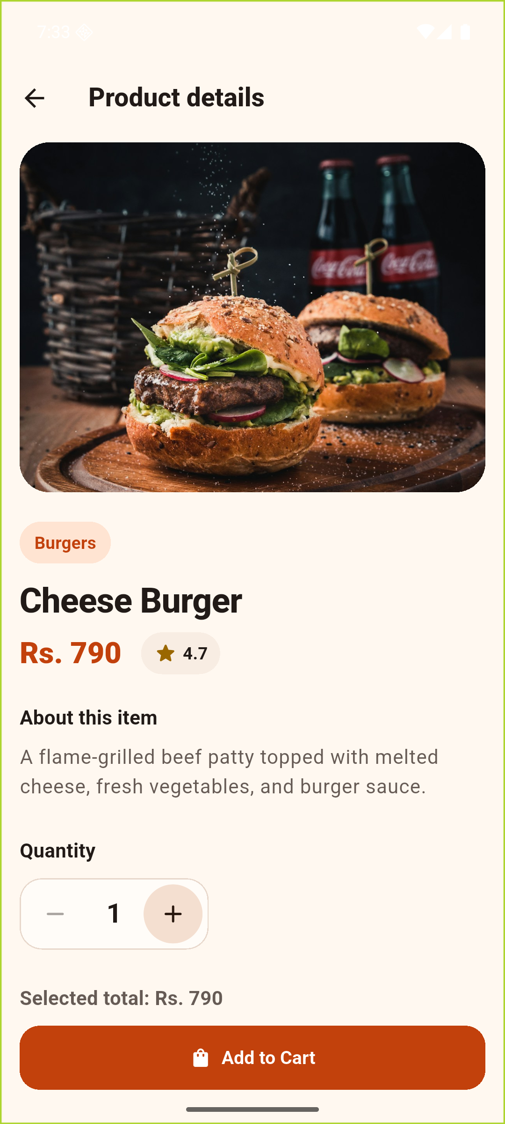
SYSTEM FUNCTIONALITY
LIVE DEMO
Demo 1 — discover the right item quickly
Home, search, category filters, product details, and quantity selection.
Narrate while tapping
✓
Promotion carousel communicates current offers
✓
Search and categories reuse ProductProvider state
✓
Product details show price, rating, and description
✓
Quantity updates the selected total before cart entry
HOME
MENU
DETAILS
PUSL2023 • VILLI’S CAFE • PROJECT DEMONSTRATION
07
Notes:
Time: 5:45–7:30 (mostly in the emulator)
On Home, identify the promotion carousel, search entry, and four categories. Open Menu and show that category selection and text search change the visible products. Open a product and explain that the typed Product model supplies the name, category, price, description, image URL, and rating. Increase the quantity once, show the selected total, then add the item to the cart.
Justification: this journey reduces discovery effort and provides price transparency before checkout.

Slide 8
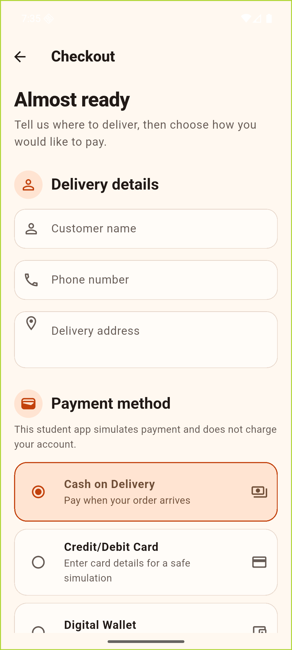
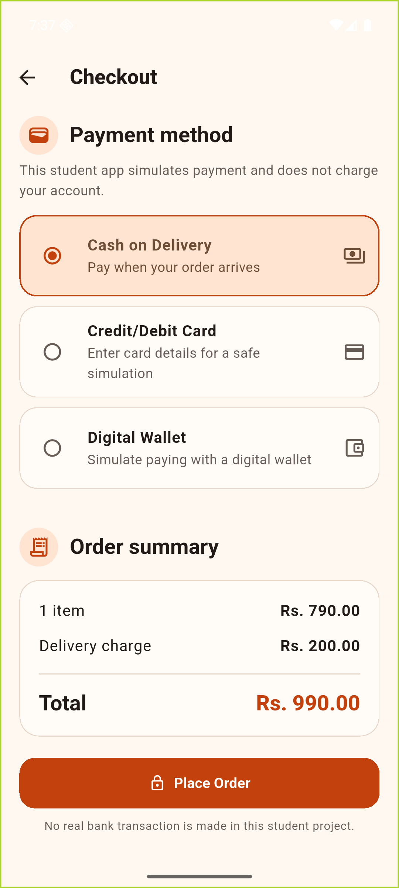
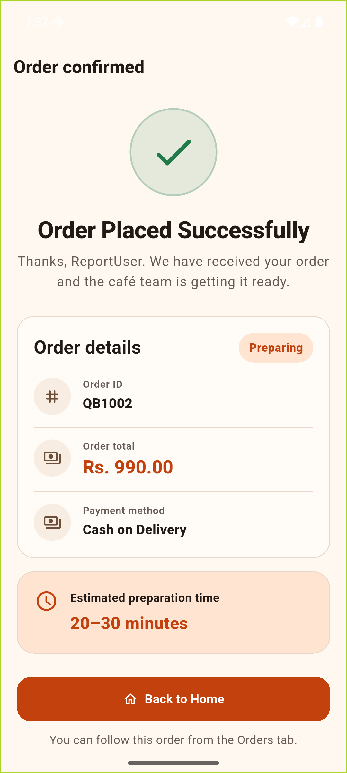
SYSTEM FUNCTIONALITY
LIVE DEMO
Demo 2 — convert the cart into a trusted order
Validation, simulated payment, atomic persistence, and confirmation.
Trust controls
● Required delivery fields
● Three clearly simulated payment choices
● Luhn, expiry, and CVV validation for card demo
● Card values never written to SQLite
● Order insert + cart clear in one transaction
DELIVERY + PAYMENT
ORDER SUMMARY
CONFIRMATION
PUSL2023 • VILLI’S CAFE • PROJECT DEMONSTRATION
08
Notes:
Time: 7:30–9:00 (mostly in the emulator)
Open Cart and explain the subtotal, fixed delivery charge, and total. Proceed to Checkout. First submit an empty required field if time allows to demonstrate validation. Select Cash on Delivery for the fastest recording route, but point out that card and wallet are simulations.
Place the order. Explain that OrderRepository recalculates the authoritative total from SQLite, inserts the order, and clears the cart inside one transaction. Show the friendly order number and preparing status on the confirmation screen.
Privacy justification: cardholder name, number, expiry, and CVV remain only in the form and are not saved in the orders table.

Slide 9
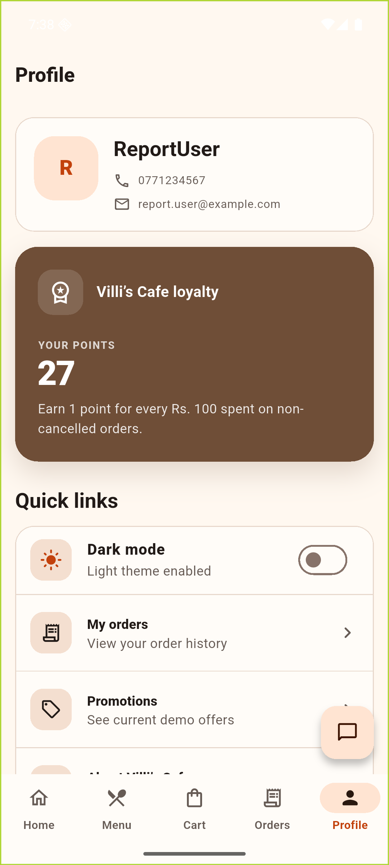
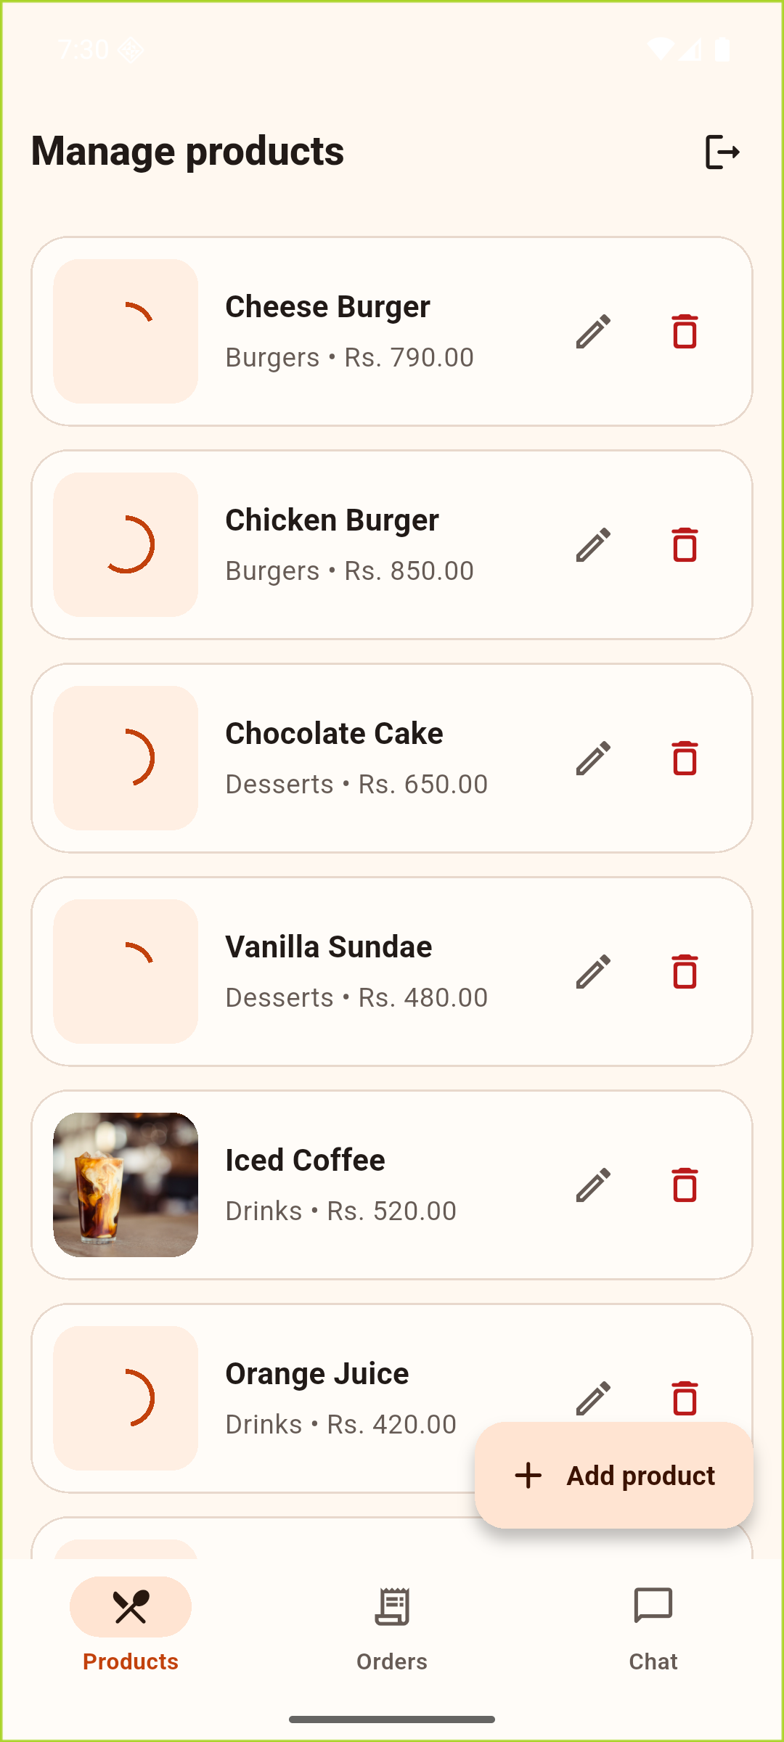
SYSTEM FUNCTIONALITY
LIVE DEMO
Demo 3 — close the loop for customers and staff
Order follow-up, loyalty, administrator maintenance, and communication.
Customer value
Saved order history • 1 point per Rs. 100 • promotions • notifications • café chat
Staff control
Add/edit/delete products • update order status • reply to customer conversations
Role boundary
AuthProvider restores one local session and routes customer or administrator UI
CUSTOMER PROFILE
ADMIN PRODUCTS
PUSL2023 • VILLI’S CAFE • PROJECT DEMONSTRATION
09
Notes:
Time: 9:00–10:30
From the confirmation, return to the main shell and show Orders or Profile. Explain that loyalty uses qualifying non-cancelled order totals and awards one point per Rs. 100. Open chat briefly to show the customer communication entry point.
Then log out and demonstrate the administrator role. Show product maintenance, order status controls, and the chat destination. Explain that the same local SQLite data is presented differently according to the restored role.
End the project demonstration here and return to the slides for the individual contribution section.

Slide 10
INDIVIDUAL CONTRIBUTION
INDIVIDUAL CONTRIBUTION • 5 MIN
10:30–12:00
My contribution covered the complete delivery path
Repository evidence showed an incremental implementation across the full system.
1
Foundation
Demonstrate contribution with evidence
23
Theme, models, database, repositories, providers
incremental commits
● Code: open one provider/repository pair
● Database: show the transaction and schema
● UI: connect a live screen to its state
● Tests: show the 42-test result
● Git: show ordered feature commits
2
Customer journey
Browse, details, cart, checkout, orders, profile
42
passing tests
3
Extended operations
Authentication, admin, chat, notifications, dark mode
4
Quality
Responsive states, accessibility, resilience tests, documentation
PUSL2023 • VILLI’S CAFE • INDIVIDUAL CONTRIBUTION
10
Notes:
Time: 10:30–12:00
This section explains the individual contribution using evidence rather than a feature list. The repository contains 23 incremental commits spanning the architecture, customer flow, administrator operations, resilience, tests, and documentation. The final suite contains 42 passing tests.
Demonstrate one traceable contribution: open CartProvider and CartRepository, then connect them to the cart operation already shown in the app. Alternatively, open OrderRepository.placeOrder and explain the transaction. Show the Git log briefly to establish the implementation sequence.
Keep the contributor name blank on the slide as requested; state it verbally only if required by the assessor.

Slide 11
TECHNOLOGY CHOICES
12:00–13:15
Each technology matched a specific project constraint
The stack stayed small enough to explain while supporting persistence and quality.
Flutter + Dart
Material 3
Provider
One Android UI codebase
Consistent and accessible interface
Simple observable state
Widget composition, typed models, hot reload
NavigationBar, forms, cards, colour schemes
ChangeNotifier matched the app’s undergraduate scale
SQLite + sqflite
crypto
Flutter test + Git
Reliable local persistence
Avoid plain-text demo passwords
Evidence and change control
Offline cart, orders, users, chat, transactions
SHA-256 hash stored locally; not claimed as production auth
42 tests, responsive cases, incremental commits
PUSL2023 • VILLI’S CAFE • INDIVIDUAL CONTRIBUTION
11
Notes:
Time: 12:00–13:15
Justify each technology through the running system. Flutter and Dart supported a single typed Android UI. Material 3 supplied familiar accessible components. Provider was sufficient for a small ChangeNotifier architecture without unnecessary complexity. SQLite matched the local-first requirement and provided transactions. The crypto package prevented plain-text demonstration passwords, although this was not presented as production authentication. Flutter tests and Git supplied repeatable quality and contribution evidence.
Avoid saying a technology was selected only because it is popular. Tie every choice to a requirement or constraint.

Slide 12
RISK MANAGEMENT
13:15–14:30
Risks were reduced through design decisions and tests
The main risks were scope, data consistency, privacy, connectivity, and device variation.
RISK
LEVEL
MANAGEMENT IN THE SYSTEM
Scope creep
HIGH
Feature phases; local data; simulated payment; explicit exclusions
Order/cart inconsistency
HIGH
SQLite transaction recalculated total, inserted order, and cleared cart atomically
Sensitive payment data
HIGH
No gateway; no card fields persisted; clear simulation messages
Duplicate committed actions
MEDIUM
Provider resilience prevented retry after a successful mutation and failed refresh
Network image failure
MEDIUM
ProductImage displayed a branded placeholder on error
Small/large screens
MEDIUM
LayoutBuilder, responsive grids, semantics, large-text and landscape tests
Risk treatment was visible in architecture, UI messages, database rules, and automated tests.
PUSL2023 • VILLI’S CAFE • INDIVIDUAL CONTRIBUTION
12
Notes:
Time: 13:15–14:30
The highest risks were scope, inconsistent order data, and payment privacy. Scope was controlled through staged delivery and explicit exclusions. The order transaction protected consistency. Payment was simulated and card values were excluded from persistence.
Two implementation-specific risks also mattered. A successful write followed by a failed refresh could tempt the UI to retry and duplicate an action; resilience tests confirmed that providers instead reported the refresh failure without retrying the committed mutation. Network image failures used placeholders, and responsive tests covered narrow, landscape, and large-text layouts.

Slide 13
VALIDATED OUTCOME
A complete, explainable Android ordering journey
The solution met its coursework objectives while clearly stating its production boundaries.
Thank you
42
0
1
Questions and demonstration follow-up
tests passed
analyzer issues
Android walkthrough
VILLI’S CAFE
Presenter: ____________________
Notes:
Time: 14:30–15:00
Conclude with evidence. The final build ran on Android, static analysis found no issues, and all 42 automated tests passed. The project achieved a complete local ordering journey and made its boundaries—especially simulated payments and local-only synchronisation—clear.
Thank the audience and invite questions. Keep the emulator available in case an assessor asks to revisit a feature or source file.

Slide 14
DO NOT PRESENT UNLESS NEEDED
BACKUP
Backup — demo recovery route
Use these prepared captures if the emulator or network image loading fails.
HOME
MENU
DETAILS
CHECKOUT
CONFIRM
ADMIN
Recovery narration: discovery → cart/checkout → confirmation → customer follow-up → administrator control
PUSL2023 • VILLI’S CAFE • BACKUP
14
Notes:
Backup only.
If the emulator fails, narrate the same end-to-end journey from left to right. State clearly that these are real screenshots captured from the Android emulator during report preparation, not mock-ups.

Slide 15
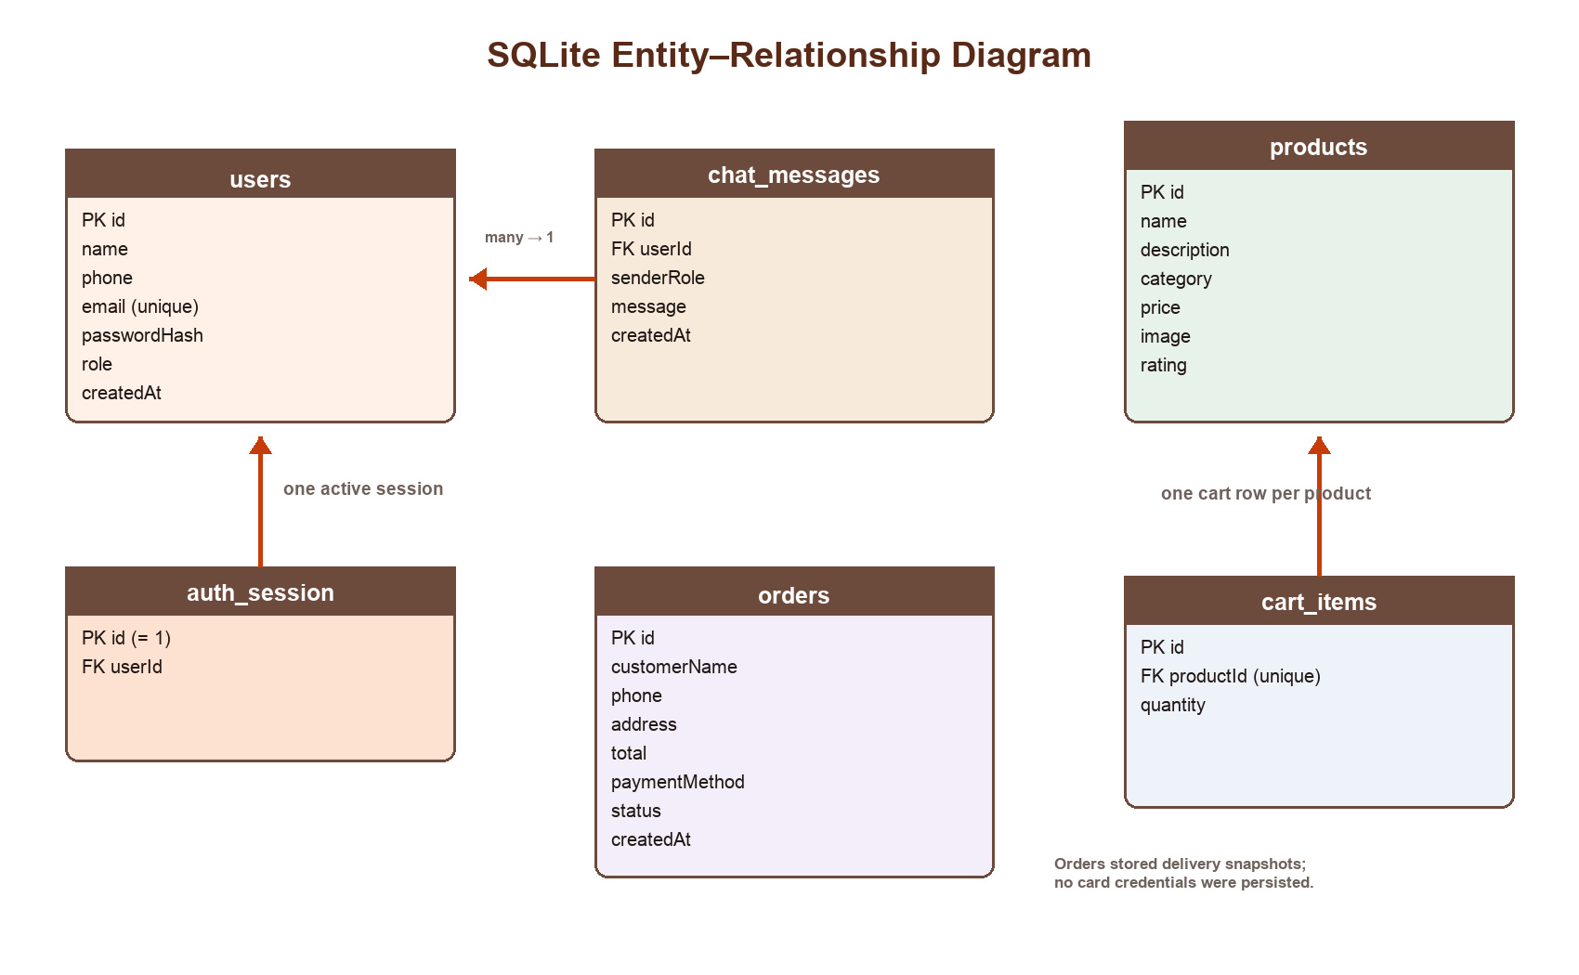
DO NOT PRESENT UNLESS ASKED
BACKUP
Backup — database and verification evidence
Use this slide for deeper architecture, privacy, or testing questions.
Evidence ready
✓
6 SQLite tables
✓
Foreign keys + constraints
✓
Versioned migrations
✓
Atomic place-order transaction
✓
No card credentials persisted
PUSL2023 • VILLI’S CAFE • BACKUP
15
Notes:
Backup only.
The schema contains users, auth_session, chat_messages, products, cart_items, and orders. Products and cart items are related; users own sessions and chat messages. Orders deliberately keep a delivery snapshot and contain no card-number, expiry, or CVV fields. Database version 4 introduced staged migrations. The place-order transaction is the key reliability control.

