Slide 1



A
backend for
Anton Obzhirov / Julien Isorce
Repository:
github.com/Samsung/ChromiumGStreamerBackend
GStreamer Conference – Dublin
8 October 2015

Slide 2
Authors
Samsung Research UK
Anton Obzhirov (a.obzhirov@samsung.com, irc: a.obzhirov)
  Senior Software Engineer, MS degree from FEFU, Russia
  WebKit committer. One of the TyGL authors.
Julien Isorce (j.isorce@samsung.com, irc: capOM)
  Senior Software Engineer, MS degree from ENSEEIHT, France
  Used to maintain GstGL-0.10. Browser media RPi
More: http://blogs.s-osg.org/announcing-a-new-gstreamer-backend-for-chromium

Slide 3
Objectives
  GStreamer - <video> tag
  Generic and efficient
  Opensource

Slide 4
Agenda
Introduction to GStreamer backend
  Chromium architecture
  Existing media backends
  GStreamer backend
DEMO 1
Advanced features
  Media Source Extension (MSE)
  Encrypted Media Extension (EME)
  Zero-copy integration
DEMO 2
Roadmap

Slide 5
Chromium architecture
“The credo”
“It's nearly impossible to build a browser that never crashes or hangs.” (chromium.org)
“For a codebase as large and diverse as Chromium, reasoning about the combined behavior of all its parts is nearly impossible. Cannot be perfectly secure” (chromium.org)
+189 external dependencies in chromium/src/third_party/
Solution: split the browser into multiple processes
  For security and stability

Slide 6
Chromium architecture
Many Processes
Browser Process (1)
Can access network and files.
No OpenGL
Render Process (N)
Blink / V8
No access to network or files
Block all system calls except local socket
GPU Process (1)
Can OpenGL
Can access graphic card only
Plugin Process (N)
Zygote Process
Broker Process
Linux kernel security feature:
  Seccomp (Secure Computing Mode) (can only call exit)
  BPF extension: allow / denied particular system calls (read, write, socket, unlink)
chroot Render Process to empty directory
New PID namespace for Render Process (kill)

Slide 7
Existing media backends
<video> tag
Existing
blink::WebMediaPlayer
New
WebMediaPlayerChro
Media::Pipeline framework
WebMediaPlayerAndroid
Android Media Framework
OpenMax
WebMediaPlayerGStreamer
Chromium Media::Pipeline API
GstPipeline
Media::VideoDecoder
Parser, Demuxer, Fake,
File, Capture, Converter
VpxDecoder
FFmpegDecoder
HWDecoder
VaapiDecoder
V4l2Decoder
DXDecoder (win)
VTDecoder (osx)
  2700 files / 170 000 lines of code
  Only FFmpegDecoder on Linux desktop. (ChromeOS for others)

Slide 8
GStreamer backend
Requirements
  Respect sandbox rules
  No video hole
  Not Platform specific (#if defined(ANDROID))
  Handle protected content
  Zero-copy

Slide 9
GStreamer backend
Problems
Render Process: no.
  Problem: cannot load gst plugins. Cannot access HW decoders.
  Static ? → break rules, duplicate, space, maintenance
Browser Process: no.
  Problem: no process isolation to handle stability and sandbox.
  Like Android ? not a long term solution
GPU Process: no
  Problem: only have access to graphic resources.
  GStreamer crash would break the whole browser rendering.

Slide 10
GStreamer backend
A new Process
  Sandbox to filter system calls
  No direct access to network and GL
  Policy to load gst plugins
  Zero-copy

Slide 11
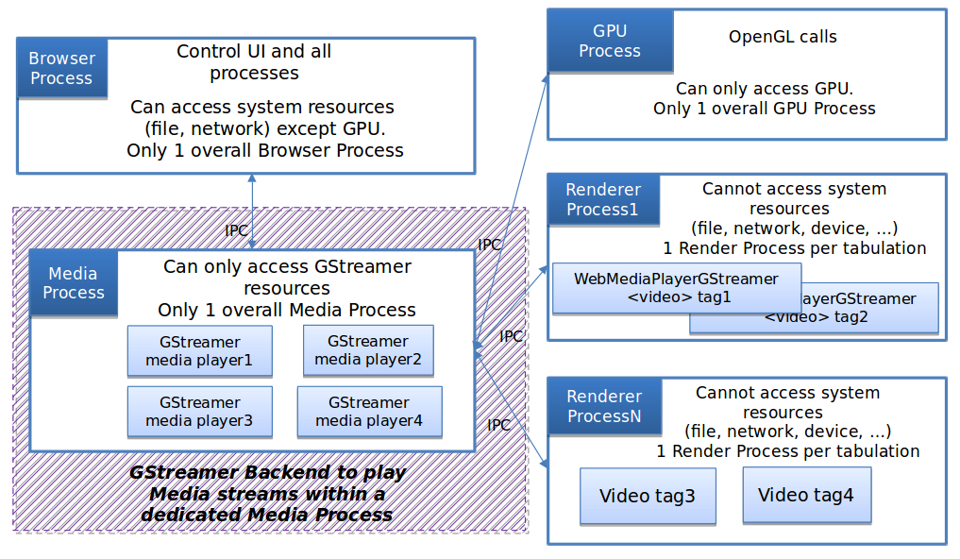
GStreamer backend
Media Process
GStreamer pipeline ↔ <video> tag

Slide 12
GStreamer backend
Built-in source and sink
Media Process
Browser Process
Url request
GstChromiumHttpSrc
TODO: GstBaseHttpSrc
content::ResourceDispatcherHost
Data shm
GPU Process
glGenTexture
GstGLContextGPUProcess
eglContext
glTexImage2D
eglContext
Shared Resources
gl textures ...
eglContext
    CommandBuffer / IPC / shm
Client: egl/gles2
Load libGLESv2.so, load libEGL.so
chromium::gles2::GetGLFunctionPointer → GstGLVtable
Server: egl/gles2, glx/gl, wgl,gl

Slide 13
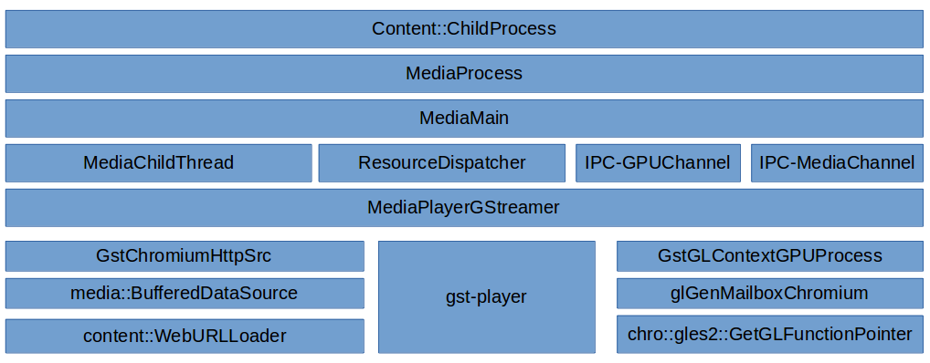
GStreamer backend
Stack
Render Process
<video> tag
blink::WebMediaPlayer
WebMediaPlayerGStreamer
  play, pause, seek
Ack
Browser Process
GPU Process

Slide 14
DEMO 1
Progressive/adaptive streaming
and sandbox

Slide 15
Media Source Extension
W3C HTML5 extension for <video> tag
YouTube / Netflix
Media Process
Render Process
MSE JavaScript
mediaSource.sourceBuffers[0].appendBuffer(mediaSegment);
GstMediaSrc
appsrc1 – appsrcN
uri=mediasourceblob://
AddSourceBuffer
blink::WebMediaSource (1)
WebMediaSourceGStreamer
AppendData
blink::WebSourceBuffer (N)
WebSourceBufferGStreamer

Slide 16
Encrypted Media Extension
W3C HTML5 extension for <video> tag (flash <object>)
Protected content - DRM (Digital Rights Management)
Media Process
Render Process
qtdemux
EME JavaScript
video.setMediaKeys(keys);
GstProtectionEvent / GstProtectionMeta
NeedKey
GstCommonEncryptionDecrypt
blink::WebMediaPlayer
WebMediaPlayerGStreamer
AddKey

Slide 17
Zero copy
What is it ?
copy
CPU memory
copy
copy
GPU memory
HW decoder
GL texture
0
Need interoperability [VA API / VDPAU / v4l2 / OpenMAX] ↔ GL
Need cross processes
Need secure

Slide 18
Zero copy
Dma-buf
Media Process
GPU Process
Cross process
FD
FD
Export:
VaAcquireBufferHandle
Import:
EGLImage_dmabuf
CPU Mem
GPU Mem
Vaapi surface
GL texture

Slide 19
Zero copy
Opensource driver
libdrm
Direct Rendering Manager
Mesa / Gallium
GStreamer
GL
glimagesink
libdrm_nouveau
struct nouveau_bo
PIPE_VIDEO
struct pipe_surface
struct pipe_resource
VA API
gstvaapidecode
VDPAU
OpenMAX
OpenCL

Slide 20
Zero copy
Chromium
Media Process
GPU Process
IPC 1
GstPlayer 4 patches
content::GpuChannel
gstreamer-vaapi / GstGL 10 / 22
gfx::GLImageEGL
Mesa VA API 8 (VPP / handle)
eglCreateImage(dmabuf-fd)
Mesa Nouveau: 4 (chunk decoding)
Mesa / EGL / GL
Libdrm / libdrm_nouveau
Libdrm / libdrm_nouveau
ioctl / export dmabuf
ioctl / import dmabuf
User
Kernel
drm.ko / drm_nouveau.ko

Slide 21
DEMO 2
MSE / EME / Zero copy

Slide 22
Summary
Current supported features
Progressive streaming (http)
Adaptive streaming (hls, dash)
Media Source Extension (YouTube)
Encrypted Media Extension (Protected content)
Zero copy (dmabuf / EGLImage / cross process)

Slide 23
Roadmap
We need your contribution
Player interface in Media Process
GstMultiAppSrc + seeking
GstBaseHttpSrc
gst-omx on desktop
WebRTC
WebM encryption
OP-TEE – secure dmabuf
Pulseaudio crash with sandbox
YouTube conformance tests

Slide 24
Thank you. Question ?
Repository:
github.com/Samsung/ChromiumGStreamerBackend

