Slide 1
Privacy Adoption: The Collision of Theory and Practice
Justin Ehrenhofer
Organizer, Monero Space

Slide 2
This isn’t another talk in support of privacy. It’s about why projects need to take responsibility for privacy tech being adopted.

Slide 3
Agenda
Privacy theory vs practice
Privacy vs coin equality (fungibility)
Defense in numbers
Results speak for themselves
Hard truths
Conclusion

Slide 4


Cool
Not Cool
Buy the blue sticker at Cypher Market
$0.50 from each purchase to MRL

Slide 5
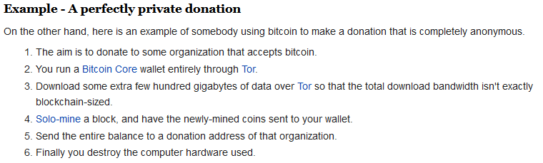
Theory or Practice?

Slide 6
Theory or Practice?
Any user who cares about privacy can:
Send a special private transaction
Download a special wallet
Spend more in fees
Wait longer
Remember to mix their change outputs
Build from source
Handle their own timing and denominations
Watch 100 hours of privacy videos

Slide 7
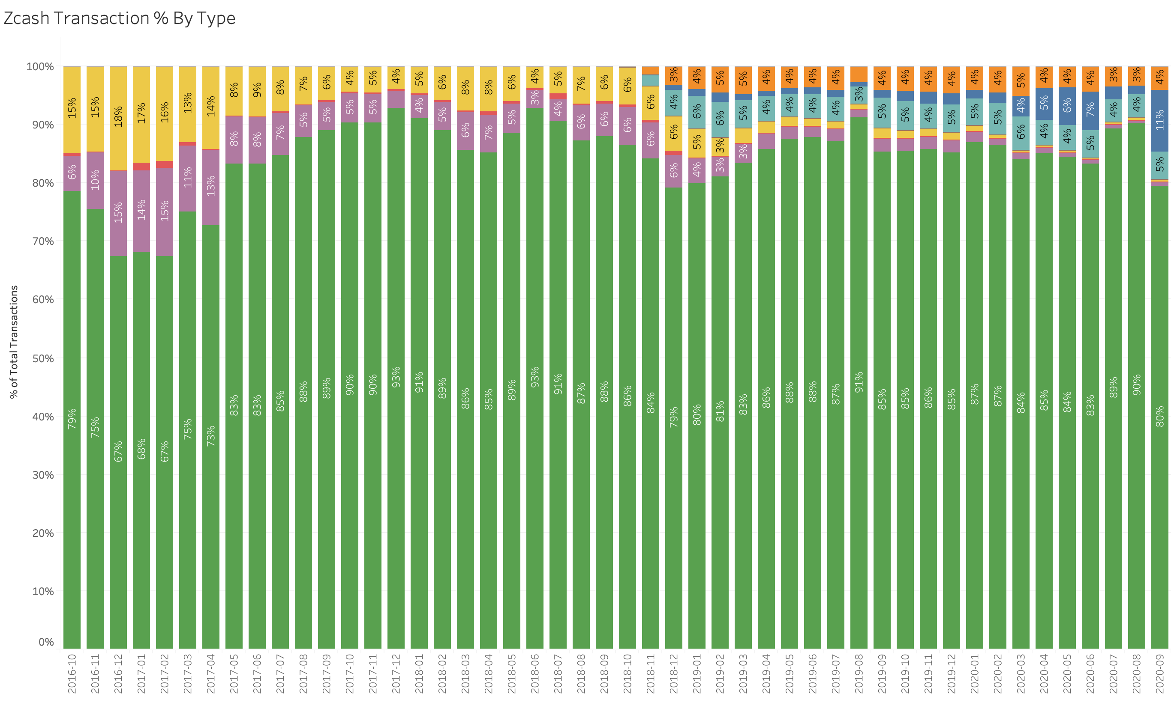
Theory or Practice?
Private
Probably not? idk
it’s complicated
Totally not private
Source: Gareth Davies
Notes:
Users care more about their transactions having basic privacy than theoretical “number go up” in a lab

Slide 8

Privacy
Coin Equality
(Fungibility)
Something that allows users to hide
Effectiveness and implementation of privacy matters
Transaction and output indistinguishability
Implementation of privacy matters more

Slide 9
Privacy Requirements
Coin Equality
(Fungibility) Requirements
Tx graph
Timing
Networking
Metadata
Amount
Other user behavior
(etc)
Good enough privacy
Implemented everywhere

Slide 10
Results of a Coin Equality Exercise
Name to Alice
Alice to Bob
Bob to Charlie

Slide 11
Results of a Coin Equality Exercise
People avoided the tainted cards
Some would only accept tainted for “something extra”
Most people would pay more for “fresh cards”
In reality, who among the attendees pays for analysis software?
Name to Alice
Alice to Bob
Bob to Charlie

Slide 12
Reality
Chain analysis companies will most likely mark the use of any optional privacy as higher risk (this is enforced by several tools)
Mandatory mining to shielded doesn’t fix
Optional privacy often harms fungibility, not helps
Name to Alice
Alice to Bob
Bob to Charlie
Mixers
Z-addresses
PrivateSend
Wasabi
Samourai

Slide 13
Defense in Numbers
Option 1
Thousands of people who have basic privacy protections without caring too much
Option 2
A handful of experts who meticulously seek ideal privacy

Slide 14
Defense in Numbers
Monero Way
Everyone has basic protections; exact protections are good not perfect
Opt-In Way
Only 1% of people have any privacy protections at all

Slide 15
Defense in Numbers
Monero Users
Privacy Fanatics
Researchers
Crypto nerds
Speculators
Miners
Everyday users
Opt-In Users
Privacy Fanatics
Researchers

Slide 16
Results of Defense in Numbers: Monero provides more privacy to more users than any other cryptocurrency project.
This benefits everyone, especially those who need privacy the most since they need a crowd to hide in

Slide 17
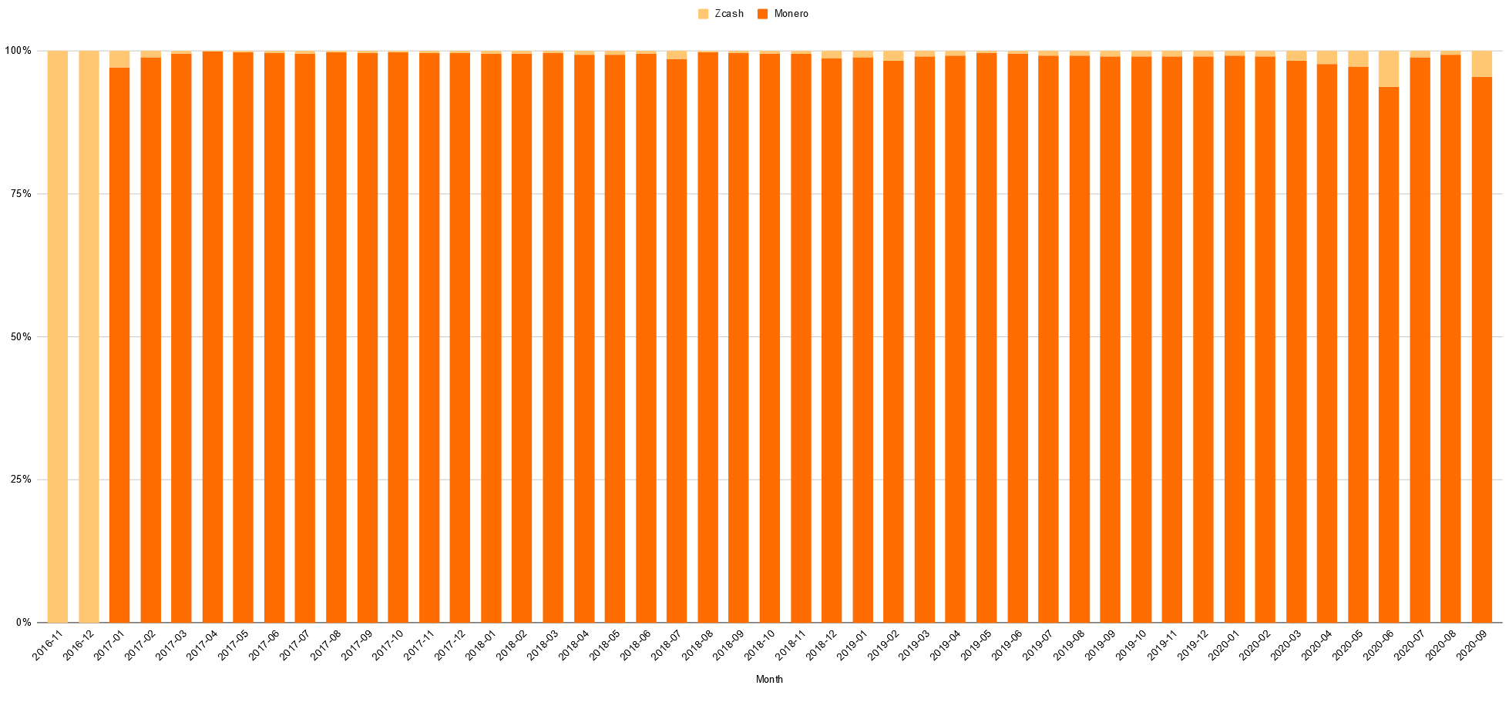
Comparative # of Transactions Hiding Sender, Receiver, Amount (XMR, ZEC)
Sources: Sarang Noether, Ph.D.; CoinMetrics; Gareth Davies
Monero has 20x the number of tx that hide basic info

Slide 18
Reader beware: No direct comparison between the # of Samourai mixing rounds and the # of Monero transactions

Slide 19
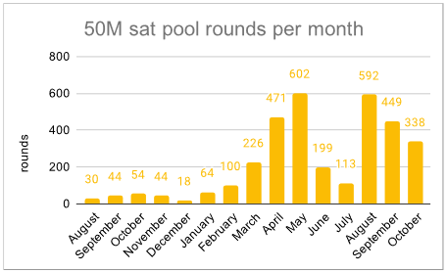
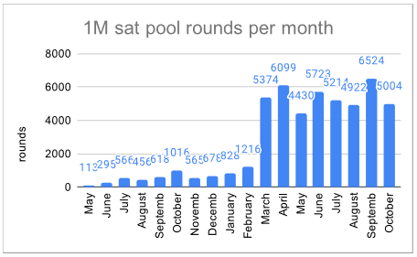
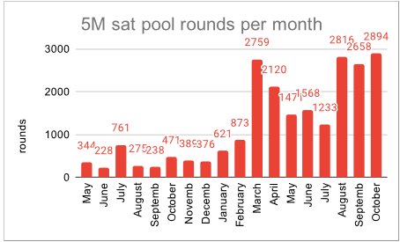
Maximum: 9,631 rounds per month
Monero had 450,000 transactions protected with ring signatures in October, or >45x Samourai’s best
Again, these #s are not directly comparable (rings vs. outputs?)
Source: https://mattodell.keybase.pub/whirlpoolstats.pdf
Notes:
Caveats:
Can’t stack rounds for total set
Samourai doesn’t hide the amount
Samourai is interactive; Monero is non-interactive
This magnitude goes beyond any nuance of the numbers; far more evidence that more users are taking advantage of privacy using Monero than with the leading Bitcoin mixing tool
How has the disparity grown so vast? (Segway)

Slide 20
Changing of Priorities
Focus on improving the base-level privacy achieved; focus less on the maximum potential privacy someone can have
Think: “how can someone fuck this up?” Start with the obvious.
Privacy will come to those who need it from the larger pool of users engaging with privacy functionality
Power users gain more flexibility and volume to play with for greater privacy results
Far more users get the basic privacy protections they need
This gives us the “easy” win of coin equality (fungibility) first

Slide 21
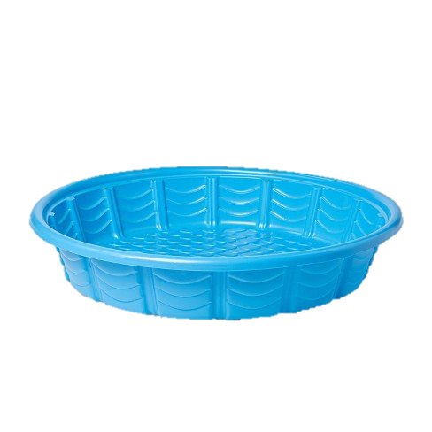
Hard Truths: Transparent Amounts = Bad
It’s effectively impossible to build a fungible and private asset where the base asset has transparent amounts.
Amount transacted is a critical piece of metadata that’s effectively impossible to work around
Example for Zcash: “Just the Tip” Pool Use Actually: Quesnelle Analysis
1.2345 ZEC
1.2345 ZEC
T-address 1
T-address 2

Slide 22
Hard Truths: Users Are Humans
Your implementation needs to honor that users are not experts
Don’t blame users for not getting it
Basic privacy protections should be achievable by newcomers, not only reserved for enthusiasts
We can’t dismiss education entirely (since advanced users will always need it for the bleeding edge of attacks), but it’s not the solution for >99% of people
Theory and implementation are identical… in theory

Slide 23
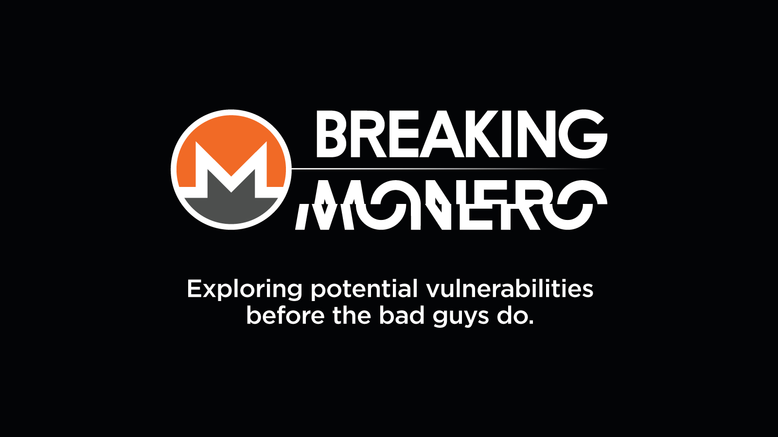
Hard Truths: Can’t Protect Against It All
Not every threat model is solvable
There will always be limitations as attackers get stronger over time
Don’t ignore the broader threats in pursuit of the niche ones
Design and build against risks that are most likely to affect the most people (build protections up from the bottom)
Clearly communicate this strategy and the known limitations

Slide 24
Conclusion
Monero offers far more privacy than any other cryptocurrency project by focusing on implementation
Monero focuses on the goals of coin equality (fungibility) and privacy for the masses
Privacy is a never-ending battle; those who take responsibility for delivering privacy will be best-prepared to win this battle
Privacy is all about accommodating for user behavior, not making an isolated experiment in a lab

Slide 25



Questions?
justin@monero.space
@JEhrenhofer
Get educated
masteringmonero.com
moneromeans.money
Get started
cakewallet.com
getmonero.org
Join the community
monero.space communityworkgroup.org

Slide 26
Acknowledgements
Sarang Noether, Ph.D. for their similar MCCVR 2020 talk
CypherMarket (MRL sticker design)
The Monero Project getmonero.org
MrMon0cle (CLSAG logo)
CoinMetrics
Gareth Davies

