Slide 1
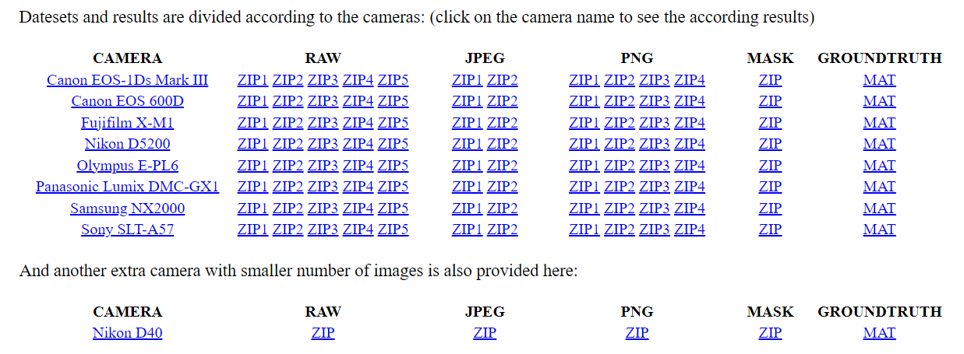
Step 1
Download and extract RAW files from the NUS dataset
Also download the Ground truth mat files to a single directory
https://cvil.eecs.yorku.ca/projects/public_html/illuminant/illuminant.html

Slide 2
Step 2
Convert RAW files to DNG using Adobe DNG converter
Save DNG files per camera in the same location as the RAW files

Slide 3
Step 3
Process DNGs to demosaiced linear-RGB images
https://github.com/karaimer/camera-pipeline-nonUI
For each camera C in the dataset
Remove all DNG files from camera-pipeline-nonUI-master\test
Copy DNGs created in Step 2 (previous slide) for camera C to camera-pipeline-nonUI-master\test folder
Run main.m
Results will be saved to camera-pipeline-nonUI-master\test\stage4 and stage11 as .tif files
Move camera-pipeline-nonUI-master\test\stage4 and stage11 folders to the camera C’s DNG folder from Step 2
Remember to repeat Steps 1 to 5 for all cameras in the dataset

Slide 4
Step 4
Run mask_color_chart_resize_save.m to mask out the color chart, resize and save as PNG files
Set paths on lines 31 and 32 to run this code. See the code for instructions.

