Slide 1
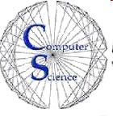

CS 154 Formal Languages and Computability April 12 Class Meeting
Department of Computer Science San Jose State University Spring 2016 Instructor: Ron Mak
www.cs.sjsu.edu/~mak

Slide 2
Turing Machines as Language Acceptors
A string w is accepted by a TM if
w is written on the tape with blanks before and after
The TM reads w, enters a final state, and halts.
The string w is rejected by the TM if
The TM halts in a nonfinal state.
The TM fails to halt.
Let be a TM.
Then the language L(M) consists of all strings over Σ that are accepted by M.

Slide 3
Turing Machines as Transducers
Because TMs are models for all computers, we must also consider TMs that produce output.
i.e., transducers
Input for a TM’s computation are the nonblank symbols on the tape at the initial time.
Output is whatever is on the tape at the conclusion of the computation.

Slide 4
Turing-Computable Functions
Suppose M is a transducer TM that is given input w and produces output f(w).
f is a function such that for some final state q_{final} of M.
For input string w, TM M produces output string f(w) and halts in a final state.
A function f over domain D is Turing-computable if there is a TM such that for all strings .
q₀w *
q₀w *

Slide 5
Is Addition Turing-Computable?
Given two positive integers x and y, design a TM that computes x + y.
Represent the quantities x and y by strings of x 1’s and y 1’s, respectively, (unary notation) and separate the two strings with a 0.
Example: Represent 3 + 2 as 111011
Program the TM to move the 0 to the right end of the string.
Example: 3 + 2 = 5, or 111110

Slide 6
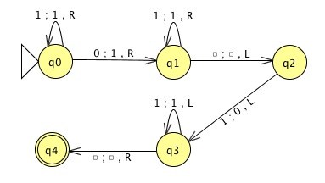
Is Addition Turing-Computable? cont’d
Demo: Jexample9.9.jff

Slide 7
A Turing Machine that Copies a String
A TM that performs the computation for any .
Pseudocode:
Replace every 1 by an x.
Find the rightmost x and replace it with a 1.
Repeatedly move the head right to the first blank and write a 1 in place of the blank.
Repeat steps 2 and 3 until there are no more x’s.
q₀w * q_{final}ww

Slide 8
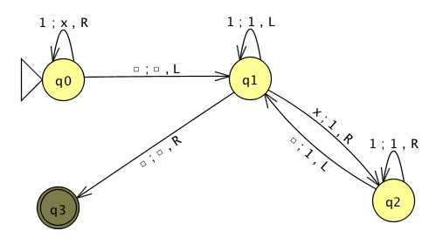
A Turing Machine that Copies a String, cont’d
Demo Jexample9.10.jff

Slide 9
A Turing Machine that Compares Values
Represent two positive integers x and y in unary notation on the input tape, separated by a 0 .
Design a TM that:
Halts in final state q_{GE} if x ≥ y.
Halts in final state q_{LT} if x < y.
Algorithm description:
Match 1’s on either side of the 0 by replacing each 1 with an x.
When the matching is done:
If tape is (e.g.) xxx…110xxx...x, restore 1’s and halt in final state q_{GE}
If tape is (e.g.) xxx…x0xxx...11, restore 1’s and halt in final state q_{LT}
Else REJECT.
So now we know that we can
program a TM to make decisions
based on arithmetic comparisons.

Slide 10
A Turing Machine that Compares Values, cont’d
Class exercise! Design a Turing Machine that compares values.
For input string 111011:
For input string 1110111:
For input string 110111:
q₀111011 * q_{GE}111011
q₀1110111 * q_{GE}1110111
q₀110111 * q_{LT}110111

Slide 11
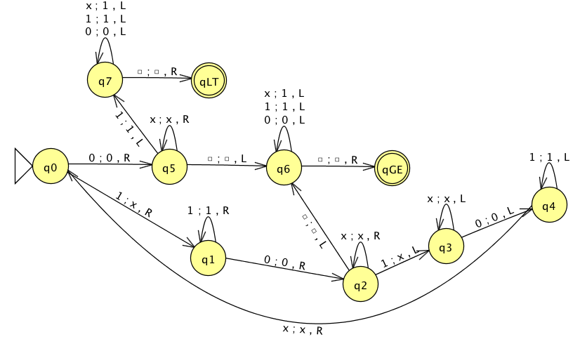
A Turing Machine that Compares Values, cont’d
Demo Jexample9.11.jff

Slide 12
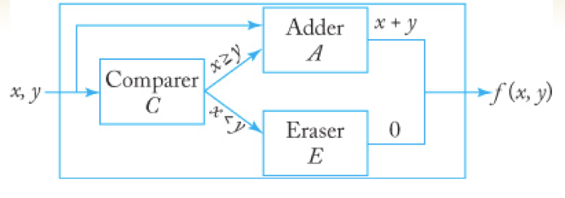
Combining Turing Machines
Design a TM to compute the function
Create the TM by combining smaller TMs:
{
x + y if x ≥ y
0 if x < y
f (x, y) =
Formal Languages
and Automata, 5th ed.
Peter Linz
Jones & Bartlett, 2012

Slide 13
Turing Machine Subprograms
Suppose TM A wants to call subprogram TM B.
We need to store A’s configuration so we can recreate the configuration upon return from B.
Example:
A is in some state q_{i} with the read/write head at a particular tape cell when it invokes B.
Upon return from B, resume A in state q_{i} with the read/write head restored to its original place.
We want A to pass information (parameters) to B.

Slide 14
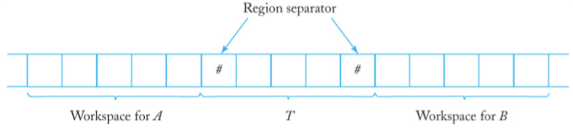
Turing Machine Subprograms, cont’d
Before A calls B:
A writes its state and any arguments for B to tape region T.
A passes control to B.
B reads tape region T for its input and starts execution.
B writes any results to tape region T.
B returns to A.

Slide 15
Turing Machine Subprograms, cont’d
A resumes control:
A reads the results and its previous state in tape region T.
A continues execution.

Slide 16
Turing’s Thesis
Claim: Any computation that can be carried out by mechanical means can be performed by some Turing Machine.
How can we prove this?
Evidence (but not proof):
TMs are more powerful than pushdown automata.
TMs can do arithmetic, string manipulation, and simple comparisons.
More powerful TMs can be built from simpler TMs.
A TM can be a subprogram for another TM.

Slide 17
Turing’s Thesis, cont’d
Is there a counterexample?
Can we find a procedure for which we can write a computer program, but for which we can show that no TM can exist.
No one has found such a counterexample.

Slide 18
Turing’s Thesis as a Definition
Definition: A computation is mechanical if and only if it can be performed by some TM.
Arguments in favor of this definition:
Anything that can be done on any existing digital computer can be done by a TM.
No one has yet been able to suggest a problem, solvable by what we intuitively consider an algorithm, for which a TM program cannot be written.
No alternative models proposed for mechanical computation is more powerful than the TM model.

Slide 19
Turing’s Thesis as Basic Laws
Turing’s thesis plays the same role in computer science as the basic laws of physics and chemistry.
Newton’s laws of motion are plausible models that explain much of the physical world.
They agree with our experiences and observations.
They cannot be proved to be true.
But they can possibly be invalidated.
Turing’s thesis are laws that agree with our experiences and observations about computers.
Attempts to invalidate them have failed so far.

Slide 20
Definition of an Algorithm
An algorithm for a function is a Turing machine M, which given as input any on its tape, eventually halts with the correct answer on its tape.
Specifically, we require that for all .
q₀d * q_{final} f (d)

Slide 21
Turing’s Writings
“Computing Machinery and Intelligence”
The imitation game
https://d1b10bmlvqabco.cloudfront.net/attach/ijz5c0k5maa63e/hr3pvq5j64p208/imwwvqfucgv7/The_Imitation_Game.pdf
The Annotated Turing
A guided tour through Alan Turing’s Historic Paper on Computability and the Turing Machine
by Charles Petzold
http://www.amazon.com/Annotated-Turing-Through-Historic-Computability/dp/0470229055/ref=sr_1_1?s=books&ie=UTF8&qid=1460438249&sr=1-1&keywords=annotated+turing

