Slide 1


Slide 1
Bank Customer Segmentation
Presented by: Samuel Sim Wei Xuan

Slide 2
Business Problem Overview
The bank aims to increase its customer base and revenue by identifying potential affluent customers within its Existing To Bank (ETB) segment. By upgrading these customers from normal to affluent status, the bank can offer tailored products and services to enhance satisfaction and drive revenue growth.
Target Segment
Focus on the Existing To Bank (ETB) customers, particularly those currently classified as normal but with the potential to become affluent.
Data Utilization
Analyze a comprehensive dataset featuring various customer attributes and a binary label indicating 'affluent' or 'normal' status to identify potential candidates for upgrade.
Expected Result
The bank is poised to effectively identify and target hidden affluent customers within the ETB segment, leading to increased revenue, customer satisfaction, and a stronger market presence.

Slide 3




Machine Learning Problem Definition (1/3)
Objectives
Data Overview
Customer Segmentation:
Utilize supervised machine learning (classification) to identify potential affluent customers within ETB segment.
Identification of Upgrade Candidates:
Predict whether a customer should be classified as "affluent" or "normal" based on their data profile, focusing on maximizing recall for the affluent class. False positives would actually be the hidden affluent customers to target.
Features:
Customer data from the provided dataset, including demographic information, transaction history, account balances, etc.
Labels Usage:
Binary labels indicating whether each customer is affluent or normal, used for training and evaluating the classification model.

Slide 4




Machine Learning Problem Definition (2/3)
Model Development
Business Application
Preprocessing and Feature Engineering:
Clean and preprocess data to ensure it's suitable for classification, including handling missing values, encoding categorical variables, etc.
Model Selection:
Choose appropriate classification algorithms (e.g., XGBoost, Random Forest) to predict the target variable effectively.
Model Evaluation:
Given the best model choice, tune the model with a focus on maximizing recall for the affluent class.
Targeted Marketing:
Utilize predictions from the classification model to target potential affluent customers with tailored marketing campaigns and product offerings.
Segment Analysis:
Analyze the characteristics and behaviors of predicted affluent customers to refine marketing strategies and enhance customer engagement.

Slide 5
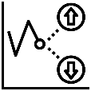




Machine Learning Problem Definition (3/3)
Rationale for Classification over Clustering
While clustering can provide valuable insights into grouping customers based on similarities in their data profiles, the decision to opt for classification instead was driven by several key factors:
Granular Predictions:
Classification provides individual predictions for each customer, enabling precise targeting and personalized strategies.
Interpretability:
Classification models offer feature importance metrics, helping understand the factors driving segmentation.
Threshold Control:
With classification, the bank can set thresholds to predict affluent customers, aligning with strategic goals.
Model Evaluation:
Clear evaluation metrics like recall allow for measuring model effectiveness and refining approaches.
Strategy Development:
Insights from classification aid in developing targeted marketing and product strategies.

Slide 6
Technical Details (1/2)
1. Folder Structure
Kedro Structure: Easier for MLE to deploy with an actual Kedro project
maybank/conf/base: yaml configurations.
maybank/conf/local: Empty as no secret credentials
maybank/data: Contains all the saved data (raw, processed) and EDA html output
maybank/docs: Contains the sphinx documentation for the src folder
maybank/notebooks/main_notebook.ipynb: Contains the data processing, EDA and modeling work
maybank/src/pipelines/main_pipeline.py: Runs the entire pipeline from end-to-end before inference
maybank/notebooks/analysis.ipynb: Contains the inferencing and analysis of results
maybank/src: Contains all the scripts that the notebook imports
maybank/tests: Empty at the moment, it is for pytest integration

Slide 7
Technical Details (2/2)
2. Dependencies Management
Used Poetry for managing project dependencies
Provides a reliable and efficient tool for dependency management
3. Linting
Implemented linting with ruff and flake8 to ensure code consistency and quality, handled by Poetry
4. Documentation
Set up sphinx documentation
To see sphinx configurations, look under docs/config.py
To view the documentation, look under docs/html/index.html to view the entire interactive HTML documentation.

Slide 8
Suggested Deployment (MLOPs) (1/9)
Overall Steps:
Develop with Kedro and Poetry
Integrate MLflow for experiment tracking and workflow
Build a Docker file to package the entire project
Set up CI/CD pipelines with Jenkins
Deploy the project to OpenShift
Create a Django REST API project to expose my deployed project endpoint
Integrate backend calls to a front-end for the bank users to quickly drop a dataset of ETB Customers for quick inference
Set up OpenTelemetry and integrate it with a UI such as Kibana for logging and tracing of deployed model inference API calls

Slide 9
Suggested Deployment (MLOPs) (2/9)
Step 1:
Develop with Kedro and Poetry
Organize this machine learning project using Kedro for project structuring and workflow management
Use Poetry for dependency management, ensuring consistent environments across different machines

Slide 10
Suggested Deployment (MLOPs)(3/9)
Step 2:
Incorporate MLflow into this Kedro project for experiment tracking, model versioning, and workflow management

Slide 11
Suggested Deployment (MLOPs)(4/9)
Step 3:
Create a Dockerfile to package this Kedro project, MLflow, and other dependencies into a containerized environment

Slide 12
Suggested Deployment (MLOPs) (5/9)
Step 4:
Write a Jenkinsfile defining the CI/CD pipeline for this project
Include stages for checking out the source code, building the Docker image, running tests and linting, pushing the image to a container registry, and deploying to OpenShift

Slide 13
Suggested Deployment (MLOPs)(6/9)
Step 5:
Set up an OpenShift cluster and create a project for deploying this machine learning project.
Prepare a deployment configuration file (deployment.yaml) describing how to deploy this dockerized project in OpenShift
Apply the deployment configuration to the OpenShift project

Slide 14
Suggested Deployment (MLOPs)(7/9)
Step 6:
Develop a Django REST API project to expose endpoints for the deployed machine learning model
Implement endpoints for inference, allowing users to send data for predictions

Slide 15
Suggested Deployment (MLOPs)(8/9)
Step 7:
Develop a front-end interface for bank users to interact with the Django REST API
Allow users to upload datasets of ETB customers for quick inference using the deployed machine learning model

Slide 16
Suggested Deployment (MLOPs)(9/9)
Step 8:
Implement OpenTelemetry for logging and tracing of deployed model inference API calls
Integrate OpenTelemetry with a UI tool like Kibana to visualize and analyze logs and traces, enabling efficient monitoring and debugging
Additional Considerations
The decision not to use PySpark for a small dataset but planning for its deployment later is a strategic choice balancing current efficiency with future scalability
There will just be a need to refactor the Pandas codes to PySpark, which is relatively simple

Slide 17
EDA (Using Sweetviz) (1/1)
Comprehensive Insights:
Offers diverse visualizations for thorough data exploration
From histograms to association analysis, it covers various aspects of dataset examination
Time Efficiency:
Automates EDA processes, saving valuable time
Provides quick insights into data distribution and associations (correlation etc.)
Quality Assessment:
Detects missing values and zeros, aiding in data quality assessment
Check maybank/data/raw/EDA.html for the interactive EDA

Slide 18
Missing Values Imputation (1/4)
Imputation Strategy Analysis
*Inside the notebook has deeper analysis with codes
Understanding Metadata:
Delve into metadata to comprehend the definition of each feature.
Facilitates informed assumptions for handling missing values effectively.
Tailored Imputation Strategies:
Customize imputation based on the characteristics and significance of each feature.
Ensures a more effective data treatment approach.

Slide 19
Missing Values Imputation (2/4)
No. | Variable | Missing % | Imputation Strategy | Explanation
1 | C_ID | 0% | No missing values | -
2 | C_AGE | 0% | No missing values | -
3 | C_EDU | 58% | Constant Imputation: "Not Provided" | Since it is the customer education, missing values are imputed with "Not Provided", cannot use "Others" as it is already specified.
4 | C_HSE | 66% | Constant Imputation: "Not Provided" | Since it is the customer house type, missing values are imputed with "Not Provided".
5 | PC | <1% | Zero Imputation | Distribution is not skewed and only <1% missing. PC is postal code, hence does not make sense to use mean/mode imputation. Hence use zero imputation instead.
6 | INCM_TYP | 45% | Mode Imputation: 2.0 | Drop at 1, 7, and 8 bins. Impute with 2, assuming no income would be already be recorded under either 1 or 8 depending on which is the lowest income type bin.
7 | gn_occ | 1% | Constant Imputation: "Not Provided" | Since it is occupation, missing values are imputed with "Not Provided", cannot use "Others" as it is already specified.
8 | NUM_PRD | 0% | No missing values | -
9 | CASATD_CNT | 38% | Zero Imputation: 0 | Impute with 0, indicating no CASA or TD accounts, verified with below CASA and TD analysis.
10 | MTHCASA | 41% | Zero Imputation: 0 | Impute with 0, indicating no CASA account.
11 | MAXCASA | 41% | Zero Imputation: 0 | Impute with 0, indicating no CASA account.
12 | MINCASA | 41% | Zero Imputation: 0 | Impute with 0, indicating no CASA account.

Slide 20
Missing Values Imputation (3/4)
No. | Variable | Missing % | Imputation Strategy | Explanation
13 | OWN_CASA (NEW) | - | New Binary Column: 1 for owned, 0 for not owned | Created a new binary column to differentiate not owning a CASA and an empty CASA account, since MTH/MAX/MINCASA already have 0s, which implies an empty CASA account.
14 | DRvCR | 55% | Zero Imputation: 0 | Impute with 0, indicating either zero debit or absence of credit (0 division).
15 | MTHTD | - | Zero Imputation: 0 | Impute with 0, indicating no TD account
16 | MAXTD | - | Zero Imputation: 0 | Impute with 0, indicating no TD account
17 | OWN_TD (NEW) | - | New Binary Column: 1 for owned, 0 for not owned | Created a new binary column, upon below CASA and TD analysis, it can be shown that indeed missing values in CASATD_CNT implies 0 CASA and TD accounts.
18 | Asset_value | 0% | No missing values | -
19 | HL_tag | 96% | Constant Imputation: 0 | Supposed to be either 1 or 0 according to metadata, and only 1 exists at the moment. Impute with 0.
20 | AL_tag | 92% | Constant Imputation: 0 | Supposed to be either 1 or 0 according to metadata, and only 1 exists at the moment. Impute with 0.
21 | pur_price_avg | 92% | Zero Imputation: 0 | Impute with 0, no 0s, hence should be safe assumption that the property purchase price is 0. Also _avg could imply average, hence if no property owned, then 0 division.
22 | UT_AVE | 96% | Zero Imputation: 0 | Impute with 0, indicating no UT transaction, no 0 exists and verified with below Unit Trust Analysis.
23 | MAXUT | 96% | Zero Imputation: 0 | Impute with 0, indicating no UT transaction, no 0 exists and verified with below Unit Trust Analysis.
24 | N_FUNDS | 96% | Zero Imputation: 0 | Impute with 0, indicating no funds owned, no 0 exists and verified with Unit Trust Analysis.

Slide 21
Missing Values Imputation (4/4)
No. | Variable | Missing % | Imputation Strategy | Explanation
25 | MAX_MTH_TRN_AMT | 82% | Zero Imputation: 0 | Impute with 0, verified with below Credit Card TRN Analysis, follow imputation of ANN_N_TRX.
26 | MIN_MTH_TRN_AMT | 82% | Zero Imputation: 0 | Impute with 0, verified with below Credit Card TRN Analysis, follow imputation of ANN_N_TRX.
27 | AVG_TRN_AMT | 82% | Zero Imputation: 0 | Impute with 0, verified with below Credit Card TRN Analysis, follow imputation of ANN_N_TRX.
28 | ANN_TRN_AMT | 82% | Zero Imputation: 0 | Impute with 0, verified with below Credit Card TRN Analysis, follow imputation of ANN_N_TRX.
29 | ANN_N_TRX | 82% | Zero Imputation: 0 | Impute with 0. 0 does not exist hence 82% either no credit transaction or no credit card owned.
30 | CC_AVE | 74% | Zero Imputation: 0 | Impute with 0, indicating no credit card owned in the past, hence safe to impute with 0.
31 | CC_LMT | 28% | Zero Imputation: 0 | Impute with 0. indicating no credit card owned at the moment, hence safe to impute with 0. Assumption still valid since 28% within the above 82% of rows 25-29.
32 | OWN_CC (NEW) | - | New Binary Column: 1 for owned, 0 for not owned | Created new binary column, to distinguish 0 credit limit due to bank assigning 0 limit and not owning a credit card hence 0 limit due to imputation.
32 | OWN_PREV_CC (NEW) | - | New Binary Column: 1 for owned, 0 for not owned | Created new binary column, to distinguish 0 CC_AVE due to 0 CC_AVE and not owning a credit card in past hence 0 limit due to imputation.

Slide 22
Data Cleaning (1/1)
Impute missing data based on above analysis
Missing data mostly imputed with 0, hence data quality might not be the best which directly affects model performance
Future steps: Rebuild everything but with other forms of imputation
Optimize efficiency by converting float64 to float32

Slide 23
Feature Engineering (1/2)
Utilizing tree-based models like XGBoost or Random Forests: No need to standardize or normalize features.
Reasoning:
Invariance to Monotonic Transformations:
Tree-based models base decisions on feature comparisons, making them insensitive to monotonic transformations like normalization or standardization.
Natural Handling of Different Scales:
These models partition the feature space based on relative feature values, not their absolute magnitude, making them robust to varying scales among features.
Furthermore, XGBoost and Random Forests are robust machine learning models that are less sensitive to outliers, unlike clustering models like SVMs that are sensitive to boundary spaces or regression-based models.

Slide 24
Feature Engineering (2/2)
For categorical variables like occupation:
Utilize Stratified K-Fold Target Encoding on the specified categorical columns.
Prevent Data Leakage
To prevent data leakage and ensure each fold is representative of the whole dataset given our imbalanced dataset.
Tracking Purpose:
Track of all the encoders used for target encoding.
Under the assumption that future observations is from a similar distribution to given training set.

Slide 25
Data Sampling (1/2)
Combine under-sampling and over-sampling strategy to ensure a more balanced training fold
Under-sampling methods:
Choice: RandomUnderSampler, due to large majority class just use a straight forward simple one
Method | Advantages | Disadvantages
ClusterCentroids | Preserves information while reducing majority class. | May not accurately capture underlying distribution.
CondensedNearestNeighbour | Selects subset representing majority class. | May inadvertently remove informative instances.
EditedNearestNeighbours | Removes noisy majority class instances. | Sensitive to noise, may not fully address imbalance.
RandomUnderSampler | Simple and fast. | May discard useful instances, effectiveness in solving imbalance may vary.

Slide 26
Data Sampling (2/2)
Over-sampling methods:
Choice: SMOTENC,
ADASYN appears preferable due to its capability to generate synthetic samples in regions where the classifier is likely to make errors but it treats variables as continuous scale
SMOTENC is tailored for datasets with a mix of categorical and continuous features, incorporating the nature of categorical features during synthetic sample generation
Method | Advantages | Disadvantages
RandomOverSampler | Simple and effective. | May lead to overfitting, reduction in diversity.
SMOTENC | Handles both numerical and categorical features. | Requires parameter tuning, can be computationally intensive.
ADASYN | Focuses on low-density regions. | Sensitive to noise, requires careful parameter adjustment.
RandomOverSampler | Simple and effective. | May lead to overfitting, reduction in diversity.

Slide 27
Modeling (1/2)
Comparing 2 common classification approaches:
Evaluated on average recall (focus on ensuring I classify all the affluent) using (k=10) k-fold cross-validation to determine the best approach to proceed with:
Random Forest
n_estimators: 100
XGBoost Classifier
objective: binary: logistic
learning_rate: 0.001
n_estimators: 100

Slide 28
Modeling (2/2)
Comparing 2 common classification approaches:
Evaluated on average recall (focus on ensuring I classify all the affluent) using (k=10) k-fold cross-validation to determine the best approach to proceed with:
Random Forest
n_estimators: 100
XGBoost Classifier
objective: binary: logistic
learning_rate: 0.001
n_estimators: 100
Results:
Random Forest - Avg Precision: 0.58
Random Forest - Avg Recall: 0.63
XGBoost - Avg Precision: 0.48
XGBoost - Avg Recall: 0.78

Slide 29
XGBoost Tuning (1/3)
Utilizing XGBoost for classification
Focus on maximizing average recall score, particularly crucial for identifying affluent classes effectively.
Employing Optuna, an optimization library
Automatically fine-tune hyperparameters for the XGBoost classifier
Optuna performs an iterative search over specified hyperparameter ranges
Maximizes recall score via k-fold cross-validation
Leveraging SelectFromModel from scikit-learn
To select the most important features for model training, integrated within the cross-validation
Aids in reducing complexity and improving interpretability by retaining only the most relevant features based on importance weights
Commented out due to the small number of features

Slide 30
XGBoost (Optuna Parameters) (2/3)
Due to time constraints (worked on the project for a day), I ran quickly over 50 trials instead of 1000s.
With our over-under resampler and k=10 fold validation
Parameter | Description | Range
objective | Objective function for XGBoost | binary:logistic
tree_method | Tree construction algorithm | gpu_hist
gpu_id | GPU device ID | 0
n_estimators | Number of trees | 1000 – 3000
max_depth | Maximum depth of a tree | 5 – 20
learning_rate | Learning rate | 0.001 - 0.1 (log scale)
subsample | Subsample ratio of the training instances | 0.6 - 1.0
colsample_bytree | Subsample ratio of columns when constructing each tree | 0.6 - 1.0
gamma | Minimum loss reduction required to make a further partition on a leaf node | 0.0 - 5.0
min_child_weight | Minimum sum of instance weight (hessian) needed in a child | 1 - 20

Slide 31
XGBoost (Optuna Parameters) (3/3)
Best Hyper-parameters (average recall of 0.56) to do Inference:
Note the average recall is “generalized”, as over-under sampling as applied to each training fold during k-fold validation, next slide will show the recall on overall ETB dataset
Parameter | Description | Range
objective | Objective function for XGBoost | binary:logistic
tree_method | Tree construction algorithm | gpu_hist
gpu_id | GPU device ID | 0
n_estimators | Number of trees | 2284
max_depth | Maximum depth of a tree | 3
learning_rate | Learning rate | 0.002192928185705617
subsample | Subsample ratio of the training instances | 0.965188332889952
colsample_bytree | Subsample ratio of columns when constructing each tree | 0.7215667495401594
gamma | Minimum loss reduction required to make a further partition on a leaf node | 2.322789657995237
min_child_weight | Minimum sum of instance weight (hessian) needed in a child | 1

Slide 32
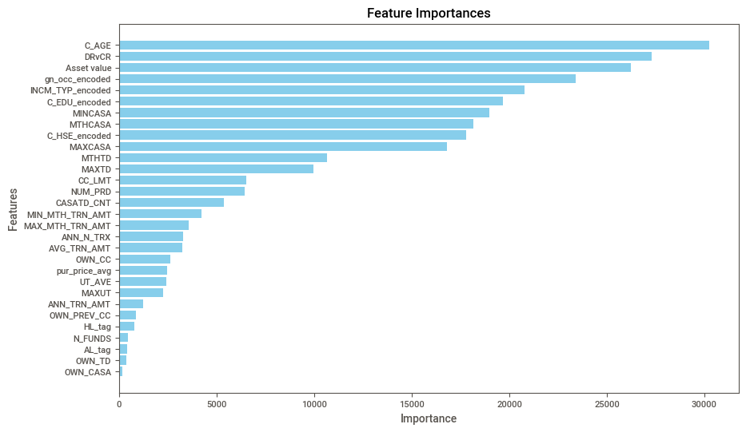
Analysis (Feature Importance) (1/2)
Here is a visualization of the ranking of the features according to their importance
Hence strategies towards these features should be prioritized:
C_AGE
DVcCR
Asset value
gn_occ_encoded
INCM_TYP_encoded
C_EDU_encoded

Slide 33
Analysis (Inference) (2/3)
Recall on the entire provided dataset:
9716 out of the 10,926 affluent customers classified correctly
Among the 55,157 normal customers
31 has been classified as affluent customers, these are our potential affluent customers
Run EDA (Sweetviz) again on just these 31 potential affluent customers
Clearly my results are not yet satisfactory, with only a recall of 89%
If more time given, I would certainly increase the number of trials for Optuna
Redo the imputation with mean/mode which might drastically improve performace, but need consult the domain experts of the dataset
Tune the resampling process, as my model is over generalizing or too much data is lost from resampling
Adjust the folds for k fold validation

Slide 34
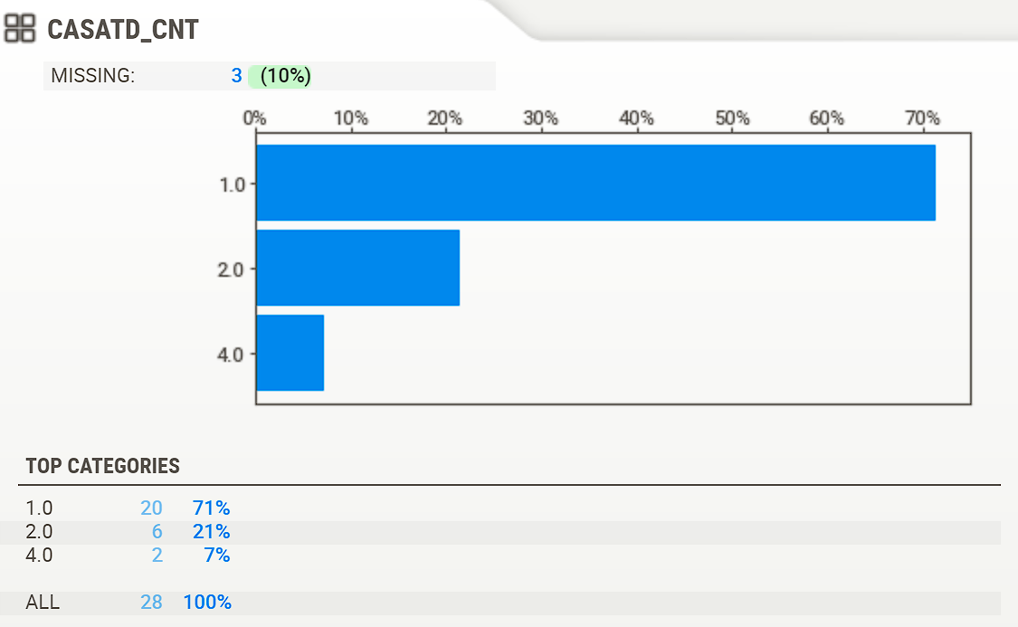
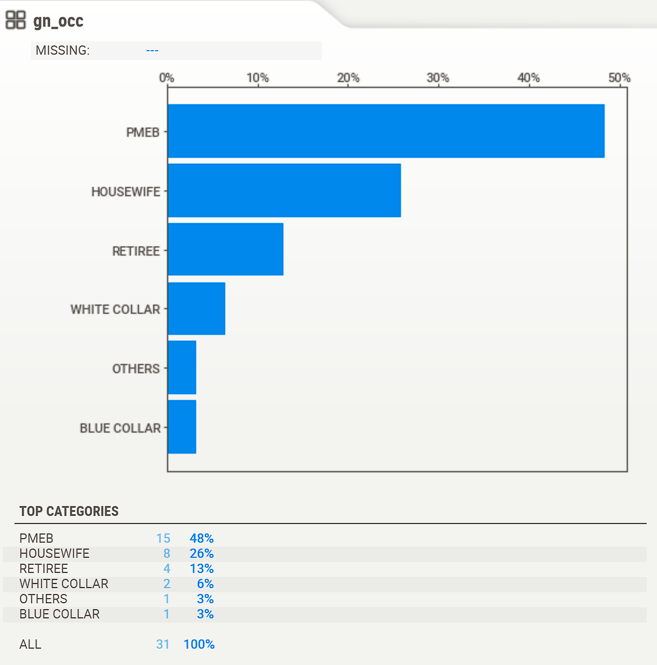
Analysis (Inference) (3/3)
EDA (Sweetviz) again on just these 31 potential affluent customers
Points Noted:
For example we know the occupation of these customers or their CASA and TD counts, and determine strategies for these customers
However need to sit down with domain experts to understand the data better and the insights that can be drawn from the EDA sweetviz results

Slide 35
Slide 1
Thank You
Refer to the README.md and notebooks for more details
Made by: Samuel Sim Wei Xuan

