Slide 1
Risk-Based Segmentation for Financial Asset Recommendation Balancing Return, Accuracy and Risk Suitability
Samuel Sim
Master of Science in Computing (Capstone)
samuel.sim.2024@msc.smu.edu.sg

Slide 2
Introduction
Financial Asset Recommendation

Slide 3
What is Financial Asset Recommendation (FAR)?
FAR ranks securities (stocks, bonds, mutual funds) for an investor by suitability.
It fuses heterogeneous signals:
Investor side: past transactions, declared risk tolerance, loss capacity, goals.
Market side: asset prices, returns, volatility, inflation.
FAR sits at the intersection of personalised ranking and regulatory obligation.
MiFID II (EU) requires a suitability check before recommending: product risk must align with the customer's declared band.
Maximising return/ranking without conditioning on the band can top a benchmark yet be a regulatory liability.

Slide 4
The benchmark measures only two axes
FAR-Trans (Sanz-Cruzado et al., 2024): first open FAR benchmark pairing real prices + real retail transactions + a declared MiFID II band per customer (Jan 2018 - Nov 2022).
Its benchmark scores algorithms on two axes only:
nDCG@10: next-purchase ranking accuracy.
ROI@10: realised profitability.
A later study finds the two are negatively correlated on FAR-Trans: winning on accuracy tends to lose on return.
Neither axis measures whether a recommendation is suitable for the customer's risk band.

Slide 5
Gap & objective
A model can lead nDCG/ROI while routinely proposing assets ≥ 2 bands from the declared tolerance, the exact failure MiFID II exists to prevent.
Existing risk-aware FAR fixes this only downstream: post-hoc re-ranking of a base model's top list. The declared band never enters training.
Our objective: balance risk suitability against return and accuracy, not trade one for another.
Approach: a risk-based segmentation of the model, then two interventions, a coherence margin loss and customer regrouping.
We evaluate on three axes and a single harmonic-mean balance.

Slide 6
Three contributions
1 · Analytical study of risk factors in FAR-Trans. Discordance between declared band and bought assets is widespread, a persistent customer-level trait, and coherent buys earn a return premium, not a penalty.
2 · A risk-based segmentation of LightGCN. Conditions training on the declared band. The two interventions build on it.
3 · Experimental studies across the three axes. Over 69 temporal splits we audit the FAR-Trans baselines and ablate the two exclusive levers. Only regrouping raises the balance.
New measurement tools introduced: Profile Coherence PC@k and the balance score.

Slide 7
FAR-Trans Benchmark
Current State

Slide 8
The FAR-Trans dataset
First public FAR dataset to pair real pricing with real retail-investor transactions.
Closes the gap left by proprietary/simulated data and the prior price-less public dataset.
Collected from a large European institution (National Bank of Greece), Jan 2018 - Nov 2022.
Makes both price-based and profile-based recommendation measurable on one dataset.
FAR-Trans at a glance
Customers | 29,090
with a MiFID II band | 28,770 (98.9%)
Assets (daily prices) | 806
Buy transactions | 228,913
Sell transactions | 159,135

Slide 9
Two anchor baselines
FAR-Trans also establishes the field's evaluation standard by benchmarking 11 FAR algorithms.
Two anchor our study, each leads one axis:
LightGCN: graph collaborative filter over the user–item bipartite graph, strongest ranking model (nDCG).
Random Forest: tree ensemble over tabular customer/asset features, strongest profitability model (ROI).
Both scored over the top-10 on nDCG@10 and ROI@10.

Slide 10
Analytical Study
FAR-Trans Dataset

Slide 11
Putting customers and assets on one scale
Measuring suitability needs customers and assets on a common scale.
Ordinal band scale, 0 to 3:
Conservative · Income · Balanced · Aggressive.
Customer band b_u: declared (or regression-imputed) MiFID II level. Missing-band customers are excluded from all coherence.
FAR-Trans supplies no asset band, hence we assign b_i with a 3-step hierarchical rule.

Slide 12
Asset banding: 3-step hierarchical rule
Step 1: subcategory metadata. Mutual funds: Money-Market to Conservative, Bond to Income, Balanced to Balanced, Equity/Large-Cap to Aggressive. Bonds by issuer: Government to Conservative, Corporate to Income, else Income.
Step 2: volatility quartiles. Untagged assets (mostly stocks): annualised SD of daily log-returns over a trailing 252-day window, bucketed into 4 bands by stock-calibrated quartiles (q₁, q₂, q₃).
Step 3: residual default. Anything left to Balanced.
Resulting asset-band distribution over 806 assets: (190, 333, 105, 178) for (Conservative, Income, Balanced, Aggressive).

Slide 13

Profile Coherence: the suitability metric
Pairwise discordance d(u,i) = |b_u − b_i| ∈ {0,1,2,3}. A recommendation is profile-coherent iff d ≤ 1.
The ±1 tolerance is by design, it mirrors MiFID II's adjacency allowance for borderline suitability.
Profile Coherence at k, share of the top-k list that is coherent:
Fewer than k items: use the actual count as denominator, no-band customers dropped. Per-split PC = unweighted mean over eligible customers. Headline = mean over splits.

Slide 14
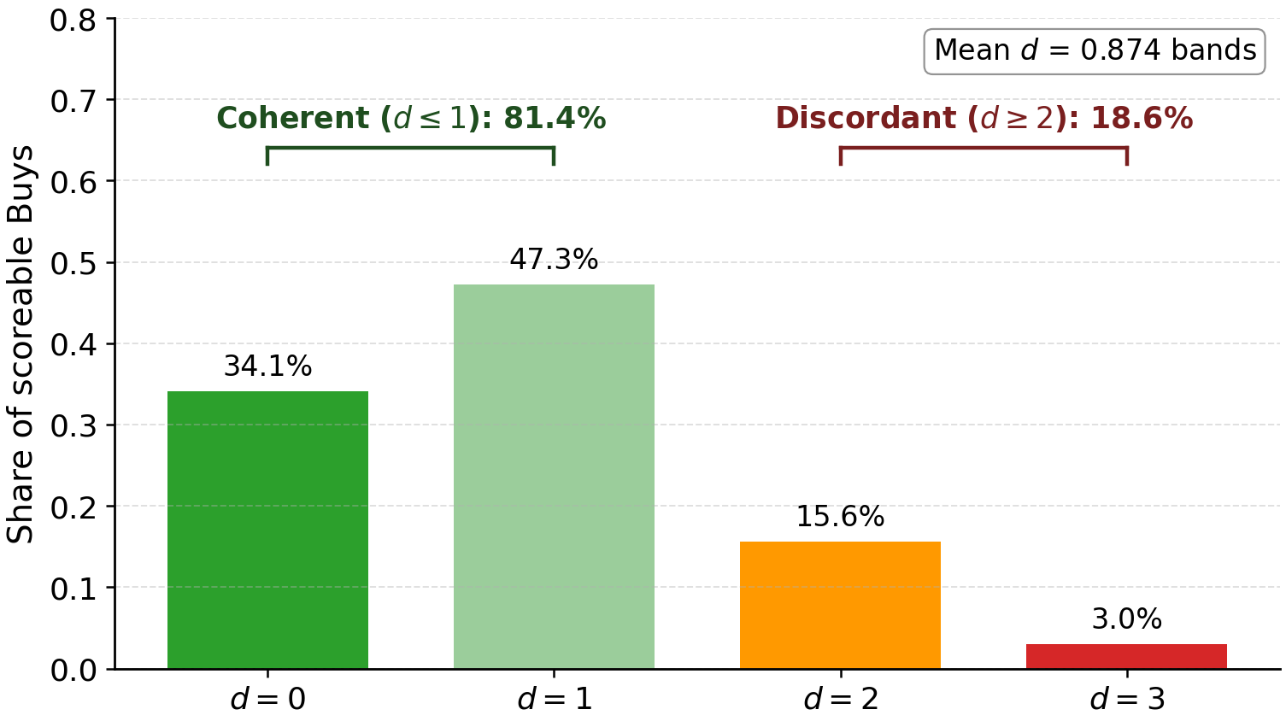
Discordance is prevalent
Over 228,241 scoreable buys:
18.6% violate the band by ≥ 2 steps.
81.4% coherent (d ≤ 1), 34.1% strictly coherent (d = 0).
Mean discordance 0.874 bands.
Nearly 1 in 5 buys lands ≥ 2 bands away, too large to dismiss as noise.

Slide 15
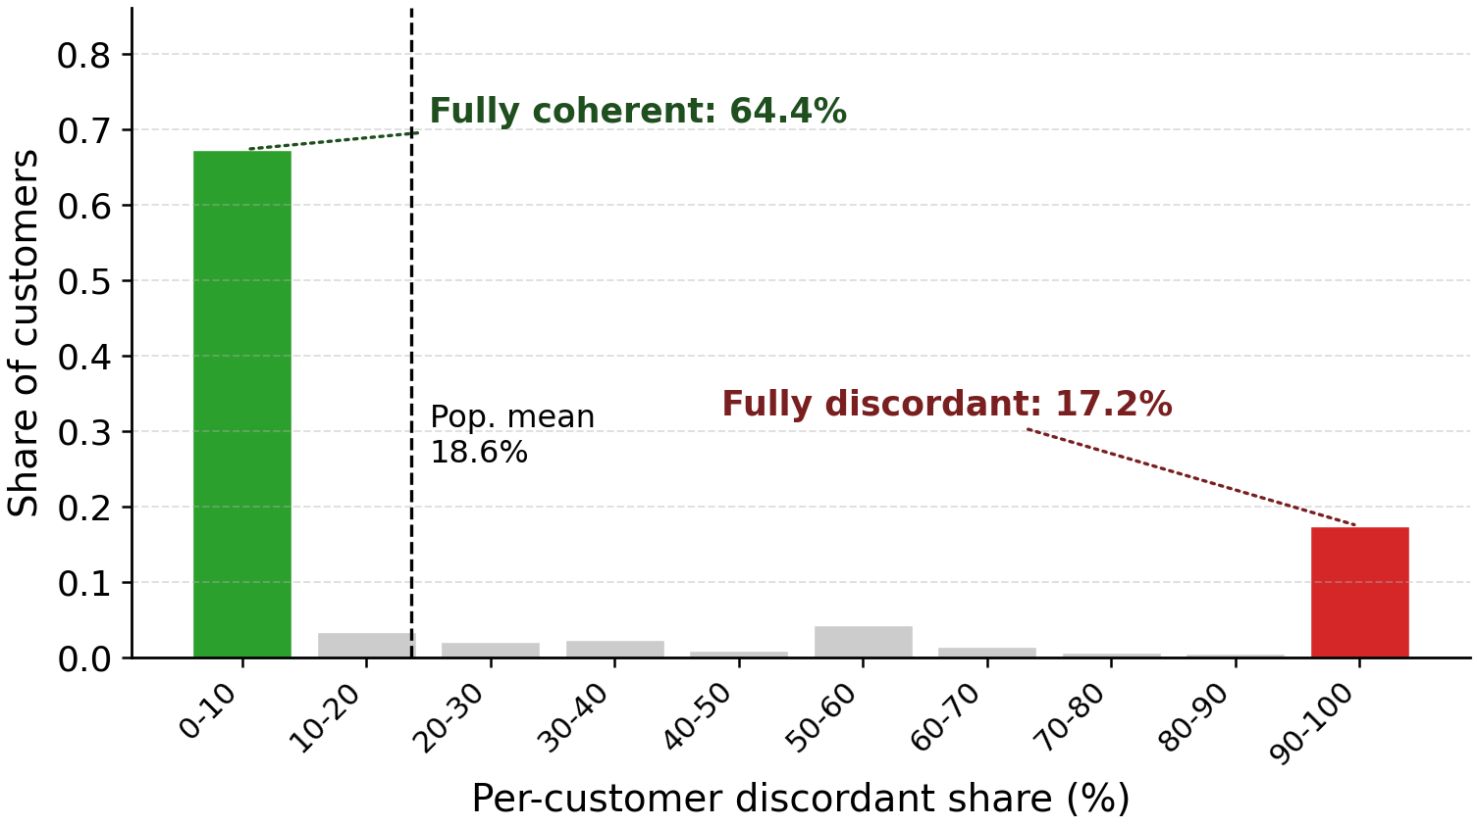
…and it is a customer-level trait
Per-customer discordant share is bimodal, concentrating at the extremes, not near the 18.6% mean.
64.4% of banded customers are fully coherent, 17.2% are fully discordant.
Hartigan's dip test (28,770 values): D = 0.086, p < 10⁻¹⁵ hence rejects unimodality.
Implies a persistent customer-level trait, not i.i.d. noise.

Slide 16
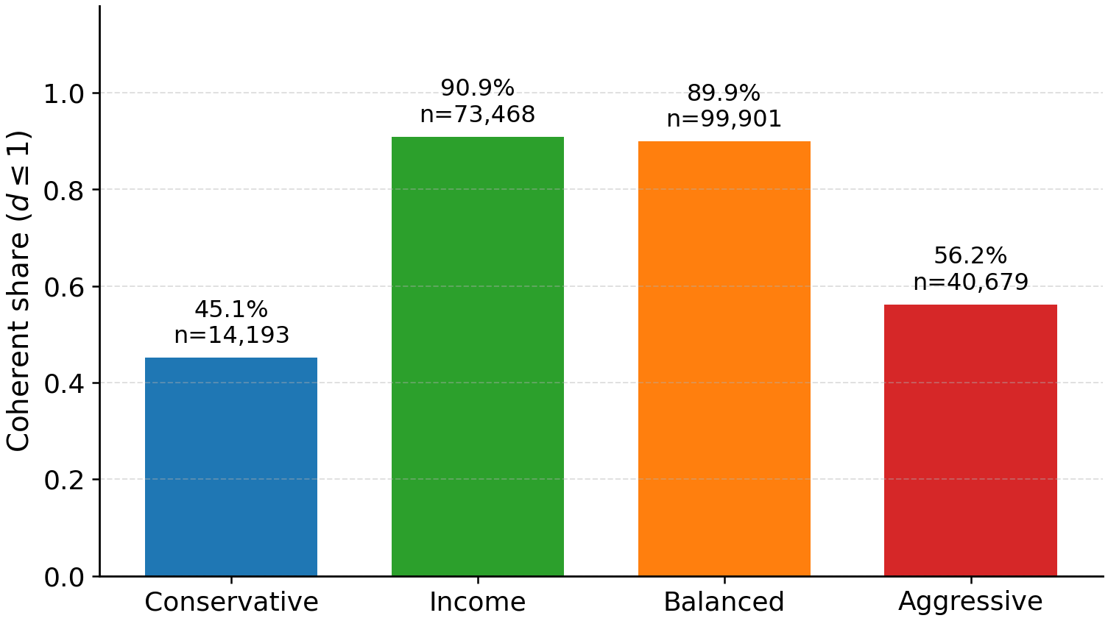
Which customers? The U-shape
Coherence by declared band is U-shaped.
Centre bands ≈ 90%, extremes dip: Conservative 45.1%, Aggressive 56.2%.
Conservative dip ≈ reach for yield. Aggressive dip ≈ pull to safety.
Mismatch concentrates at the ordinal extremes.

Slide 17
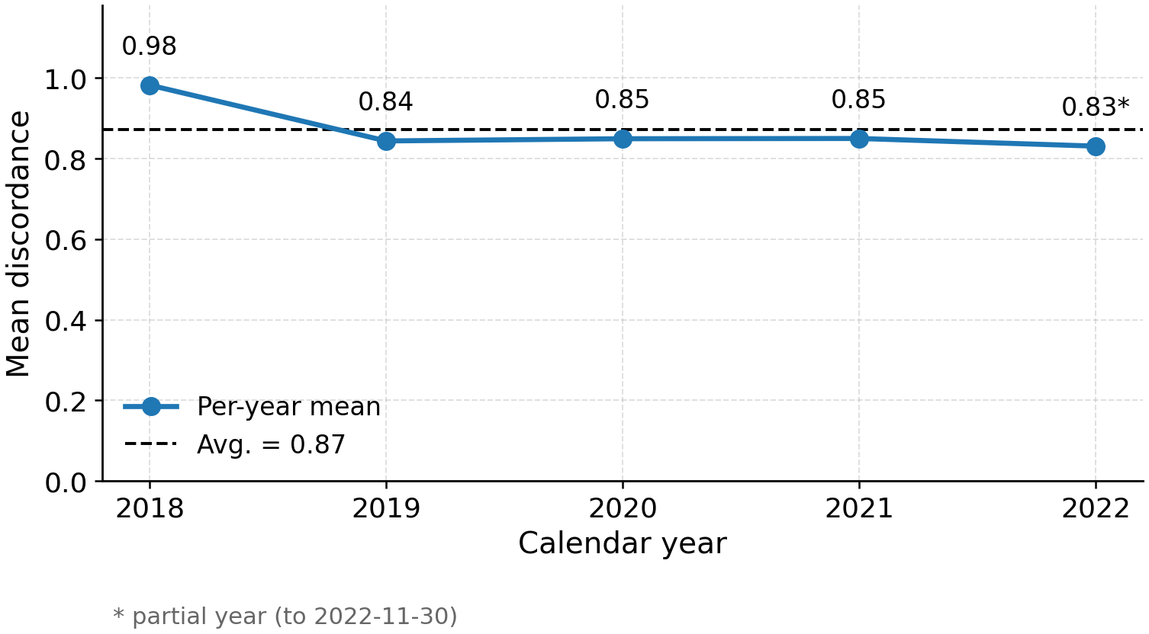
Not a single-year artefact
Mean discordance is flat across 2019–2022 (within 0.02 bands), hence not a single market regime.
2018 is elevated at 0.98.
MiFID II took force 2018-01-03, the exact start of FAR-Trans indicates a transition-effect hypothesis (stated, not tested here).

Slide 18
Does discordance cost return? Regression spec
Question: do discordant buys earn lower returns than coherent ones?
Transaction-level OLS on 208,029 priced buys. Cluster-robust SE on Customer ID (avg 7.46 buys/customer). Two-sided Wald, α = 0.05.
r = (p_end − p_start)/p_start = 6-month realised return. Coherence indicator binary (d ≤ 1).
Prices: backward-nearest join (≤ 7-day tolerance each endpoint). Null hypothesis H₀: β₁ = 0.

Slide 19
The coherence return premium
Coherent buys earn +2.94 pp higher 6-month return than discordant, conditional on volatility, segment, year.
Significance: p = 2.3×10⁻¹³: reject H₀: β₁ = 0 (associational, not causal).
Controls barely move it: raw gap +3.31 pp (4.23% coherent vs 0.92% discordant) narrows to +2.94 pp conditional (controls absorb ~11%).
Volatility −10.25 pp/unit, year dummies all significant (2020 +21.07 pp, 2022 −1.95 pp), customer-type dummies all insignificant.
Term | Est. | 95% CI | p
is_coherent | +0.0294 | [+0.022, +0.037] | 2.3e-13
asset_volatility | −0.1025 | [−0.135, −0.070] | 5.5e-10
C(year)[2020] | +0.2107 | [+0.199, +0.223] | 6e-259
C(year)[2022] | −0.0195 | [−0.028, −0.011] | 1.4e-5
Intercept | −0.0471 | [−0.075, −0.020] | 8.1e-4

Slide 20
Analytical study: takeaways & limits
Takeaways: discordance is:
prevalent (≈ 1 in 5 buys ≥ 2 bands off),
a persistent customer-level trait concentrated at the extremes,
and carries a positive return premium which removes the economic objection to optimising for suitability.
Limitations:
Observational: confounders (literacy, advisor channel, account constraints) not ruled out, 2018 transition untested.
Asset-band heuristic: bands assigned, not externally validated. Volatility-quartile mislabels propagate into every coherence number.

Slide 21
Methodology
Risk-based Segmentation Modeling

Slide 22
The suitability gap of a single global model
FAR-Trans LightGCN baseline: one collaborative filter over a single user–item graph, per-customer/asset embeddings, scores by inner product, trains with BPR.
The model never sees the risk band, so suitability is whatever the purchase graph implies.
The analytical study showed purchases are frequently discordant.
So a band-agnostic model trained to reproduce them inherits that discordance.
Why LightGCN as the backbone: a differentiable loss + per-customer embeddings let us condition on the band and attach a coherence margin. Random Forest carries no customer-level signal to segment, so not extended.

Slide 23
Risk-based segmentation
Approach 2 (data lever):
regroup to revealed band
Conservative sub-model
Income sub-model
Evaluate on 3 axes
Return (ROI) · Accuracy (nDCG)
Risk suitability (PC)
+ harmonic Balance
FAR-Trans
Data
Risk-band
router
Balanced sub-model
Aggressive sub-model
Approach 1 (model lever):
coherence margin loss
Partition customers by declared band, then train one LightGCN sub-model per band. A band router serves each customer. No-band customers fall back to Balanced at inference.

Slide 24
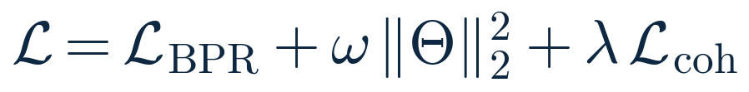
Approach 1 (model lever): coherence margin loss
On top of BPR, draw one coherent asset i_c (d ≤ 1) and one discordant i_d (d > 1) from the sub-model's universe, and push the coherent score above the discordant one:
Total objective adds the term to BPR with weight λ ≥ 0:
λ = 0 recovers plain segmentation. λ > 0 steers scores toward coherent assets. Softplus is differentiable and matches BPR's form.

Slide 25
Approach 2 (data lever): regrouping
Fix the label at its source: before training, reassign each banded customer to the band implied by their purchases.
Revealed band = the lower median of the risk classes of the assets they bought (even-count ties resolve to the more conservative band).
Segmentation then routes/trains on these regrouped bands.
So the data is made coherent in the first place, rather than penalising incoherence during training.

Slide 26
Two exclusive levers, contrasted
Both start from the same segmentation. They are mutually exclusive operating points.
Model lever (margin): steer the model, declared bands kept, adds a training penalty.
Data lever (regroup): correct the data, bands replaced by revealed bands, standard BPR objective.
The question the experiments answer: where is suitability best enforced, in the model, or in the data?

Slide 27
Experimental Setup
Data preparation and Evaluation metrics

Slide 28
Temporal split protocol
69 temporal splits, ~biweekly split points on an evenly spaced trading-day grid: Aug 2019 to Dec 2021. Per-split test windows extend coverage to May 2022. Cadence follows the FAR-Trans benchmark.
Per split:
Train = all buys up to the split point.
Test = buys from split point to test-window end, deduplicated vs train, filtered to the training-asset universe.
Eligible customers: ≥ 1 interaction in both train and test. Eligible assets: priced on both endpoints.

Slide 29
Metrics: return & accuracy
ROI@10 (return). Holding-period return of each recommended asset from the split-point close to the test-window-end close, converted to a per-month geometric rate, then averaged over the 10 assets, then over customers. Reported per month.
nDCG@10 (accuracy). Rank-discounted hit rate of the held-out test buys within the top-10, normalised by the ideal ordering and averaged over customers.
These are the two original FAR-Trans axes, the suitability axis is what we add next.

Slide 30

Metrics: risk suitability + PC-lift
PC@10 as defined in the analytical study.
To compare across bands, normalise by a band-conditional random baseline (closed form):
77.9% of assets sit in Conservative/Income/Balanced, so “recommend Income to everyone” scores high on raw PC. Dividing by π removes the easy-band advantage.

Slide 31
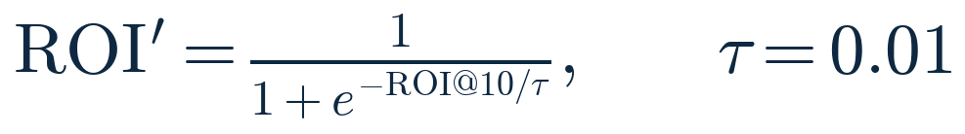
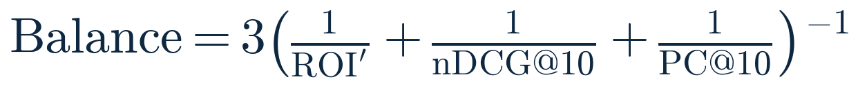
The harmonic balance
nDCG@10 and PC@10 are already in [0,1]. ROI can be negative, so we apply a logistic squash (flat at 0.5, scale = 1 pp/month):
Balance = harmonic mean of the three axes:
High only when return, accuracy, and suitability are strong together. Collapses if any one is sacrificed.

Slide 32
Configurations & hyperparameter grids
Four configurations on the same 69 splits, each on all three axes + balance:
Baseline (LightGCN best trial, RF for per-axis reference).
Segmentation (no margin): isolates the architecture.
Model lever (segmentation + margin loss).
Data lever (segmentation on regrouped bands).
All segmented configs inherit the best LightGCN backbone, same BPR + edge-dropout.
Param | Search | Best
LightGCN: tuned on nDCG@10
embedding_dim | {64, 128} | 64
num_layers | {2, 3} | 3
learning_rate | {1e-2, 1e-3} | 1e-3
Random Forest: tuned on ROI@10
num_estimators | {20,30,40,50} | 40
max_depth | {15, 25, 50} | 50

Slide 33
Results
Findings

Slide 34
Aggregate results: mean over 69 splits
Only one intervention beats the LightGCN baseline overall: regrouping the data (highest balance, 0.452).
Configuration | nDCG@10 | ROI@10 | PC@10 | Balance | PC-lift
Random Forest baseline | 0.019 | +0.014 | 0.667 | 0.054 | 1.06×
LightGCN baseline | 0.330 | −0.005 | 0.794 | 0.428 | 1.17×
Segmentation | 0.332 | −0.007 | 0.821 | 0.411 | 1.19×
+ margin (model lever) | 0.309 | −0.007 | 0.918 | 0.407 | 1.40×
+ regrouping (data lever) | 0.352 | −0.006 | 0.949 | 0.452 | n/a
+ regrouping + margin (combined) | 0.333 | −0.005 | 0.982 | 0.444 | n/a

Slide 35
Baseline audit
The two baselines sit at opposite corners of the return–accuracy tradeoff, neither balances the three:
Random Forest wins return (+1.4%/mo) but ranks near-random (nDCG 0.019), so balance collapses to 0.054.
LightGCN wins ranking (nDCG 0.330, PC 0.794) but slightly negative ROI, giving balance 0.428.
Aggregate PC looks adequate (1.17× / 1.06× lift) but it averages over bands whose random baselines π span 0.35–0.78, it hides which bands are served.

Slide 36
Per-band audit: PC-lift@10 (= PC@10 / π(b))
Both baselines' lift rises monotonically with the band and under-serve Conservative (below random), RF also under-serves Income. Aggressive's high lift is partly mechanical (π = 0.35 is the lowest bar).
Band | π(b) | RF | LightGCN | Seg | +Margin | +Regroup | Combined
Conservative | 0.65 | 0.52 | 0.75 | 0.91 | 1.19 | 1.21 | 1.25
Income | 0.78 | 0.70 | 1.13 | 1.20 | 1.26 | 1.25 | 1.26
Balanced | 0.76 | 1.03 | 1.17 | 1.22 | 1.28 | 1.24 | 1.30
Aggressive | 0.35 | 1.88 | 1.35 | 1.17 | 1.97 | 2.24 | 2.68

Slide 37
Reading the ablation
Segmentation alone: PC 0.794 to 0.821, ranking flat (0.332), small ROI cost, giving balance 0.411 (marginally below baseline).
Model lever (margin): PC rises to 0.918 but spends accuracy (nDCG falls to 0.309), giving balance 0.407 (below baseline).
Data lever (regrouping): PC rises to 0.949 and nDCG rises to 0.352, ROI ≈ unchanged, giving balance 0.452, the only config above baseline.
Combined: highest raw PC (0.982) but balance falls back to 0.444, margin spends accuracy even on corrected bands.

Slide 38
Why regrouping wins
Of the two exclusive levers, only regrouping raises the harmonic-mean balance.
It corrects the noisy declared labels at their source rather than fighting them during training.
The proof: nDCG@10 and ROI@10 neither use the risk band, yet both rise under regrouping, only possible if the declared bands were adding noise to training.
So the declared bands, not the model, were holding performance back.
Recommended operating point: the data lever alone, margin is then unnecessary and even lowers balance (0.452 to 0.444).

Slide 39
Per-band: where each lever spends effort
Margin loss mostly rescues the two extremes the baselines failed: Conservative 0.75 to 1.19, Aggressive 1.35 to 1.97.
Segmentation alone barely moves Conservative (0.75 to 0.91, still below random) and even lowers Aggressive to 1.17, sub-models still train on uncorrected discordant purchases.
Regrouping clears the random baseline in every band (1.21, 1.25, 1.24, 2.24).
Combined reaches the highest per-band lifts (1.25, 1.26, 1.30, 2.68). The Conservative deficit is closed by either lever, but only regrouping closes it without the accuracy penalty.

Slide 40
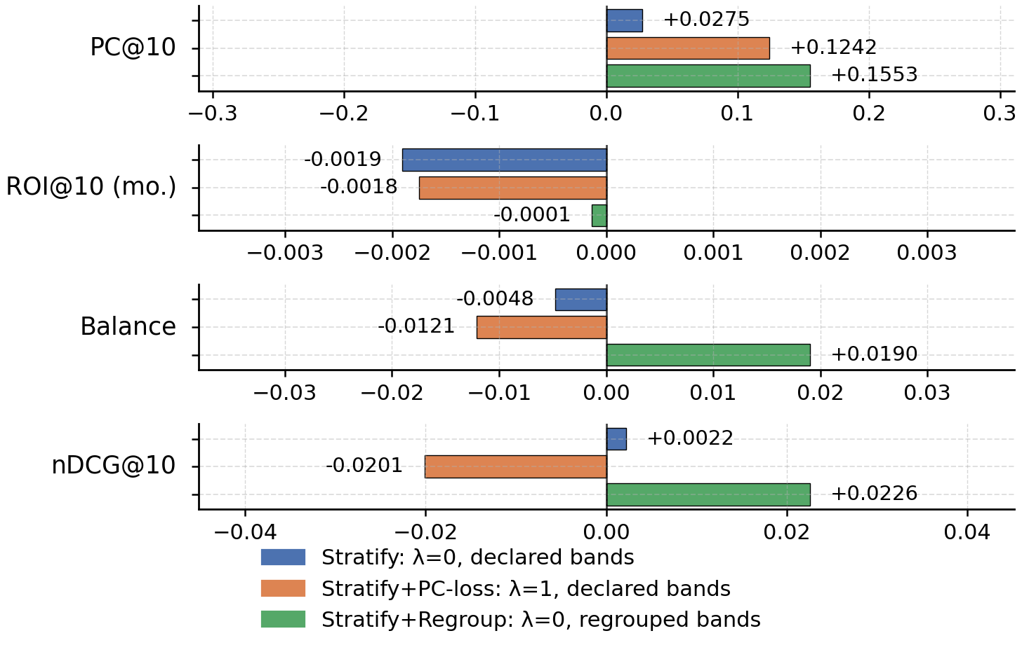
Consistency across splits: deltas
Per-split Δ vs the LightGCN baseline, by metric, for the three contrasts.
PC@10 is positive on every one of the 69 splits for all three configurations.
Balance delta is positive only for regrouping (+0.019 on average). Negative for segmentation-alone and the margin loss.

Slide 41
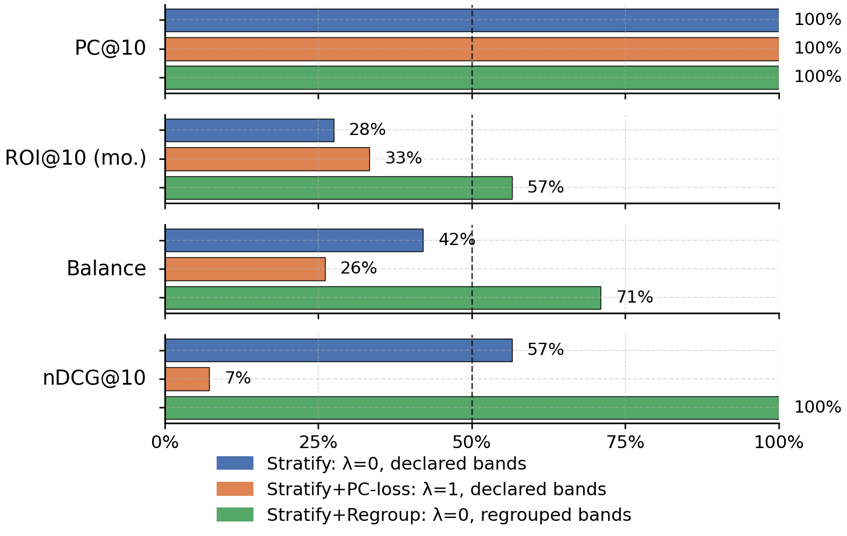
Consistency across splits: win rates
Fraction of splits that beat the baseline, by metric.
Regrouping wins balance on 71% of splits and nDCG@10 on 100%.
Margin loss wins balance on only 26%, nDCG@10 on a mere 7%, indicating a uniform downward shift, not a few bad splits.
The per-split story matches the averages.

Slide 42
Limitations
Future Work

Slide 43
Limitations & future work
Single operating point & backbone. Baselines audited only at their primary-metric optimum. One margin point on inherited hyperparameters, segmentation only on LightGCN. So suitability gains are a lower bound, accuracy costs an upper bound.
*Future:* full Pareto sweep + end-to-end re-tune. Extend to sequential / transformer / content models.
Regrouping leakage. Revealed bands use each customer's full buy history, creating look-ahead vs each split. *Future:* per-split rolling variant using only training-window buys.
Associational premium. The coherence premium is not causal. *Future:* IV / difference-in-differences across a regulatory boundary. Test the 2018 transition directly.
Hand-set metric parameters. ±1 tolerance and the asset-band heuristic are set, not derived. *Future:* calibrate tolerance from data. Validate bands vs external MiFID II classifications.

Slide 44
Conclusion
Summary of Contributions

Slide 45
Conclusion
Central finding: return, ranking accuracy, and regulatory risk suitability need not conflict on FAR-Trans, a recommender can be made far more suitable while keeping and even improving accuracy and return.
Suitability is an architectural choice, not a tradeoff patched by post-hoc re-ranking.
Diagnostic-to-remedy chain: analytical study (discordance prevalent + persistent + a return premium), then the baseline audit (both under-serve specific bands, neither balances), then segmentation closes the per-band deficit, and regrouping is the dominant lever (raises suitability + accuracy at no cost to return). The margin loss buys suitability by spending accuracy.
Broader impact: regulatory suitability can be encoded as a training-time objective and, better, corrected at the data source, a path for recommenders in other regulated domains (e.g., insurance product suitability).

Slide 46
Thank You
Questions & Answers

Slide 47
Appendix
Others

Slide 48
Full OLS coefficient table
208,029 priced buys · cluster-robust SE on Customer ID · reference = Inactive customer, 2018.
Term | Estimate | Std. Err. | 95% CI | p
Intercept | −0.0471 | 0.0141 | [−0.0746, −0.0195] | 8.1e-4
is_coherent | +0.0294 | 0.0040 | [+0.0215, +0.0372] | 2.3e-13
asset_volatility | −0.1025 | 0.0165 | [−0.1349, −0.0701] | 5.5e-10
C(type)[Legal Entity] | +0.0154 | 0.0486 | [−0.0798, +0.1106] | 0.751
C(type)[Mass] | +0.0011 | 0.0132 | [−0.0248, +0.0269] | 0.936
C(type)[Premium] | +0.0058 | 0.0135 | [−0.0206, +0.0322] | 0.667
C(type)[Professional] | +0.0247 | 0.0169 | [−0.0084, +0.0578] | 0.143
C(year)[2019] | +0.1759 | 0.0129 | [+0.1507, +0.2012] | 1.4e-42
C(year)[2020] | +0.2107 | 0.0061 | [+0.1986, +0.2227] | 6e-259
C(year)[2021] | +0.0754 | 0.0053 | [+0.0651, +0.0858] | 4.1e-46
C(year)[2022] | −0.0195 | 0.0045 | [−0.0283, −0.0107] | 1.4e-5

Slide 49
Asset-band assignment & π(b)
Asset-band distribution by category, with totals (190, 333, 105, 178) over 806 assets.
π(b) = share of assets within ±1 of each band: (0.65, 0.78, 0.76, 0.35).
Category | Conservative | Income | Balanced | Aggressive
Bond | 55 | 154 | 0 | 0
MTF (mutual funds) | 66 | 110 | 28 | 109
Stock | 69 | 69 | 77 | 69
Total | 190 | 333 | 105 | 178

