Slide 1
Stratification and Regrouping for Profile-Coherent Financial Asset Recommendation
Samuel Sim Wei Xuan
School of Computing and Information Systems
Singapore Management University
MSc Capstone · samuel.sim.2024@msc.smu.edu.sg
Notes:
Good morning. I am Samuel Sim, and this is my capstone on profile-coherent financial asset recommendation. The one-line version: financial recommenders are judged on ranking quality and on return, but never on whether they respect the customer's regulatory risk profile. I build a metric for that gap, show it carries real economic signal, audit the standard baselines against it, and then close the gap with two cheap changes to LightGCN, stratification and regrouping.

Slide 2
The regulatory gap in Financial Asset Recommendation
Financial Asset Recommendation (FAR) ranks securities for investors by suitability
Standard FAR benchmarks optimise two axes: ranking quality (nDCG@10) and realised return (ROI@10)
MiFID II requires a suitability check first: a product's risk must match the customer's declared risk tolerance
The gap: a model can win on nDCG and ROI while recommending products that breach the declared risk band
No published FAR metric exposes this profile (mis)alignment. We introduce one, then fix it.
Notes:
Financial asset recommendation sits between personalised ranking and regulation. The benchmarks optimise two things, nDCG for ranking and ROI for return. But MiFID II, the EU suitability rule, says a product's risk has to match the customer's declared tolerance before you are allowed to recommend it. So a model can top the leaderboard on ranking and return while systematically recommending products that breach suitability, and no published metric would catch it. That blind spot is the entire motivation for the work.

Slide 3
Background: the financial asset recommendation problem
FAR identifies and ranks securities (stocks, bonds, mutual funds) for an investor by suitability
Investor-side signals: past transactions, declared risk tolerance, investment capacity, and personal goals
Market-side signals: asset returns, currency value, and inflation
So a FAR system draws on heterogeneous data: time-series pricing, customer profiles, and historical transactions
Most prior FAR used proprietary or simulated data, and the only earlier public set lacked pricing and asset identifiers
This blocked fair, price-based cross-method comparison, until FAR-Trans.
Notes:
A little background on the problem itself. Financial asset recommendation ranks securities, stocks, bonds, and mutual funds, by suitability to an investor. Suitability draws on investor-side signals like past transactions, declared risk tolerance, investment capacity, and goals, and on market-side signals like returns, currency, and inflation. So any FAR system has to combine heterogeneous data: pricing time series, customer profiles, and transaction history. The reason the field stalled is data. Most prior work used proprietary or simulated data, and the one earlier public dataset had no pricing and no asset identifiers, which rules out any price-based method. That is the gap FAR-Trans fills.

Slide 4
Setting: the FAR-Trans dataset
FAR-Trans (Sanz-Cruzado et al., 2024): the first public FAR dataset pairing real asset pricing with real retail-investor transactions
Large European institution, January 2018 to November 2022, with daily closing prices
228,913 Buy and 159,135 Sell transactions over 806 assets and 29,090 customers
228,241 Buys (99.7%) are scoreable: the asset has a derived risk class and the customer a declared band
28,770 customers (98.9%) carry a declared MiFID II band, and 320 are excluded
Profiles also include customerType and investmentCapacity, used later as regression controls
The only open FAR dataset that makes both price-based and profile-based recommendation measurable.
Notes:
Everything runs on FAR-Trans, the first open dataset that pairs real asset pricing with real retail transactions, from a large European institution between 2018 and 2022. The counts are 228,913 Buys and 159,135 Sells over 806 assets and 29,090 customers. About 228,000 of those Buys are scoreable, meaning we can measure alignment because the asset has a risk class and the customer has a declared band. Nearly 99% of customers carry a band. Profiles also include customer type and investment capacity, which become controls in the RQ1 regression. The feature that matters most is daily pricing, which is what makes both price-based and profile-based recommendation measurable on one dataset.

Slide 5
The two-axis benchmark and its blind spot
FAR-Trans also sets the field's evaluation standard, benchmarking 11 algorithms on two axes over the top-10 items:
nDCG@10: next-purchase ranking quality
ROI@10: realised profitability
A follow-up study (Sanz-Cruzado et al., 2026) shows the two axes are negatively correlated on FAR-Trans: a model that wins one tends to lose the other
They capture genuinely different objectives, but neither measures alignment with the declared MiFID II band
That regulatory suitability dimension is the blind spot this paper targets.
Notes:
FAR-Trans does not just provide data, it sets the evaluation standard, benchmarking eleven algorithms on two axes over the top ten items: nDCG for next-purchase ranking and ROI for realised profitability. A 2026 follow-up made an important point: on this data those two axes are actually negatively correlated, so a model that wins one tends to lose the other. They measure genuinely different things. But here is the gap that motivates everything: neither axis says whether a recommendation matches the customer's declared MiFID band. That suitability dimension is the blind spot.

Slide 6
Research questions: a diagnostic-to-remedy chain
RQ1
Diagnose and test
How prevalent is profile-discordance, and is it a stable customer trait or noise? Do discordant Buys earn lower 6-month return once volatility, segment, and year are controlled?
RQ2
Audit baselines
At their best published settings, do the FAR-Trans baselines lift coherence above the band-conditional random baseline π(b) for every declared band?
RQ3
Remedy
Can a profile-coherent LightGCN (stratification + coherence margin + regrouping) raise coherence, and at what cost to nDCG, Recall, and ROI?
Notes:
The work is a chain: diagnose, audit, then remedy. RQ1 diagnoses how common discordance is and whether it is a stable customer trait, and it tests whether discordance actually costs return. RQ2 audits whether the existing baselines even beat a random baseline band by band. RQ3 is the fix. I will take all three in order.

Slide 7
Contributions
Each measured with Profile Coherence at top-k (PC@k) and its band-conditional random baseline π(b):
Profile-coherent margin loss atop BPR that makes PC@k a training-time objective
Band stratification that routes each customer to a per-band sub-model
Customer regrouping that reassigns each customer to the band implied by their revealed purchases
An ablation isolates each component.
We bring suitability inside the training loop instead of filtering for it afterwards.
Notes:
Three contributions, all measured through PC@k and its chance baseline. First, a profile-coherent margin loss on top of BPR that turns PC@k into something the model optimises during training, not just a number we report. Second, band stratification, routing each customer to a sub-model for their band. Third, customer regrouping, relabelling each customer onto the band their purchases actually imply. An ablation separates the contribution of each. The throughline is that we put suitability inside the training loop rather than bolting it on as a filter afterwards.

Slide 8
Related work and positioning
Profile-aware FAR architectures (Ghiye et al., 2024): LightGCN with causal graph convolution and sliding-window training for credit bonds, showing LightGCN can carry domain structure beyond plain BPR
Risk-aware re-ranking, RURA (Sakurai et al., 2026): a mean-variance re-ranking on the base ranker's top list, lifting ROI but not quantifying ordinal alignment with the declared band
Fairness-aware recommendation (Zhao et al., 2024): group-level quality guarantees. PC@k is a per-group quality view where the groups are MiFID bands, with PC-lift adjusting for chance
Prior work optimises profitability or ranking, with risk entering only as a post-hoc weight. We score suitability on the same top-k list and train an objective for it.
Notes:
Three strands of prior work position the contribution. Ghiye and colleagues extend LightGCN with causal graph convolution for credit bonds, which shows LightGCN can carry domain-specific structure beyond plain BPR, and that motivates our backbone. RURA, from Sakurai and colleagues, does risk-aware re-ranking on FAR-Trans: it conditions a mean-variance objective on risk tolerance and lifts ROI, but it never quantifies how aligned the resulting list is with the declared band in ordinal terms, which is exactly the gap PC@k fills. And fairness-aware recommendation enforces group-level quality, which is the closest lens: PC@k is per-group quality where the groups are MiFID bands, except the target is a regulatory constraint rather than a social one.

Slide 9
PC@k: the Profile Coherence metric
Shared 4-point ordinal scale: Conservative (0) · Income (1) · Balanced (2) · Aggressive (3)
Pairwise discordance: d(u, i) = | b_u − b_i | ∈ {0, 1, 2, 3}
Coherent iff d ≤ 1: a ±1 band tolerance mirroring MiFID II's adjacency allowance for borderline suitability
PC@k(u) = share of the customer's top-k list with d ≤ 1
Per-split PC@k = mean over eligible customers; customers with no band are dropped
One ordinal-distance metric, computable on any ranker's existing top-k list.
Notes:
Here is the metric. Customers and assets share a single four-point ordinal scale, Conservative through Aggressive, encoded 0 to 3. Discordance is just the absolute distance between the customer's band and the asset's band. We call a recommendation coherent when that distance is at most one. The plus or minus one tolerance is deliberate: it mirrors MiFID's adjacency allowance for borderline cases, so we are not punishing every single-band drift. PC@k is then simply the share of the top-k list that is coherent, and it drops onto any ranker's existing output without retraining.

Slide 10
Normalising for chance: π(b) and PC-lift
Raw PC@k flatters easy bands: 77.9% of assets sit in Conservative, Income, or Balanced
Band-conditional random baseline: π(b) = share of assets within ±1 of band b
π(b) = (0.65, 0.78, 0.76, 0.35) for (Conservative, Income, Balanced, Aggressive)
PC-lift@k(u) = PC@k(u) / π(b_u)
lift > 1 beats random at the customer's own band, lift = 1 matches it
Dividing by π(b) puts every band on equal footing, so easy bands get no free credit.
Notes:
One subtlety makes the metric honest. Raw PC@k flatters easy bands, because almost 78% of assets sit in the middle three bands, so pushing Income at everyone already scores well. So we define a band-conditional random baseline, pi of b, the share of assets within one step of band b. It runs from 0.78 for Income down to 0.35 for Aggressive. PC-lift then divides each customer's score by pi at their own band. Lift above one means you genuinely beat chance, and this is what lets us compare very different bands on equal footing.

Slide 11
Asset risk-band assignment
FAR-Trans carries no MiFID band per asset, so we assign b_i by a 3-step hierarchical rule:
Step 1 (subcategory metadata): funds and bonds labelled directly (Money Market → Conservative, Bond → Income, Equity → Aggressive)
Step 2 (volatility quartiles): stocks bucketed by trailing 252-day annualised volatility
Step 3 (residual default): anything remaining → Balanced
Asset universe |A| = 806: distribution (190, 333, 105, 178) across the four bands, which feeds π(b)
Heuristic, not an externally validated label: flagged as an RQ1 limitation.
Notes:
One caveat to state up front. FAR-Trans does not label asset risk bands, so I assign them with a three-step rule. Funds and bonds are labelled directly from their subcategory. Stocks have no usable tag, so they fall through to volatility quartiles on a trailing 252-day window. Anything left over defaults to Balanced. That produces 806 assets distributed as 190, 333, 105, and 178, and that distribution is exactly what feeds pi of b. It is a heuristic rather than an external classification, and I flag it as a limitation later.

Slide 12
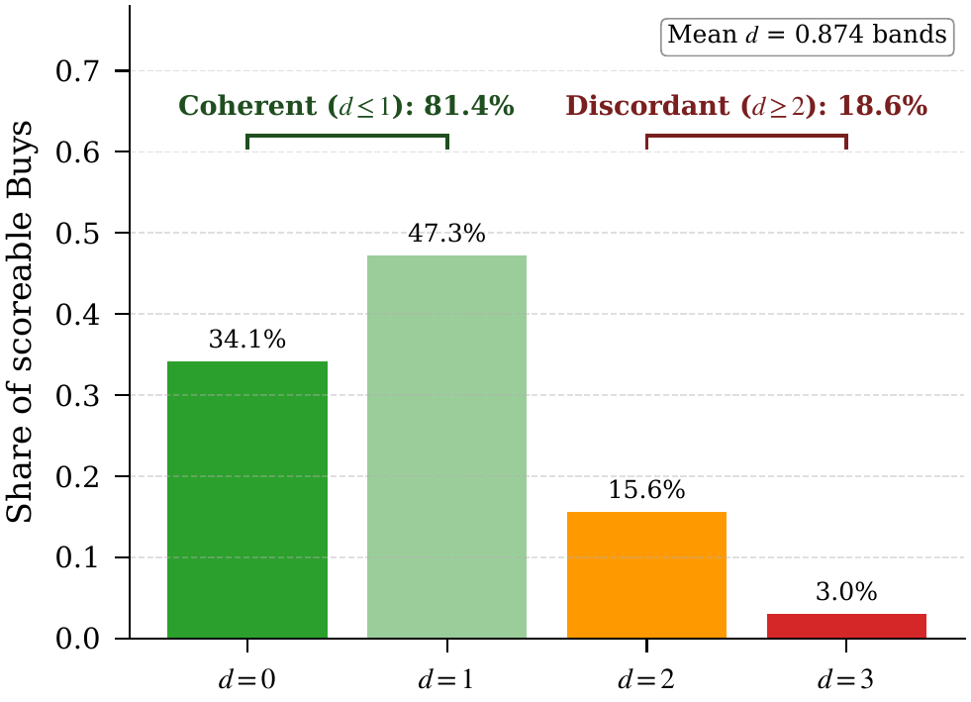
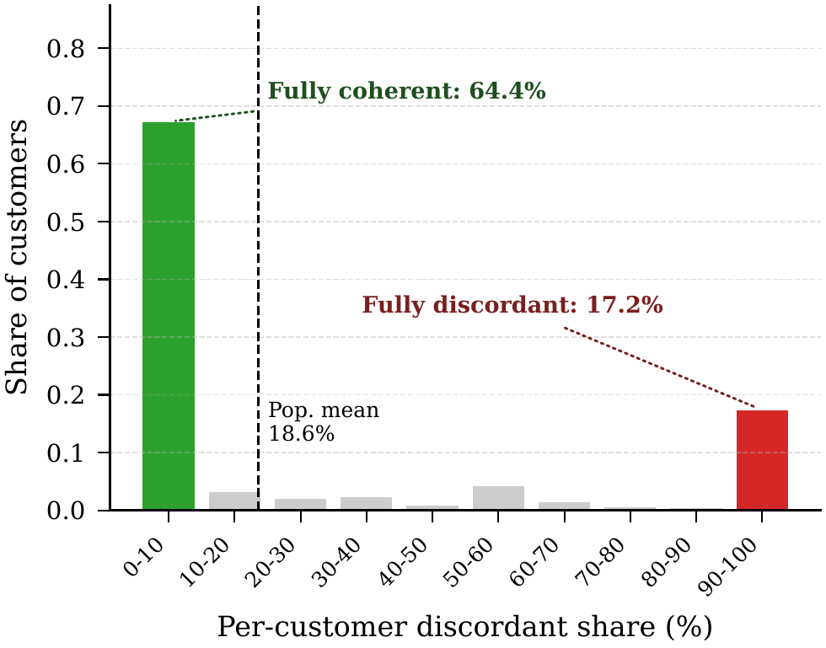
RQ1 · Discordance is common and customer-level
18.6% of 228,241 scoreable Buys breach the band by ≥ 2 steps. The trait is bimodal: 64.4% of customers fully coherent, 17.2% fully discordant (dip test p < 1e-15).
Transaction-level discordance d over scoreable Buys
Per-customer discordant share is sharply bimodal
Notes:
Now RQ1, the diagnosis, two findings on one slide. On the left, at the transaction level, 18.6% of scoreable Buys breach the band by two or more steps. That is nearly one in five, far too large to dismiss as noise. On the right, and this is the key result, the violations are not spread evenly. The per-customer distribution is sharply bimodal: 64% of customers are coherent on every Buy, and 17% are discordant on every Buy. A Hartigan dip test rejects a single mode at p below ten to the minus fifteen. So discordance is a structural customer-level trait, and a trait is something you can route on.

Slide 13
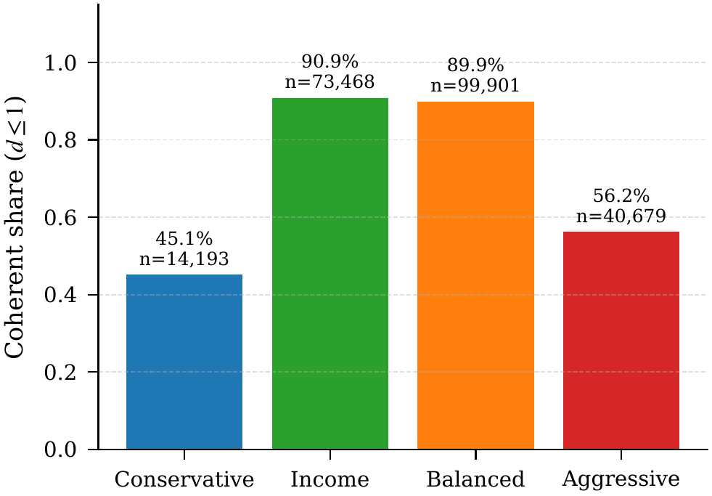
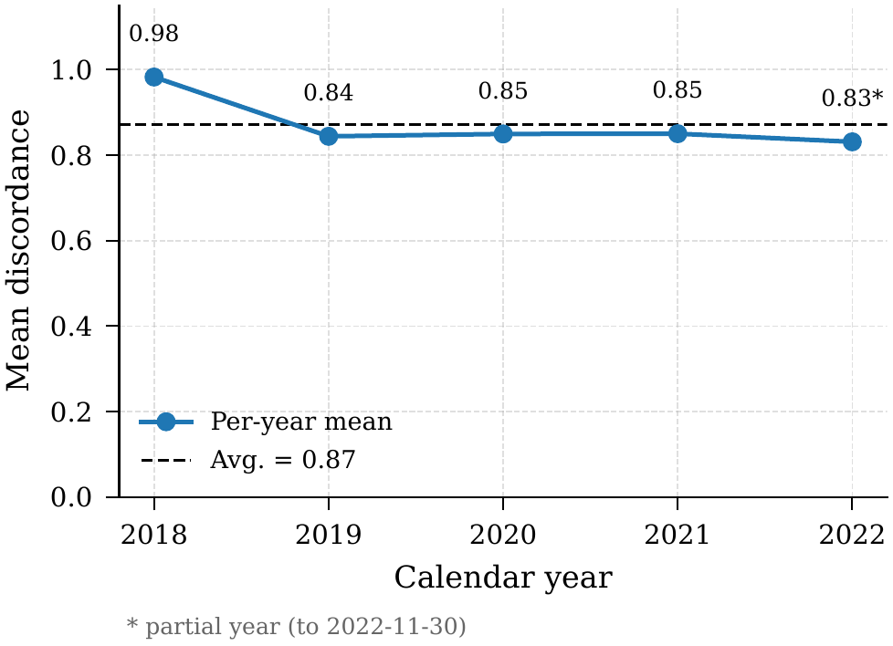
RQ1 · Robust across bands and across years
Coherence is U-shaped by band (extremes mismatch most: Conservative 45.1%, Aggressive 56.2%). Mean discordance is flat across 2019 to 2022 (within 0.02 bands).
Coherent share by declared band (U-shaped)
Mean discordance by year (2018 elevated: transition hypothesis)
Notes:
Two robustness checks so this does not look like an artefact. On the left, coherence by band is U-shaped. The extremes mismatch most, Conservative at 45% and Aggressive at 56%, while the middle bands sit near 90. That reinforces the bimodality. On the right, mean discordance is essentially flat from 2019 to 2022, within 0.02 of a band, so this is not driven by any single year's market regime. 2018 sits a little higher, and because MiFID came into force in the very first week of the data, we hypothesise a transition effect, though we do not test it.

Slide 14
RQ1 · Return-premium regression specification
Transaction-level OLS on 208,029 priced Buys, testing whether coherent Buys earn a different 6-month realised return
r = β0 + β1 · is_coherent + β2 · asset_volatility + C(type)·γ + C(year)·δ + ε
r = (p_end − p_start) / p_start, the 6-month realised return as a decimal fraction
Prices matched by backward-nearest join (last close on or before the date), dropping any Buy unmatched within 7 days at either endpoint
Cluster-robust SE on customerID, since each customer makes about 8 Buys whose residuals share unobserved shocks
Null hypothesis H0: β1 = 0, a two-sided Wald test at α = 0.05
Notes:
Before the result, the specification, because a careful examiner will ask. It is a transaction-level OLS on 208,000 priced Buys. The outcome is the six-month realised return, end price over start price minus one. The coefficient of interest is on is_coherent, a binary for distance at most one, and I control for asset volatility, customer segment, and year. Prices are matched with a backward-nearest join, the last close on or before each date, and I drop any Buy with no price within seven days at either end. Standard errors are clustered by customer, because each customer makes about eight Buys whose residuals share shocks, so treating them as independent would overstate significance. The null is simply that the coherence coefficient is zero.

Slide 15
RQ1 · Coherent Buys earn a return premium
Transaction-level OLS on 208,029 priced Buys, cluster-robust SE on customerID
Controls: asset volatility, customer segment, year
Coherent Buys earn +2.94 pp higher 6-month return
Controls absorb only 0.37 pp of the +3.31 pp raw gap (~11%)
No return tax for regulatory coherence
Term | Estimate | p-value
is_coherent | +2.94 pp | 2.3e-13
asset_volatility | -10.25 pp | 5.5e-10
year 2019 | +17.59 pp | 1.4e-42
year 2020 | +21.07 pp | 6.2e-259
year 2021 | +7.54 pp | 4.1e-46
year 2022 | -1.95 pp | 1.4e-05
customer_type (all) | n.s. | > 0.14
Key OLS coefficients (pp on 6-month return), reference year 2018
Notes:
This is the economic test, and it is the result I would defend hardest. A transaction-level OLS on 208,000 priced Buys, with standard errors clustered by customer, controlling for volatility, segment, and year. The coherence coefficient is plus 2.94 percentage points on six-month return, at p of ten to the minus thirteen. So coherent Buys earn more, not less. The controls barely move it: the raw gap is 3.31 points and conditioning removes only 0.37 of that. The headline is that there is no return tax for staying inside the risk profile, which removes the main objection to optimising for coherence.

Slide 16
RQ1 · Reading the controls: years and volatility
All four year dummies reject H0, reflecting distinct market regimes relative to the 2018 reference:
2019 (+17.59 pp): broad equity recovery after the December 2018 sell-off (CNBC, 2019)
2020 (+21.07 pp): rapid rebound from the COVID-19 sell-off, record highs by August (Reuters, 2020)
2021 (+7.54 pp): continued gains under accommodative policy before the expected Fed taper (Reuters, 2021)
2022 (-1.95 pp): aggressive Fed hiking drove a broad fixed-income drawdown (Reuters, 2022)
Volatility -10.25 pp per unit: low-volatility outperformance over 2019 to 2022 and the 2022 rate shock. customerType adds no return signal
Adjusted R² = 0.051: covariates explain little of individual-return variation, but the premium is still estimated precisely
Notes:
Quickly, what the controls say, since they are a good sanity check that the regression behaves. All four year dummies are significant and they line up with the actual market regimes relative to the 2018 base year. 2019 is strongly positive, the recovery after the late-2018 sell-off. 2020 is the largest, the rebound from the COVID crash to record highs by August. 2021 is positive but smaller, late-cycle gains before the Fed taper. And 2022 turns negative, the year aggressive rate hikes drove a broad drawdown. Those four are backed by news citations in the paper. Volatility is strongly negative, consistent with low-volatility outperformance over this window. And the R-squared is only about five percent, which is expected because individual returns are mostly idiosyncratic, but that concerns prediction, not the hypothesis test, and the premium itself is estimated precisely.

Slide 17
RQ2 · Temporal split protocol
69 temporal splits on an evenly spaced trading-day grid, approximately biweekly, following the FAR-Trans benchmark
Split points run August 2019 to December 2021, with per-split test windows extending coverage to May 2022
Per split, train = all Buys in [0, time_point], test = all Buys in [time_point, test_end]
Test set is deduplicated against training and filtered to the training-asset universe
Eligible customers have at least one interaction in both train and test, and eligible assets have prices on both endpoints
A rolling temporal protocol, so no test Buy is ever seen in training.
Notes:
RQ2 needs an evaluation protocol, so here it is. Sixty-nine temporal splits on a roughly biweekly trading-day grid, following the original FAR-Trans cadence. Split points run from August 2019 to December 2021, and the per-split test windows push coverage out to May 2022. For each split, training is everything up to the split point and the test set is the window just after, deduplicated against training and restricted to assets seen in training. A customer has to appear in both training and test to be eligible, and an asset needs prices at both endpoints. The important property is that it is strictly forward-looking, no test Buy leaks into training.

Slide 18
RQ2 · Baselines and hyperparameter grids
From the 11 FAR-Trans algorithms we audit the two leaders, each swept with Ray Tune on its own axis: LightGCN on nDCG@10, Random Forest on ROI@10
Model | Parameter | Search space | Best
LightGCN | embedding_dim | {64, 128} | 64
LightGCN | num_layers | {2, 3} | 3
LightGCN | learning_rate | {1e-2, 1e-3} | 1e-3
LightGCN | weight_decay / keep_prob | 1e-5 / 0.6 | fixed
LightGCN | epochs / batch_size | 50 / 1024 | fixed
Random Forest | num_estimators | {20, 30, 40, 50} | 40
Random Forest | max_depth | {15, 25, 50} | 50
Random Forest | horizon / random_state | 6 months / 42 | fixed
Grid rows are searched, fixed rows held constant.
Notes:
These are the two baselines and how they were tuned. Both are swept with Ray Tune, LightGCN on average nDCG and Random Forest on average ROI, each on its own best axis so we audit them at their strongest. For LightGCN the grid is embedding size, number of layers, and learning rate, with weight decay, dropout, epochs, and batch size fixed, and the best trial is 64 dimensions, three layers, and the smaller learning rate. For Random Forest the grid is the number of trees and the max depth, landing on forty trees at depth fifty, with a six-month horizon. I show the full grid so it is clear the audit is at each model's optimum, not a hobbled version.

Slide 19
RQ2 · Aggregate metrics at each model's optimum
Per-band audit method: average per-customer PC@10 over all (customer, split) pairs, then divide by π(b) for lift
LightGCN wins ranking, Random Forest wins ROI, and aggregate PC@10 looks adequate for both
Model | nDCG@10 | Recall@10 | ROI@10 | PC@10 | PC-lift@10
LightGCN | 0.330 | 0.495 | -0.005 | 0.794 | 1.17×
Random Forest | 0.019 | 0.036 | +0.014 | 0.667 | 1.06×
Aggregate over 69 splits. ROI@10 is per-month. PC-lift@10 = PC@10 / π(b).
But one aggregate number averages over bands whose π(b) ranges from 0.35 to 0.78.
Notes:
Start with the aggregate numbers before we break them down. The audit method is to average per-customer PC@10 across every customer and split, then divide by the chance baseline for lift. LightGCN clearly wins ranking, nDCG of 0.33 and recall around 0.5, but its ROI is slightly negative. Random Forest is the mirror image, near-random on ranking but positive on ROI. On coherence both look fine in aggregate, lift of 1.17 and 1.06. The catch, which the next slide exposes, is that this single PC number averages across bands whose chance baselines run from 0.35 up to 0.78, so it can hide a lot.

Slide 20
RQ2 · Aggregate hides a per-band deficit
Aggregate PC@10 looks adequate: LightGCN 1.17×, RF 1.06×
Per band, both skew to higher-risk assets and under-serve the low bands
Lift rises monotonically with the band: coherence is a passive byproduct, not a controlled output
Aggressive clears easily because π = 0.35 is the lowest bar
Model | Band | π(b) | PC@10 | lift
RF | Conservative | 0.65 | 0.34 | 0.52×
RF | Income | 0.78 | 0.54 | 0.70×
RF | Balanced | 0.76 | 0.79 | 1.03×
RF | Aggressive | 0.35 | 0.66 | 1.88×
LightGCN | Conservative | 0.65 | 0.48 | 0.75×
LightGCN | Income | 0.78 | 0.88 | 1.13×
LightGCN | Balanced | 0.76 | 0.89 | 1.17×
LightGCN | Aggressive | 0.35 | 0.47 | 1.35×
Per-band PC@10 and PC-lift@10 vs π(b), 69 splits; lift below 1 in red
Notes:
The answer is no, and you would miss it from the aggregate. Aggregate lift looks fine, 1.17 for LightGCN and 1.06 for Random Forest. But broken out by band, both under-serve the low bands. Look at Conservative: LightGCN at 0.75 and Random Forest at 0.52, both below random. For both models lift rises monotonically with the band, which means they skew toward higher-risk assets. Aggressive looks strong, but that is mechanical, its bar is only 0.35. Neither model has band labels or a band-aware loss, so coherence here is an accident of training rather than a controlled output.

Slide 21
RQ3 · A profile-coherent LightGCN
Band-stratified LightGCN
Three components on a LightGCN backbone: (1) stratify per band · (2) coherence-margin loss · (3) regroup onto the revealed band
Conservative
Income
Customer u
band b_u
Band
Router
Scores
s(u, i)
Top-k
list
Balanced
Inference
Aggressive
L_BPR
λ · L_coh
Training
Notes:
RQ3 is the fix, three components on a LightGCN backbone. First, stratify: train four sub-models, one per band, and route each customer to theirs. Second, add a coherence-margin loss on top of BPR. Third, regroup: relabel each customer onto the band their actual purchases imply. The diagram shows the flow. A customer hits the router, goes into the band-stratified sub-models, comes out as scores, and then either the top-k list at inference or the two losses at training. The next two slides cover the loss and the regrouping.

Slide 22
RQ3 · Why extend LightGCN, not Random Forest
LightGCN
Differentiable BPR loss: the coherence margin attaches directly at training time
Per-customer embeddings over the user-item graph: a user-level signal to condition on
Random Forest
Ranks assets by predicted return from technical indicators alone
No customer-level signal to condition on, so it is not extended
The extension needs a differentiable, customer-conditioned scorer, and LightGCN is the natural backbone.
Notes:
A quick justification for why the fix targets LightGCN and not Random Forest, since Random Forest actually won on ROI. Two reasons, both structural. LightGCN has a differentiable BPR loss, so I can attach the coherence margin directly as another loss term at training time. And it learns per-customer embeddings, so there is an actual user-level representation to condition on. Random Forest has neither: it ranks purely from technical indicators of the asset, with no customer-side signal to push on, so there is nothing to attach a coherence objective to. The extension needs a differentiable, customer-conditioned scorer, and LightGCN is the natural choice.

Slide 23
RQ3 · Coherence margin, total loss, regrouping
Coherence margin: sample one coherent asset i_c (d ≤ 1) and one discordant asset i_d (d > 1), push the coherent score above the discordant one
L_coh(u) = softplus( s(u, i_d) − s(u, i_c) )
L = L_BPR + ω ‖Θ‖² + λ · L_coh
softplus(x) = ln(1 + e^x): a smooth, everywhere-differentiable hinge matching BPR's −ln σ(·) form
Regrouping: reassign each customer to the band implied by purchases (lower median of bought-asset risk classes, ties → more conservative)
Notes:
The margin loss. Independently of BPR, we sample one coherent asset and one discordant asset and push the coherent score above the discordant one through a softplus. We use softplus rather than a hard hinge because it is differentiable everywhere and it matches BPR's own log-sigmoid form, so the two terms stay consistent. Lambda sets its weight. Regrouping is even simpler: reassign each customer to the lower median of the risk classes of the assets they bought, with ties going conservative. The logic is that RQ1 already told us the declared bands are noisy, so we correct the label instead of fighting it with a penalty.

Slide 24
RQ3 · Ablation and evaluation setup
The stratified PC-LightGCN inherits the best LightGCN trial's backbone hyperparameters
Two trials on the same 69 splits isolate each component:
λ = 0: stratified BPR alone, isolating the architecture
λ = 1: adds the coherence margin on top
Regrouping is evaluated by rerunning the same λ ∈ {0, 1} ablation on the regrouped bands
Every metric is reported against the baseline LightGCN
Five configurations: baseline, declared λ ∈ {0,1}, and regrouped λ ∈ {0,1}.
Notes:
The ablation is designed to separate the three components cleanly. The stratified model inherits the best LightGCN backbone hyperparameters, so any difference comes from the intervention, not retuning. Lambda zero is stratified BPR alone, which isolates the architecture. Lambda one adds the coherence margin, which isolates the loss. Then I rerun that pair on the regrouped bands, which isolates regrouping. That gives five configurations: the baseline, declared at lambda zero and one, and regrouped at lambda zero and one. Every number is reported as a delta against the baseline LightGCN.

Slide 25
RQ3 · Coherence gained at near-zero ranking cost
Trial | nDCG@10 | ROI@10 | Recall@10 | PC@10 | PC-lift@10
Baseline LightGCN | 0.330 | -0.005 | 0.495 | 0.794 | 1.17×
Declared · Stratify (λ=0) | 0.332 | -0.007 | 0.501 | 0.821 | 1.19×
Declared · Stratify + PC (λ=1) | 0.309 | -0.007 | 0.467 | 0.918 | 1.40×
Regrouped · Stratify (λ=0) | 0.352 | -0.006 | 0.522 | 0.949 | n/a
Regrouped · Stratify + PC (λ=1) | 0.333 | -0.005 | 0.493 | 0.982 | n/a
Declared λ=1 lifts PC@10 0.794 → 0.918 (+12.4 pp): stratification is cheap (+2.7 pp), the margin buys the rest at a bounded ranking cost
Regrouped λ=0 is the recommended operating point: PC@10 0.949 while also raising nDCG and Recall, ROI flat
Notes:
Results. Reading down the table: declared lambda equal to one lifts PC@10 from 0.79 to 0.92, a twelve-point gain. Decomposed, stratification alone is cheap and buys about a quarter of that at no real cost. The margin buys the rest, but it spends a couple of points of nDCG and Recall to do it. Now the highlighted row, regrouped with lambda zero: PC@10 of 0.949, higher than the full declared treatment, and crucially nDCG and Recall go up rather than down, with ROI flat. That is the recommended operating point. Correcting the label beats penalising the model.

Slide 26
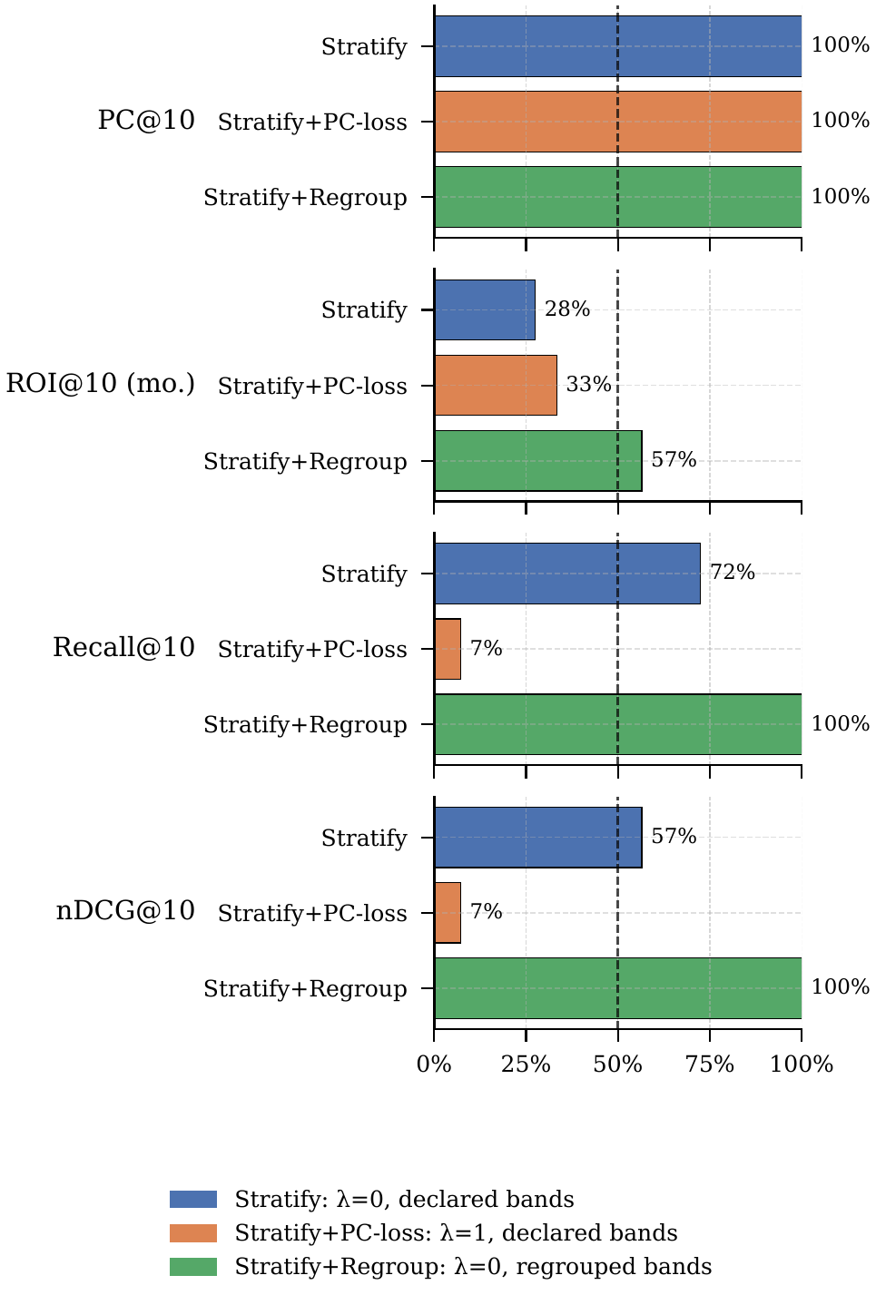
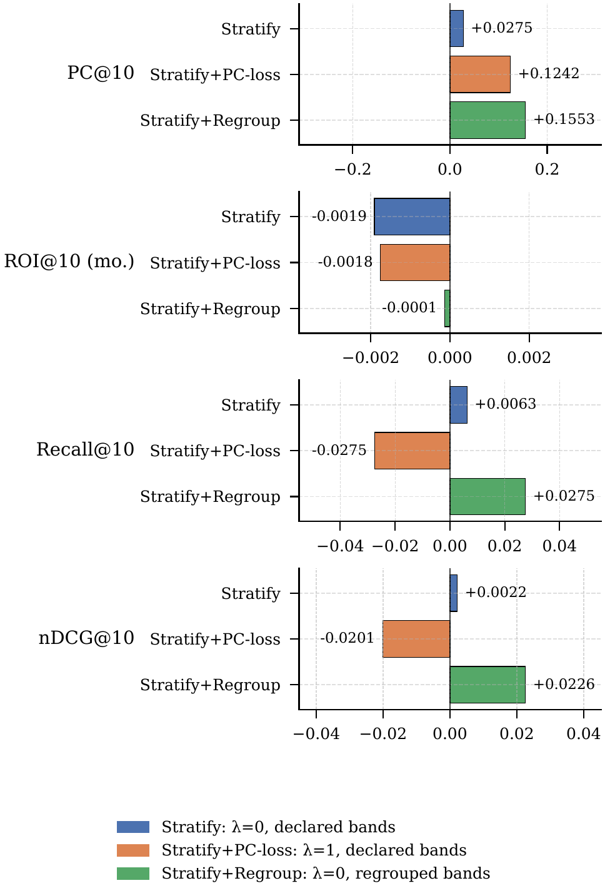
RQ3 · Regrouping is the winning lever
Regrouped λ=0 wins on every one of the 69 splits for PC@10, nDCG, and Recall, with ROI flat. Correcting labels beats penalising incoherence.
Per-split win rate vs baseline
Paired per-split deltas vs baseline
Notes:
This is the per-split evidence that the regrouping win is real and not an averaging effect. On the left, win rates: regrouped lambda zero beats the baseline on all 69 splits, simultaneously on coherence, ranking, and recall. On the right, the actual deltas split by split: coherence is positive on every single split, and the ranking metrics are positive too, exactly where the margin loss was negative. So the gain is uniform across every split, not a few lucky ones. And because nDCG and Recall do not depend on the band, their improvement is direct evidence that the declared bands were injecting label noise.

Slide 27
RQ3 · Every band clears the random baseline
Band | Baseline | Decl λ=0 | Decl λ=1 | Regr λ=0 | Regr λ=1
Conservative | 0.75× | 0.91× | 1.19× | 1.21× | 1.25×
Income | 1.13× | 1.20× | 1.26× | 1.25× | 1.27×
Balanced | 1.17× | 1.22× | 1.28× | 1.24× | 1.30×
Aggressive | 1.35× | 1.17× | 1.97× | 2.24× | 2.68×
Per-band PC-lift@10. Conservative crosses random only once the margin or regrouping is applied; regrouped columns lift all four bands above π(b).
Aggressive climbs to 2.68×: its low π(b) = 0.35 makes the bar easy to clear once routing is band-aware
Notes:
Last results slide, the per-band breakdown, and the story is Conservative, the band everyone failed. Baseline 0.75, below random. Stratification alone lifts it to 0.91, still below. Only the margin, or regrouping, finally pushes it over the line. Under the regrouped columns every band clears random for the first time. Aggressive jumps to 2.68, partly because its bar is so low. The point is that the intervention specifically rescues the band the baselines neglected, rather than just inflating an aggregate.

Slide 28
Limitations · RQ1 and RQ2
RQ1, observational nature: the coherence premium is associational. Unobserved confounders such as financial literacy, advisor channel, account constraints, and prior portfolio are not ruled out
RQ1, asset-band assignment: bands come from a hierarchical heuristic, not an external classification, so any mislabelling (especially the stock volatility step) propagates into every coherence number
RQ2, single operating point: each baseline is audited only at its primary-metric optimum, not swept across the full grid
RQ2, baseline-relative reading: per-band lift must be read against its π(b), since low-π(b) bands such as Aggressive clear the bar more easily
Notes:
Limitations for the first two questions, and I want to be direct. The RQ1 premium is associational, full stop. I control for volatility, segment, and year, but I cannot rule out confounders like financial literacy, advisor channel, or account constraints, so I do not claim causation. The asset bands are the bigger caveat: they come from my own three-step heuristic, not an external classification, the stock volatility step in particular could mislabel, and any mislabelling flows into every coherence number in the paper. For RQ2, the audit is at each model's single best operating point, not a full grid sweep, and the per-band lifts have to be read against their chance baseline, because a low-baseline band like Aggressive clears the bar easily.

Slide 29
Limitations · RQ3
Single backbone and operating point: the intervention extends only LightGCN and reports a single λ=1 Pareto point on inherited best-trial hyperparameters, rather than re-tuning end-to-end
So the coherence gains are a lower bound and the nDCG and Recall costs an upper bound on a full frontier sweep
Regrouping leakage and tautology: revealed bands use each customer's full Buy history, so they carry look-ahead relative to each split, and the regrouped PC@10 gain is partly guaranteed by construction
The trustworthy signal is the simultaneous nDCG, Recall, and ROI gains, none of which is defined relative to the band
A per-split regrouping variant using training-window Buys only is left as future work.
Notes:
And the RQ3 limitations, including the one I would raise on myself before anyone else does. I extend only LightGCN, at a single lambda, on inherited hyperparameters, so the coherence gains are really a lower bound and the ranking costs an upper bound on what a full sweep could do. The important one is regrouping leakage. The revealed bands are computed from each customer's entire Buy history, so they carry look-ahead relative to any given split, and because I then score coherence against those same bands, part of the regrouped coherence gain is true by construction. That is exactly why I lean on the ranking and return gains instead, nDCG, recall, and ROI, none of which is defined relative to the band, so they cannot be inflated this way. A per-split version using only training-window purchases is the obvious fix and is future work.

Slide 30
Future work
Causal identification: instrumental variables or difference-in-differences across a regulatory boundary, also testing the 2018 transition hypothesis
Metric calibration: data-driven tolerance instead of a fixed d ≤ 1, and band assignment validated against external MiFID II classifications
Broader interventions: apply stratification and the margin to sequential, transformer, and content-based recommenders, with a full Pareto sweep
Online evaluation: bridge realised return on executed Buys and forward return on recommended slates via off-policy or online tests, across jurisdictions
Notes:
Future directions follow from those limitations. Causal identification with instrumental variables or difference-in-differences across a regulatory boundary, which would also let us test the 2018 transition hypothesis directly. Data-driven calibration of both the tolerance and the band assignment, validated against real fund classifications. Extending the treatment beyond LightGCN to sequential and transformer recommenders with a full Pareto sweep. And bridging realised return on executed Buys with forward return on recommended slates through online or off-policy evaluation.

Slide 31
Conclusion
Regulatory coherence and economic return are not in structural conflict on FAR-Trans: coherence is an architectural choice, not a post-hoc tradeoff.
RQ1: discordance is a structural customer-level trait, and coherent Buys earn a significant return premium
RQ2: both FAR-Trans baselines under-serve specific declared bands in ways the aggregate metrics hide
RQ3: stratification with regrouping lifts PC@10 to 0.949 while also improving nDCG and Recall, at no ROI cost
Regulatory suitability can be encoded as a training-time objective, not a filtering step.
Notes:
To conclude. The central finding is that regulatory coherence and economic return are not in structural conflict on this data. You can make a recommender meaningfully more profile-coherent and keep the return story intact. RQ1 showed the trait is real and earns a premium. RQ2 showed the baselines hide per-band failures. RQ3 showed that stratification with regrouping lifts coherence to 0.95 while also improving ranking, at no return cost. The broader message is that suitability, and regulatory constraints more generally, can be encoded as a training objective rather than a post-hoc filter.

Slide 32
Thank you
Code, configuration grids, and evaluation artefacts:
github.com/Samthesimpsons/SMU-Capstone
Samuel Sim Wei Xuan · samuel.sim.2024@msc.smu.edu.sg
Notes:
That is the work. All code, configuration grids, and evaluation artefacts are in the linked repository. Thank you, and I am happy to take questions, especially on the metric design or on the regrouping leakage point, which I expect someone will push on.

