Slide 1
Risk-Based Segmentation for Financial Asset Recommendation
Balancing Return, Accuracy and Risk Suitability
Samuel Sim
Master of Science in Computing (Capstone)
samuel.sim.2024@msc.smu.edu.sg

Slide 2
01 Introduction
Financial Asset Recommendation

Slide 3
What is Financial Asset Recommendation (FAR)?
Ranking financial products for an investor
Contains many signals:
Investor side: past transactions, declared risk tolerance, etc.
Market side: asset prices, returns, volatility, inflation, etc.
Markets in Financial Instruments Directive II (MiFID II) is a EU regulation requires a suitability check before product recommendation
Product risk needs to align with the customer's declared risk band

Slide 4
1st Open Public Dataset: FAR-Trans
Consisting of 29,090 customers and 806 assets
Collected from a large EU institution between Jan 2018 and Nov 2022
Customer ID | Customer Type | Risk level | Capacity | ISIN | Type | Date | Value | Units | Channel
73D…534D | Mass | Conservative | Less than 30k | GRS260333000 | Buy | 2018-01-02 | 47 | 4 | Branch
2AF…44B2 | Premium | Income | Less than 30k | GRS343313003 | Buy | 2021-07-12 | 1876 | 7000 | Branch
6F8…71BC | Premium | Balanced | 30k to 80k | GRS343313003 | Buy | 2018-01-02 | 1869 | 1600 | Internet Banking
8C9…43BB | Premium | Aggressive | 80k to 300k | GRS298343005 | Buy | 2022-09-22 | 500 | 80 | Phone Banking
ISIN | Asset Name | Category | Sub-category | Market | Date | Closing Price
CH0198251305 | Coca-Cola Hellenic Bottling | Stock | Large Cap | XATH | 2022-11-29 | 23.240
AU3CB0237881 | Apple Inc. | Bond | Corporate | XETR | 2020-05-27 | 67.893
DE0005933956 | iShares Core EURO STOXX 50 ETF | MTF | Equity | XETR | 2022-11-29 | 39.660
Notes:
Closes the gap left by proprietary or simulated datasets

Slide 5
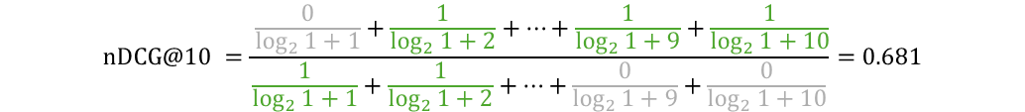
The FAR-Trans benchmarking
Benchmarked against 11 machine learning approaches
Evaluated on (1) ranking accuracy and (2) realised return
For ranking accuracy, Normalized Discounted Gain (nDCG@10) was used
1
2
3
4
5
6
7
8
9
10
Predicted:
Reordered (ideal):
$$\text{nDCG}\text{@10 }=\frac{ \frac{0}{\log_{2}{1+1}}+\frac{1}{\log_{2}{1+2}}+…+\frac{1}{\log_{2}{1+9}}+\frac{1}{\log_{2}{1+10}}}{\frac{1}{\log_{2}{1+1}}+\frac{1}{\log_{2}{1+2}}+…+\frac{0}{\log_{2}{1+9}}+\frac{0}{\log_{2}{1+10}}}=0.681$$

Slide 6
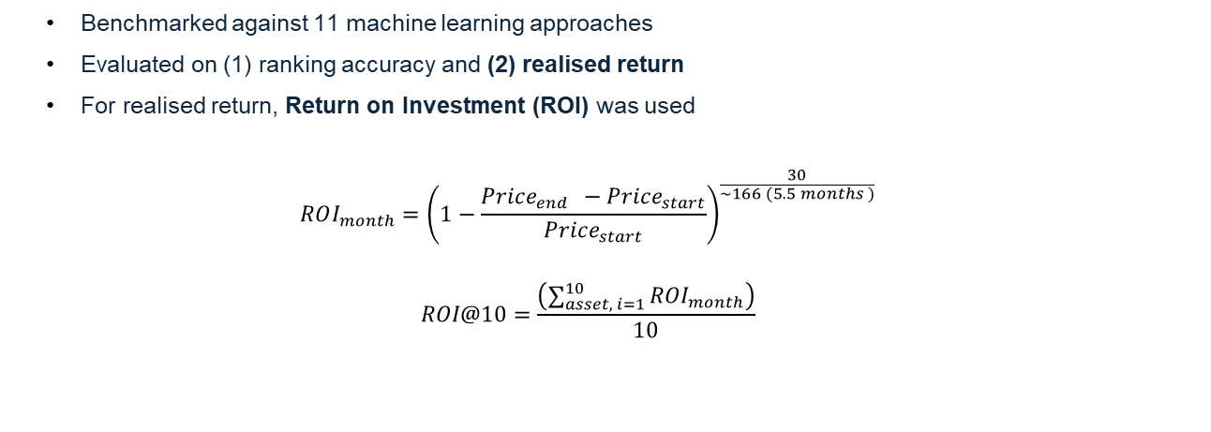
The FAR-Trans benchmarking
Benchmarked against 11 machine learning approaches
Evaluated on (1) ranking accuracy and (2) realised return
For realised return, Return on Investment (ROI) was used
$$ROI_{month}={\left(1−\frac{Price_{end } −Price_{start}}{Price_{start}}\right)}^{\frac{30}{\sim 166 (5.5 months )}}$$
$$ROI@10=\frac{\left(\sum_{asset, i=1}^{10}{ROI_{month}}\right)}{10}$$
Notes:
LightGCN: graph collaborative filter over the user–item bipartite graph, strongest ranking model (nDCG)
Random Forest: tree ensemble over tabular customer/asset features, strongest returns model (ROI)

Slide 7
Filling in the missing gap of risk suitability
Current gap: Risk suitability is not evaluated
Existing Work: Post-hoc re-ranking of recommendations to adjust for risk ^{[1]}
3 contributions:
1
Analytical Study:
Measure of discoherence (mismatch of transacted asset to customer’s risk band)
2
Methodology
Risk-based segmentation LightGCN modelling with 2 extra extensions
3
Experimental Study:
Ablation studies; Evaluated on ranking accuracy, returns and risk suitability
[1] Sakurai et al., Risk-Aware Utility Re-Ranking for Financial Asset Recommendation (RURA), WSDM '26

Slide 8
02 Analytical Study
FAR-Trans Dataset

Slide 9
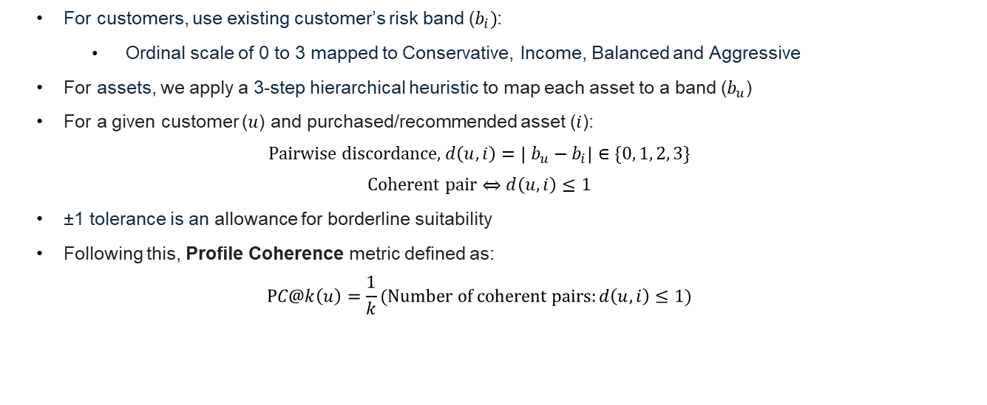
Measuring Risk Suitability via Profile Coherence
For customers, use existing customer’s risk band ($b_{i})$:
Ordinal scale of 0 to 3 mapped to Conservative, Income, Balanced and Aggressive
For assets, we apply a 3-step hierarchical heuristic to map each asset to a band ($b_{u}$)
For a given customer ($u$) and purchased/recommended asset ($i$):
$$\text{Pairwise} \text{discordance}\text{, }d\left(u,i\right)=\left| b_{u}−b_{i}\right|∈\{0, 1, 2, 3\}$$
$$\text{Coherent} \text{pair}⇔d\left(u,i\right)≤1$$
±1 tolerance is an allowance for borderline suitability
Following this, Profile Coherence metric defined as:
$$PC@k\left(u\right)=\frac{1}{k}(\text{Number} \text{of} \text{coherent} \text{pairs}:d\left(u,i\right)≤1)$$
Notes:
Step 1: subcategory metadata. Mutual funds: Money-Market to Conservative, Bond to Income, Balanced to Balanced, Equity/Large-Cap to Aggressive. Bonds by issuer: Government to Conservative, Corporate to Income, else Income
Step 2: volatility quartiles. Untagged assets (mostly stocks): annualised SD of daily log-returns over a trailing 252-day window, bucketed into 4 bands by stock-calibrated quartiles (q₁, q₂, q₃)
Step 3: residual default. Anything left to Balanced

Slide 10
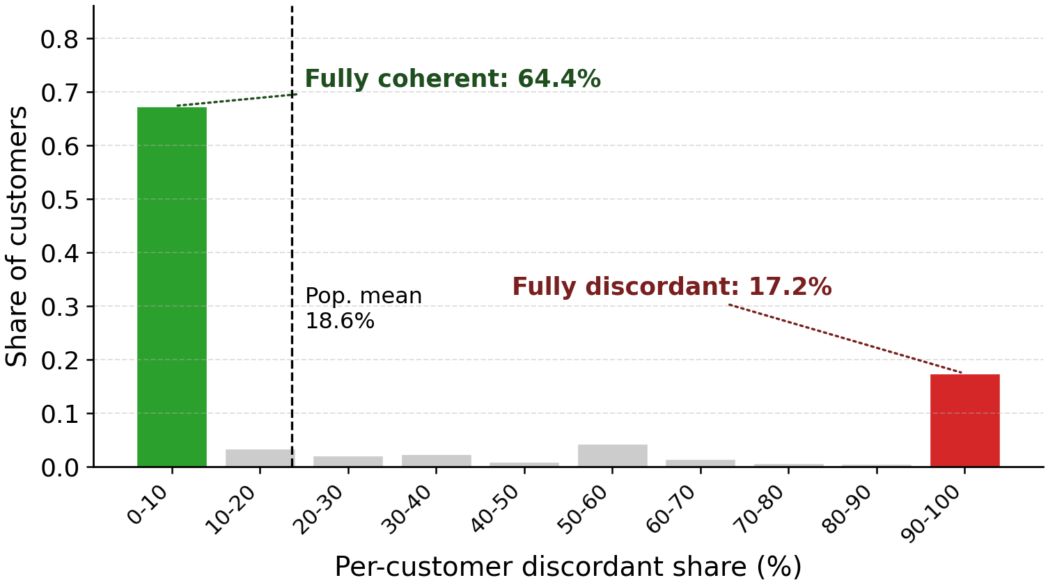

Discordance is prevalent and it is a customer-level trait
Additionally, a Hartigan's dip test of $\text{p}\text{-}\text{valu}e<10⁻¹⁵$rejects unimodality
Notes:
Hartigan's dip test: the max distance between the empirical CDF and the best-fit unimodal CDF
Empirical CDF is just the fraction of customers whose discordant share ≤ x
A high D / low p rejects unimodality
Our D = 0.086, p < 10⁻¹⁵ confirms the discordant-share distribution is not a single bump with noise

Slide 11
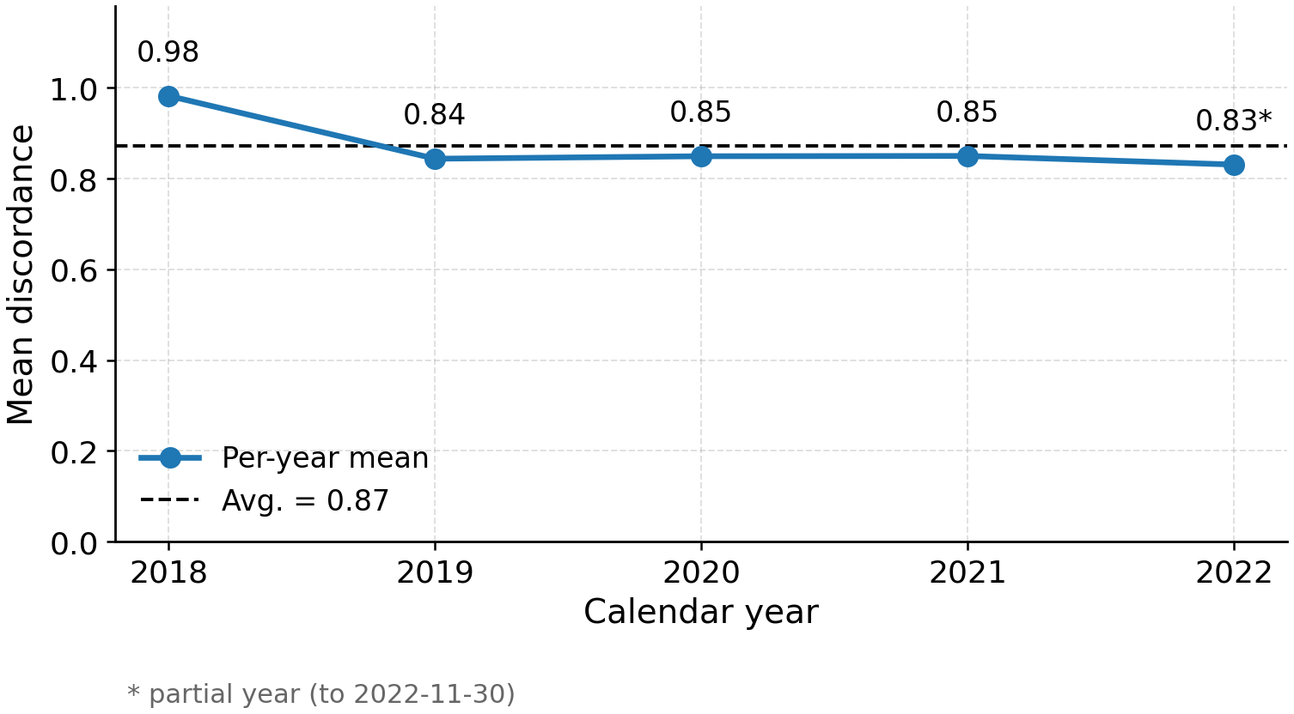
Discordance is not a single-year artefact
MiFID II took force 2018-01-03, the exact start of FAR-Trans
Higher 2018 value hypothesized to be a transition-effect

Slide 12
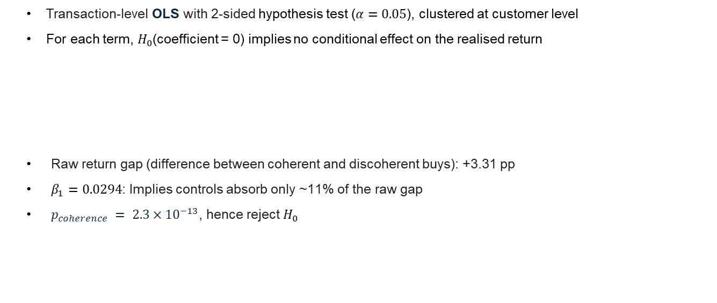


Regression Study
Transaction-level OLS with 2-sided hypothesis test ($α=0.05$), clustered at customer level
For each term, $H_{0}$(coefficient = 0) implies no conditional effect on the realised return
Raw return gap (difference between coherent and discoherent buys): +3.31 pp
$β_{1}=0.0294$: Implies controls absorb only ~11% of the raw gap
$p_{coherence} = 2.3×{10}^{−13}$, hence reject $H_{0}$
$$Realised return (6 \text{months}) \sim β_{0}+β_{1}∙coherent+β_{2}∙volatility_{asset}+$$
$$C\left(customer_{type}\right)∙γ+$$
$$C\left(year\right)∙δ+ε$$
Notes:
On 208,029 priced buys
For each term, we need to hold other covariates fixed
Year effect all significant
Customer type all not significant

Slide 13
03 Methodology
Risk-based Segmentation Modeling

Slide 14


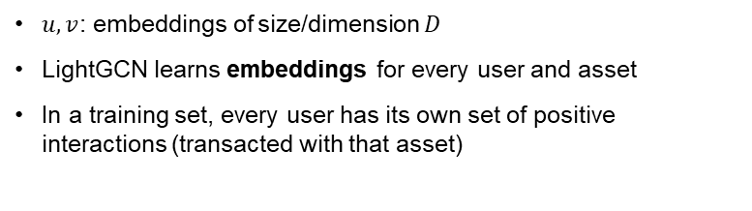





LightGCN: Bipartite Graph
Assets
$u, v$: embeddings of size/dimension $D$
LightGCN learns embeddings for every user and asset
In a training set, every user has its own set of positive interactions (transacted with that asset)
Users
$$v_{0}$$
$$u_{0}$$
$$v_{1}$$
$$u_{1}$$
$$v_{2}$$
$$u_{2}$$
Positive
Interactions
…
$$v_{3}$$
…
Notes:
Top ranking accuracy model: LightGCN
Top return model: Random Forest carries no customer-level signal to segment, so not extended

Slide 15
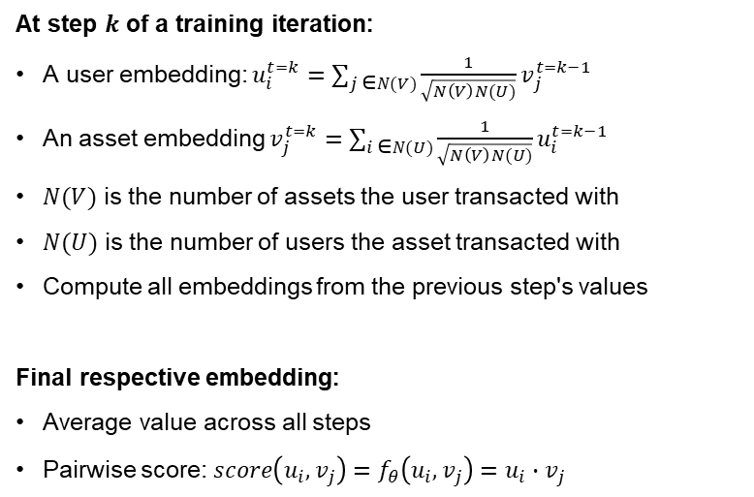
LightGCN baseline model – Forward Propagation
Assets
At step $k$ of a training iteration:
A user embedding: $u_{i}^{t=k}=\sum_{j \text{∈}N(V)}{{\frac{1}{\sqrt{N\left(V\right)N(U)}}v}_{j}^{t=k−1}}$
An asset embedding $v_{j}^{t=k}=\sum_{i \text{∈}N(U)}{{\frac{1}{\sqrt{N\left(V\right)N(U)}}u}_{i}^{t=k−1}}$
$N(V)$ is the number of assets the user transacted with
$N(U)$ is the number of users the asset transacted with
Compute all embeddings from the previous step's values
Final respective embedding:
Average value across all steps
Pairwise score: $score\left(u_{i},v_{j}\right)=f_{θ}\left(u_{i}, v_{j}\right)=u_{i}∙v_{j}$
Users
$$v_{0}$$
$$u_{0}$$
$$v_{1}$$
$$u_{1}$$
$$v_{2}$$
$$u_{2}$$
Positive
Interactions
…
$$v_{3}$$
…

Slide 16
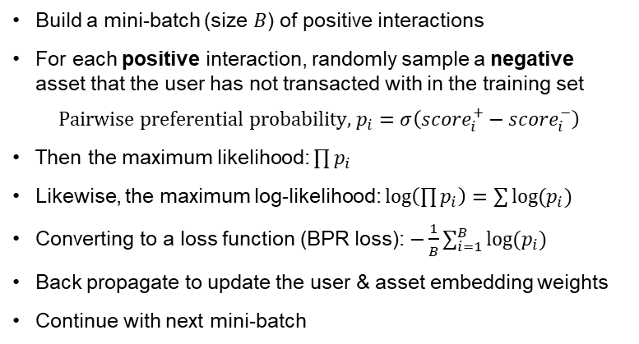
LightGCN baseline model – Back Propagation
Positive
Interactions
Assets
Build a mini-batch (size $B$) of positive interactions
For each positive interaction, randomly sample a negative asset that the user has not transacted with in the training set
$$\text{Pairwise} \text{preferential} \text{probability}\text{,} p_{i}=σ\left({score}_{i}^{+}−score_{i}^{−}\right)$$
Then the maximum likelihood: $\prod{p_{i}}$
Likewise, the maximum log-likelihood: $\log\left(\prod{p_{i}}\right)=\sum{{log⁡(p}_{i})}$
Converting to a loss function (BPR loss): $−\frac{1}{B}\sum_{i=1}^{B}{\log{(p_{i})}}$
Back propagate to update the user & asset embedding weights
Continue with next mini-batch
Users
$$v_{0}$$
$$u_{0}$$
$$v_{1}$$
$$u_{1}$$
$$v_{2}$$
$$u_{2}$$
…
$$v_{3}$$
Negative
Interactions
…
Notes:
We use this BPR loss as it is differentiable (surrogate loss) compared to nDCG which is non-differentiable

Slide 17


Risk-based segmentation approach
Approach 2 (data lever):
Regroup customers to revealed band
Conservative sub-model
Income sub-model
Evaluate on:
Ranking accuracy (nDCG)
Returns (ROI)
Risk suitability (PC)
With a harmonic balance
FAR-Trans
Data
Risk-band
router
Balanced sub-model
Aggressive sub-model
$$Balance=3{\left(\frac{1}{ROI^{′}}+\frac{1}{nDCG}+\frac{1}{PC}\right)}^{−1}$$
Approach 1 (model lever):
Add a coherence margin loss
$$ROI^{′}=\frac{1}{1+e^{−ROI/0.01}}$$

Slide 18
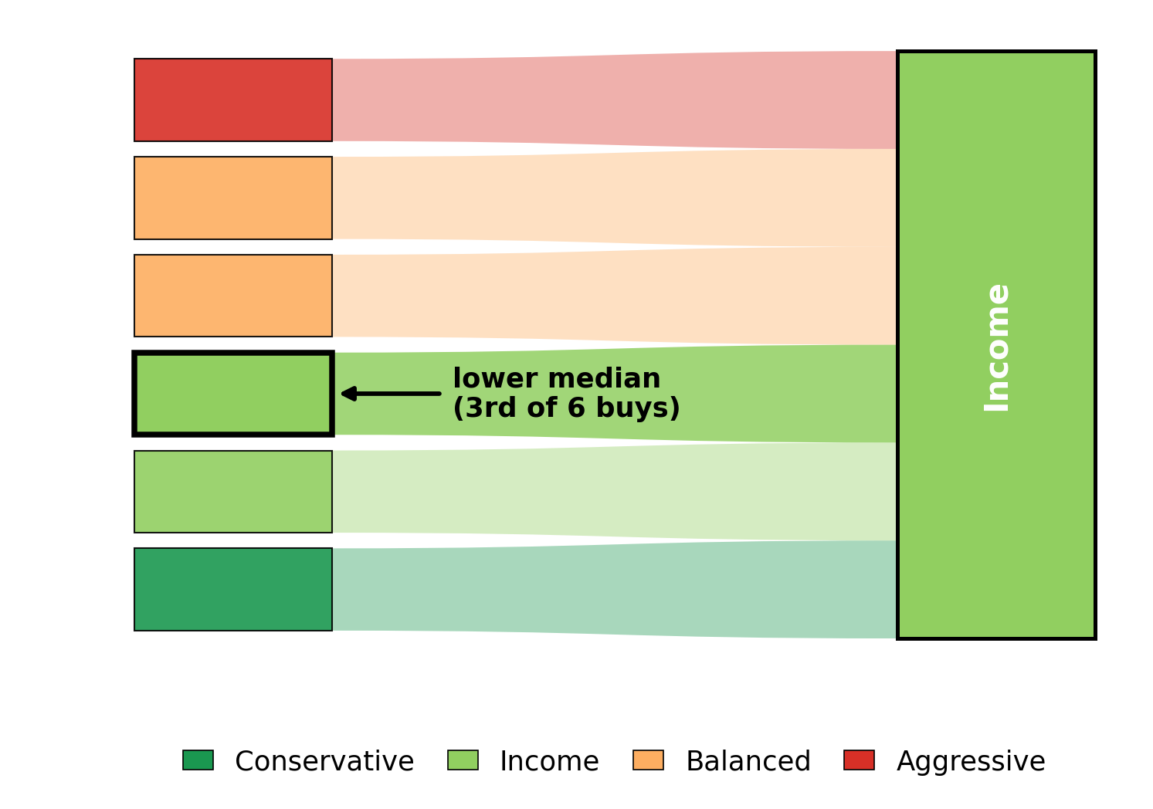
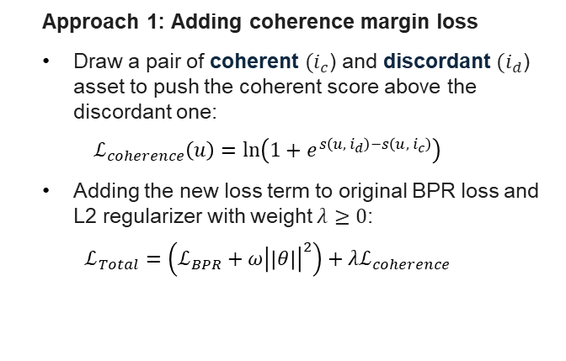
Alternative approaches
Approach 1: Adding coherence margin loss
Draw a pair of coherent $(i_{c}$) and discordant $(i_{d}$) asset to push the coherent score above the discordant one:
$$ℒ_{coherence}\left(u\right)=\ln\left(1+e^{s\left(u, { i}_{d}\right)−s\left(u, i_{c}\right)}\right)$$
Adding the new loss term to original BPR loss and L2 regularizer with weight $λ≥0$:
$$ℒ_{Total}=\left(ℒ_{BPR}+ω{\left|\left|θ\right|\right|}^{2}\right)+{λℒ}_{coherence}$$
Approach 2: Regrouping Customers
Regroup customers based on their lower median purchase:
Notes:
Softplus is just smooth version of ReLU
Bands are ordinal, so the median is the scale-correct, outlier-robust summary that returns a real band
Rounding ties down keeps the bias conservative, the safe direction under MiFID II

Slide 19
04 Experimental Setup
Data preparation and hyperparameters

Slide 20
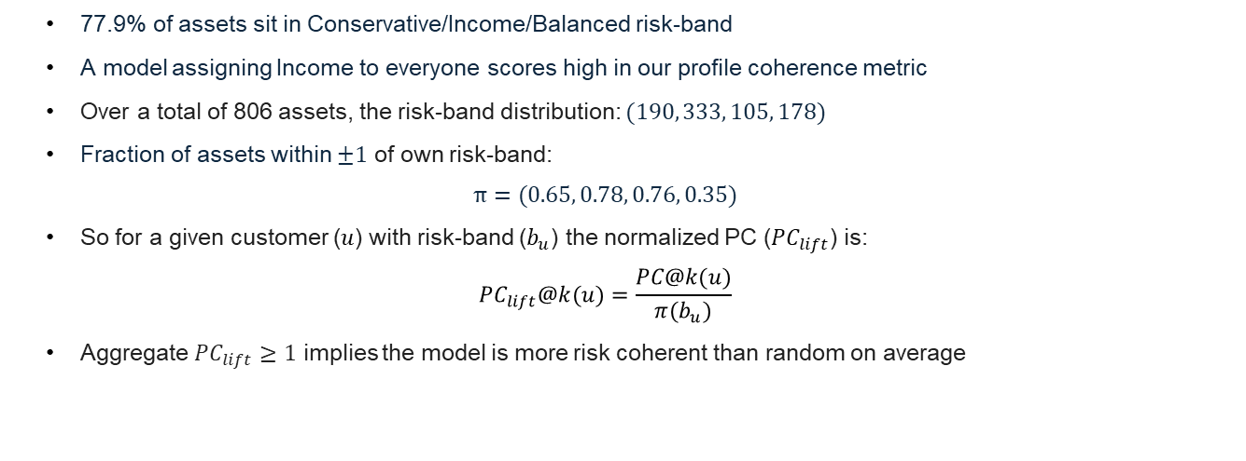
Normalisation of risk suitability metric
77.9% of assets sit in Conservative/Income/Balanced risk-band
A model assigning Income to everyone scores high in our profile coherence metric
Over a total of 806 assets, the risk-band distribution: $(190, 333, 105, 178)$
Fraction of assets within $±1$ of own risk-band:
$$π=(0.65, 0.78, 0.76, 0.35)$$
So for a given customer ($u$) with risk-band ($b_{u}$) the normalized PC ($PC_{lift}$) is:
$$PC_{lift}@k(u)=\frac{PC@k(u)}{π(b_{u})}$$
Aggregate $PC_{lift}≥1$ implies the model is more risk coherent than random on average

Slide 21
Data training test split
Each cutoff walk forwards ~13 days (biweekly)
Training window
Cumulative buys
Test window
Split 1
Each test window is ~5.5 months (semi-annual)
Split 2
Split 3
…
Split 68
…
Split 69
…
Jan 2018 (Start)
May 2022 (End)
1st cutoff
Aug 2019
Last cutoff
Dec 2021
Notes:
Following the original FAR-trans paper split

Slide 22
Configurations & hyperparameter grids
Random Forest (scored highest return in original paper)
LightGCN (scored highest ranking accuracy in original paper)
Model | Param | Search | Best
LightGCN | Dimension of Embedding layers | 64, 128 | 64
LightGCN | Number of layers | 2, 3 | 3
LightGCN | Learning rate | 0.01, 0.001 | 0.001
Random Forest | Number of estimators | 20, 30, 40, 50 | 40
Random Forest | Maximum tree depth | 15, 25, 50 | 50
With the best LightGCN setting:
LightGCN with risk-based segmentation
LightGCN with risk-based segmentation + Coherence margin loss
LightGCN with risk-based segmentation + Customer risk-band regrouping
LightGCN with risk-based segmentation + Both

Slide 23
Results
Findings

Slide 24
Aggregate results over 69 splits
Configuration | Ranking Accuracy nDCG@10 | Returns ROI@10 | Risk Suitability PC@10 | Harmonic Balance | Normalized PC
Random Forest | 0.019 | +0.014 | 0.667 | 0.054 | 1.06×
LightGCN | 0.330 | −0.005 | 0.794 | 0.428 | 1.17×
LightGCN with risk-based segmentation | 0.332 | −0.007 | 0.821 | 0.411 | 1.19×
LightGCN with risk-based segmentation + Coherence margin loss | 0.309 | −0.007 | 0.918 | 0.407 | 1.40×
LightGCN with risk-based segmentation + Customer risk-band regrouping | 0.352 | −0.006 | 0.949 | 0.452 | -
LightGCN with risk-based segmentation + Both | 0.333 | −0.005 | 0.982 | 0.444 | -
Notes:
Only one intervention beats the LightGCN baseline overall, highest balance

Slide 25
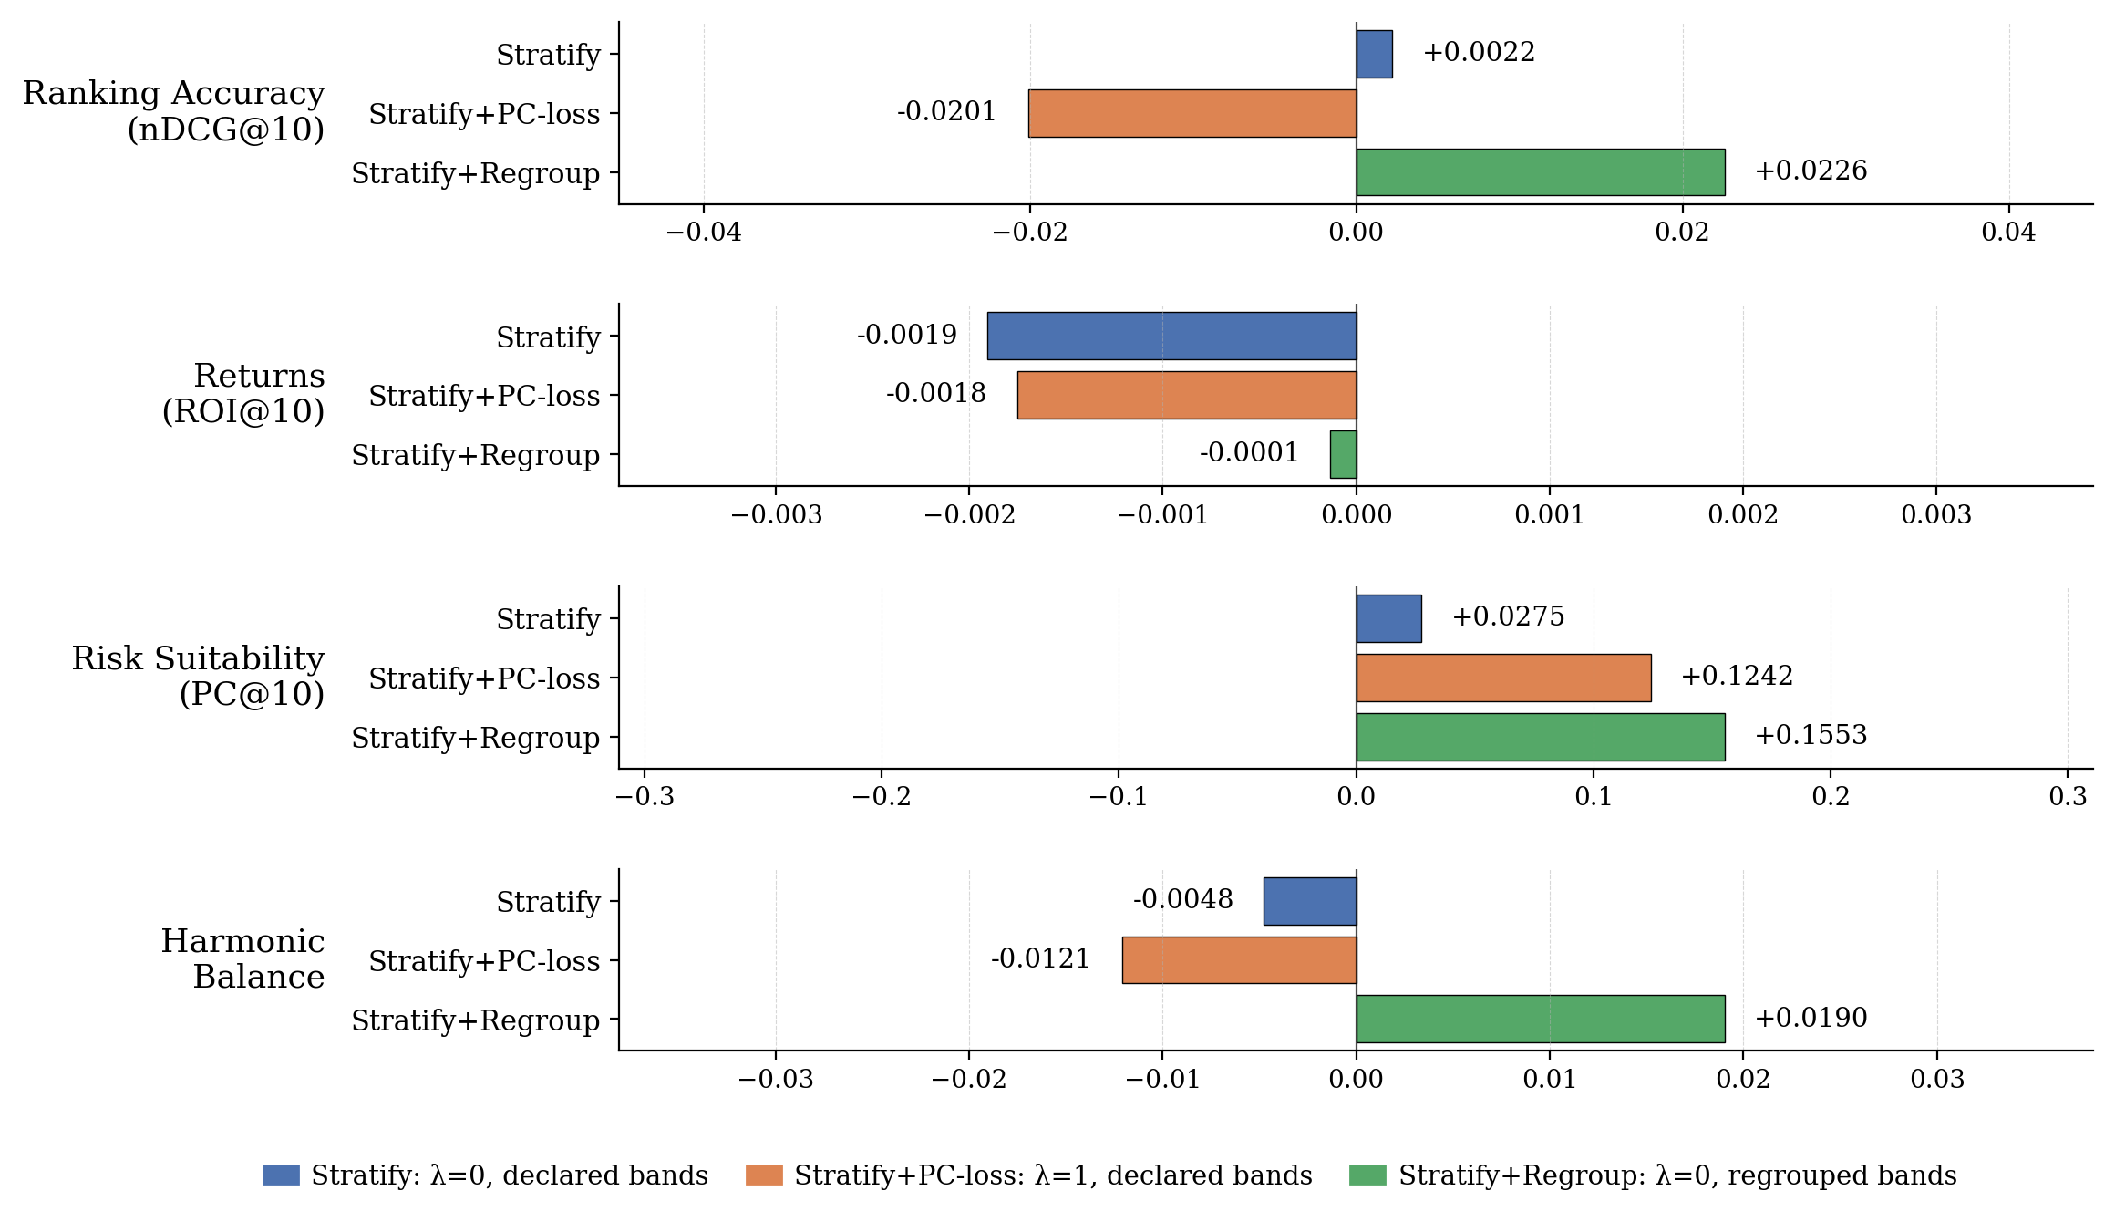
Comparison to baseline LightGCN

Slide 26
Normalized Profile Coherence at band-level
Risk band | Random Forest | LightGCN | LightGCN with risk-based seg. | LightGCN with risk-based seg. + Coherence margin loss | LightGCN with risk-based seg. + Customer risk-band regrouping | LightGCN with risk-based seg. + Both
Conservative | 0.52 | 0.75 | 0.91 | 1.19 | 1.21 | 1.25
Income | 0.70 | 1.13 | 1.20 | 1.26 | 1.25 | 1.26
Balanced | 1.03 | 1.17 | 1.22 | 1.28 | 1.24 | 1.30
Aggressive | 1.88 | 1.35 | 1.17 | 1.97 | 2.24 | 2.68
Notes:
Both approaches clear the random baseline for all bands
Best is with both implemented but recall at the cost of lower accuracy compared to just regrouping

Slide 27
Conclusion
Limitations and Future Work

Slide 28
Limitations & future work
Robustness of Methodology
Only LightGCN experimented on
Lack of full pareto sweep for the coherence margin loss function
Regrouping leakage
Revealed bands use entire buy history of a customer
Future work to implement a per-split rolling variant using only training-window buys
Associative premium
Conduct a Difference-in-Differences (DiD) regression to estimate causal effects

Slide 29
Conclusion
Central finding
A recommender system can be made risk suitable while improving accuracy and return
Customer regrouping approach raises risk suitability and ranking accuracy at no cost to return
Coherence margin loss approach buys risk suitability at the cost of ranking accuracy
Broader impact
A regulatory risk suitability can be encoded or corrected at its data source
A path for recommenders in other regulated domains (e.g. insurance product suitability)

Slide 30
Thank You
Questions & Answers

Slide 31
Appendix

Slide 32
Full OLS coefficient table
Term | Estimate | 95% CI | p-value
Intercept | −0.0471 | [−0.0746, −0.0195] | 8.1e-4
is_coherent | +0.0294 | [+0.0215, +0.0372] | 2.3e-13
asset_volatility | −0.1025 | [−0.1349, −0.0701] | 5.5e-10
C(type)[Legal Entity] | +0.0154 | [−0.0798, +0.1106] | 0.751
C(type)[Mass] | +0.0011 | [−0.0248, +0.0269] | 0.936
C(type)[Premium] | +0.0058 | [−0.0206, +0.0322] | 0.667
C(type)[Professional] | +0.0247 | [−0.0084, +0.0578] | 0.143
C(year)[2019] | +0.1759 | [+0.1507, +0.2012] | 1.4e-42
C(year)[2020] | +0.2107 | [+0.1986, +0.2227] | 6e-259
C(year)[2021] | +0.0754 | [+0.0651, +0.0858] | 4.1e-46
C(year)[2022] | −0.0195 | [−0.0283, −0.0107] | 1.4e-5

