Slide 1

Retail Banking Transaction Analysis

Slide 2

About Me
Samudrala Praharshitha
Background : Btech
Work Experience: Fresher
Why you want to learn Data Science: I want to learn Data Science to develop practical skills and build a career in the IT field.
LinkedIn: https://www.linkedin.com/in/samudrala-praharshitha-a8706436b
GitHub: https://github.com/SamudralaPraharshitha24

Slide 3
Table of contents
Project Overview
Business Scenario
Business Objectives
Dataset & Database Overview
ER Diagram & Database Structure
Analysis of the Objectives
Overall Key Findings
Business Recommendations
Conclusion

Slide 4
Project Overview
Retail Banking Transaction Analysis using SQL.
Developed a relational banking database using MySQL.
Analyzed customer, account, transaction, loan, card, and branch data.
Performed data cleaning, validation, and database structuring.
Established PK–FK relationships and an EER diagram.
Applied SQL queries and joins to derive actionable business insights.
The Project aims to analyze banking data using SQL and provide data-driven insights for better business decision-making.

Slide 5
Business Scenario
The bank wants to understand customer needs and behavior.
It needs to monitor accounts, transactions, loans, and card activities.
Identify high-value customers and different customer segments.
Analyze transaction and loan patterns to identify business trends.
Use these insights to improve customer service and banking strategies.
Support data-driven decision-making and business growth.
Data Collection
Data Cleaning
MySQL Database
SQL Analysis
Business Insights
EER Diagram and Relationships

Slide 6
Business Objectives
Build a structured banking database for organized data management.
Establish relationships between customers, accounts, branches, loans, and transactions.
Analyze banking data using SQL techniques.
Identify meaningful patterns and trends from the data.
Generate actionable insights to support business decisions

Slide 7
DataSet And DataBase Structure
Table | Purpose | Records
Customers | Customer details | 500
Branches | Branch information | 40
Accounts | Account details | 700
Loans | Loan information | 300
Transactions | Transaction details | 5,000
Cards | Card details | 600
Loan Payments | Repayment details | 2,000

Slide 8
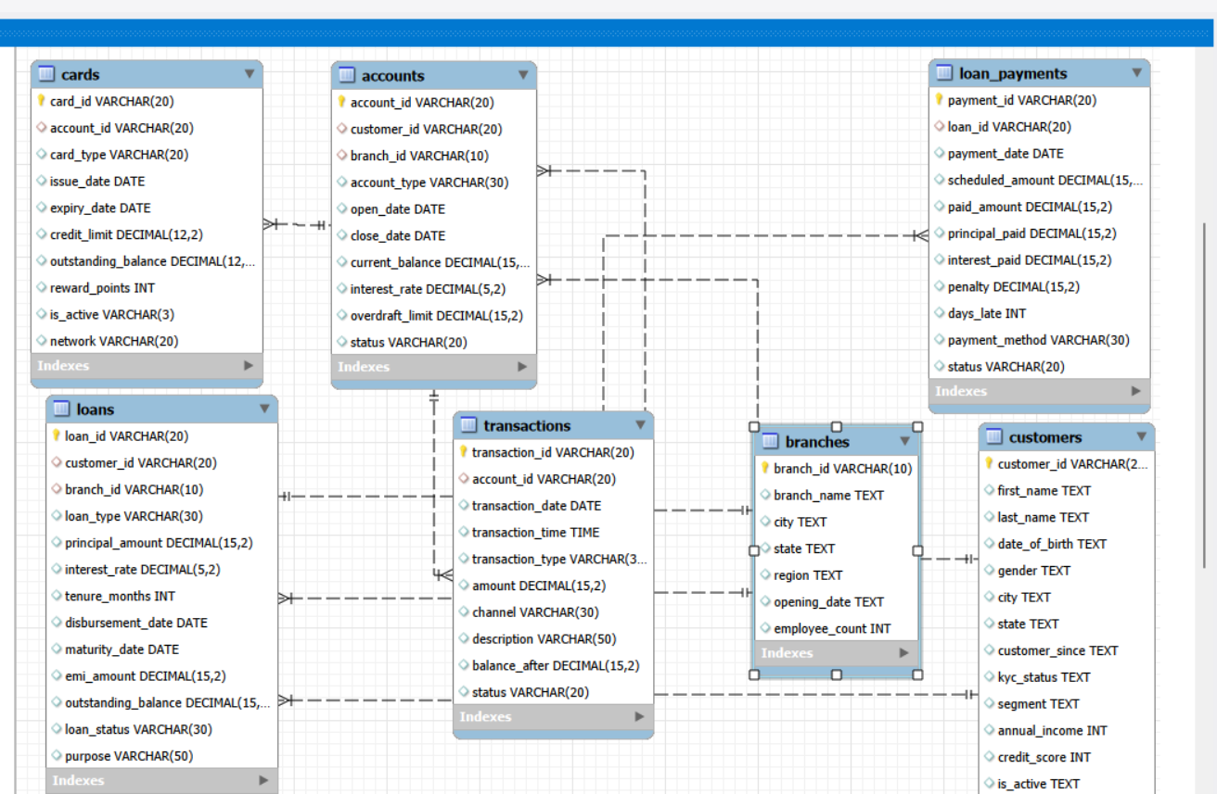
EER Diagram & Database Structure
Main Relationships:
Customers → Accounts → Transactions Customers → Loans → Loan Payments Accounts → Cards Branches → Accounts & Loans
Primary Keys (PK): uniquely identifies each record
Customers → Customer_ID
Branches → Branch_ID
Accounts → Account_ID
Transactions → Transaction_ID
Loans → Loan_ID
Loan Payments → Payment_ID
Cards → Card_ID
Foreign Keys (FK):connects one table to another
Accounts → Customer_ID, Branch_ID
Transactions → Account_ID
Loans → Customer_ID, Branch_ID
Loan Payments → Loan_ID
Cards → Account_ID

Slide 9
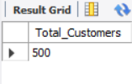

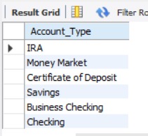
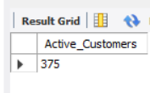
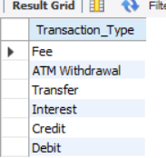
Analysis Of The Objectives
1. Total number of customers
SELECT COUNT(*) AS total_customers FROM customers;
2. Total number of accounts
SELECT COUNT(*) AS total_accounts FROM accounts;
3. Different account types
SELECT DISTINCT account_type FROM accounts;.
4. Active customers
SELECT COUNT(*) AS active_customers FROM customers WHERE is_active = ‘Yes;
5. Different transaction types
SELECT DISTINCT transaction_type FROM transactions;
Key Findings
The bank has 500 customers.
The bank has 700 accounts.
Multiple account types are available.
The number of active customers was identified.
Multiple transaction types are recorded
Key Insights
The customer base provides a foundation for further analysis.
Customers holding multiple accounts indicate varied banking needs.
Account types help understand customer preferences.
Active-customer analysis helps measure customer engagement.
Transaction types show how customers use banking services.

Slide 10
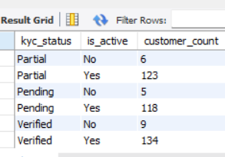
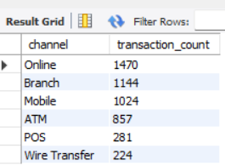
Basic SQL Check
6. How many active and inactive customers are there by KYC status?
SELECT kyc_status,
is_active,
COUNT(*) AS customer_count
FROM customers
GROUP BY kyc_status, is_active
ORDER BY kyc_status, is_active;
7. Which transaction channels are used most frequently?
SELECT channel,
COUNT(*) AS transaction_count FROM transactions
GROUP BY channel
ORDER BY transaction_count DESC;
Key Insight:
I looked at customer activity, KYC status, demographics, income, credit score, and tenure.
For example, I compared active and inactive customers across different KYC statuses.
This helps the bank understand customer engagement and identify customer groups that may require attention.”
Key Insight:
Identifies the most frequently used transaction channels.
The output shows each transaction channel with its transaction count, arranged from highest to lowest.

Slide 11
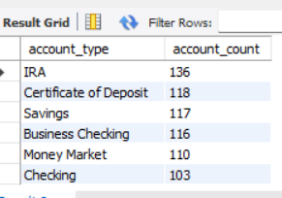
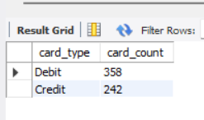
8. How many accounts are there for each account type?
SELECT account_type,
COUNT(*) AS account_countFROM accounts
GROUP BY account_type
ORDER BY account_count DESC;
9.What are the different card types and how many cards are available for each type?
SELECT card_type, COUNT(*) AS card_count
FROM cards
GROUP BY card_type
ORDER BY card_count DESC;
Key Insight:
Shows which account types are most commonly used by customers.
The output will list each account type with its number of accounts, from highest to lowest.
Key Insight:
This analysis shows the distribution of cards across different card types and identifies which card types are most commonly available.

Slide 12
Overall Key Findings
Customer & KYC Insights
Account & Branch Usage
Transaction Behaviour
Loan & Repayment Performance
Card & Product Engagement
Overall Banking Insights

Slide 13
Business Recommendations
Improve customer engagement by targeting inactive customers.
Promote suitable account products based on customer usage.
Monitor transaction activity to identify unusual or changing behavior.
Strengthen loan follow-up for delayed or outstanding repayments.
Increase card engagement through relevant rewards and offers.
Use customer insights to provide personalized banking services.

Slide 14
Conclusion
Successfully analyzed retail banking data using MySQL and SQL.
Studied customer profiles, KYC status, accounts, branches, transactions, loans, and cards.
Identified important customer and banking trends from the data.
Used SQL queries, joins, aggregations, and filtering to generate meaningful insights.
Evaluated loan repayment and product usage behaviour.
Converted analytical results into business recommendations.
The analysis can help banks improve customer engagement, product offerings, and decision-making.
Overall, the project demonstrates how data-driven insights can support better banking strategies.

Slide 15

THANK YOU

