Slide 1
Parabola
X – IIT FOUNDATION | OLYMPIAD · MATHS VOL-2
A step-by-step guide: what it is, where the equation comes from, and how to use it

Slide 2
What is a conic?
CONCEPT 1
SP = distance from focus; PM = perpendicular distance to directrix.
e is the eccentricity.
e = 1 → parabola
e < 1 → ellipse
e > 1 → hyperbola
IN SIMPLE WORDS
Pick a point S (focus) and a line l (directrix). For any point P, compare its distance to S with its distance to l. If the ratio is always the same number, P traces a conic.
SP / PM = e (constant)

Slide 3
Equation of a conic: how it is built
CONCEPT 1
Focus S(a,b); directrix px + qy + r = 0; P(x₁,y₁) on the conic.
Simplified: (1 − p²e²/(p²+q²))x² + (1 − q²e²/(p²+q²))y² − 2pqe²/(p²+q²)·xy − 2(a + pre²/(p²+q²))x − 2(b + qre²/(p²+q²))y + (a²+b²−r²e²/(p²+q²)) = 0 …(1)
This is Ax² + 2Hxy + By² + 2Gx + 2Fy + C = 0: a conic is a 2nd-degree equation (converse proved later).
IN SIMPLE WORDS
Write “SP² = e²·PM²” in coordinates, expand, and collect terms. The result always has x², xy, y², x, y and a constant.
PM = (px₁+qy₁+r)/√(p²+q²)
(x₁−a)² + (y₁−b)² = e²(px₁+qy₁+r)²/(p²+q²)

Slide 4
Parabola: definition
CONCEPT 1
Put e = 1 in (1): (qx − py)²/(p²+q²) − 2(a + pr/(p²+q²))x − 2(b + qr/(p²+q²))y + (a²+b²−r²/(p²+q²)) = 0.
Its second-degree terms form a perfect square: a quick test for a parabola.
IN SIMPLE WORDS
A parabola is the special conic with e = 1: every point is exactly as far from the focus as from the directrix.
SP = PM

Slide 5
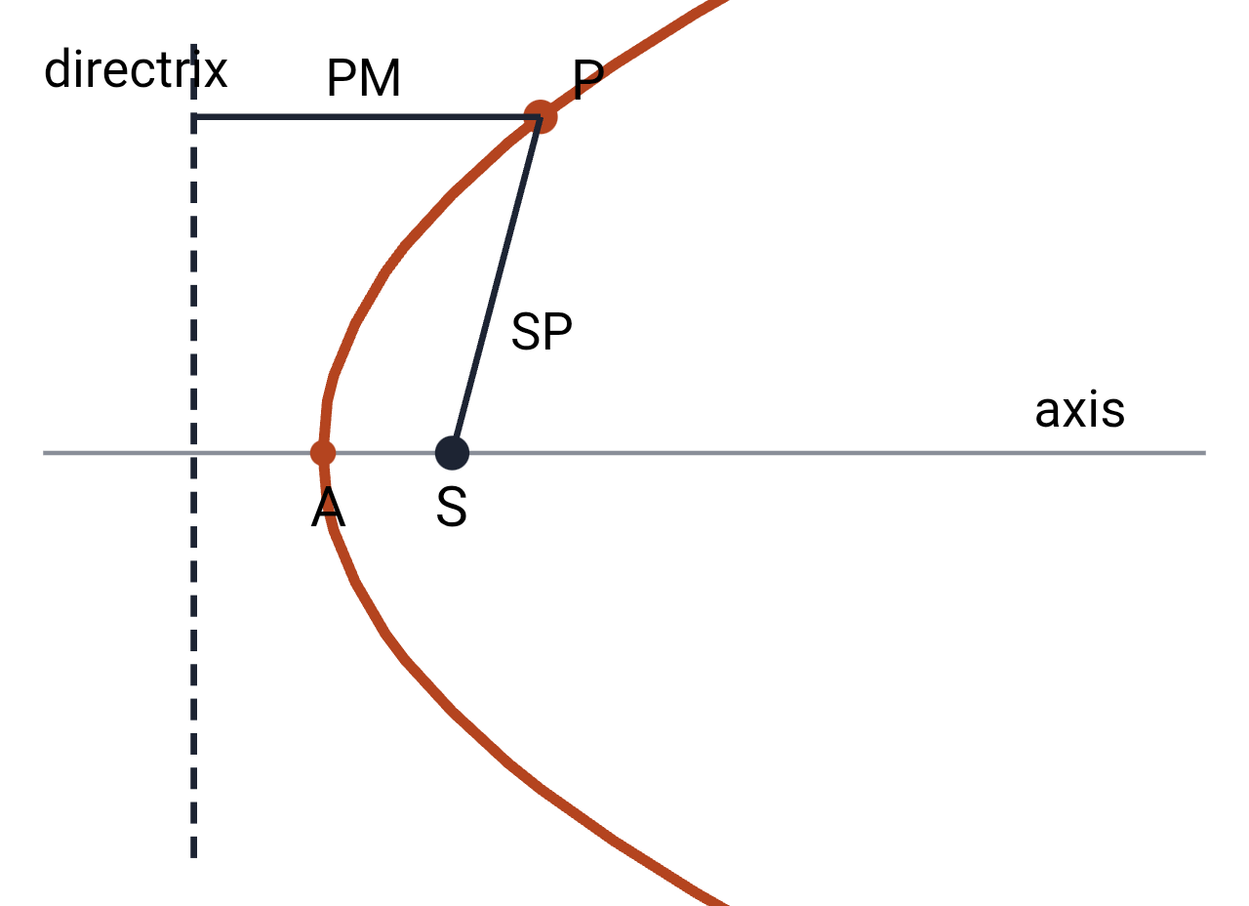
Deriving y² = 4ax
CONCEPT 1
S = focus, Z = foot of S on directrix l. A = midpoint of SZ, SA = AZ = a, so SA/AZ = 1 = e: A is on the parabola.
Take AS as x-axis, AY ∥ l as y-axis: A(0,0), S(a,0), Z(−a,0).
SP² = MP² gives the result.
Vertex A(0,0); focus S(a,0); directrix x + a = 0.
IN SIMPLE WORDS
Choose axes smartly: put the vertex at the origin and the axis along the x-axis. The equation then becomes very simple.
(x−a)² + y² = (x+a)²
⇒ y² = 4ax

Slide 6
Shape of y² = 4ax (a > 0)
CONCEPT 1
(x,y) on C ⇔ (x,−y) on C: symmetric about the x-axis (the axis).
y = 0 ⇒ x = 0: meets the axis only at (0,0).
x > 0 ⇒ y has two real values: lies in quadrants I and IV.
x = 0 ⇒ y = 0,0: the y-axis touches it at the origin.
x < 0 ⇒ no real y: nothing in quadrants II, III.
x → +∞ ⇒ y → ±∞: not bounded on the right.
P(x₁,y₁) is external/internal as y₁² > or < 4ax₁.
IN SIMPLE WORDS
Read the equation to “see” the curve: signs and symmetry tell you where it lives and how it behaves.
y² = 4ax

Slide 7
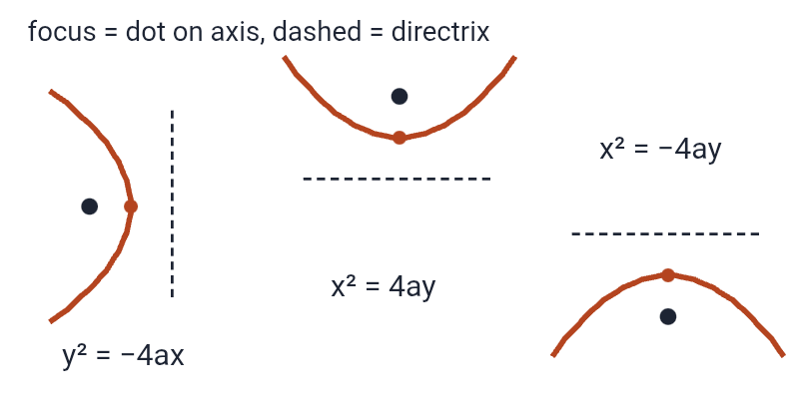
Other forms: same shape, different position
CONCEPT 1
y² = −4ax: focus (−a,0), directrix x − a = 0.
x² = 4ay: focus (0,a), directrix y + a = 0.
x² = −4ay: focus (0,−a), directrix y − a = 0.
(y−β)² = 4a(x−α): axis ∥ x-axis, vertex (α,β), focus (α+a,β), directrix x = α − a; reducible to x = ly² + my + n.
(x−α)² = 4a(y−β): axis ∥ y-axis, vertex (α,β), focus (α,β+a), directrix y = β − a.
(x−a)² + (y−b)² = (lx+my+n)²/(l²+m²): focus (a,b), directrix lx+my+n = 0, axis m(x−a) − l(y−b) = 0.
IN SIMPLE WORDS
Rotate or shift the standard parabola and only the focus, vertex and directrix change.
(y−β)² = 4a(x−α)
(x−α)² = 4a(y−β)

Slide 8
Focal distance, focal chord, double ordinate
CONCEPT 1
Focal distance: SP. Since SP = PM = NZ = NA + AZ = x₁ + a. Equals abscissa of P + ¼(latusrectum).
Focal chord: chord drawn through the focus.
Double ordinate of P: chord through P perpendicular to the axis.
IN SIMPLE WORDS
Three names to learn: distance to the focus, chords through the focus, and chords perpendicular to the axis.
Focal distance of P(x₁,y₁) = x₁ + a

Slide 9
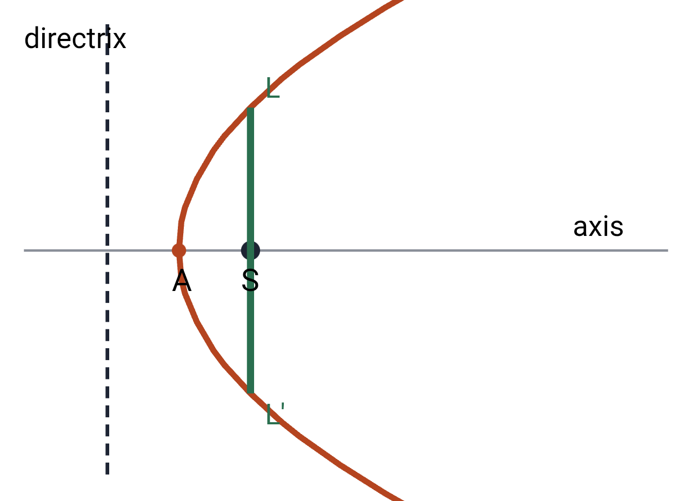
Latusrectum
CONCEPT 1
LL′ = chord through S, perpendicular to the axis.
Length = 4a = 4 × (distance of focus from vertex).
Its line is x − a = 0.
Hence the double ordinate through the focus is the latusrectum.
IN SIMPLE WORDS
The latusrectum is the double ordinate that passes through the focus. Its length is found by putting x = a in the equation.
L = (a, l): l² = 4a² ⇒ l = ±2a
LL′ = 2l = 4a

Slide 10
Parametric form and chord
CONCEPT 2
(at², 2at) satisfies y² = 4ax for every t.
Proof: (y−2at₁)/(2at₁−2at₂) = (x−at₁²)/(at₁²−at₂²); cancel t₁−t₂ ⇒ (y−2at₁)/2 = (x−at₁²)/(t₁+t₂).
Focal chord: passes through (a,0) ⇒ 0 − 2a − 2at₁t₂ = 0 ⇒ t₁t₂ = −1 (remember).
IN SIMPLE WORDS
Instead of x and y, describe each point with one number t. Then chords and tangents become easy algebra.
(at², 2at)
Chord t₁,t₂: y(t₁+t₂) − 2x − 2at₁t₂ = 0

Slide 11
Tangent at t
CONCEPT 2
dy/dx = 2a/y, so slope at (at²,2at) = 2a/2at = 1/t.
Line: y − 2at = (1/t)(x − at²) ⇒ yt − x − at² = 0.
Solve yt₁ − x − at₁² = 0 and yt₂ − x − at₂² = 0 for the intersection.
IN SIMPLE WORDS
A tangent is a line with the same slope as the curve at that point. Differentiate to get the slope.
Tangent at t: yt − x − at² = 0
Tangents at t₁,t₂ meet at (at₁t₂, a(t₁+t₂))

Slide 12
Normal at t
CONCEPT 2
Slope of normal = −t ⇒ y − 2at = −t(x − at²) ⇒ y + xt = 2at + at³.
Where it meets the curve again: normal at t₁ passes through (at₂²,2at₂): 2(t₂−t₁) = t₁(t₁²−t₂²) ⇒ −2/t₁ = t₁ + t₂ ⇒ t₂ = −t₁ − 2/t₁.
IN SIMPLE WORDS
The normal is perpendicular to the tangent, so its slope is −t (negative reciprocal of 1/t).
Normal at t: y + xt = 2at + at³
t₂ = t₁ − 2/t₁

Slide 13
How many normals from a point?
CONCEPT 2
y₁ + x₁t = 2at + at³ ⇒ at³ + t(2a−x₁) − y₁ = 0.
(a) P internal: three normals.
(b) P on the parabola: two normals.
(c) P external: one normal.
IN SIMPLE WORDS
Substitute (x₁,y₁) into the normal equation: you get a cubic in t. A cubic has at most three real roots, so at most three normals.
at³ + t(2a − x₁) − y₁ = 0
t₁+t₂+t₃ = 0
Σt₁t₂ = (2a−x₁)/a; t₁t₂t₃ = y₁/a

Slide 14
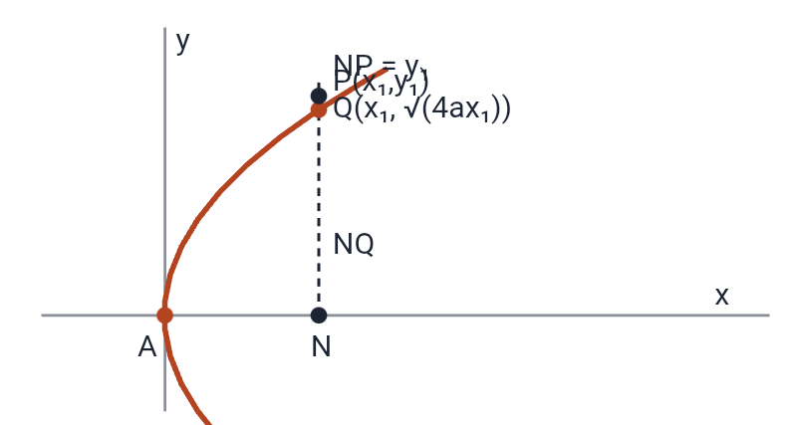
Notation and position of a point
CONCEPT 3
N=(x₁,0), Q=(x₁,√(4ax₁)); NP = y₁, NQ = √(4ax₁).
S₁₁ > 0 (NP > NQ): P outside.
S₁₁ = 0 (NP = NQ): P on the parabola.
S₁₁ < 0 (NP < NQ): P inside.
IN SIMPLE WORDS
Plug the point into y² − 4ax and look at the sign: it tells inside, on, or outside.
S = y² − 4ax; S₁ = yy₁ − 2a(x+x₁)
S₁₂ = y₁y₂ − 2a(x₁+x₂); S₁₁ = y₁² − 4ax₁

Slide 15
Chord and tangent from S₁, S₂, S₁₂
CONCEPT 3
Proof: S₁₁ = S₂₂ = 0; S₁+S₂ = S₁₂ is first degree (a line).
Put (x₁,y₁): S₁₁ + S₁₂ = S₁₂ ✓. Same for (x₂,y₂).
As Q → P: 2S₁ = S₁₁ = 0 ⇒ S₁ = 0.
Check by calculus: slope 2a/y₁ ⇒ y − y₁ = (2a/y₁)(x−x₁) ⇒ yy₁ − 4ax₁ = 2ax − 2ax₁ ⇒ S₁ = 0.
If y₁ = 0 then x₁ = 0: tangent at vertex is the y-axis.
IN SIMPLE WORDS
Two points on the parabola give a chord with a neat formula. Let one point slide into the other and the chord becomes a tangent.
Chord: S₁ + S₂ = S₁₂
Tangent at (x₁,y₁): S₁ = 0, i.e. yy₁ − 2a(x+x₁) = 0

Slide 16
Tangent in slope form
CONCEPT 3
Tangent at (x₁,y₁): yy₁ − 2a(x+x₁) = 0 ⇒ y₁/1 = 2a/m = 2ax₁/c ⇒ x₁ = c/m, y₁ = 2a/m.
On the parabola: 4a²/m² = 4a(c/m) ⇒ c = a/m.
Line lx + my + n = 0 (l≠0) touches iff ln = am²; contact (n/l, −2am/l). Proof: compare with yy₁ − 2a(x+x₁) = 0: l/−2a = m/y₁ = n/−2ax₁.
IN SIMPLE WORDS
Often you know the slope, not the point. Then the tangent must have a fixed intercept c = a/m.
y = mx + a/m (m ≠ 0)
Contact point (a/m², 2a/m)

Slide 17
Lines that are NOT tangents
CONCEPT 3
m = 0, c ≠ 0: y = c meets at (c²/4a, c): not a tangent. Any line parallel to the axis meets in one point.
m ≠ 0, c = 0: meets at (0,0) and (4a/m², 4a/m): not a tangent.
m = 0, c = 0: y = 0 cuts at (0,0): not a tangent.
x = c: real points for c > 0; touches for c = 0.
IN SIMPLE WORDS
Quick checks to eliminate special lines.
y = mx + c

Slide 18
Normal with given slope m
CONCEPT 3
Using y₁² = 4ax₁: 4a²m² = 4ax₁ ⇒ x₁ = am².
Equation: y + 2am = m(x − am²).
Example: y² = 8x, a = 2, m = 2/3: y = (2/3)x − 4(2/3) − 2(8/27) ⇒ 18x − 9y − 88 = 0.
IN SIMPLE WORDS
Slope of tangent = 2a/y₁; normal slope m = y₁/2a ⇒ y₁ = −2am, x₁ = am².
y = mx − 2am − am³
Foot: (am², −2am)

Slide 19
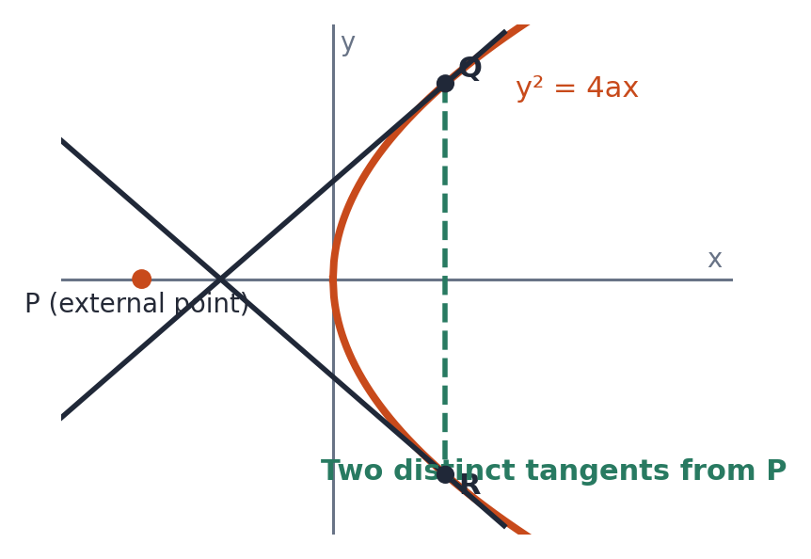
Tangents from an external point
CONCEPT 3
y₁² − 4ax₁ > 0 (outside): two real tangents.
= 0: on the parabola, coincident tangents.
< 0 (inside): no real tangent.
Perpendicular tangents: m₁m₂ = a/x₁ = −1 ⇒ x₁ + a = 0: locus is the directrix.
Example: from (−2,1) to y² = 2x: (y−x+2)² = 5(y²−2x) ⇒ x² − 2xy − 4y² + 6x + 4y + 4 = 0.
IN SIMPLE WORDS
Put the point into y = mx + a/m: you get a quadratic in m. Its discriminant decides how many tangents.
m²x₁ − my₁ + a = 0
Pair of tangents: S₁² = S·S₁₁
GEOMETRY: TWO TANGENTS FROM AN EXTERNAL POINT

Slide 20
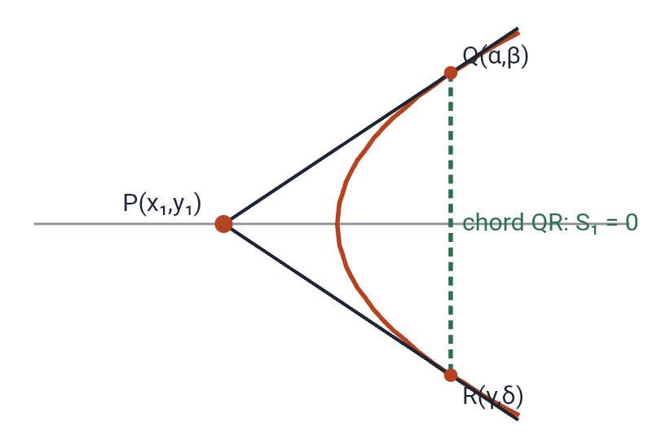
Chord of contact
CONCEPT 3
Tangents from P(x₁,y₁) touch at Q(α,β), R(γ,δ).
Tangent at Q: yβ − 2a(x+α) = 0 passes through P: y₁β − 2a(x₁+α) = 0 …(1).
Similarly y₁δ − 2a(x₁+γ) = 0 …(2).
So Q and R satisfy yy₁ − 2a(x+x₁) = 0: that is QR.
IN SIMPLE WORDS
The line joining the two points where tangents from P touch the parabola.
Chord of contact of (x₁,y₁): S₁ = 0

Slide 21
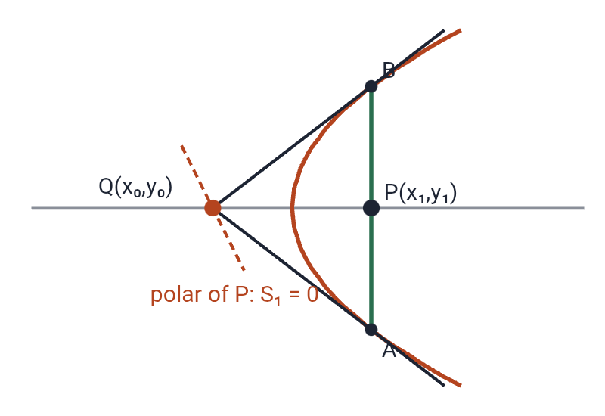
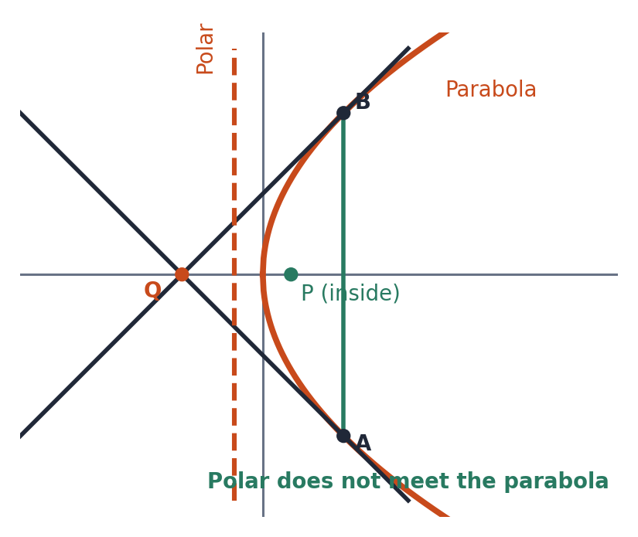
Pole and polar
CONCEPT 4
Chord AB through P; tangents at A, B meet at Q(x₀,y₀). AB is the chord of contact S₀ = 0 and passes through P: y₁y₀ − 2a(x₁+x₀) = 0. Locus of Q: S₁ = 0.
P outside: polar meets the parabola in real points.
P inside: polar does not meet it.
P on it: polar is the tangent at P.
Example: y(−3) − 1(x+2) = 0 ⇒ x + 3y + 2 = 0.
IN SIMPLE WORDS
The polar of a point is the line formed by where tangents at the ends of chords through the point meet. The point is the pole.
Polar of (x₁,y₁): S₁ = 0
CASE (b): P INSIDE — POLAR DOES NOT INTERSECT

Slide 22
Conjugate points, lines and pole of a line
CONCEPT 4
Polar of P(x₁,y₁) through Q(x₂,y₂): S₂₁ = 0 ⇒ S₁₂ = 0, so polar of Q passes through P.
Pole of a line: match lx+my+n = 0 with yy₁ − 2a(x+x₁) = 0.
Example: pole of x − y − 2 = 0 w.r.t. y² = 6x (a = 3/2) = (−2, 3).
Conjugate lines: pole of line 1 is (n₁/l₁, −2am₁/l₁); on line 2 ⇒ condition; it is symmetric.
IN SIMPLE WORDS
Two points are conjugate if each lies on the polar of the other. The same idea works for lines.
Conjugate points: S₁₂ = 0
Pole of lx+my+n=0: (n/l, −2am/l)
Conjugate lines: l₁n₂ + l₂n₁ = 2am₁m₂

Slide 23
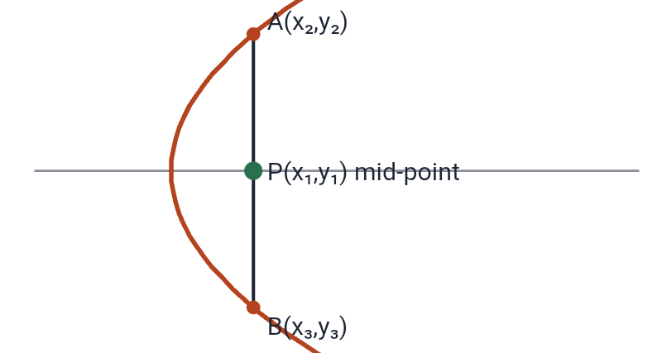
Chord with a given mid-point
CONCEPT 4
Example: y² = 2x, mid-point (1,1): y(1) − (x+1) = 1² − 2(1) ⇒ x − y = 0.
IN SIMPLE WORDS
If P is the mid-point of a chord, the chord equation is S₁ = S₁₁.
S₁ = S₁₁
yy₁ − 2a(x+x₁) = y₁² − 4ax₁

Slide 24
Formula summary
REVISION
Parametric (at²,2at); tangent yt − x − at² = 0; normal y + xt = 2at + at³.
Tangent S₁ = 0; chord of contact S₁ = 0; polar S₁ = 0; pair of tangents S₁² = SS₁₁; mid-point chord S₁ = S₁₁.
Tangent condition c = a/m; ln = am². Focal chord t₁t₂ = −1.
IN SIMPLE WORDS
Everything in one place.
y² = 4ax; vertex (0,0); focus (a,0); directrix x = −a
Latusrectum 4a; focal distance x₁ + a

