Slide 1
Image Depth Estimation
Bc. Samuel Kuchta
Bc. Marek Bahník

Slide 2
Task definition
Estimate depth from single image
Design CNN based on ResNet and U-Net
Train the CNN on relevant data
Evaluate the results

Slide 3
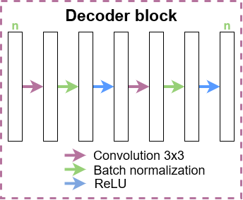
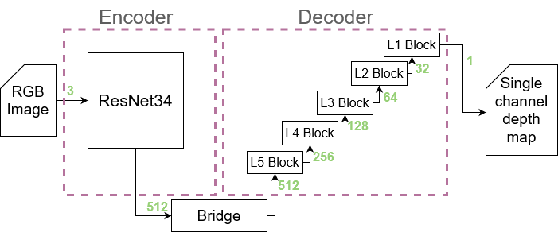
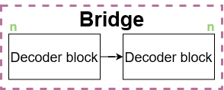
Architecture
ResNet backbone
Started with ResNet18
Ended up with ResNet34
Notes:
Experimenty s různými ResNet architekturami – nejprve 18, potom 50, ale na to by bylo potřeba měnit víc architekturu dekodéru, takže nakonec 34 jako ideální zástupce
Bridge – dva konvoluční bloky za sebou
Dekodér – mezi bloky je up-convoluce která zvětší rozlišení a zmenší poček kanálů
Block – convoluce 3x3 s paddingem 1 pro zachování rozlišení, normalizace následovaná ReLU, na bázi původní Unet architektury dekodéru

Slide 4
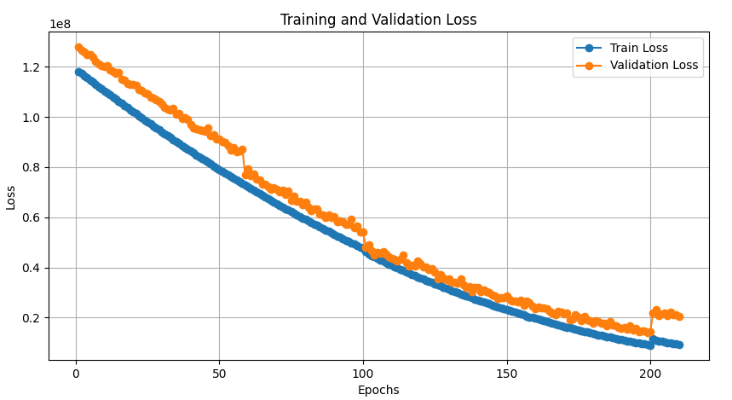
Training
CityScapes dataset
5000 annotated images
Imperfect ground truth
MSE loss and ADAM optimizer

Slide 5
Training
Notes:
Training:
50 epochs testing image sizes, batch sizes and training setup
Purge of data and start of logging
3 epochs to test the final setup to be sure
50 epochs (3 – 53) – different sizes, 100 validation images, batch size 1, logging
47 epochs (53 – 100) - different sizes, 500 validation images, batch size 1, logging
100 epochs (100 - 200) – error, only trained on small images
10 epochs (200 – 210) – trying to fix the error

Slide 6
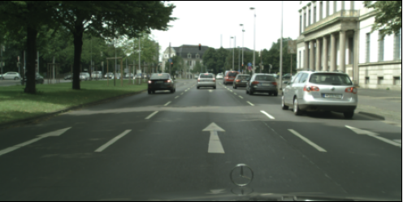
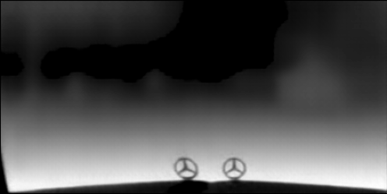
Training progress
ResNet18 best result on small (224x448) image 41 epochs
Notes:
Training:
50 epochs testing image sizes, batch sizes and training setup
Purge of data and start of logging
3 epochs to test the final setup to be sure
50 epochs (3 – 53) – different sizes, 100 validation images, batch size 1, logging
47 epochs (53 – 100) - different sizes, 500 validation images, batch size 1, logging
100 epochs (100 - 200) – error, only trained on small images
10 epochs (200 – 210) – trying to fix the error

Slide 7
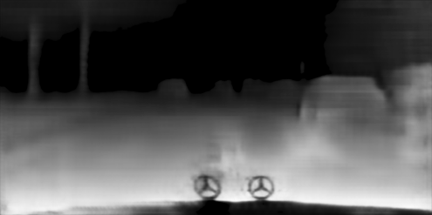
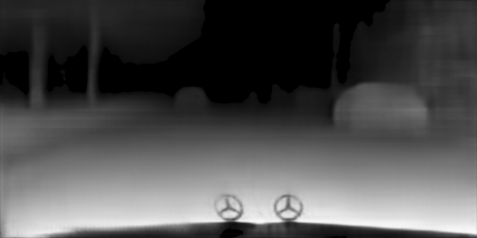
Training progress
ResNet18 best result on large image 47 epochs (top) and ResNet34 on mixed sizes after 3 epochs (bottom)
Notes:
Training:
50 epochs testing image sizes, batch sizes and training setup
Purge of data and start of logging
3 epochs to test the final setup to be sure
50 epochs (3 – 53) – different sizes, 100 validation images, batch size 1, logging
47 epochs (53 – 100) - different sizes, 500 validation images, batch size 1, logging
100 epochs (100 - 200) – error, only trained on small images
10 epochs (200 – 210) – trying to fix the error

Slide 8
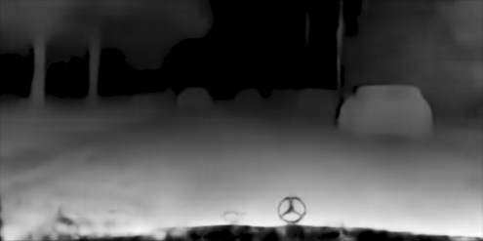
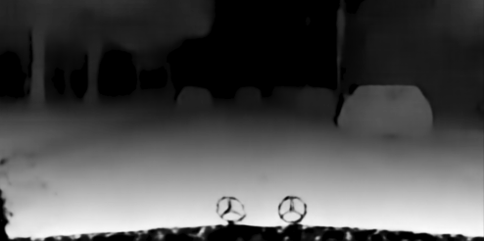
Training progress
a
b
c
ResNet34 trained with mixed images after (a) 3 epochs (b) 53 epochs (c) 100 epochs
Notes:
Training:
50 epochs testing image sizes, batch sizes and training setup
Purge of data and start of logging
3 epochs to test the final setup to be sure
50 epochs (3 – 53) – different sizes, 100 validation images, batch size 1, logging
47 epochs (53 – 100) - different sizes, 500 validation images, batch size 1, logging
100 epochs (100 - 200) – error, only trained on small images
10 epochs (200 – 210) – trying to fix the error

Slide 9
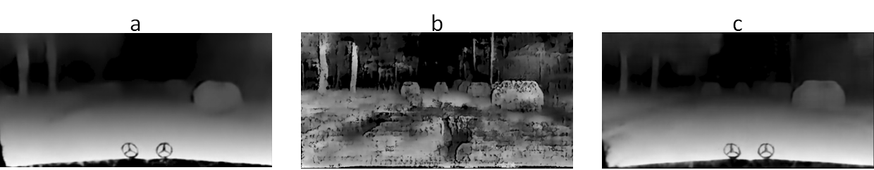
Training progress
ResNet34 trained with small images after another 100 epochs tested on (a) small image (b) large image and (c) after 10 more epochs using different sizes
Notes:
Training:
50 epochs testing image sizes, batch sizes and training setup
Purge of data and start of logging
3 epochs to test the final setup to be sure
50 epochs (3 – 53) – different sizes, 100 validation images, batch size 1, logging
47 epochs (53 – 100) - different sizes, 500 validation images, batch size 1, logging
100 epochs (100 - 200) – error, only trained on small images
10 epochs (200 – 210) – trying to fix the error

Slide 10
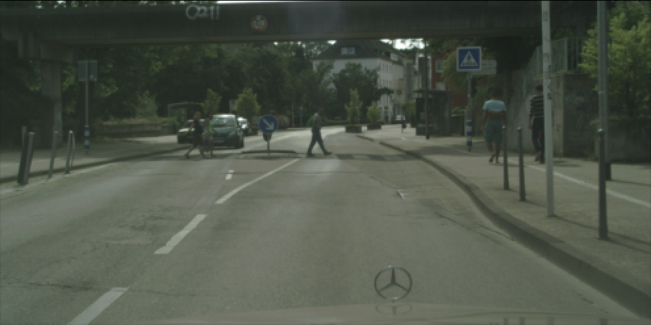
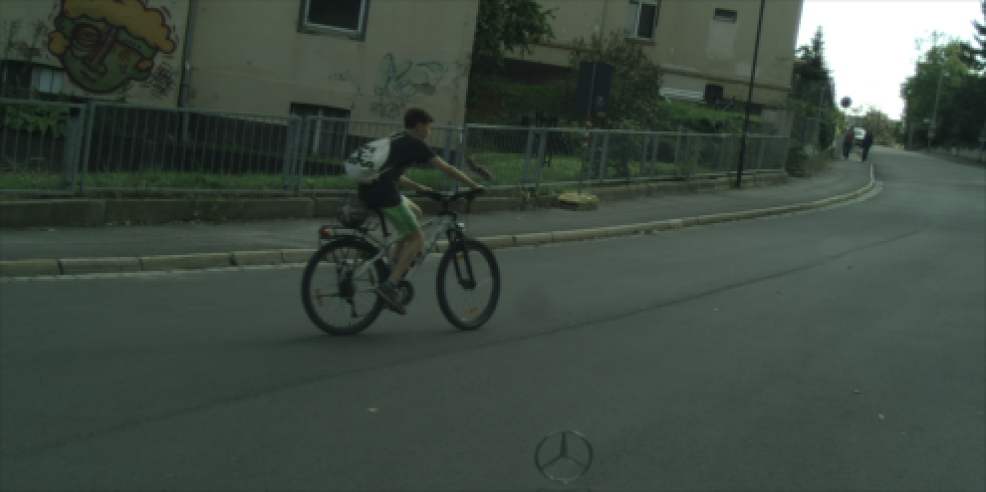
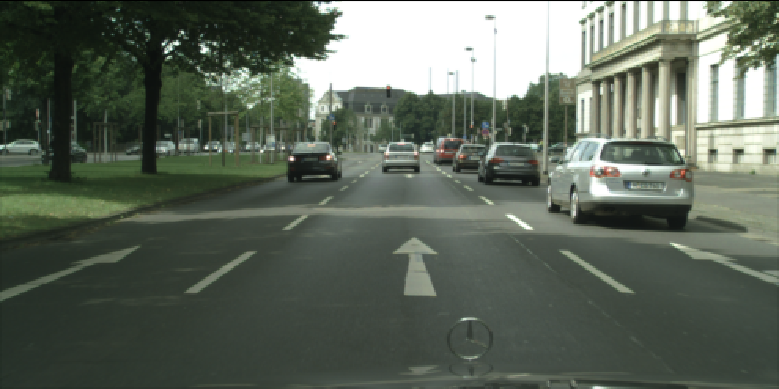
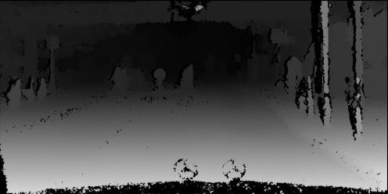
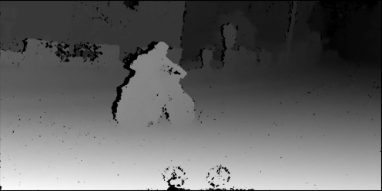
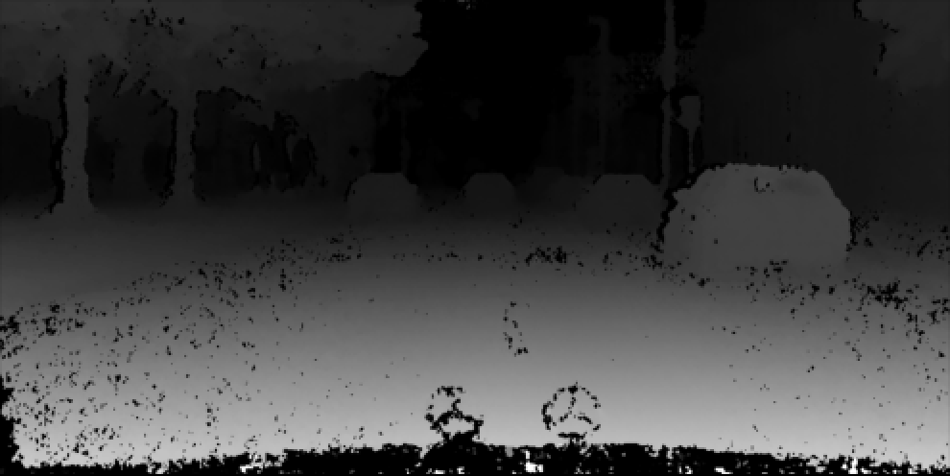
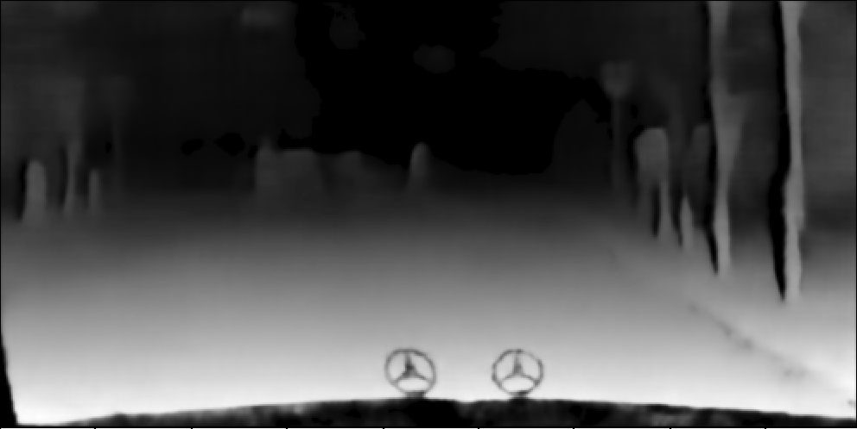
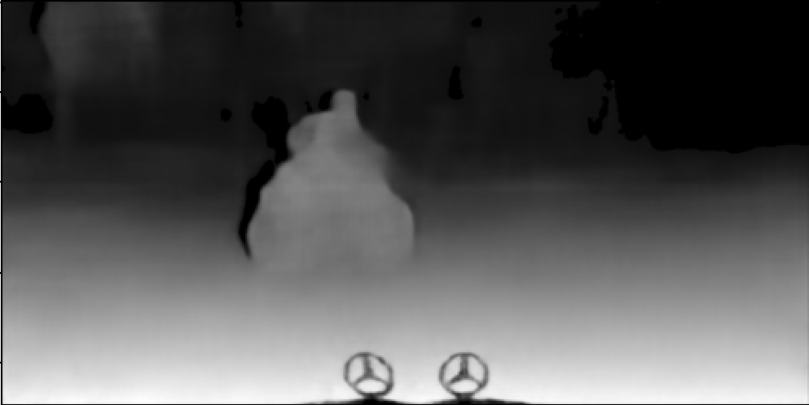
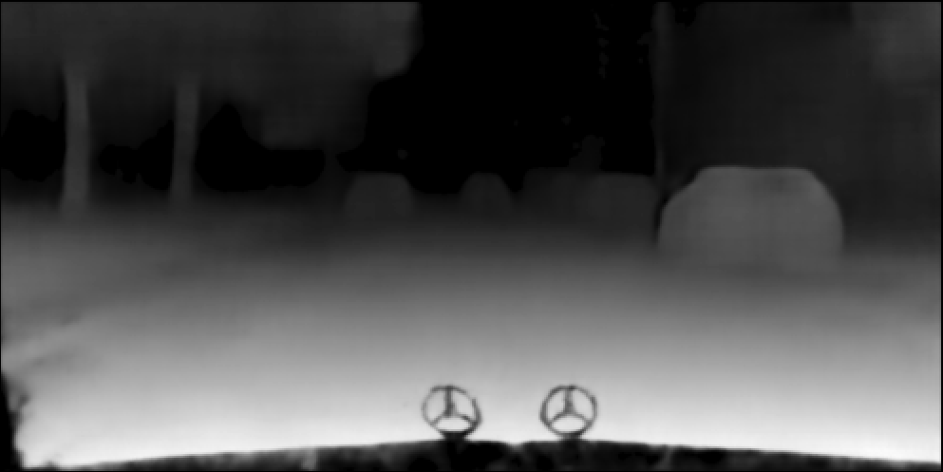
Training results
Notes:
Training:
50 epochs testing image sizes, batch sizes and training setup
Purge of data and start of logging
3 epochs to test the final setup to be sure
50 epochs (3 – 53) – different sizes, 100 validation images, batch size 1, logging
47 epochs (53 – 100) - different sizes, 500 validation images, batch size 1, logging
100 epochs (100 - 200) – error, only trained on small images
10 epochs (200 – 210) – trying to fix the error

Slide 11
Thank you for your attention!

