Slide 1
DSCI 430 Project 1
Samuel Andrews

Slide 2
Forward:
Main goal is to see if development indicators representing a countries state prior to the pandemic impacted how they were affected by Covid-19
All development data barring % open defecation were from 2018, as that was the latest year unaffected by the pandemic.
Overall findings mostly supported the notion that the situation a country was in prior to the pandemic could not be correlated with Covid-19 ability to spread or lethality.

Slide 3
Starting out:
More visuals are found in the notebook, most generated were ultimately uninteresting
Visuals shown here give an idea of what was routinely generated and looked at, ones I found the most interesting ended up here
The first aspect I looked at was simply what countries were the most/least ravaged by the virus.

Slide 4
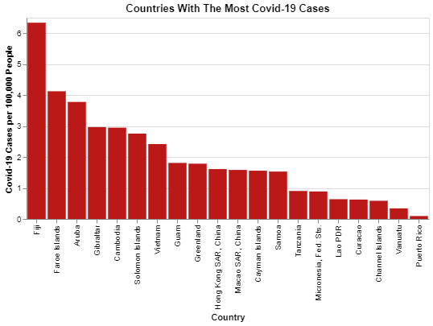

Slide 5
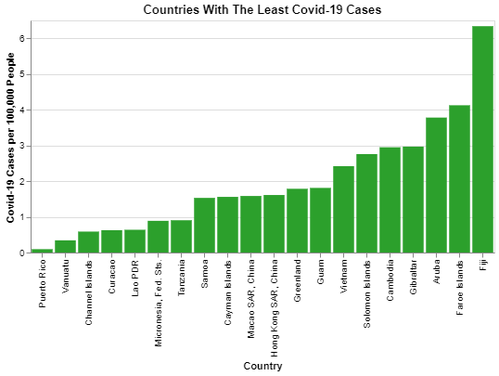

Slide 6
Starting out:
Geography seemed to have little role in the population adjusted cases, as it seemed almost random looking at the countries on their own
Moving on from here, using the 10 development indicators, I tried finding correlations between them and adjusted cases, deaths, and recoveries. No correlation found was strong, but a few I still found interesting for other reasons.
PowerPoint cannot showcase the interactive tooltips that usually make these a much more useful resource.

Slide 7
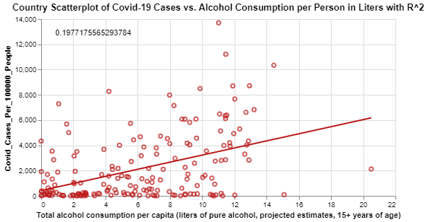

Slide 8
Alcohol vs adjusted Cases:
Drinking culture across the world varies wildly, but most gat do in my mind evoke images of crowded spaces and public interaction. To see that such culture itself did not have a stronger impact surprised me
This may be due to the policies being enacted in response to the pandemic being effective in curtailing such public gatherings.

Slide 9
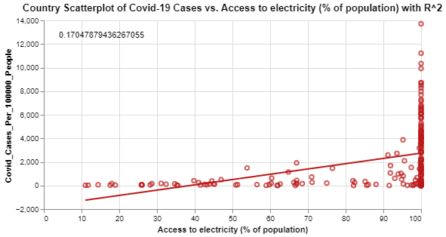

Slide 10
Access to electricity vs adjusted Cases:
This visual is on odd looking output, but it does showcase a potential flaw that I fear pervades the Covid-19 data sets.
Because a lot of the Covid-19 data from countries is self-reported, it may be possible that countries lacking electricity in many areas may also lack the resources to properly track the virus, leading to the odd appearance shown prior.
This does not defeat the analysis, but it is something to consider

Slide 11
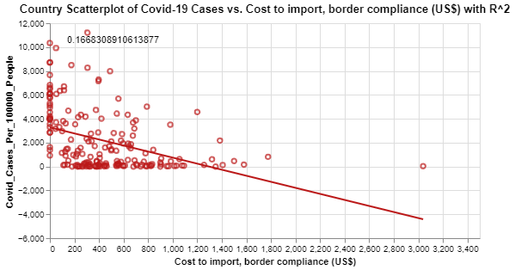

Slide 12
Cost to import vs adjusted Cases:
Though for most countries this seems to be a non-issue, it is interesting to see that at the extreme end the effect is more pronounced.
This may be the result of some other variable, but it still may provoke further investigation.
Though not shown due to a lack of tooltips, those countries tend to be mostly from Central Africa and Northern South America, such as the DRC, Venezuela, Grenada, and Cameroon

Slide 13
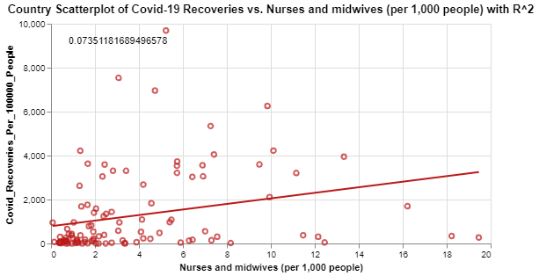

Slide 14
Nurses and Midwives vs adjusted Recoveries:
It was striking to me that having more medical personnel did not intrinsically lead to a greater amount of recoveries
Compared to deaths and cases, recoveries were not tracked as much based on my work in part 1, which may be impacting this.
The adjusted recoveries per cases lead to ludicrously low recovery cases (such as 1%) for many countries, which is likely not the actual value.

Slide 15
Looking for Patterns
After not finding much of note looking at all countries, a reran the scatterplot again highlighting the top and bottom 20 infected countries to see if any pattern among them emerged
I did so in mass using Altair's repeat function. The next slide shows a smaller version that better fits into PowerPoint
The observation I found was that no distinct pattern emerged

Slide 16
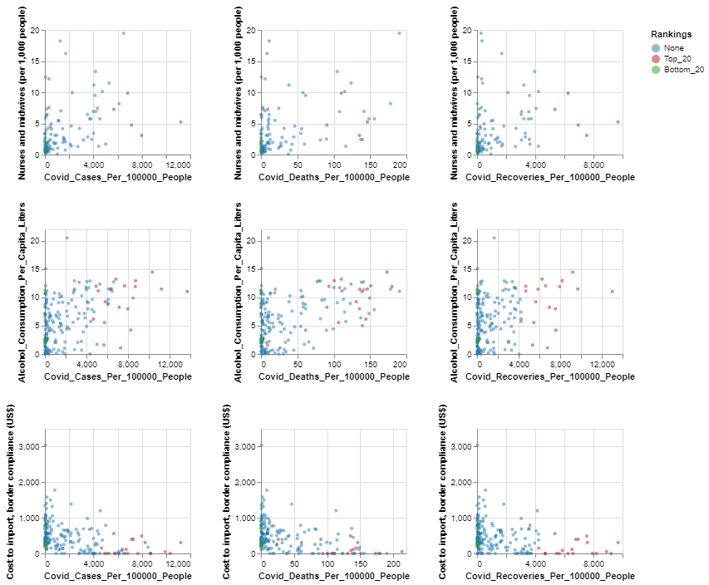

Slide 17
Looking for Patterns
After not finding much of note looking at all countries, a reran the scatterplot again highlighting the top and bottom 20 infected countries to see if any pattern among them emerged
I did so in mass using Altair's repeat function. The next slide shows a smaller version that better fits into PowerPoint
The observation I found was that no distinct pattern emerged

Slide 18
Looking Geographic subsets
In an attempt to see if geographic areas had any patterns, I subset on various groups.
Most lead nowhere, and were removed from the python notebook entirely to avoid clutter
Western Europe, Europe proper, and NAFTA did provide findings I did find to at least provoke some thought.

Slide 19
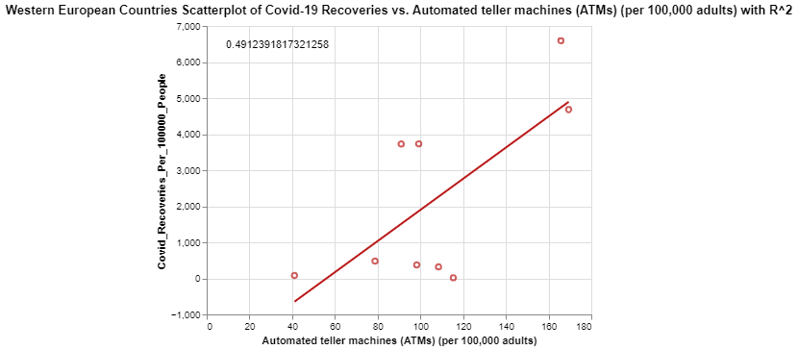

Slide 20
Western European Countries: Recoveries vs. Adjusted ATMS count
This has the largest correlation of anything I found. However, the amount of wrangling and digging it took to produce leads me more to believe it is the result of random chance than anything else
How does an ATM relate to recovery? This is not seen in cases or deaths, just specifically this
This serves as a reminder that if we look deep enough, we will eventually find something, but it may not necessarily be good output.

Slide 21
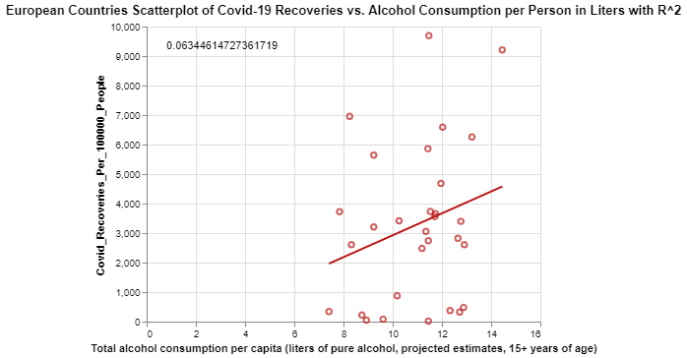

Slide 22
European Countries: Cases vs. Alcohol Consumption
Looking at Europe, this variable again saw little impact
This jumped out at me mostly because I remember that earlier in the pandemic, certain European new networks promoted worry about how certain drinking culture might be a detriment
Similar results to looking at all of the countries

Slide 23
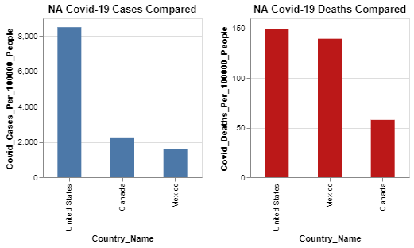
Looking at NAFTA Countries

Slide 24
Looking at NAFTA
An attempt to see what could be found on a smaller, more connected group
Due to their only being three observations, bar graphs became a more useful tool for looking for patterns
Mexico's disparity in cases compared to Deaths jumps out immediatley.

Slide 25
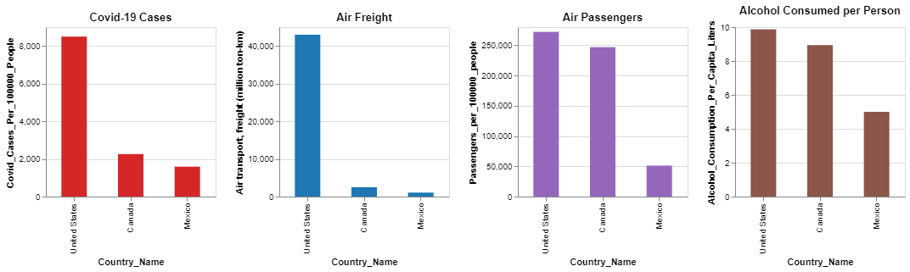
Comparing Variables

Slide 26
Looking at NAFTA for various variable
These three variables performed the best looking at other correlation visuals, this was more an exercise of Altair's concatenation feature
However, now disparity seems outright inconsistent
This also leads me to one last point

Slide 27
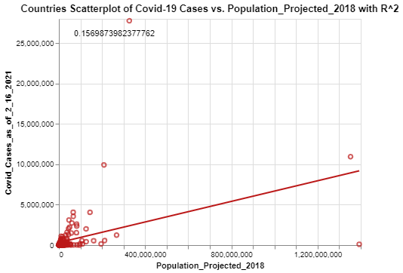

Slide 28
Project Population vs. Total Covid Cases
Population itself is not the main indicator for cases, something else is likely at play
The common belief could be considered that the reactions of governments played the biggest role, not there prior status. The findings here would support that hypothesis
A greater discussion and further visuals is had within the notebook itself.

