Slide 1
Kaggle 2019 User Survey Data DSCI 415
Samuel Andrews

Slide 2
The Data
19,171 responses that are usable from Oct 8-28th
Each respondent only got some of the questions
Other text responses are in a separate table and shuffled (no joins)
No true continuous variables
Attempt to categorize respondents

Slide 3
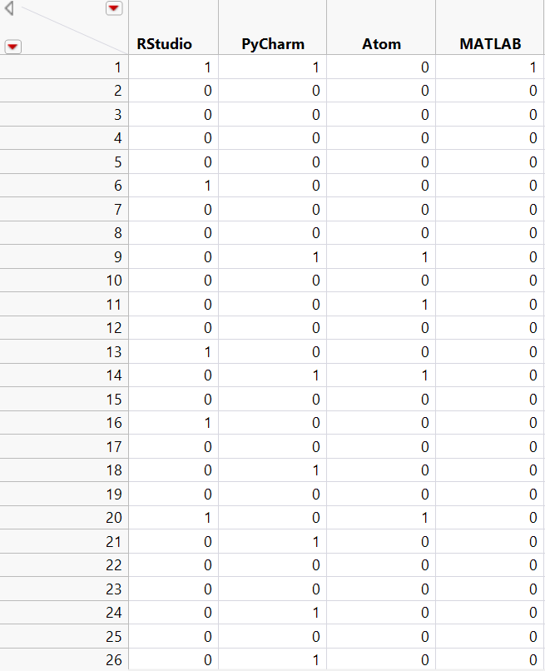
Method #1:
Multi-Correspondence Analysis
Turn the columns into transactions
Relabeled columns, separated multiple choice responses
What respondents use
What respondents know

Slide 4
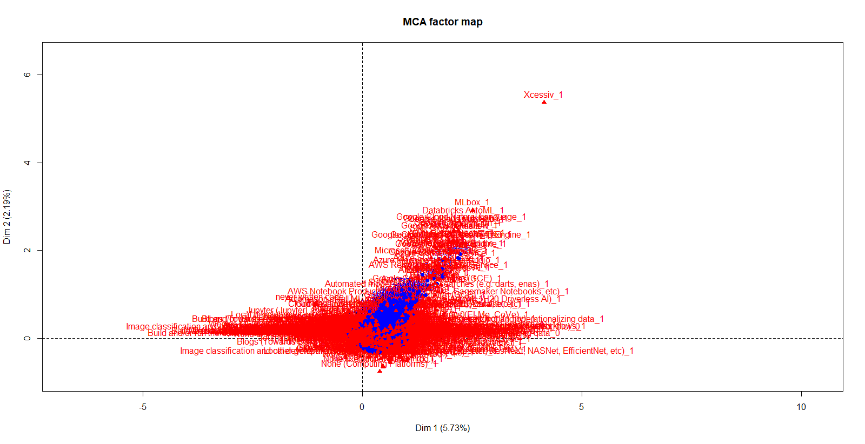
Everything: basic and messy.

Slide 5
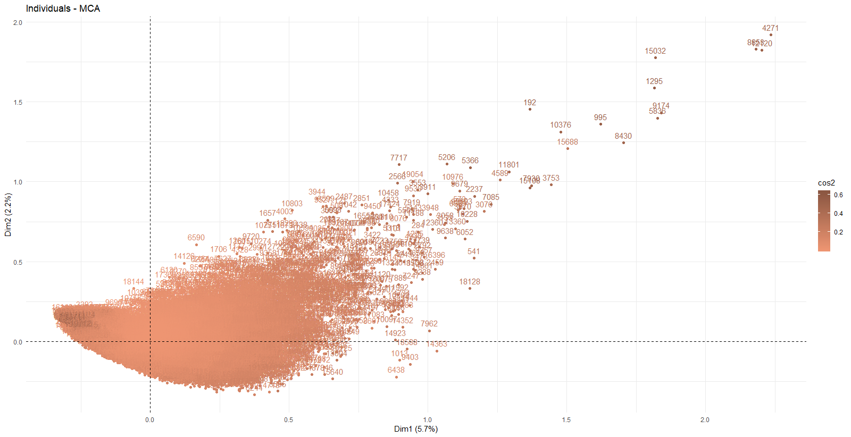
Individual Representation

Slide 6
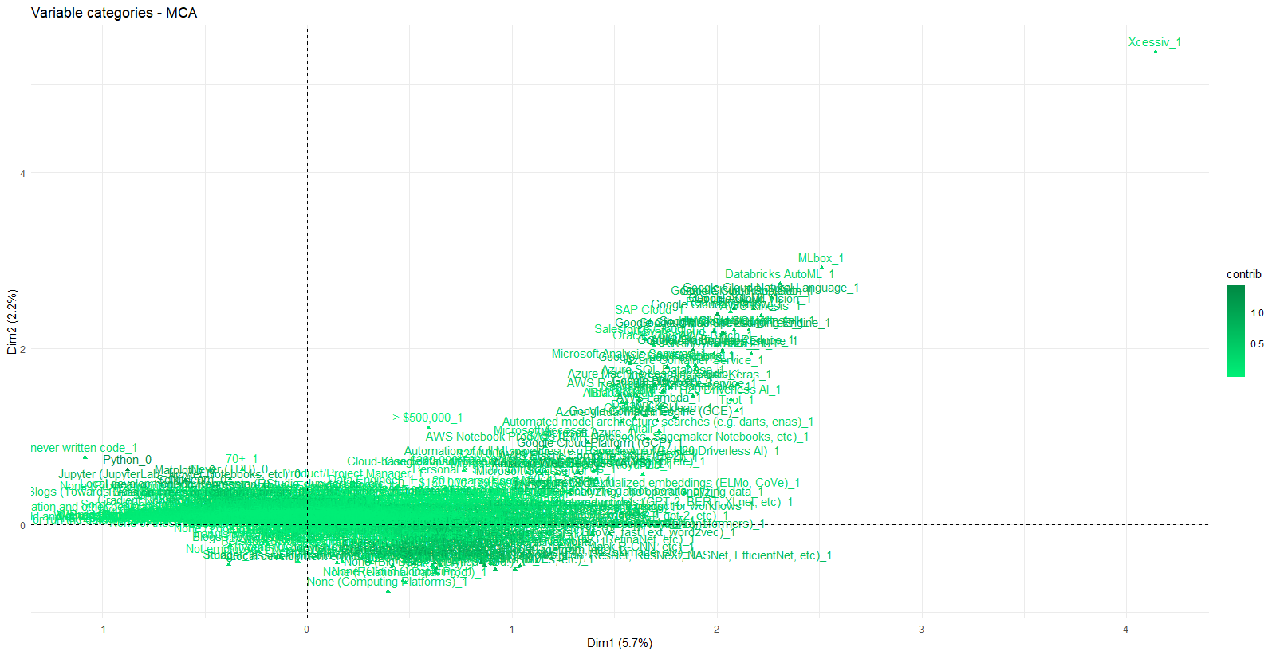
Variable Representation

Slide 7
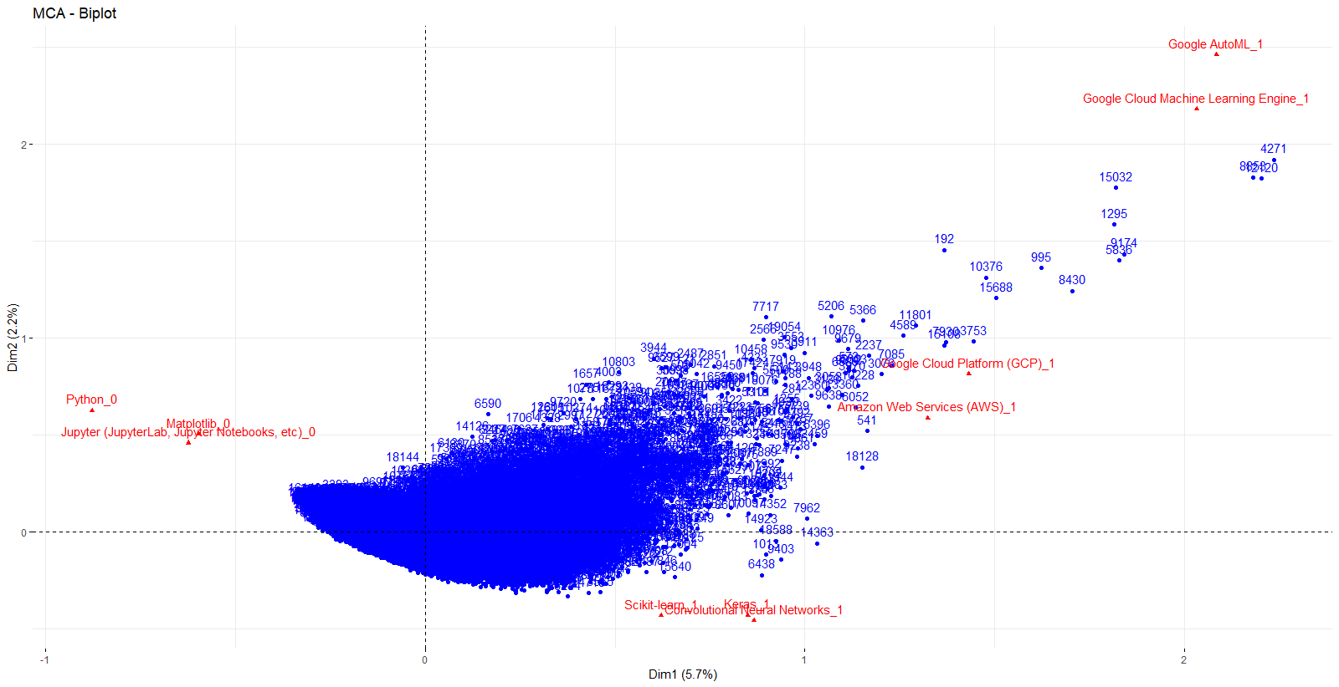
Top ten contributing Variables
Python_0
Matplotlib_0
Jupyter suite_0
Google AutoML_1
Scikit_learn_1
Keras_1
Convultional Nueral Networks_1
Google_AutoML_1
Google_machine_leanring
Engine_1

Slide 8
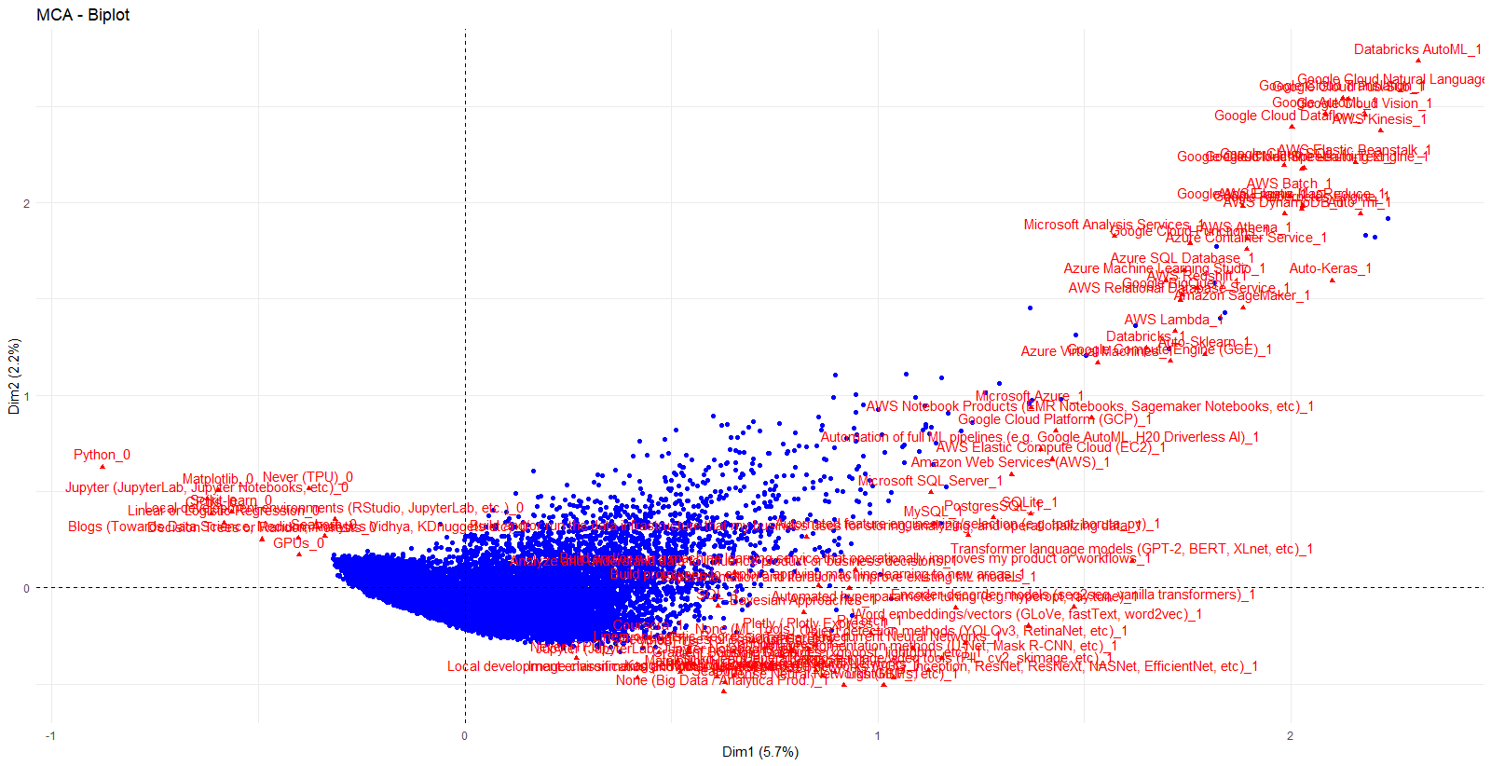
Top 100 contributing variables

Slide 9
Final Thoughts on MCA
Not great results
Variables measure similar ideas
The Advanced users vs. More casual respondents
Most users aren't distinct among each other

Slide 10
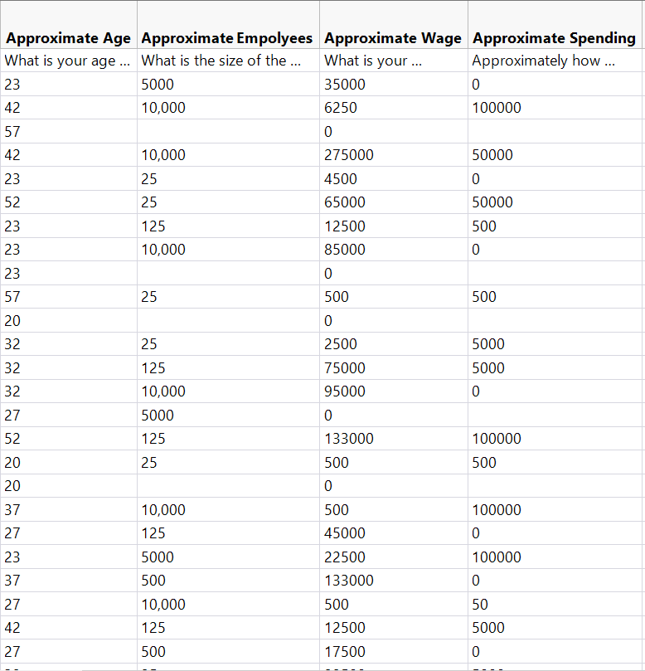
Method #2:
Principle Component Analysis
Turn Ordinal Data into numeric using midpoints
Most variables measure work of monetary measures
Only 7 variables
Not an optimal scenario

Slide 11
missMDA package to Handle Missing Values
Library(missMDA)
Kpca.comp <- imputePCA(Kpca.mat, ncp = Kpca.ms$ncp)
Kpca.comp$completeObs[1:10,]
Allows us to impute values as substitutes for missing data
Similar to imputing for a regression model
https://www.rdocumentation.org/packages/missMDA/versions/1.14/topics/imputePCA For full documentation

Slide 12
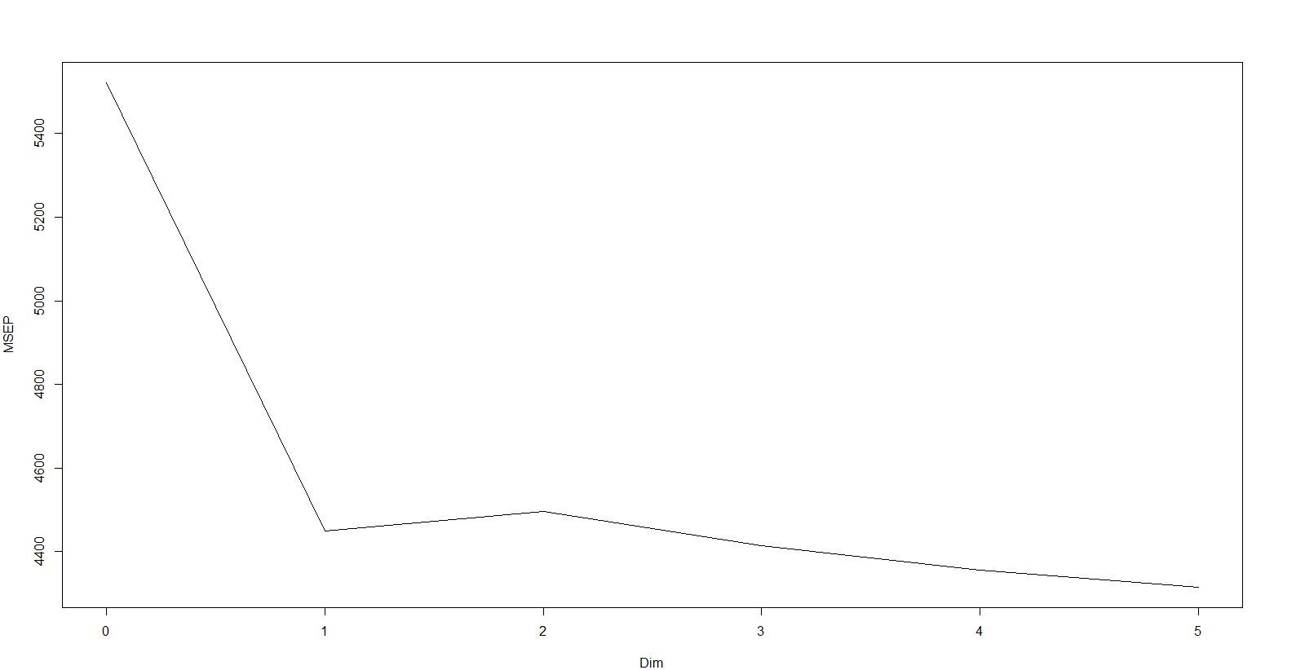
Skree Plot
The most success was had with retaining 2 PCs

Slide 13
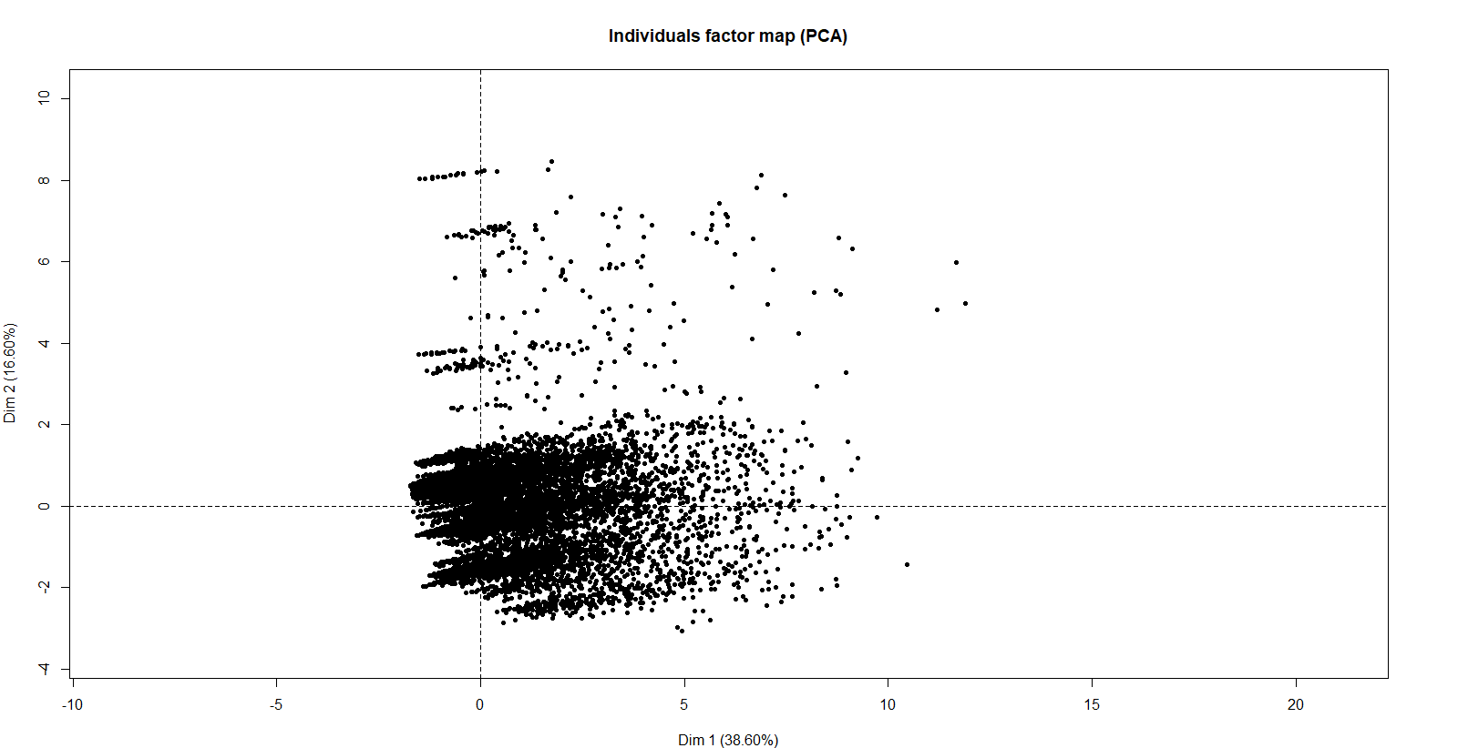
Individual Factor Map
Explains roughly 64% in 2 dimensions

Slide 14
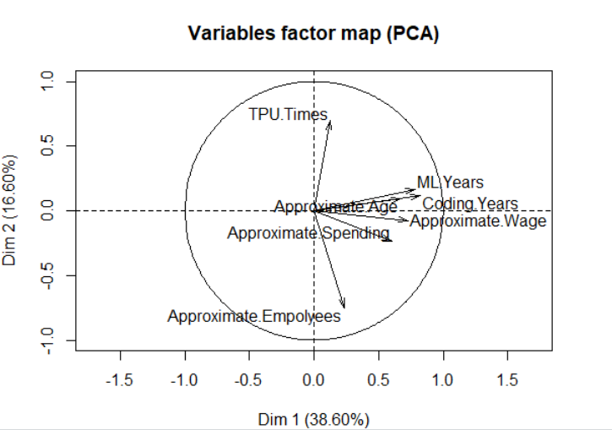
Individual Variable Map
Similar to MCA
Casts a Cone from middle
Every used variable seems relevant
Only a reduction of 5 elements

Slide 15
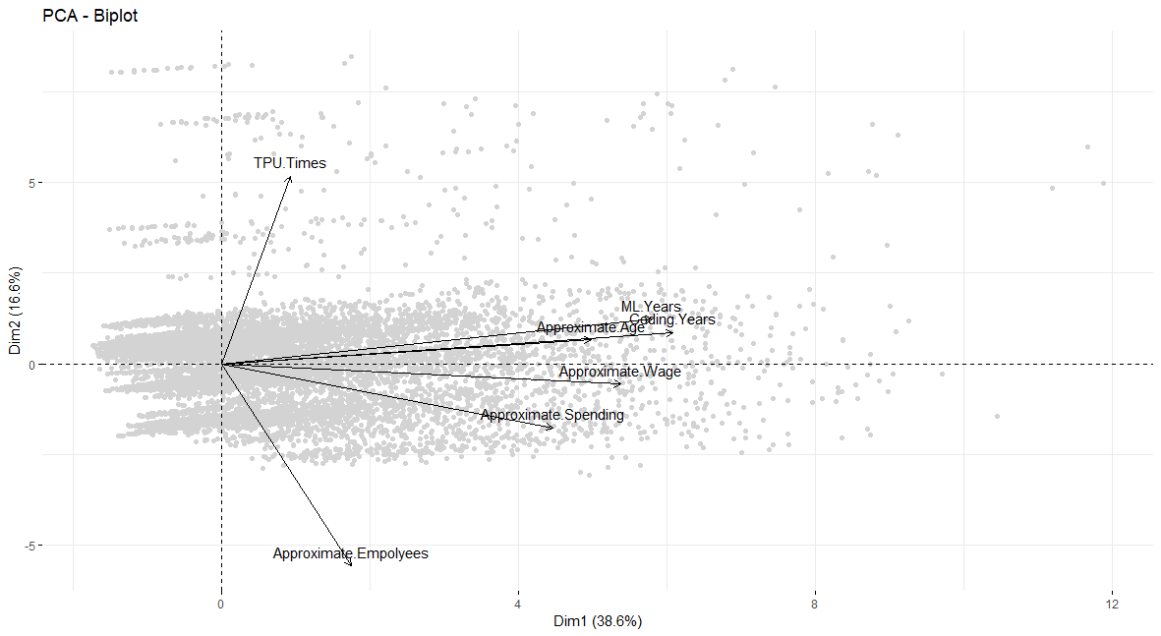
Biplot of Variables and Individuals

Slide 16
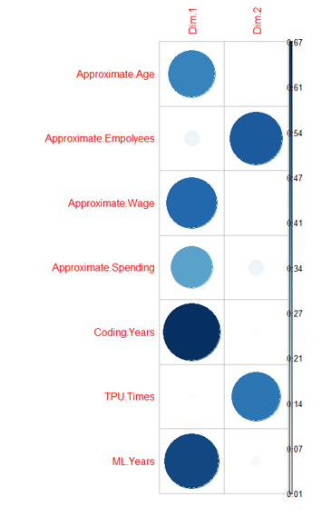
Correlation Plot of Dimensions
Dim 1:
The Oldest, highest paid, most experienced data workers
Dim 2:
People who work as part of larger companies that interact with TPUs

Slide 17
Final Thoughts on PCA
Better than expected
Pattern is consistent with MCA
missMDA is useful solution for missing data
The proficient individuals vs. Corporate workers
Almost caused my computer to catch fire

Slide 18
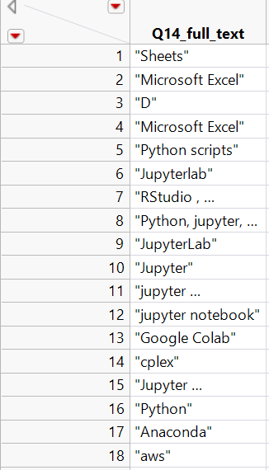
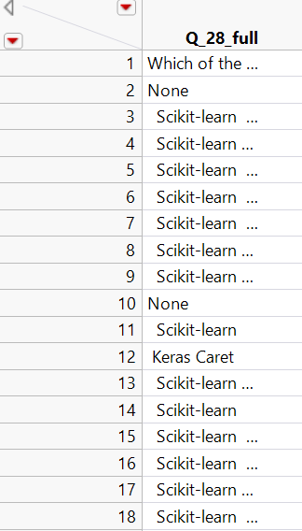
Method #3:
Text Association Rules
Concatenating responses to check-box questions 14 and 28
Both also had "Other" free text response options
Stop words like Google and Microsoft removed
Null rows removed
15,673 rows
13,754 rows

Slide 19
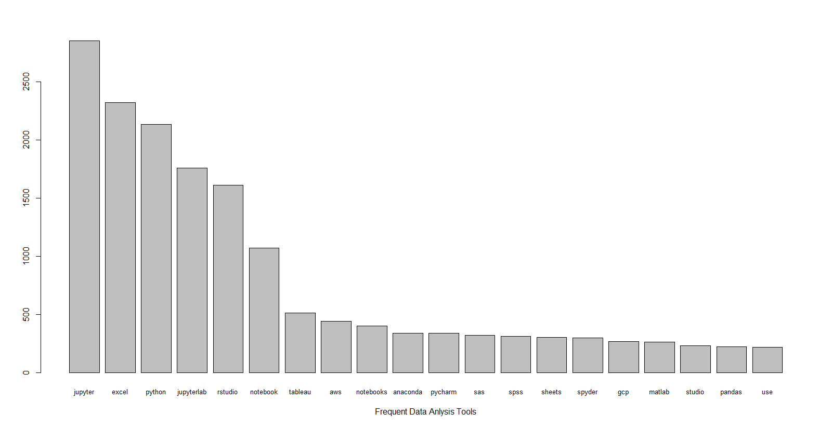
Question 14 asks:
“What is the primary tool that you use at work or school to analyze data?”

Slide 20

Word Cloud of Responses:
Q14

Slide 21
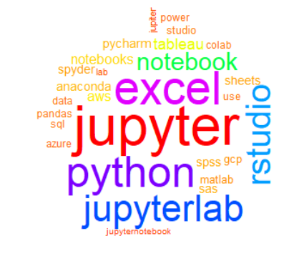
Word Cloud of Responses:
Q14
Minimum Frequency = 100

Slide 22
Top 10 Association Rules by lift (min sup = 0.001, conf = 0.5)
Support for rules overall is excessively low.
lhs rhs support confidence lift count
[1] {science} => {data} 0.001467492 0.9583333 76.243443 23
[2] {analyze} => {data} 0.001339884 0.9130435 72.640256 21
[3] {matplotlib} => {pandas} 0.002105532 0.6600000 46.179375 33
[4] {watson} => {studio} 0.001403688 0.6470588 43.712728 22
[5] {sklearn} => {pandas} 0.001212276 0.6129032 42.884073 19
[6] {server} => {sql} 0.001850316 0.5471698 40.837107 29
[7] {sagemaker} => {aws} 0.001212276 0.5588235 19.905548 19
[8] {scripts} => {python} 0.001403688 0.7857143 5.778742 22
[9] {access} => {excel} 0.001403688 0.7333333 4.945582 22
[10] {keras} => {python} 0.001467492 0.6052632 4.451567 23
Jupyter rules were removed as everything implied them

Slide 23
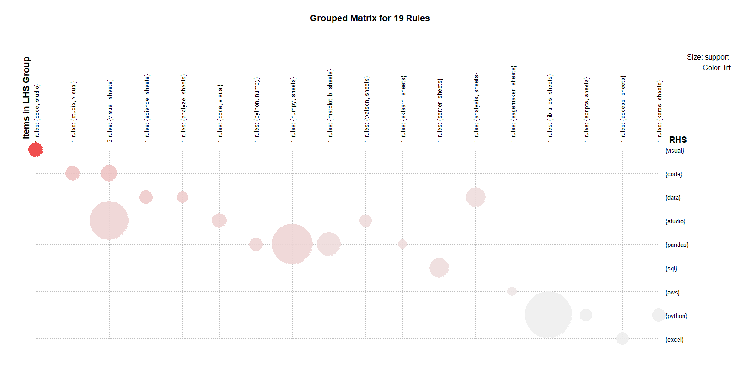
Correlation Plot For Top 19 Rules

Slide 24
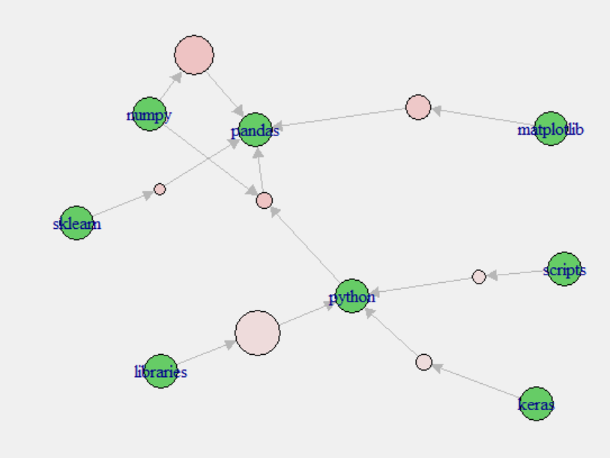
Interesting Misc. Associations
Python and Pandas are popular targets
Python itself implies Pandas
Libraries are more associated with python then R

Slide 25
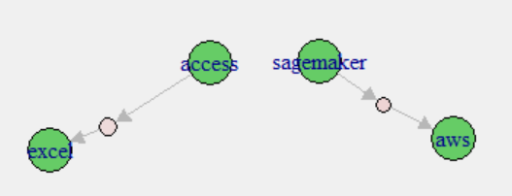
Interesting Misc. Associations
Access to Excel and Sagemaker to AWS (MS and Amazon)

Slide 26
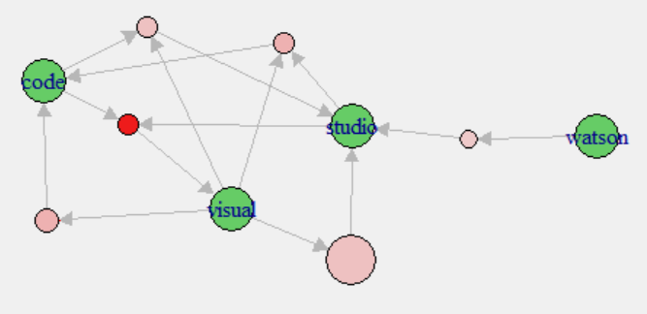
Interesting Misc. Associations
Google products tend to be intertwined
Watsons links by itself to studio
Otherwise all are separated

Slide 27
Q14 Summary
Not a lot of support for associations
Most respondents primarily used one tool
Rules were very consistant
Could likely get better repsones in a future survey

Slide 28
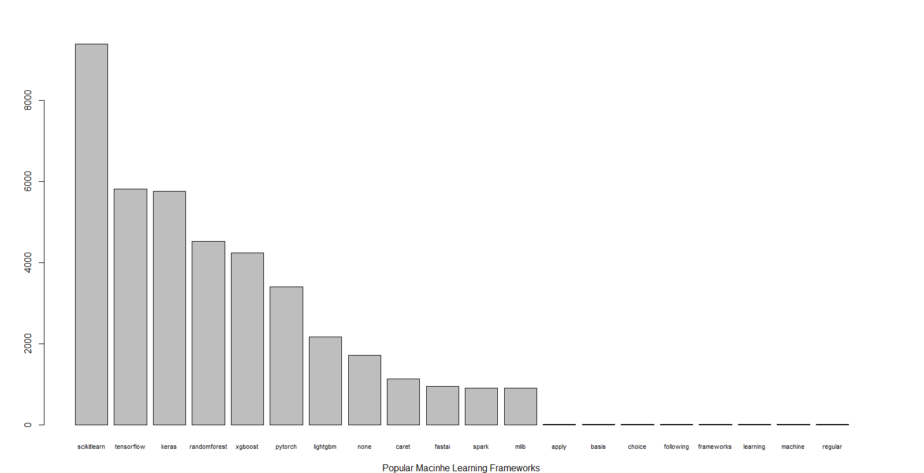
Question 28 asks:
“Which of the following machine learning frameworks do you use on a regular basis?”

Slide 29
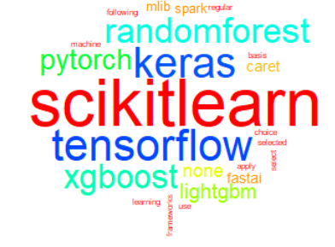
Word Cloud of Responses:
Q28

Slide 30
Top 10 Association Rules by conf (min sup = 0.1, conf = 0.5)
Support for rules is much better
lhs rhs support confidence lift count
[1] {xgboost} => {scikitlearn} 0.2677039 0.8677822 1.271084 3682
[2] {keras,tensorflow} => {scikitlearn} 0.2679221 0.8481013 1.242256 3685
[3] {randomforest} => {scikitlearn} 0.2735204 0.8315650 1.218035 3762
[4] {keras} => {scikitlearn} 0.3476807 0.8307853 1.216892 4782
[5] {tensorflow} => {scikitlearn} 0.3375745 0.7974923 1.168127 4643
[6] {scikitlearn,tensorflow} => {keras} 0.2679221 0.7936679 1.896475 3685
[7] {keras,scikitlearn} => {tensorflow} 0.2679221 0.7705981 1.820475 3685
[8] {keras} => {tensorflow} 0.3159081 0.7548645 1.783306 4345
[9] {tensorflow} => {keras} 0.3159081 0.7463071 1.783306 4345
[10] {scikitlearn} => {keras} 0.3476807 0.5092652 1.216892 4782

Slide 31
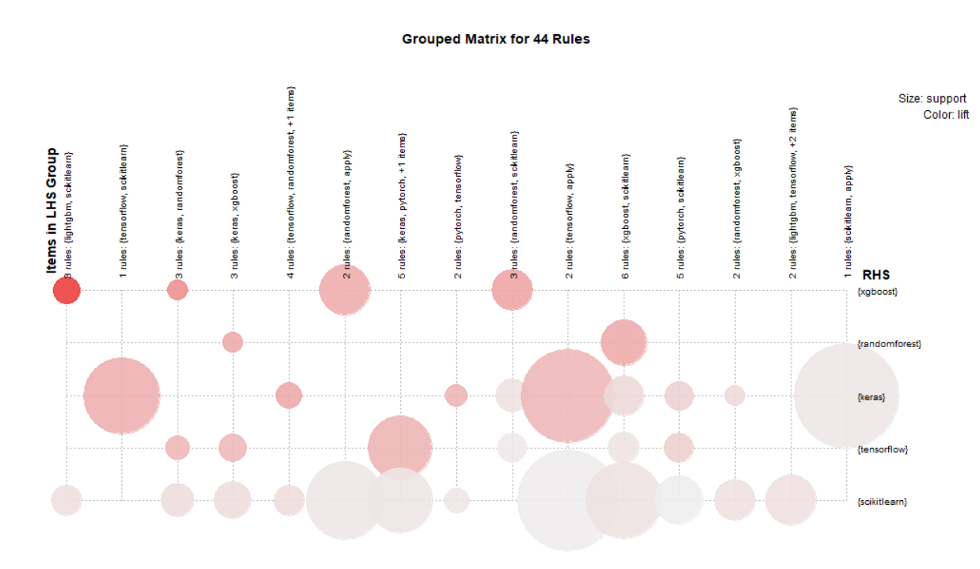
Correlation Plot For Top 44 Rules

Slide 32
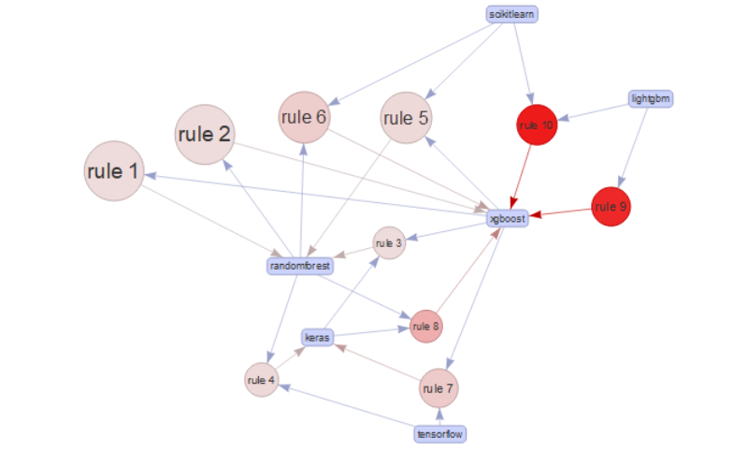
Top 10 Rules By Lift
Xgboost and RandomForest are implied a lot
Lightgbm users tend to also know xgboost
We something similar with tensorflow

Slide 33
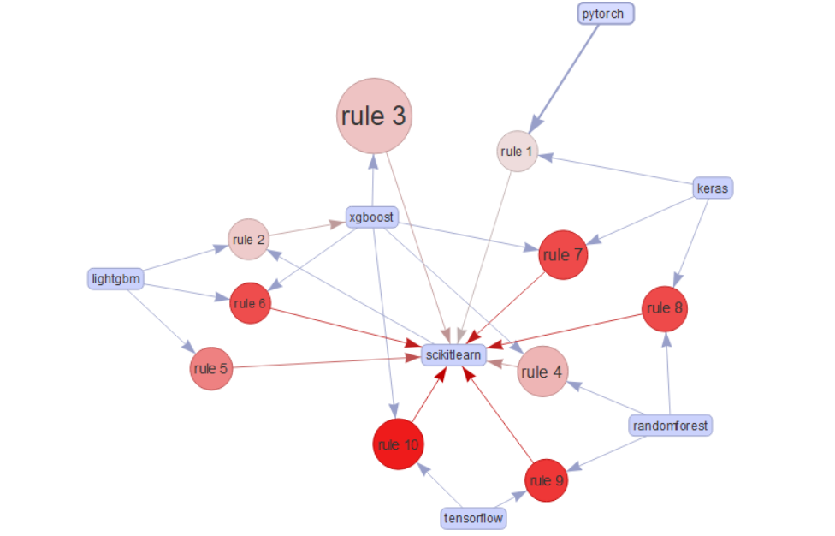
Top 10 Rules By Confidence
Everybody wants Scikitlearn as a second framework
Xgboost is a close second

Slide 34
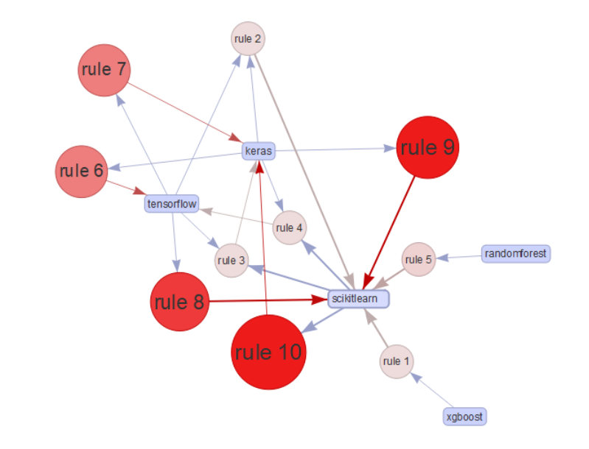
Top 10 Rules By Support
Scikitlearn is also just generally common
Additional Frameworks such as keras, xgboost, and rf seem to make up the standard kit

Slide 35
Q28 Summary
A good pool of intertwined frameworks exists
Scikitlearn presents itself as a starting or intro framework
A large portion of respondents know multiple if they know one
Not a lot of oddballs

Slide 36
Final Thoughts on Text Associations
Question dependent
Frameworks are more consistent than standard tools
For Kaggle users, there seem to be a few distinct items that usually branch off into separate groups
ML Frameworks have a standard group

Slide 37
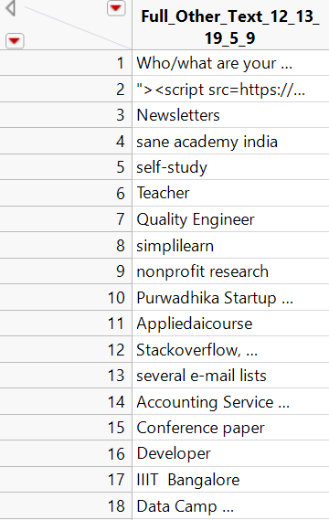
Method #4:
Sentiment Analysis
Concatenating responses from "other" or "optional" text responses to get individual sentiments
Questions 5, 9,12, 13, 19
Reduced row count significantly
Questions were not intended to get sentiments
3,093 rows

Slide 38
Questions Used (Writes-ins only)
Q5: Select the title most similar to your current role (or most recent title if retired):
Q9: Select any activities that make up an important part of your role at work:
Q12: Who/what are your favorite media sources that report on data science topics?
Q13: On which platforms have you begun or completed data science courses?
Q19: What programming language would you recommend an aspiring data scientist to learn first?

Slide 39
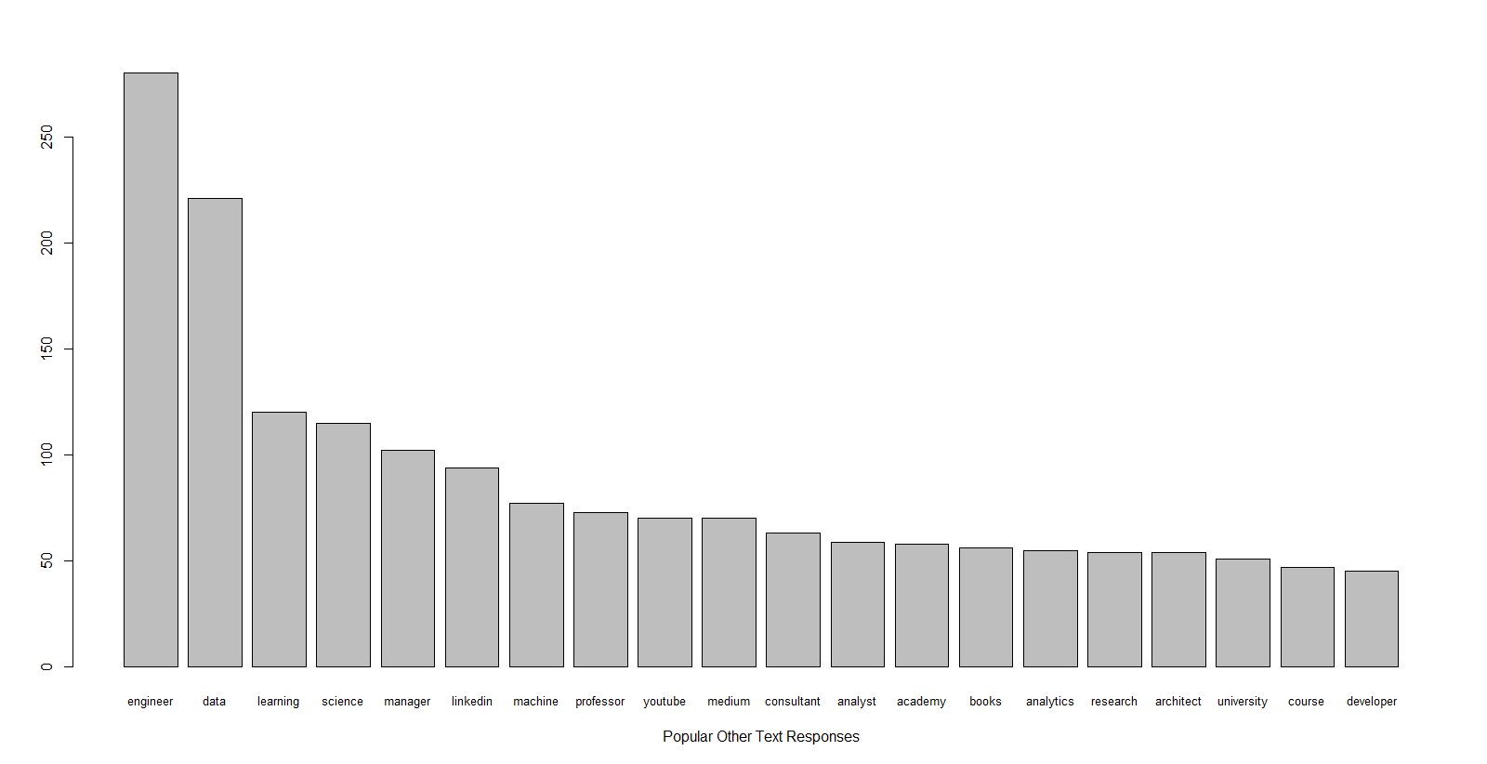
Common Words

Slide 40
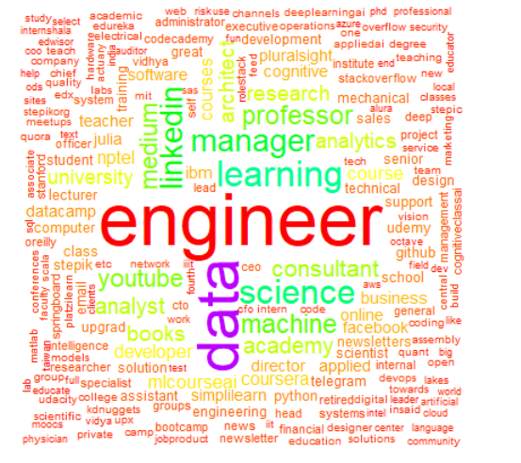
Word Cloud of Responses:
Sentiment

Slide 41
Sentiment Methods
Hu & Liu’s (2004)
originally intended for customer reviews
specific strings of words that indicate positive or negative features
Cambria, Poria, Bajpai,& Schuller’s (2016)
focused on individual words as opposed to larger phrases.
may leave us vulnerable to flat sentiment being misinterpreted
Taboada, Brooke, Tofiloski, Voll, & Stede’s (2011)
able to tell orientation of the word based on those around it
Claims to better handles intensification and negation

Slide 42
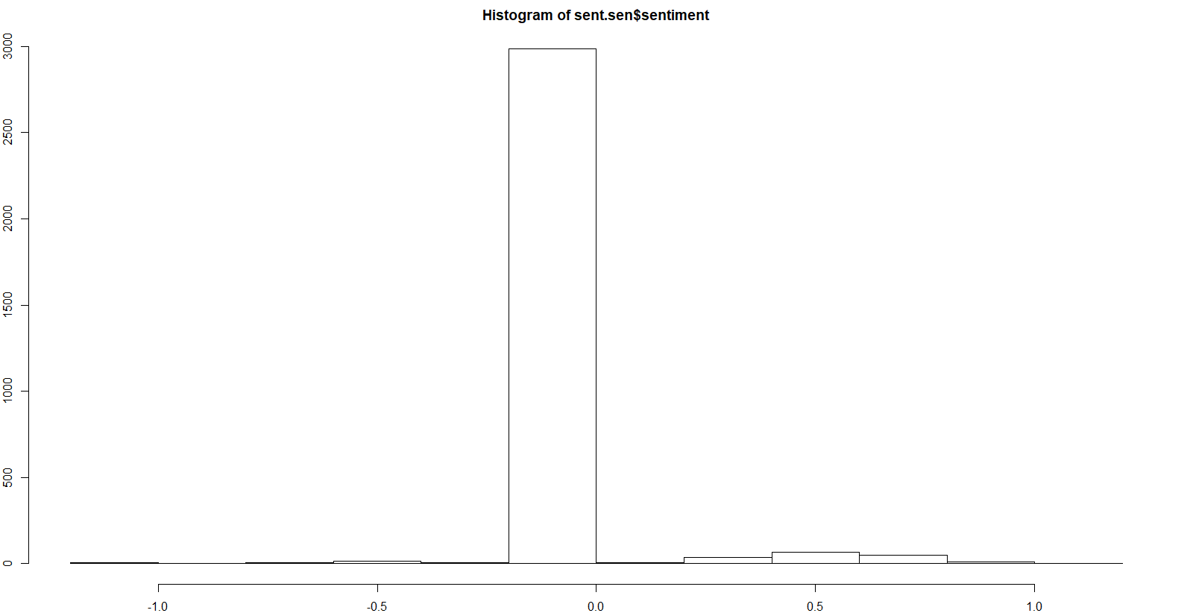
Hu & Liu’s (2004) hash_sentiment_huliu

Slide 43
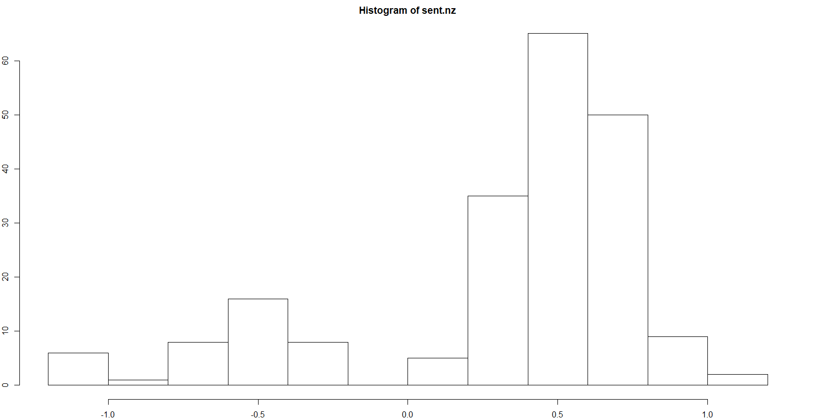
Hu & Liu’s (2004) hash_sentiment_huliu Zeros Removed

Slide 44
Cambria, Poria, Bajpai,& Schuller’s (2016) hash_sentiment_senticnet

Slide 45
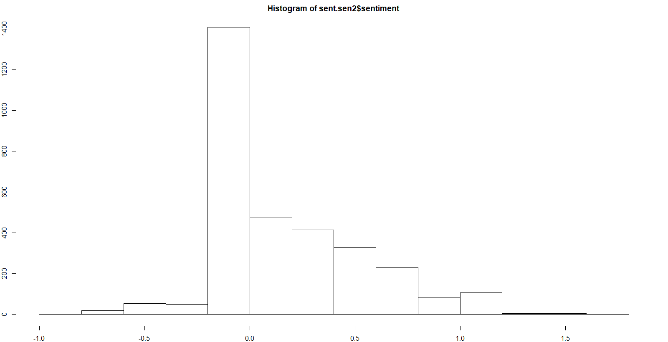
Cambria, Poria, Bajpai,& Schuller’s (2016) hash_sentiment_senticnet Zeros Removed

Slide 46
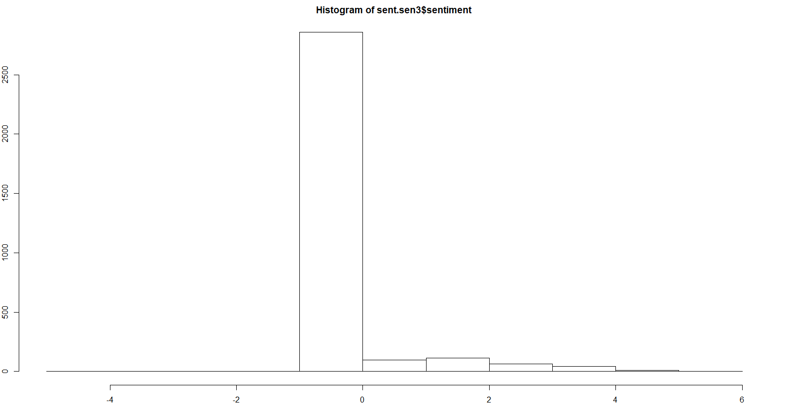
Taboada, Brooke, Tofiloski, Voll, & Stede’s (2011) hash_sentiment_socal_google

Slide 47
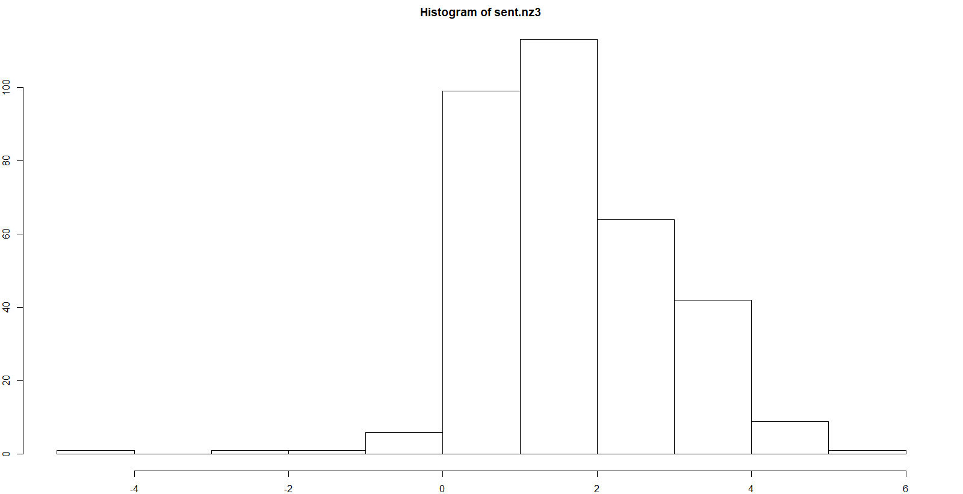
Taboada, Brooke, Tofiloski, Voll, & Stede’s (2011) hash_sentiment_socal_google Zeros Removed

Slide 48
Sentiment Results
Hu & Liu’s (2004)
Mean Sentiment: 0.022 (0.34 adjusted for zeros)
Cambria, Poria, Bajpai,& Schuller’s (2016)
Mean Sentiment: 0.19 (0.33 adjusted for zeros)
Taboada, Brooke, Tofiloski, Voll, & Stede’s (2011)
Mean Sentiment: 0.17 (0.24 adjusted for zeros)

Slide 49
Final Thoughts on Sentiment Analysis
Results are questionable, but positive
About what we might've expected from the questions
Sentiment lists mattered for some responses and not others
Certainly interesting, could be better mapped with better questions

Slide 50
Project Summary
Challenge is a fair title
Did not visualize well
Seemed better suited for summary
Survey itself may benefit from revision
Not overly conducive to Unsupervised Methods

Slide 51
Project Summary Continued
We saw some evidence that Kaggle users may sit in two or three camps
PCA showed promise, but might benefit from more true continuous variables
Machine Learning Frameworks have clear distinction, but all are closely intertwined
Sentiment analysis showed that emotions are not overly impacting written responses.

