Slide 1

Proximal Policy Optimization vs Deep Q-Network vs Advantage Actor-Critic: A Comparative Study on Pong
Members: Cherie Duong, Minh Tri An, Raghav Gulati, Samuel Dietrich
Presentation Title Goes in Here
The School of Graduate and Postdoctoral Studies
Notes:
‹#›

Slide 2

Outline
Introduction
Environment
Models
Results
Conclusion
Future Work

Slide 3
Introduction
Primary Goal: Comparing the performances and optimal use cases of three foundational RL techniques
Models:
Proximal Policy Optimization (PPO)
Deep Q-Network (DQN)
Advantage Actor-Critic (A2C)
Scope: Benchmark performance within the Atari Pong environment
Core Evaluation Metrics:
Training Time
Computational Resources Required
Average Pong Score

Slide 4
Environment
Environment Base: Standard PongNoFrameskip (Gymnasium API)
Game Objective: First to 21 points (Reward range: -21 to +21).
Data Preprocessing: Stacked 4 consecutive frames per state
Vectorization: The model was trained using multiple parallel environments (up to 16), allowing faster collection of experience data
Environment Sample:

Slide 5
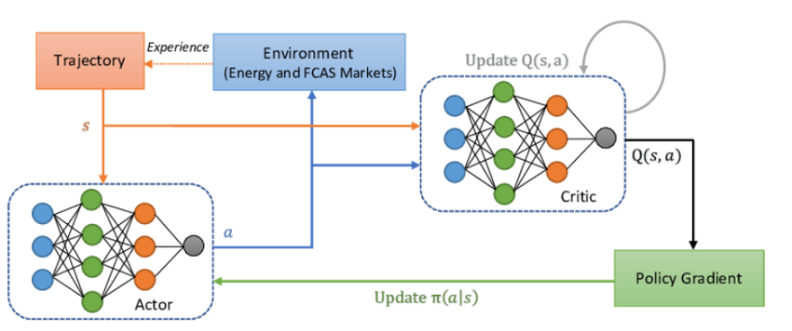
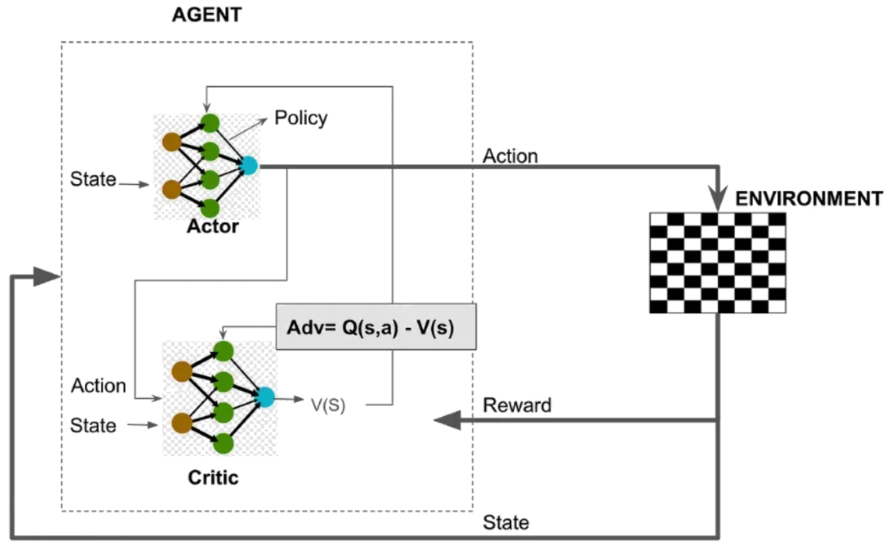
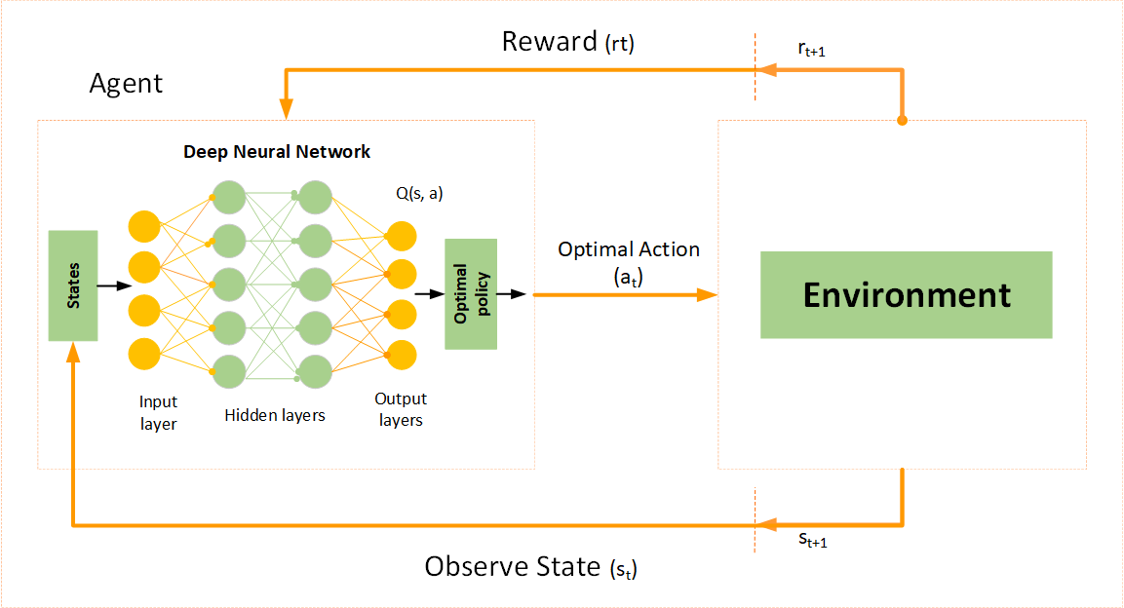
Models
A2C
PPO
DQN

Slide 6
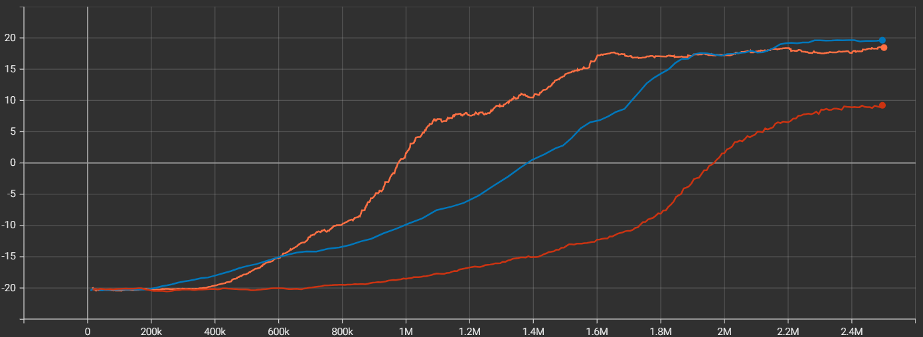
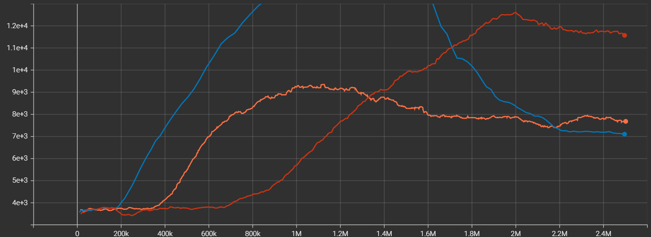
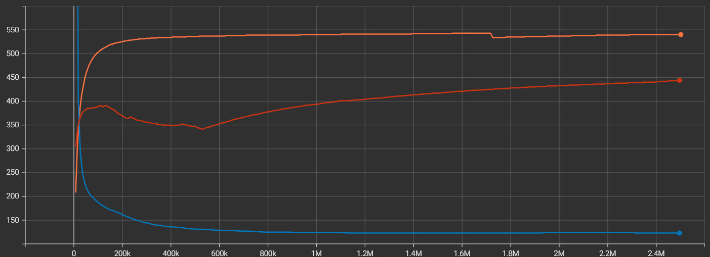
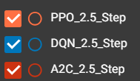
Results
Rewards
Time steps per game
FPS
Notes:
PPO began very strong increasing its rewards quickly but starts plateauing soon at 1.6 million time steps with a score of 17.19. It slowly gets better rewards ending with a score of 18.45. PPO breaks into a positive score at 975,000 time steps.
DQN
Increases steadily until it begins to slow at 1.9 million TS with score of 17.4 getting to 19.63
breaks into positives at 1,380,000 time steps
A2C
Slow increase in rewards with a late rise ending with 9.22
breaks into positives at 1,950,000 time steps.

Slide 7
Conclusion
PPO: The optimal choice for fast, stable and sample efficient convergence, especially on resource-limited hardware
DQN: Learned slower initially, but achieved better results than PPO toward the end. Experience Replay Buffer severely hindered the system’s performance
A2C: Required the most time to converge, highly sample inefficient early on, but maintained a healthy processing speed

Slide 8
Future Work
Further optimize all models
Produce a comparative model for each checkpoint
Compare finished models against each other at the key checkpoints to determine where and when to use each technique

