Slide 1

PHASE 1 PROJECT: MICROSOFT MOVIE STUDIO
12th March 2023

Slide 2
INTRODUCTION
Microsoft sees all the big companies creating original video content and they want to get in on the fun.
They have decided to create a new movie studio, but they don’t know anything about creating movies.
This project seeks to explore what types of films are currently doing the best at the box office and translate those findings into actionable insights that the head of Microsoft's new movie studio can use to help decide what type of films to create.

Slide 3
Project overview
The project seeks to give actionable insights to Microsoft who have decided to create a new movie studio but do not know anything about creating movies. This is done after exploring what types of movies do best at the Box Office.

Slide 4
CHARACTERISTICS OF MOVIES CONSIDERED
THE MOVIE BUSINESS
The genre of movies to be produced. This is done by performing an analysis of the most popular movie genres with popularity considered by the highest ratings.
The movie run-time. The length of movies that viewers prefer is analyzed.
The most popular regions by movie consumption are considered.
The domestic market is compared to the global market to find out which is most profitable.

Slide 5
DATASETS USED
THE DATA
The data is taken from different locations and includes data from:
IMDB which is located in a SQLite database. Certain characteristics such as language, run-time, attributes and ratings are described in this dataset.
The Movie DB shows the genre, language and popularity of a set of 26,516 movies
The numbers dataset describes production budget and is used to compare the profitability of domestic vs global markets.
Box Office Mojo which contains data about studios and gross incomes of various films.

Slide 6
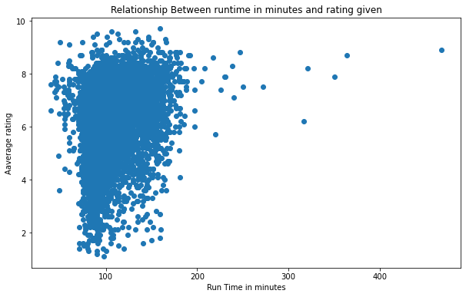
DATA ANALYSIS
Analysis of correlation between the length of a movie and its rating
Analysis of the scatter plot:
The scatter plot shows that there is no correlation between average rating and the run time.
An increase or a decrease in run time does not relate to a change in the average rating.

Slide 7
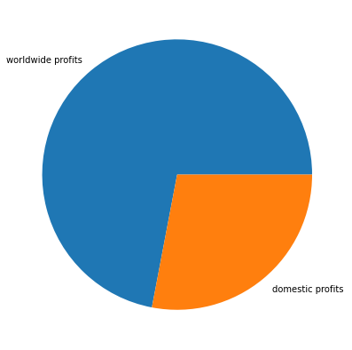
DATA ANALYSIS
Analysis of profits between the worldwide and the domestic markets
Analysis of the pie chart:
The pie chart illustrates that in 71.999% of instances, worldwide profits were larger than domestic profits.
This means that 71.999% of the moves in the dataset made more money from the worldwide market compared to the domestic market.

Slide 8
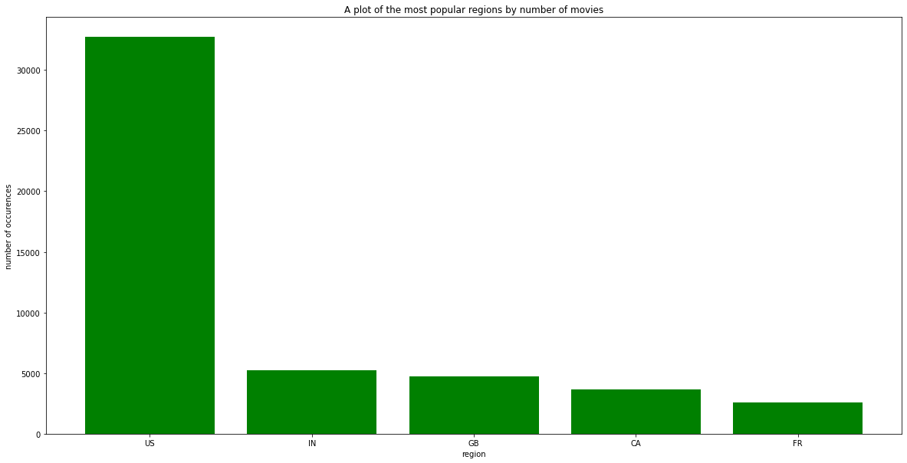
DATA ANALYSIS
Analysis of the most popular regions based on the number of movies.
Analysis of the bar chart:
From the bar graph above, the United States is the most popular region by a very large margin compared to the second country. It takes 66.87 % of all the movies.
India is second with 5246 movies, representing 10.71% of total movies
Great Britain comes third with a share of 9.66%
Canada is 4th with 7.52%
France comes 5th with a share of 5.23%

Slide 9



Project analysis slide 3
RECOMMENDATIONS
MAIN OBJECTIVE
The project makes the following recommendations to Microsoft:
PROFITS
Movie run - time
MOST POPULAR REGION
Microsoft should not only focus on the domestic market but the global market as this offers the highest returns.
Although there is no correlation between runtime and popularity, the average movie time is 105 minutes for the best performing movies.
Microsoft should strive to focus on the United States as it is the largest movie market. It should however also produce movies in other languages

Slide 10
Thank You. Any questions?
NAME: SAMUEL KIIO KYALO
LinkedIn: https://www.linkedin.com/mwlite/in/samuel-k-b2654995

