Slide 1


Upgrading Network buisnesws infrasturctier

Slide 2
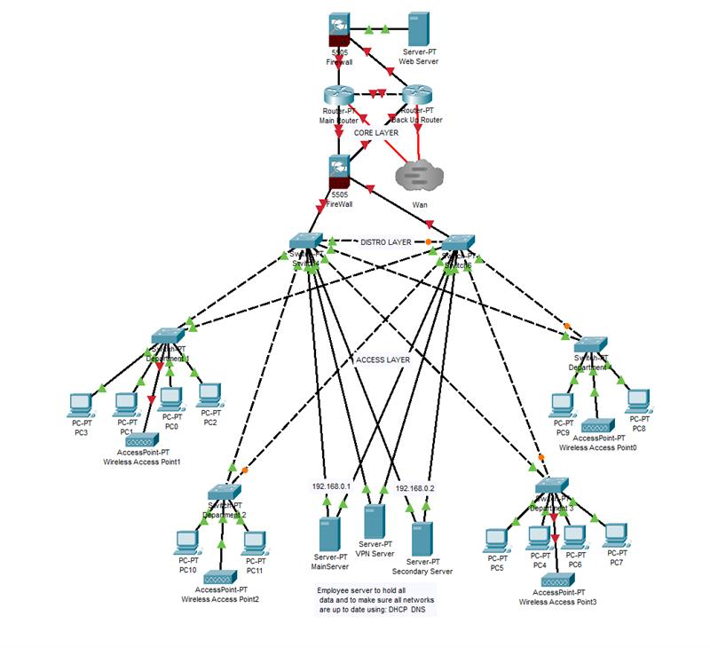
Network Design
My Network Design incroportates 3 layers such as the Core, Access,Distrobutuin layer these 3 layers allow for intrrnal and external communication whilst also having a low risk of failure and continunties

Slide 3
Access And Distrubtion Layers
For my Access Layer I desided to go with a star topology this allowed me to make sure that all clines a connect to the switch would be able to communicate with each other and the server is also allows for upgradeability for the future
It also hosts the 3 servers
for vpn dhcp dns and file
handling these serve3rs
will have a static ip allowinmg
for anyuser to connect at any time
For the distribution
layer is has high speed
switches allwoiung for instant
connections and high download
speeds

Slide 4
Core Layer
The core server is made up of a Wan connection to the outside 2 routers for redundancy's sake a firewall for the webserver and a firewall for the distribution and access layer, this way if anything goes down the backup router can kick in until the main router is fixed and fully operational
The firewall blocks incoming and outgoing connections depending on where your going for instance the firewall for the server is differenct for the accesss layer
Wan has a static ip and the router is setpu for vpn

Slide 5
Remote Access Solution
My solution for not habong a remopte connection is to add a vpn server in the access layer this way anyone who has the correct key, username and password can access the internal servers and communicate with the servers in the access layer
Using IPsec with a key shared before hand increases security by miles it stops unwanted people from remoting in
How this works is that when a remote user wants to remote in and has the correct information the router route all of the traffic to the vpn is then checks its credentials and if it has the correct credientials it is then given a dhcp ip and the location to the dns server

Slide 6
Mobile Device Intergration
To integrate mobile device usage the most efficient way possible would be to ass wireless access points as shown here these can connect the mobile devices to the internal data server allowing access to all of its servers and files

Slide 7
Hosting a web server
For my webserver I have a dedicated firewall to restrict unwanted users coming to our website stopping ddosing and other forms of attacks whilst allowing wanted users connecting to the server
The firewall also only allows HTTPS traffic to the server disallowing traffic to the internal server

Slide 8
Scalability

Slide 9
Security Measures

Slide 10
Cost Analysis

Slide 11
Timeline

Slide 12
Risk Assesment

