Slide 1
Introduction to Java & Object-Oriented Programming
Unveiling the Power of Java and its Core Principles
S. Samuel Rickson

Slide 2
Agenda
Introduction to Java
What is Java?
Key Features
History of Java
The Green Project (Origins)
Major Milestones & Releases
Object-Oriented Programming (OOP) in Java
What is OOP?
Why OOP?
The Four Pillars of OOP (with Java examples)
Encapsulation
Procrastination (Typo: Should be Polymorphism)
Inheritance
Abstraction

Slide 3
What is Java?
A High-Level, Object-Oriented Programming Language
Developed by Sun Microsystems (now Oracle)
Released in 1995
"Write Once, Run Anywhere" (WORA)
Java code is compiled into bytecode (.class files)
Bytecode runs on any Java Virtual Machine (JVM), regardless of the underlying hardware or operating system.
Platform Independent
Linux, Windows, macOS, etc.
Widely Used For:
Enterprise-level applications (e.g., banking, e-commerce)
Android mobile app development
Web applications (backends)
Big Data technologies
Scientific applications and more...

Slide 4
Key Features of Java
Simple: Relatively easy to learn if you understand OOP concepts.
Object-Oriented: Based on the object-oriented paradigm.
Platform Independent: WORA principle thanks to JVM.
Secure: Built-in security features, no explicit pointers.
Robust: Strong memory management, automatic garbage collection, exception handling.
Multithreaded: Supports concurrent execution of multiple parts of a program.
High Performance: Just-In-Time (JIT) compilers optimize bytecode during runtime.
Distributed: Designed for networked environments.
Portable: Architecture-neutral.
Dynamic: Can adapt to evolving environments.

Slide 5
The History of Java - Inception
The Green Project (1991):
Initiated by James Gosling, Mike Sheridan, and Patrick Naughton at Sun Microsystems.
Original goal: Create a language for consumer electronic devices (VCRs, toasters, etc.) that could run on various processors.
Needed to be small, robust, and platform-independent.
Original Name: "Oak" (1991)
Named after an oak tree outside Gosling's office.
Renamed "Java" due to a trademark conflict.
Birth of "Java" (1995):
Officially announced by Sun Microsystems.
Shifted focus from consumer electronics to the burgeoning World Wide Web.
Applets (small Java programs embedded in web pages) were a major initial driver.

Slide 6
The History of Java - Key Milestones
JDK 1.0 (1996):
The first stable release, gaining rapid popularity for web applets.
J2SE 1.2 (1998 - "Playground"):
Significant revamp, introduced Collections Framework, Swing GUI toolkit, and JIT compiler.
Renamed to "Java 2 Platform, Standard Edition" (J2SE).
J2SE 5.0 (2004 - "Tiger"):
Major release with generics, autoboxing/unboxing, enums, variable arguments, enhanced for loop, static import.
Java SE 6 (2006 - "Mustang"):
Improved performance, JAX-WS 2.0, Java Compiler API.
Oracle Acquisition (2010):
Oracle acquires Sun Microsystems, including Java.
Java SE 7 (2011):
"Project Coin" (small language enhancements), try-with-resources.
Java SE 8 (2014):
Lambda Expressions, Stream API: Revolutionized functional programming in Java.
Date and Time API (Joda-Time inspired).
Java SE 9 (2017 - Jigsaw):
Module System.
Java SE 11 (2018):
Long-Term Support (LTS) release, HTTP Client API.
Recent Releases (e.g., Java 17, 21 - LTS):
Continued evolution with new features and performance enhancements. (Oracle now releases new versions every 6 months, with LTS releases every 2 years).

Slide 7
Introduction to Object-Oriented Programming (OOP)
What is OOP?
A programming paradigm based on the concept of "objects," which can contain data (attributes/fields) and code (methods/behaviors).
Aims to model real-world entities and their interactions.
Why OOP?
Modularity:
Breaks down complex problems into smaller, manageable objects.
Reusability:
Objects can be reused in different parts of the program or in other projects.
Maintainability:
Easier to modify and debug code as changes are localized to objects.
Scalability:
Facilitates the development of large and complex systems.
Real-world Modeling:
Closer to how we perceive the real world.

Slide 8
The Four Pillars of OOP in Java Pillar 1: Encapsulation
Definition:
Bundling data (attributes) and methods (operations) that operate on the data into a single unit (a class).
Data Hiding:
Restricting direct access to some of an object's components (fields). Access is typically provided through public methods (getters and setters).
Benefits:
Protects data from accidental modification.
Allows internal implementation to change without affecting external code.

Slide 9
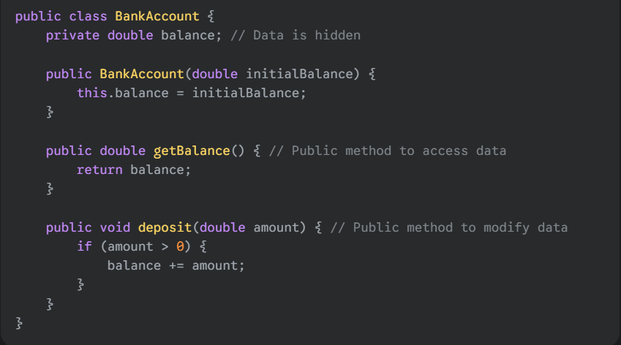
Java Example on Encapsulation:

Slide 10
Pillar 2: Abstraction
Definition:
Showing only the essential features of an object while hiding the complex implementation details.
Focuses on "what" an object does rather than "how" it does it.
Benefits:
Reduces complexity, making systems easier to understand and use.
Allows internal implementation changes without impacting users.

Slide 11
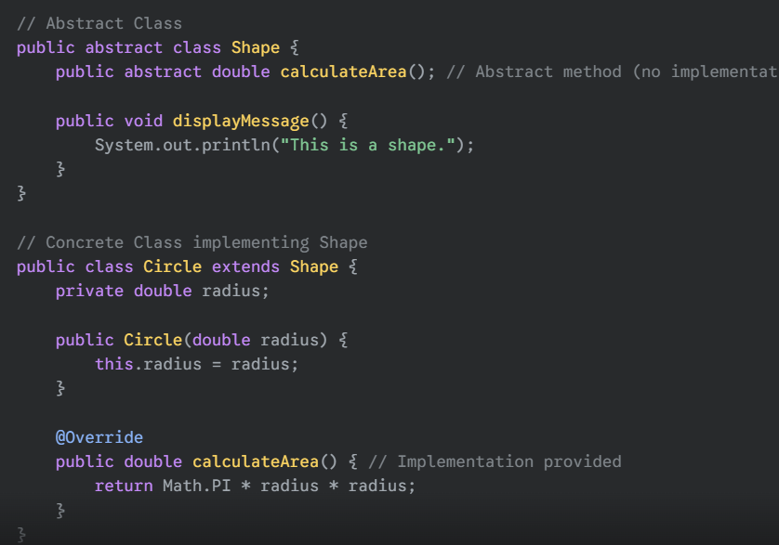
Java Example on Abstraction:

Slide 12
Pillar 3: Inheritance
Definition:
A mechanism where one class (subclass/child class) acquires the properties (fields)
and behaviors (methods) of another class (superclass/parent class).
Promotes code reusability.
is-a Relationship:
A subclass is-a type of superclass (e.g., a Dog is-a Animal).
Keywords:
extends (for classes), implements (for interfaces).

Slide 13
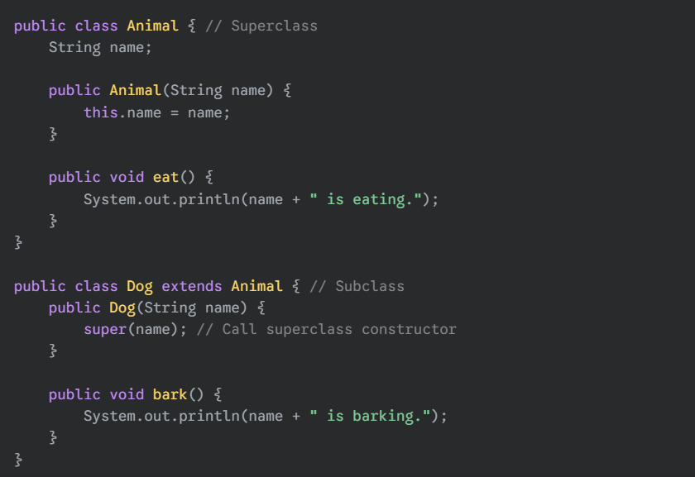
Java Example on Inheritance

Slide 14
Pillar 4: Polymorphism
Definition:
"Many forms." The ability of an object to take on many forms.
Allows objects of different classes to be treated as objects of a common superclass.
A single method or operator can have different implementations depending on the object it's called on.
Types in Java:
Compile-time Polymorphism (Method Overloading): Multiple methods with the same name but different parameters within the same class.
Runtime Polymorphism (Method Overriding): A subclass provides a specific implementation for a method that is already defined in its superclass. Achieved through method overriding.

Slide 15
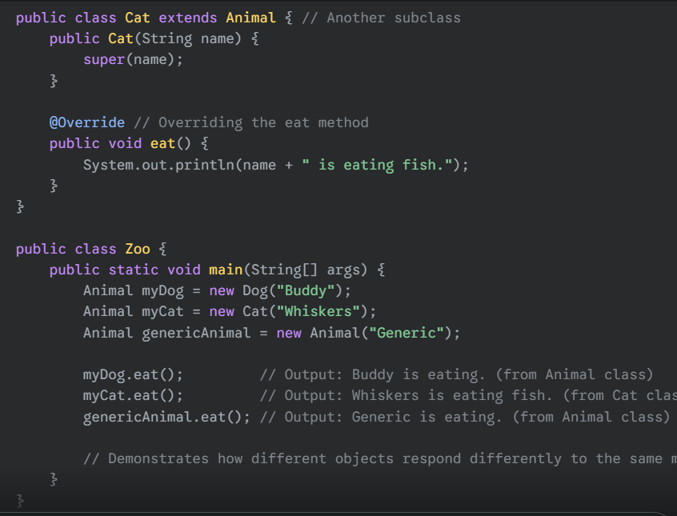
Java Example (Runtime Polymorphism):

Slide 16
Summary
Java is a powerful, platform-independent, object-oriented language.
Its history reflects its evolution from embedded systems to the dominant force in enterprise and mobile development.
OOP principles (Encapsulation, Abstraction, Inheritance, Polymorphism) are fundamental to writing robust, maintainable, and scalable Java applications.
Understanding these concepts is key to becoming a proficient Java developer.

Slide 17
THANK YOU!

