Slide 1
LWP REVIEW 02
01
AquaTrack
Industrial Water Management
and Monitoring System
Dynamic Web Application using PHP & MySQL
Samuel Chinokopota
24CS257
PHP + MYSQL
B.E. Computer Science and Engineering

Slide 2
PROJECT OVERVIEW
02
Problem Statement & Objectives
INDUSTRIAL PROBLEM
PROJECT OBJECTIVES
Manual water-issue reporting can make recording, tracking and reviewing operational problems difficult.
1
Dynamic PHP application
2
MySQL data storage
• Record water issues digitally
• Store reports centrally
3
Issue reporting workflow
• Display operational indicators
4
Dashboard & report retrieval
• Review submitted reports
AquaTrack • LWP Review 02 • Samuel Chinokopota • 24CS257

Slide 3
SYSTEM DESIGN
03
Stage 2 Architecture
USER / BROWSER
APACHE + PHP
MYSQL
DASHBOARD / REPORTS
User submits issue → PHP processes request → MySQL stores data → PHP retrieves results → Dashboard/Reports display data
AquaTrack • LWP Review 02 • Samuel Chinokopota • 24CS257

Slide 4
IMPLEMENTATION
04
Technology Stack
HTML5
CSS3
PHP
Structure & forms
Visual design
Server-side processing
MySQL
Apache
XAMPP
Relational storage
Web server
Local environment
AquaTrack • LWP Review 02 • Samuel Chinokopota • 24CS257

Slide 5
DATABASE
05
MySQL Database Design
Database: aquatrack_db
issue_reports
id • name • area • issue_type • description • status • created_at
aquatrack_db
Relational database
for AquaTrack
water_usage
water usage and savings metrics
AquaTrack • LWP Review 02 • Samuel Chinokopota • 24CS257

Slide 6
FUNCTIONALITY
06
Issue Reporting Workflow
1
2
3
4
5
Enter details
Submit form
PHP processes
MySQL stores
Reports retrieve
Test result: “Report saved successfully. ID: 1”
AquaTrack • LWP Review 02 • Samuel Chinokopota • 24CS257

Slide 7
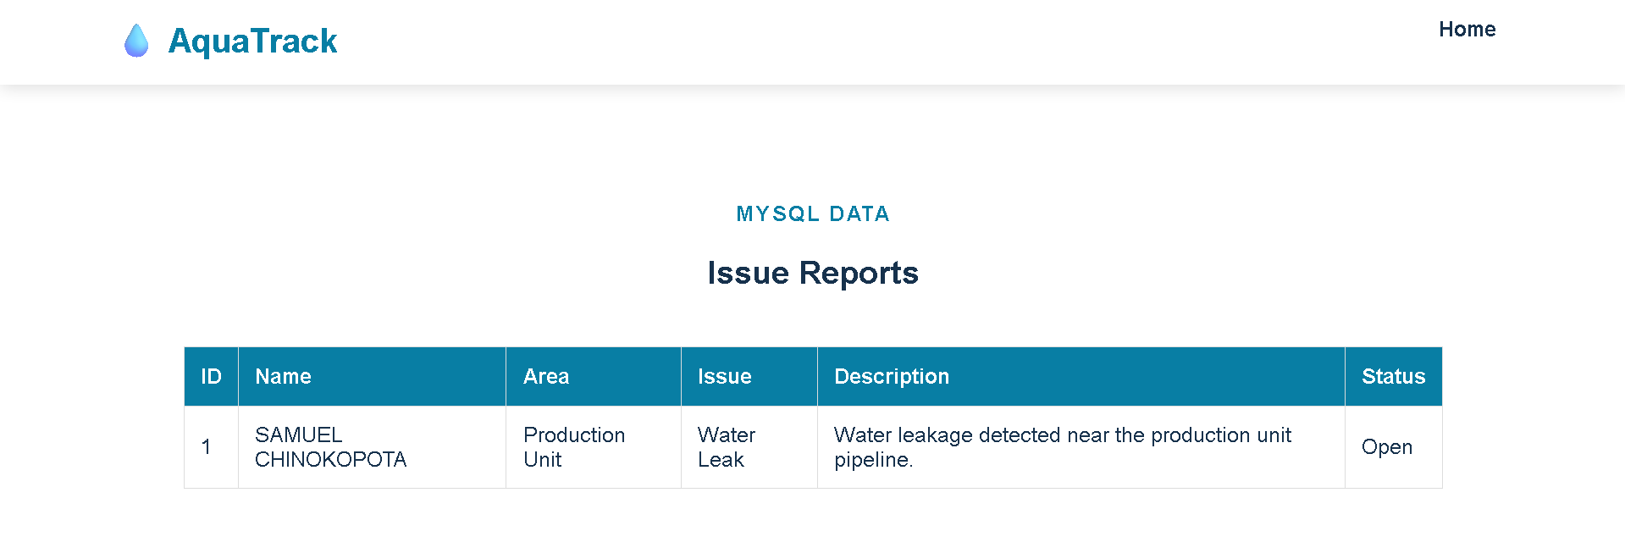
TESTING
07
Live MySQL Report Verification
AquaTrack • LWP Review 02 • Samuel Chinokopota • 24CS257

Slide 8
RESULTS
08
Stage 2 Test Results
PHP processing
Working
MySQL insertion
Working
Report retrieval
Working
Dashboard open issues
1
Report listing
Record displayed
AquaTrack • LWP Review 02 • Samuel Chinokopota • 24CS257

Slide 9
PROJECT DELIVERY
09
GitHub & Local Deployment
GitHub Repository
Stage 2 Local Deployment
AquaTrack-Industrial-Water-Management
XAMPP
Apache + PHP + MySQL
Stage 1 files + documentation + presentation
http://localhost/AquaTrack_Stage2/
AquaTrack • LWP Review 02 • Samuel Chinokopota • 24CS257

Slide 10
CONCLUSION
10
A Working Dynamic Web Application
AquaTrack extends the Stage 1 concept into a PHP + MySQL application that can receive, store and display industrial water issue reports.
1
Dynamic processing with PHP
2
Persistent storage with MySQL
3
Dashboard and report retrieval
4
Tested successfully on XAMPP
Thank You
Samuel Chinokopota • 24CS257

