Slide 1
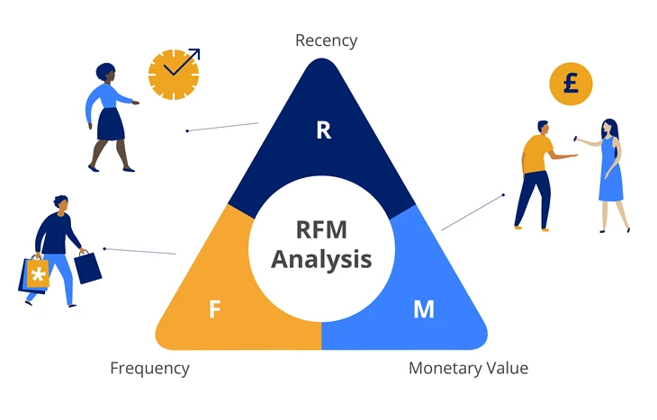
Final Project - RFM Analysis (Machine learning Final Project )
By Samuel,
(Skill-Lync Student)

Slide 2
CONTENTS
1. Context.
2. Customer Segmentation Problem Statement
3. Import Modules,Load The Dataset.
4. Removing the Cancelled Orders.
5. Removing Missing Values.
6. Merging DataFrames.
7. Calculating Recency.
8. Data Analysis.
9. Remove Outliers.
10. Applying K-Means clustering.
11. Summarising clusters.

Slide 3
1. Context
Activities
In this project you will implement RFM analysis for analysing customers based on three factors: Recency, Frequency, and Monetary Value.
You will remove outliers from the dataset and apply K-means clustering to create clusters of customers exhibiting similar purchase behaviour.

Slide 4
2. Customer Segmentation Problem Statement
We have a transactional data set which contains all the transactions occurring between 01/12/2010 and 09/12/2011 for a UK-based and registered non-store online retail. The company mainly sells unique all-occasion gifts. Many customers of the company are wholesalers.
The company wants to segment its customers and determine marketing strategies according to these segments.
The dataset consists of the following attributes:
InvoiceNo: Invoice number. Nominal, a 6-digit integral number uniquely assigned to each transaction. If this code starts with letter 'c', it indicates a cancellation.
StockCode: Product (item) code. Nominal, a 5-digit integral number uniquely assigned to each distinct product.
Description: Product (item) name. Nominal.
Quantity: The quantities of each product (item) per transaction. Numeric.
InvoiceDate: Invoice Date and time. Numeric, the day and time when each transaction was generated. The date-time format used here is yyyy-mm-dd hh:mm:ss
UnitPrice: Unit price. Numeric, Product price per unit in pound sterling, also known as GBP (Great Britain Pound).
CustomerID: Customer number. Nominal, a 5-digit integral number uniquely assigned to each customer.
Country: Country name. Nominal, the name of the country where each customer resides.
Dataset Credits: https://archive.ics.uci.edu/ml/datasets/online+retail
Citation: Dr Daqing Chen, Director: Public Analytics group. chend '@' lsbu.ac.uk, School of Engineering, London South Bank University, London SE1 0AA, UK.

Slide 5
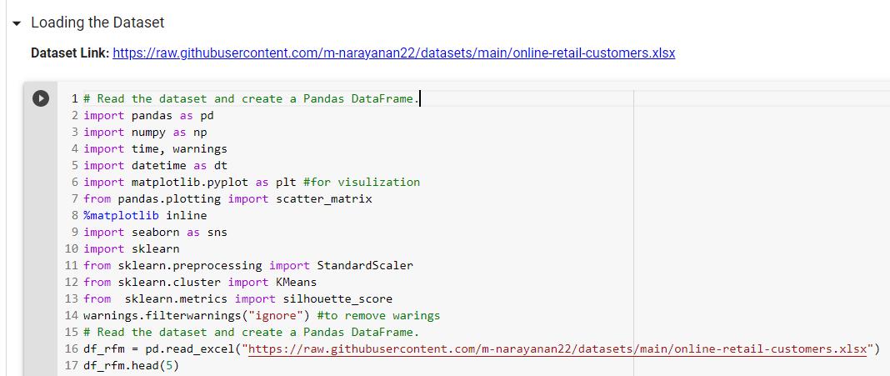
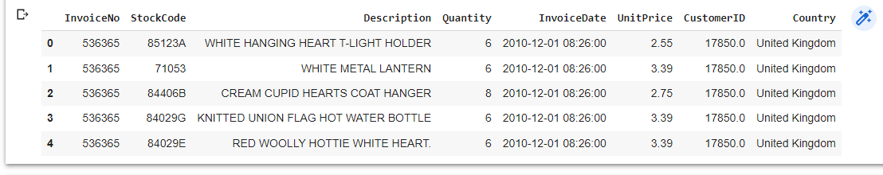
3. Import Modules,Load The Dataset.
Importing modules and loading data set:
Output:

Slide 6
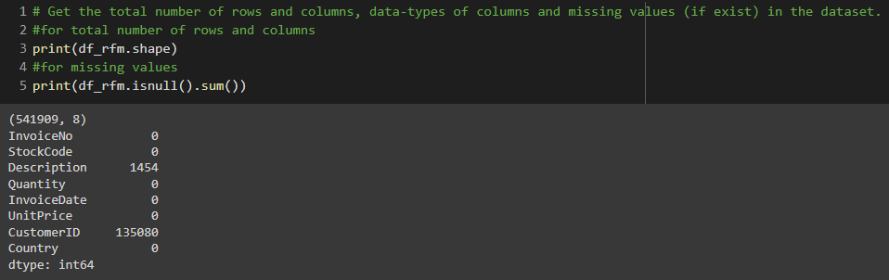
for total number of rows and column and for missing values.

Slide 7
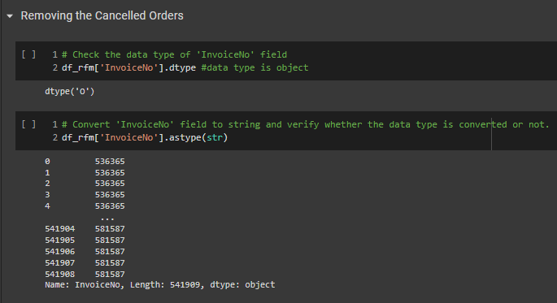
4.Removing the Cancelled Orders.

Slide 8
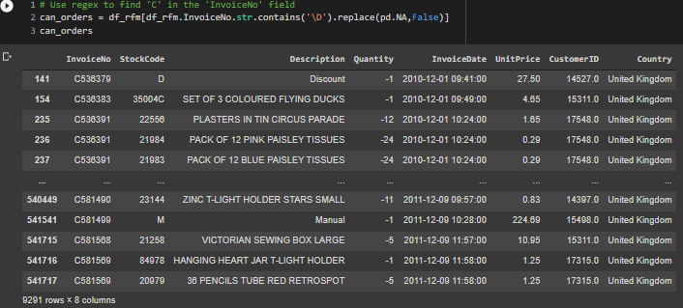

Slide 9



Slide 10
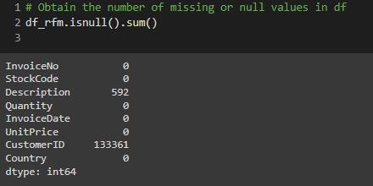
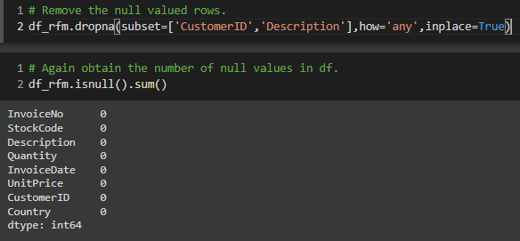
5. Removing Missing Values.

Slide 11
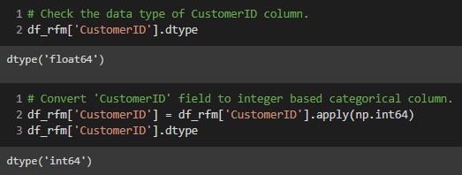

Slide 12
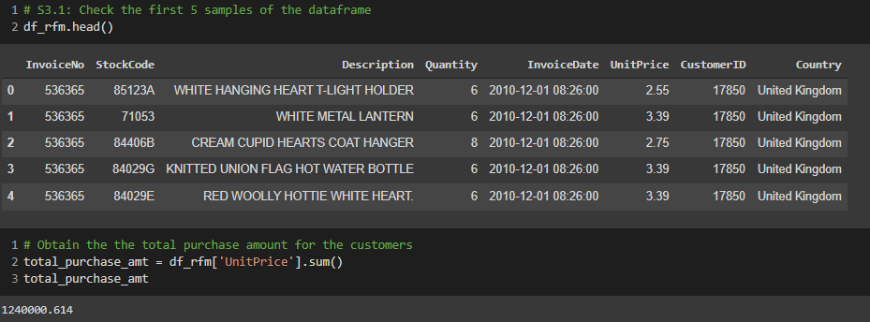

Slide 13
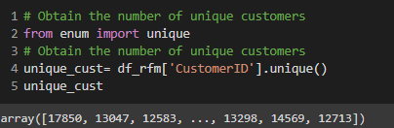
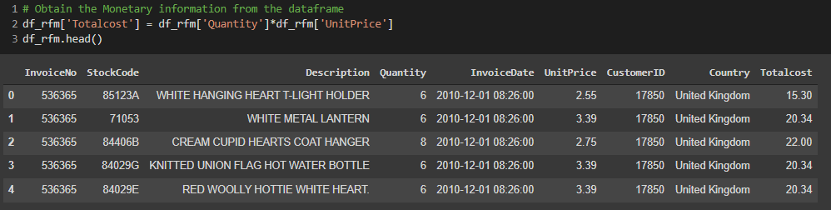

Slide 14
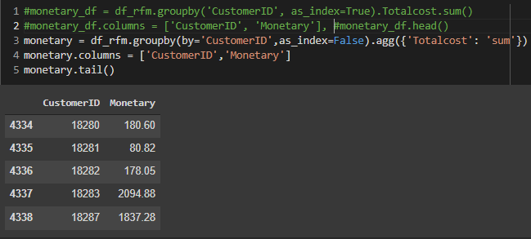
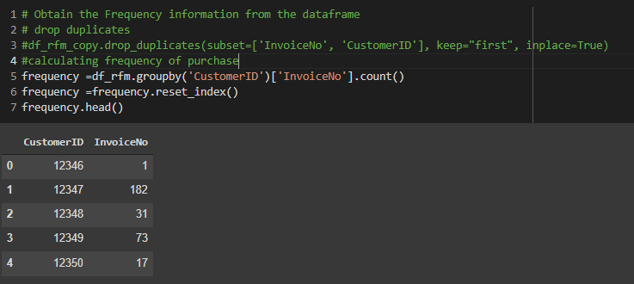

Slide 15
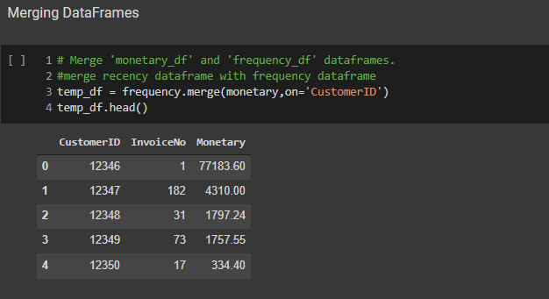
6. Merging DataFrames.

Slide 16
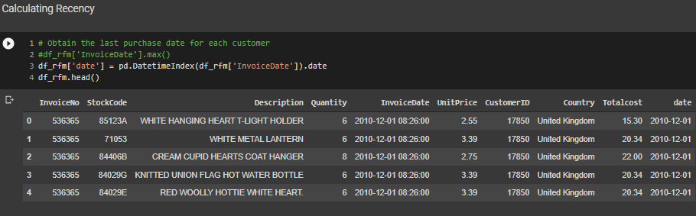
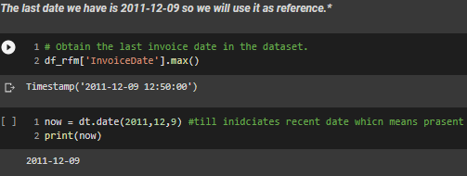
7. Calculating Recency.
.

Slide 17
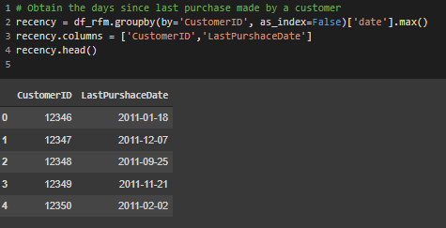
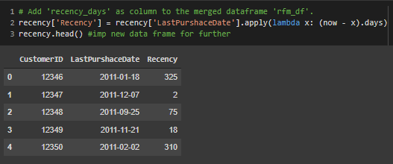

Slide 18
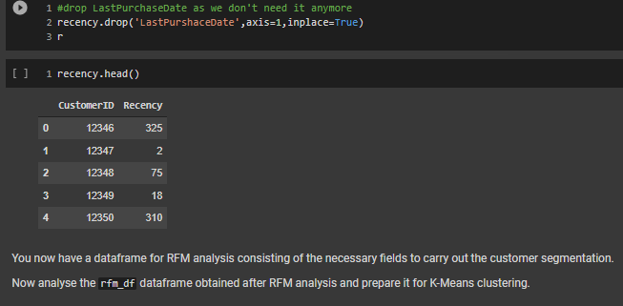

Slide 19
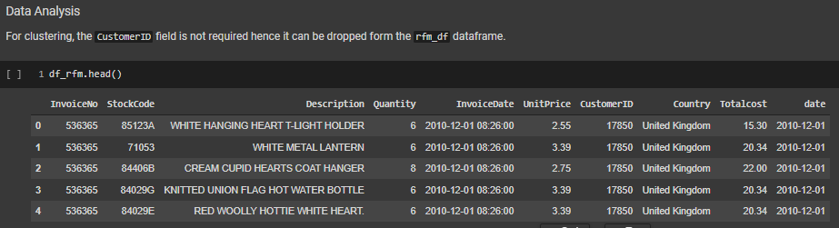
8. Data Analysis.

Slide 20
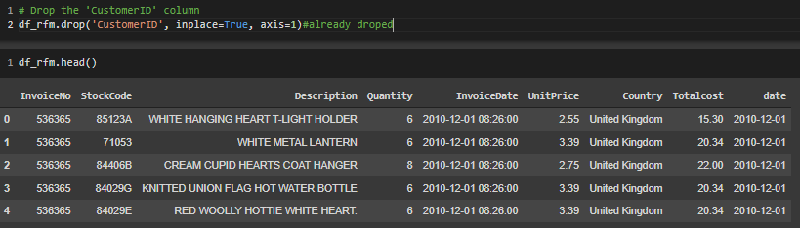

Slide 21
Create histogram and boxplots to understand the distribution of Monetary, Frequency, and Recency columns.
Use subplots() function of matplotlib.pyplot module to display all the three histograms in the first row and the boxplots in the second row.
Follow the steps given below to create this subplot:
1.Call the subplots() function on an object of matplotlib.pyplot and unpack the figure and axis objects in two different variables, say fig and axis. Inside the subplots() function, pass:
nrows = 2 and ncols = 3 parameters to create a figure having 2 rows and 3 columns.
figsize = (15, 5) parameter to create the figure of 15 units wide and 5 units high.
dpi = 100 parameter to further enlarge the figure based on their pixel density.
2.Construct a histogram to visualise the distribution of Monetary column using first row, first column subplot's axes i.e axis[0, 0].
3.Construct a boxplot to visualise the distribution of Monetary column using second row, first column subplot's axes i.e axis[1, 0].
4.Also call the set_title() function using the axis[0, 0] object to set the title for histogram and boxplot.
5.Similarly, construct histograms and boxplots for Frequency and Recency columns using the respective subplots's axes.
6.Call the show() function on the matplotlib.pyplot object.

Slide 22
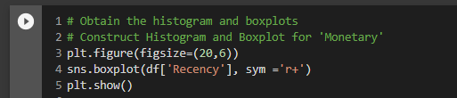
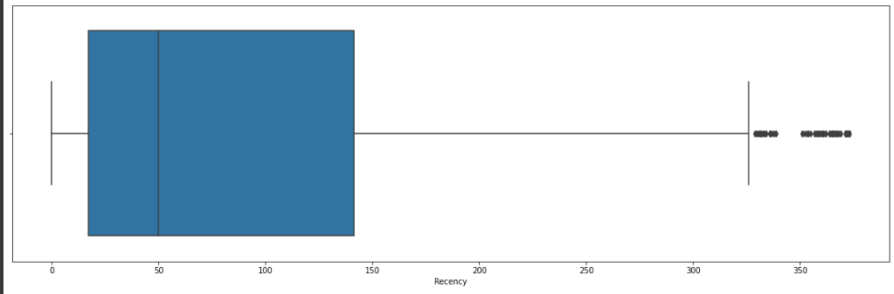

Slide 23

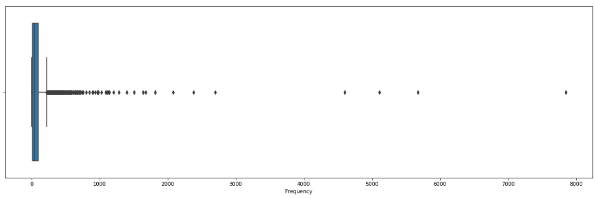

Slide 24

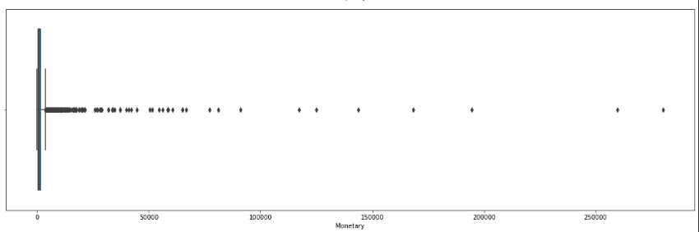

Slide 25
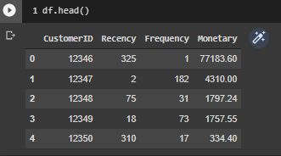
we can obsereve that, outliers are in three plots are very high so for better result we have to remove outliers
Outliers: These are the points which lies beyond the "Minimum" and "Maximum" value. So any value more than the upper bound or lesser than the lower bound will be considered as outliers.

Slide 26
9. Removing Outliers
Remove Outliers:
We had already learned how boxplots are useful in identifying outliers in column data in one of the previous lessons (Lesson: Meteorite Landings - Box Plots). Let us recall that.
What are outliers?
Outlier is a value in a data series which is either very small or very large.
Outliers are abnormal values that can affect the overall observation due to its very high or very low extreme values.
Hence they should be removed from the actual data.
The best way to detect outliers is to create a boxplot. It plots the minimum, first quartile, second quartile, third quartile and maximum values in the form of a box. Any value beyond minimum and maximum limit is considered as an outlier.

Slide 27
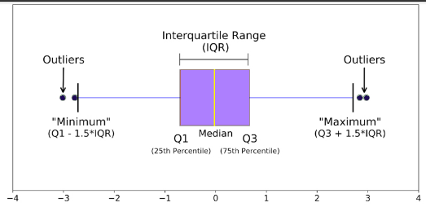
Median or Second quartile (Q2): The middle value of the dataset. Also known as 50th percentile.
First quartile (Q1): The middle value between the smallest value (not the "minimum") and the median of the dataset. Also known as 25th percentile which means that 25% of the data lies between smallest value and Q1.
Third quartile (Q3): The middle value between the median and the highest value (not the "maximum") of the dataset. Also known as 75th percentile which means 75% of the data lies between smallest value and Q3.
InterQuartile Range (IQR): 25th to the 75th percentile. IQR tells how spread the middle values are. It is defined as:
IQR=Q3−Q1
Minimum or Lower Bound: Q1−1.5×IQR
Maximum or Upper Bound: Q3+1.5×IQR
Outliers: These are the points which lies beyond the "Minimum" and "Maximum" value. So any value more than the upper bound or lesser than the lower bound will be considered as outliers.

Slide 28
let's define a function remove_outliers() which removes outlier from the column data and returns an outlier free dataframe. this function takes two paramters as input: df: the dataframe which consists of columns containing outliers. col: the column of dataframe df from which the outliers needs to be flushed out. Inside this funtion, 1.calculate q1 or 25th quartile for column col using quantile() function of pandas module and store it in a variable q1. pass 0.25 as input to quantile() function. Syntax of quantile() function: dataframe.quantile(q) where, q is the quantile to be computed. by default, q = 0.5 (50% quantile) 2.calculate q3 or 75th quartile for column col using quantile() function and store it in a variable q3. pass 0.75 as input to quantile() function. 3.calculate iqr by subtracting q3 from q1 and store it in a variable iqr. 4.calculate lower bound and upper bound using the following formula and store it in lower_bound and upper_bound variables respectively. lower bound=q1−1.5×iqr upper bound=q3+1.5×iqr

Slide 29

Obtain only those values from dataframe df which matches the following condition:
(df[col] >= lower_bound) & (df[col] <= upper_bound)
This condition will return those values of the column col which are between lower bound and upper bound.
Return the filtered dataframe.
Note: Here, the terms quartile and quantile are being used interchangeably. However, quantile is something which divides the dataset into equal parts. A quantile which divides the dataset into 4 equal parts i.e. at 0.25, 0.5 , 0.75, 1.00 is called a quartile. Thus, quartile is a type of quantile.

Slide 30
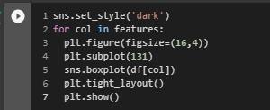
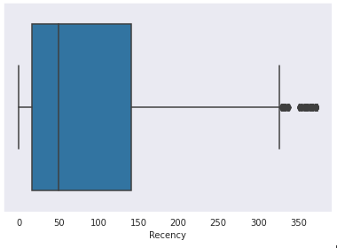
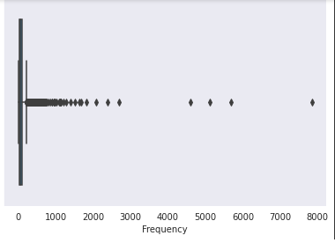
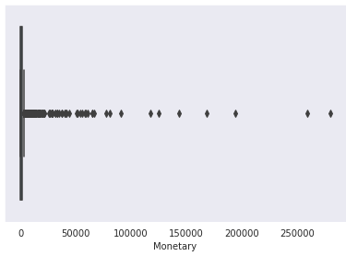

Slide 31
Now that you have created a function for removing outliers, we can easily remove outliers from rfm_df dataframe. To remove the outliers from the Monetary field: 1.Call the remove_outliers() function and pass rfm_df and 'Monetary' as input to this function. Save the returned dataframe in a variable m_clean_df. 2.Reset the index of m_clean_df dataframe using reset_index(drop = True) function. This function deletes the old index and resets the index in the new dataframe.

Slide 32
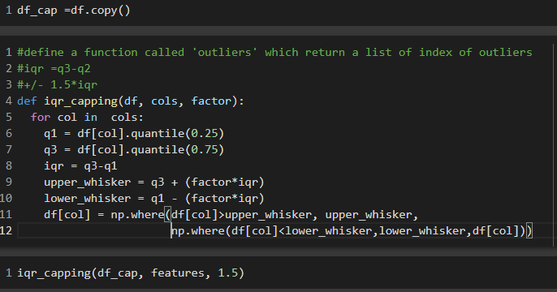

Slide 33
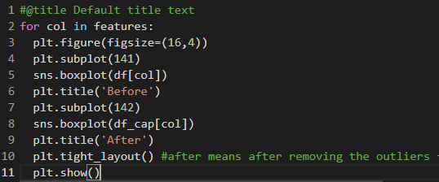
Fig.24

Slide 34
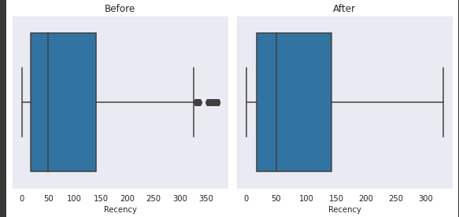
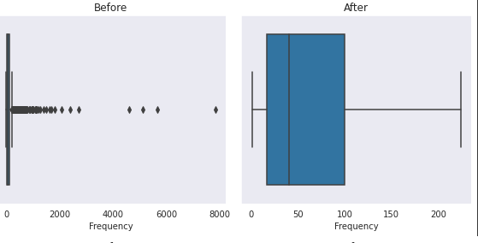
Fig.26

Slide 35
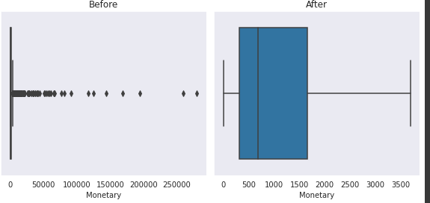

Slide 36
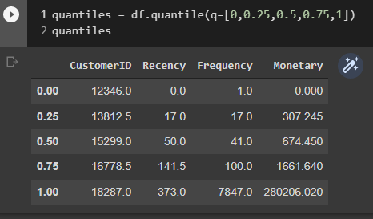
Now that you have created a function for removing outliers, we can easily remove outliers from rfm_df dataframe. To remove the outliers from the Monetary field: 1.Call the remove_outliers() function and pass rfm_df and 'Monetary' as input to this function. Save the returned dataframe in a variable m_clean_df. 2.Reset the index of m_clean_df dataframe using reset_index(drop = True) function. This function deletes the old index and resets the index in the new dataframe. now the plot are well distrubuited without outliers as shown below.

Slide 37

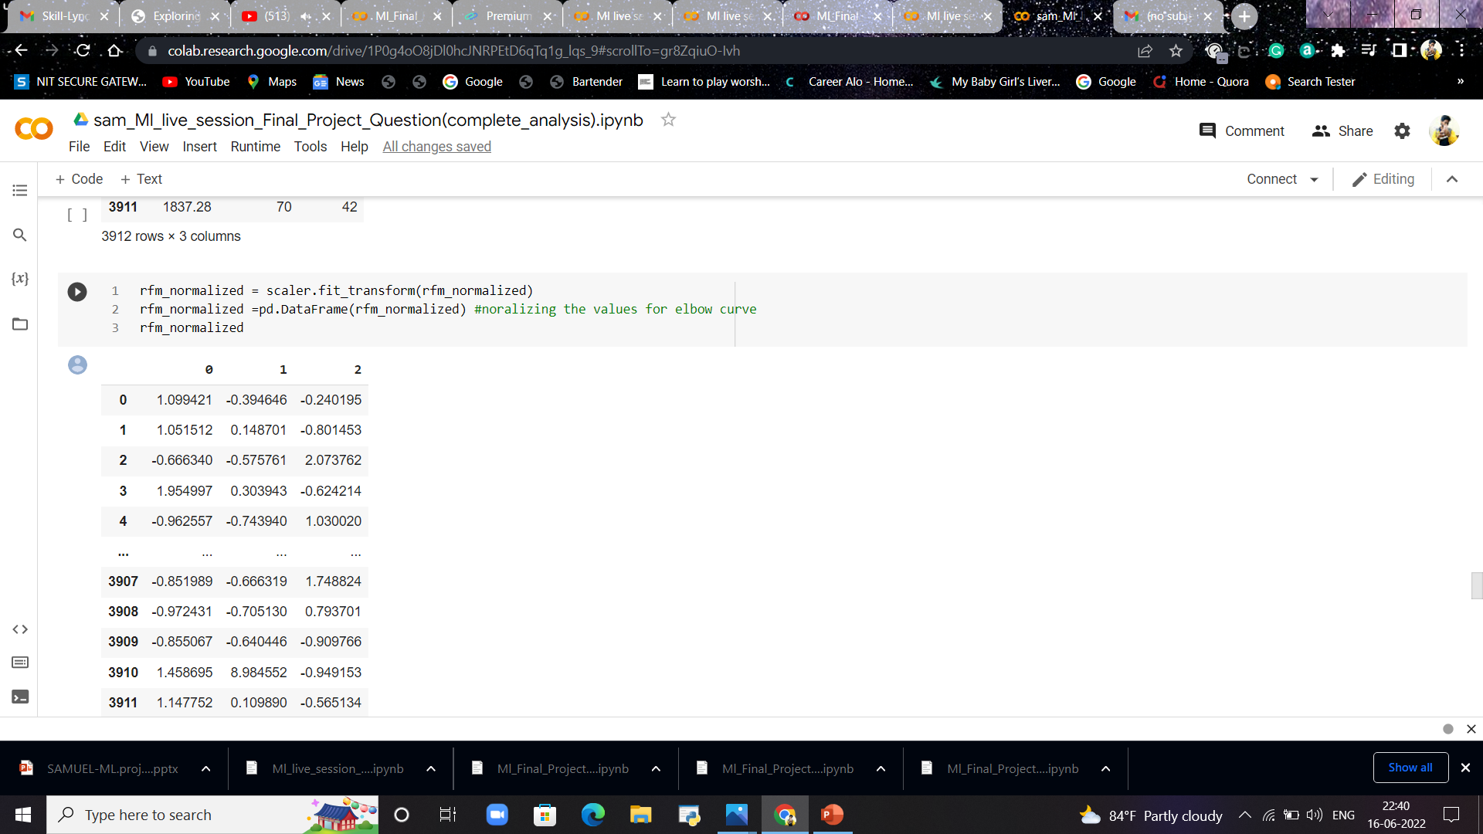
RFM Normalized values

Slide 38
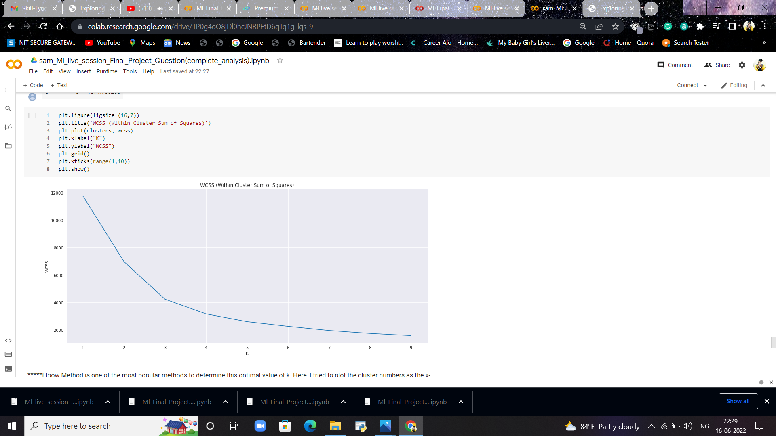
Elbow curve of RFM Normalized

Slide 39
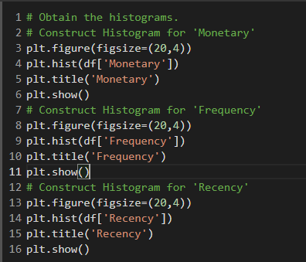
Again create histograms for Monetary, Frequency and Recency columns to check whether all of them have similar mean and variance after standardisation.

Slide 40
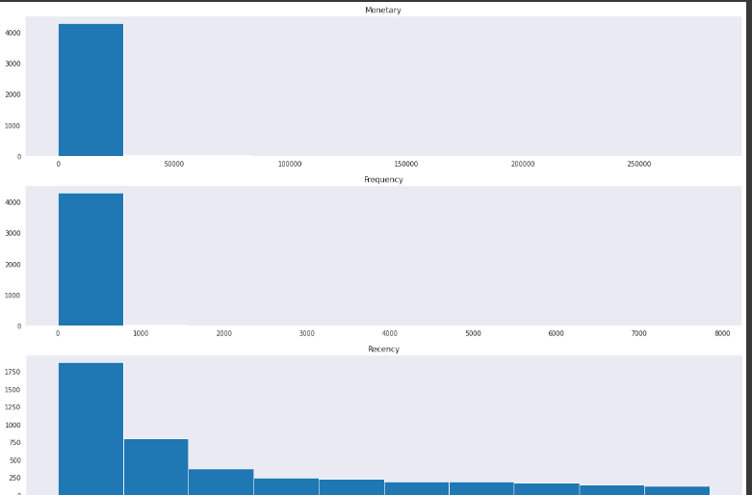

Slide 41
You may note that all the columns now have same mean and variance. Now our dataframe is ready for K-Means clustering.
Applying K-Means clustering
Start by finding the optimal number of clusters for the K-Means algorithm. We will use the elbow method.
Recall the steps for Elbow method:
Compute K-Means clustering for different values of K by varying K from 1 to 10 clusters.
For each K, calculate the total within-cluster sum of square (WCSS) using inertia_ attribute of KMeans object.
Plot the curve of WCSS vs the number of clusters K.

Slide 42
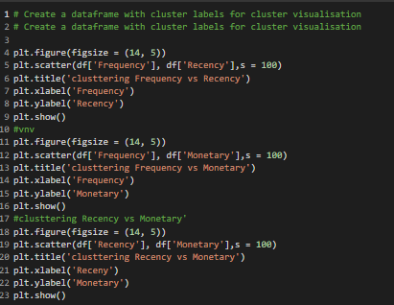

Slide 43
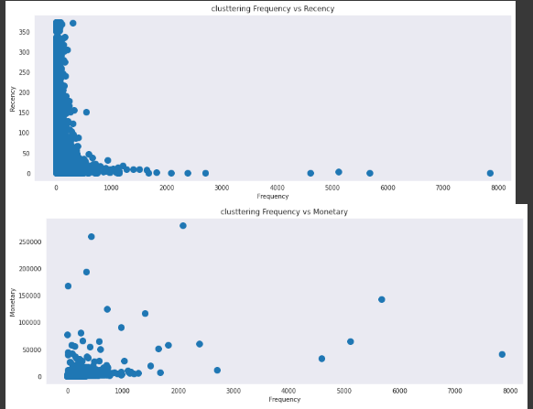

Slide 44
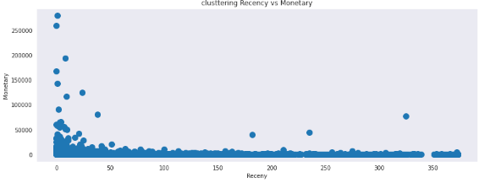

Slide 45
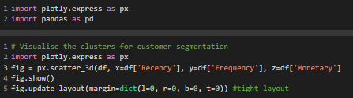

Slide 46
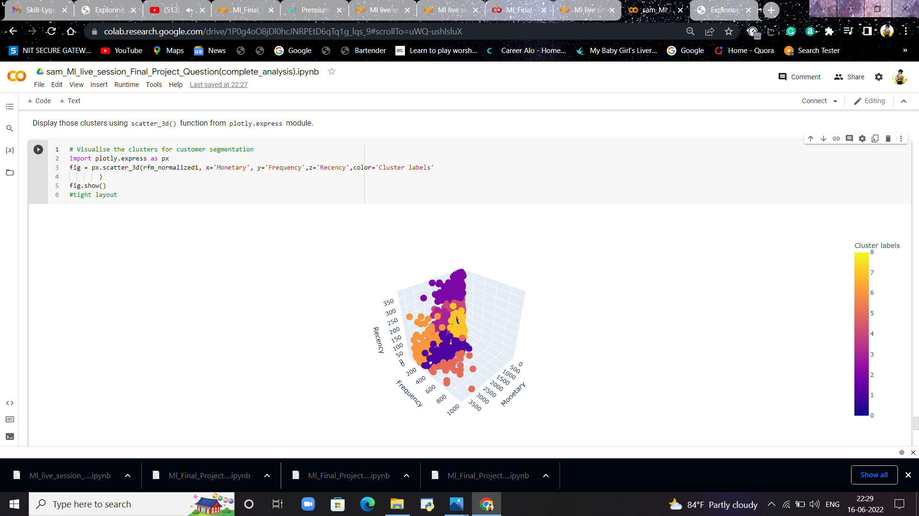
3D visualization of RFM

Slide 47
Summarising clusters: Calculate the mean recency, frequency and monetary values of all the clusters by applying agg() function on km_df dataframe.
Observations from the clusters and conclusion:
The distribution of rfm analysis is not normally distributed and they are forming many clusters because of lot frameworks in given dataset.
Here cluster-0 indicates the best customer, rfm characteristics are frequent and recent shopping and heavy spending on shopping here cluster 1 indicates, new customer, rfm characteristics are recent shopping with low frequency here cluster 2 indicates leaving customer/churned, frequent and heavy shopping spent, only some time since last shopping here cluster 3 indicates low frequency and spending

Slide 48
--THANK YOU--

