Slide 1
Making Figures: from MatLab to Adobe Illustrator
Download examples: https://github.com/SamuelAcunaPhD/tutorial_makingFigures
Created by: Samuel Acuña, Ph.D.
Date Created: 23 Jan 2019 Date Updated: 07 Mar 2022
1

Slide 2
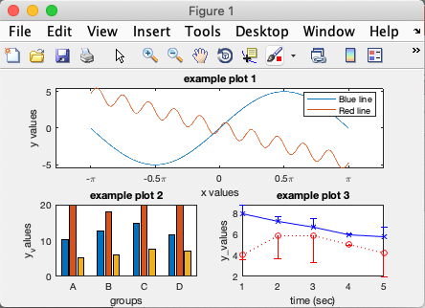
Introduction
Getting nice figures out of MatLab is annoying and unintuitive.
This training covers the basic process that I use regularly.
Download examples:
https://github.com/SamuelAcunaPhD/tutorial_makingFigures
Note: created using R2018a

Slide 4
A few examples
4

Slide 5
Before Illustrator
(out of MatLab)
After Illustrator
(publication worthy)
Acuña, 2019, J Electro & Kines

Slide 6
Before Illustrator
After Illustrator
(In review) Acuña, 2019, Hum Move Sci

Slide 7
After Illustrator
Before Illustrator

Slide 8
The Basic Steps
Making Figures: from MatLab to Adobe Illustrator
Get MatLab to do as much formatting as possible
Export figure to a vector file
Touch up figure in Adobe Illustrator
8

Slide 9
The Basic Steps
Making Figures: from MatLab to Adobe Illustrator
Get MatLab to do as much formatting as possible
Export figure to a vector file
Touch up figure in Adobe Illustrator
9

Slide 10
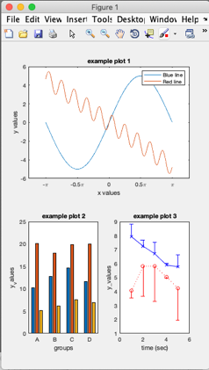
Some issues with MatLab figures
Inconsistent sizing
Figure saved differently than it looked like on screen
Font and axis scaling
Example: dummyFigure_v1.m

Slide 11

Get MatLab to do as much formatting as possible
Do this through code, not through Plot Tools or the Property Inspector
Will probably need to regenerate your figure. Don’t want to work it again by hand.
To access Plot Tools:
type: >> plottools
or click the icon:
To access the Property Inspector:
type: >> inspect
Plot Tools
BUT, this is a good way to get a sense of what properties can be changed.
AND, can file > generate code to make your changes reproducible.

Slide 12
Get MatLab to do as much formatting as possible
Automate plot elements by changing their handles
Key things to automate:
Figure background color
Line widths and styles
Sizing: plots, axes, fonts
Axis limits & ticks
Leave room for a legend
Legends and Marker Styles
Marker Size
Layout of how data is presented
Don’t worry too much about automating:
Fonts (Arial vs Times)
Legend Locations
Colors
Spacing between subplots, labels, titles
Font Styles (bold, italics, underline)
Example: dummyFigure_v2.m

Slide 13
Pro Tip!
It looks like you are trying to make a figure.
Would you like help?
Set your default figure preferences, either:
at the start of the script
in a startup.m file
Examples:
example2_preferencesAtStartOfScript.m
example3a_preferencesInStartupFile.m
example3b_startupFile.m

Slide 14
The Basic Steps
Making Figures: from MatLab to Adobe Illustrator
Get MatLab to do as much formatting as possible
Export figure to a vector file
Touch up figure in Adobe Illustrator
14

Slide 15

Export figure to a vector file
Raster File
Vector File
.png, .bmp, .jpg
.eps, . pdf, .svg

Slide 16
Export figure to a vector file
Do NOT save using the menu
MatLab often exports a file with the “boxes” error, which randomly divides up your figure elements into weird unusable chunks. Usually when you have subplots.

Slide 17
Export figure to a vector file
Do NOT save using the menu
MatLab often exports a file with the “boxes” error, which randomly divides up your figure elements into weird unusable chunks. Usually when you have subplots.
Unable to accurately specific size and dimensions of figure
Imaged saved is proportional to size of figure window, and can be messed up if you resize the window
Pro Tip!
Match the figure size to the publication requirements
1 column = 90 mm
1.5 columns = 140 mm
2 columns = 190 mm
Key things to automate:
PaperUnits (centimeters, inches, …)
PaperPosition (use to set size of image)
Use print to save as ’-depsc’, a colorized .eps file
better than .pdf
Example: dummyFigure_v3.m

Slide 18
The Basic Steps
Making Figures: from MatLab to Adobe Illustrator
Get MatLab to do as much formatting as possible
Export figure to a vector file
Touch up figure in Adobe Illustrator
Note: everything we do after this point is not automated. If you need to regenerate your figure, you will need to manually repeat almost everything you do from this point on.
18

Slide 19
Vector Graphics Editors
These apps all have the same basic functionality, but the layout of the tools will differ.
Adobe Illustrator
($240/year, Win & Mac)
Affinity Designer
($50, Win & Mac)
Inkscape
(open source, Win & Mac)

Slide 20

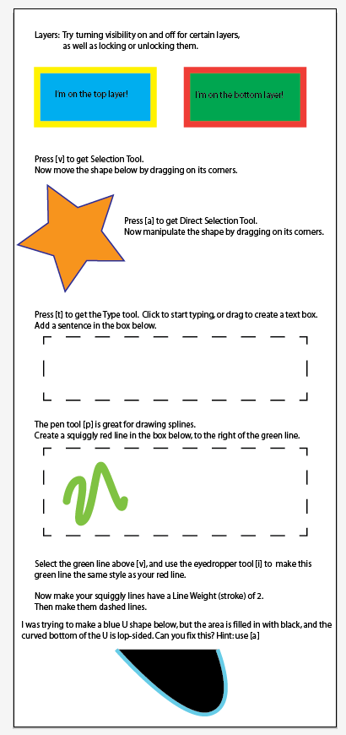


Important elements:
Layers
Selection Tool (v) vs Direct Selection Tool (a)
Type tool (t)
Pen tool (p)
Eyedropper tool (i)
Fill Color vs Line Color
Stroke
Artboard tool
New to Vector editing?
Work through the exercise:
example_illustrator_basics.ai

Slide 21
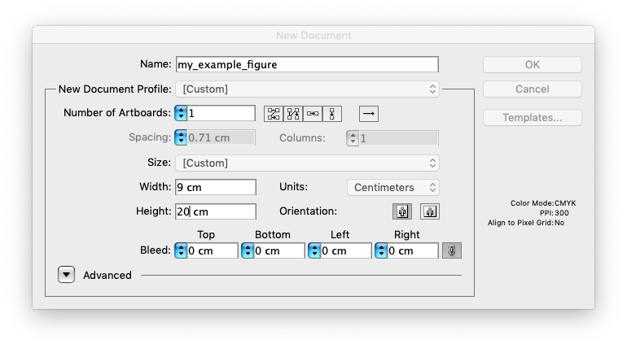
Touch up figure in Adobe Illustrator
Step 1: Create new document. Set artboard size (width is most important)
Note: by creating a new document, I have better control over the size and layers. So, I prefer this over opening my MatLab generated .eps file directly in Illustrator.
Step 2: Set up workspace. Show rulers.

Slide 22
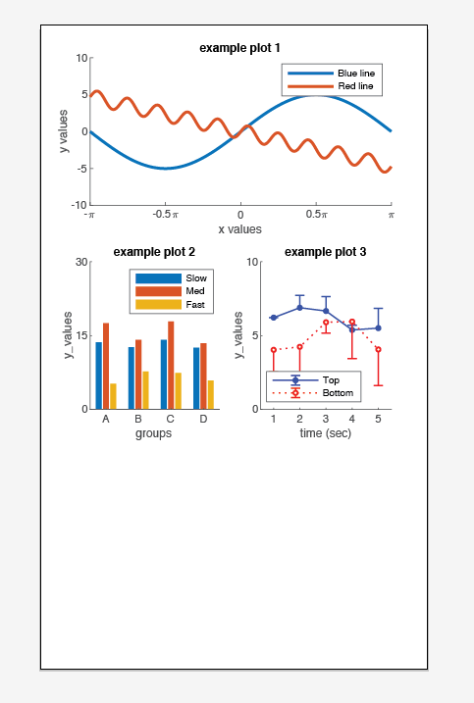
Step 3: Place your figure (File > Place)
It will appear as a group (see Layers panel). With various subgroupings, with no obvious reason why they were grouped that way.
Structures you probably don’t want:
Right click to Ungroup weird Groups
Right click to Release Clipping Masks
Right click to Release Compound Paths
Optional: Regroup logical groupings.
Delete unnecessary background elements:
White background rectangles
Extra legend entries
Unused plot elements

Slide 23
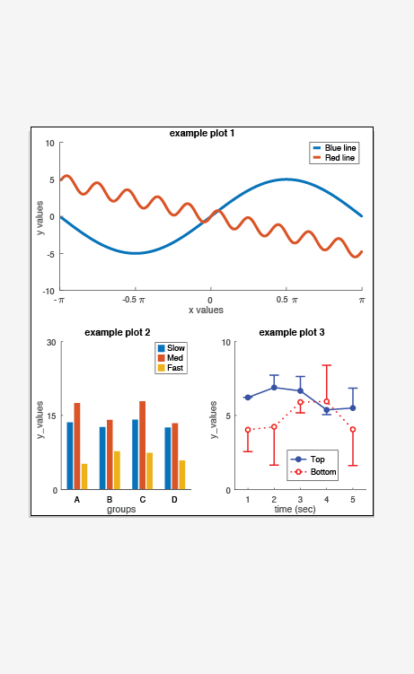
Step 4: Resize plots (if needed) to fill width of artboard.
Leave plenty of white space. It helps tremendously.
Adjust spacing between subplots
Adjust spacing between titles, labels, and plots.
Align and distribute tools come in handy here
Finalize fonts: type, size, and styles
Finalize title and label names
Use artboard tool to set bottom height of figure
Pro tip: create multiple layers, so you can try out different drafts of your layouts
Step 5: Probably should reduce size of legend
Put legend in a new layer.
Remove unnecessary features (error bars)
Shorten width of symbols.
Slightly reduce font size, if desired (size: 6)
Finalize location of legend

Slide 24
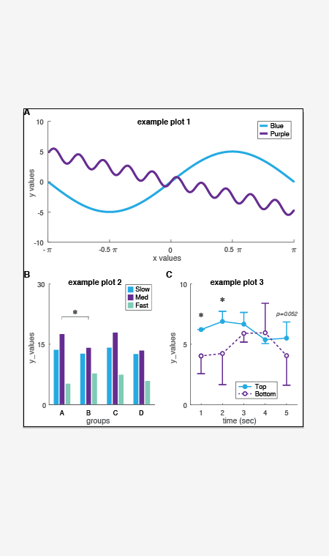
Step 6: Finalize colors and line styles
Eyedropper tool works really well to transfer formatting across plot elements
Make sure it matches your legend!
Step 7: Add significance stars as new layer
Can also add p-values
Use font ‘symbol’ for asterisks [* vs ∗]
Simpler is better here
Pro tip: create multiple layers, so you can try out different drafts of your stars

Slide 25
Step 8: Clean up little details
Check axis lines are in front of plot lines
Make sure axes scale numbers are aligned
I recommend printing a hard copy, so you can examine figure at scale
Step 9: Save As… a .eps file for publication
Check “Use Artboards”, to keep it cropped to your artboard boundaries

Slide 27
Your turn!
Follow the steps to touch up your MatLab figure in Illustrator (or alternative app). Use the figure you generated, or use the copy I made:
figure_beforeIllustator.eps
If you need practice with vector editing tools, run through the practice tutorial: example_illustrator_basics.ai
For guidance, check out the example figure: figure_withinIllustrator.ai
This takes practice and patience, but have fun!

