Slide 1
Prevalence of COVID-19
vs.
Popularity of Cryptocurrencies
Samuel Adamson

Slide 2
Purpose
Evaluate any correlation between popularity of cryptocurrency and prevalence of COVID-19
Time Period: January 2020 – Present
Metrics: COVID-19 Confirmed Cases, COVID-19 Deaths, Bitcoin Transaction/Block Frequency, Ethereum Transaction/Block Frequency

Slide 3
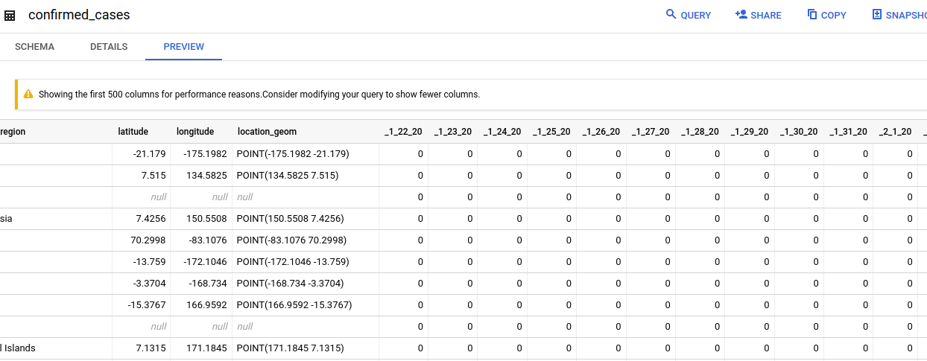
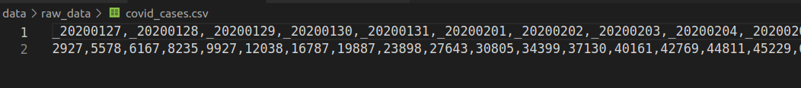
Source Data
BigQuery Public Datasets

Slide 4
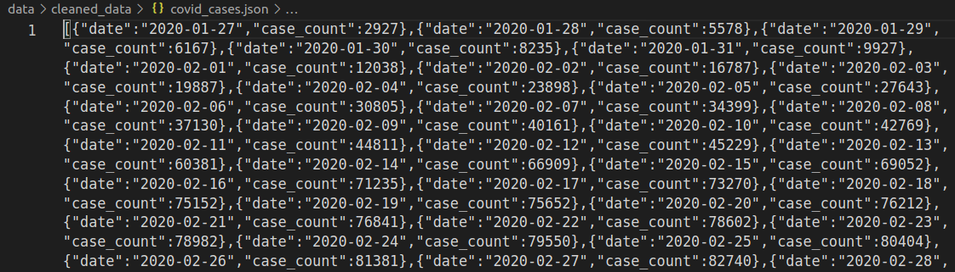
Data Cleaning
Utilizing the ‘pandas’ library, data is cleaned, oriented for new tables, and formatted as JSON

Slide 5
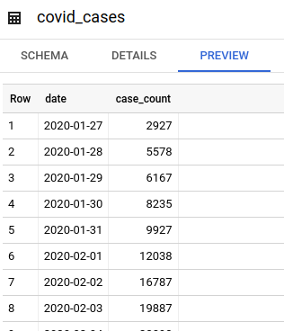
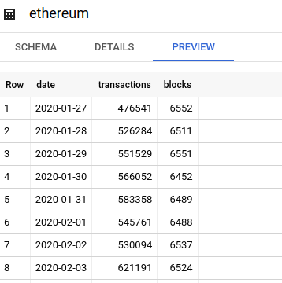
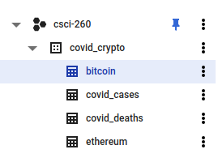
Tables in BigQuery
New tables are created/updated in BigQuery using the Google Cloud Python Library

Slide 6
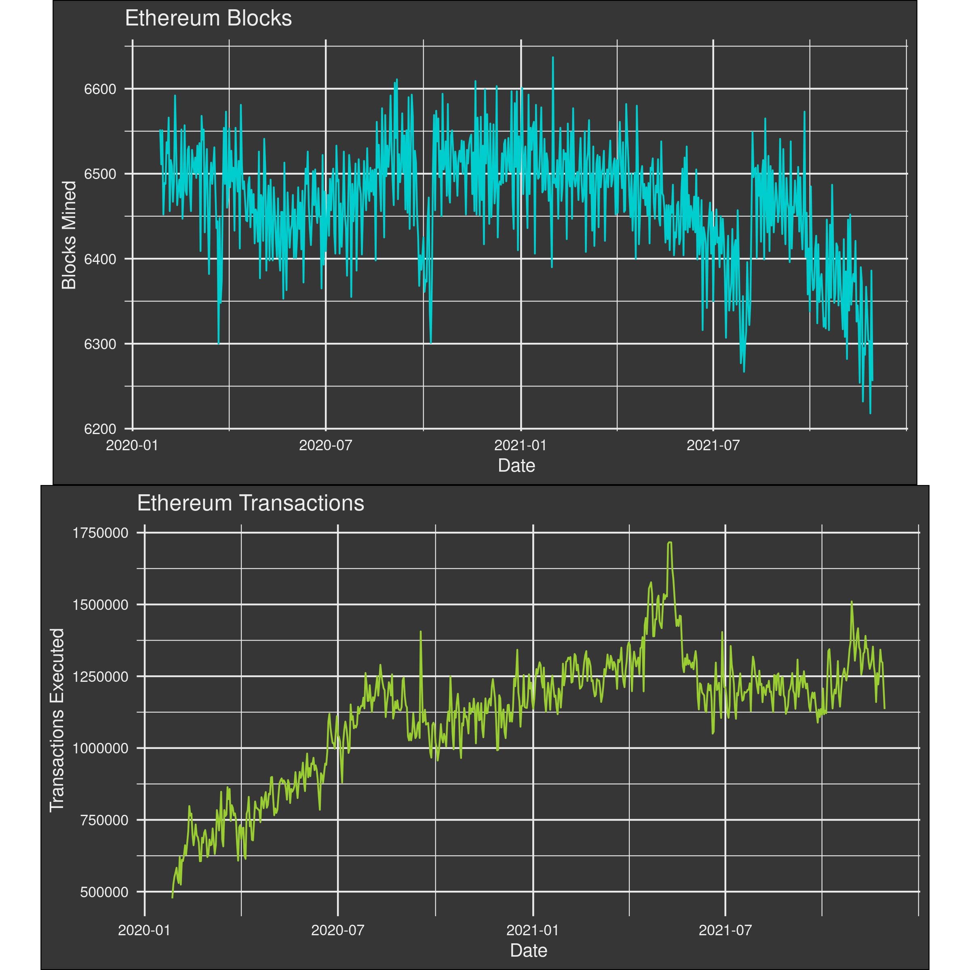
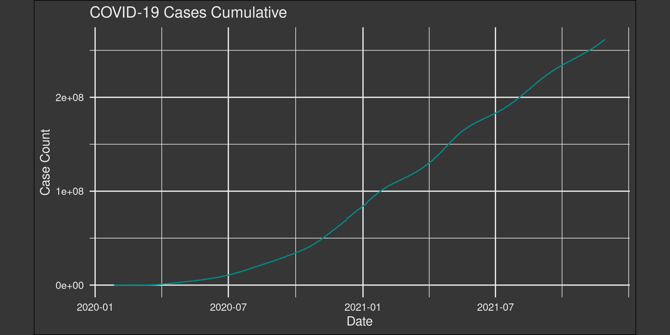
Queries
Using R, and the GGPlot2 package the data is queried and visualized

Slide 7
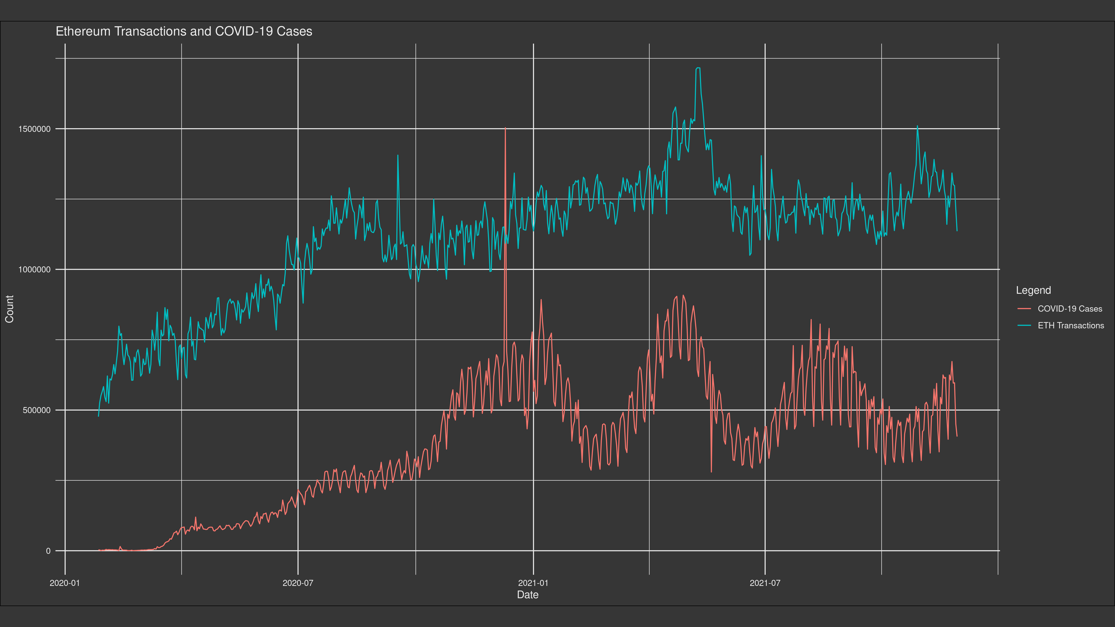
More Queries
With more complex queries, we can evaluate connections between different data categories

Slide 8
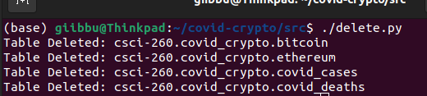
Deleting Tables
The BigQuery tables can be deleted using the Google Cloud Python Library

