Slide 1
Exploring data job roles from current job advertisements
Data source: https://gitlab.uwe.ac.uk/pd2-matthews/data-science-mini-challenges/-/tree/master/jobs

Slide 2
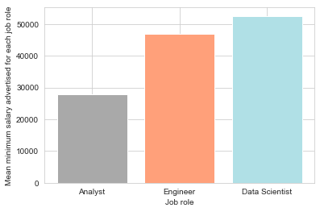
Average minimum salaries advertised for each role
The data appears to suggest that as a data scientist and engineer you are likely to earn more than for a data analyst.

Slide 3
Average minimum salaries advertised for each role
Key caveat:
All three roles have a large standard deviation ( Analyst: £16,397; Engineer: £26,218; Scientist: £25,474). Just under or over 50% of the mean which suggests that the roles minimum salaries cover a wide range.
This suggests that we shouldn't be expecting to get this salary in our first jobs. It may be more worthwhile to look at the lower end of the range

Slide 4
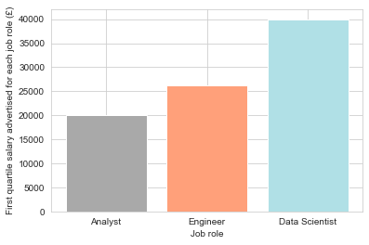
Average first quartile minimum salaries advertised for each role

Slide 5
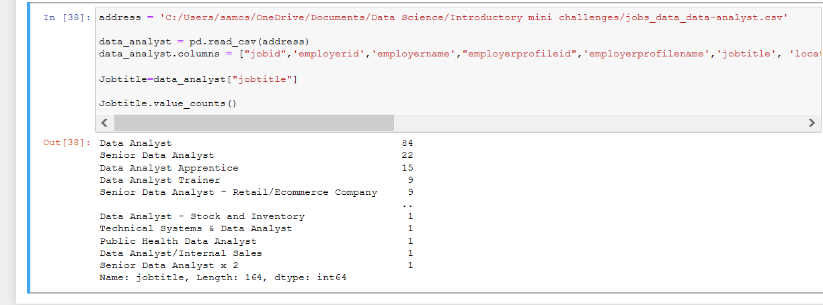
Other causes for large standard deviation
Using the first quartile may give us a more accurate minimum salary for these job roles for people with less experience such as ourselves. Ideally, we should focus on more junior roles. As can be seen below these datasets encompass multiple roles including 22 senior data analysts which are unlikely to be entry roles.

Slide 6
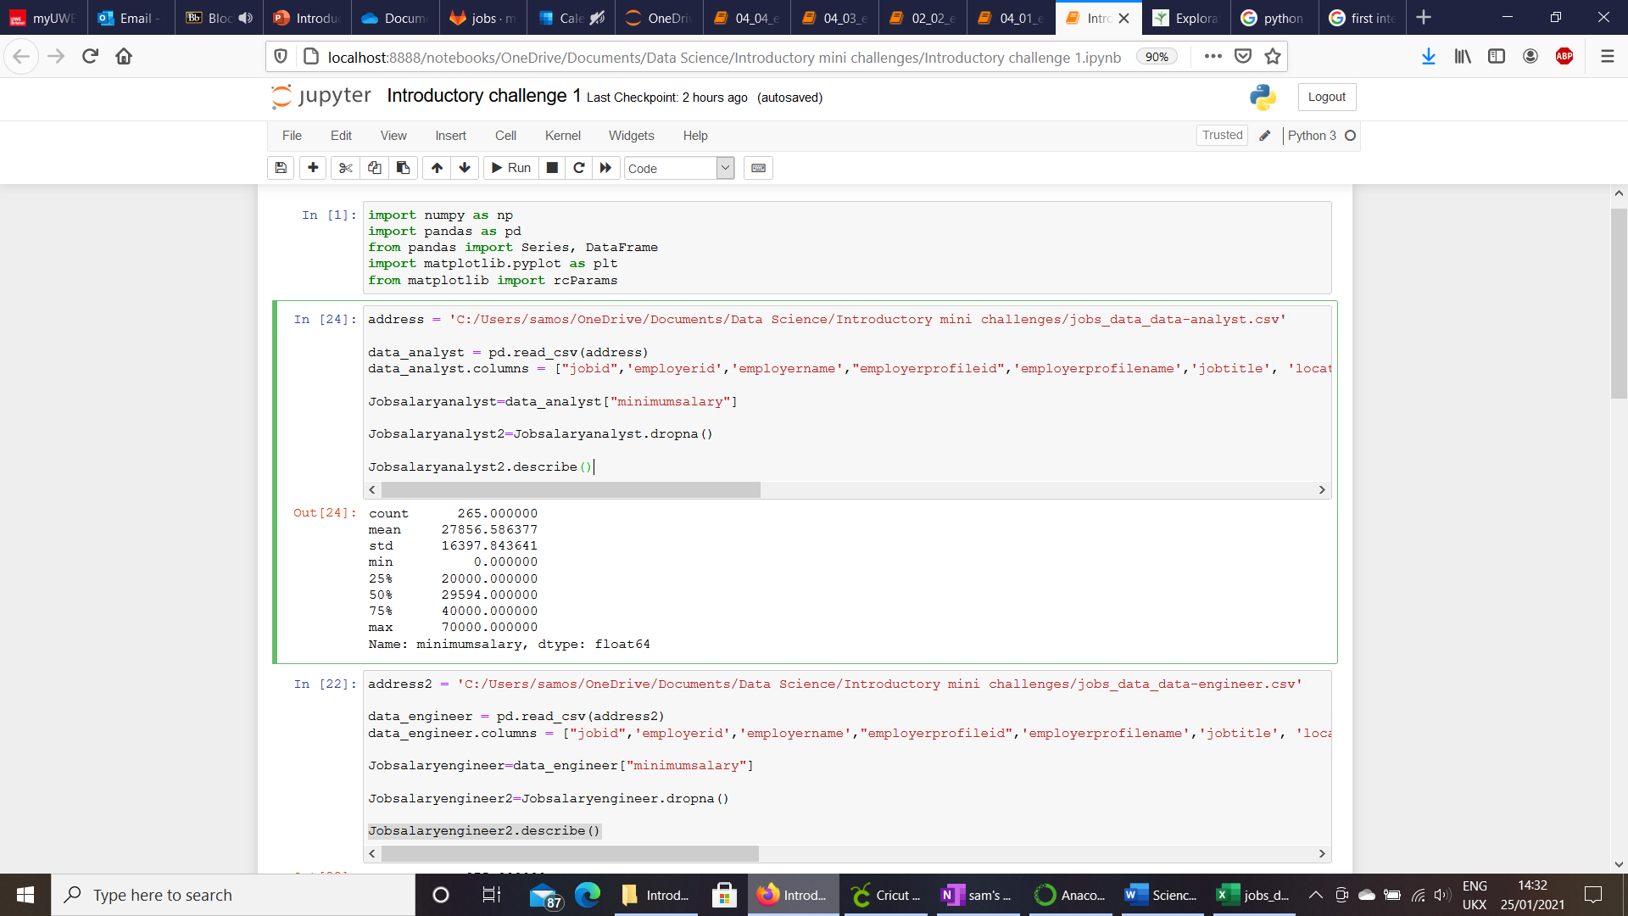
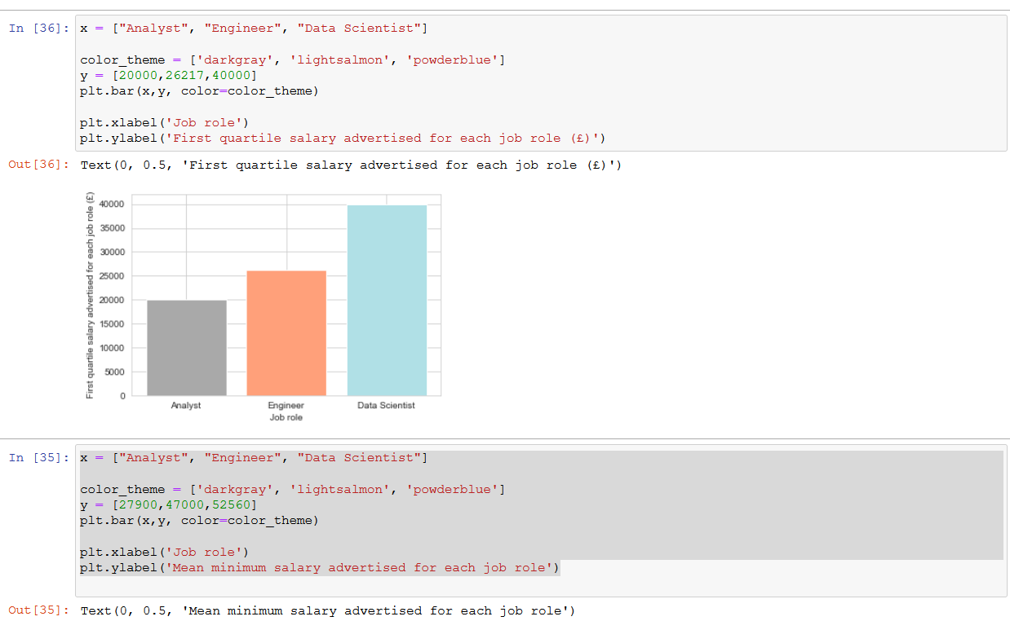

Slide 7
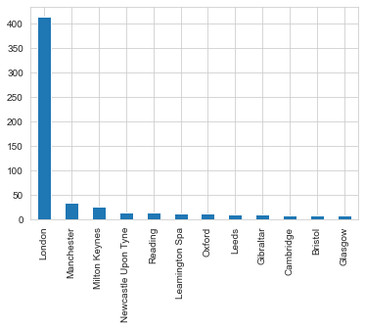
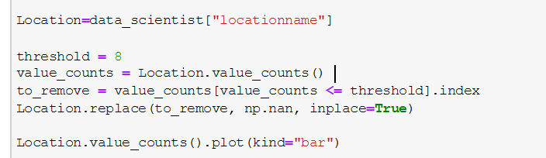
Where can I get these data scientist roles?
The vast majority of these jobs can be found in London with a handful appearing on most major cities.
Milton Keynes has a surprisingly high amount.

Slide 8
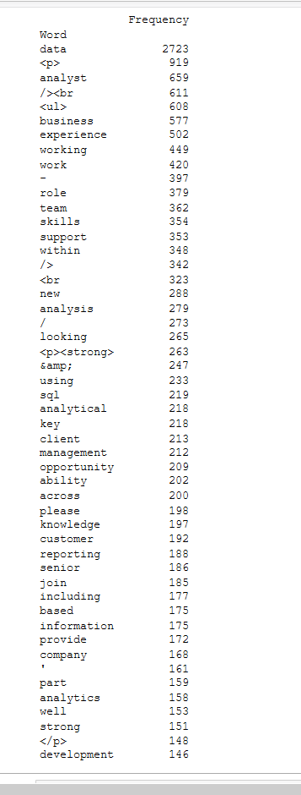
What do I need to be a data analyst?
Of the top 50 “words” identified using the NLKT library, excluding stopwords, the most common word by a long way is data.
Words of interest:
-Experience (though how much not sure)
-SQL needed
-Analyse, analytics, analyst
-”Team” and “working”.
-Customer
-Reporting

Slide 9
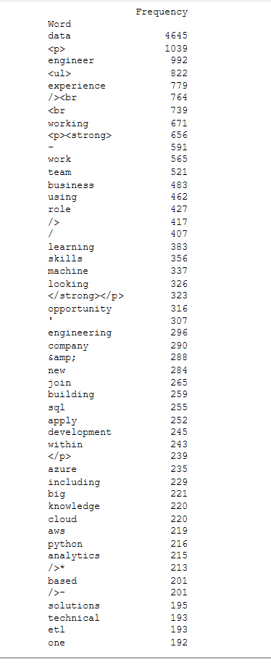
What do I need to be a data engineer?
Of the top 50 “words” identified using the NLKT library, excluding stopwords, the most common word again data.
Words of interest:
-Experience (though how much not sure)
-SQL needed again
-”machine” and “learning” both present
-”Python”, “Azure”, “AWS”, “Cloud”, “ETL” are other technical programmes/processes referenced

Slide 10
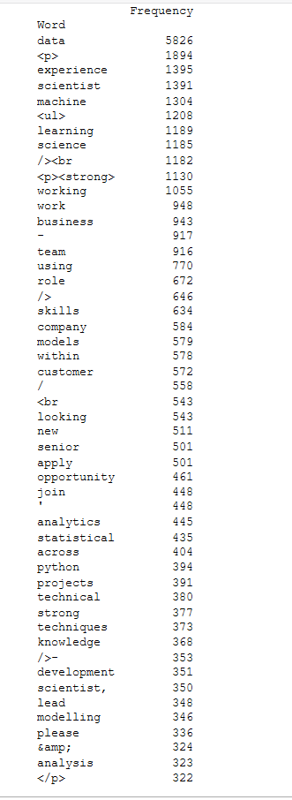
What do I need to be a data scientist?
Of the top 50 “words” identified using the NLKT library, excluding stopwords, the most common word again data.
Words of interest:
-Experience (though how much not sure)
-Python needed
-”machine” and “learning” both present
-Models and modelling
-Statistical and analytics

Slide 11
