Slide 1
Assessing reading age based on previous books

Slide 2
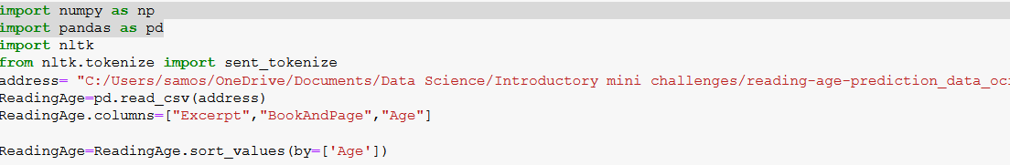

Calculating the mean number of words and sentences per page for current books with known reading age

Slide 3
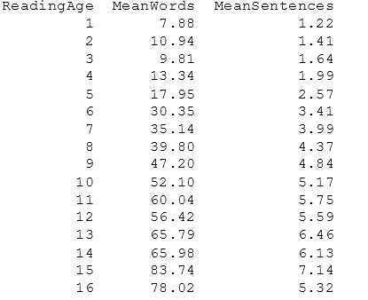
Calculating the mean number of words and sentences per page for current books with known reading age

Slide 4
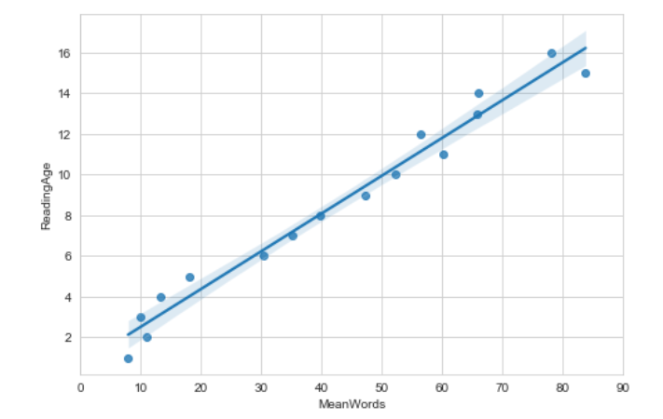
Calculating the mean number of words and sentences per page for current books with known reading age
Pearson correlation=
0.99

Slide 5
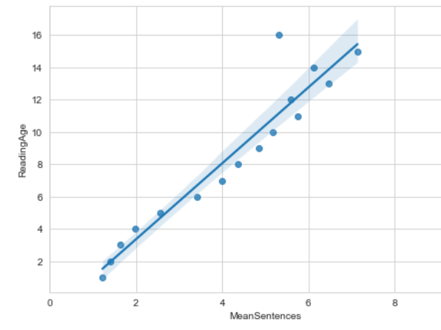
Calculating the mean number of words and sentences per page for current books with known reading age
Pearson correlation=
0.95

Slide 6
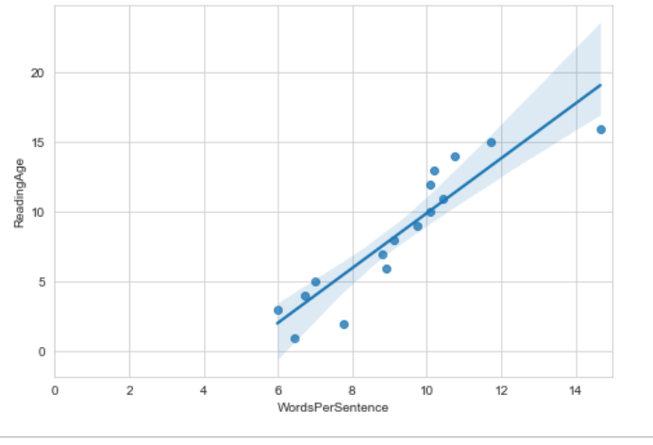
Reading age based on number of words per sentence

Slide 7
Thoughts
Crudely, you should be able to count either the number of sentences on a page or the number of words. Using the line of best fit you could then predict the reading age (RA).
RA= (0.19*Number of words) + 0.66
RA=(2.34*Number of sentences)-1.34
Margin of error would make me lean towards the former, particularly in early years
These methods don’t take number of syllables into account which could used to determine word complexity and used for reading age formulas such as Flesch-Kincaid
These methods would don’t take into account end of chapter pages in novels or textbooks with complicated language but large amount of space given over to diagrams/pictures.
Would probably apply this to novels only and ensure that multiple pages of the book are used to calculate a mean before using the above formulae
Not sure accurate it is for books of a low reading age or high reading age

Slide 8
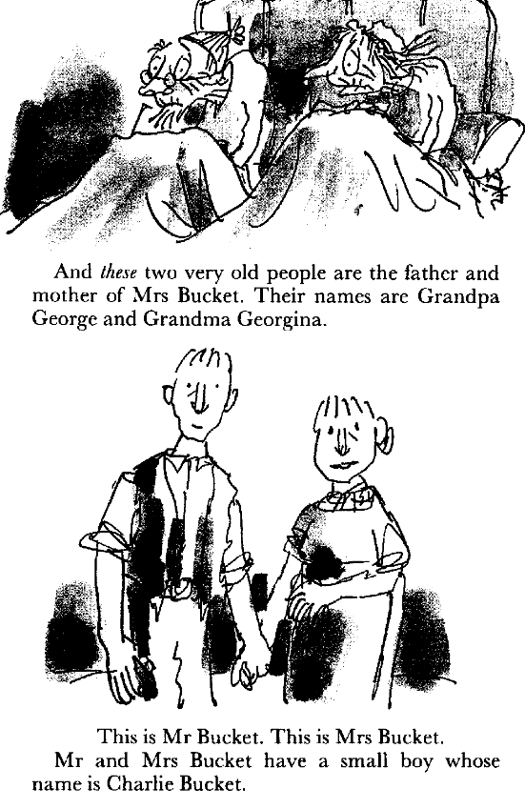
Is this model applicable?
RA= (0.19*42) + 0.66
RA=8.64
RA=(2.34*5)-1.34
RA=10.36
It has a reading RA of 8-12 according to Amazon and a Lexile level of 810L which seems to be used more. Haven’t quite worked out how this links to RA but think it is RA 10. Finding books RA rather than Lexile Level seems quite challenging to test the model
Image on the right from Charlie and the Chocolate Factory by Roald Dahl published by Penguin

