Slide 1
KnoBAB: Optimized Database Conformance Checking
Samuel Appleby, Giacomo Bergami, Graham Morgan

Slide 2
Conformance Checking
A process mining technique that determines the conformance of a log (𝓛) to a given model (𝓜) (Business Process Management)
Used to validate whether a business is following good behavioral practices (though can be applied to many environments: security, healthcare, gaming etc.)
Different techniques can be used for the conformance calculation (Maximum Satisfiability (MAX-SAT), Support and Conjunctive Query (CQ))
Notes:
‘Will explain these on the next slides with examples’

Slide 3
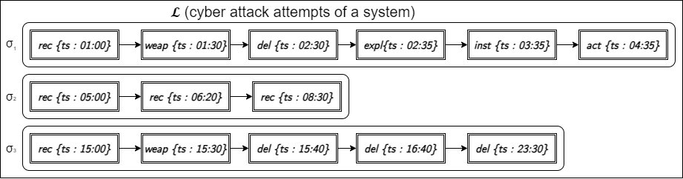
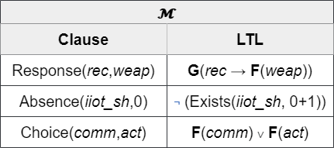
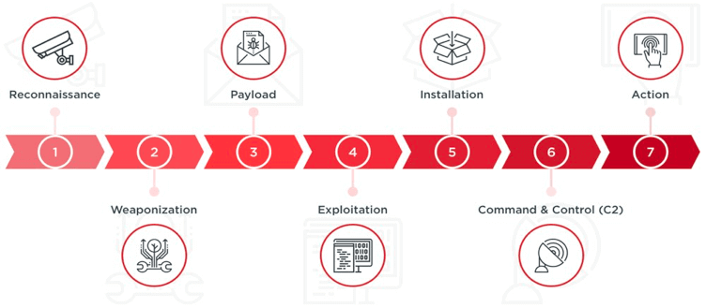
A More Concrete Example – The Cyber Kill Chain
Reconnaissance: rec
Weaponization: weap
Payload/Delivery: del
Exploitation: expl
Installation: inst
Command & Control: comm
Action: act
Industrial IoT Shields: iiot_sh
MAX-SAT Support Confidence CQ
1.0 CQ
0.33
0.66
2 / 3 = 0.66, 2 / 3 = 0.66
3 / 3 = 1.0, 3 / 3 = 1.0
1 / 3 = 0.33, 1 / 1 = 1.0
Notes:
Support: number of traces containing A and B / total number of transactions
Confidence: number of traces containing A and B / number of traces containing activation (A)

Slide 4
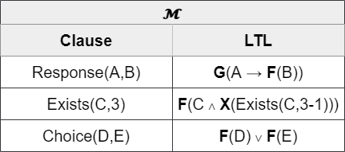
The Model (𝓜)
Is a collection of rules defining the (un)successful behaviour of a log in a given environment
Rules can be formulated and encoded in a variety of formats – KnoBAB represents rules (clauses) using the Declare modelling language
Clauses are decomposed into Linear Temporal Logic (LTL) expressions
Like logs, can also include payload conditions (activation, target & correlation)
A model can be manually created or generated through mining/learning techniques
A model that is mined also uses conformance checking
Notes:
Declare

Slide 5
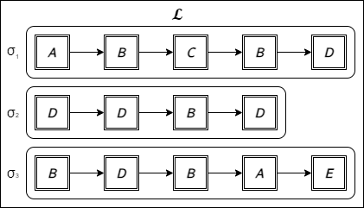
The Log (𝓛)
Suitable models can often only be determined after sufficient historical data is collected (used to detect future deviations)
Companies will therefore record log information from the behavior of previous scenarios (e.g., audit logs)
A log Is a set of traces
A trace (σ) represents a sequence of events
An event (ε) is marked with a unique event label (e.g., A) identifying the action taken at the current time
Each ε can also contain payload information (𝝆)
Logs can be infinite, KnoBAB works on finite trace
Notes:
Can have data
Trace payload vs event payload

Slide 6
Why KnoBAB?
Conformance checking is a well researched area that has several existing implementations
However, these are (mostly) inefficient, and no solution exists that abstracts from Declare directly into logic (providing greater expressiveness)
KnoBAB is a custom relational database that is tailored to efficiently solve the conformance checking problem with data payloads
Supports: MAX-SAT, Support and CQ

Slide 7
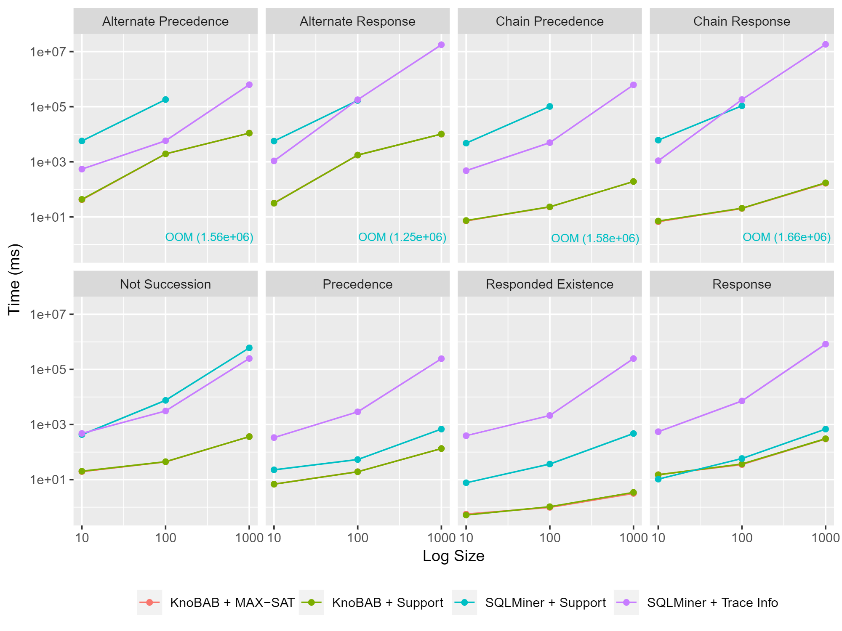
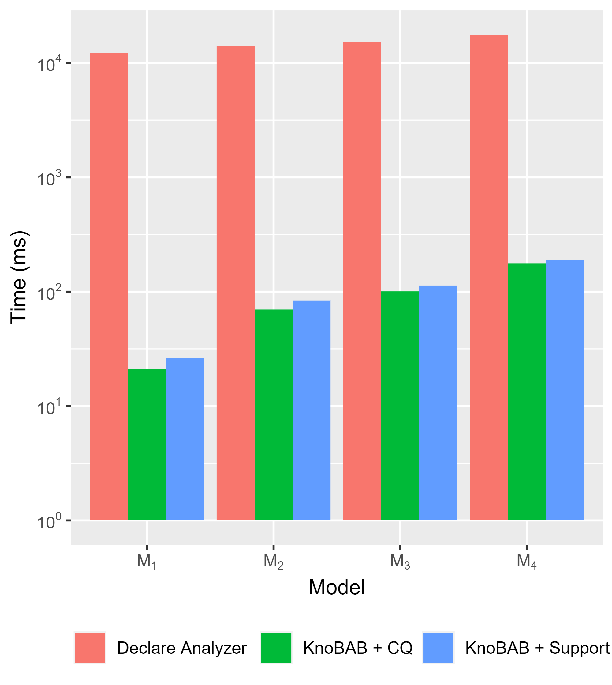
Results
Vs. DBMS (PostgreSQL) (trace data)
Vs. Tailored Solution (ProM) (event data)
Notes:
SQL Miner: trace payload
ProM: event payload
Ours: Both

Slide 8
Thank you
Notes:
Graphs? : Can be decomposed into a trace through graph – trace techniques

