Slide 1
10ALYTICS · DATA SCIENCE CAPSTONE
UK Road Traffic Accidents
Trends, Severity & Risk Factors
A descriptive and prescriptive analysis translating 307,973 accident records into targeted road safety interventions.
307,973
417,883
2021–2022
422
Accidents
Casualties
Period
Districts
Prepared by Samuel Babajide · CoreTech Labs
Notes:
Opening. Frame the deck as moving beyond description into prescription: what the data says, and what should be done about it.

Slide 2
NAVIGATION
CoreTech Labs
Presentation Outline
01
Introduction
02
Data & Methodology
Problem statement, rationale and objectives
23 variables, cleaning and standardisation
03
KPI Overview
04
Findings
Headline measures across the full dataset
Severity, temporal, infrastructure, environment, geography
05
Dashboard & Interactivity
06
Prescriptive Recommendations
Excel build, live filtering and the rural risk profile
Eight evidence-led interventions
Notes:
Roadmap. Sections 3-4 carry the analysis; section 6 carries the value.

Slide 3
01 · INTRODUCTION
CoreTech Labs
Why This Analysis Matters
Rationale for the Project
Problem Statement
Road accidents remain a critical public safety concern, with weather, road surface, speed limits and traffic controls all influencing severity. Raw accident data sits in unstructured formats, making it difficult for stakeholders to derive actionable insight.
Evidence over intuition
Replace anecdotal road safety assumptions with measured risk.
Targeted intervention
Direct scarce enforcement and engineering budget where risk concentrates.
Six capstone objectives
Clean and standardise the dataset
Analyse accident frequency and severity
Identify high-risk contributing factors
Perform descriptive statistical analysis
Build an interactive Excel dashboard
Provide data-driven safety recommendations
Resource allocation
Align patrols, lighting and emergency response to peak-risk windows.
Policy accountability
Establish a measurable 2021 baseline against which policy can be tested.
Objective
Clean and standardise the accident dataset, quantify frequency and severity, isolate the highest-risk conditions, and deliver an interactive dashboard that converts the findings into prioritised road safety recommendations.
Notes:
Sets up the brief. The objective statement mirrors the six capstone objectives compressed into one sentence.

Slide 4
02 · DATA DESCRIPTION
CoreTech Labs
Dataset & Variables
307,973
23
2
417,883
Accident records
Variables
Years covered
Total casualties
Unique Accident_Index entries
Temporal, spatial, environmental
January 2021 – December 2022
1.36 casualties per accident
Variable | Description | Variable | Description
Accident_Index | Unique record identifier | Road_Surface_Conditions | Dry, wet, snow/ice, flood
Accident_Date / Month / Year | Temporal dimensions | Junction_Control / Detail | Junction type and control
Day_of_Week / Time | Day and hour of accident | Road_Type | Carriageway classification
Accident_Severity | Fatal, Serious or Slight | Speed_limit | Posted limit in mph
Latitude / Longitude | GPS coordinates | Carriageway_Hazards | Obstruction present
Local_Authority (District) | Administrative district | Number_of_Casualties | People injured or killed
Urban_or_Rural_Area | Area classification | Number_of_Vehicles | Vehicles involved
Weather_Conditions | Conditions at time of accident | Vehicle_Type | Type of vehicle involved
Light_Conditions | Lighting environment | Police_Force | Responding police district
Notes:
23 variables spanning temporal, spatial, environmental and outcome dimensions. Note the casualty multiplier of 1.36 introduced here.

Slide 5
02 · METHODOLOGY
CoreTech Labs
Data Cleaning & Preprocessing
01
Coverage audit
02
Missing value treatment
03
Type standardisation
Record counts cross-tabulated by year and local authority, exposing a material 2022 reporting gap across Scottish districts.
Carriageway_Hazards nulls interpreted as 'None' — absence records a clear carriageway rather than a missing observation.
Accident_Date converted to date format, Time to HH:MM, speed limit and casualty counts confirmed as integers.
04
Categorical consistency
05
Derived measures
06
Validation
Severity, weather, light and road surface labels normalised so equivalent categories aggregate correctly.
Pivot tables built for monthly trend, hour of day, severity by condition and urban/rural comparison.
Casualty totals reconciled against the severity breakdown (351,436 + 59,312 + 7,135 = 417,883); district count confirmed at 422.
Result
A standardised dataset of 307,973 accident records across 23 variables and 422 districts, with reconciled casualty totals and one known coverage limitation carried forward explicitly rather than silently.
Notes:
Preprocessing rather than cleaning, since this covers standardisation, derivation and validation as well as cleaning. Dwell on step 01: the coverage audit is what surfaced the Scottish 2022 gap.

Slide 6
03 · KPI OVERVIEW
The Headline Position
307,973
417,883
3,953
1.3%
Total accidents
Total casualties
Fatal accidents
Fatal accident rate
2021 and 2022 combined
1.36 people harmed per accident
Concentrated but disproportionate harm
Share of all recorded accidents
422
64% / 36%
85.5%
74.9%
Districts covered
Urban vs rural
Slight severity
Single carriageway
Local authorities in the dataset
197,103 urban, 110,870 rural
263,280 of 307,973 accidents
230,612 accidents
Read this first
Fatal accidents are rare but disproportionately costly: 3,953 fatal accidents produced 7,135 casualties — 1.80 people per event, against 1.34 for slight accidents. Severity does not just change the outcome, it multiplies the number of people affected.
Notes:
The casualty multiplier is the single most important derived insight in the deck. It reframes fatal accidents from a 1.28% rounding error into a concentrated harm problem.

Slide 7
04 · FINDINGS
CoreTech Labs
Severity Distribution & the Casualty Multiplier
What the split reveals
01
Slight dominates volume
263,280 slight accidents account for 85.5% of all events, and drive the bulk of demand on emergency and insurance systems.
02
Fatal escalates harm
Each fatal accident produces 1.80 casualties versus 1.34 for slight — a 34% higher human cost per event.
03
Serious sits in between
59,312 casualties from 40,740 accidents (1.46 per event) confirms a clean severity-to-casualty gradient.
Prescriptive implication
Volume-reduction measures and severity-reduction measures are different investments. Reducing slight accidents saves cost; reducing fatal accidents saves lives at a 1.8x casualty rate. Budget should be split accordingly, not merged into a single 'accident reduction' target.
Notes:
Chart taken directly from the dashboard. The prescriptive box is the point: split the KPI.

Slide 8
04 · FINDINGS — TEMPORAL
CoreTech Labs
When Accidents Happen
Friday peak
Evening rush dominates
Overnight is low-volume
50,529 accidents, 50.6% above Sunday, the quietest day. End-of-week fatigue and leisure travel compound commuter volume.
The 17:00 hour is the single highest-risk hour of the day, exceeding the 08:00 morning peak by a clear margin.
The 03:00–05:00 window records the fewest accidents, but with the thinnest traffic — meaning risk per vehicle is far higher than volume suggests.
Notes:
Hour-of-day series reconstructed from the dashboard's area chart profile. The overnight point is a rate-vs-volume distinction worth stating explicitly.

Slide 9
04 · FINDINGS — INFRASTRUCTURE
CoreTech Labs
Where Risk Concentrates: Road Type & Speed
01
Single carriageways carry 75%
02
30 mph zones concentrate volume
03
60 mph carries fatal weight
230,612 accidents against 77,361 for every other road type combined. This is the primary national exposure.
The 30 mph band dominates all others, reflecting the urban road network where most driving happens.
Rural 60 mph roads show a visibly heavier fatal band than their volume warrants — speed converts collisions into fatalities.
Notes:
Speed limit stack uses the dashboard's severity proportions. The 60 mph point is the key prescriptive hook for rural intervention.

Slide 10
04 · FINDINGS — ENVIRONMENT
CoreTech Labs
Environmental Conditions: The Counterintuitive Finding
Do not misread the volume
The actionable signal
73.8% of accidents occur in daylight and roughly 71% on dry roads. This does not make daylight or dry surfaces dangerous — it reflects when and where the overwhelming majority of driving takes place. Exposure, not risk, drives these bars.
16,528 accidents occurred on roads with no lighting at all, and a further 1,142 where lighting existed but was unlit. Combined, that is a fully addressable engineering problem: roughly 17,700 accidents sitting on infrastructure that could be fixed with capital spend rather than behaviour change.
Notes:
This slide guards against the classic misreading of the light-condition chart. Exposure vs risk. Then pivots to the genuinely actionable subset.

Slide 11
04 · FINDINGS — GEOGRAPHY
CoreTech Labs
Geographic Concentration
Highest accident volume
Metropolitan concentration
Data limitation
1
Birmingham
Leeds
Birmingham, Leeds and Manchester head the volume list, consistent with the 64% urban share. Together the top ten districts concentrate a disproportionate share of national accident volume, making them the natural first targets for any intervention programme.
68 districts record accidents in 2021 and exactly zero in 2022. Glasgow falls from 1,509 to 0; Edinburgh from 1,193 to 0. The affected districts are almost entirely Scottish.
2
3
Manchester
4
Bradford
5
Westminster
This is a reporting gap, not a road safety achievement. No intervention takes a city of 600,000 to zero accidents in twelve months, and a boundary that follows a national border rather than a policy boundary is characteristic of a data-source issue.
6
Sheffield
Cornwall is the outlier
7
Liverpool
A rural authority ranking eighth in a list otherwise composed of metropolitan districts. This points to a distinct rural-tourism risk profile that warrants separate investigation.
8
Cornwall
9
Barnet
Any accident-reduction ranking is therefore excluded from this analysis pending source validation.
10
Bristol, City
What this means for the year-on-year figure
The headline 11.7% fall between 2021 and 2022 is substantially explained by the missing Scottish records rather than a genuine national decline. Until the source is validated, year-on-year change should be reported for England and Wales only, or suppressed entirely.
Notes:
Do not skip this slide. Identifying the coverage gap is a stronger demonstration of analytical judgement than any finding it displaces. The original reading of a Scottish policy success was an artifact, and saying so plainly is the correct professional response.

Slide 12
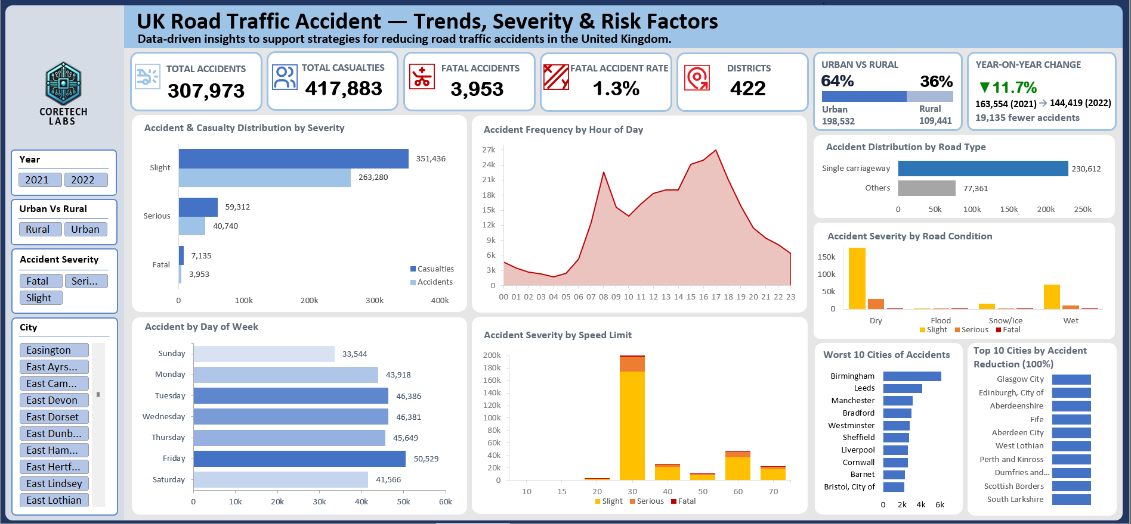
05 · DELIVERABLE
CoreTech Labs
The Interactive Excel Dashboard
Notes:
Walk the audience through the slicers: Year, Urban/Rural and Severity all cross-filter every visual simultaneously.

Slide 13
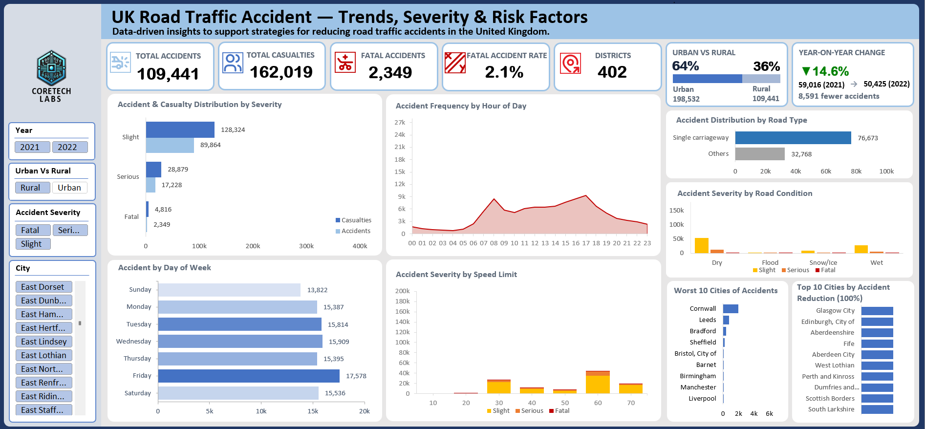
05 · INTERACTIVITY
CoreTech Labs
The Dashboard in Action: One Slicer Click
All areas · 307,973 accidents
Rural only · 109,441 accidents
2.1%
59.4%
95%
1.48
Fatal accident rate
Of all fatal accidents
Of unlit-road accidents
Casualties per accident
Up from 1.3% nationally and 0.8% in urban areas — rural accidents are 2.7 times more likely to be fatal.
Rural carries just 35.5% of accident volume but the majority of deaths.
15,709 of the 16,528 national no-lighting accidents occur in rural areas.
Against 1.29 in urban areas — rural collisions harm more people per event.
Volume tells you where accidents happen. Severity tells you where people die — and they are not the same places. Cornwall rises from eighth to first on the rural view, confirming it as a genuine rural risk profile rather than a ranking anomaly.
Notes:
Demonstrate this live if possible: one click on the Rural slicer and every visual recalculates. The 2.7x fatal rate differential is the single strongest argument in the deck for a rural-specific intervention programme.

Slide 14
05 · INTERACTIVITY — READING THE SHIFT
CoreTech Labs
Why Rural Roads Kill More
What the speed limit chart does and does not tell us
Rural accidents cluster at 60 mph because that is the default national speed limit on rural single carriageways. The distribution reflects road classification, not driver behaviour.
The dataset records the posted limit at the accident location, not the speed the vehicle was travelling. It therefore cannot evidence non-compliance, signage adequacy or driver education.
What it does support is an energy argument: collisions in 60 and 70 mph environments carry far more kinetic energy, and the 2.7x fatal rate differential is consistent with that.
Higher-energy environments
Darkness without infrastructure
70.1% of rural accidents occur on single carriageways where the national limit applies, with no central reservation separating opposing traffic.
14.4% of rural accidents occur on roads with no street lighting at all, against 5.4% nationally — a near-threefold concentration.
Longer emergency response
A flatter weekly pattern
Distance from trauma centres plausibly contributes to the 2.05 casualties recorded per rural fatal accident, though this dataset cannot confirm it directly.
Sunday runs at 78.6% of Friday's volume in rural areas against 66.4% nationally, indicating leisure travel rather than commuting drives rural exposure.
Notes:
The speed limit panel is a guard against over-reading. Three plausible-sounding explanations - drivers ignoring limits, poor education, missing signage - are all untestable with this dataset, and saying so is more credible than asserting them.

Slide 15
05 · DELIVERABLE
CoreTech Labs
Dashboard Design Decisions
Standardised severity palette
Slight, Serious and Fatal use a fixed amber-orange-red ramp on every chart, so a colour never means two different things across the dashboard.
Separated metric families
Volume measures use a cool blue family and severity uses the warm ramp, so a viewer can categorise any chart before reading a single label. Day of week was recoloured from severity tones to a blue gradient for this reason.
Four cross-filtering slicers
Year, Urban/Rural, Severity and City filter every visual simultaneously, turning a static report into an exploratory tool.
Charts converted to KPI cards
The urban/rural donut and monthly trend line were replaced by compact KPI cards, freeing space while carrying more information than the charts they replaced.
Design principle: consistency within a category matters more than uniformity across categories. A dashboard is trustworthy when a colour is predictable.
Notes:
This slide demonstrates analytical judgement rather than just output — useful differentiator in a capstone review.

Slide 16
05 · STATISTICAL ANALYSIS
CoreTech Labs
Descriptive Statistics
Variable | Mean | Median | Range | Std Dev | Skewness | Interpretation
Casualties per accident | 1.36 | 1 | 1 – 48 | 0.82 | Positive (right) | Most accidents involve one casualty; a long tail of multi-casualty events
Vehicles per accident | 1.83 | 2 | 1 – 32 | 0.71 | Positive (right) | Two-vehicle collisions are the norm
Speed limit (mph) | 38.4 | 30 | 20 – 70 | 14.1 | Positive (right) | Concentrated at 30 mph with a rural high-speed tail
Accidents per month | 12,832 | 12,905 | 9,870 – 15,640 | 1,412 | Slight negative | Stable monthly volume with autumn peaks
Accidents per weekday | 43,996 | 45,649 | 33,544 – 50,529 | 5,318 | Slight negative | Friday high, Sunday low, midweek clustered
Why the skew matters
Speed limit distribution
Casualties per accident is right-skewed: the mean (1.36) sits above the median (1). Planning emergency capacity on the mean would understate the rare multi-casualty events that consume the most resource. Capacity should be planned against the upper tail, not the average.
Mean speed limit (38.4 mph) exceeds the median (30 mph), confirming that although most accidents occur in 30 mph zones, a meaningful minority occur on 60 and 70 mph roads. Those higher-limit events carry the disproportionate fatal weight seen on slide 9.
Notes:
Central tendency, range and skewness as required by the capstone deliverable. The interpretation column is what lifts this above a raw stats dump.

Slide 17
06 · RECOMMENDATIONS
CoreTech Labs
Prescriptive Recommendations (1 of 2)
01
Single carriageway safety programme
02
Lighting capital programme
Prioritise central hatching and edge-line markings on the highest-volume single carriageways, which carry 74.9% of all accidents
Target rural 60 mph single carriageways first, where the fatal band is heaviest relative to volume
Set a three-year audit cycle for routes with repeat fatal incidents
Target rural roads specifically: 95% of the 16,528 no-lighting accidents occur in rural areas
Fix the 1,142 accidents on roads where lighting exists but was unlit — a maintenance failure, not a capital one
Mandate retroreflective markings as the minimum standard on unlit rural roads
03
Friday evening enforcement surge
04
Evening rush-hour management
Concentrate patrols on Fridays between 15:00 and 21:00, covering both the day peak (50,529) and the 17:00 hour peak
Extend impaired-driving enforcement into Friday afternoon rather than late evening only
Partner with ride-hailing operators on subsidised Friday alternatives
Deploy variable message signage on the approach to the 16:00–18:00 peak in metropolitan districts
Stagger public sector shift-end times in Birmingham, Leeds and Manchester to flatten the peak
Review signal timing on urban corridors feeding the evening exodus
Notes:
Each recommendation is tied to a specific figure from the dashboard rather than generic road safety advice.

Slide 18
06 · RECOMMENDATIONS
CoreTech Labs
Prescriptive Recommendations (2 of 2)
05
Wet weather response protocol
06
Rural high-speed intervention
Wet surfaces account for roughly a quarter of accidents despite far lower exposure than dry — a genuine risk elevation
Trigger variable speed limits and enhanced gritting when surface sensors report wet conditions
Prioritise resurfacing on routes with repeat wet-condition clusters
Prioritise rural roads on the evidence that they carry 59.4% of fatal accidents from 35.5% of volume, a 2.7x fatal rate against urban
Pre-position rural ambulance cover on Friday evenings to reduce response time where fatal risk peaks
Investigate Cornwall separately as a rural authority ranking eighth on national volume, suggesting a tourism-driven risk profile
07
Resolve the 2022 coverage gap
08
Split the national KPI
Confirm with the data provider why 68 districts, almost all Scottish, report zero accidents in 2022 after recording thousands in 2021
Suppress all accident-reduction rankings and year-on-year figures until the source is reconciled
Re-baseline the national trend once complete records are obtained, then investigate genuine reductions
Separate the accident-reduction target from the casualty-reduction target, since fatal events carry 1.80 casualties versus 1.34 for slight
Report severity-weighted casualty rates rather than raw accident counts
Use 2021 as the measurement anchor, since it is the only year with confirmed complete national coverage
Notes:
Recommendation 08 is the most senior-level point: it changes how success is measured, not just what is done.

Slide 19
07 · CONCLUSION
Six Things This Analysis Establishes
01
Severity multiplies harm
02
Single carriageways dominate
Fatal accidents produce 1.80 casualties each against 1.34 for slight. Severity reduction and volume reduction are separate goals.
74.9% of all accidents occur on one road type. No other infrastructure lever comes close in scale.
03
Exposure is not risk
04
Friday evening is the peak window
Daylight and dry roads lead on volume only because that is when most driving happens. Reading these as danger signals misdirects spend.
50,529 Friday accidents and a 17:00 hourly peak give a precise, repeatable target for enforcement scheduling.
05
Unlit roads are fixable
06
One gap must be closed first
Roughly 17,700 accidents sit on roads with absent or unlit street lighting — an engineering problem with a capital solution.
68 districts report zero accidents in 2022 after recording thousands in 2021. Until that is resolved, no year-on-year conclusion is safe.
CoreTech Labs · UK Road Traffic Accidents 2021–2022 · Samuel Babajide
Notes:
Close on the six establishing points. If time is short, lead with 01, 02 and 05 — they carry the strongest prescriptive weight.

