Slide 1
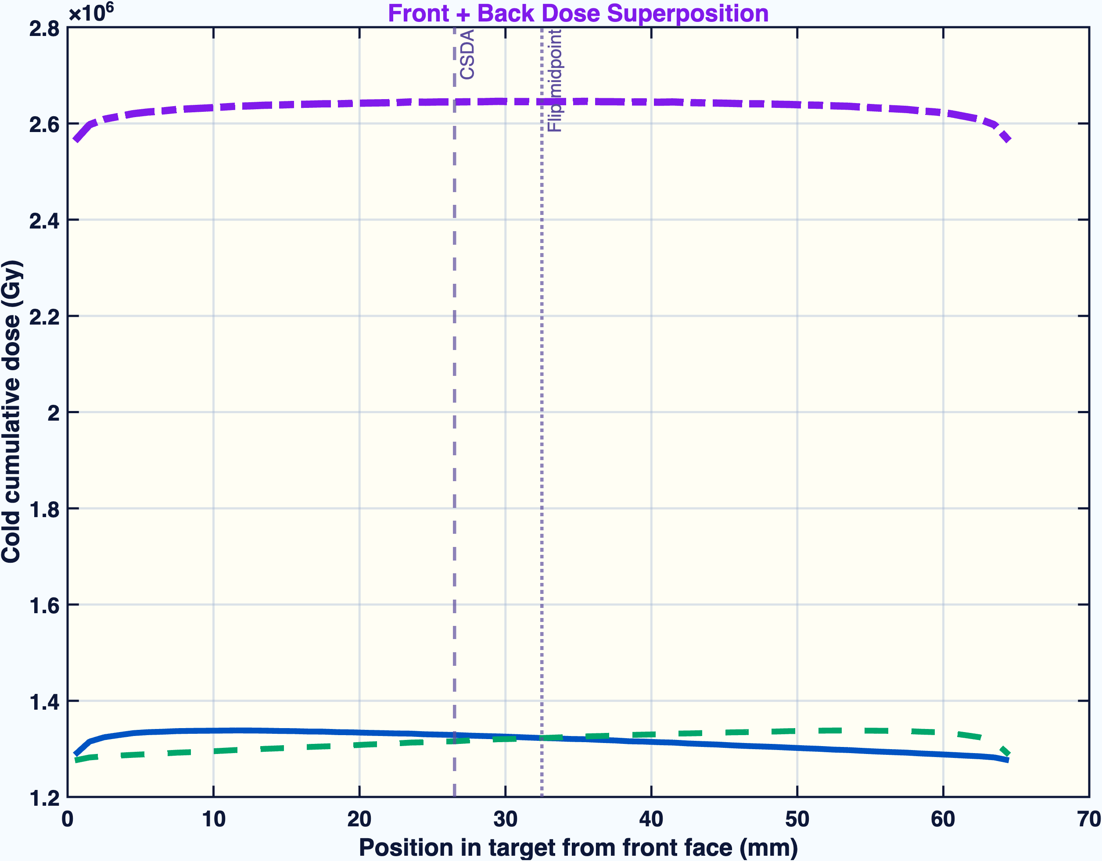
UITF DNP Target Irradiation
TOPAS Monte Carlo supports the proposal front/back irradiation protocol
front/back dose proof
8 MeV electrons through the cryostat, aluminum spreading window, liquid helium bath, and packed ND3 target volume. Results are based on the completed 100M front and 100M back runs.
Histories
Cold current
Warm current
Target
100M + 100M
1 uA
10 uA
250 mg ND3
Main claim
The simulation now matches the proposal's required two-sided irradiation logic: one pass is range-limited, while front + back superposition gives the target-volume dose field used for interpretation.
TOPAS / Geant4 MC | UITF DNP target irradiation | generated May 7, 2026
01

Slide 2
PROPOSAL RECREATION
The model tracks the beamline and batch protocol the proposal actually describes
Beam
8 MeV electrons, 1-10 uA
front/back run pairing
Target
250 mg packed ND3 in 6.5 cm x 1.42 cm volume
Geometry
cryostat windows, liquid helium bath, target holder, front/back source
Warm run
1.0e17 e-/cm2 per side at 10 uA, 2.85 h/side
Cold run
5.0e15 e-/cm2 per side at 1 uA, 1.42 h/side
Protocol
two-sided irradiation because 8 MeV electrons are range-limited
Single-bead microdosimetry was removed from the report figures: the proposal mentions 1 mm target spheres, but it does not use single-bead dose as an experimental observable.
TOPAS / Geant4 MC | UITF DNP target irradiation | generated May 7, 2026
02

Slide 3
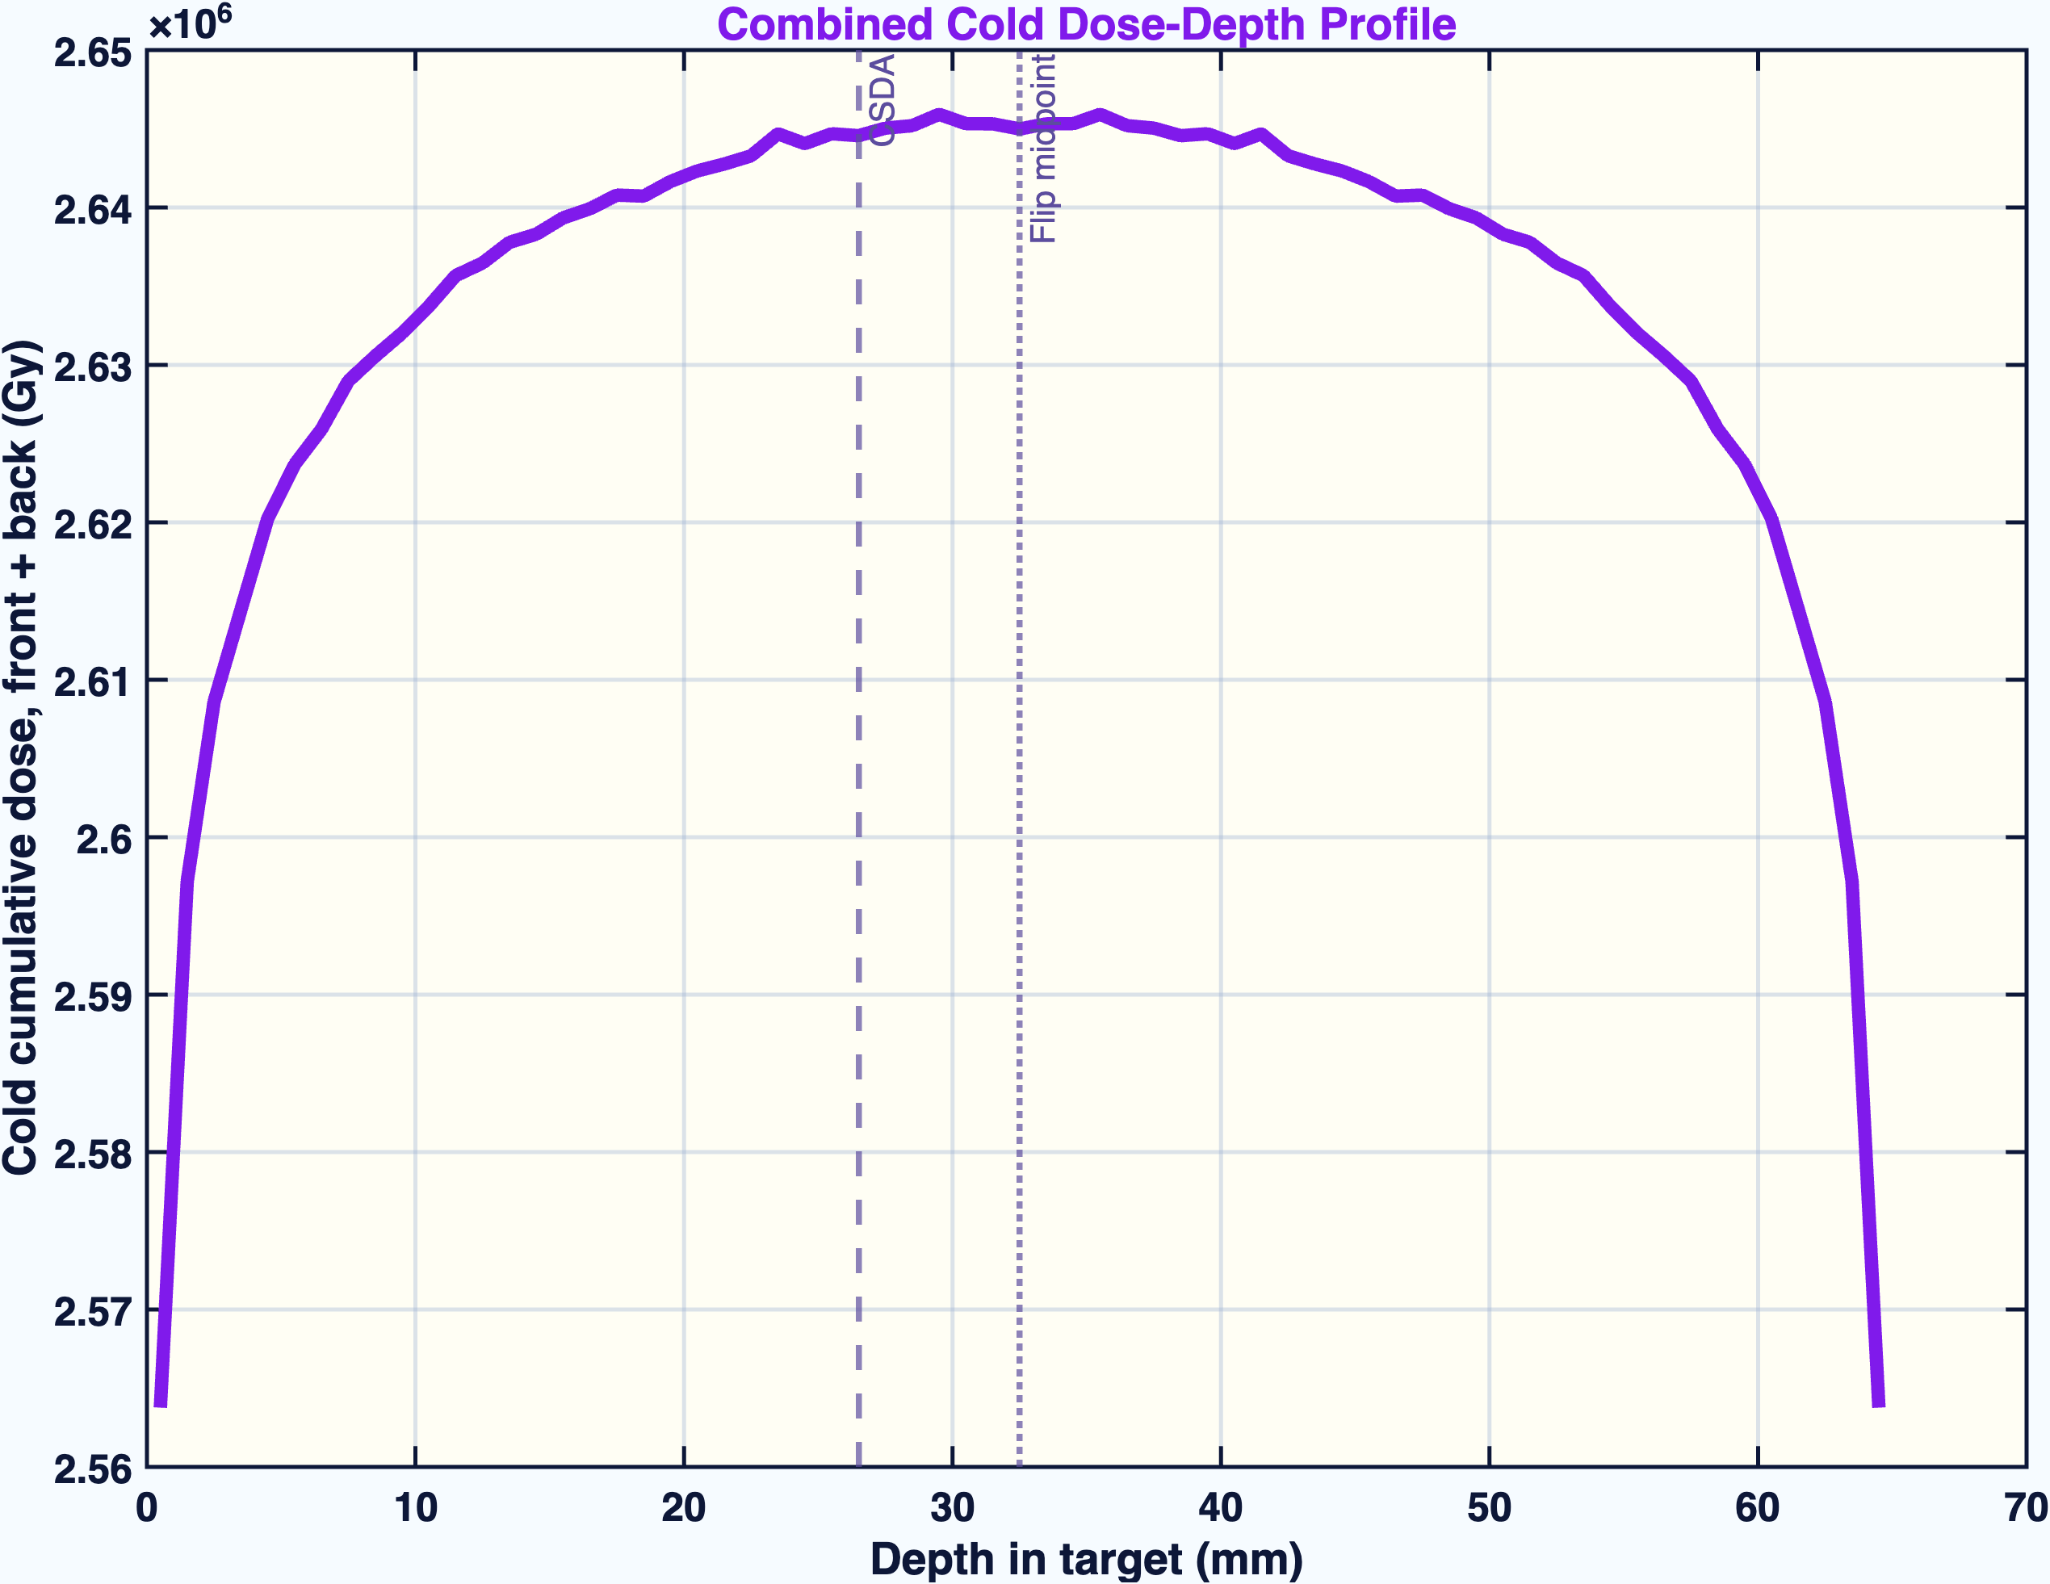
DOSE RESULT
Front + back superposition is the key physics result
individual sides plus combined profile
combined cold dose-depth profile
Cold mean cumulative dose: one side 1.317e6 Gy; front + back 2.633e6 Gy. The combined curve is not just a copy of one run.
TOPAS / Geant4 MC | UITF DNP target irradiation | generated May 7, 2026
03

Slide 4
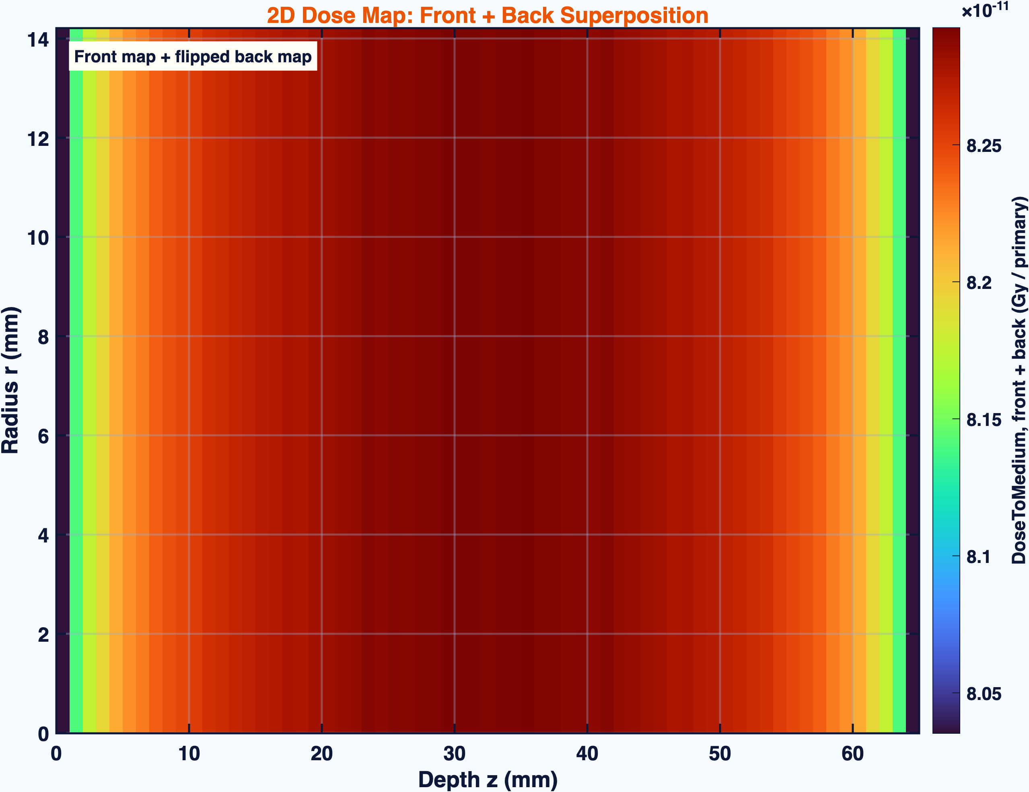
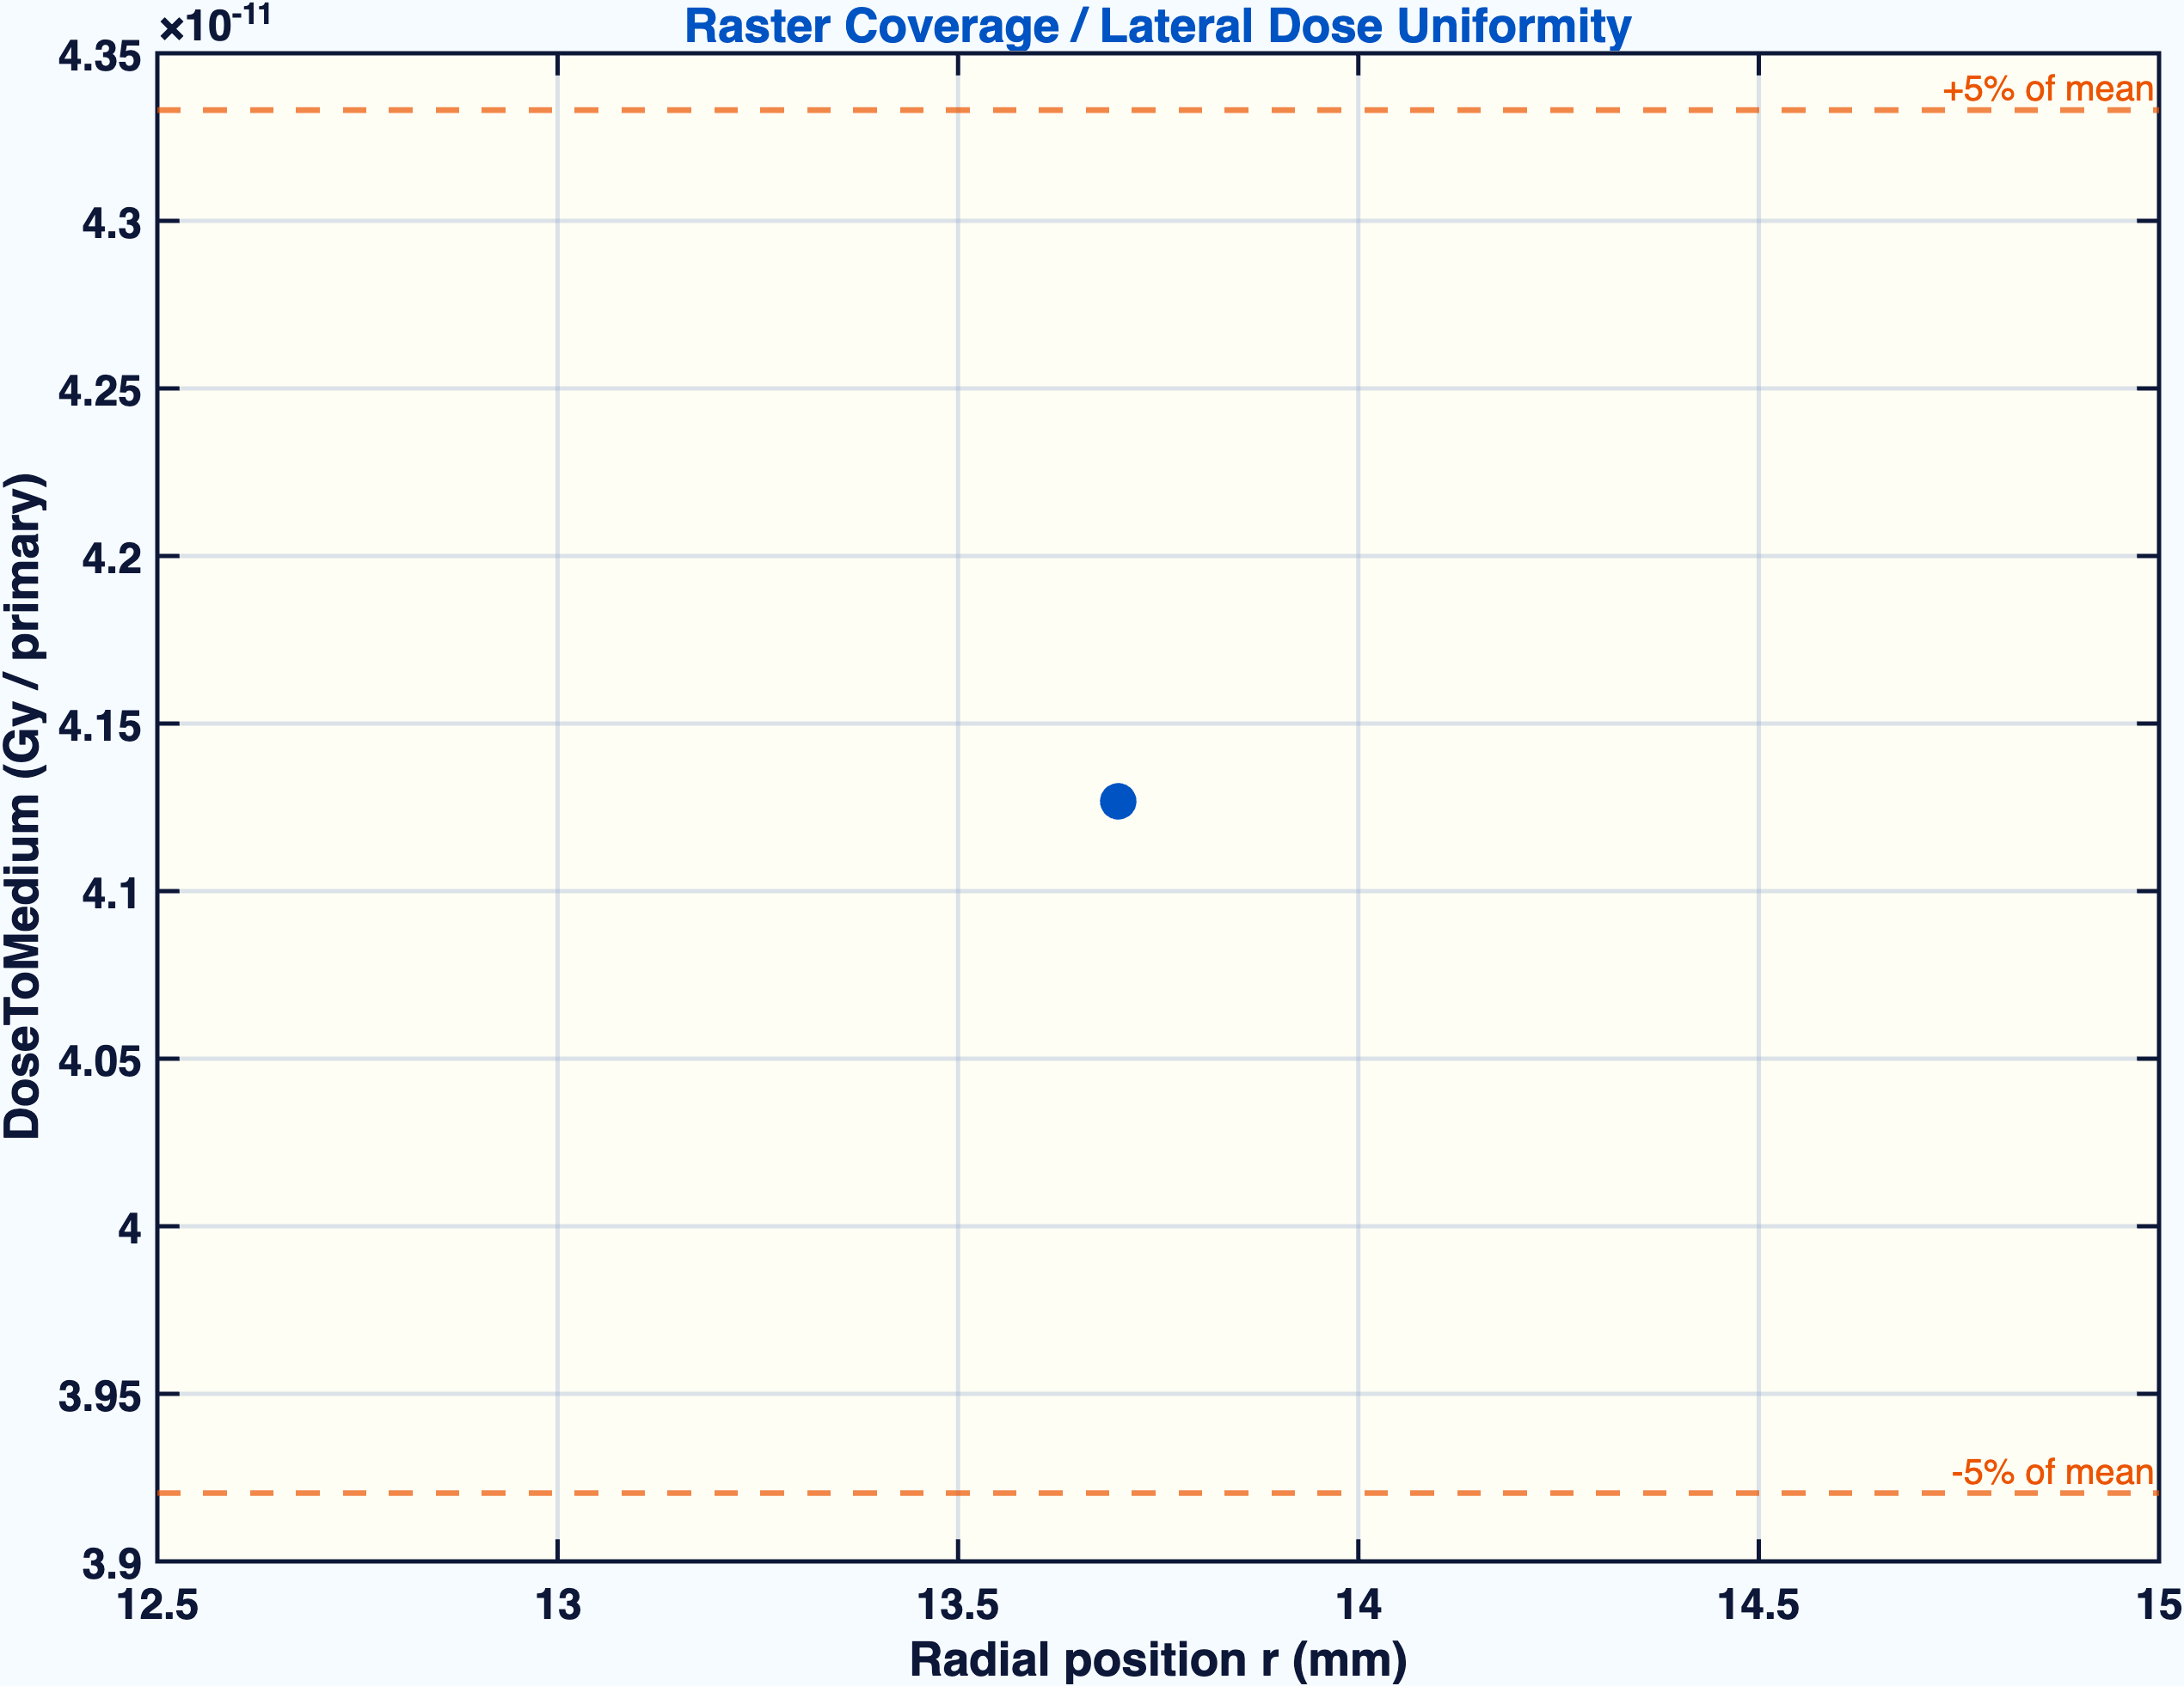
SPATIAL COVERAGE
The combined dose map is now superimposed across depth and radius
2D R-Z dose map, front + back
raw radial dose profile
This is the slide to use when someone asks whether the target volume is being covered, not just whether the central depth profile looks good.
TOPAS / Geant4 MC | UITF DNP target irradiation | generated May 7, 2026
04

Slide 5
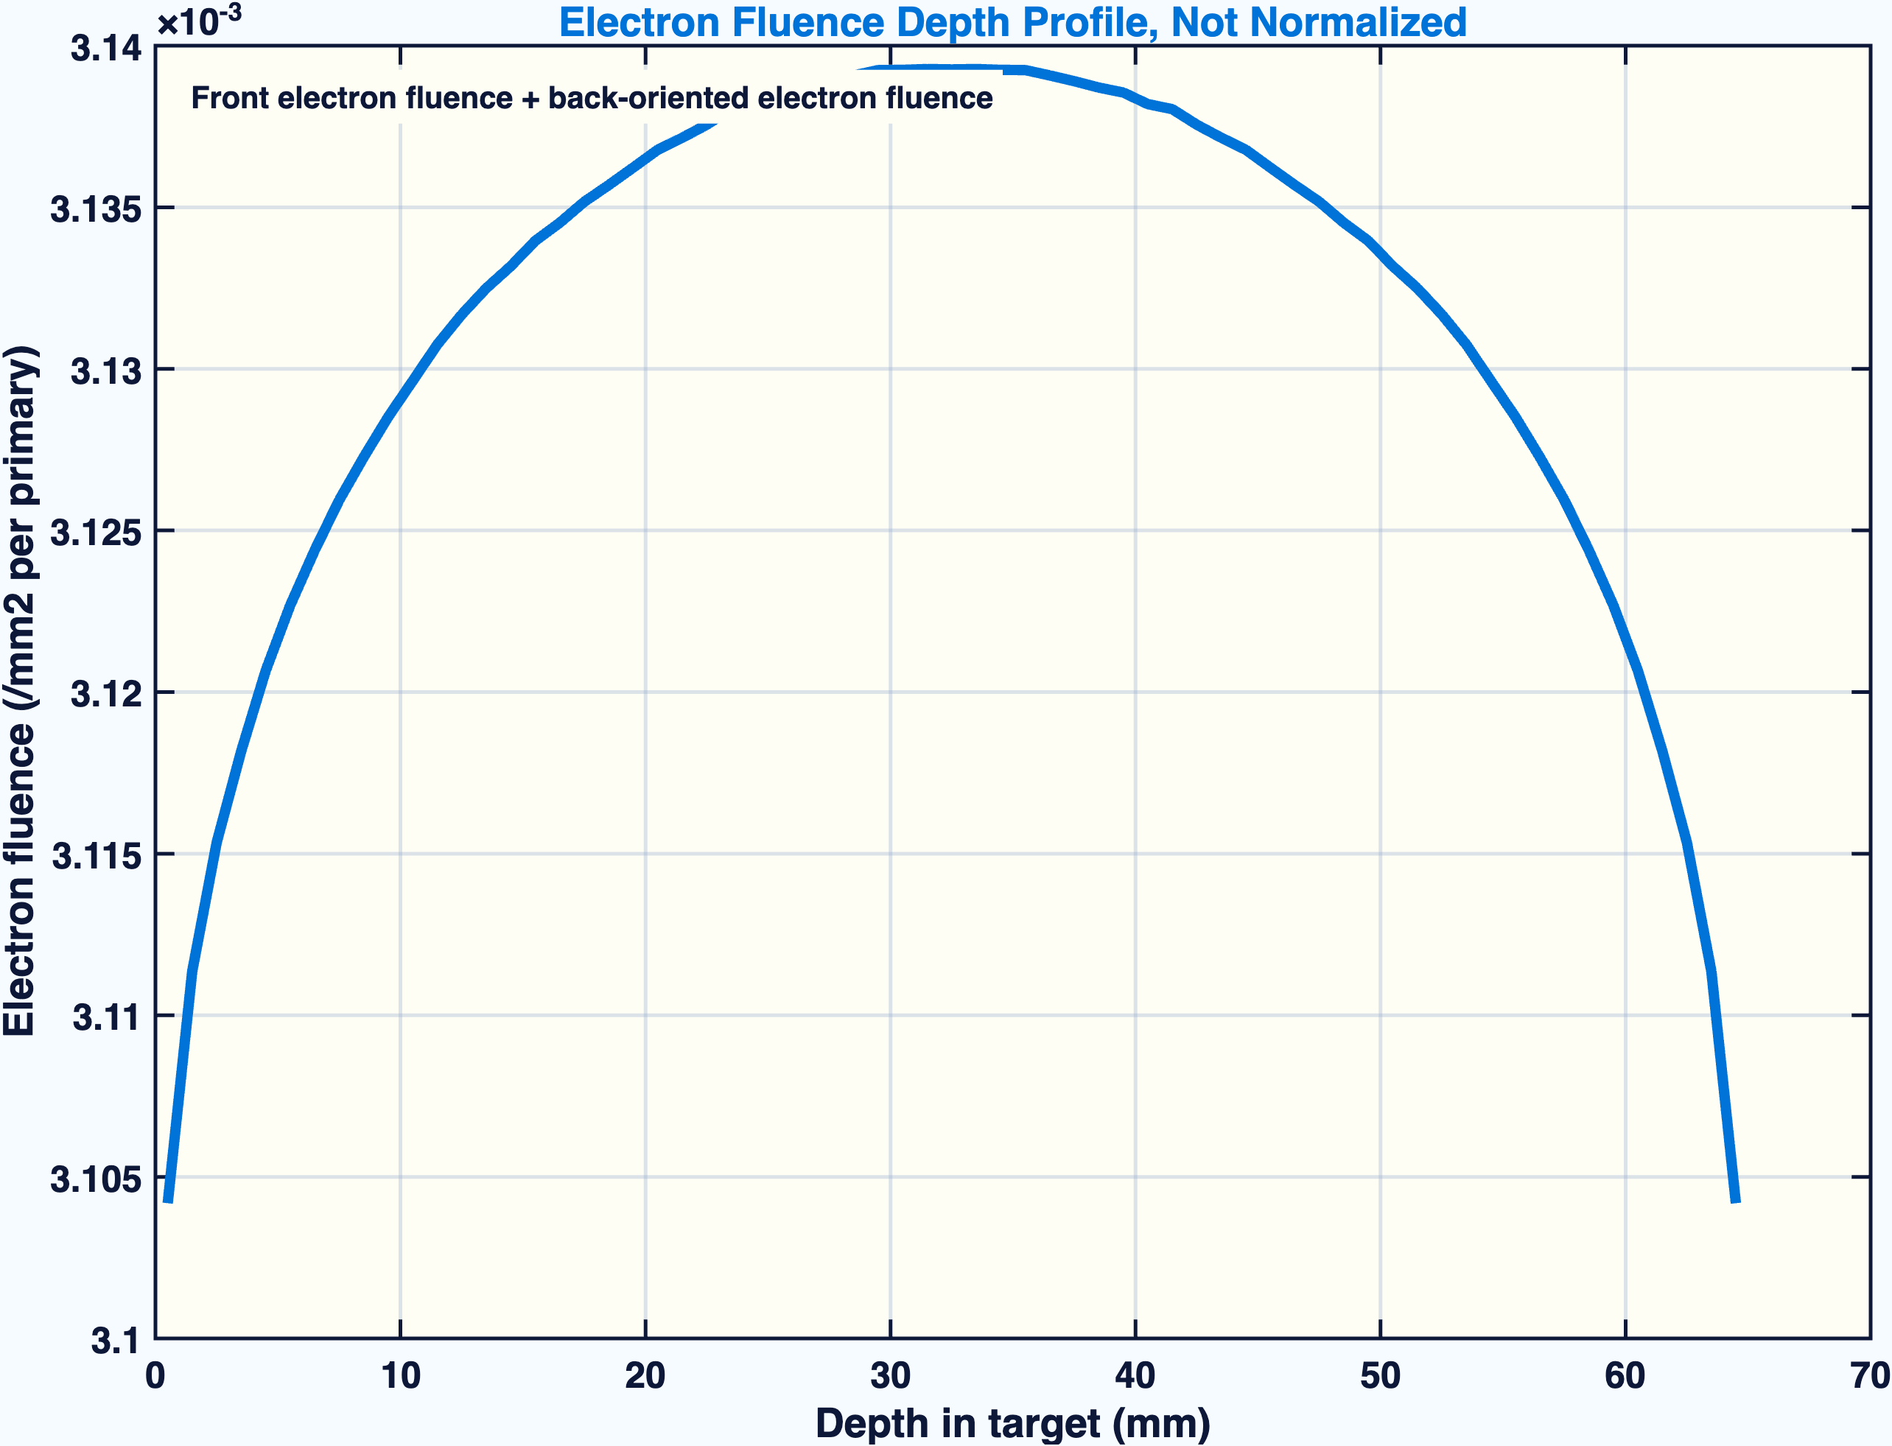
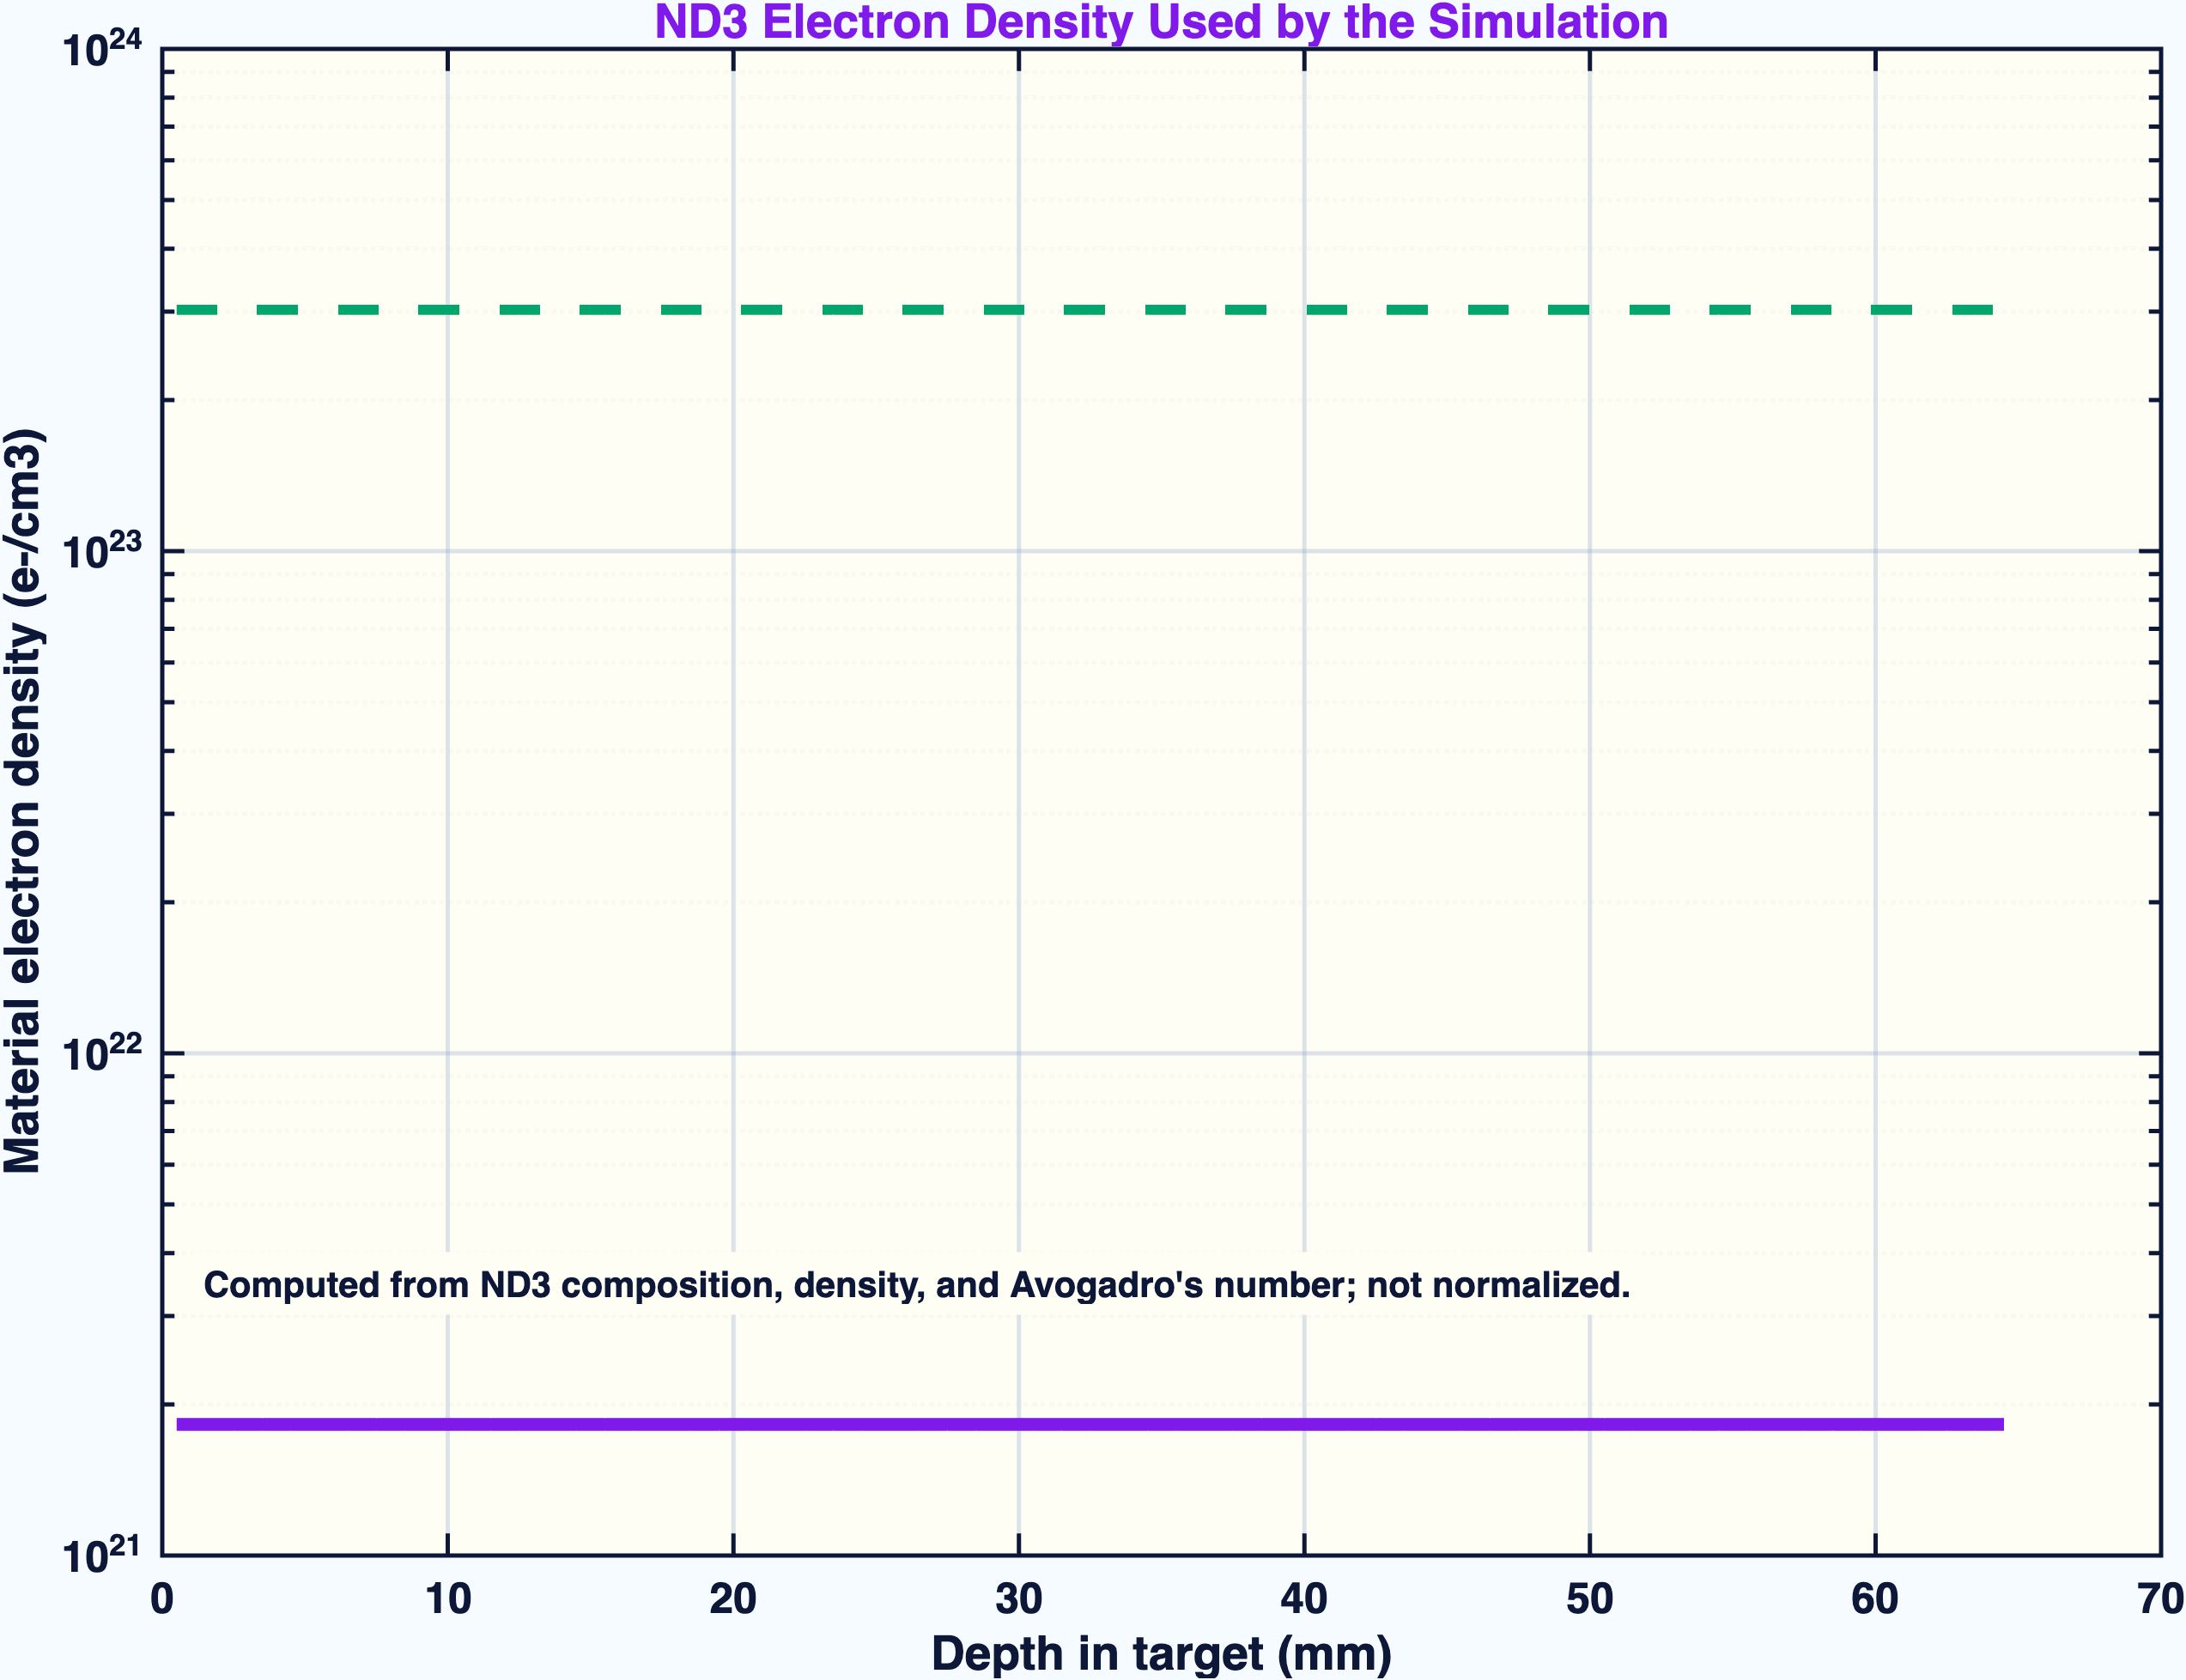
ELECTRON TRANSPORT
Fluence and material electron density are shown without normalization
electron fluence scorer
ND3 material electron density
The density curve is not particle fluence. It is the ND3 electron density computed from composition and density; the packed target volume is much lower than solid ND3 because the 250 mg batch is distributed over the holder volume.
TOPAS / Geant4 MC | UITF DNP target irradiation | generated May 7, 2026
05

Slide 6
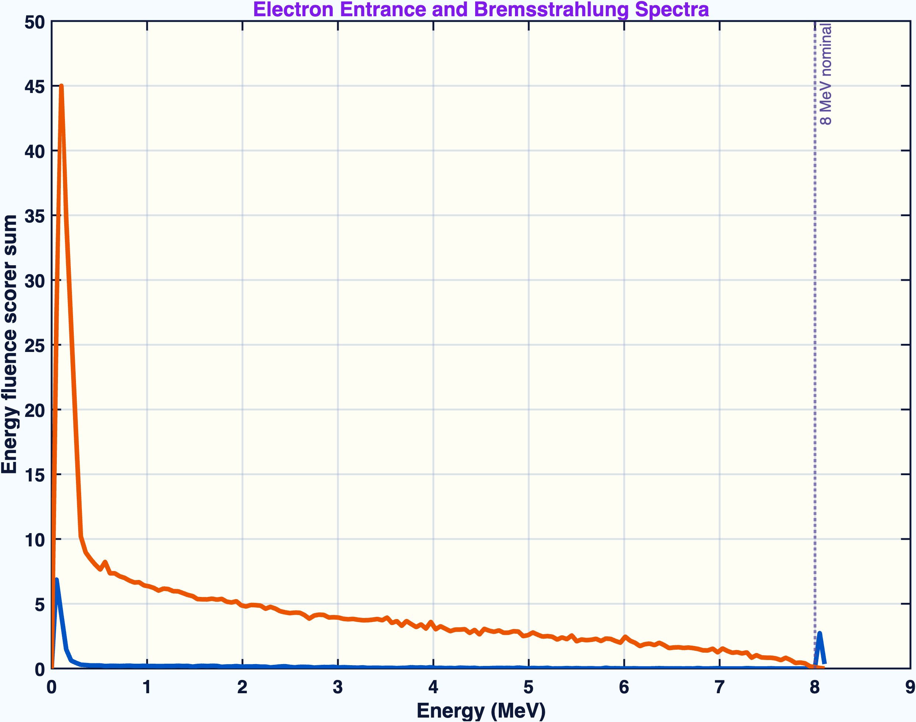
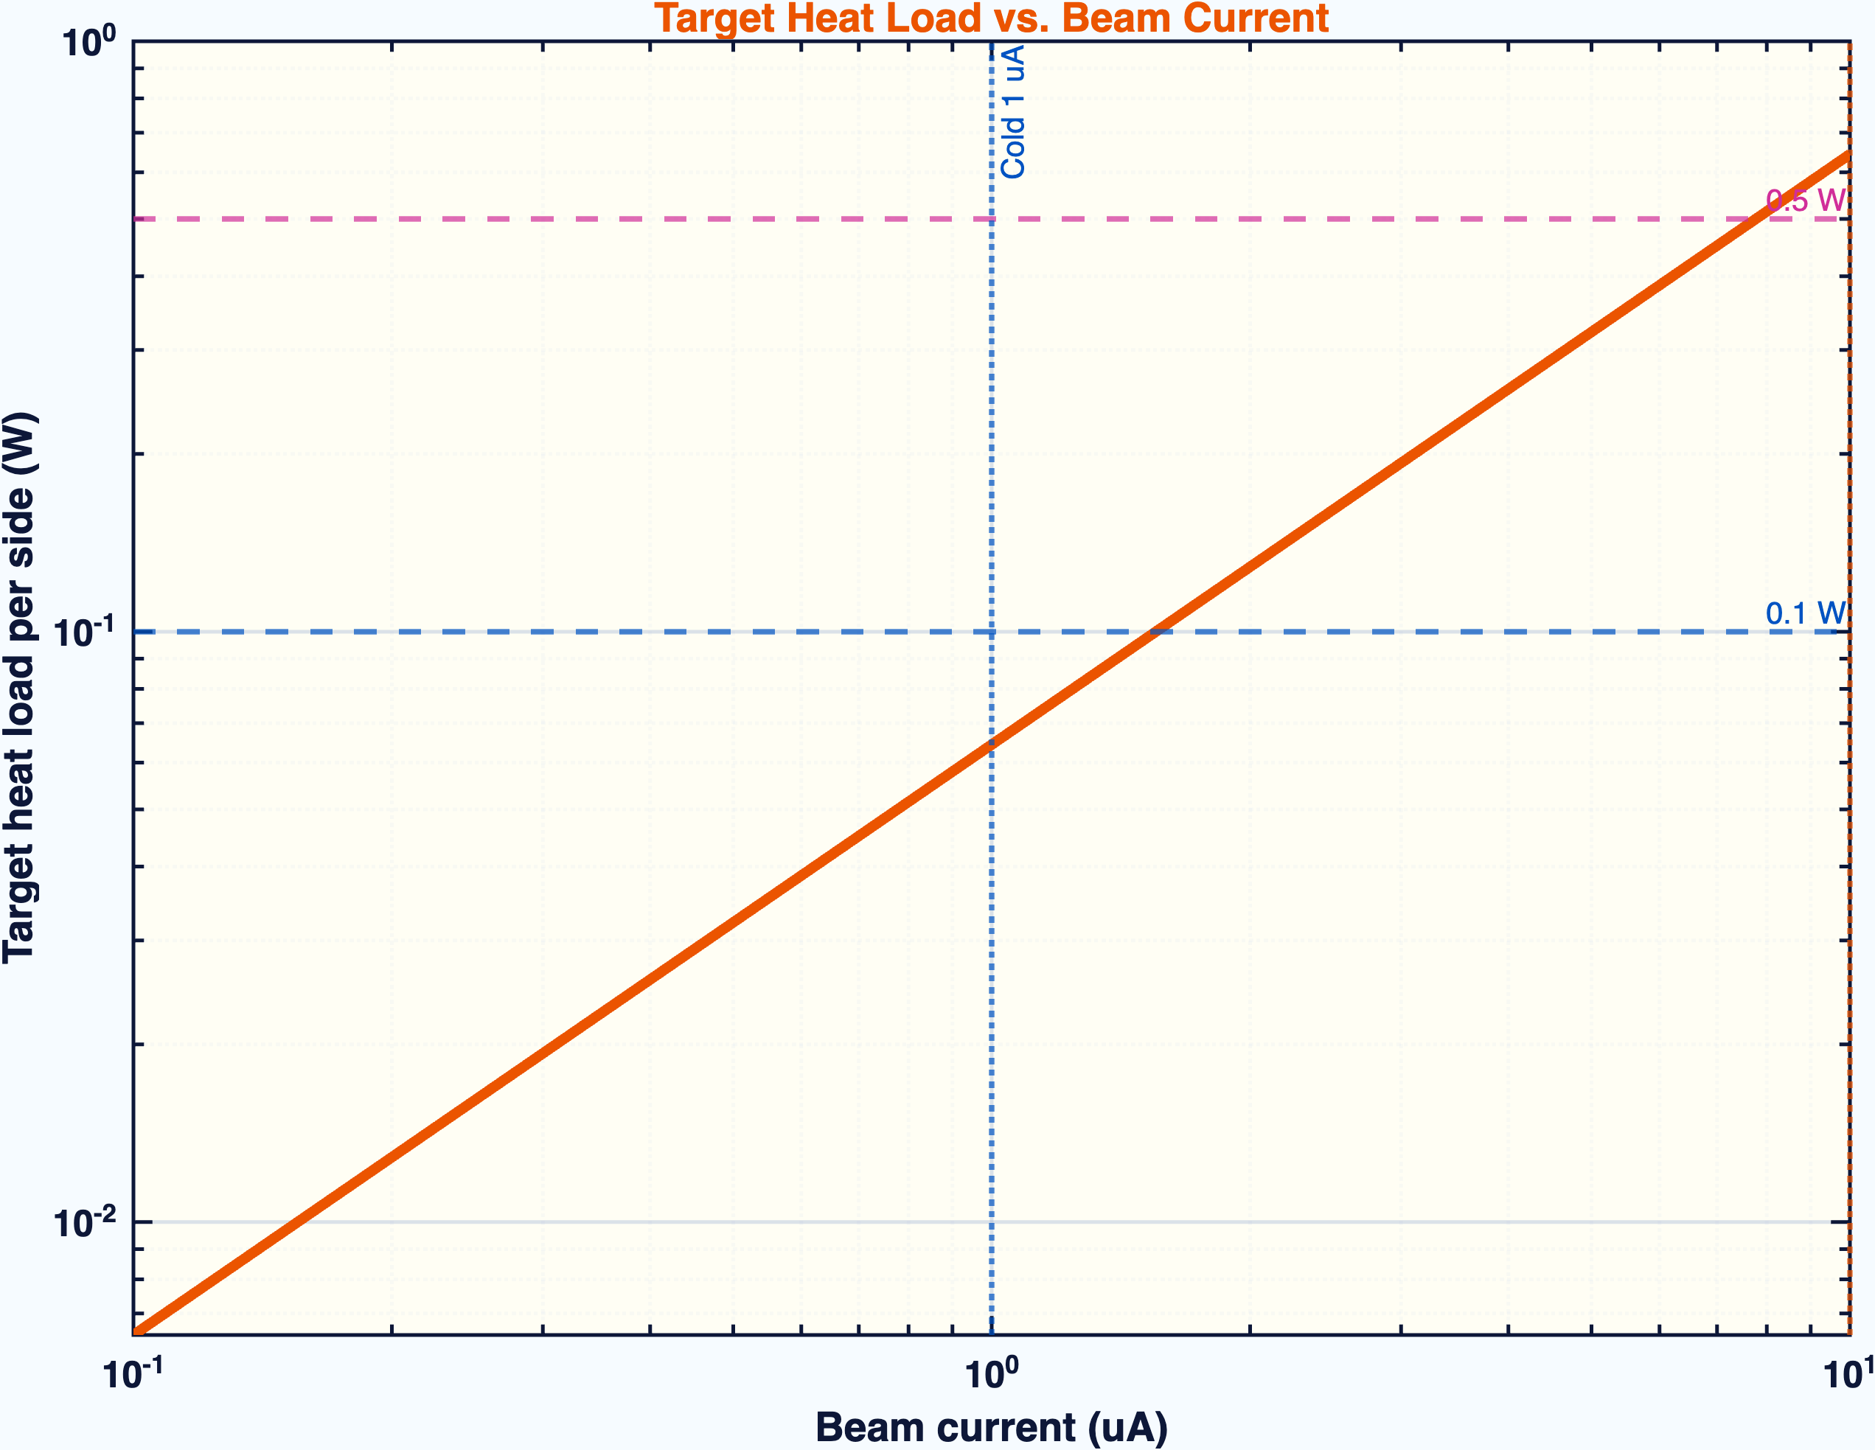
FEASIBILITY CHECKS
Spectra and heat load show whether the proposed currents are plausible
entrance electrons and exit photons
target heat load versus current
- Cold irradiation at 1 uA is the relevant low-heat condition for 2 K running.
- Warm 10 uA running is evaluated separately because heat load is not simultaneous front + back.
- Spectra confirm the nominal 8 MeV entrance beam and the secondary photon component.
TOPAS / Geant4 MC | UITF DNP target irradiation | generated May 7, 2026
06

Slide 7
INTERPRETATION
What this deck can safely claim
Strong
Geometry, beam energy, target dimensions, front/back timing, and fluence targets match the proposal.
Strong
The 100M front/back analysis is loaded from both completed output folders and superimposed in depth and R-Z maps.
Useful
Electron fluence and material electron density are unnormalized and separated conceptually.
Useful
Heat load is quoted per irradiation side, matching the actual procedure.
Not claimed
No measured DNP polarization or ESR radical population is predicted by TOPAS alone.
TOPAS / Geant4 MC | UITF DNP target irradiation | generated May 7, 2026
07

Slide 8
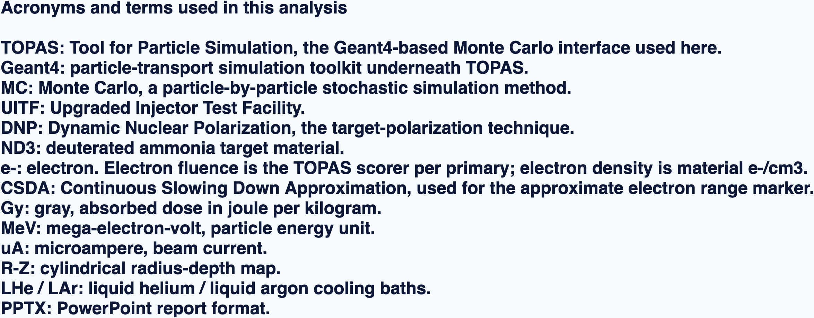
APPENDIX
Acronym quick reference for the report
definitions used in the figures
TOPAS / Geant4 MC | UITF DNP target irradiation | generated May 7, 2026
08

