Slide 1
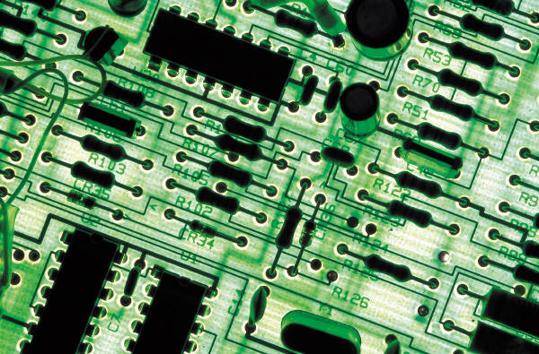
Lab#4
4 Bit Full Adder Implementation on vivado2018

Slide 2
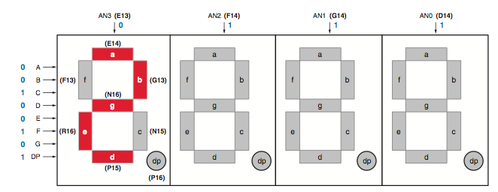
7-segment LED display
Shares eight common control signals to light individual LED
segments → LEDDisplay.vhd
Has a separate anode control input → AnodeControl.vhd

Slide 3
File description
Adder4Bench : Top level file
Fig2_04 : 4-bit full adder (Adder4)
FullAdder : a full adder
LEDDisplay : 7-segment Display
Dec_7seg : Converter from binary to 7-segmant display
AnodeControl : 7-segment selector
XDC file : Matching between PIN locations and variables

Slide 4
Xdc file
## Clock signal
set_property -dict { PACKAGE_PIN E3 IOSTANDARD LVCMOS33 } [get_ports { clk }];
##Switches
set_property -dict { PACKAGE_PIN J15 IOSTANDARD LVCMOS33 } [get_ports { A[0] }];
IO_L24N_T3_RS0_15 Sch=A[0]
set_property -dict { PACKAGE_PIN L16 IOSTANDARD LVCMOS33 } [get_ports { A[1] }];
IO_L3N_T0_DQS_EMCCLK_14 Sch=A[1]
set_property -dict { PACKAGE_PIN M13 IOSTANDARD LVCMOS33 } [get_ports { A[2] }];
IO_L6N_T0_D08_VREF_14 Sch=A[2]
set_property -dict { PACKAGE_PIN R15 IOSTANDARD LVCMOS33 } [get_ports { A[3] }];
IO_L13N_T2_MRCC_14 Sch=A[3]
set_property -dict { PACKAGE_PIN R17 IOSTANDARD LVCMOS33 } [get_ports { B[0] }];
IO_L12N_T1_MRCC_14 Sch=B[0]
set_property -dict { PACKAGE_PIN T18 IOSTANDARD LVCMOS33 } [get_ports { B[1] }];
IO_L7N_T1_D10_14 Sch=B[1]
set_property -dict { PACKAGE_PIN U18 IOSTANDARD LVCMOS33 } [get_ports { B[2]}];
IO_L17N_T2_A13_D29_14 Sch=B[2]
set_property -dict { PACKAGE_PIN R13 IOSTANDARD LVCMOS33 } [get_ports { B[3] }];

Slide 5
Xdc file
##7 segment display
set_property -dict { PACKAGE_PIN T10 IOSTANDARD LVCMOS33 } [get_ports { segment_a }];
IO_L24N_T3_A00_D16_14 Sch=segment_a
set_property -dict { PACKAGE_PIN R10 IOSTANDARD LVCMOS33 } [get_ports { segment_b }];
IO_25_14 Sch=segment_b
set_property -dict { PACKAGE_PIN K16 IOSTANDARD LVCMOS33 } [get_ports { segment_c }];
IO_25_15 Sch=segment_c
set_property -dict { PACKAGE_PIN K13 IOSTANDARD LVCMOS33 } [get_ports { segment_d }];
IO_L17P_T2_A26_15 Sch=segment_d
set_property -dict { PACKAGE_PIN P15 IOSTANDARD LVCMOS33 } [get_ports { segment_e }];
IO_L13P_T2_MRCC_14 Sch=segment_e
set_property -dict { PACKAGE_PIN T11 IOSTANDARD LVCMOS33 } [get_ports { segment_f }];
IO_L19P_T3_A10_D26_14 Sch=segment_f
set_property -dict { PACKAGE_PIN L18 IOSTANDARD LVCMOS33 } [get_ports { segment_g }];
IO_L4P_T0_D04_14 Sch=segment_g
set_property -dict { PACKAGE_PIN H15 IOSTANDARD LVCMOS33 } [get_ports { segment_dp }];
#IO_L19N_T3_A21_VREF_15 Sch=segment_dp

Slide 6
Xdc file
set_property -dict { PACKAGE_PIN J17 IOSTANDARD LVCMOS33 } [get_ports { AN0 }];
IO_L23P_T3_FOE_B_15 Sch=an0
set_property -dict { PACKAGE_PIN J18 IOSTANDARD LVCMOS33 } [get_ports { AN1 }];
IO_L23N_T3_FWE_B_15 Sch=an1
set_property -dict { PACKAGE_PIN T9 IOSTANDARD LVCMOS33 } [get_ports { AN2 }];
IO_L24P_T3_A01_D17_14 Sch=an2
set_property -dict { PACKAGE_PIN J14 IOSTANDARD LVCMOS33 } [get_ports { AN3 }];
IO_L19P_T3_A22_15 Sch=an3
#set_property -dict { PACKAGE_PIN P14 IOSTANDARD LVCMOS33 } [get_ports { AN[4] }];
#IO_L8N_T1_D12_14 Sch=an[4]
#set_property -dict { PACKAGE_PIN T14 IOSTANDARD LVCMOS33 } [get_ports { AN[5] }];
#IO_L14P_T2_SRCC_14 Sch=an[5]
#set_property -dict { PACKAGE_PIN K2 IOSTANDARD LVCMOS33 } [get_ports { AN[6] }];
#IO_L23P_T3_35 Sch=an[6]
#set_property -dict { PACKAGE_PIN U13 IOSTANDARD LVCMOS33 } [get_ports { AN[7] }];
#IO_L23N_T3_A02_D18_14 Sch=an[7]
##Bottoms
set_property -dict { PACKAGE_PIN P17 IOSTANDARD LVCMOS33 } [get_ports { Ci}];
IO_L12P_T1_MRCC_14 Sch=Ci

