Slide 1
presentation

Slide 2
Requirements
1. The user must be registered to use the application
2. The application allows the user to visit profiles of other users, such that he can see statistics about the previous bets of another user.
3. The application allows the user to manage a list of friends.
4. The application allows chat between friends. (next version)
5. Each new event (such as chat/bet/friend’s request/conrm) must raise a notfication by the application in the phone
of the relevant user (e.g. in the case of chat's event it will be the friend user who got the message).
6. The application allows two users to bet and, if necessary, an arbitrator can judge and declare the winner (the arbitrator is chosen before the beginning of the bet).
7. If there is no agreement about the bet, like the gain, or the arbitrator, or even the formulation of the bet, the bet cannot begin.
8. The application allows the next types of gain: Real money or fictive money (via the application), or anything else.
(in this version, the bettors can bet on real money. The amount will be agreed in the application but won’t transfer by the application
9. The application doesn’t allow to bet real money, unless there is an arbitrator. (again, in the next version)
10. The application allows to mark a user as a cheater. Also, allows the admin to banish any user.
11. The application saves all the data of all the users.
12. Added requirements

Slide 3
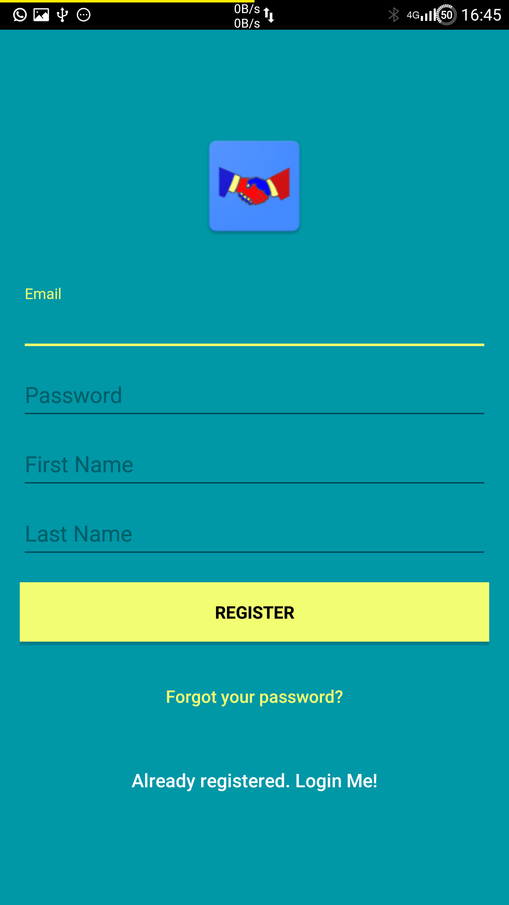
The user must be registered to use the application

Slide 4
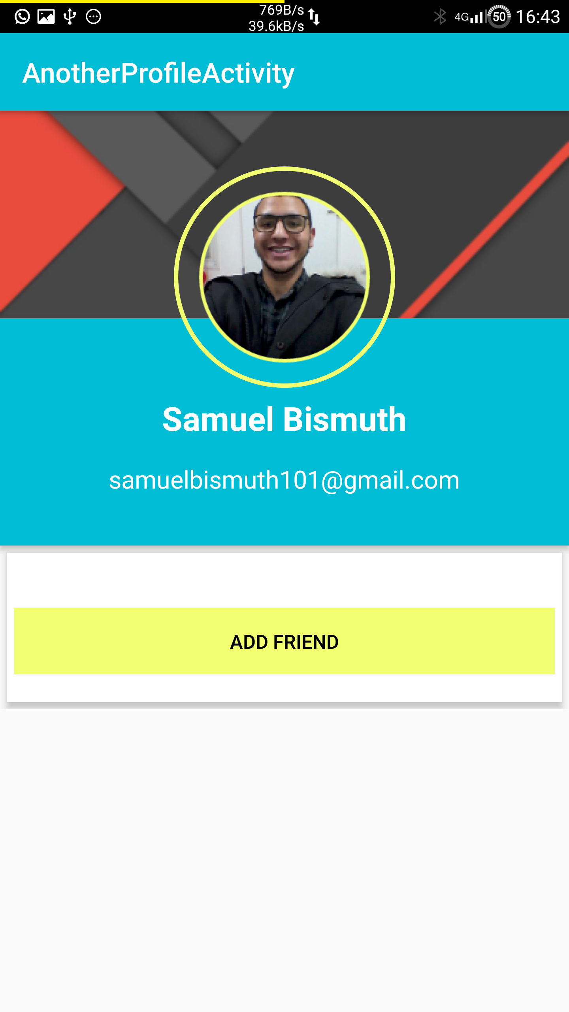
The application allows the user to visit profiles of other users, such that he can see statistics about the previous bets of another user.
Next version

Slide 5
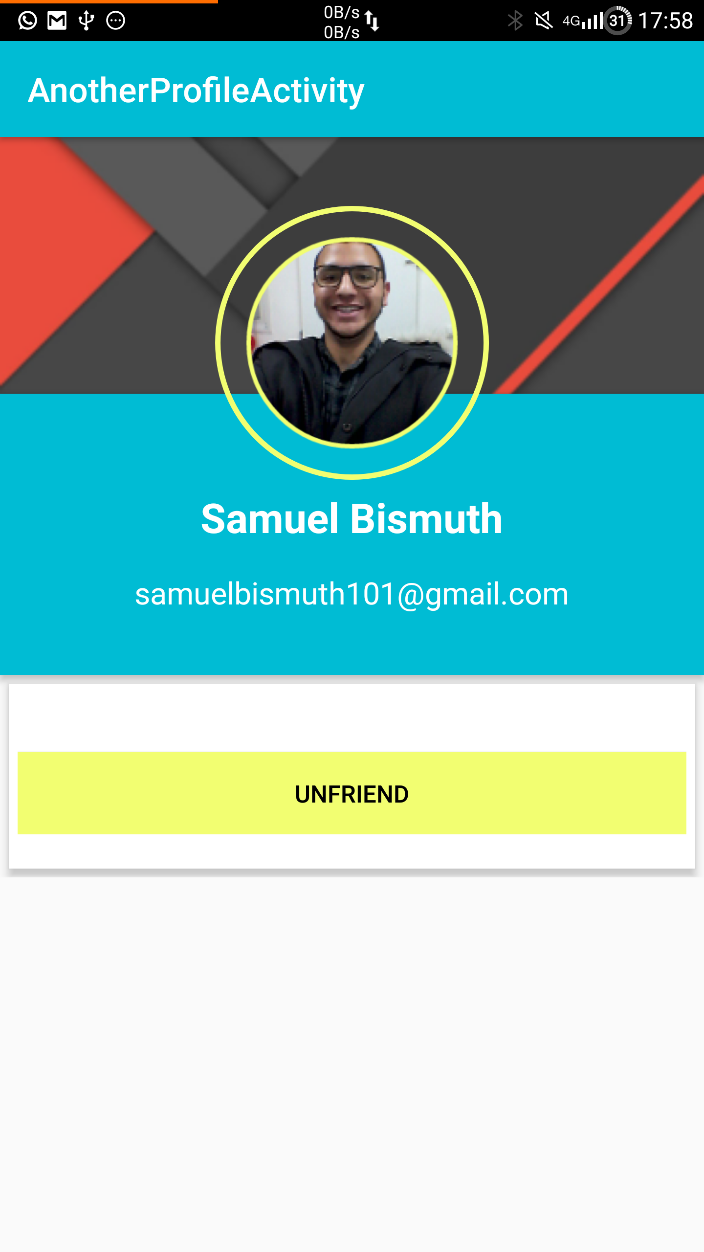
The application allows the user to manage a list of friends.

Slide 6
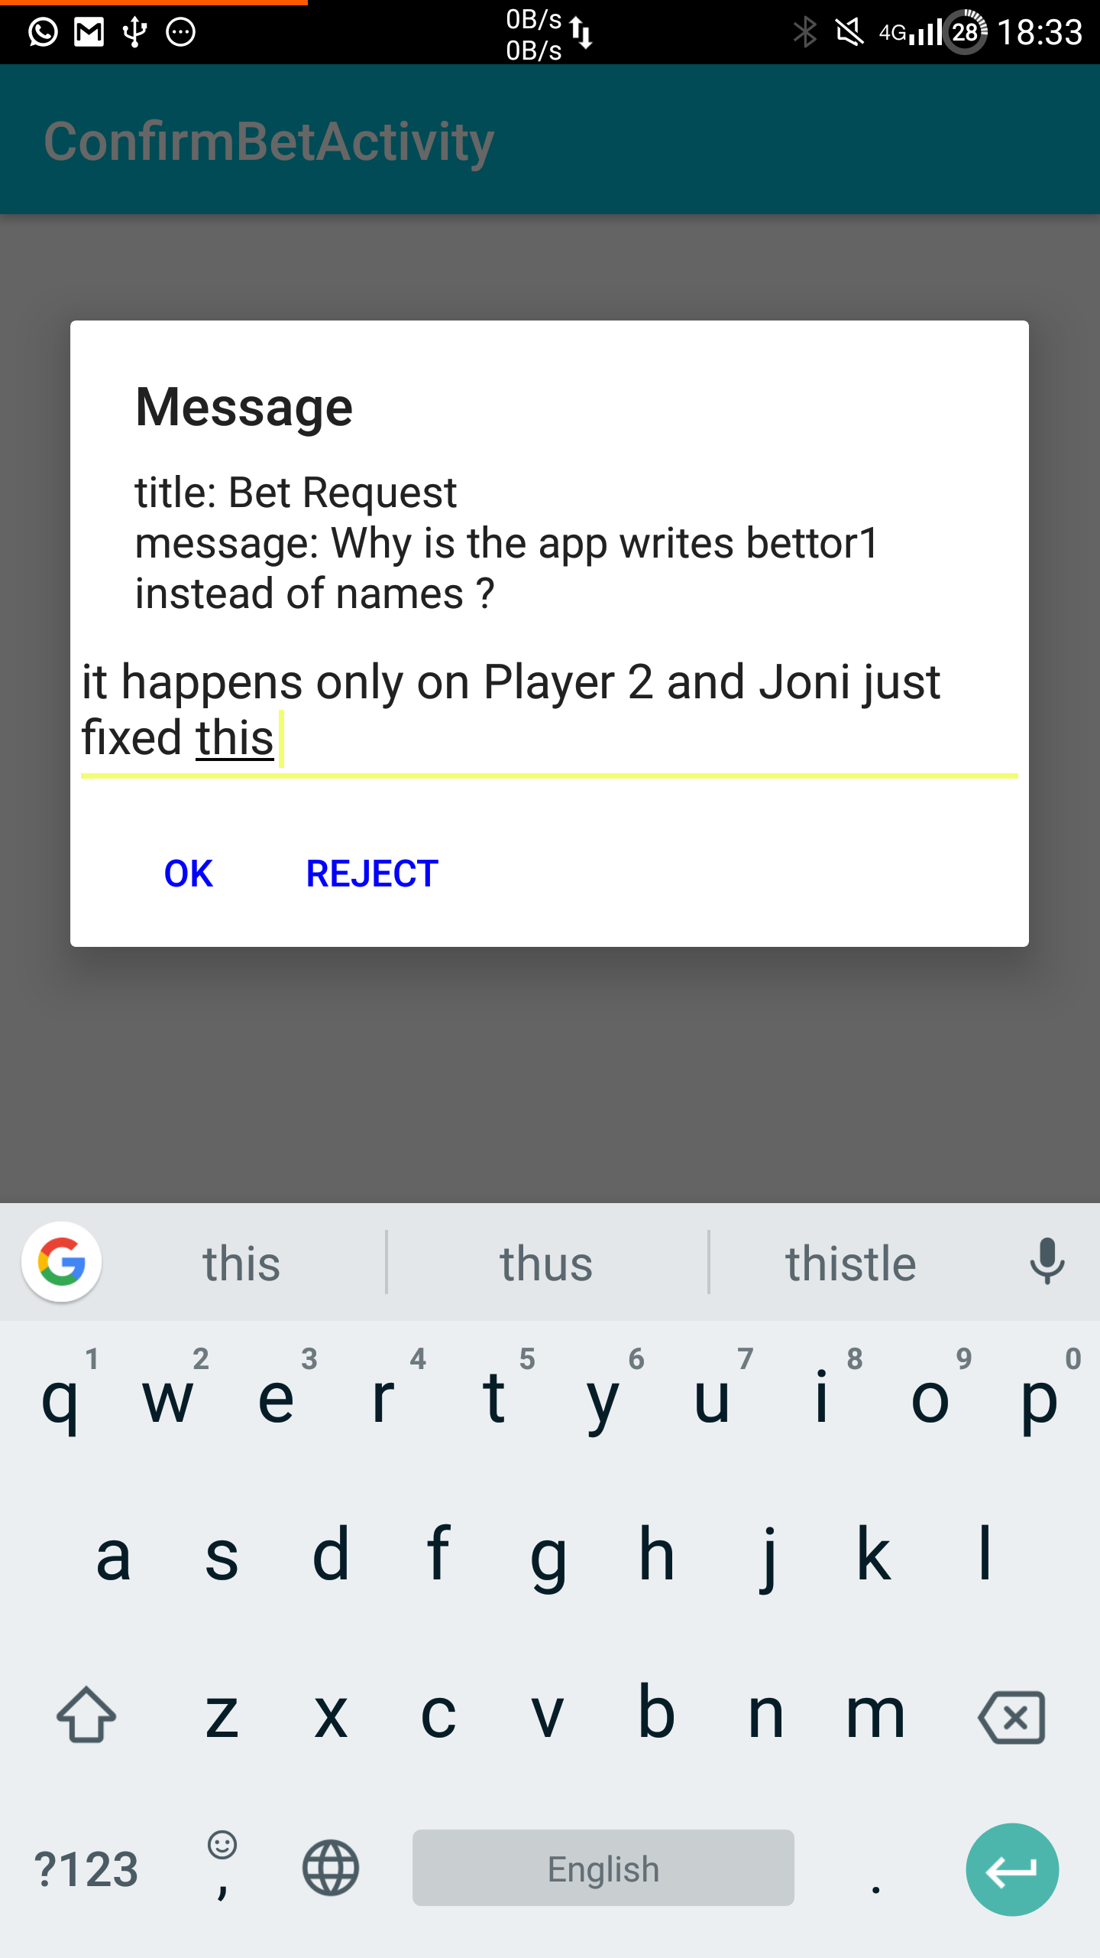
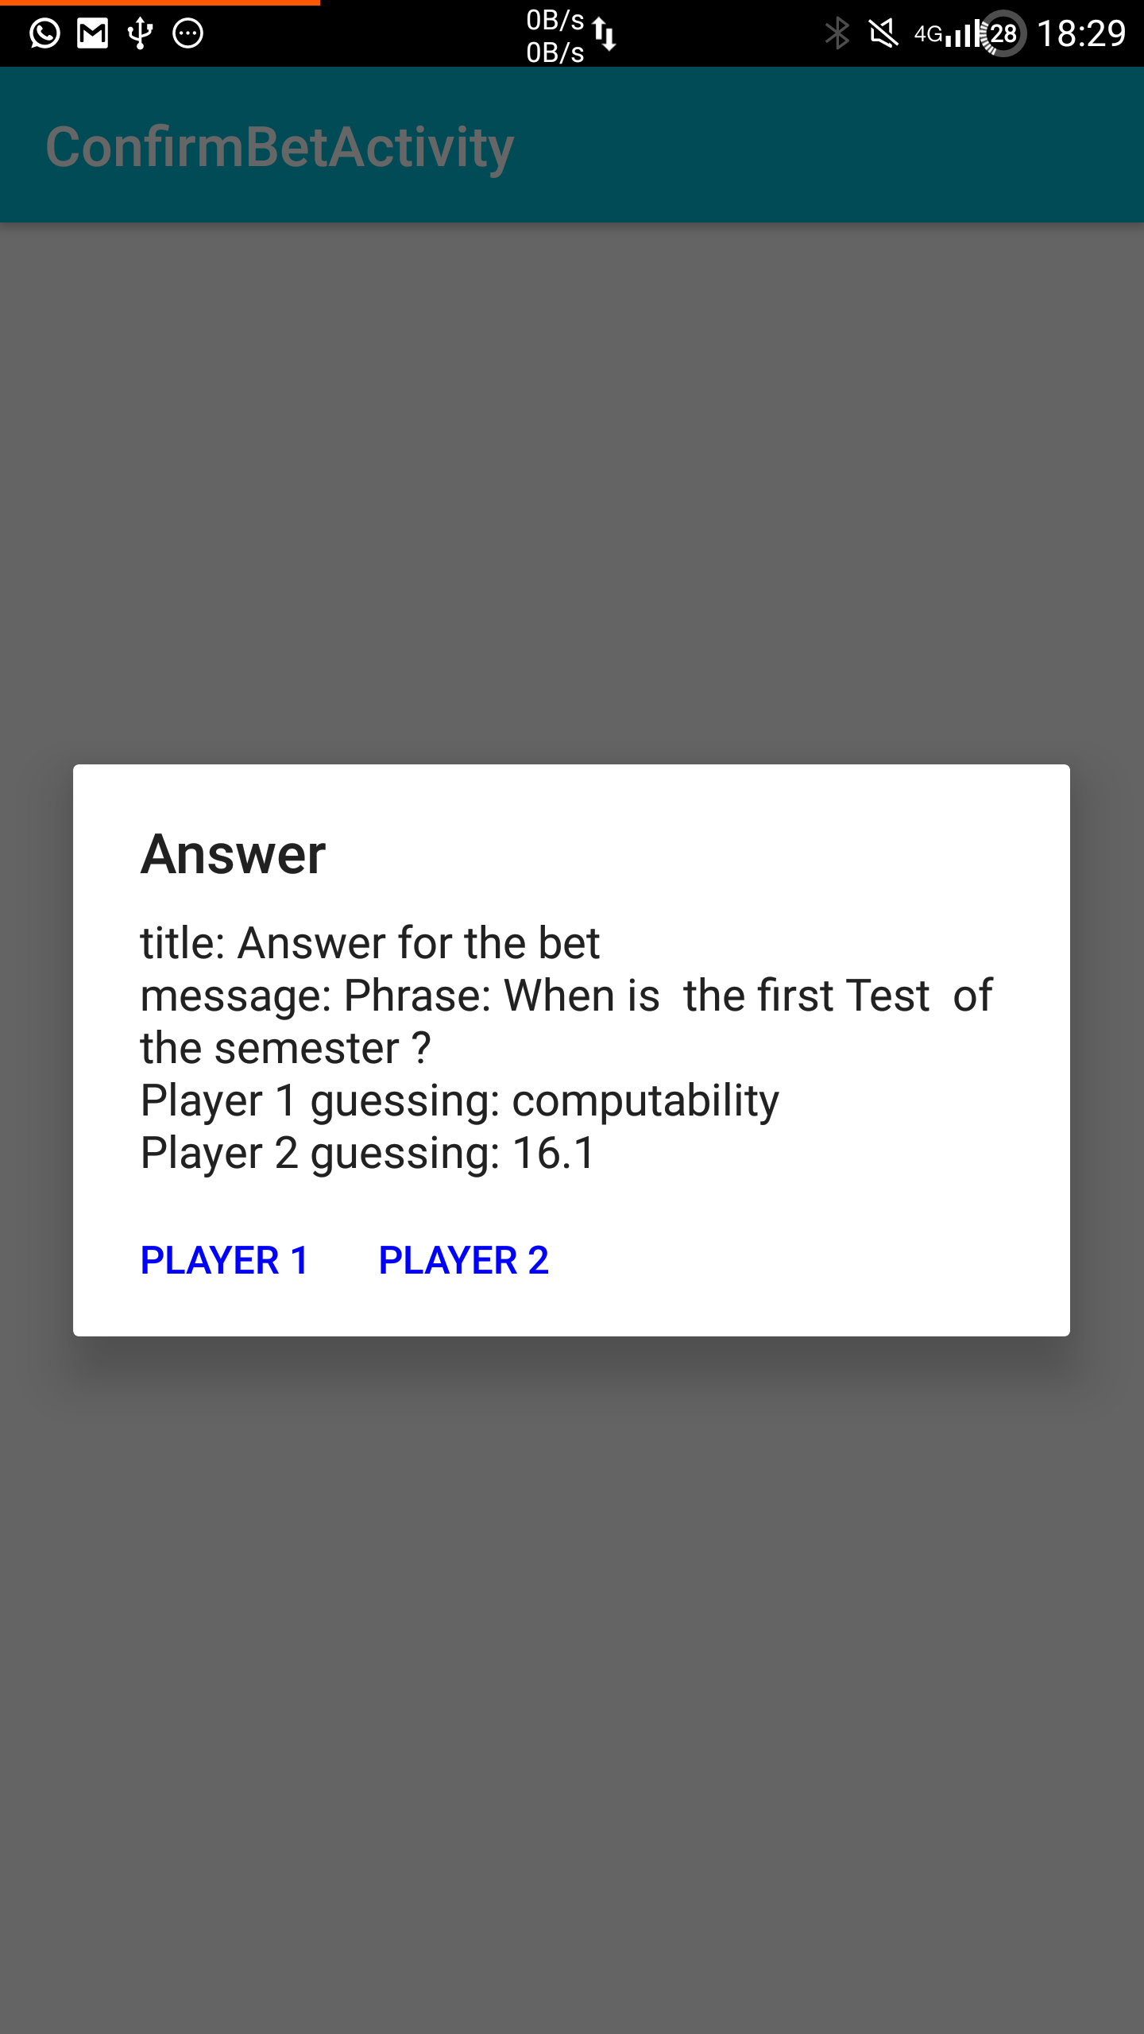
Each new event (such as chat/bet/friend’s request/confirm) must raise a notification by the application in the phone
of the relevant user (e.g. in the case of chat's event it will be the friend user who got the message).

Slide 7
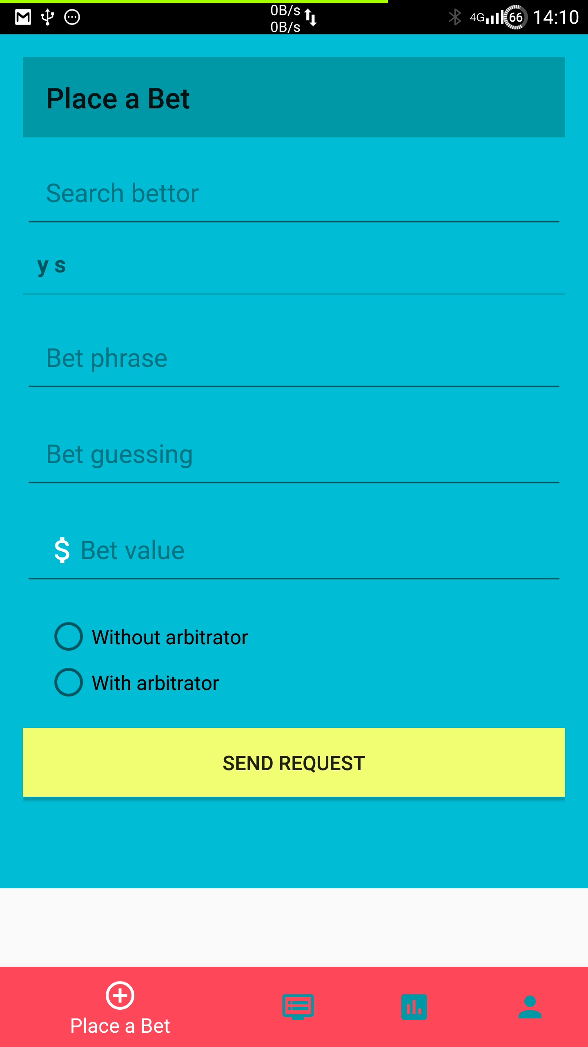
The application allows two users to bet and, if necessary, an arbitrator can judge and declare the winner (the arbitrator is chosen before the beginning of the bet).

Slide 8
If there is no agreement about the bet, like the gain, or the arbitrator, or even the formulation of the bet, the bet cannot begin.

Slide 10
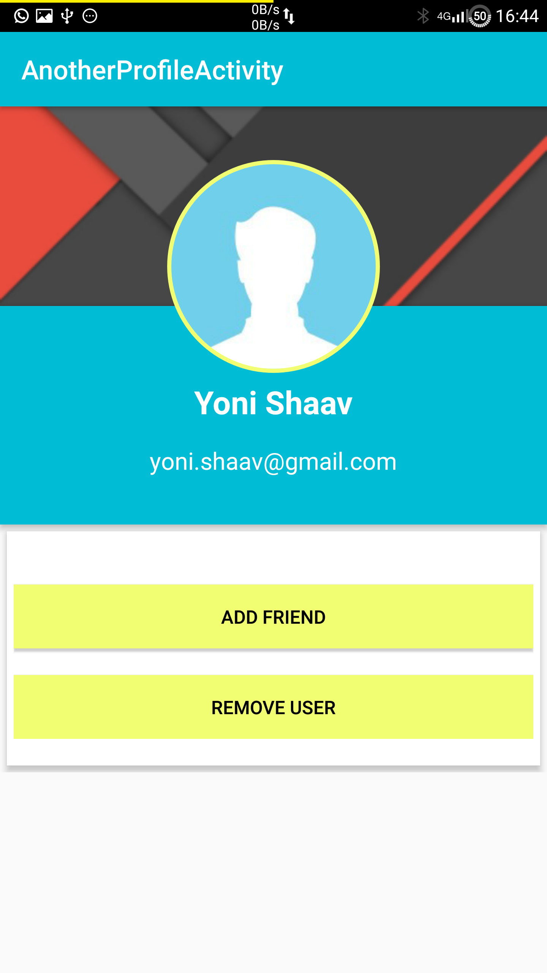
The application allows to mark a user as a cheater. Also, allows the admin to banish any user.
Next version

Slide 11
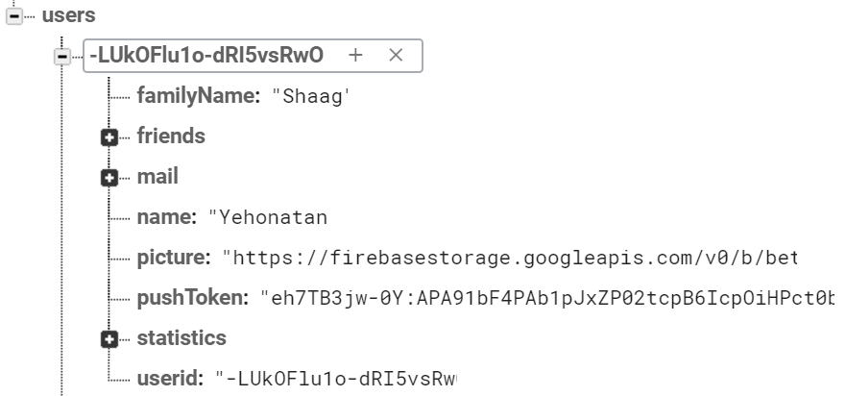
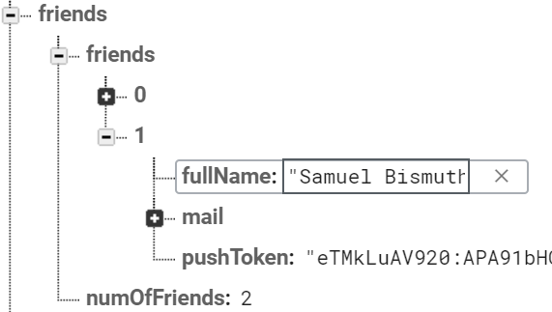

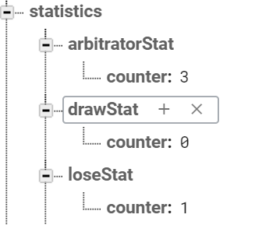

The application saves all the data of all the users.

Slide 12
Added requirements
1. Save all data about bets.
2. The user can see his own statistics
3. The user can see his bets
4. The application will be available to dementic people and “satlanim” that forgot their password

Slide 13
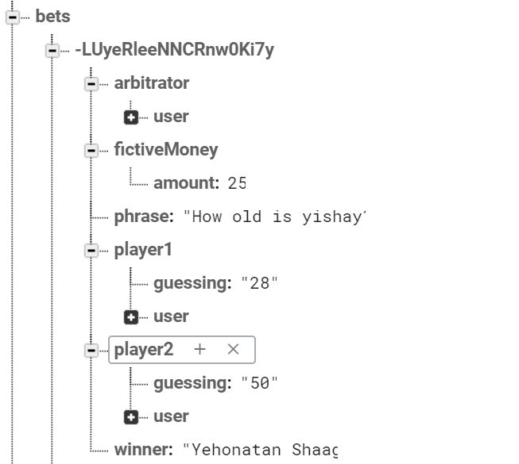
Save all data about bets.

Slide 14
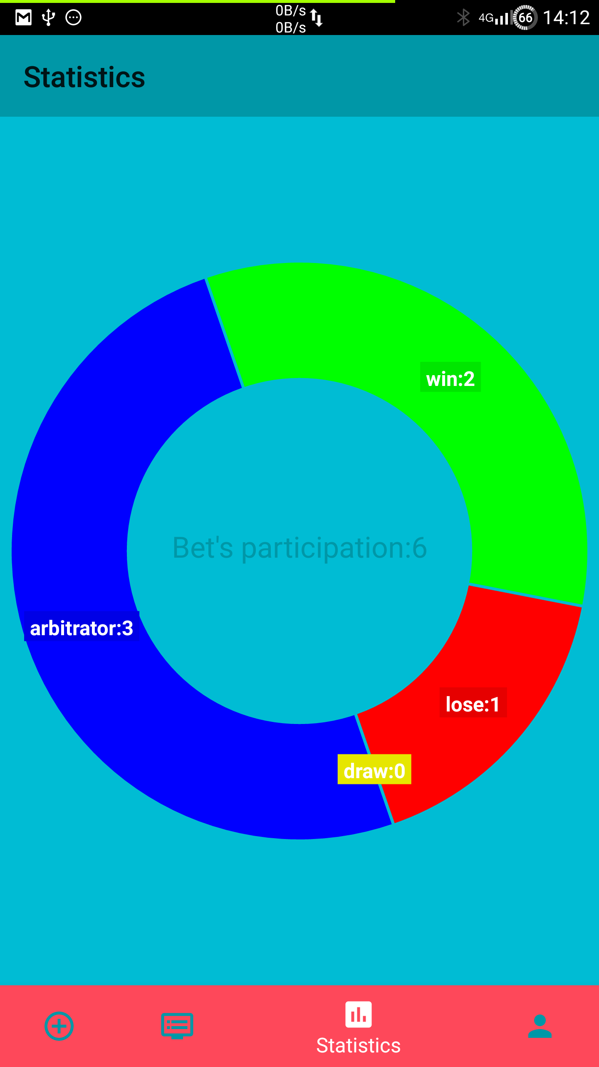
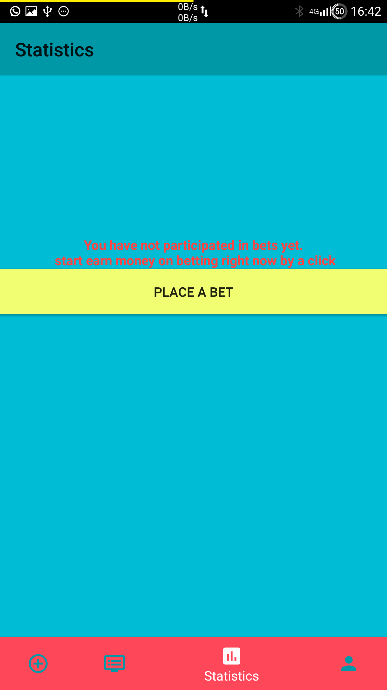
The user can see his own statistics

Slide 15
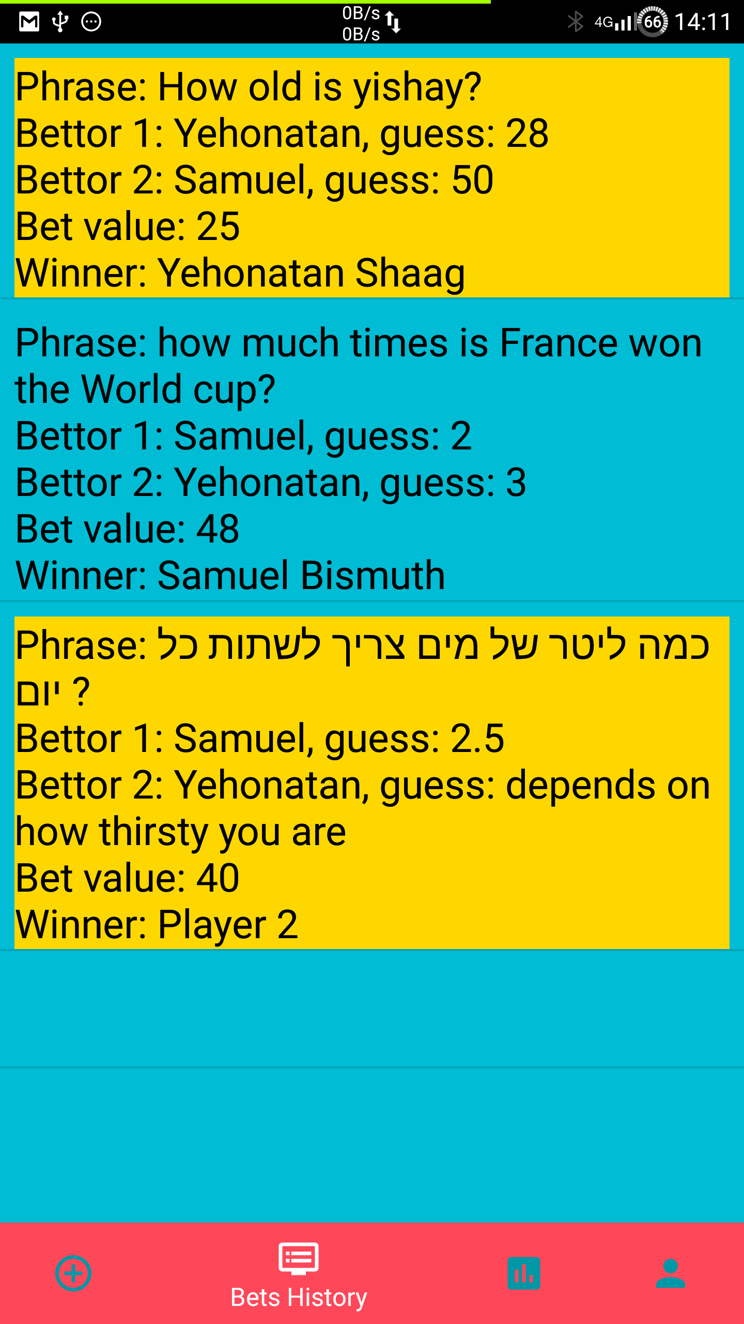
The user can see his bets

Slide 16
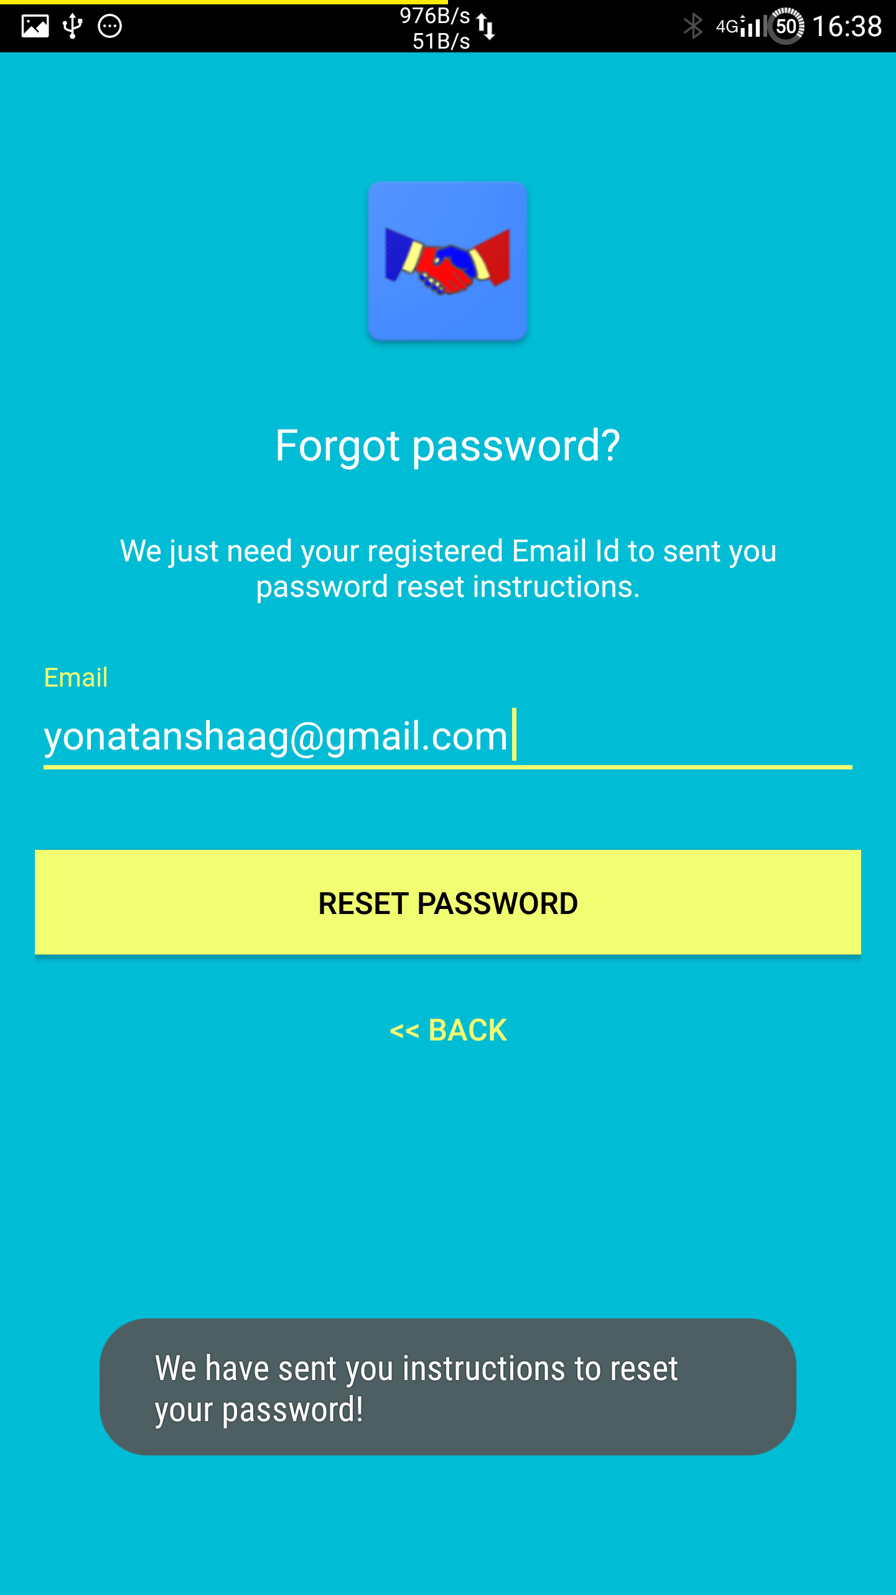
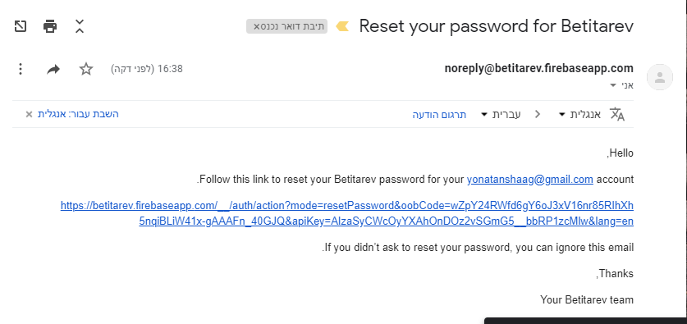
The application will be available to dementic people and “satlanim” that forgot their password

Slide 17
diagram
firebase

