Slide 1
Principles of
Operating Systems
Lecture 1 - Introduction and Overview
Principles of Operating Systems - Lecture 1

Slide 2
Course logistics and details
Textbook:
    Operating System Concepts -- Seventh Edition
    Silberschatz and Galvin, Addison-Wesley Inc.
    (Sixth edition).
Alternate Book
  Principles of Operating Systems, L.F. Bic and A.C. Shaw, Prentice-Hall/Pearson Education, 2003. ISBN 0130266116.
Principles of Operating Systems - Lecture 1

Slide 3
Course logistics and details
Homeworks and Assignments
  3 homeworks FROM 4.
  Late homeworks will not be accepted.
Tests
  Final Exam - as per JCT course catalog
Principles of Operating Systems - Lecture 1

Slide 4
Grading Policy
Homeworks - 10%
Final exam - 90% of the final grade
Principles of Operating Systems - Lecture 1

Slide 5
What is an Operating System?
An OS is a program that acts an intermediary between the user of a computer and computer hardware.
Major cost of general purpose computing is software.
  OS simplifies and manages the complexity of running application programs efficiently.
Principles of Operating Systems - Lecture 1

Slide 6
Goals of an Operating System
Simplify the execution of user programs and make solving user problems easier.
Use computer hardware efficiently.
  Allow sharing of hardware and software resources.
Make application software portable and versatile.
Provide isolation, security and protection among user programs.
Improve overall system reliability
    error confinement, fault tolerance, reconfiguration.
Principles of Operating Systems - Lecture 1

Slide 7
Computer System Components
Hardware
  Provides basic computing resources (CPU, memory, I/O devices).
Operating System
  Controls and coordinates the use of hardware among application programs.
Application Programs
  Solve computing problems of users (compilers, database systems, video games, business programs such as banking software).
Users
  People, machines, other computers
Principles of Operating Systems - Lecture 1

Slide 8
Abstract View of System
User
1
User
2
User
3
User
n
...
System and Application Programs
compiler
assembler
Text editor
Database
system
Operating System
Computer
Hardware
Principles of Operating Systems - Lecture 1

Slide 9
Operating System Views
Resource allocator
    to allocate resources (software and hardware) of the computer system and manage them efficiently.
Control program
    Controls execution of user programs and operation of I/O devices.
Kernel
    The program that executes forever (everything else is an application with respect to the kernel).
Principles of Operating Systems - Lecture 1

Slide 10
Operating System Spectrum
Monitors and Small Kernels
    special purpose and embedded systems, real-time systems
Batch and multiprogramming
Timesharing
    workstations, servers, minicomputers, timeframes
Transaction systems
Principles of Operating Systems - Lecture 1

Slide 11
Supervisor/Operator Control
  Secure monitor that controls job processing
    Special cards indicate what to do.
    User program prevented from performing I/O
  Separate user from computer
    User submits card deck
    cards put on tape
    tape processed by operator
    output written to tape
    tape printed on printer
  Problems:
    Long turnaround time - up to 2 DAYS!!!
    Low CPU utilization
      I/O and CPU could not overlap.
      slow mechanical devices.
Principles of Operating Systems - Lecture 1

Slide 12
Batch Systems - Issues
  Solutions to speed up I/O:
  Offline Processing
    load jobs into memory from tapes, card reading and line printing are done offline.
  Spooling
    Use disk (random access device) as large storage for reading as many input files as possible and storing output files until output devices are ready to accept them.
    Allows overlap - I/O of one job with computation of another.
    Introduces notion of a job pool that allows OS choose next job to run so as to increase CPU utilization.
Principles of Operating Systems - Lecture 1

Slide 13
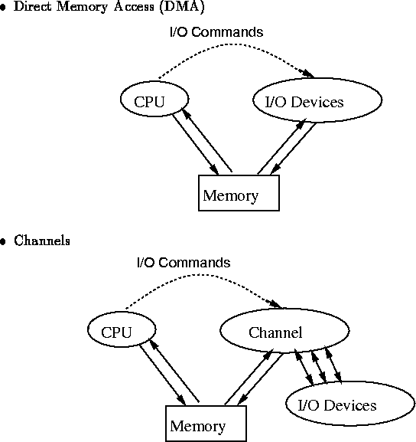
Speeding up I/O
Principles of Operating Systems - Lecture 1

Slide 14
Batch Systems - I/O completion
How do we know that I/O is complete?
  Polling:
    Device sets a flag when it is busy.
    Program tests the flag in a loop waiting for completion of I/O.
  Interrupts:
    On completion of I/O, device forces CPU to jump to a specific instruction address that contains the interrupt service routine.
    After the interrupt has been processed, CPU returns to code it was executing prior to servicing the interrupt.
Principles of Operating Systems - Lecture 1

Slide 15
Multiprogramming
Use interrupts to run multiple programs simultaneously
    When a program performs I/O, instead of polling, execute another program till interrupt is received.
Requires secure memory, I/O for each program.
Requires intervention if program loops indefinitely.
Requires CPU scheduling to choose the next job to run.
Principles of Operating Systems - Lecture 1

Slide 16
Timesharing
Programs queued for execution in FIFO order.
Like multiprogramming, but timer device interrupts after a quantum (timeslice).
    Interrupted program is returned to end of FIFO
    Next program is taken from head of FIFO
Principles of Operating Systems - Lecture 1

Slide 17
Timesharing (cont.)
Interactive (action/response)
  when OS finishes execution of one command, it seeks the next control statement from user.
Virtual memory
  Job is swapped in and out of memory to disk.
Principles of Operating Systems - Lecture 1

Slide 18
Personal Computing Systems
Single user systems, portable.
I/O devices - keyboards, mice, display screens, small printers.
Laptops and palmtops, Smart cards, Wireless devices.
Single user systems may not need advanced CPU utilization or protection features.
Advantages:
  user convenience, responsiveness, ubiquitous
Principles of Operating Systems - Lecture 1

Slide 19
Parallel Systems
Multiprocessor systems with more than one CPU in close communication.
Improved Throughput, economical, increased reliability.
Kinds:
      Vector and pipelined
      Symmetric and asymmetric multiprocessing
      Distributed memory vs. shared memory
Programming models:
      Tightly coupled vs. loosely coupled ,message-based vs. shared variable
Principles of Operating Systems - Lecture 1

Slide 20
Distributed Systems
Distribute computation among many processors.
Loosely coupled -
      no shared memory, various communication lines
client/server architectures
Advantages:
      resource sharing
      computation speed-up
      reliability
      communication - e.g. email
Applications - digital libraries, digital multimedia
Principles of Operating Systems - Lecture 1

Slide 21
Real-time systems
Correct system function depends on timeliness
Feedback/control loops
Sensors and actuators
Hard real-time systems -
    Failure if response time too long.
    Secondary storage is limited
Soft real-time systems -
    Less accurate if response time is too long.
    Useful in applications such as multimedia, virtual reality.
Principles of Operating Systems - Lecture 1

