Slide 1
Principles of
Operating Systems

Slide 2
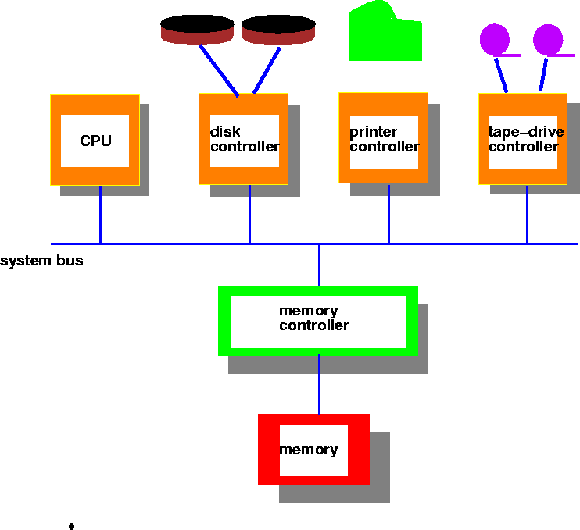
Computer System Architecture
Notes:
When an interrupt occurs, the control is transferred to the interrupt service routine. The interrupt service routine is generally accessed through an interrupt vector. Interrupt vector knows where to find the appropriate interrupt service routine for the current interrupt. The interrupt architecture must save the address of the instruction that has been interrupted (the program counter). Incoming interrupts must be disabled if there is an interrupt currently being processed. This is to prevent interrupts from being lost or overwritten by newly arriving interrupts. An interrupt is generally caused by a hardware device such as a device driver letting the CPU know that some data has been read from the device and is waiting in the local device buffer. A trap is a software-generated interrupt that is either caused by an error or by a user request for an I/O operation. An operating system is interrupt driven. This means that if there are no interrupts, then the system will be idle. The operating system must preserve the state of the CPU by storing the contents of the registers and the program counter. The operating system must determine which type of interrupt has occurred. This can be done either by polling or by using a vectored interrupt system. Polling is the systematic checking of each device to see if it was the device responsible for generating the interrupt. If the operating system has a vectored interrupt system, then the identity of the device and the type of interrupt will be easily identifiable without checking each device. The operating system must provide a segment of code that specifies what action is to be taken in the event of an interrupt. There must be a code segment that is specific to each type of interrupt.

Slide 3
Computer System Organization
I/O devices and the CPU execute concurrently.
Each device controller is in charge of a particular device type
  Each device controller has a local buffer. I/O is from the device to local buffer of controller
CPU moves data from/to main memory to/from the local buffers
Device controller interrupts CPU on completion of I/O

Slide 4
Interrupts
Interrupt transfers control to the interrupt service routine
  Interrupt Service Routine: Segments of code that determine action to be taken for each type of interrupt.
  Interrupt vector contains the address of service routines.
OS preserves the state of the CPU
  stores registers and the program counter (address of interrupted instruction).
Trap
  software generated interrupt caused either by an error or a user request.
Notes:
Classification of Interrupts
Different classes of interrupts are as follows:
Supervisor Call Interrupts (SVC): These interrupts are initiated by a running process that executes SVC instruction. It is a user request for a particular system service such as performing I/O or obtaining more storage etc.
I/O Interrupts: These are initiated by I/O. hardware. These interrupts send signal to CPU to indicate that the status of a channel or device has changed. I/O interrupts occur when I/O operation completes, I/O error occurs or a device gets ready etc.
External Interrupts: These are caused by different events. These events can the" expiration of a quantum on interrupting clock, pressing of interrupt key or receipt of a signal from another processor in a multiprocessor system etc.
Restart Interrupts: These interrupts occur when the restart button of console is pressed or restart signal is received from another processor in multiprocessor system.Program Check Interrupt: These are caused by different problems during the execution of machine language instructions. Some problems include division by zero, arithmetic overflow or underflow, wrong format of data etc.
Machine Check Interrupts: These are caused by the hardware that does not function, properly.

Slide 5
Interrupt Handling
Types of interrupt
  Polling
  Vectored interrupt system
Incoming interrupts are disabled while another interrupt is being processed to prevent a lost interrupt.
Notes:
In a computer, a vectored interrupt is an I/O interrupt that tells the part of the computer that handles I/O interrupts at the hardware level that a request for attention from an I/O device has been received and also identifies the device that sent the request.A vectored interrupt is an alternative to a polled interrupt , which requires that the interrupt handler poll or send a signal to each device in turn in order to find out which one sent the interrupt request.
An operating system is interrupt driven. This means that if there are no interrupts, then the system will be idle.

Slide 6
I/O Structure
Synchronous I/O
    wait instruction idles CPU until next interrupt
    no simultaneous I/O processing, at most one outstanding I/O request at a time.
Asynchronous I/O
  After I/O is initiated, control returns to user program without waiting for I/O completion.
    System call
    Device Status table - holds type, address and state for each device
    OS indexes into I/O device table to determine device status and modify table entry to include interrupt.

Slide 7
Direct Memory Access (DMA)
Used for high speed I/O devices able to transmit information at close to memory speeds.
Device controller transfers blocks of data from buffer storage directly to main memory without CPU intervention.
Only one interrupt is generated per block, rather than one per byte (or word).
Memory
CPU
I/O devices
I/O instructions

Slide 8
Storage Structure
Main memory - only large storage media that the CPU can access directly.
Secondary storage - extension of main memory that has large nonvolatile storage capacity.
  Magnetic disks - rigid metal or glass platters covered with magnetic recording material.
    Disk surface is logically divided into tracks, subdivided into sectors.
    Disk controller determines logical interaction between device and computer.

Slide 9
Storage Hierarchy
Storage systems are organized in a hierarchy based on
  Speed
  Cost
  Volatility (נדיפות)
Caching - process of copying information into faster storage system; main memory can be viewed as fast cache for secondary storage.

Slide 10
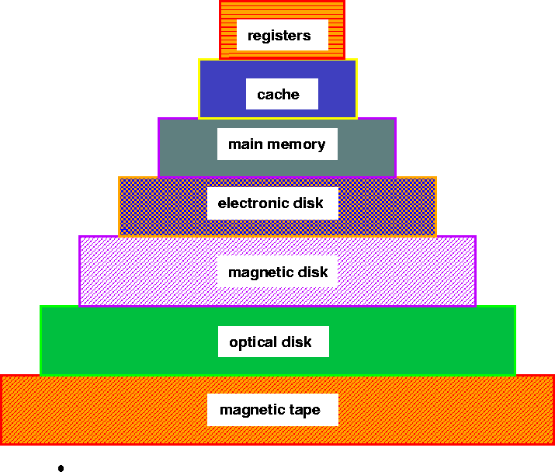
Storage Device Hierarchy

Slide 11
Hardware Protection
Dual Mode Operation
I/O Protection
Memory Protection
CPU Protection

Slide 12
Dual-mode operation
Sharing system resources requires operating system to ensure that an incorrect program cannot cause other programs to execute incorrectly.
Provide hardware support to differentiate between at least two modes of operation:
  1. User mode -- execution done on behalf of a user.
  2. Monitor mode (supervisor/kernel/system mode) -- execution done on behalf of operating system.

Slide 13
Dual-mode operation(cont.)
Mode bit added to computer hardware to indicate the current mode: monitor(0) or user(1).
When an interrupt or fault occurs, hardware switches to monitor mode.
Privileged instructions only in monitor mode.
User
Interrupt/
fault
Set
user
mode
Monitor

Slide 14
I/O Protection
All I/O instructions are privileged instructions.
Must ensure that a user program could never gain control of the computer in monitor mode, for e.g. a user program that as part of its execution, stores a new address in the interrupt vector.

Slide 15
Memory Protection
Must provide memory protection at least for the interrupt vector and the interrupt service routines.
To provide memory protection, add two registers that determine the range of legal addresses a program may address.
  Base Register - holds smallest legal physical memory address.
  Limit register - contains the size of the range.
Memory outside the defined range is protected.
0
monitor
256000
Job1
Base register
300040
300040
Job 2
420940
120900
Job 3
Limit register
880000
Job 4
1024000

Slide 16
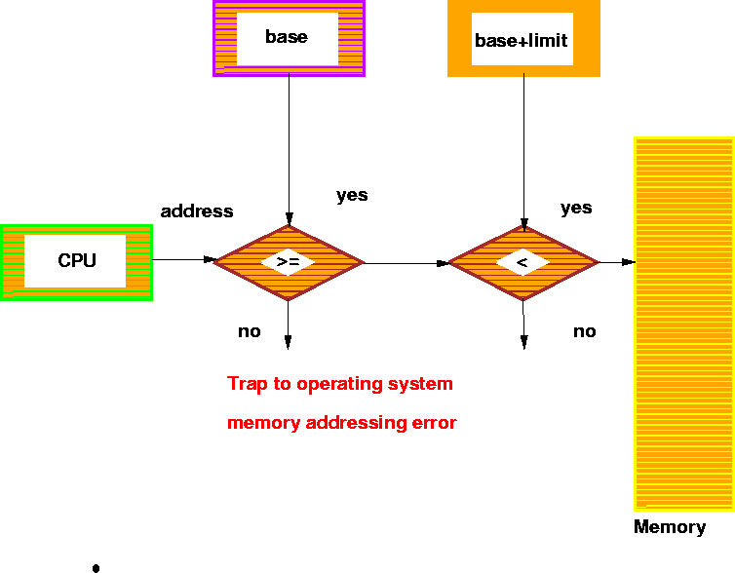
Hardware Address Protection

Slide 17
Protection Hardware (cont.)
When executing in monitor mode, the OS has unrestricted access to both monitor and users’ memory.
The load instructions for the base and limit registers are privileged instructions.

Slide 18
CPU Protection
Timer - interrupts computer after specified period to ensure that OS maintains control.
  Timer is decremented every clock tick.
  When timer reaches a value of 0, an interrupt occurs.
Timer is commonly used to implement time sharing.
Timer is also used to compute the current time.
Load timer is a privileged instruction.

Slide 19
General System Architecture
Given the I/O instructions are privileged, how do users perform I/O?
Via system calls - the method used by a process to request action by the operating system.

Slide 20
Operating System Structures
Operating System Components
  Process Management, Memory Management, Secondary Storage Management, I/O System Management, File Management, Protection System, Networking, Command-Interpreter.
Operating System Services, System calls, System Programs
Virtual Machine Structure and Organization
A Structural Approach to Operating Systems
OS Design and Implementation

Slide 21
Operating System Services
Services that provide user-interfaces to OS
    Program execution - load program into memory and run it
    I/O Operations - since users cannot execute I/O operations directly
    File System Manipulation - read, write, create, delete files
    Communications - interprocess and intersystem
    Error Detection - in hardware, I/O devices, user programs
Services for providing efficient system operation
    Resource Allocation - for simultaneously executing jobs
    Accounting - for account billing and usage statistics
    Protection - ensure access to system resources is controlled

Slide 22
System Calls
Interface between running program and the OS.
  Assembly language instructions (macros and subroutines)
  Some higher level languages allow system calls to be made directly (e.g. C)
Passing parameters between a running program and OS via registers, memory tables or stack.
Unix has about 32 system calls
  read(), write(), open(), close(), fork(), exec(), ioctl(),…..

Slide 23
System Programs
Convenient environment for program development and execution. User view of OS is defined by system programs, not system calls.
    Command Interpreter (sh, csh, ksh) - parses/executes other system programs
    File manipulation - copy (cp), print (lpr), compare(cmp, diff)
    File modification - editing (ed, vi, emacs)
    Application programs - send mail (mail), read news (rn)
    Programming language support (cc)
    Status information, communication
    etc….

Slide 24
Command Interpreter System
Commands that are given to the operating system via command statements that execute
  Process creation and deletion, I/O handling, Secondary Storage Management, Main Memory Management, File System Access, Protection, Networking.
Obtains the next command and executes it.
Programs that read and interpret control statements also called -
  Command-line interpreter, shell (in UNIX)

Slide 25
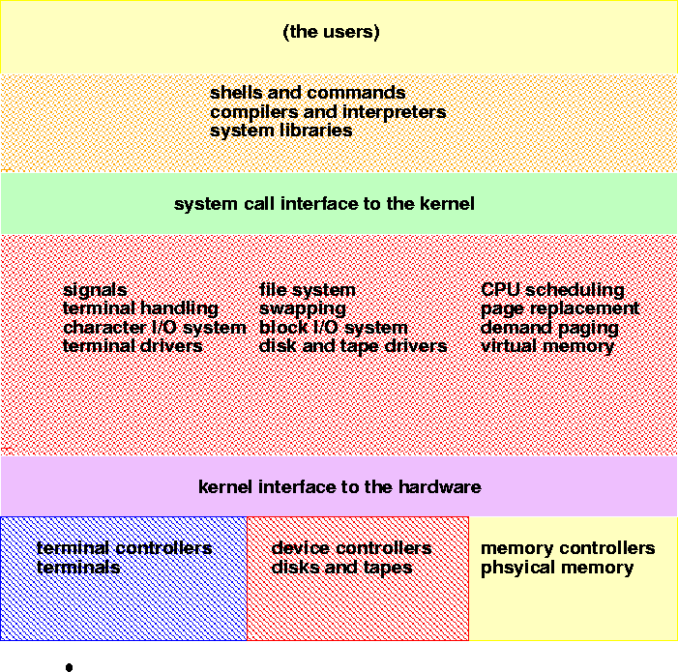
UNIX System Structure

Slide 26
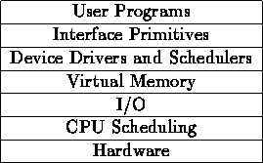
Layered OS Structure
OS divided into number of layers - bottom layer is hardware, highest layer is the user interface.
Each layer uses functions and services of only lower-level layers.
THE Operating System Kernel has successive (עוקב) layers of abstraction.

Slide 27
Virtual Machines
Logically treats hardware and OS kernel as hardware
Provides interface identical to underlying bare hardware.
Creates illusion of multiple processes - each with its own processor and virtual memory
processes
processes
processes
kernel
kernel
kernel
Virtual machine
hardware

