Slide 1
Principles of
Operating Systems
Lectures 3 and 4 - Processes and Threads

Slide 2
Process Concept
An operating system executes a variety of programs
    batch systems - jobs
    time-shared systems - user programs or tasks
    job and program used interchangeably
Process - a program in execution
    process execution proceeds in a sequential fashion
A process contains
    program counter, stack and data section

Slide 3
Process State
A process changes state as it executes.
new
admitted
exit
terminated
interrupt
ready
running
I/O or
event
completion
Scheduler
dispatch
I/O or
event wait
waiting

Slide 4
Process States
New - The process is being created.
Running - Instructions are being executed.
Waiting - Waiting for some event to occur.
Ready - Waiting to be assigned to a processor.
Terminated - Process has finished execution.

Slide 5
Process Control Block
Contains information associated with sngdfb process
      Process State - e.g. new, ready, running etc.
      Program Counter - address of next instruction to be executed
      CPU registers - general purpose registers, stack pointer etc.
      CPU scheduling information - process priority
      Memory Management information - base/limit information
      Accounting information - time limits, process number
      I/O Status information - list of I/O devices allocated

Slide 6
Process Scheduling Queues
Job Queue - set of all processes in the system
Ready Queue - set of all processes residing in main memory, ready and waiting to execute.
Device Queues - set of processes waiting for an I/O device.
Process migration between the various queues.
Queue Structures - typically linked list, circular list etc.

Slide 7
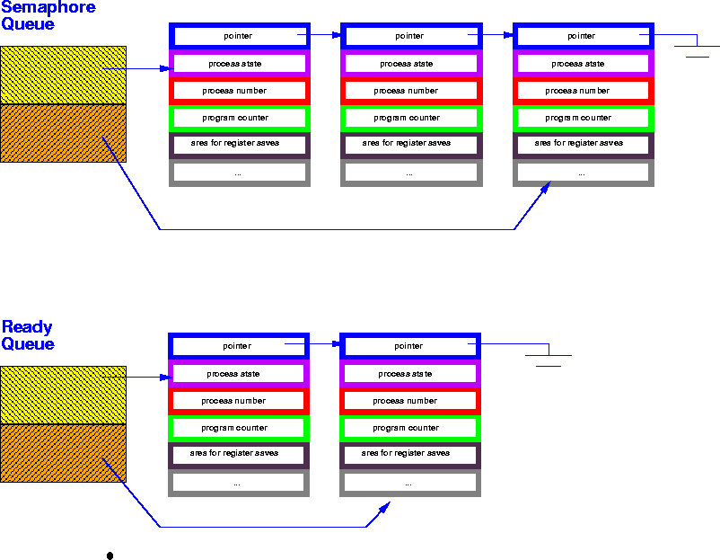
Process Queues
Device
Queue
Ready
Queue

Slide 8
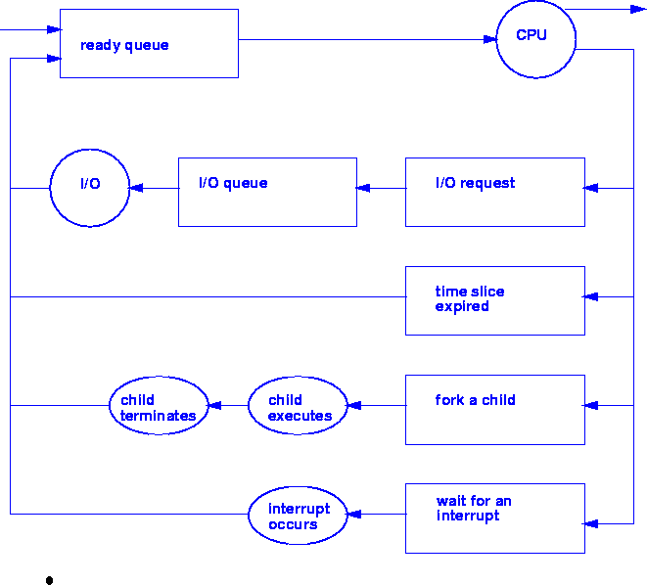
Process Scheduling Queues

Slide 9
Schedulers
Long-term scheduler (or job scheduler) -
      selects which processes should be brought into the ready queue.
      invoked very infrequently (seconds); may be slow.
      controls the degree of multiprogramming
Short term scheduler (or CPU scheduler) -
      selects which process should execute next and allocates CPU.
      invoked very frequently (milliseconds) - must be very fast
Medium Term Scheduler
      swaps out process temporarily
      balances load for better throughput

Slide 10
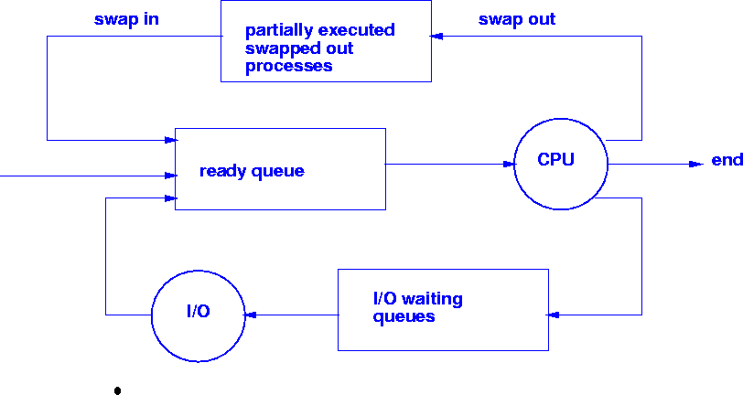
Medium Term (Time-sharing) Scheduler

Slide 11
Process Profiles
I/O bound process -
      spends more time in I/O, short CPU bursts, CPU underutilized.
CPU bound process -
      spends more time doing computations; few very long CPU bursts, I/O underutilized.
The right job mix:
      Long term scheduler - admits jobs to keep load balanced between I/O and CPU bound processes

Slide 12
Context Switch
Task that switches CPU from one process to another process
      the CPU must save the PCB state of the old process and load the saved PCB state of the new process.
Context-switch time is overhead;
      system does no useful work while switching
      can become a bottleneck
Time for context switch is dependent on hardware support ( 1- 1000 microseconds).

Slide 13
Process Creation
Processes are created and deleted dynamically
Process which creates another process is called a parent process; the created process is called a child process.
Result is a tree of processes
    e.g. UNIX - processes have dependencies and form a hierarchy.
Resources required when creating process
    CPU time, files, memory, I/O devices etc.

Slide 14
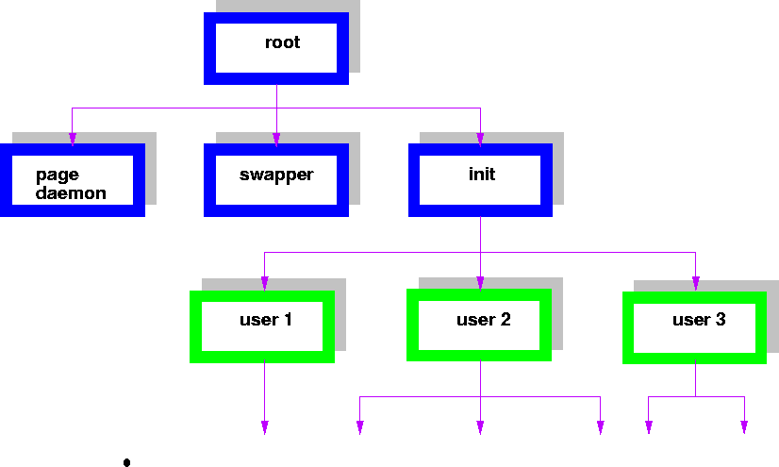
UNIX Process Hierarchy

Slide 15
Process Creation (options)
Resource sharing
      Parent and children share all resources.
      Children share subset of parent’s resources - prevents many processes from overloading the system.
      Parent and children share no resources.
Execution
      Parent and child execute concurrently.
      Parent waits until child has terminated.
Address Space
      Child process is duplicate of parent process.
      Child process has a program loaded into it.

Slide 16
UNIX Process Creation
fork - system call creates new processes
execve - system call is used after a fork to replace the processes memory space with a new program.

Slide 17
Process Termination
Process executes last statement and asks the operating system to delete it (exit).
      Output data from child to parent (via wait).
      Process’ resources are deallocated by operating system.
Parent may terminate execution of child processes.
      Child has exceeded allocated resources.
      Task assigned to child is no longer required.
      Parent is exiting
        OS does not allow child to continue if parent terminates
        Cascading termination

Slide 18
Process Termination
Process executes last statement and asks the operating system to delete it (exit).
      Output data from child to parent (via wait).
      Process’ resources are deallocated by operating system.
Parent may terminate execution of child processes.
      Child has exceeded allocated resources.
      Task assigned to child is no longer required.
      Parent is exiting
        OS does not allow child to continue if parent terminates
        Cascading termination

Slide 19
Throughput – number of processes that complete their execution per time unit. Parent may terminate execution of child processes.
Turnaround time – amount of time to execute a particular process.
Waiting time – amount of time a process has been waiting in the ready queue.
Response time – amount of time it takes from when a request was submitted until the first response is produced, not output (for time-sharing environment).

Slide 20
Threads
Processes do not share resources well
      high context switching overhead
A thread (or lightweight process)
      basic unit of CPU utilization; it consists of:
        program counter, register set and stack space
    A thread shares the following with peer threads:
        code section, data section and OS resources (open files, signals)
    Collectively called a task.
Heavyweight process is a task with one thread.

Slide 21

Single and Multithreaded Processes

Slide 22
Benefits
Responsiveness
Resource Sharing
Economy
Utilization of MP Architectures

Slide 23
Threads(Cont.)
In a multiple threaded task, while one server thread is blocked and waiting, a second thread in the same task can run.
    Cooperation of multiple threads in the same job confers higher throughput and improved performance.
    Applications that require sharing a common buffer (i.e. producer-consumer) benefit from thread utilization.
Threads provide a mechanism that allows sequential processes to make blocking system calls while also achieving parallelism.

Slide 24
Threads (cont.)
Thread context switch still requires a register set switch, but no memory management related work!!
Thread states -
    ready, blocked, running, terminated
Threads share CPU and only one thread can run at a time.
No protection among threads.

Slide 25
Threads (cont.)
Kernel-supported threads (Mach and OS/2)
User-level threads
Hybrid approach implements both user-level and kernel-supported threads (Solaris 2).

Slide 26
User Threads
Thread management done by user-level threads library
Supported above the kernel, via a set of library calls at the user level.
  Threads do not need to call OS and cause interrupts to kernel - fast.
  Disadv: If kernel is single threaded, system call from any thread can block the entire task.
Example thread libraries:
  POSIX Pthreads
  Win32 threads
  Java threads

Slide 27
Kernel Threads
Supported by the Kernel
Examples
  Windows XP/2000
  Solaris
  Linux
  Tru64 UNIX
  Mac OS X
  Mach, OS/2

Slide 28
Multithreading Models
Many-to-One
One-to-One
Many-to-Many

Slide 29
Many-to-One
Many user-level threads mapped to single kernel thread
Examples:
  Solaris Green Threads
  GNU Portable Threads

Slide 30

Many-to-One Model

Slide 31
One-to-One
Each user-level thread maps to kernel thread
Examples
  Windows NT/XP/2000
  Linux
  Solaris 9 and later

Slide 32

One-to-one Model

Slide 33
Many-to-Many Model
Allows many user level threads to be mapped to many kernel threads
Allows the operating system to create a sufficient number of kernel threads
Solaris prior to version 9
Windows NT/2000 with the ThreadFiber package

Slide 34

Many-to-Many Model

Slide 35
Thread Support in Solaris 2
Solaris 2 is a version of UNIX with support for
      kernel and user level threads, symmetric multiprocessing and real-time scheduling.
Lightweight Processes (LWP)
      intermediate between user and kernel level threads
      each LWP is connected to exactly one kernel thread

Slide 36
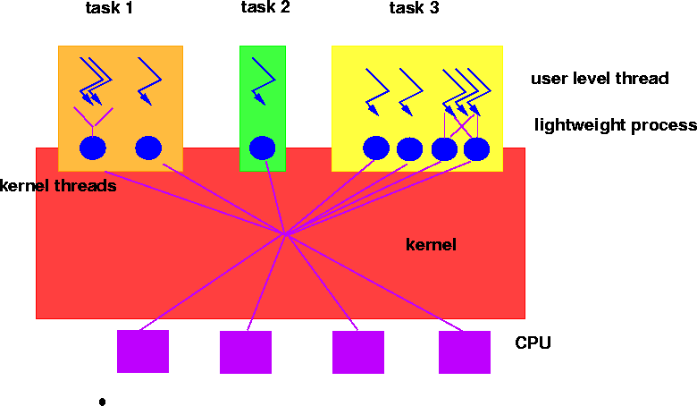
Threads in Solaris 2

Slide 37
Threads in Solaris 2
Resource requirements of thread types
    Kernel Thread: small data structure and stack; thread switching does not require changing memory access information - relatively fast.
    Lightweight Process: PCB with register data, accounting and memory information - switching between LWP is relatively slow.
    User-level thread: only needs stack and program counter; no kernel involvement means fast switching. Kernel only sees the LWPs that support user-level threads.

Slide 38
Two-level Model
Similar to M:M, except that it allows a user thread to be bound to kernel thread
Examples
  IRIX
  HP-UX
  Tru64 UNIX
  Solaris 8 and earlier

Slide 39

Two-level Model

Slide 40
Threading Issues
Semantics of fork() and exec() system calls
Thread cancellation
Signal handling
Thread pools
Thread specific data
Scheduler activations

Slide 41
Interprocess Communication (IPC)
Mechanism for processes to communicate and synchronize their actions.
      Via shared memory
      Via Messaging system - processes communicate without resorting to shared variables.
Messaging system and shared memory not mutually exclusive -
        can be used simultaneously within a single OS or a single process.
IPC facility provides two operations.
        send(message) - message size can be fixed or variable
        receive(message)

Slide 42
Producer-Consumer using IPC
    Producer
        repeat
        …
        produce an item in nextp;
        …
        send(consumer, nextp);
        until false;
    Consumer
        repeat
        receive(producer, nextc);
        …
        consume item from nextc;
        …
        until false;

Slide 43
Cooperating Processes via Message Passing
If processes P and Q wish to communicate, they need to:
      establish a communication link between them
      exchange messages via send/receive
Fixed vs. Variable size message
      Fixed message size - straightforward physical implementation, programming task is difficult due to fragmentation
      Variable message size - simpler programming, more complex physical implementation.

Slide 44
Implementation Questions
  How are links established?
  Can a link be associated with more than 2 processes?
  How many links can there be between every pair of communicating processes?
  What is the capacity of a link?
  Fixed or variable size messages?
  Unidirectional or bidirectional links?
  …….

Slide 45
Direct Communication
Sender and Receiver processes must name each other explicitly:
      send(P, message) - send a message to process P
      receive(Q, message) - receive a message from process Q
Properties of communication link:
      Links are established automatically.
      A link is associated with exactly one pair of communicating processes.
      Exactly one link between each pair.
      Link may be unidirectional, usually bidirectional.

Slide 46
Indirect Communication
Messages are directed to and received from mailboxes (also called ports)
        Unique ID for every mailbox.
        Processes can communicate only if they share a mailbox.
        Send(A, message) /* send message to mailbox A */
        Receive(A, message) /* receive message from mailbox A */
Properties of communication link
        Link established only if processes share a common mailbox.
        Link can be associated with many processes.
        Pair of processes may share several communication links
        Links may be unidirectional or bidirectional

Slide 47
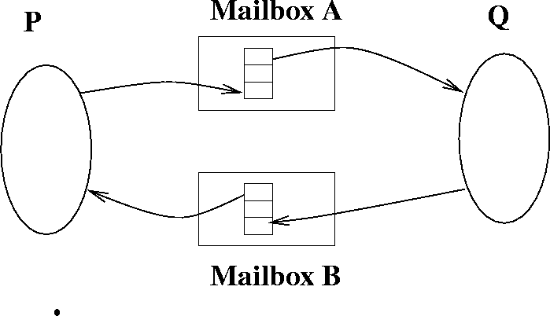
Indirect Communication using mailboxes

Slide 48
Mailboxes (cont.)
Operations
        create a new mailbox
        send/receive messages through mailbox
        destroy a mailbox
Issue: Mailbox sharing
        P1, P2 and P3 share mailbox A.
        P1 sends message, P2 and P3 receive… who gets message??
Possible Solutions
        disallow links between more than 2 processes
        allow only one process at a time to execute receive operation
        allow system to arbitrarily select receiver and then notify sender.

Slide 49
Message Buffering
Link has some capacity - determine the number of messages that can reside temporarily in it.
Queue of messages attached to link
      Zero-capacity Queues: 0 messages
        sender waits for receiver (synchronization is called rendezvous)
      Bounded capacity Queues: Finite length of n messages
        sender waits if link is full
      Unbounded capacity Queues: Infinite queue length
        sender never waits

Slide 50
Message Problems - Exception Conditions
  Process Termination
    Problem: P(sender) terminates, Q(receiver) blocks forever.
      Solutions:
        System terminates Q.
        System notifies Q that P has terminated.
        Q has an internal mechanism(timer) that determines how long to wait for a message from P.
    Problem: P(sender) sends message, Q(receiver) terminates. In automatic buffering, P sends message until buffer is full or forever. In no-buffering scheme, P blocks forever.
      Solutions:
        System notifies P
        System terminates P
        P and Q use acknowledgement with timeout

Slide 51
Message Problems - Exception Conditions
Lost Messages
        OS guarantees retransmission
        sender is responsible for detecting it using timeouts
        sender gets an exception
Scrambled Messages
      Message arrives from sender P to receiver Q, but information in message is corrupted due to noise in communication channel.
      Solution
        need error detection mechanism, e.g. CHECKSUM
        need error correction mechanism, e.g. retransmission

Slide 52
Cooperating Processes
Concurrent Processes can be
      Independent processes
        cannot affect or be affected by the execution of another process.
      Cooperating processes
        can affect or be affected by the execution of another process.
Advantages of process cooperation:
        Information sharing
        Computation speedup
        Modularity
        Convenience(e.g. editing, printing, compiling)
Concurrent execution requires
        process communication and process synchronization

Slide 53
Producer-Consumer Problem
Paradigm for cooperating processes;
  producer process produces information that is consumed by a consumer process.
We need buffer of items that can be filled by producer and emptied by consumer.
      Unbounded-buffer places no practical limit on the size of the buffer. Consumer may wait, producer never waits.
      Bounded-buffer assumes that there is a fixed buffer size. Consumer waits for new item, producer waits if buffer is full.
  Producer and Consumer must synchronize.

Slide 54
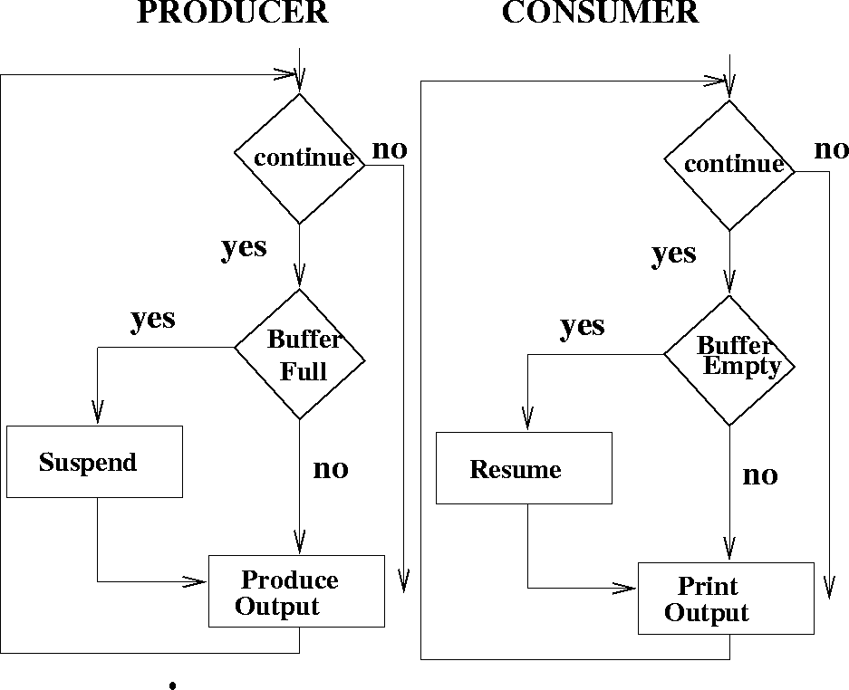
Producer-Consumer Problem

Slide 55
Bounded-buffer - Shared Memory Solution
Shared data
      var n;
      type item = ….;
      var buffer: array[0..n-1] of item;
      in, out: 0..n-1;
      in :=0; out:= 0; /* shared buffer = circular array */
      /* Buffer empty if in == out */
      /* Buffer full if (in+1) mod n == out */
      /* noop means ‘do nothing’ */

Slide 56
Bounded Buffer - Shared Memory Solution
Producer process - creates filled buffers
      repeat
      …
      produce an item in nextp
      …
      while in+1 mod n = out do noop;
      buffer[in] := nextp;
      in := in+1 mod n;
      until false;

Slide 57
Bounded Buffer - Shared Memory Solution
Consumer process - Empties filled buffers
      repeat
      while in = out do noop;
      nextc := buffer[out] ;
      out:= out+1 mod n;
      …
      consume the next item in nextc
      …
      until false

